Slide 1
We Must Broaden Our Vision
Matthew 28:18-20

Slide 2
The Field is the World
Matthew 28:18-20
  The church exists to communicate God’s word.
  Every Christian plays a part.
Matthew 13:24-30, 36-43
  The field is the world

Slide 3
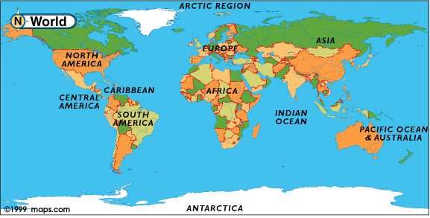

Slide 4
The Field is the World
2 Corinthians 8:12-15
  According to what one has
  At this time your abundance may supply their lack
  Think of what we have as Americans!!
  What can I do more than I am doing?

Slide 5
What Can I Do?
Stay at home and get involved
  Pray for evangelists
  Adopt and evangelist and his family
  Support evangelistic efforts personally
  www.EvangelismUpdate.com

Slide 6
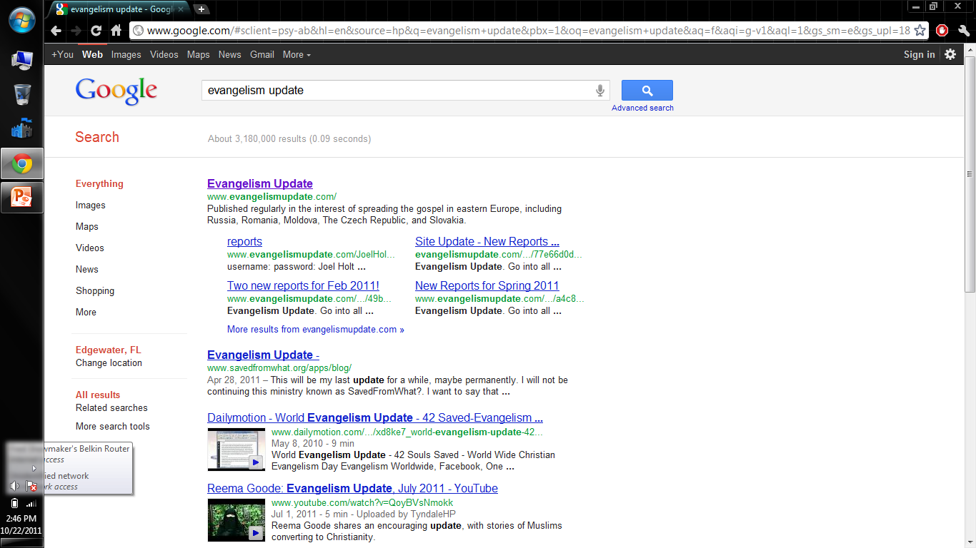

Slide 7
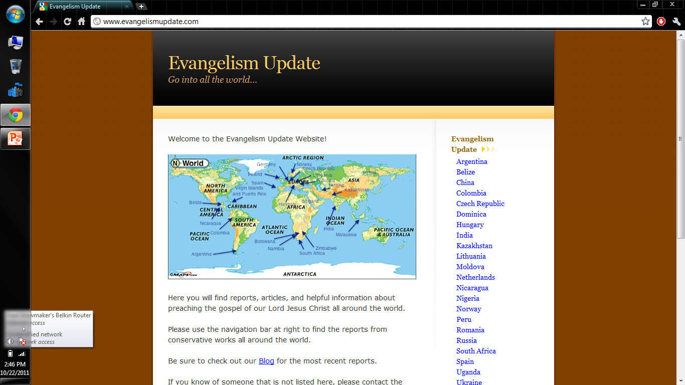

Slide 8
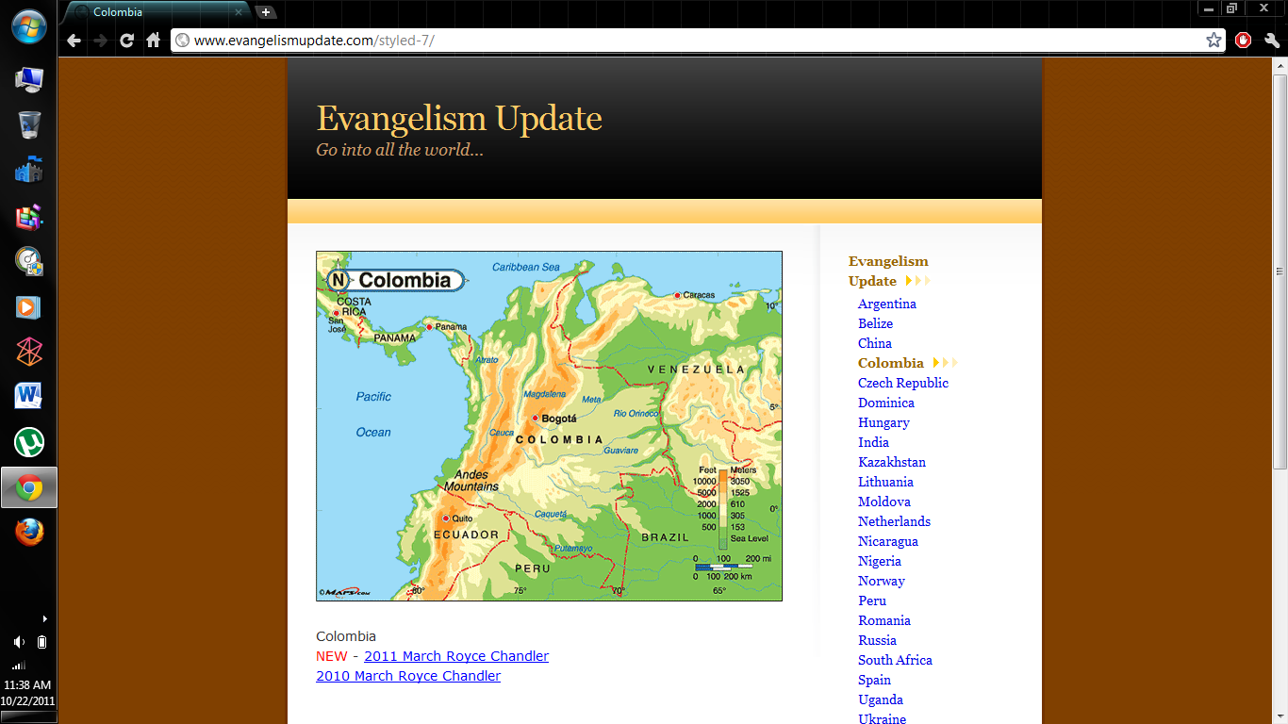

Slide 9
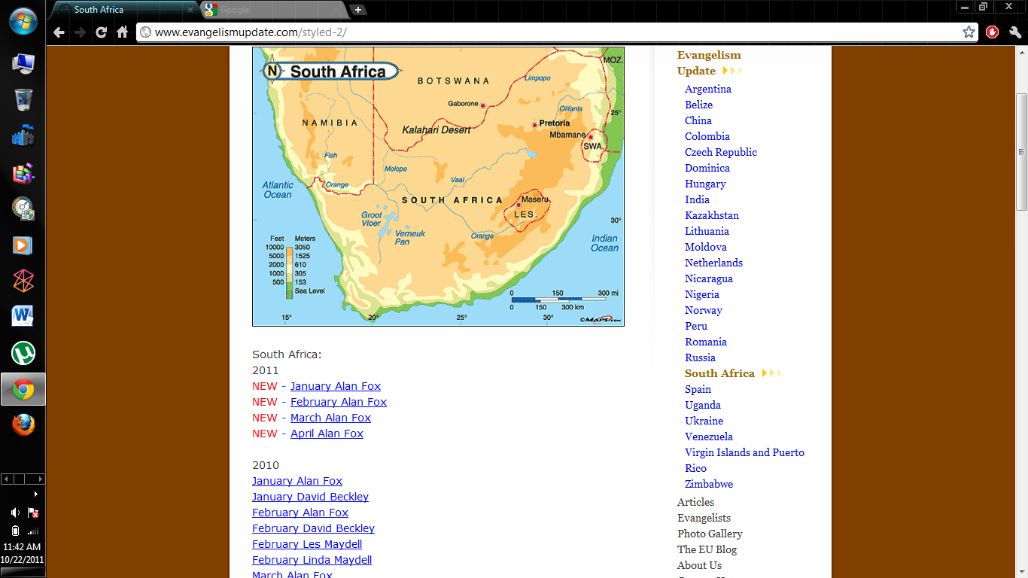

Slide 10
What Can I Do?
Stay at home and get involved
  Send correspondence courses or study via the internet
  www.biblestudyguide.org

Slide 11
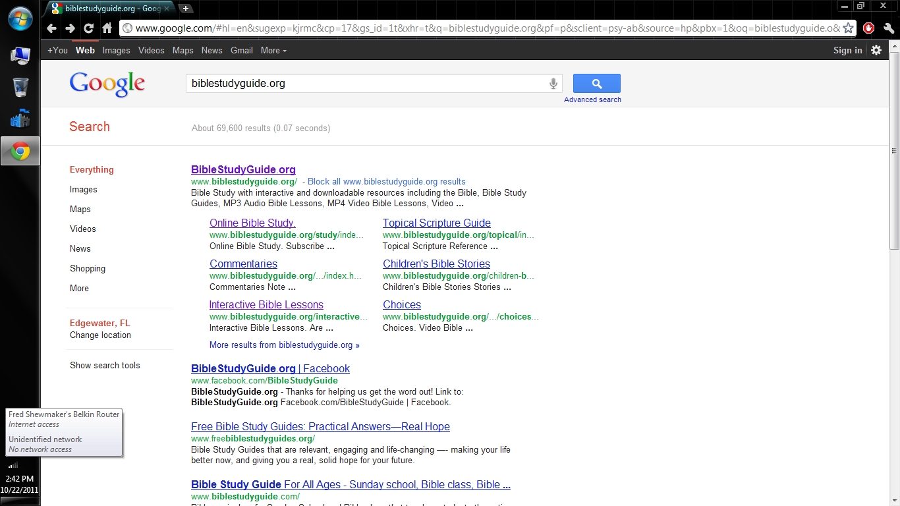

Slide 12
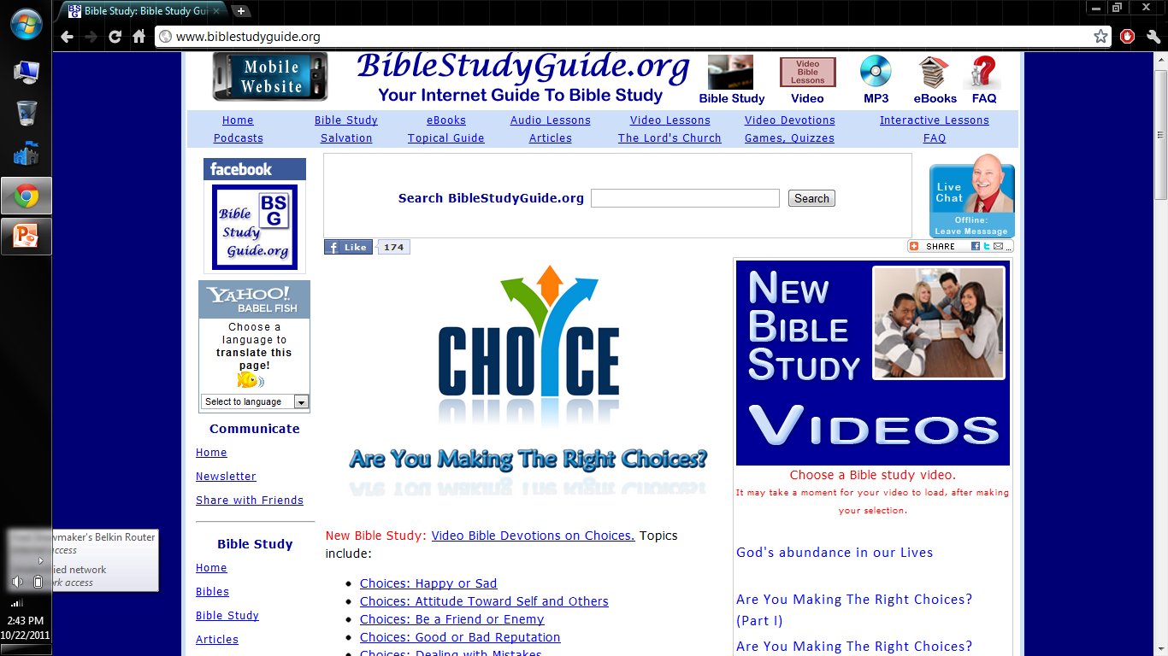

Slide 13
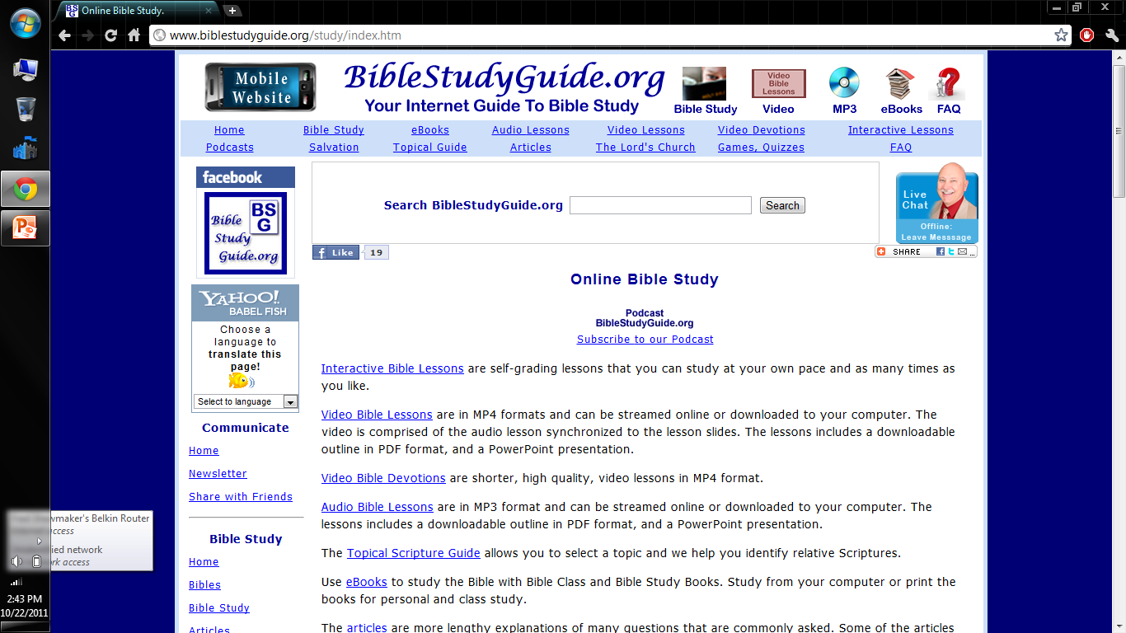

Slide 14
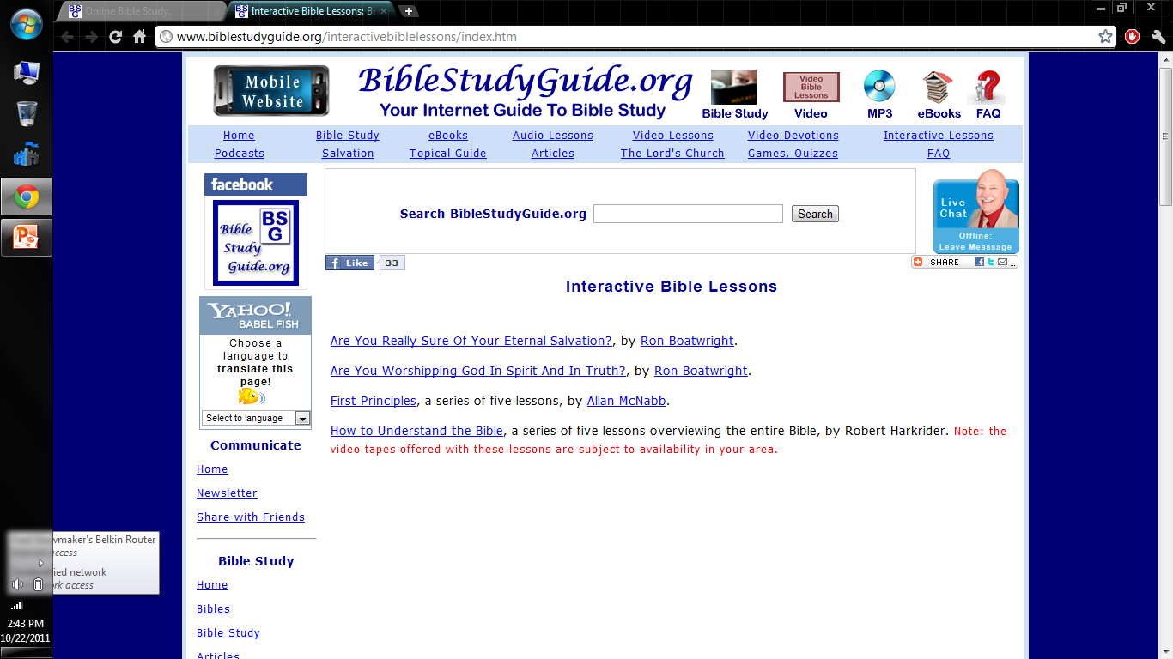

Slide 15
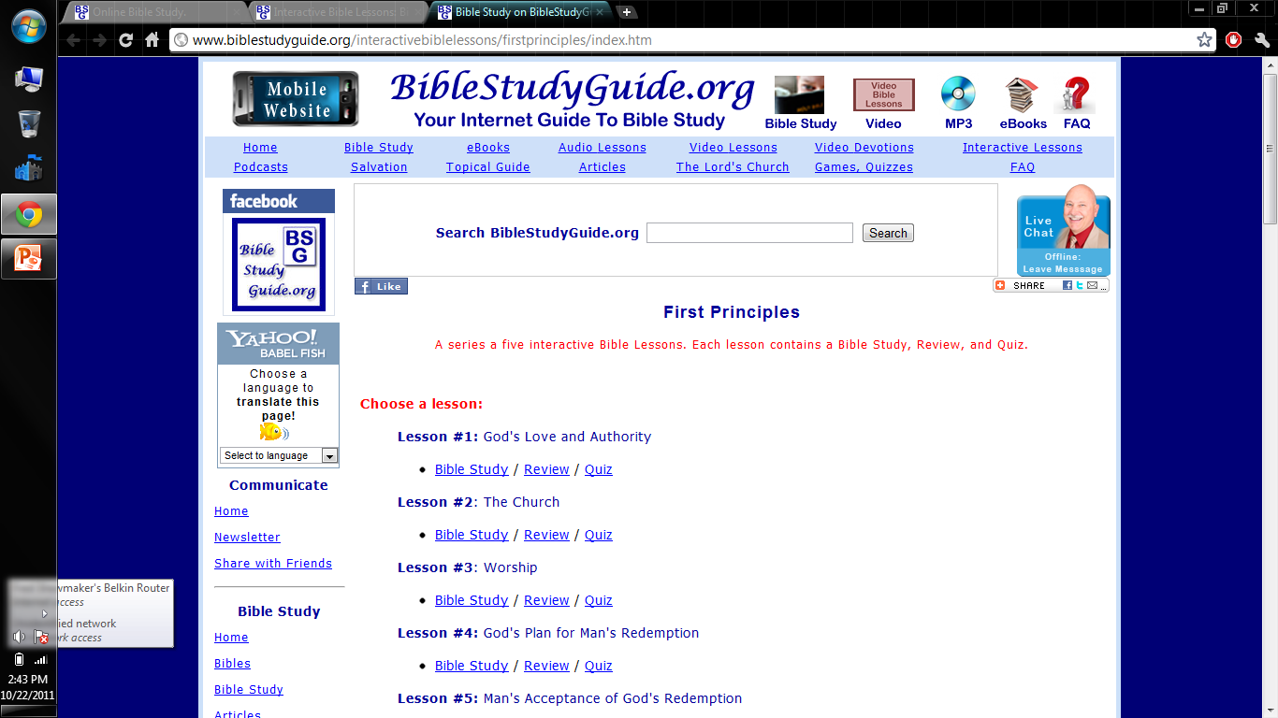

Slide 16
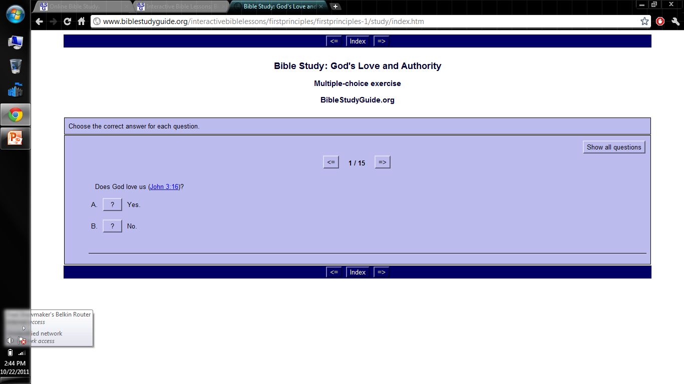

Slide 17
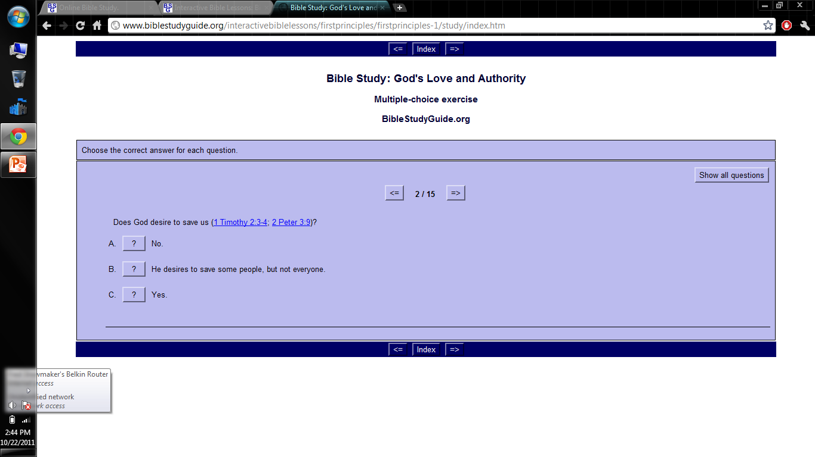

Slide 19
What Can I Do?
Stay at home and get involved
  Send correspondence courses or study via the internet
  Help evangelistic efforts here
  Learn a foreign language

Slide 20
What Can I Do?
Go and get involved
  Short journeys
    Well-Planned
    Vacations
  Longer journeys
    Business opportunities
    Move your family to evangelize
2 Timothy 2:2
God’s Way Will Work!

Slide 21
We Must Broaden Our Vision

