Slide 1

Making A Covenant Marriage

Slide 2
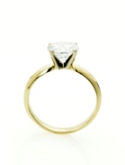

Covenant Marriage
Marriage And Covenants Are Both Vows Taken Before God !
  Deuteronomy 23:21-23

Slide 3
Covenant Marriage
Marriage And Covenants Are Both Conducted Before Witnesses !
  Matthew 18:16

Slide 4
Covenant Marriage
Marriage And Covenants Both Declare The Seriousness Of The Commitment!
  Ruth 1:16-17

Slide 5
Covenant Marriage
Marriage And Covenants Do Not Come With Escape Mechanisms!
Matthew 19:6

