Slide 1
Affair Proofing Your Marriage

Slide 2
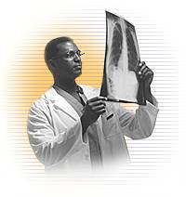
Diagnosis: Infiltrating Ductal Carcinoma
  Specimen Type: Complete excision
  Tumor Size: 2.1 cm
  Histological Type: Invasive ductal
  Histological Grade: Total Score: 2.6 Points
  Extent of Invasion: T1 – T2
  Margins: Margins uninvolved
  ER: 89% - Favorable
  PR: 98% - Favorable
  Her2/neu: N/A – Normal limit
  P53: 8% - Favorable
  Regional Lymph Nodes: N0
  Metastasis: M0

Slide 3
Pathology Of An Affair
Vulnerability

Slide 4
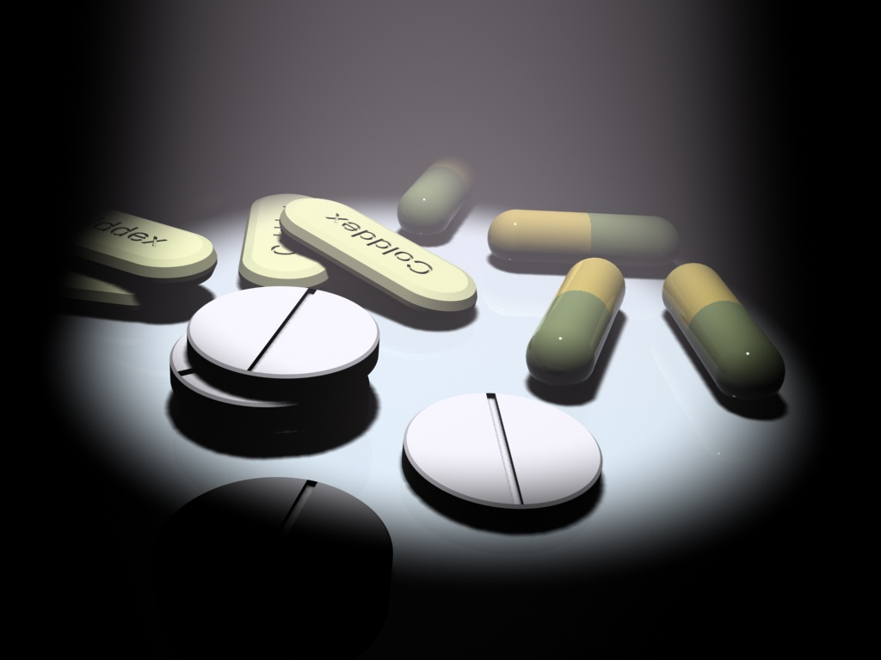
"Preventing affairs is not like having a one-time inoculation - or even getting occasional booster shots. It's more like taking a pill every day for the rest of your life."
Peggy Vaughn

Slide 5
Pathology Of An Affair
Vulnerability
Emotional Involvement

Slide 6
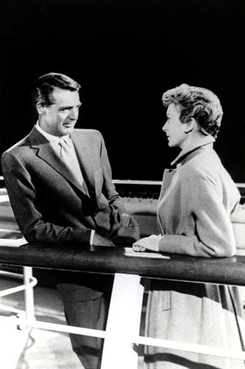
Because people tend to say that nothing is going on when there is no physical contact, they feel safe because they think they are still walking within the boundary – when they are really crossing the line.

Slide 7
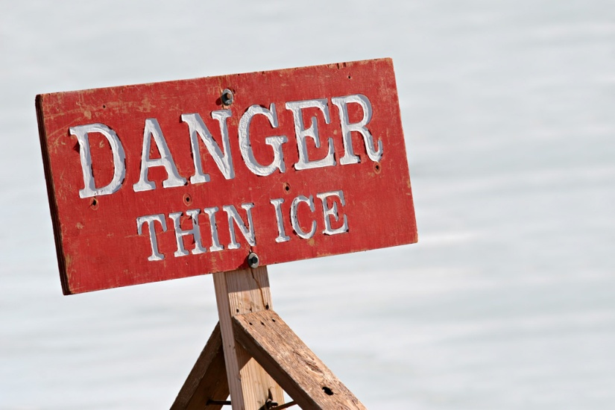
Three signs indicate that a friendship between people of the opposite sex has crossed the line into infidelity:
Dr. Shirley Glass
  (1) Emotional Intimacy,
  (2) Sexual Tension
  (3) Secrecy

Slide 8
Pathology Of An Affair
Vulnerability
Emotional Involvement
Physical Involvement

Slide 9
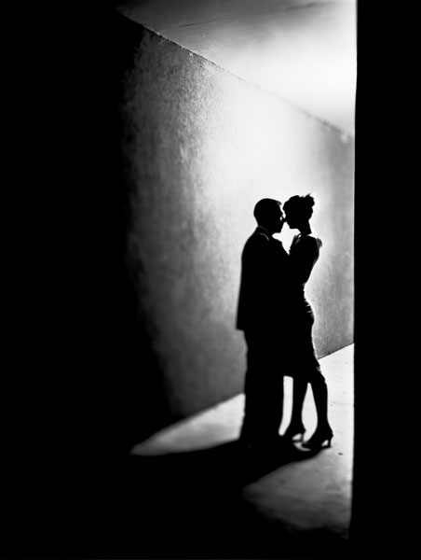
Once a relationship becomes physical, it is hard to get out. It is like a full-blown addiction to the relationship.

Slide 10
Pathology Of An Affair
Vulnerability
Emotional Involvement
Physical Involvement
Rationalization

Slide 11
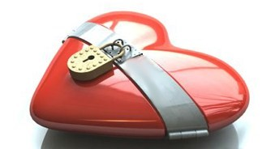
Preventing An Affair
Guard Your Heart

Slide 12
Do not let your heart turn to her ways
Proverbs 7:25a

Slide 13

Preventing An Affair
Watch Your Step

Slide 14
Do not stray into her paths
Proverbs 7:25b

Slide 15
Two Arenas Of Temptation
The Workplace And
The Internet

Slide 16

Preventing An affair
Consider The Cost

Slide 17
Can a man scoop fire into his lap without his clothes being burned without his feet being scorched? So is he who sleeps with another man’s wife; no one who touches her will go unpunished.
Proverbs 6:27-29

Slide 18

Preventing An Affair
Keep The Home Fires Burning

Slide 19
Drink water from your own cistern, running water from your own well.
May your fountain be blessed, and may you rejoice in the wife of your youth.
A loving doe, a graceful deer— may her breasts satisfy you always, may you ever be captivated by her love.
Proverbs 5:15, 18

