Slide 1
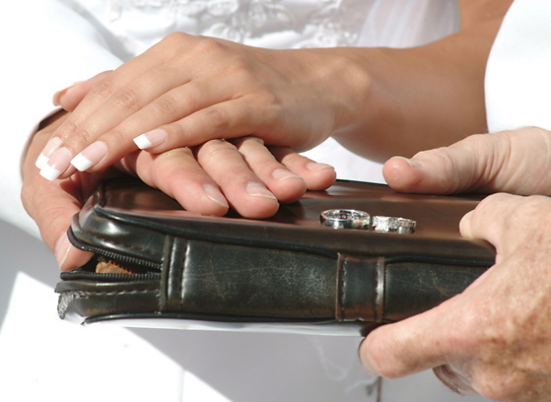
FINDING GOD IN
YOUR MARRIAGE

Slide 2

“By all means marry. If you get a good wife, you’ll become happy. If you get a bad one, you’ll become a philosopher.”
-- Socrates

Slide 3
“One of the best wedding gifts God gave you was a Full Length Mirror called your spouse. Had there been a card attached, it would have said, Here’s to helping you discover what you’re really like!”
Gary & Betsy Ricucci

Slide 4

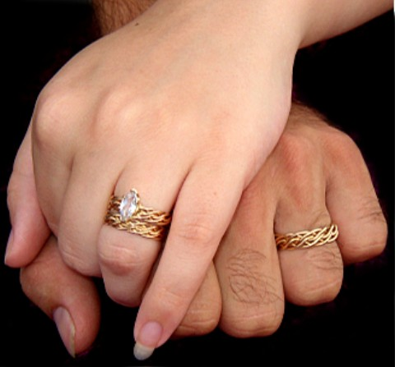
What Is Marriage For?
Happiness Is Not The Goal – Not Even Here On Earth!
Happiness Is The By-Product Or Result Of A Life Properly Lived.
Happiness Is The End Game!

Slide 5
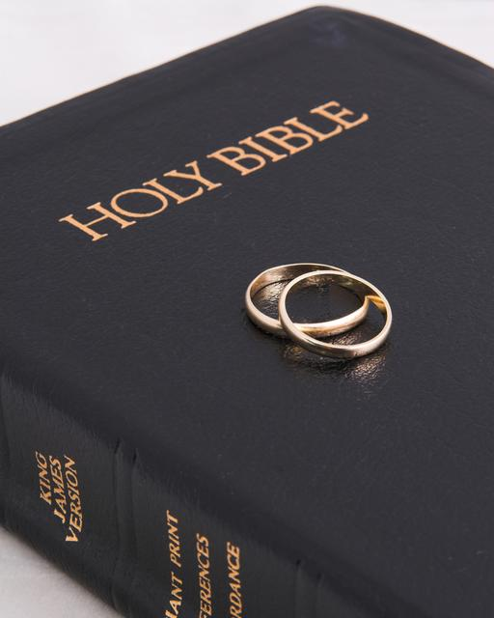
What Is Marriage For?
What If God Designed Marriage To Make Us Holy More Than To Make Us Happy?

Slide 6

It is important to remember that Romance is a relatively modern pursuit in marriage.

Slide 7


Setting The Right Goal
No Marriage Can Endure On Romance And Feelings Alone.
  Romantic love has no elasticity to it!
  The kind of love that is needed to sustain a good marriage – must stretch!

Slide 8
Setting The Right Goal
When We Strive for Happiness – We Strive for the Wrong Goal!
When We Strive for Happiness From Our Spouse – We Strive for the Wrong Goal and From the Wrong Source!

Slide 9
Marital Analogies
Marital Analogies Teach Us Truths About God!
  God Views His People As a Husband Views His Wife
  God Rejoices in His People

Slide 10

A Marriage Picture
Marriage Is the Divine Picture of Reconciliation!

Slide 11
The Goal In Marriage
The Goal in Marriage – As in All Life …
Is To Please God!

