Slide 2

702 - THANK YOU LORD - TITLE

Slide 3
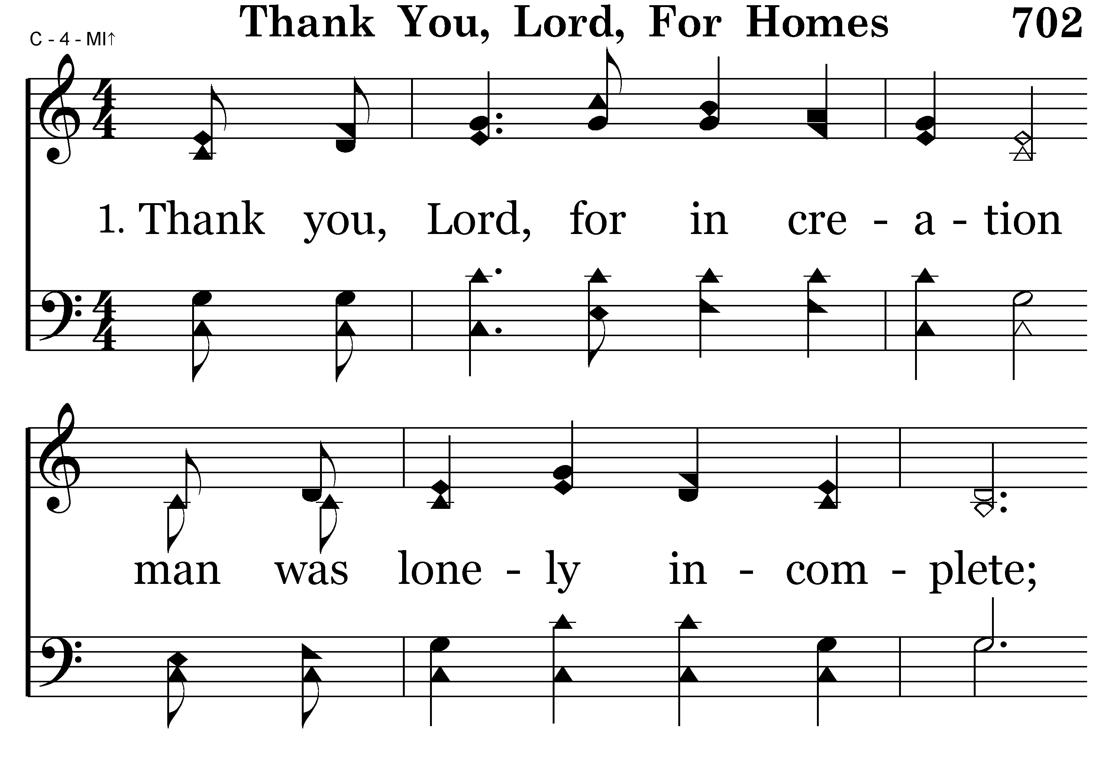
702 - THANK YOU LORD – 1.1

Slide 4
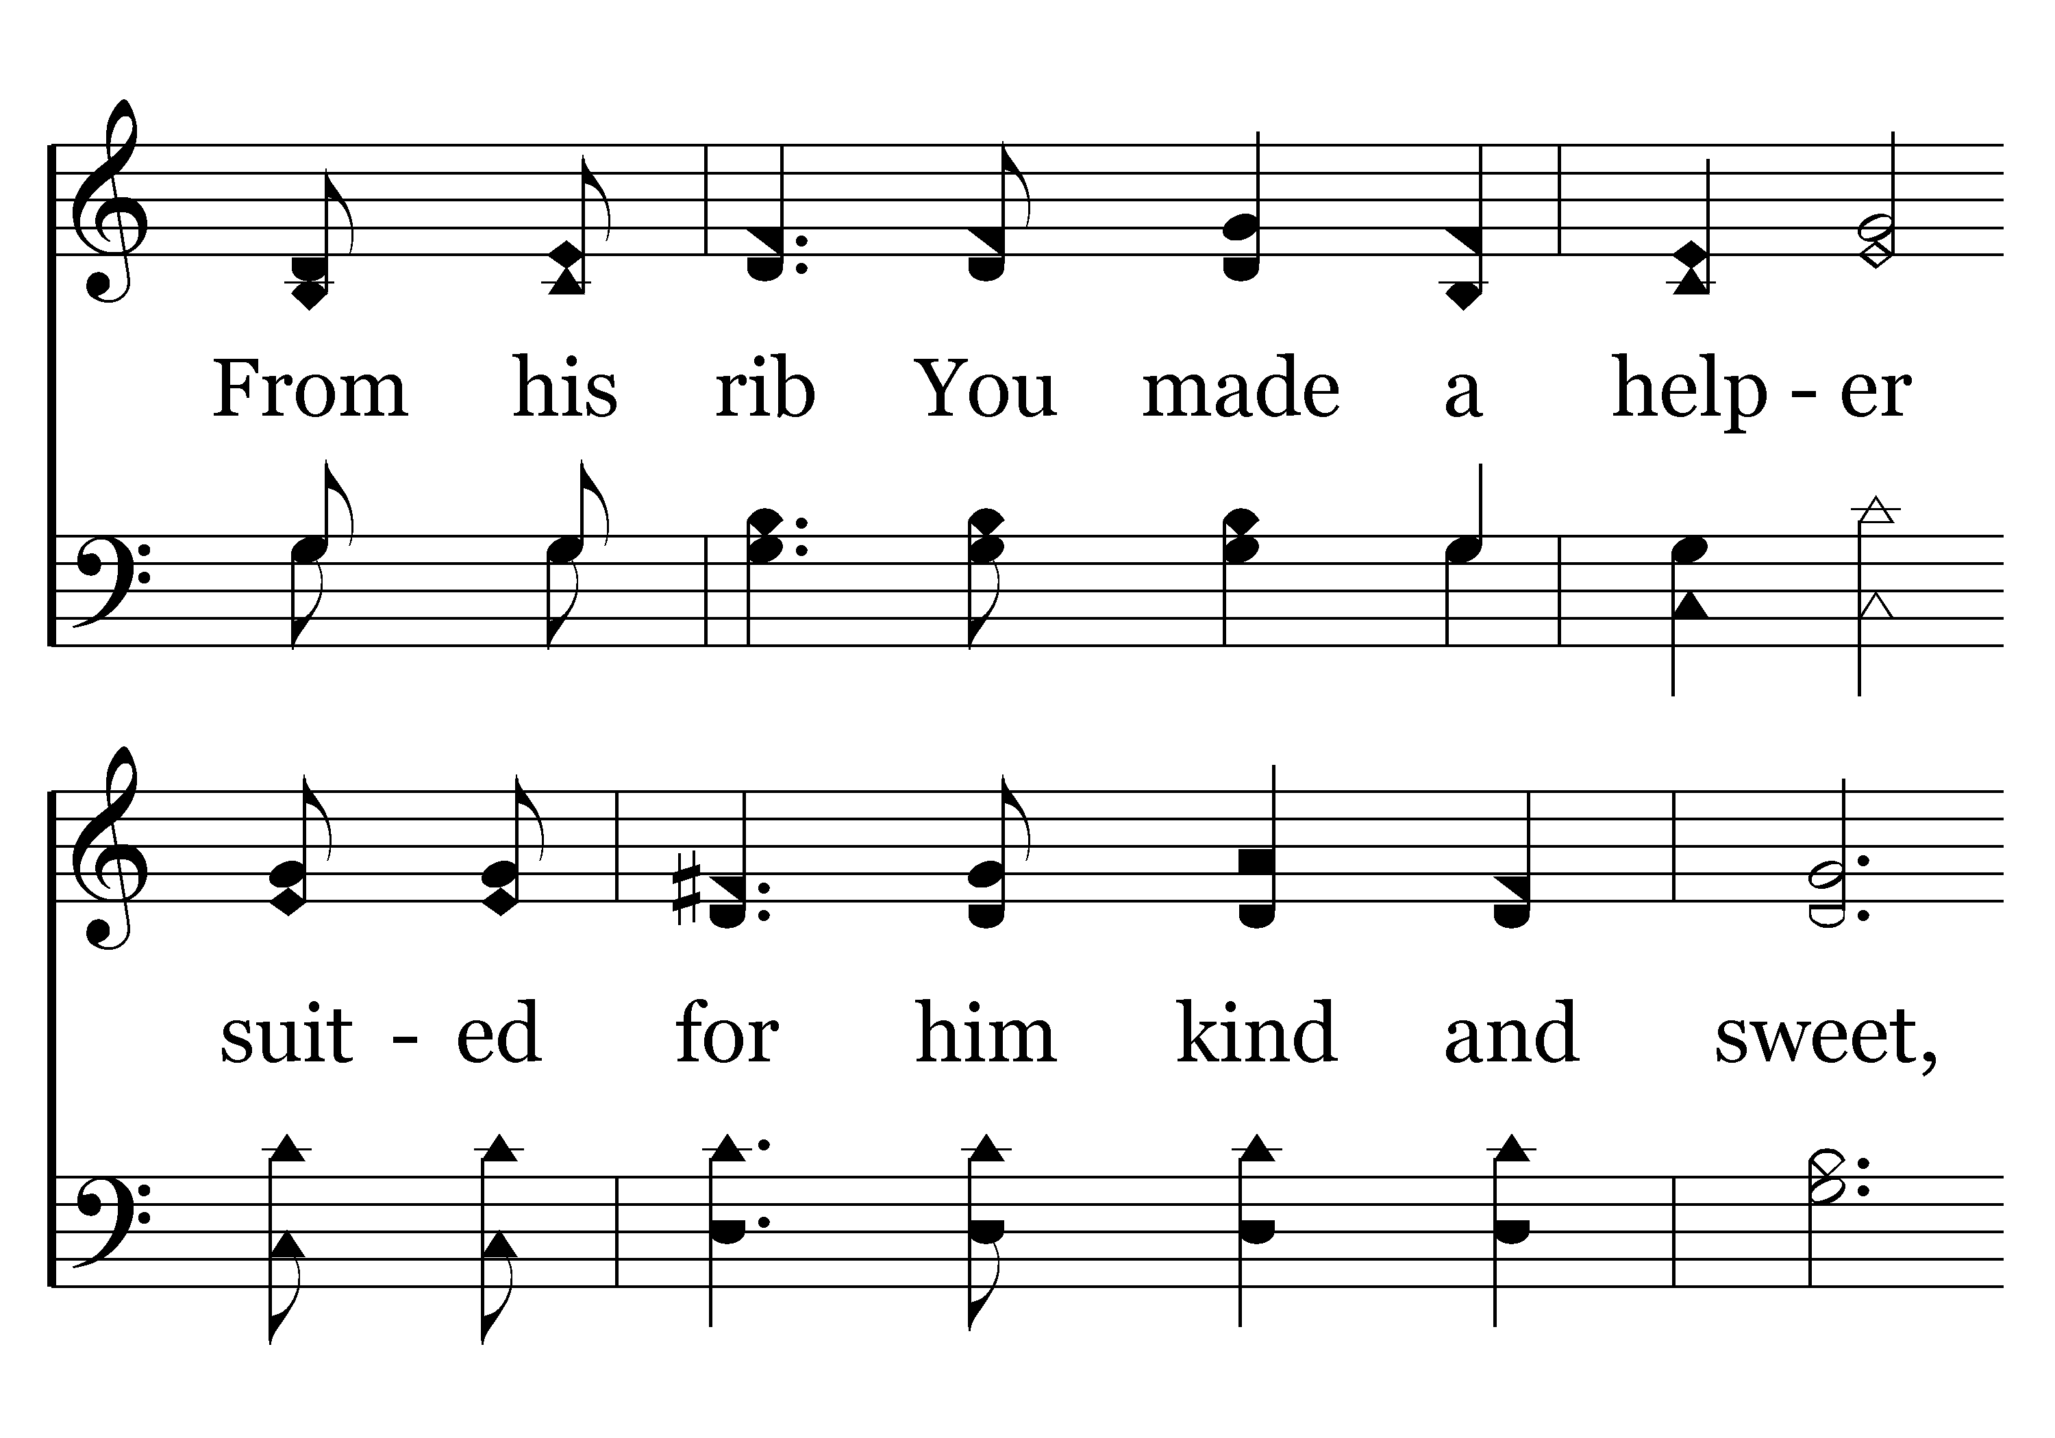
702 - THANK YOU LORD – 1.2

Slide 5
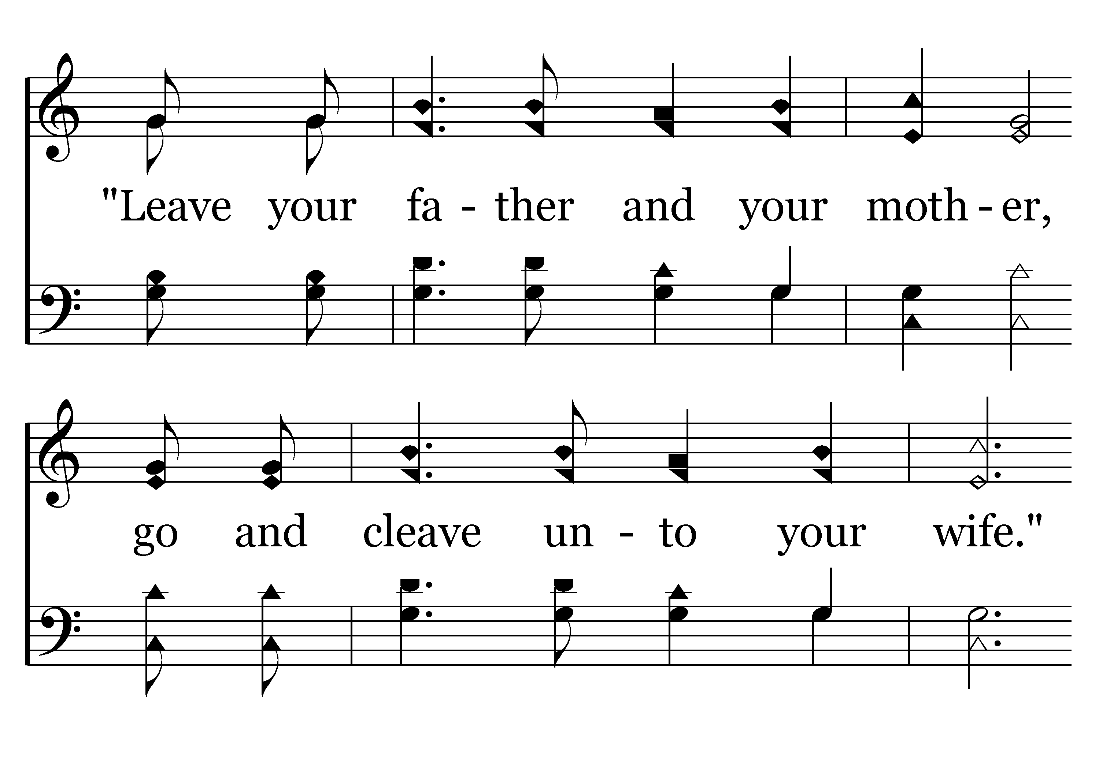
702 - THANK YOU LORD – 1.3

Slide 6
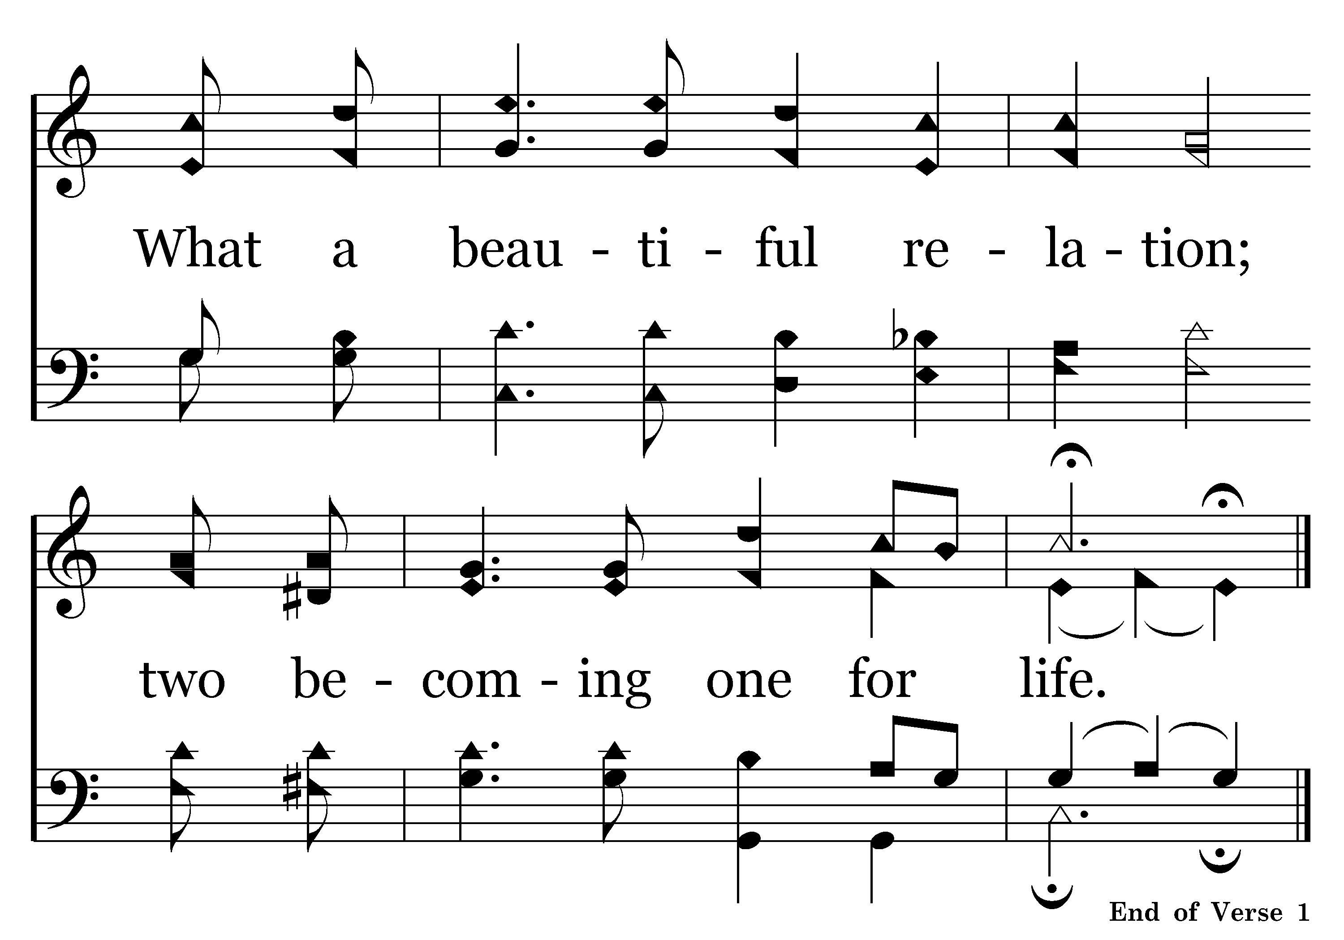
702 - THANK YOU LORD – 1.4
End of Song

Slide 7

308 - WHERE LOVE IS - TITLE

Slide 8
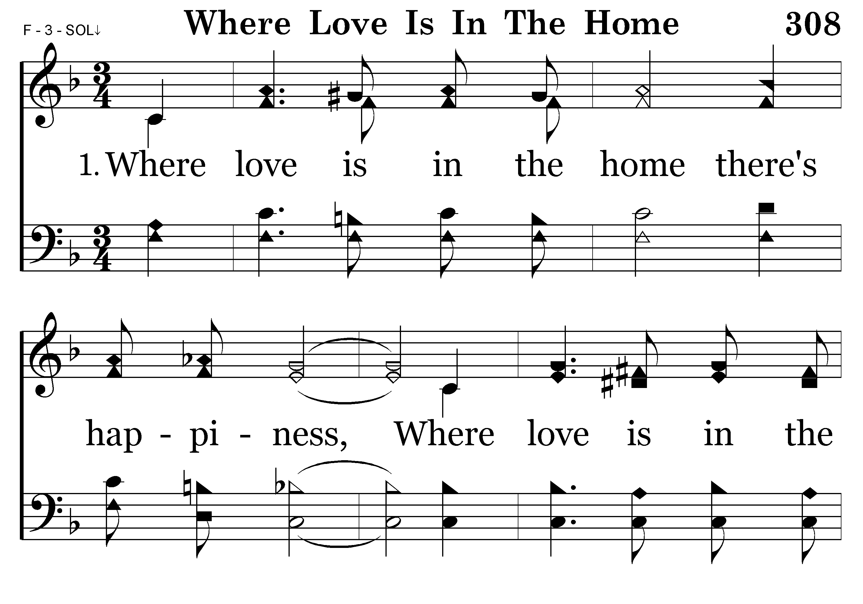
308 - WHERE LOVE IS – 1.1

Slide 9
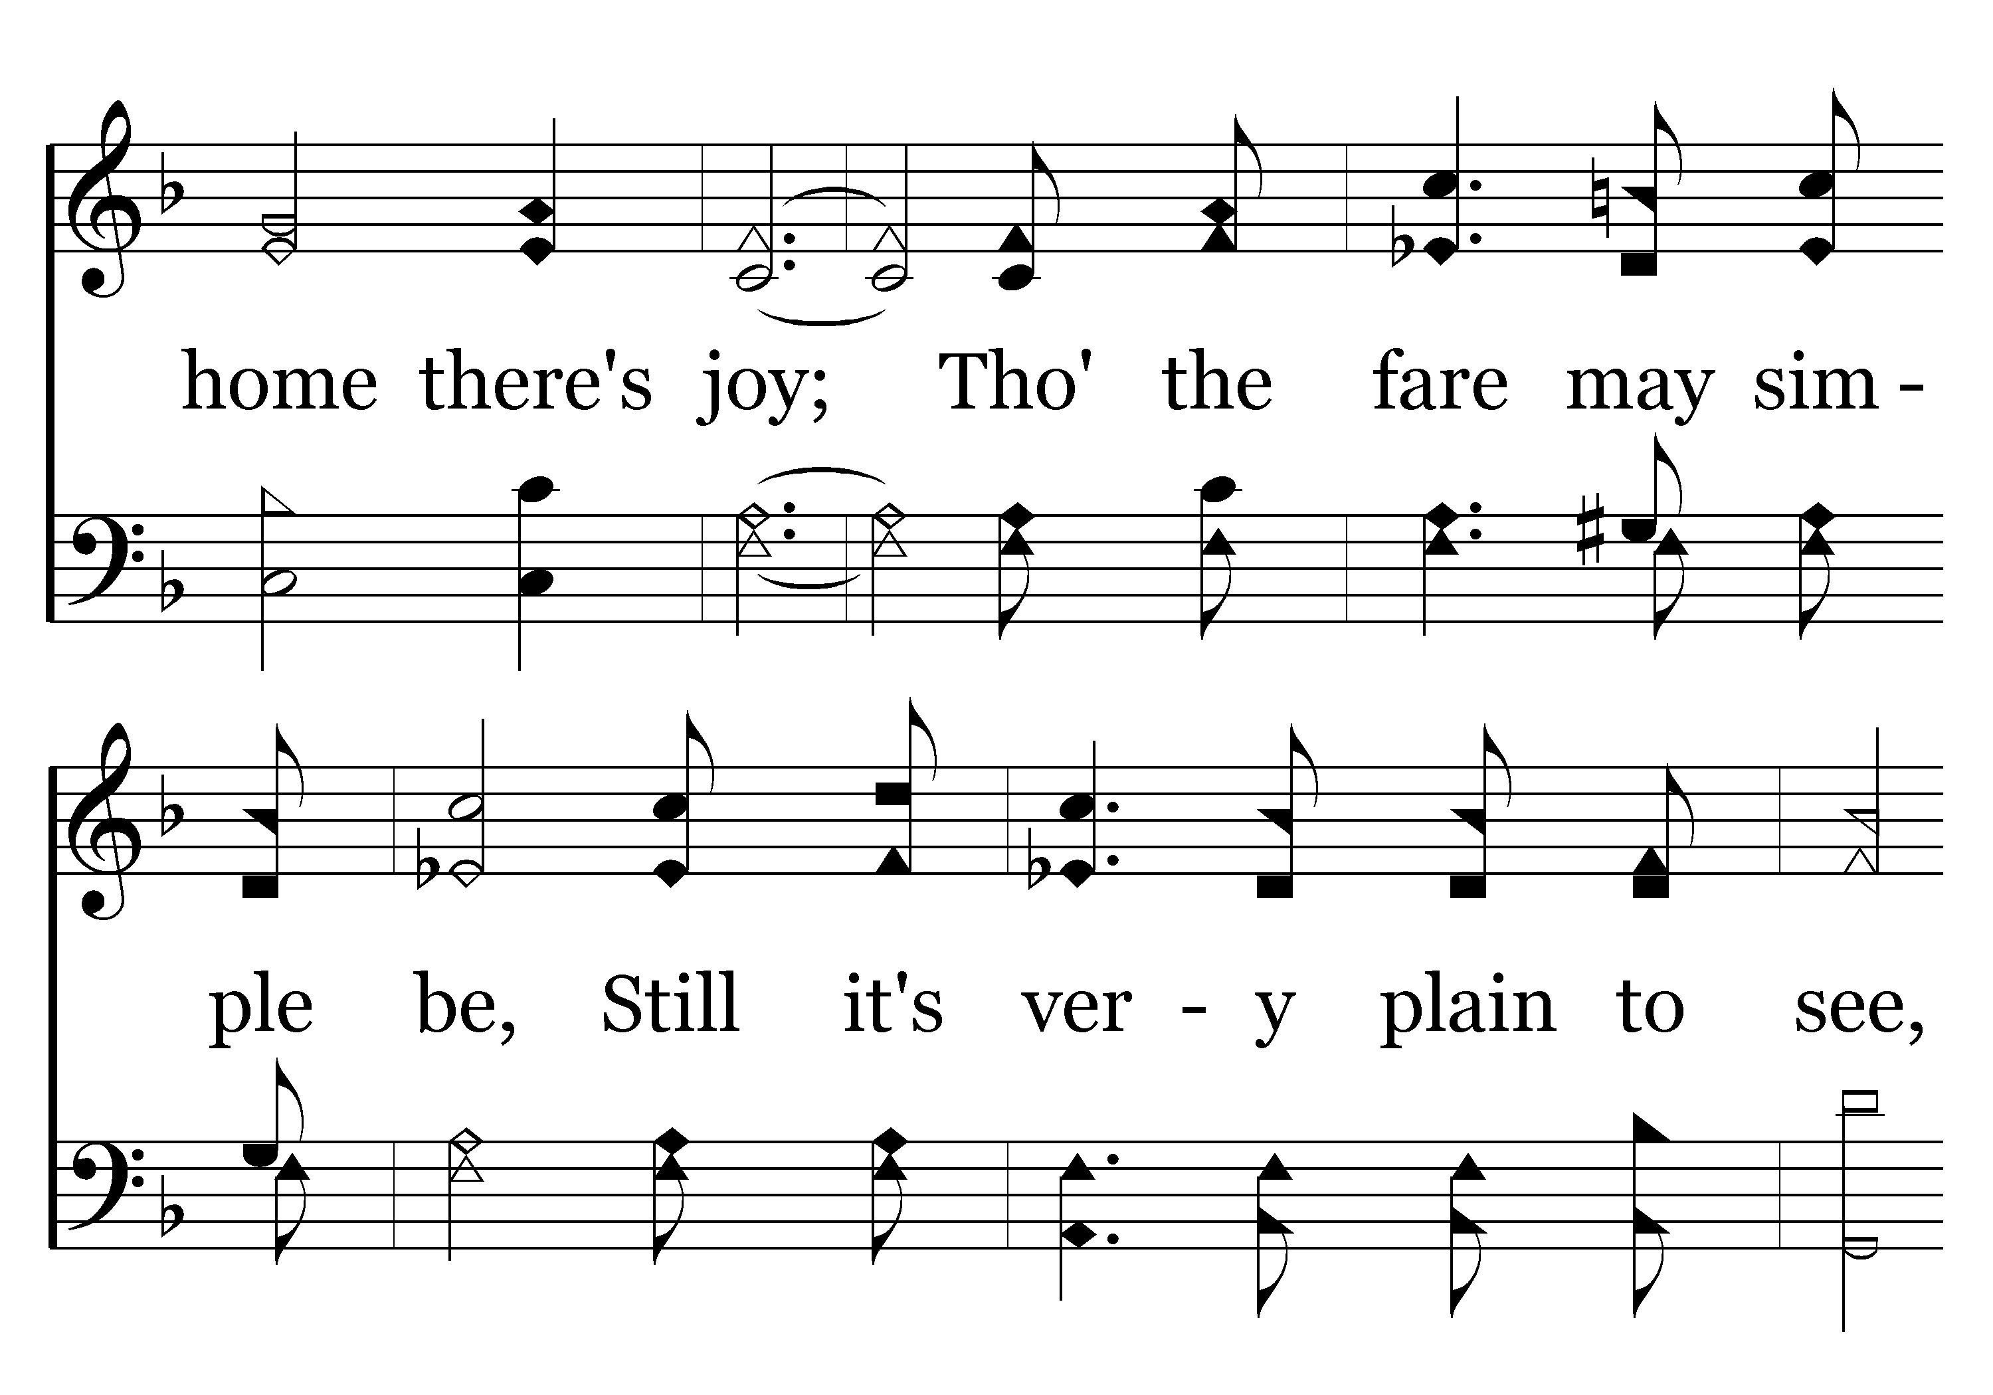
308 - WHERE LOVE IS – 1.2

Slide 10
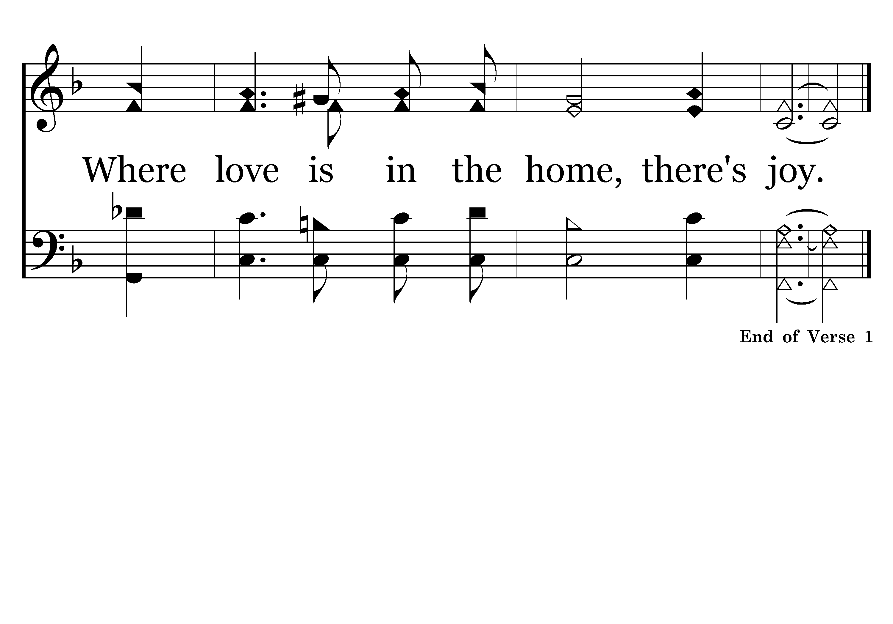
308 - WHERE LOVE IS – 1.3

Slide 11
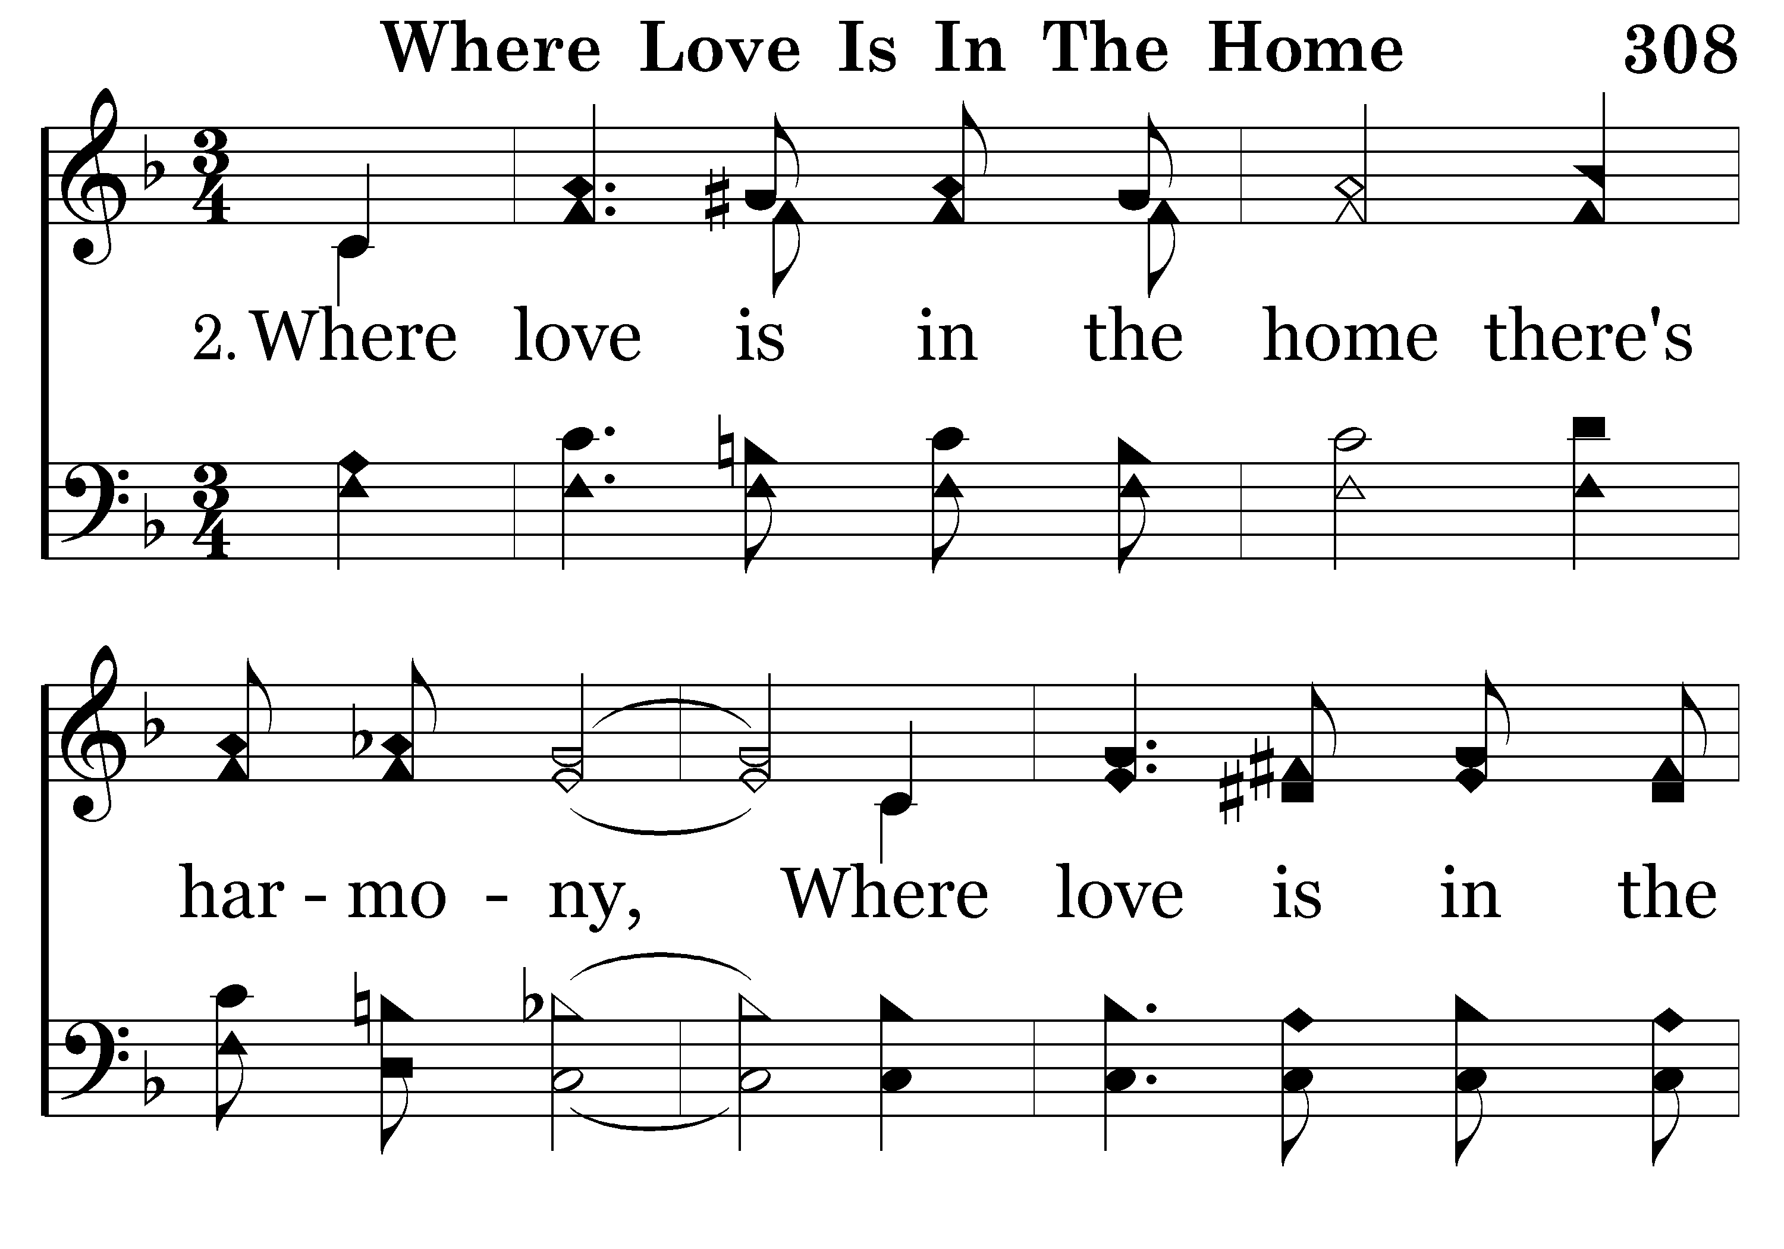
308 - WHERE LOVE IS – 2.1

Slide 12
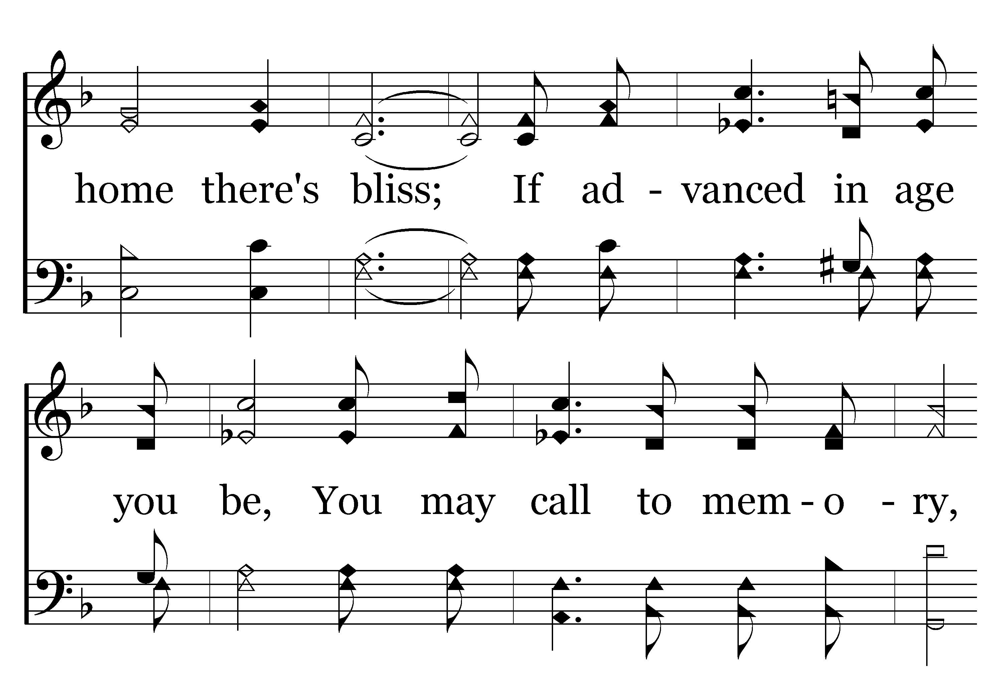
308 - WHERE LOVE IS – 2.2

Slide 13
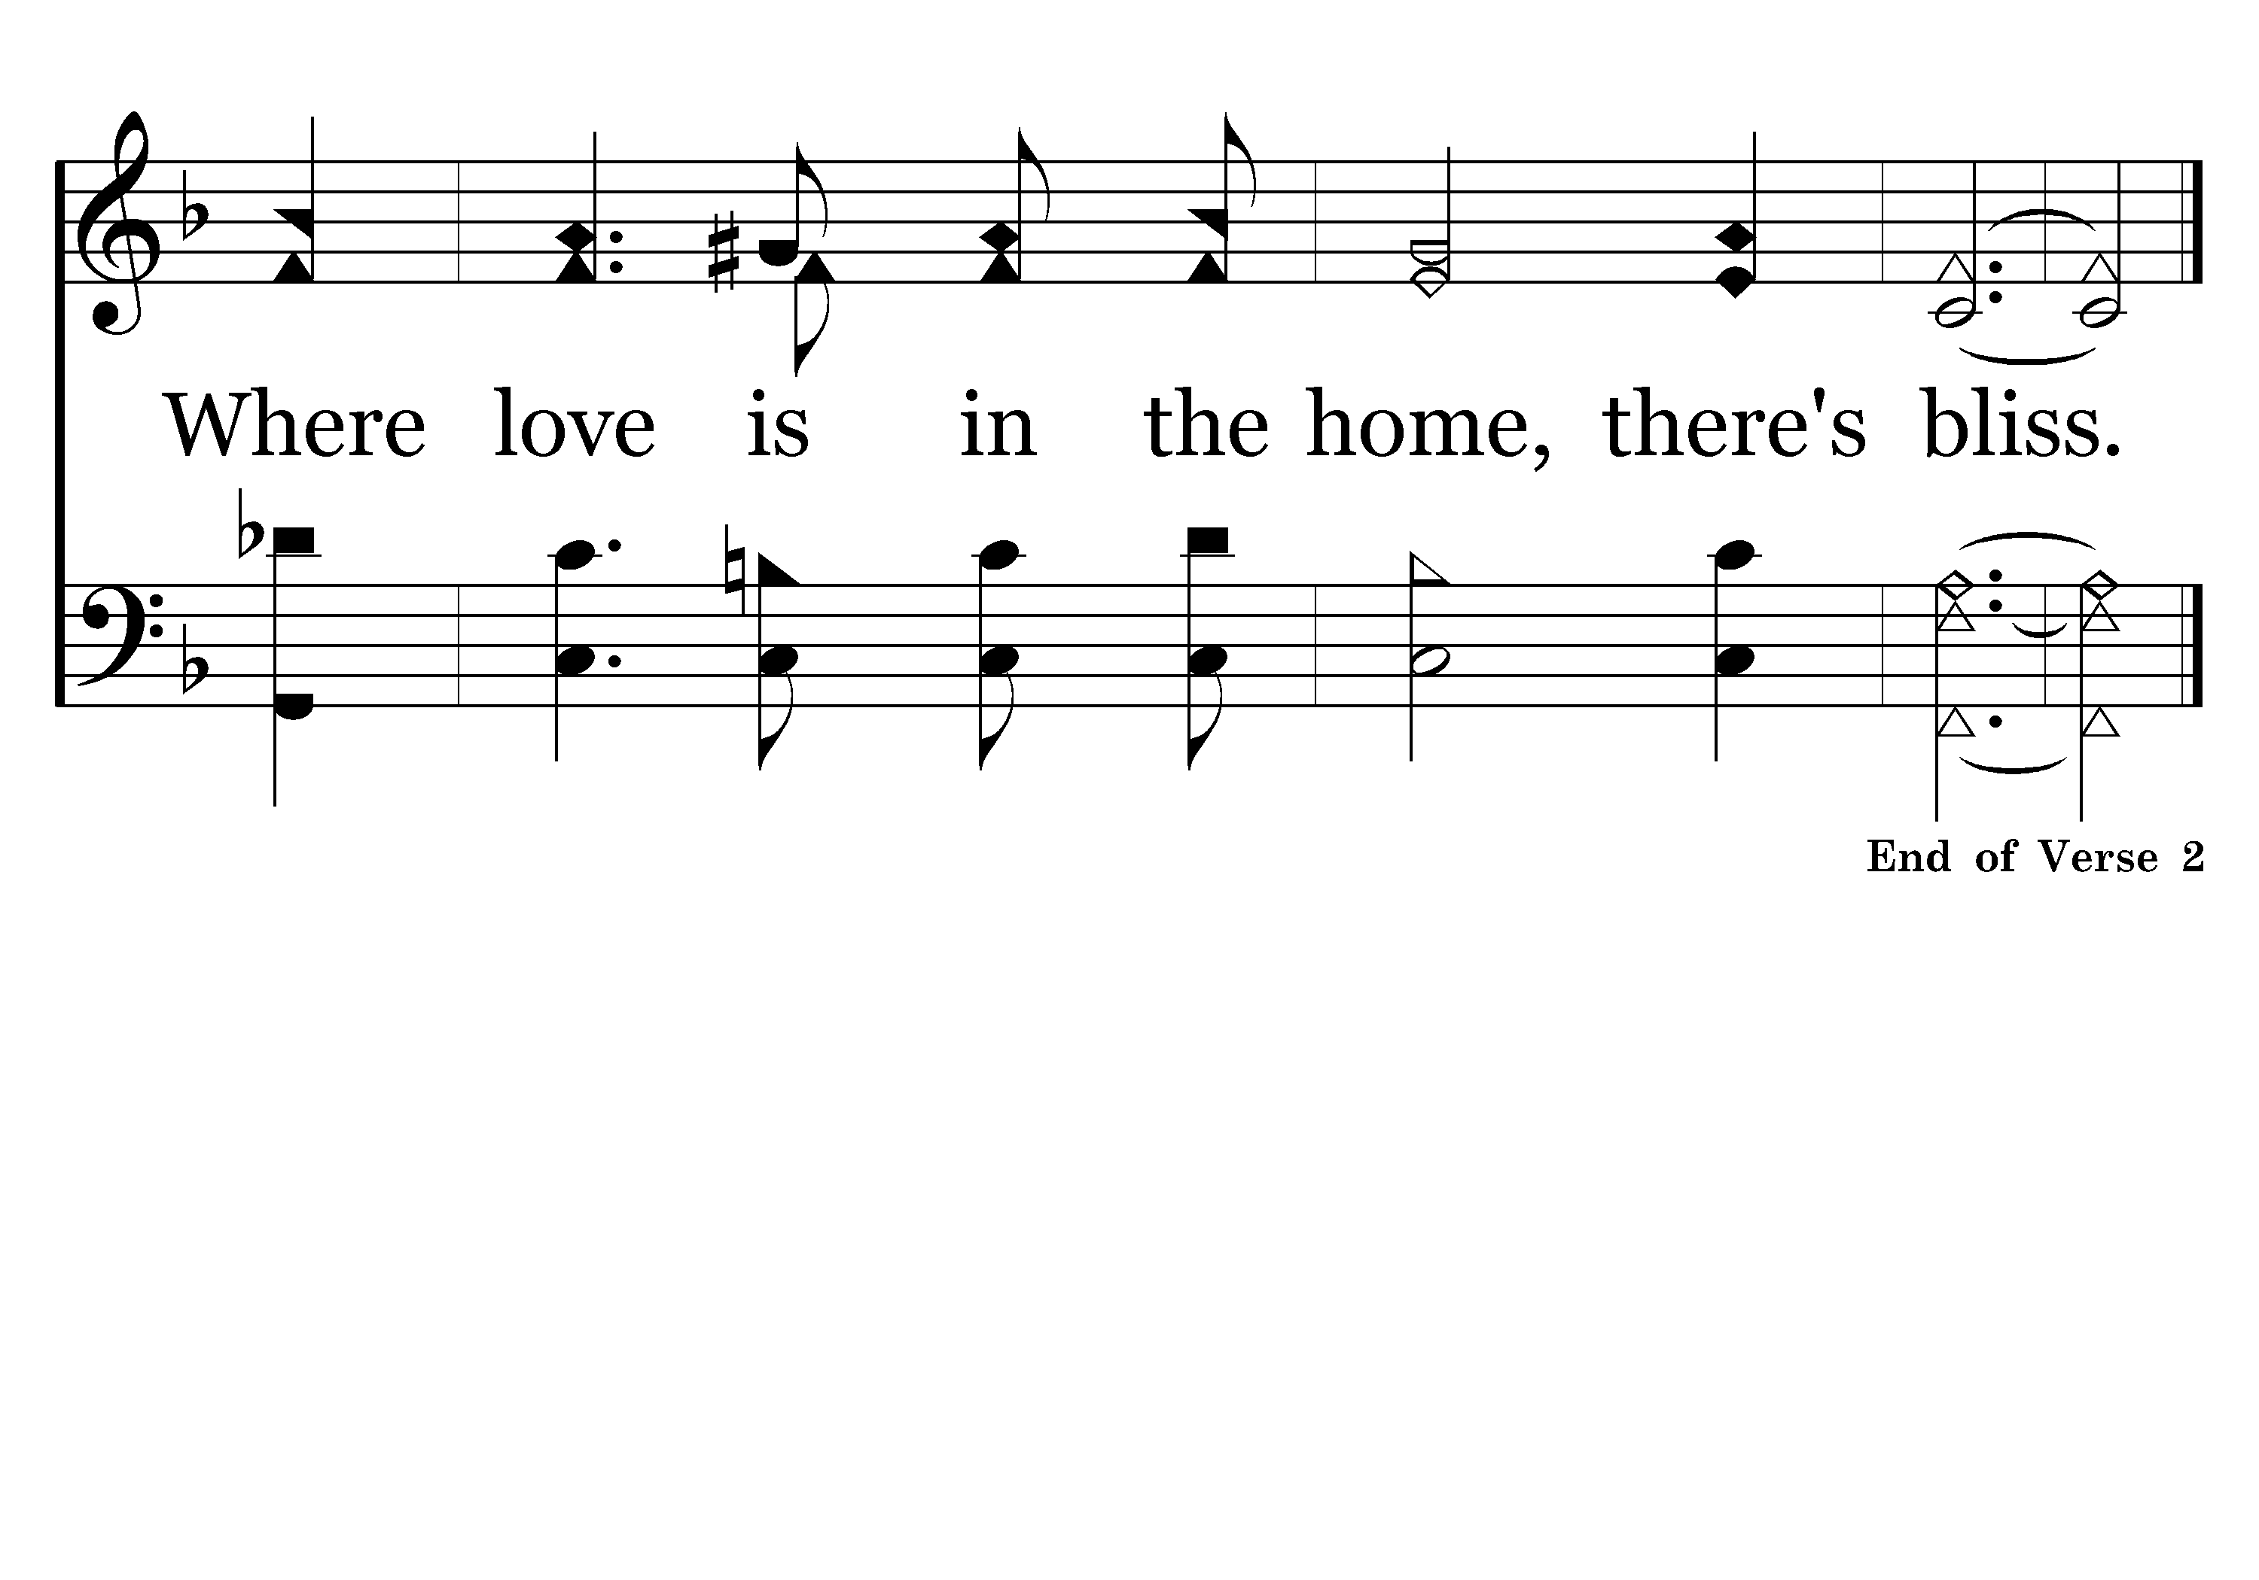
308 - WHERE LOVE IS – 2.3

Slide 14
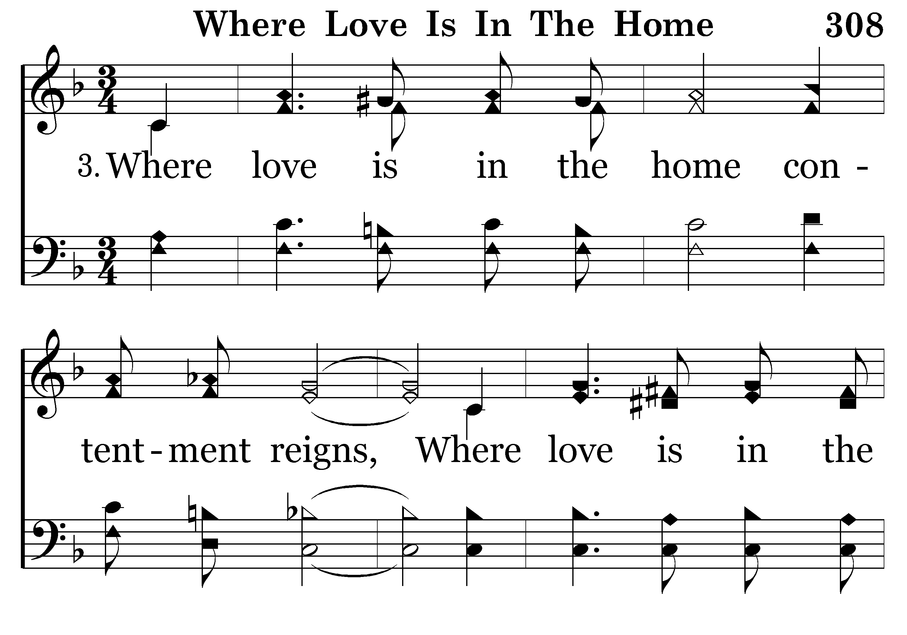
308 - WHERE LOVE IS – 3.1

Slide 15
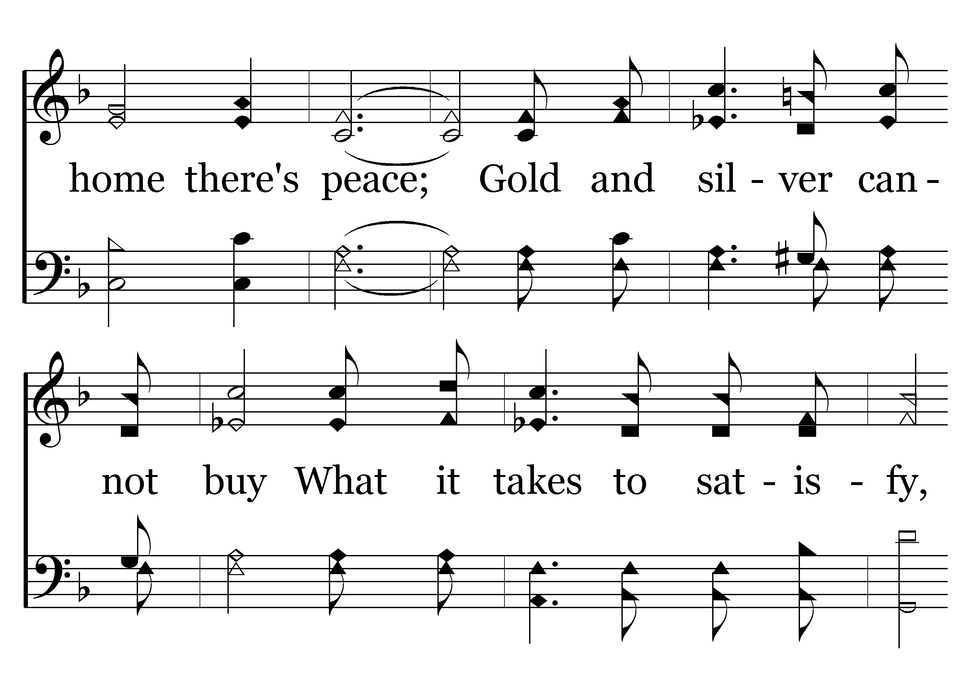
308 - WHERE LOVE IS – 3.2

Slide 16
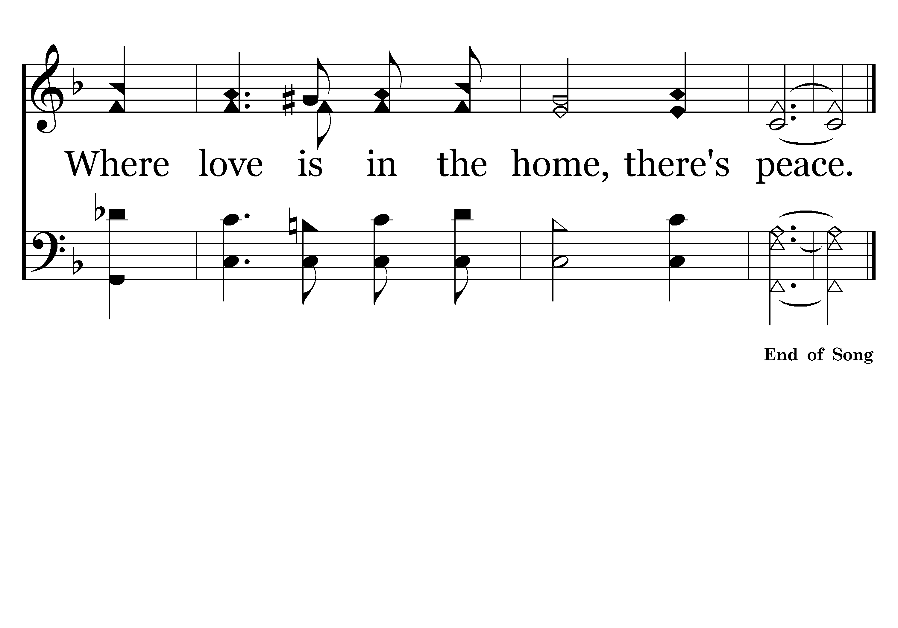
308 - WHERE LOVE IS – 3.3

Slide 17

472 - GOD, GIVE US CHRISTIAN – TITLE

Slide 18
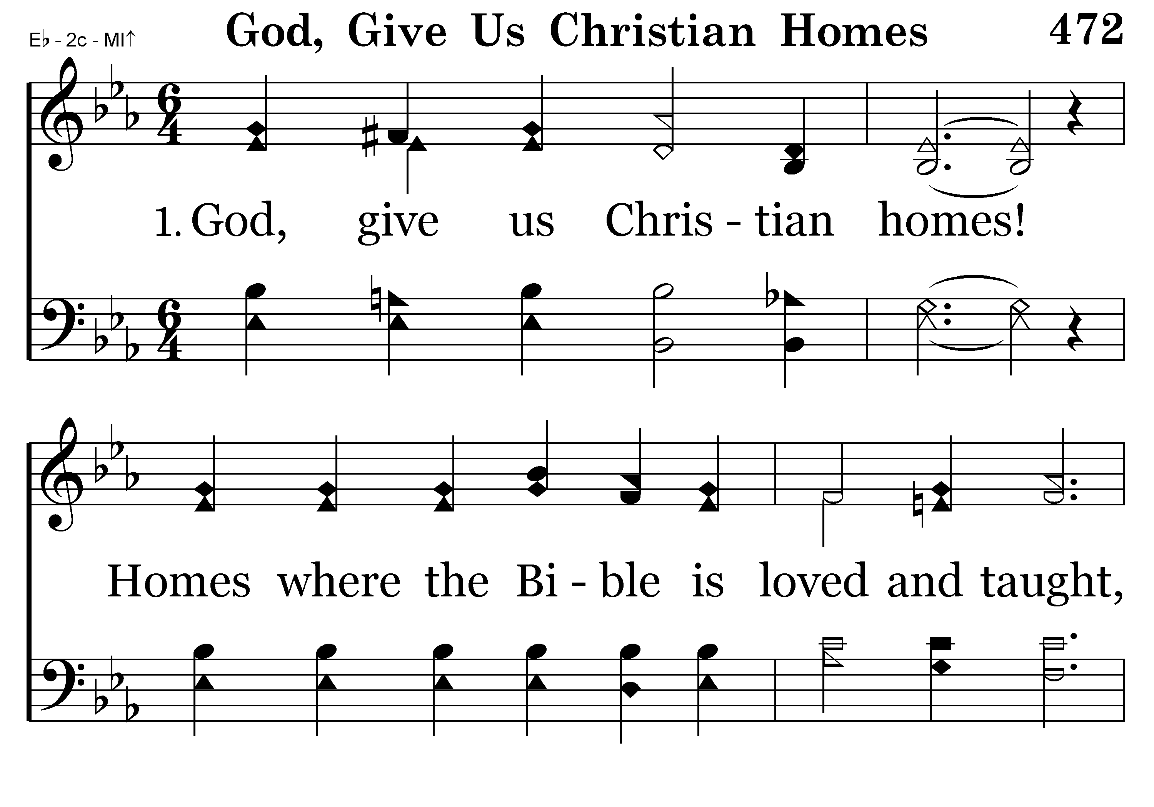
472 - GOD, GIVE US CHRISTIAN – 1.1

Slide 19
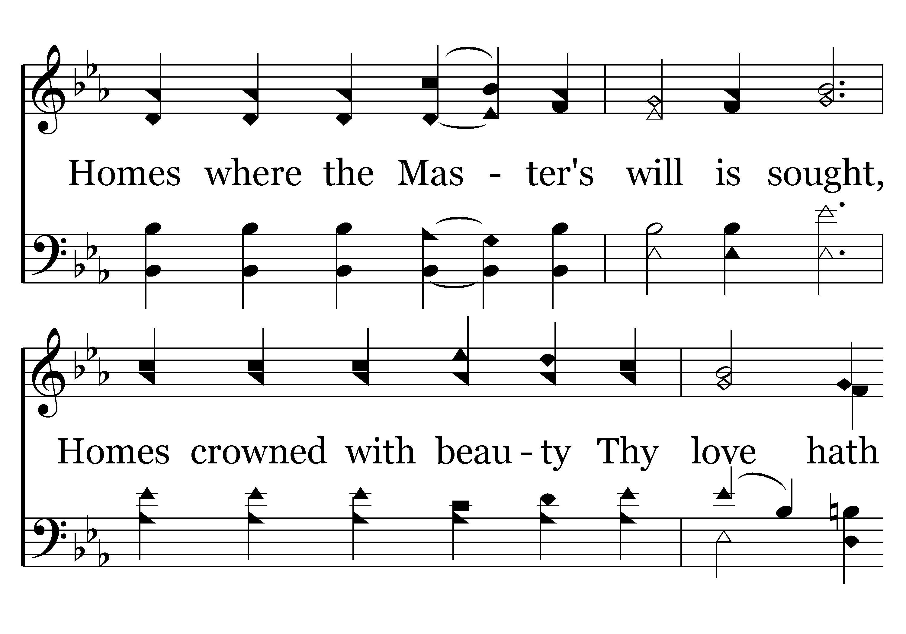
472 - GOD, GIVE US CHRISTIAN – 1.2

Slide 20
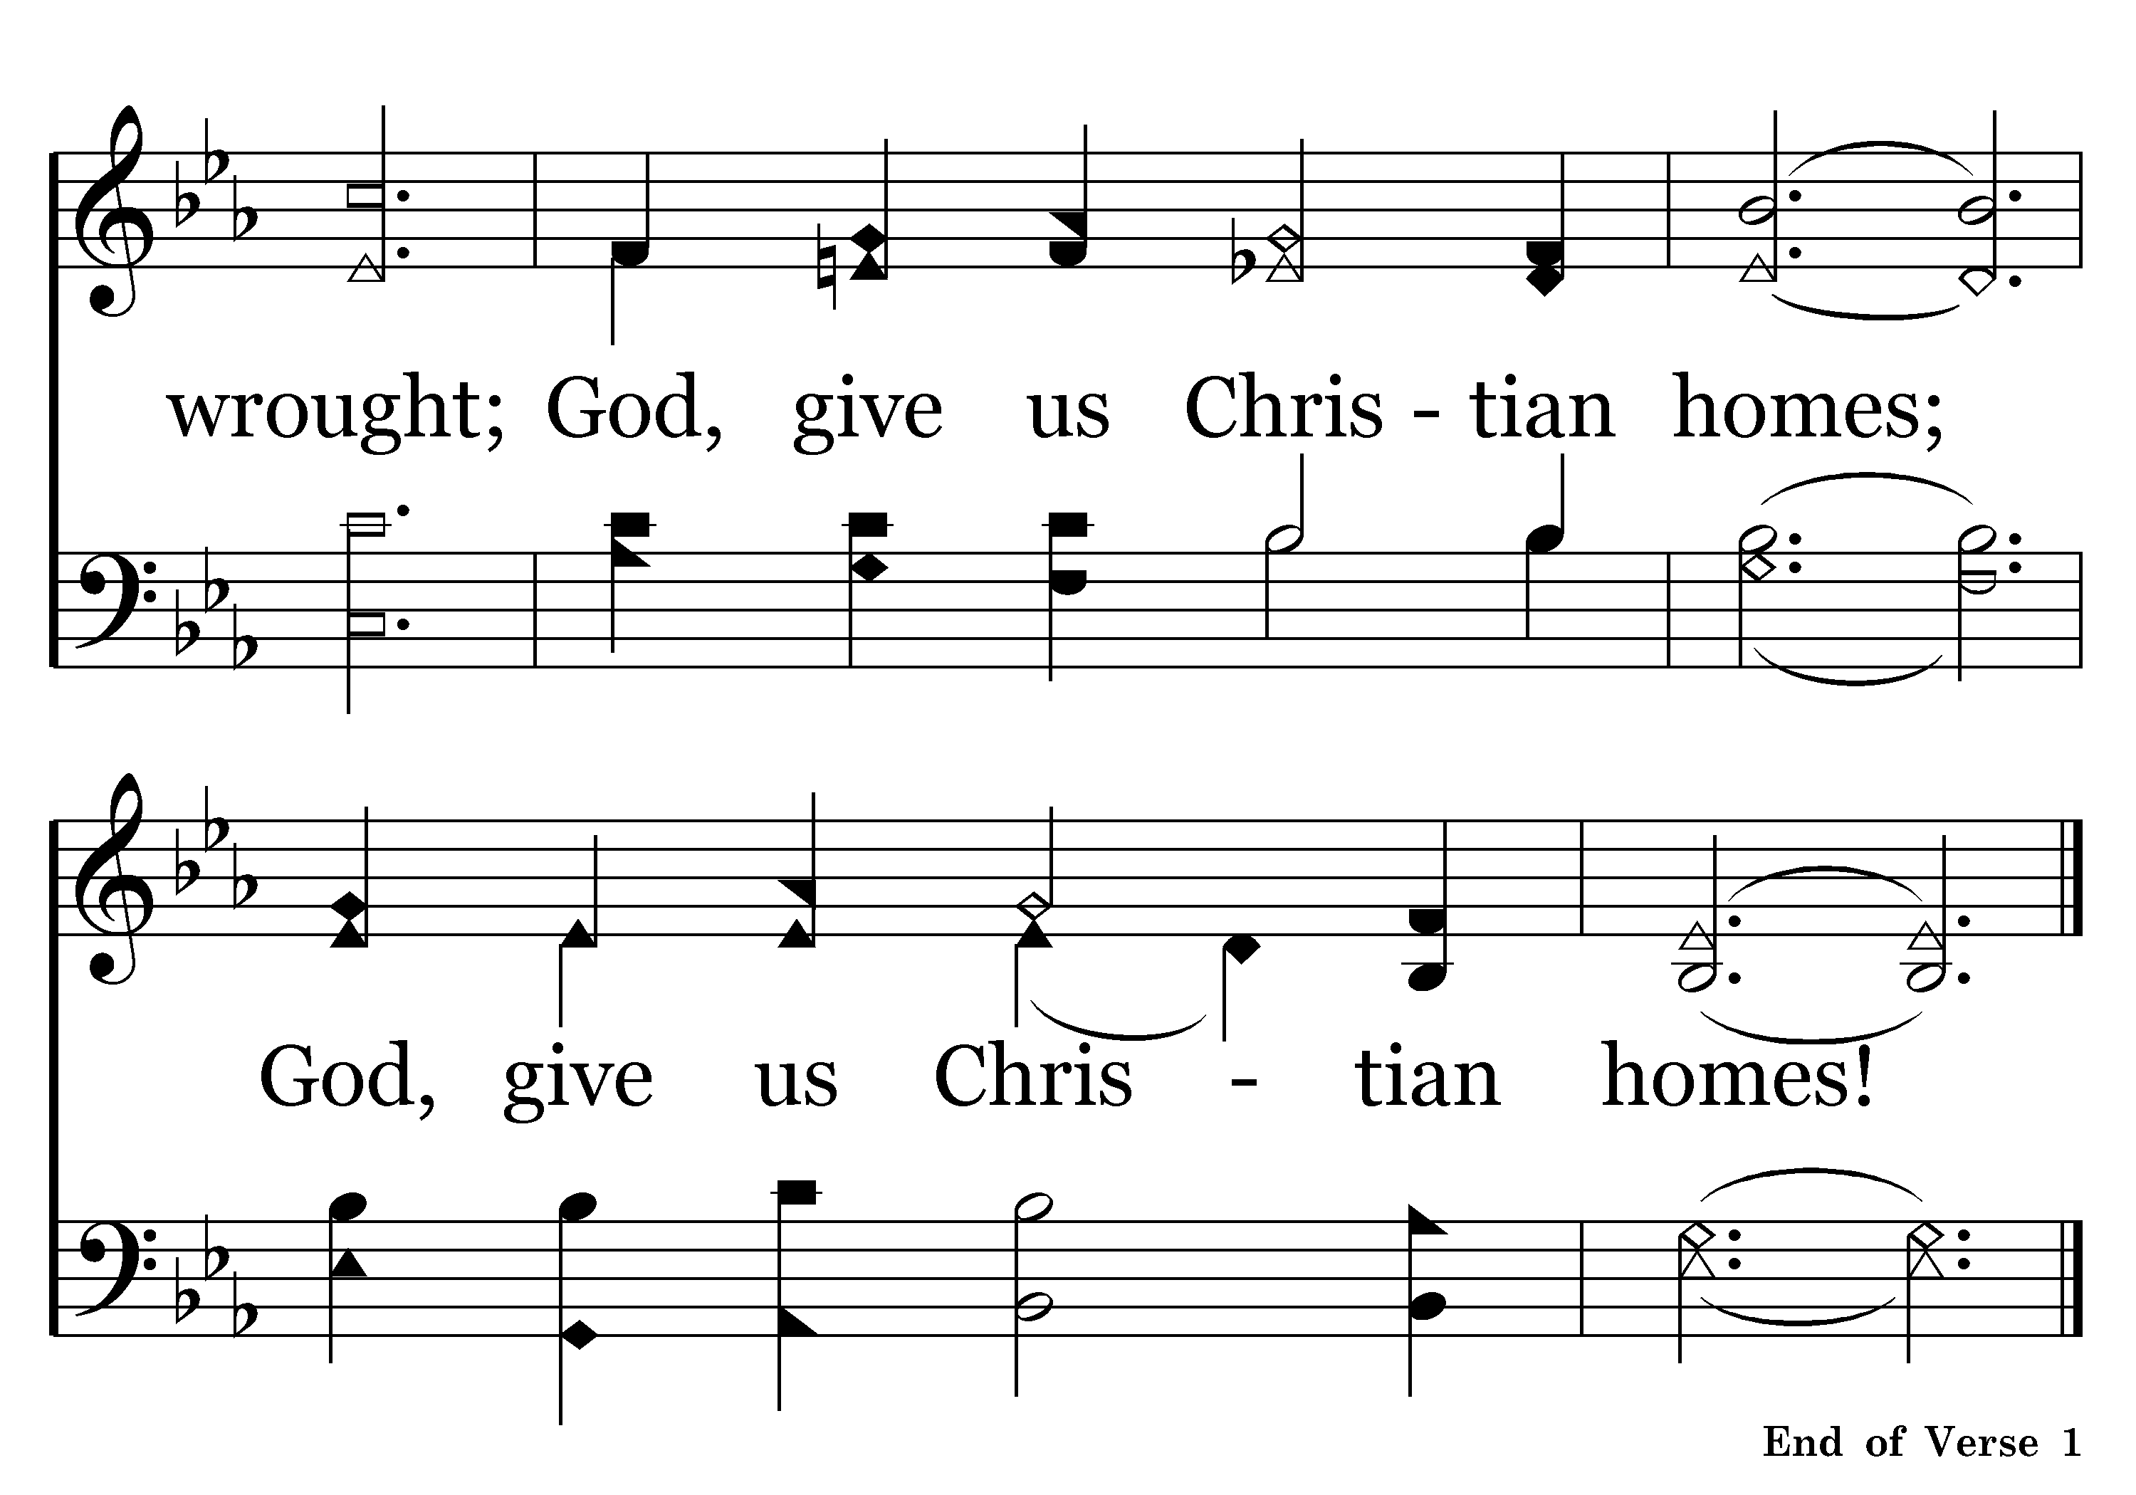
472 - GOD, GIVE US CHRISTIAN – 1.3

Slide 21

472 - GOD, GIVE US CHRISTIAN – 2.1

Slide 22
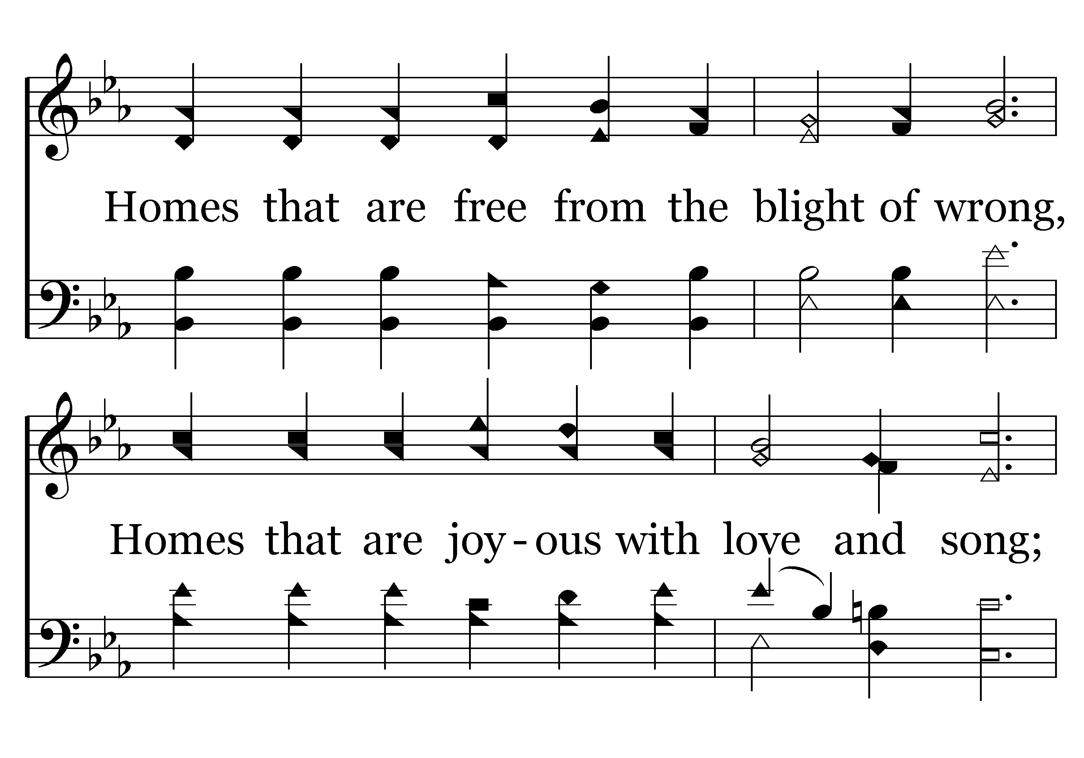
472 - GOD, GIVE US CHRISTIAN – 2.2

Slide 23
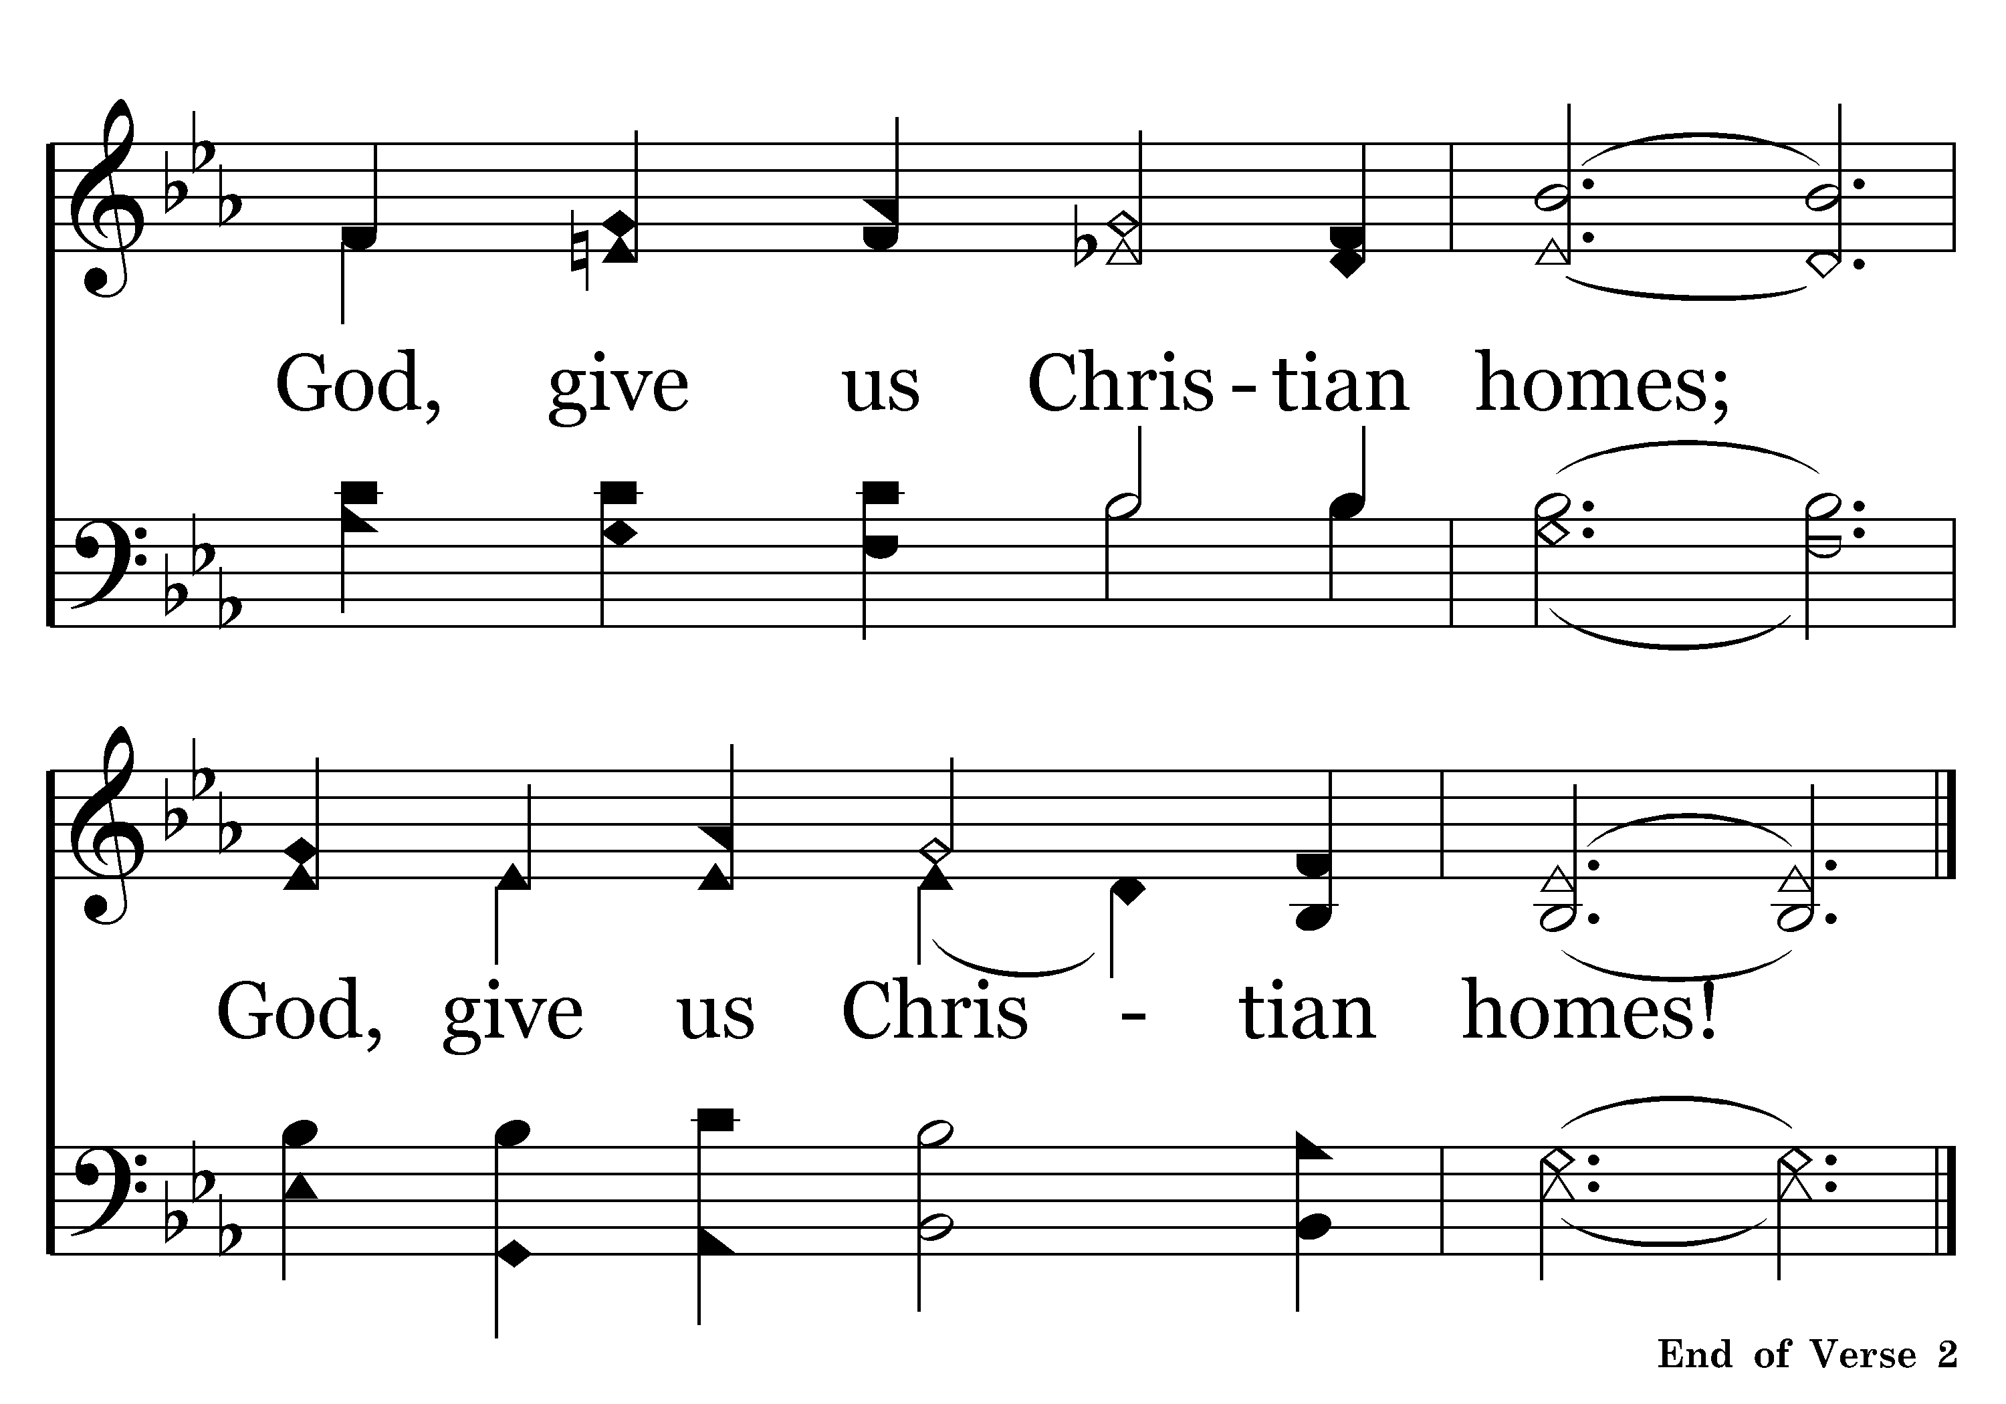
472 - GOD, GIVE US CHRISTIAN – 2.3

Slide 24
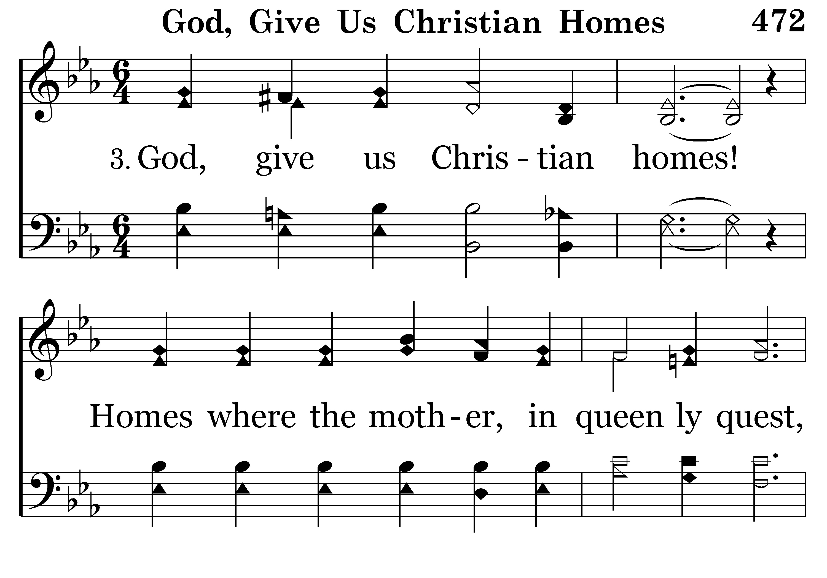
472 - GOD, GIVE US CHRISTIAN – 3.1

Slide 25
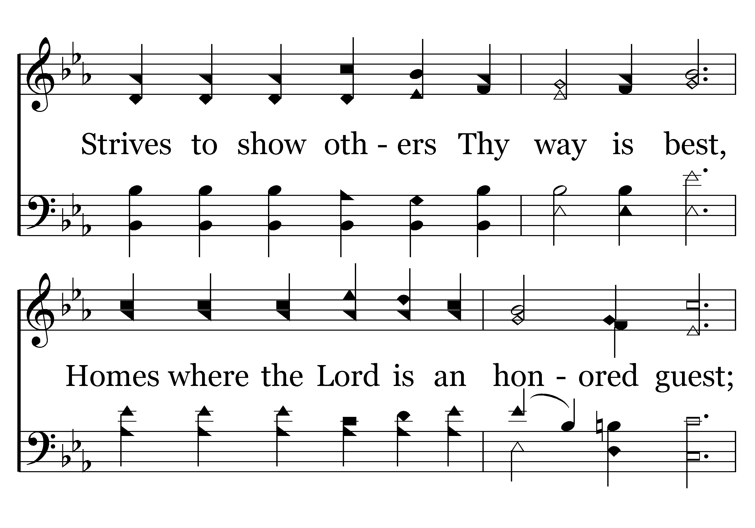
472 - GOD, GIVE US CHRISTIAN – 3.2

Slide 26
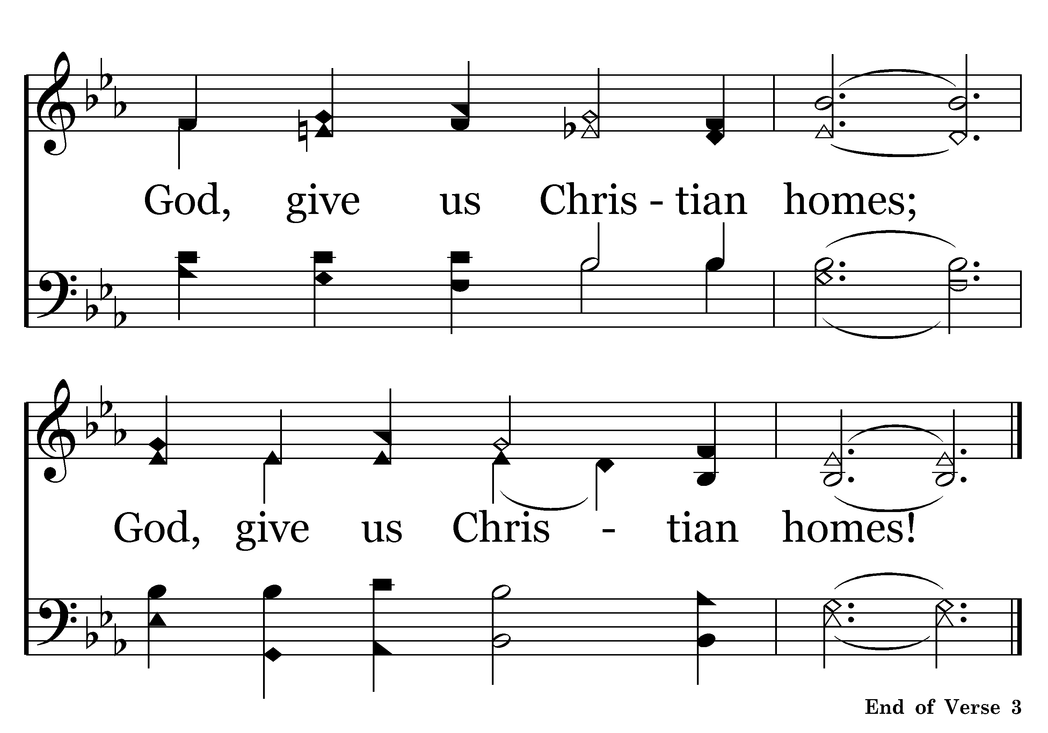
472 - GOD, GIVE US CHRISTIAN – 3.3

Slide 27
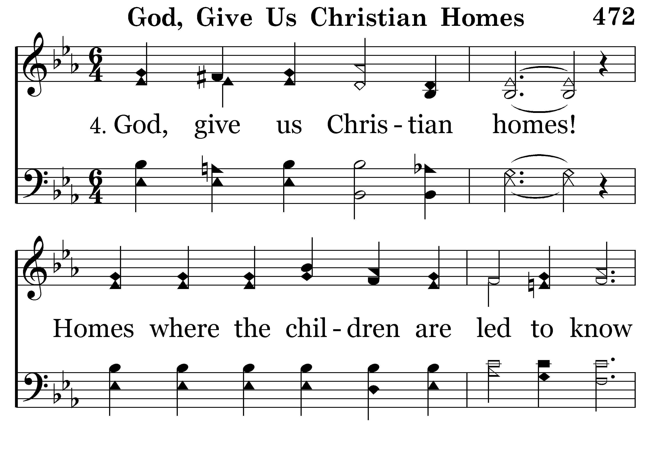
472 - GOD, GIVE US CHRISTIAN – 4.1

Slide 28
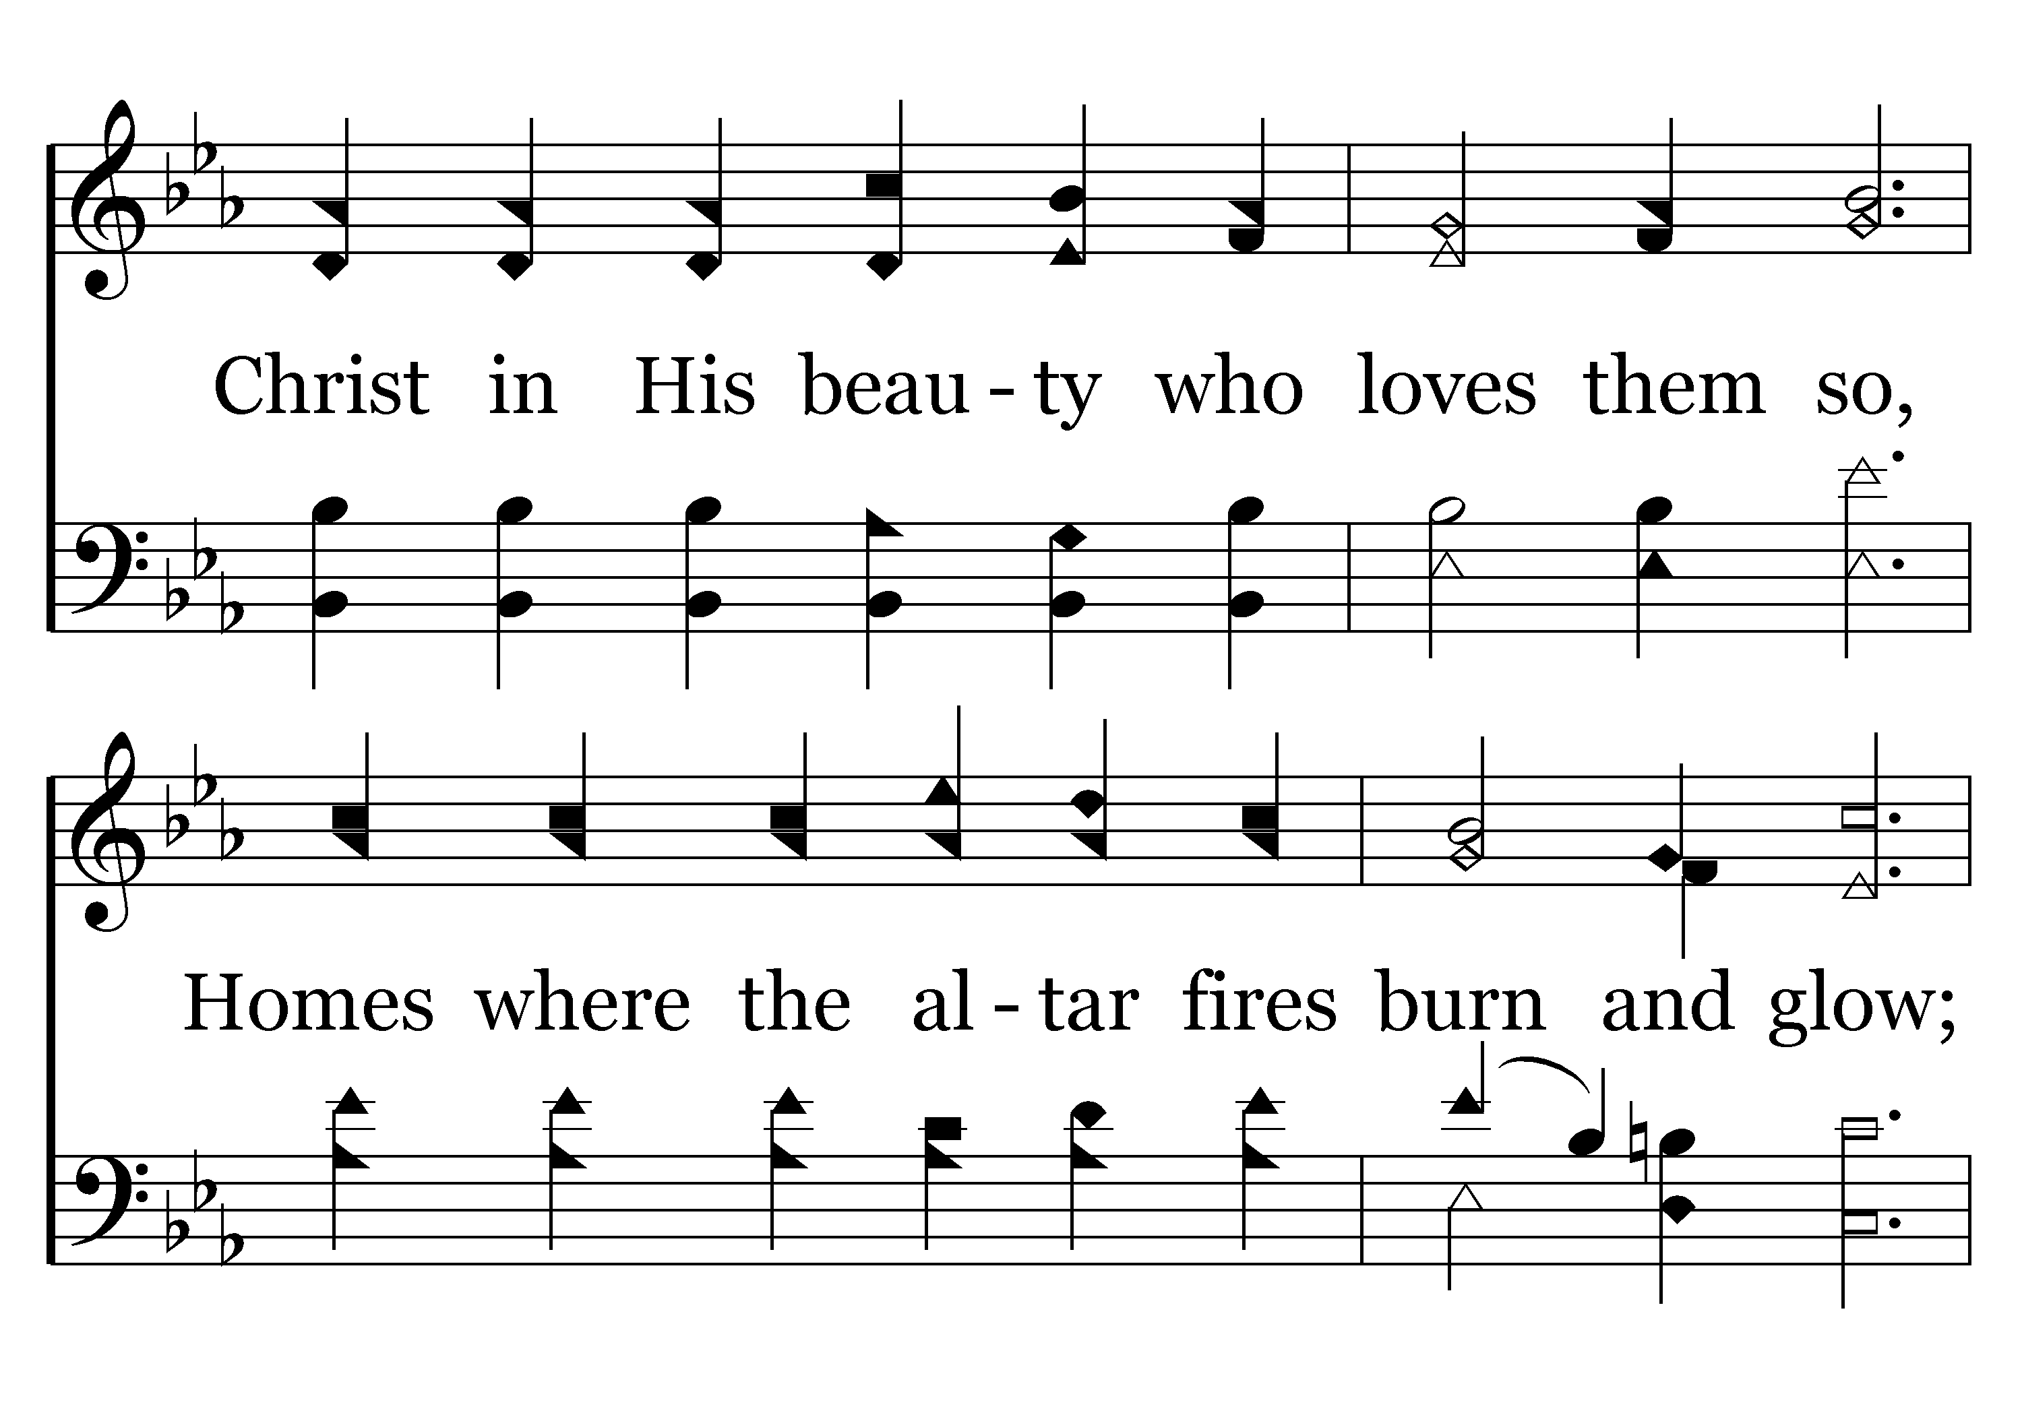
472 - GOD, GIVE US CHRISTIAN – 4.2

Slide 29
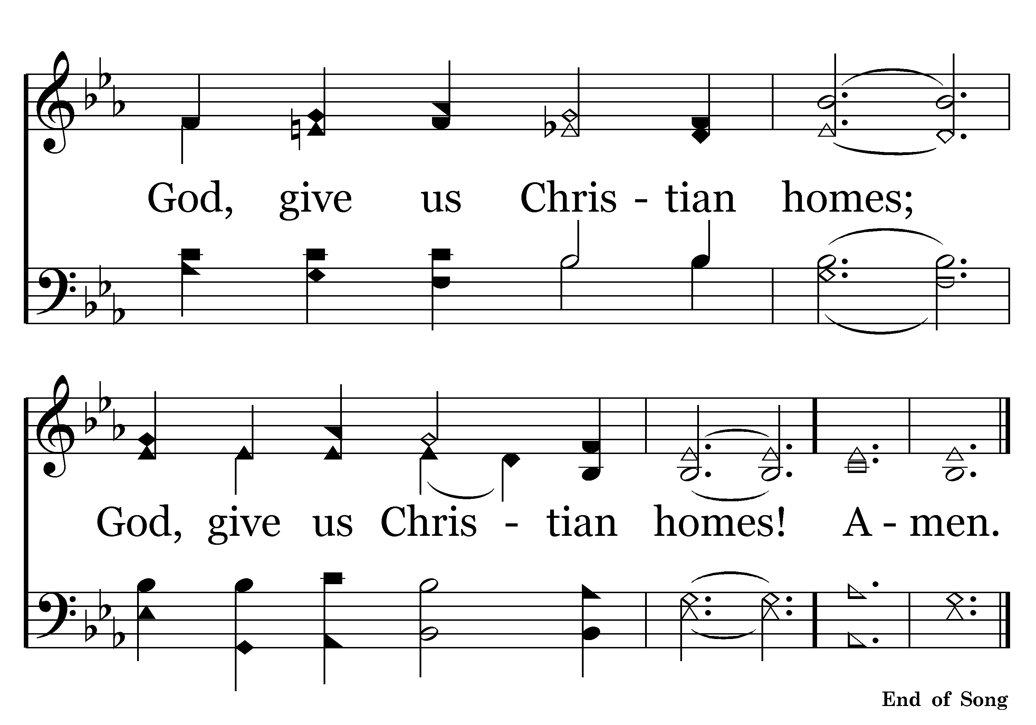
472 - GOD, GIVE US CHRISTIAN – 4.3

Slide 30
“God Give Us Christian Homes”

Slide 31
“In the year 2000 there were 5.5 million Americans living together outside of marriage, an 11 fold increase since 1960.”
“More than half of all marriages in our country are now preceded by a period of living together” (Ibid.).
Wm. J. Bennett, The Broken Hearth – p. 13

Slide 32
Hebrews 13:4
4 Marriage is honorable among all, and the bed undefiled; but fornicators and adulterers God will judge.

Slide 33
“After people get married, the picture is just as bleak: The United States has the highest divorce rate in the world.”
Wm. J. Bennett, The Index of Leading Cultural Indicators – p. 59

Slide 34
Malachi 2:16
16 “. . . God . . . hates divorce, . .”

Slide 35
Historian Lawrence Stone has assessed divorce to be “as much a part of our culture and our lives as death and taxes”
Wm. J. Bennett, The Broken Hearth – p. 13
“Currently, one out of two children will witness the breakup of their parents’ marriage” (Ibid. 12).

Slide 36
Psalm 127:3-5
3 Behold, children are a heritage from the LORD, the fruit of the womb is a reward.
4 Like arrows in the hand of a warrior, so are the children of one's youth.
5 Happy is the man who has his quiver full of them; . . .

Slide 38
“God Give Us Christian Homes”
Where the Bible is Loved & Taught.
Where the Father is True & Strong.
Where the Mother is the Homemaker.
Where Children are Led to Know About Christ.

Slide 39
“God, Give Us Homes . . .”

Slide 40
The Bible is Loved & Taught.
Matthew 19:4-6
4 And He answered and said to them, "Have you not read that He who made them at the beginning 'made them male and female,'
5 "and said, 'For this reason a man shall leave his father and mother and be joined to his wife, and the two shall become one flesh'?
6 "So then, they are no longer two but one flesh. Therefore what God has joined together, let not man separate."
2 Timothy 3:16-17
16 All Scripture is given by inspiration of God, and is profitable for doctrine, for reproof, for correction, for instruction in righteous-ness,
17 that the man of God may be complete, thoroughly equipped for every good work.
Matthew 6:33
33 "But seek first the kingdom of God and His righteousness, and all these things shall be added to you.
James 4:8
8 Draw near to God and He will draw near to you. . .”

Slide 41

249 - SEEK YE FIRST - TITLE

Slide 42
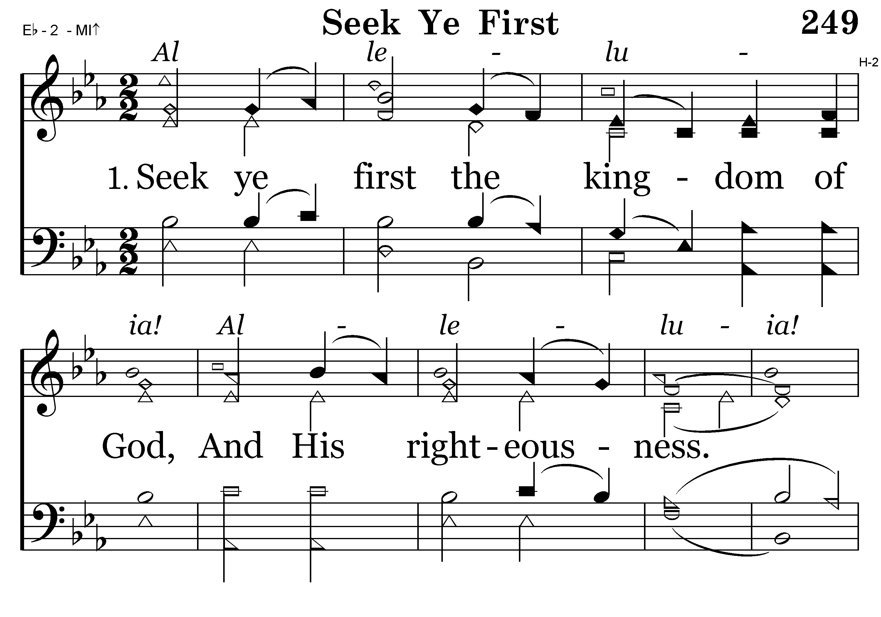
249 - SEEK YE FIRST – 1.1

Slide 43
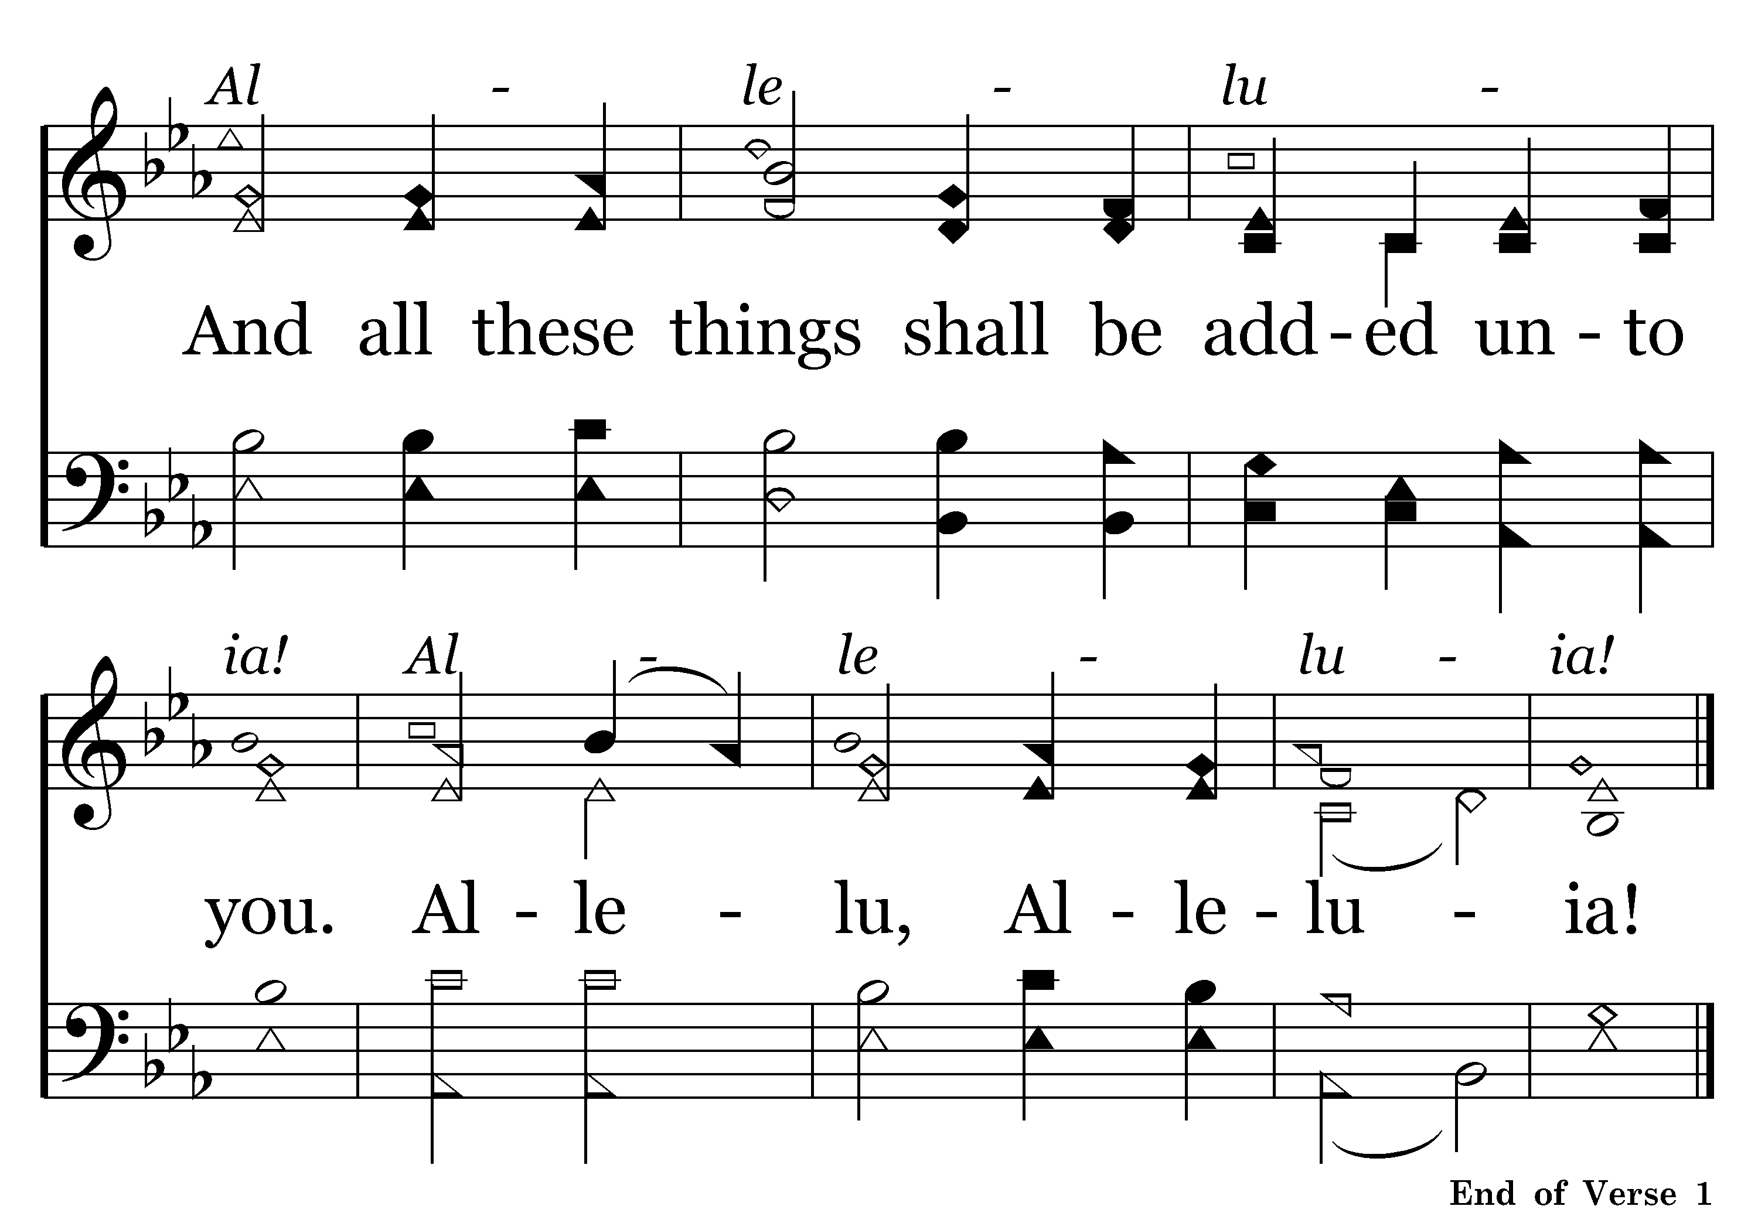
249 - SEEK YE FIRST – 1.2

Slide 44
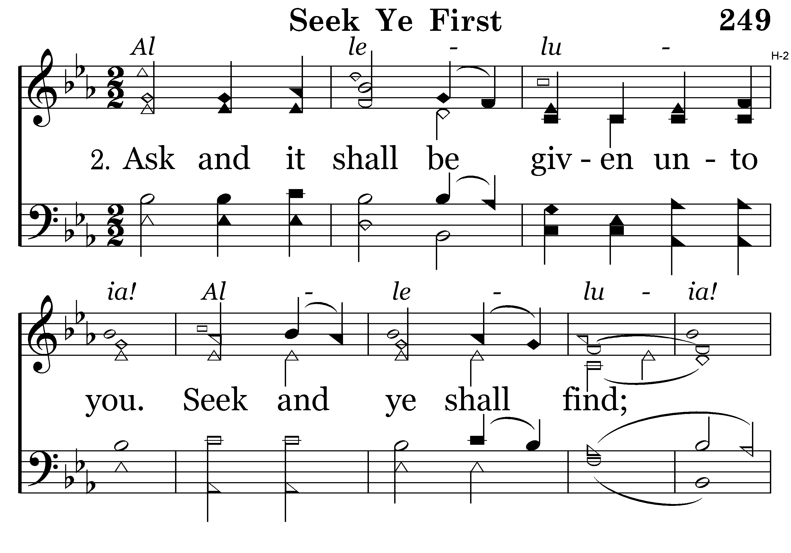
249 - SEEK YE FIRST – 2.1

Slide 45
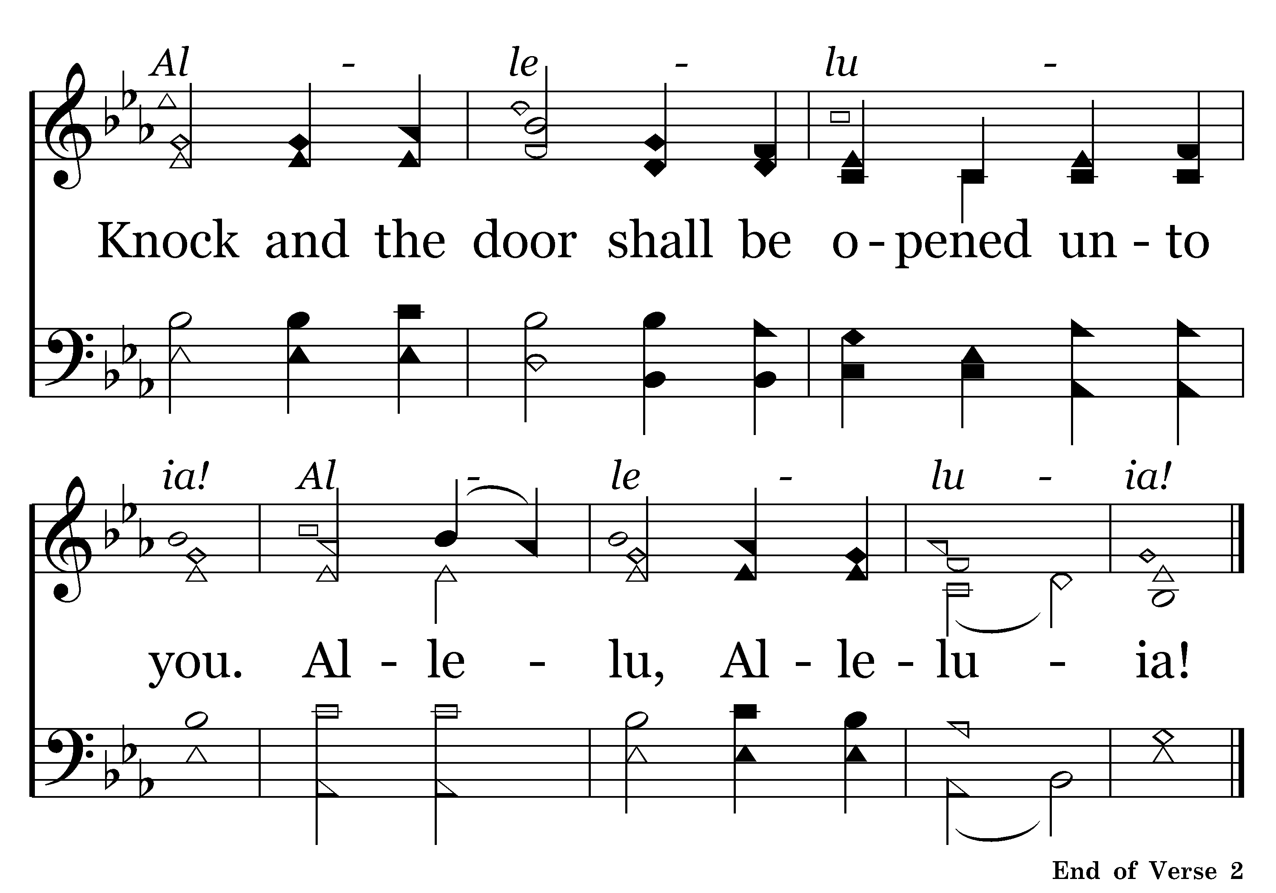
249 - SEEK YE FIRST – 2.2

Slide 46
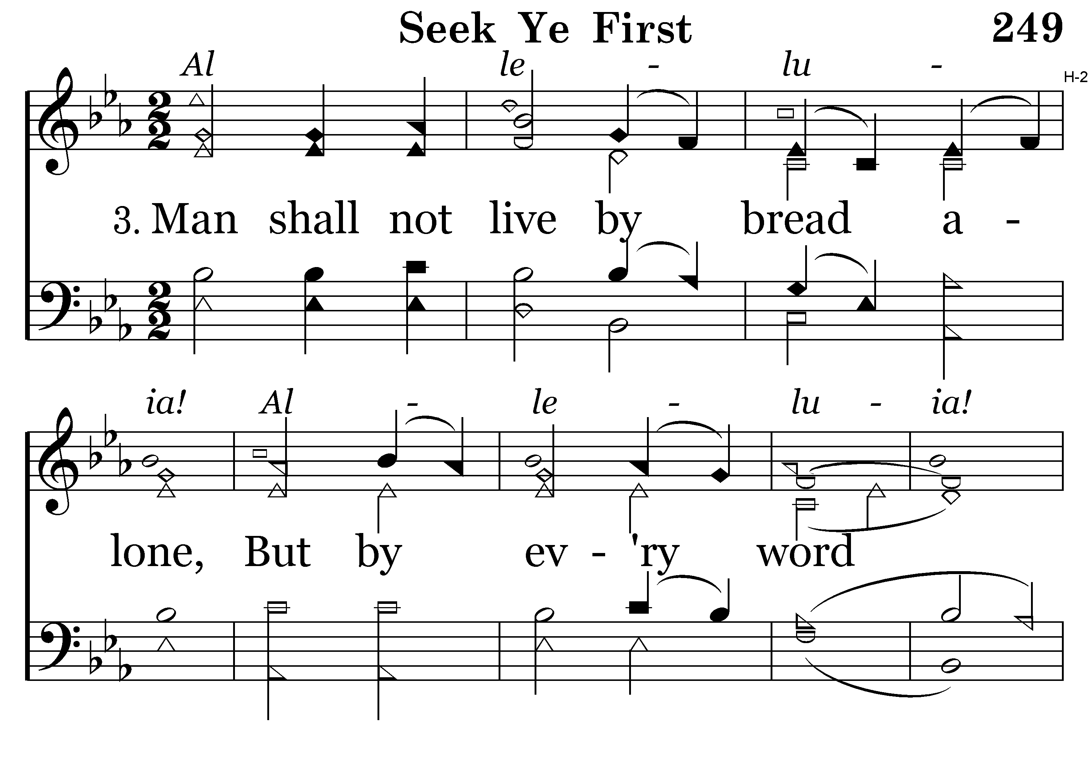
249 - SEEK YE FIRST – 3.1

Slide 47
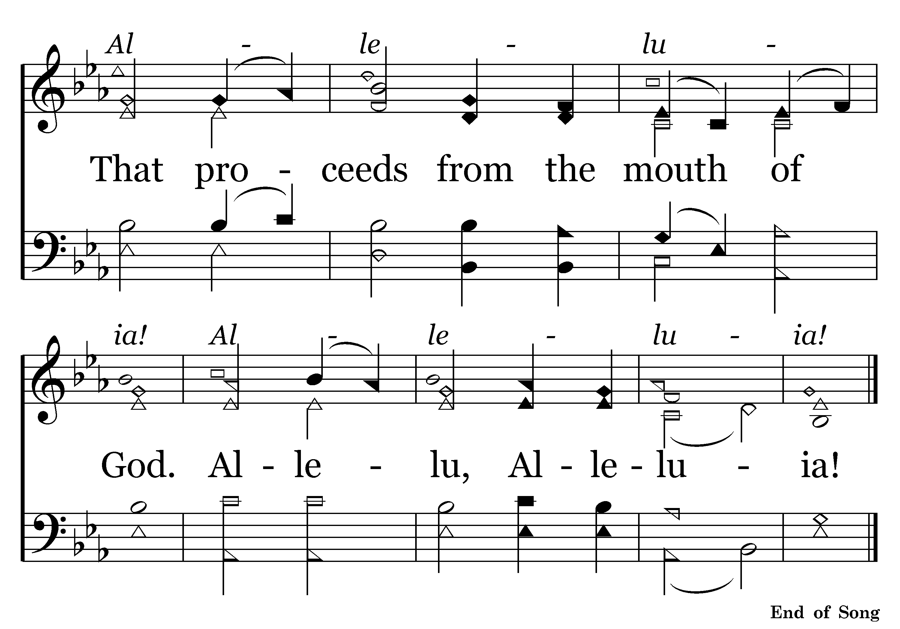
249 - SEEK YE FIRST – 3.2

Slide 49
The Father is True & Strong.
Ephesians 5:23-25
23 For the husband is head of the wife, as also Christ is head of the church; and He is the Savior of the body.
24 Therefore, just as the church is subject to Christ, so let the wives be to their own husbands in everything.
25 Husbands, love your wives, just as Christ also loved the church and gave Himself for her,
“as for me and my house, we will serve the Lord”
- Joshua 24:15
Next: Josh. 24:15

Slide 50

480 - DARE TO STAND – TITLE

Slide 51
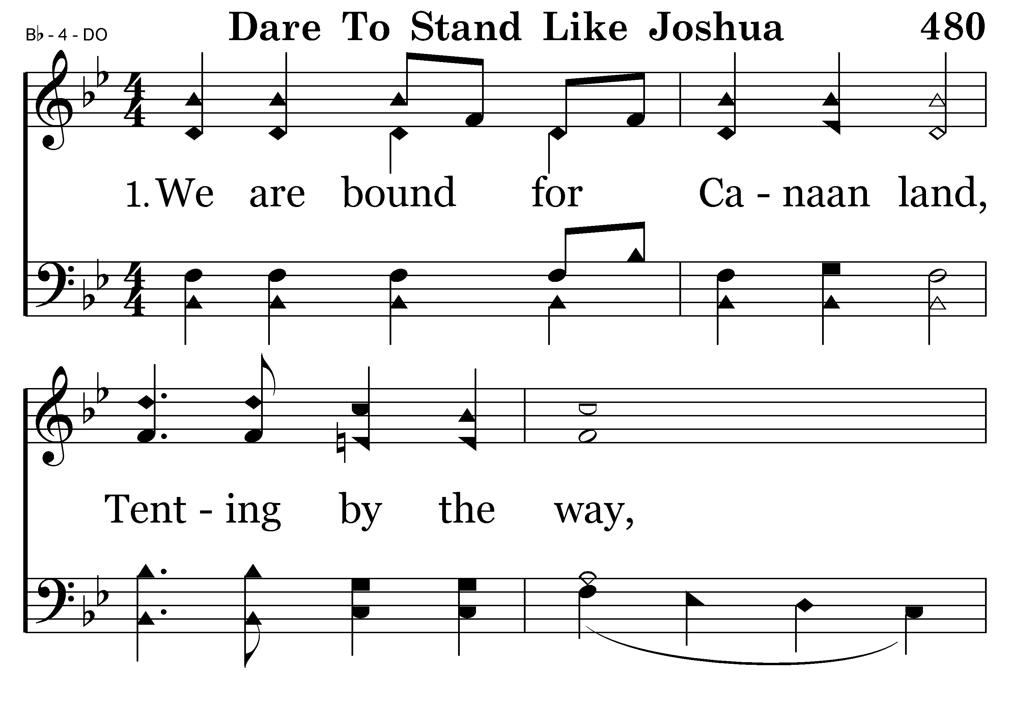
480 - DARE TO STAND – 1.1

Slide 52
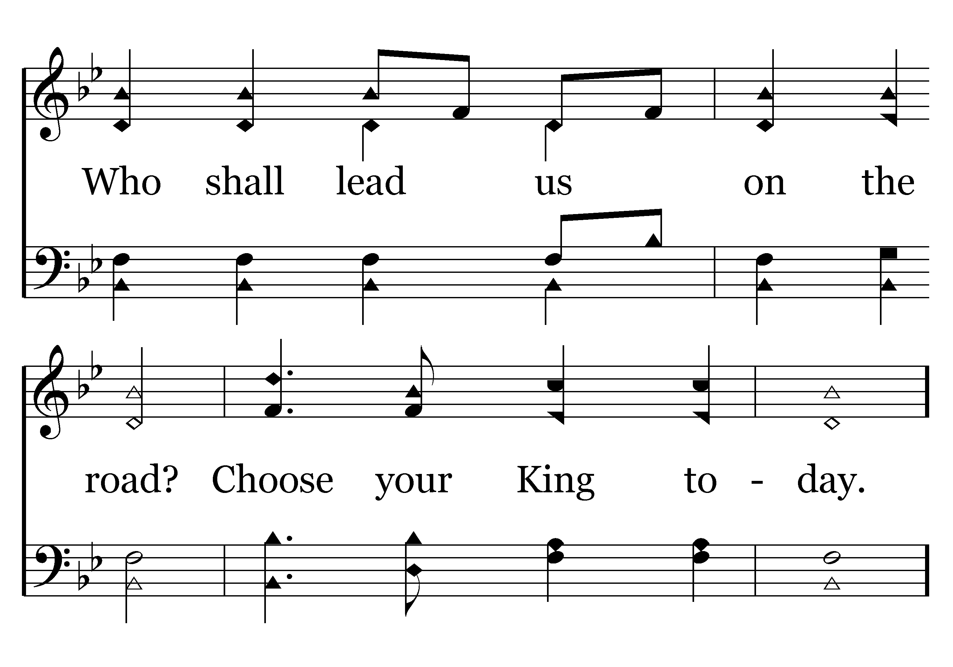
480 - DARE TO STAND – 1.2

Slide 53
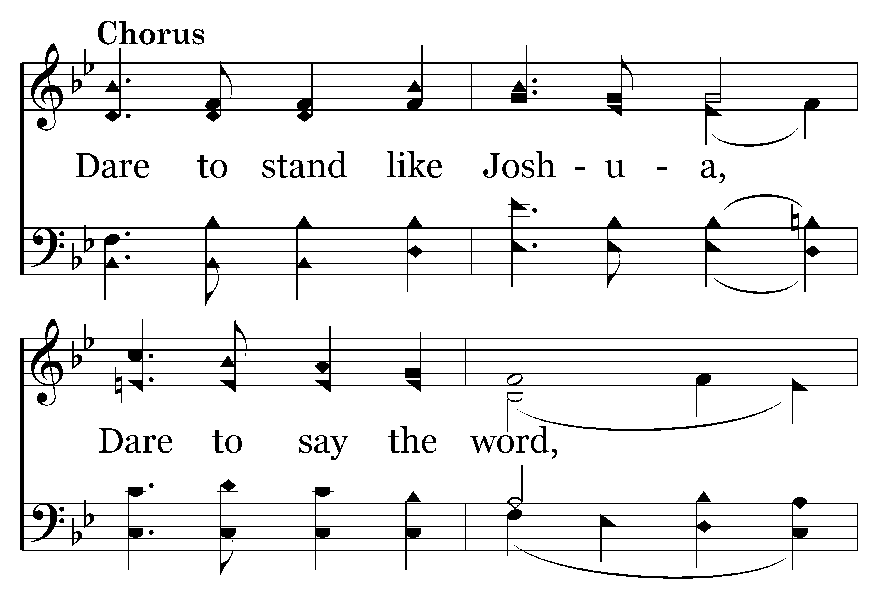
480 - DARE TO STAND – 1.3-C1

Slide 54
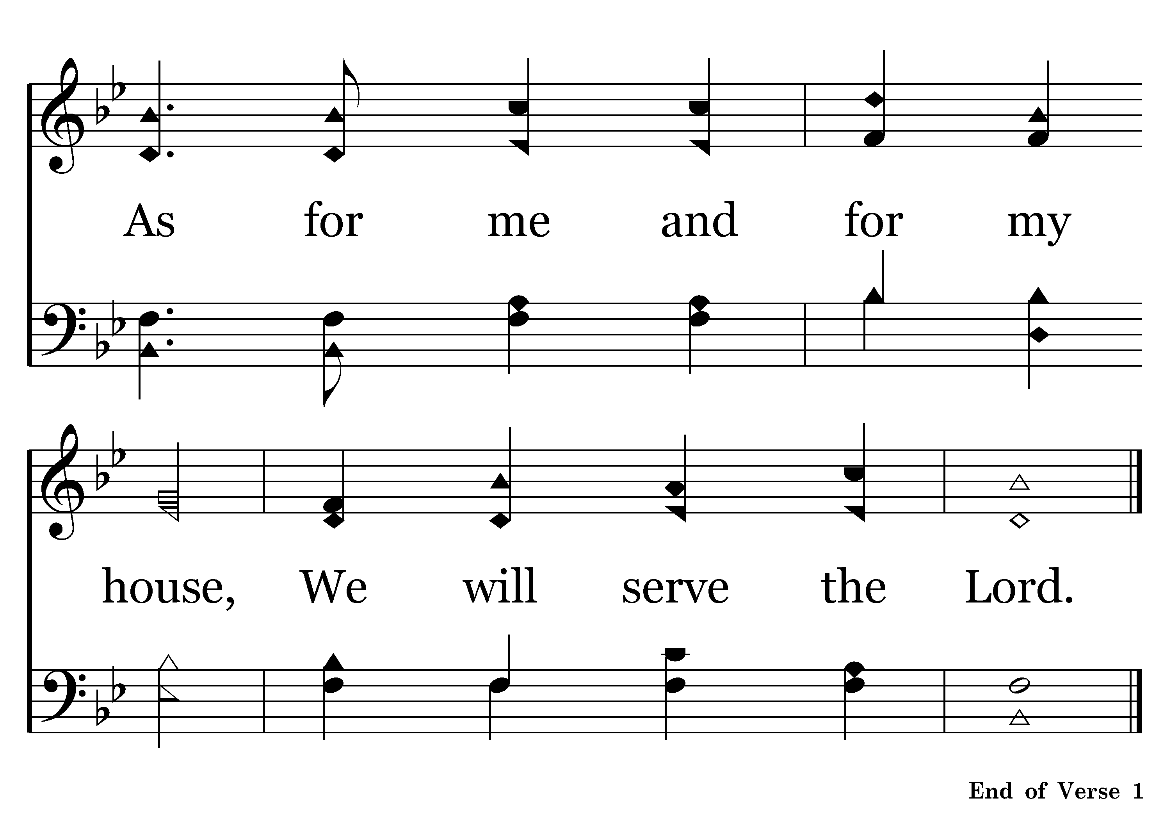
480 - DARE TO STAND – 1.4-C2

Slide 55
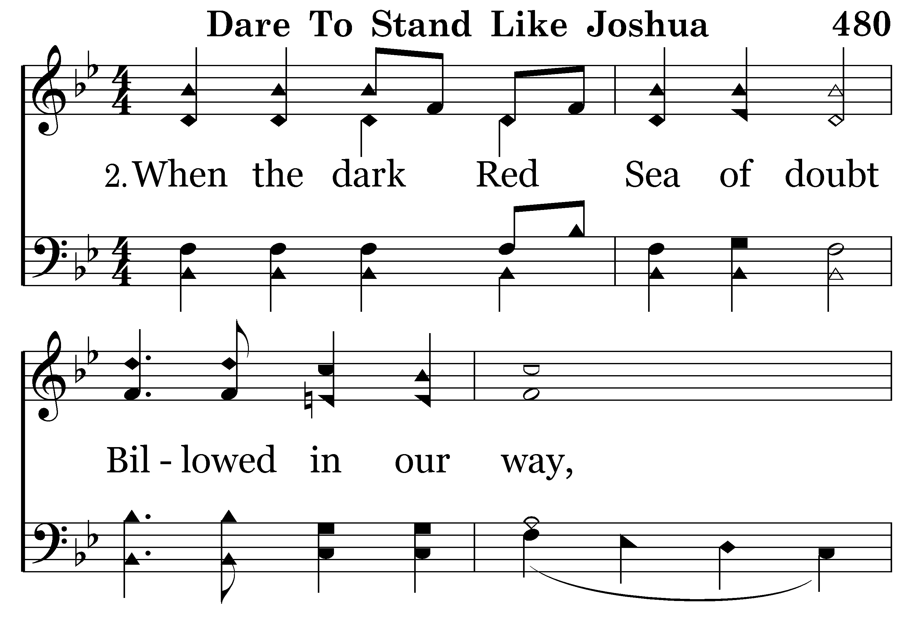
480 - DARE TO STAND – 2.1

Slide 56
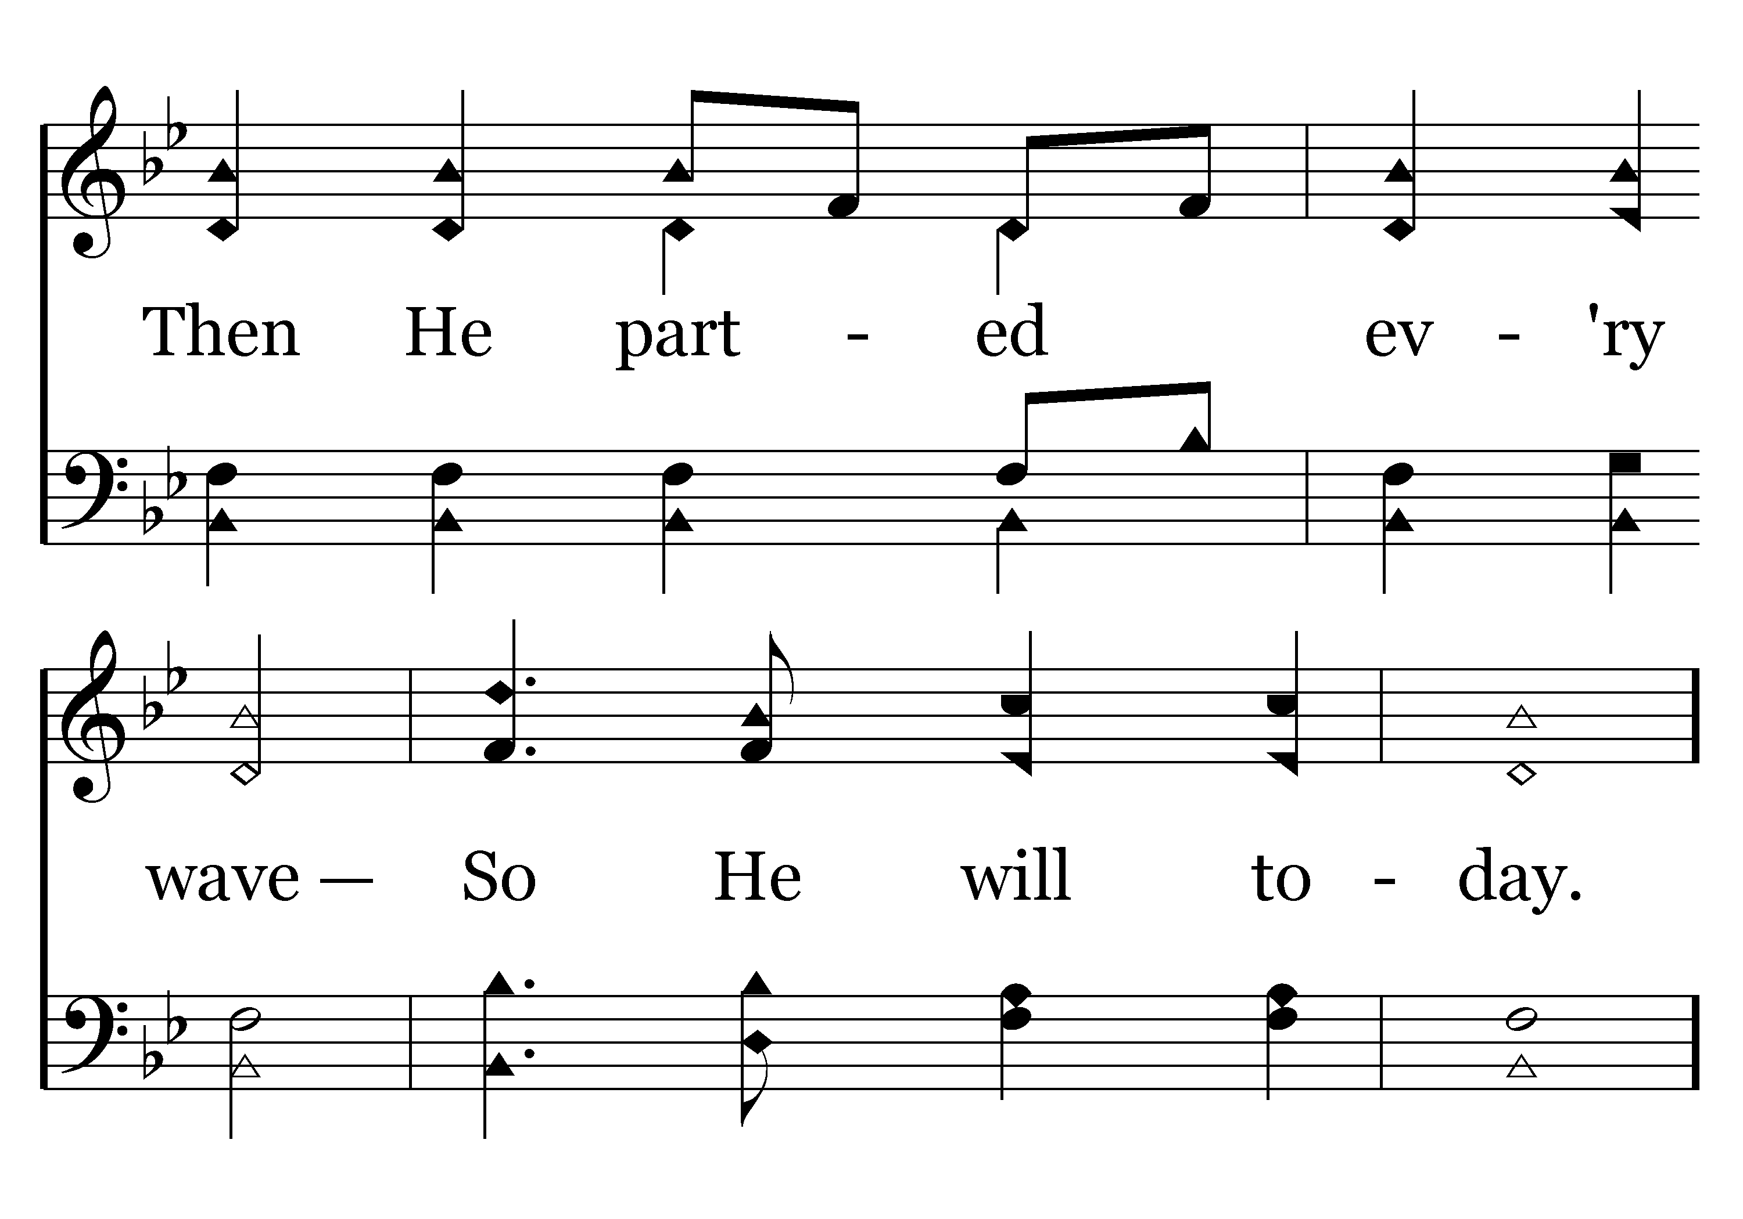
480 - DARE TO STAND – 2.2

Slide 57

480 - DARE TO STAND – 2.3-C1

Slide 58
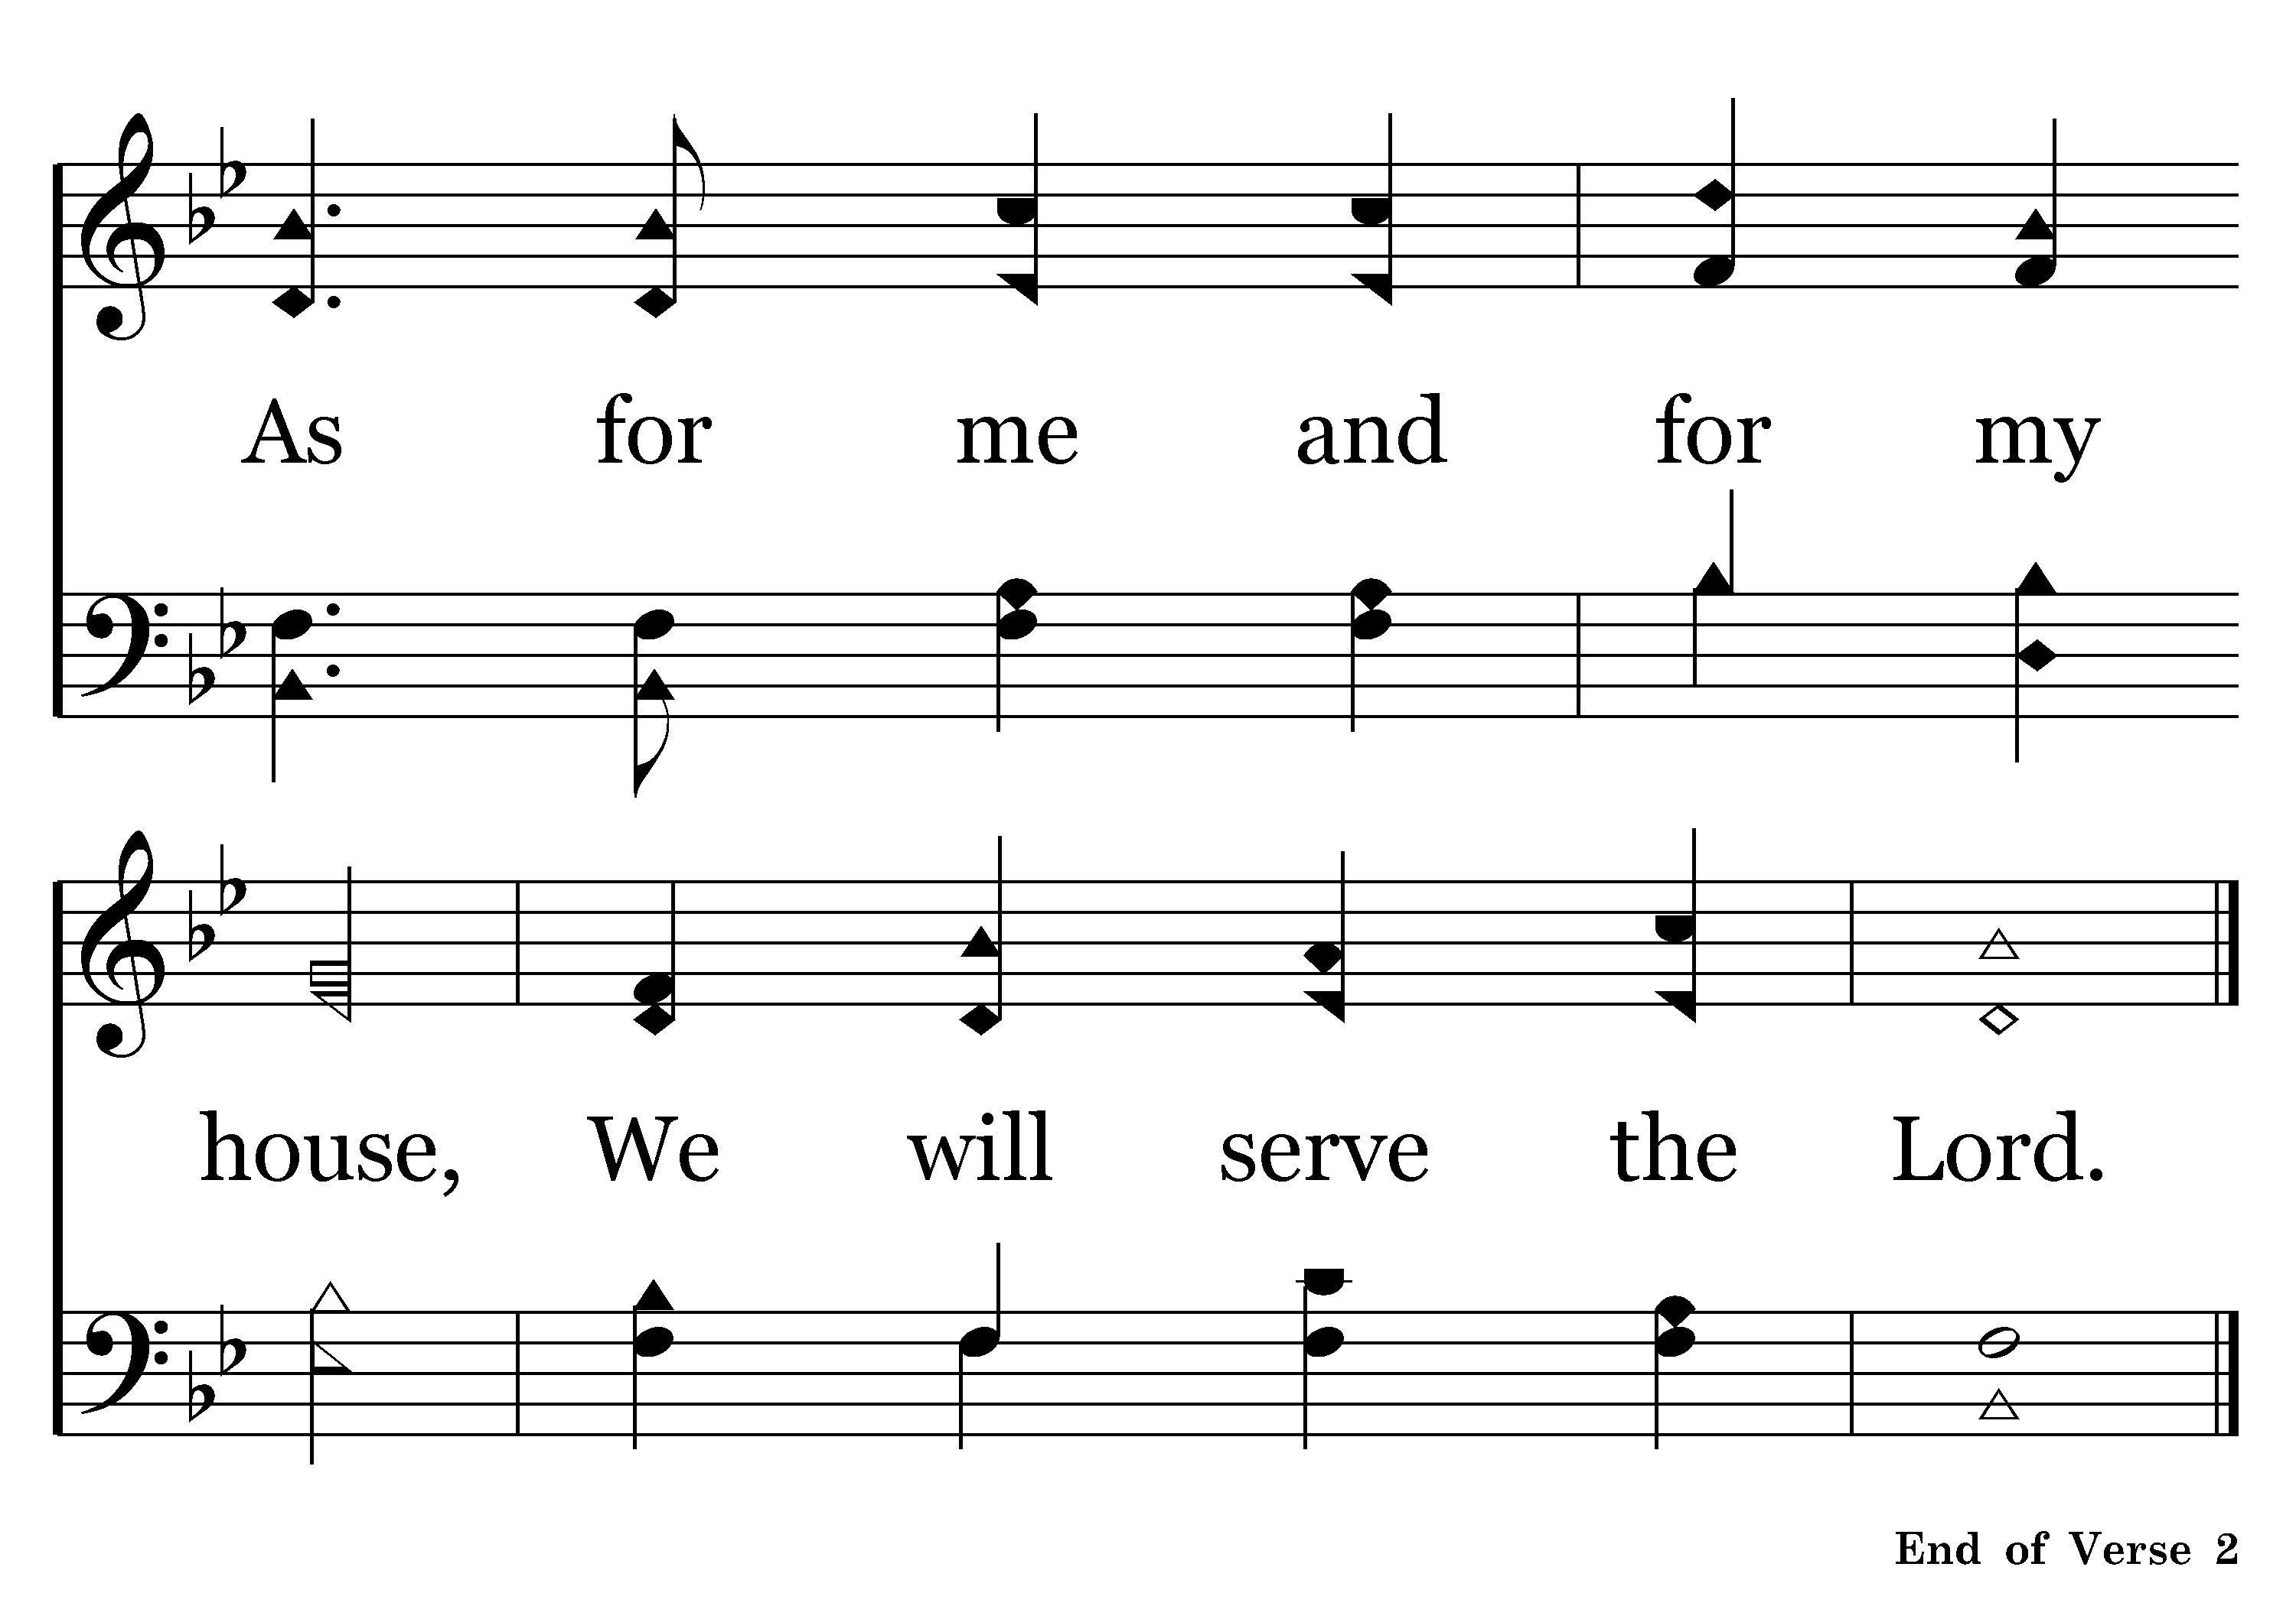
480 - DARE TO STAND – 2.4-C2

Slide 59
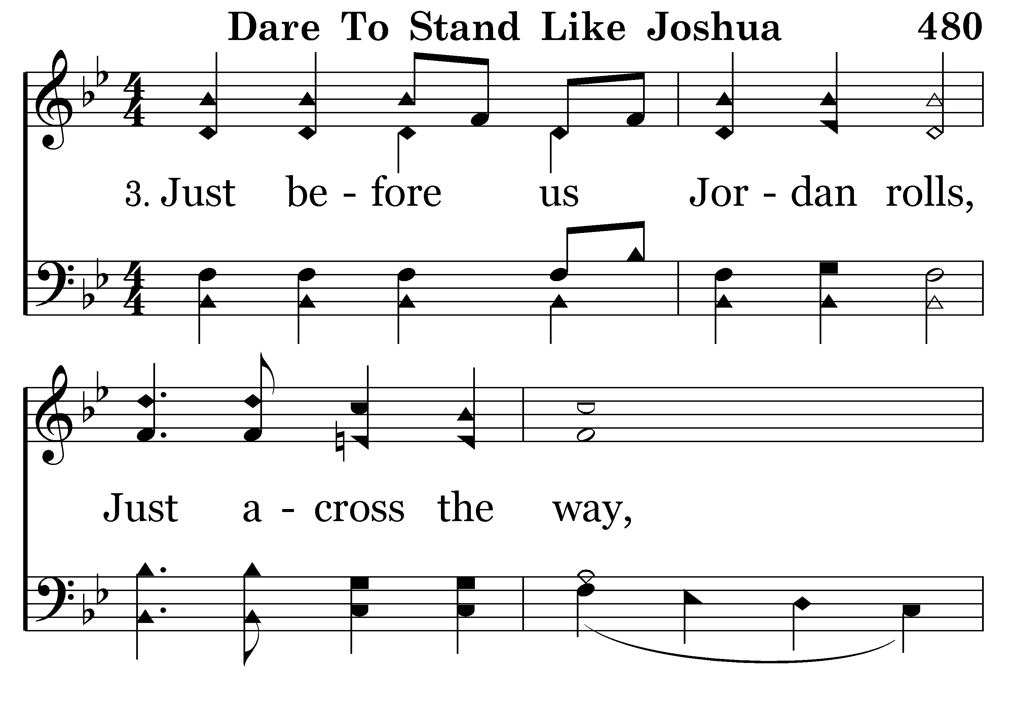
480 - DARE TO STAND – 3.1

Slide 60
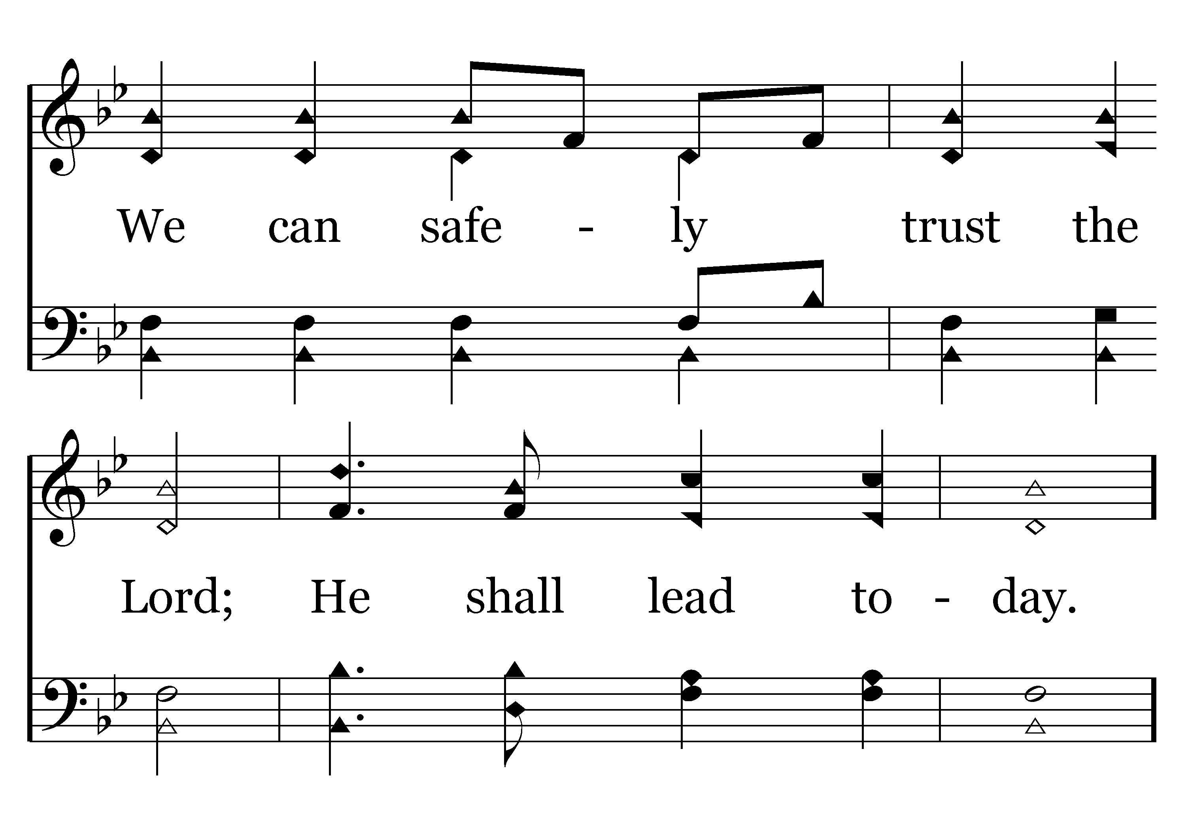
480 - DARE TO STAND – 3.2

Slide 61
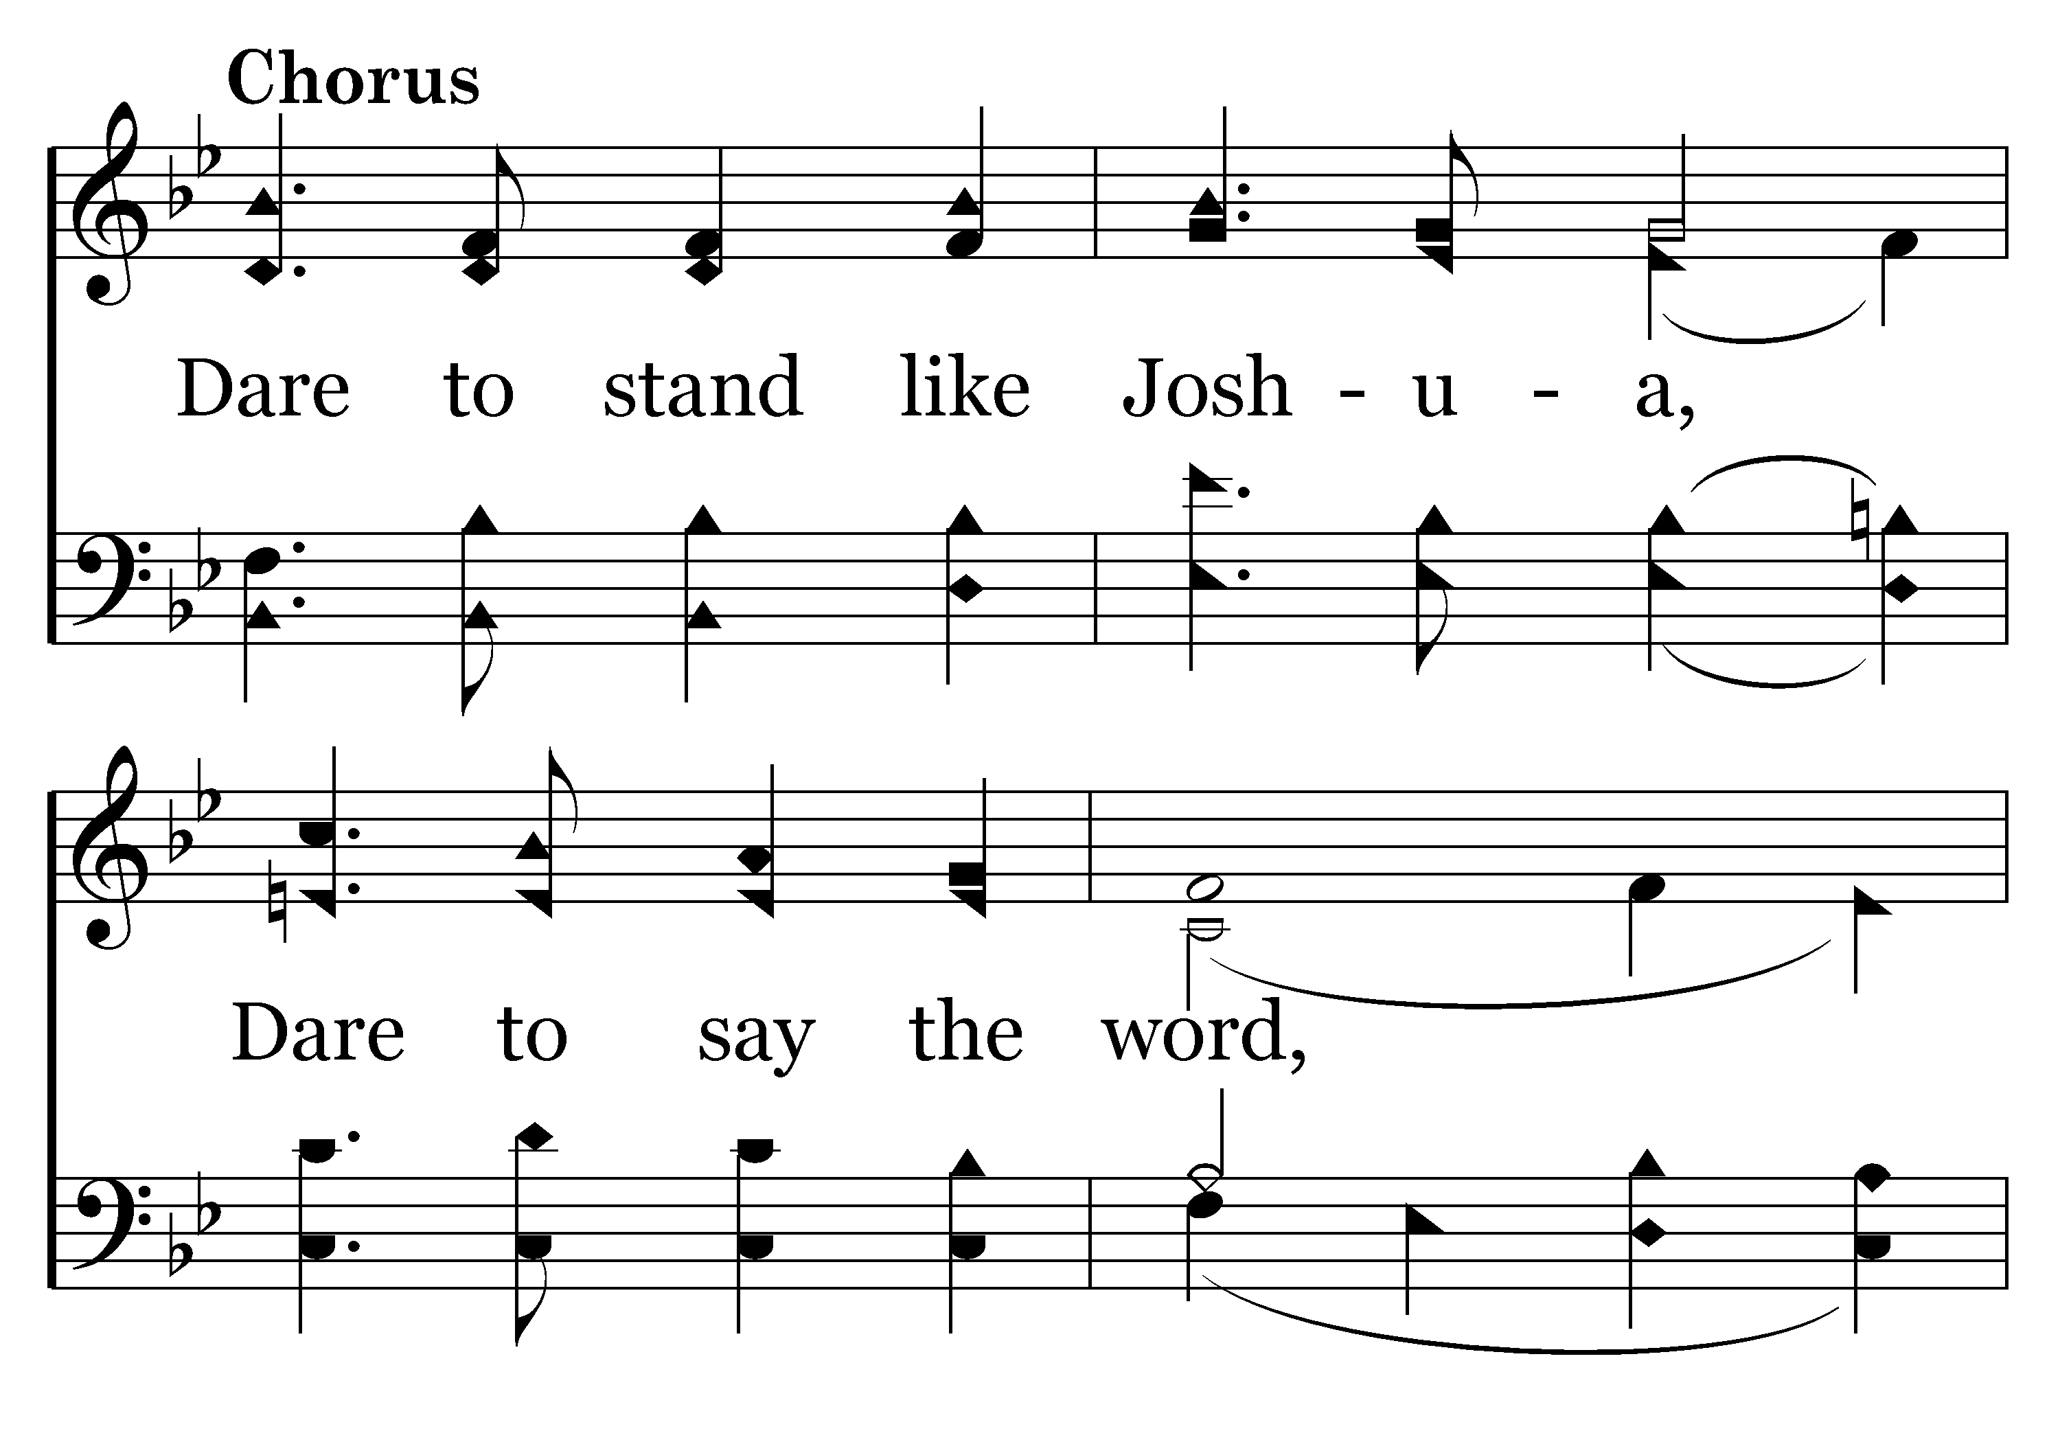
480 - DARE TO STAND – 3.3-C1

Slide 62
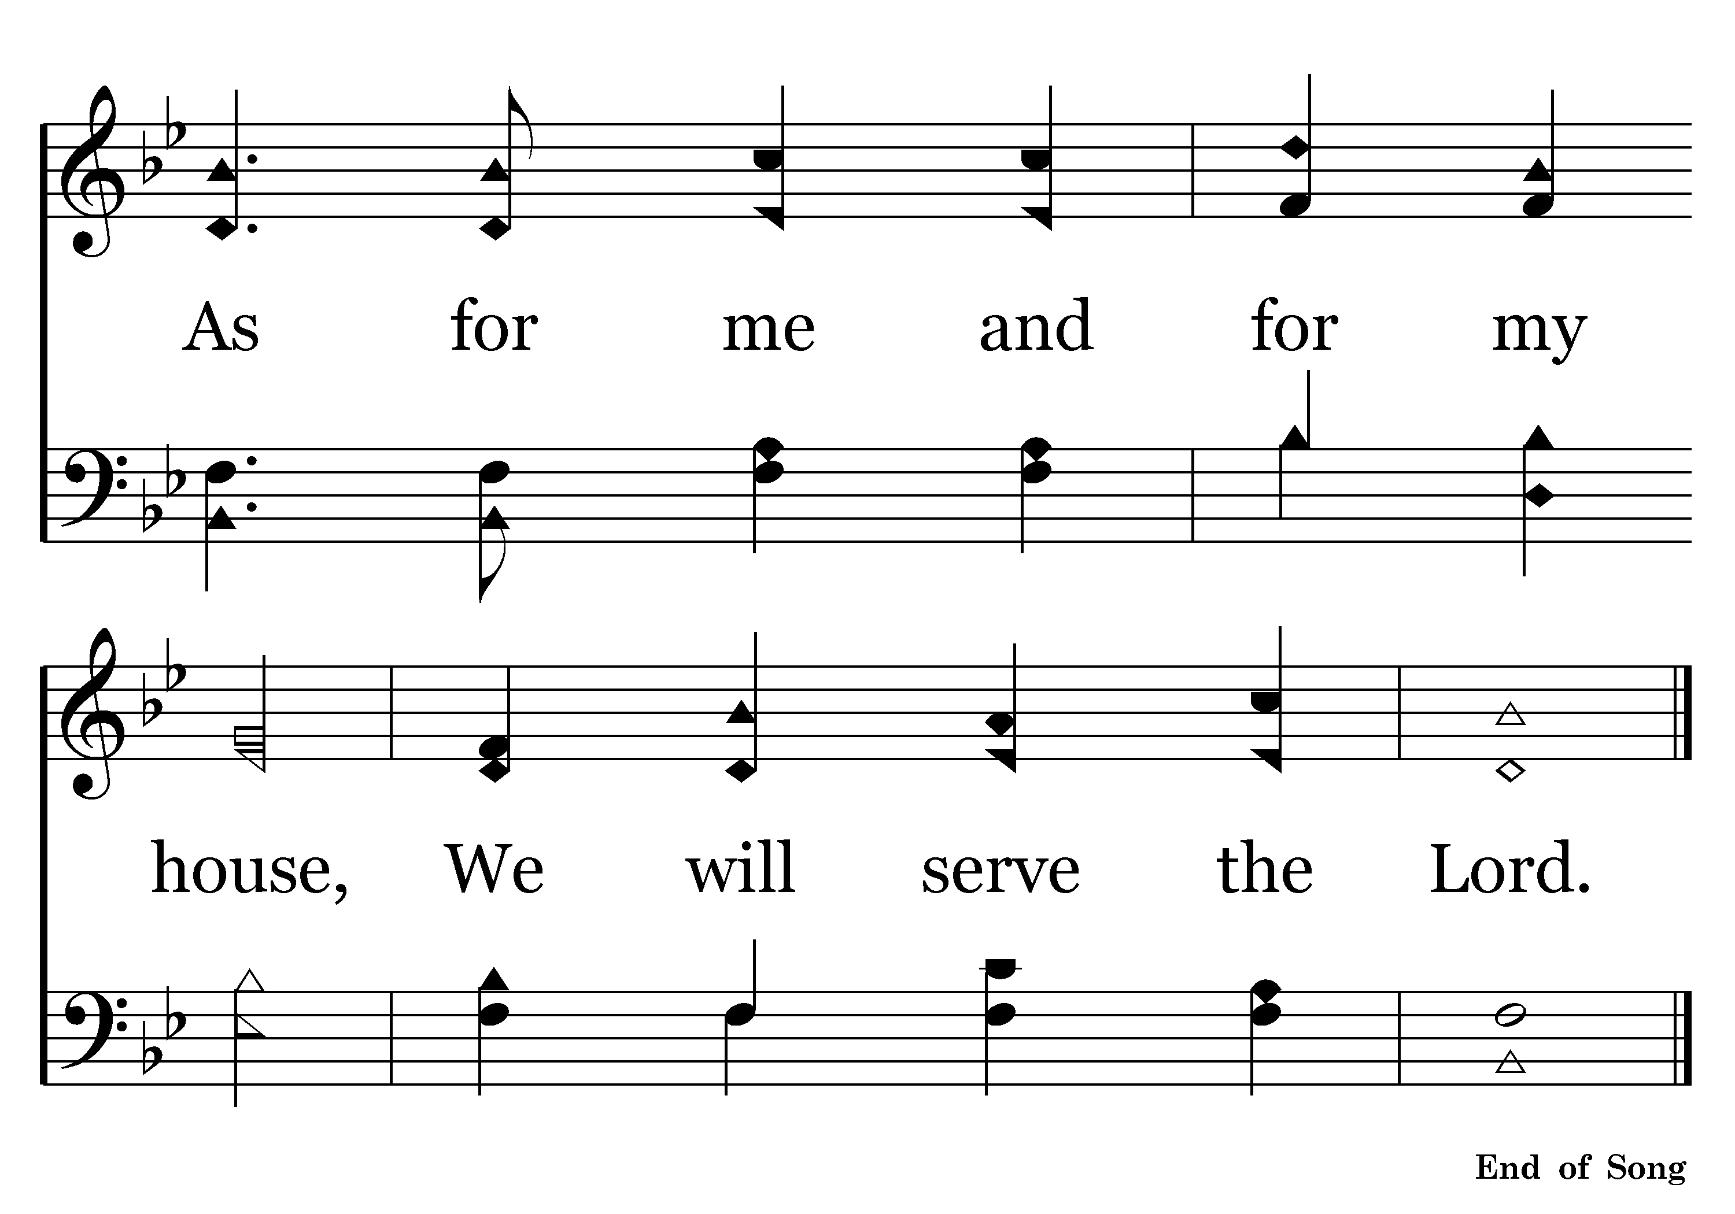
480 - DARE TO STAND – 3.4-C2

Slide 63
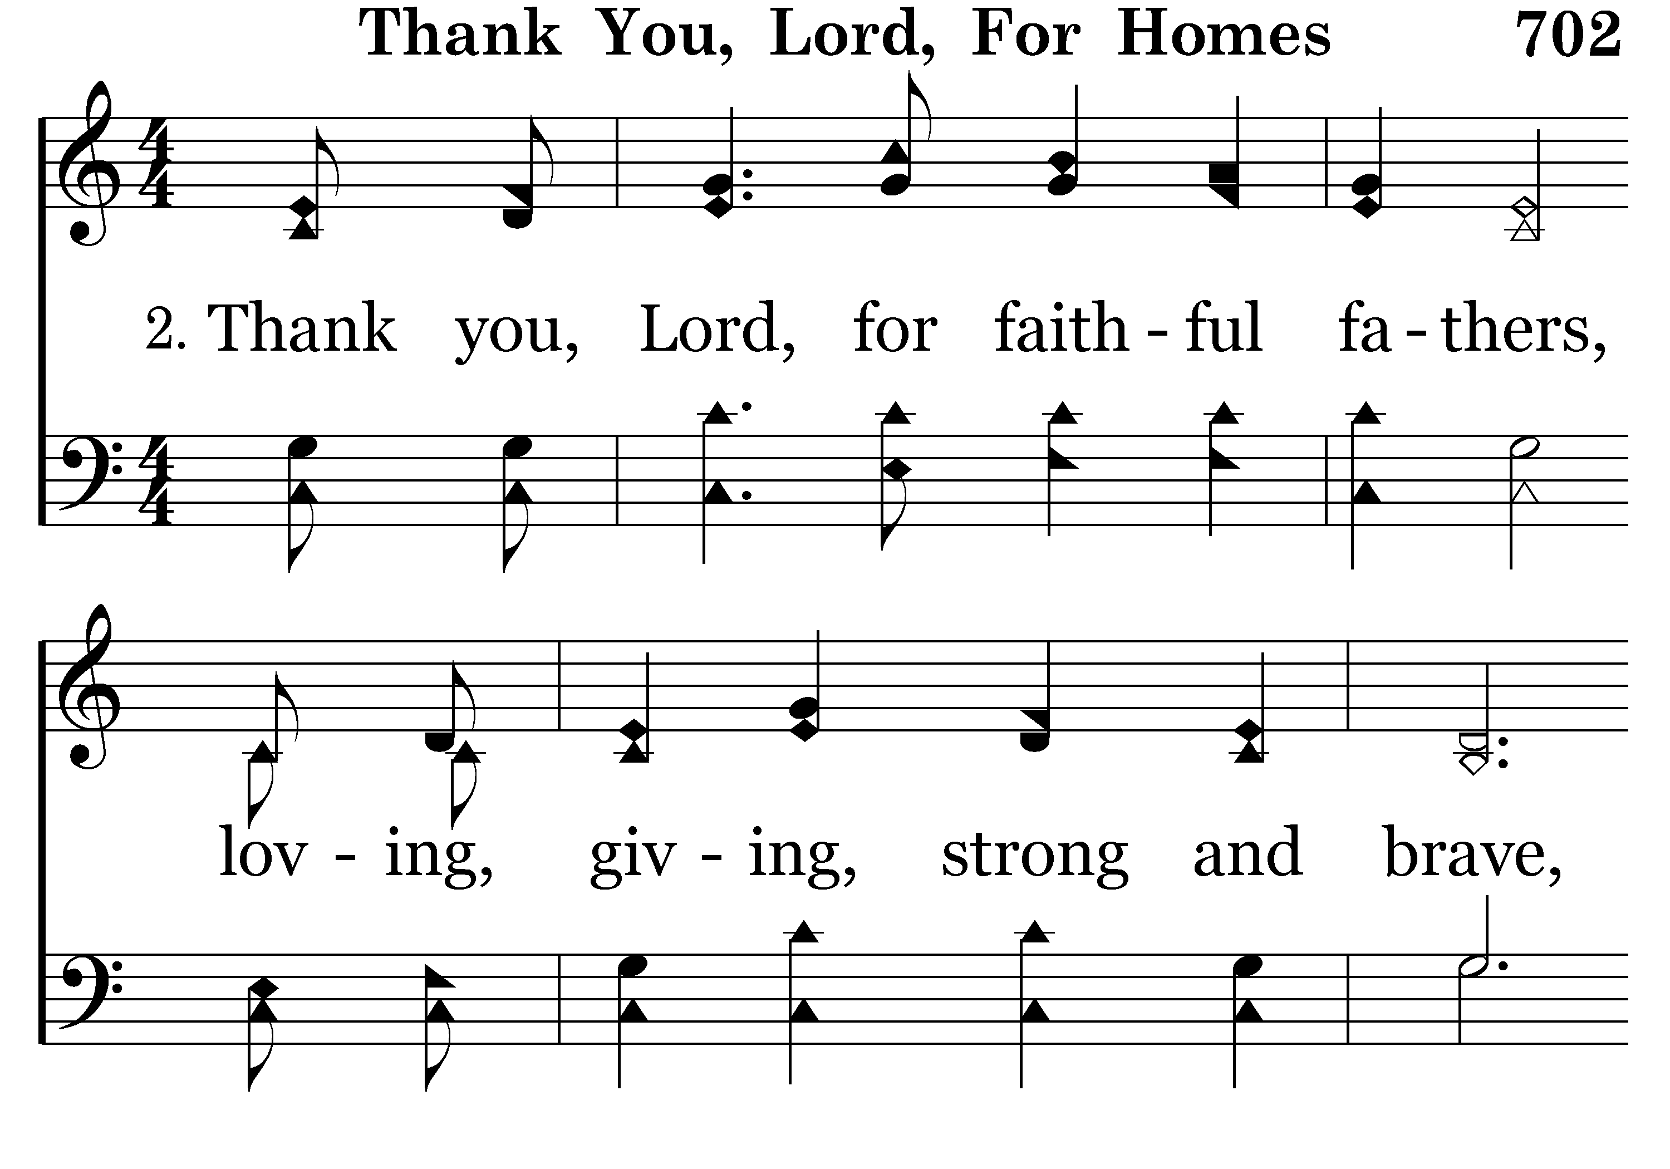
702 - THANK YOU LORD – 2.1

Slide 64
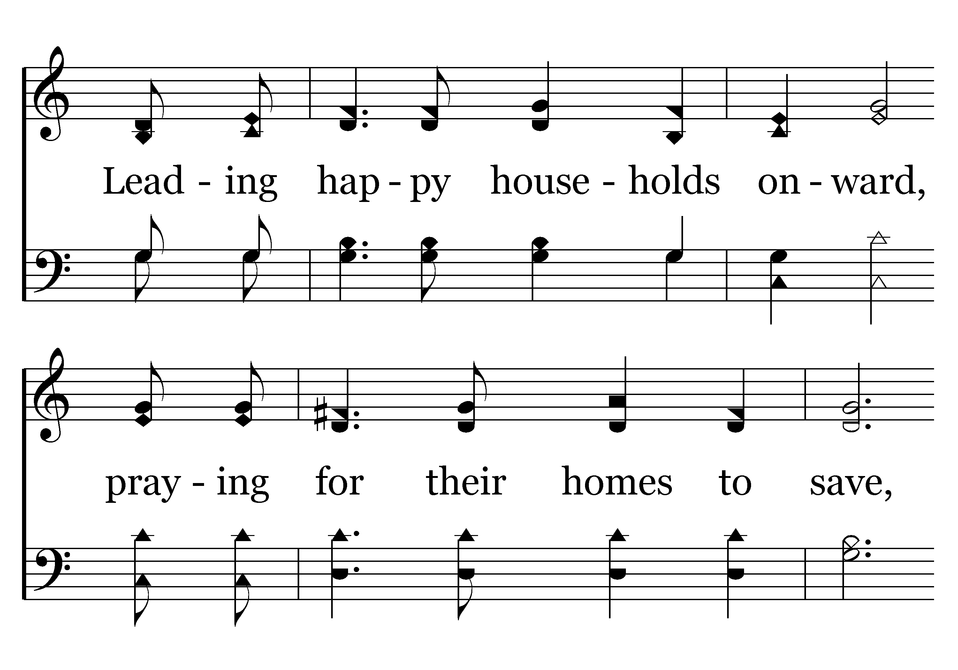
702 - THANK YOU LORD – 2.2

Slide 65
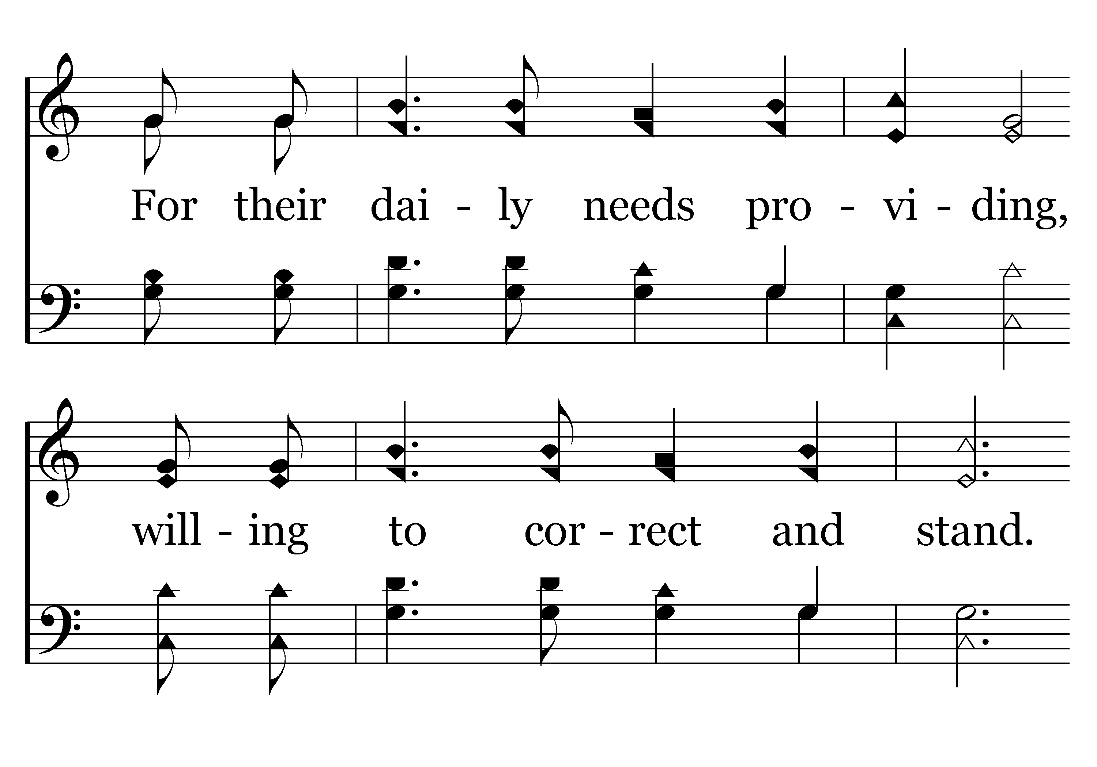
702 - THANK YOU LORD – 2.3

Slide 66
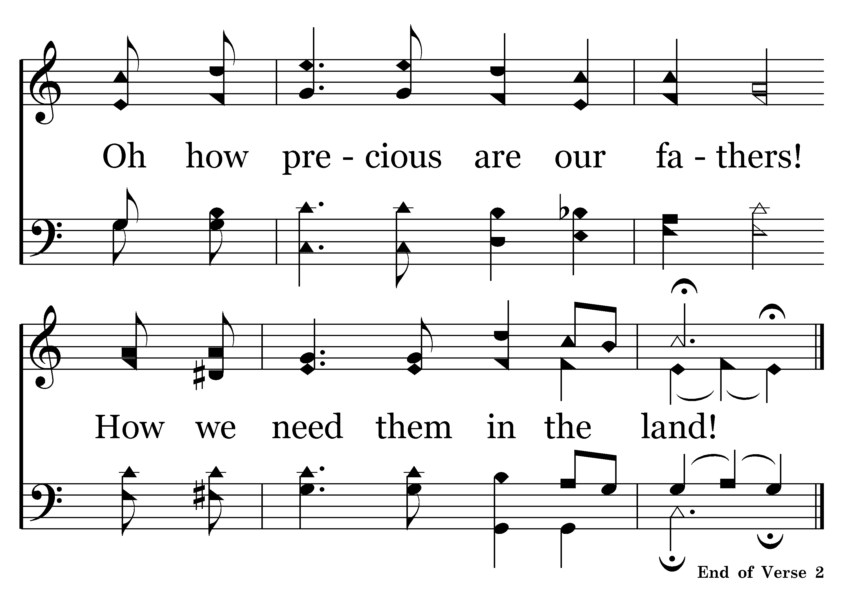
702 - THANK YOU LORD – 2.4
End of Song

Slide 67
“No success in life makes up for failure in the home.”

Slide 68
The Mother is the Homemaker.
Titus 2:4-5
4 that they admonish the young women to love their husbands, to love their children,
5 to be discreet, chaste, homemakers, good, obedient to their own husbands, that the word of God may not be blasphemed.
1 Timothy 5:14
14 Therefore I desire that the younger widows marry, bear children, manage the house, give no opportunity to the adversary to speak reproachfully.
Ephesians 5:24
24 Therefore, just as the church is subject to Christ, so let the wives be to their own husbands in everything.

Slide 69
Proverbs 31:10-31
10 Who can find a virtuous wife? For her worth is far above rubies.
15 She also rises while it is yet night, and provides food for her household, and a portion for her maidservants.
27 She watches over the ways of her household, and does not eat the bread of idleness.
28 Her children rise up and call her blessed; her husband also, and he praises her:
29 "Many daughters have done well, but you excel them all."
30 Charm is deceitful and beauty is passing, but a woman who fears the LORD, she shall be praised.
31 Give her of the fruit of her hands, and let her own works praise her in the gates.

Slide 70
Proverbs 31:10-31
10 Who can find a virtuous wife? For her worth is far above rubies.
15 She also rises while it is yet night, and provides food for her household, and a portion for her maidservants.
27 She watches over the ways of her household, and does not eat the bread of idleness.
28 Her children rise up and call her blessed; her husband also, and he praises her:
29 "Many daughters have done well, but you excel them all."
30 Charm is deceitful and beauty is passing, but a woman who fears the LORD, she shall be praised.
31 Give her of the fruit of her hands, and let her own works praise her in the gates.

Slide 71
Proverbs 31:10-31
10 Who can find a virtuous wife? For her worth is far above rubies.
15 She also rises while it is yet night, and provides food for her household, and a portion for her maidservants.
27 She watches over the ways of her household, and does not eat the bread of idleness.
28 Her children rise up and call her blessed; her husband also, and he praises her:
29 "Many daughters have done well, but you excel them all."
30 Charm is deceitful and beauty is passing, but a woman who fears the LORD, she shall be praised.
31 Give her of the fruit of her hands, and let her own works praise her in the gates.

Slide 72
Proverbs 31:10-31
10 Who can find a virtuous wife? For her worth is far above rubies.
15 She also rises while it is yet night, and provides food for her household, and a portion for her maidservants.
27 She watches over the ways of her household, and does not eat the bread of idleness.
28 Her children rise up and call her blessed; her husband also, and he praises her:
29 "Many daughters have done well, but you excel them all."
30 Charm is deceitful and beauty is passing, but a woman who fears the LORD, she shall be praised.
31 Give her of the fruit of her hands, and let her own works praise her in the gates.

Slide 74
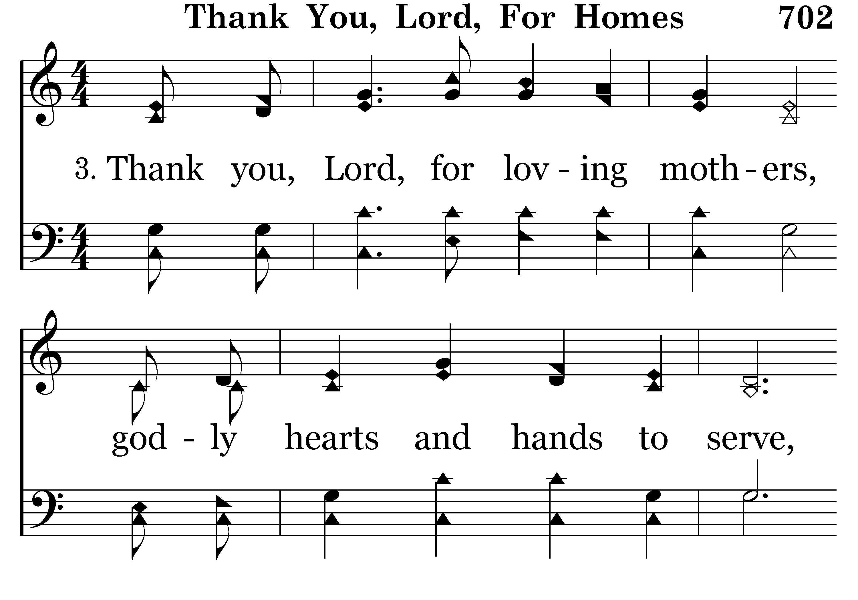
702 - THANK YOU LORD – 3.1

Slide 75
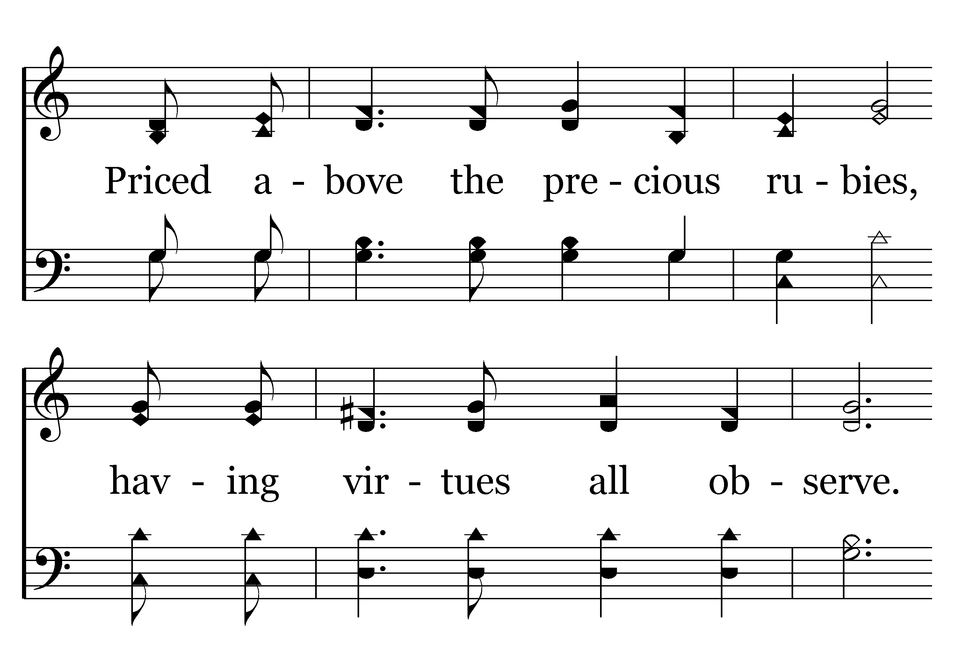
702 - THANK YOU LORD – 3.2

Slide 76
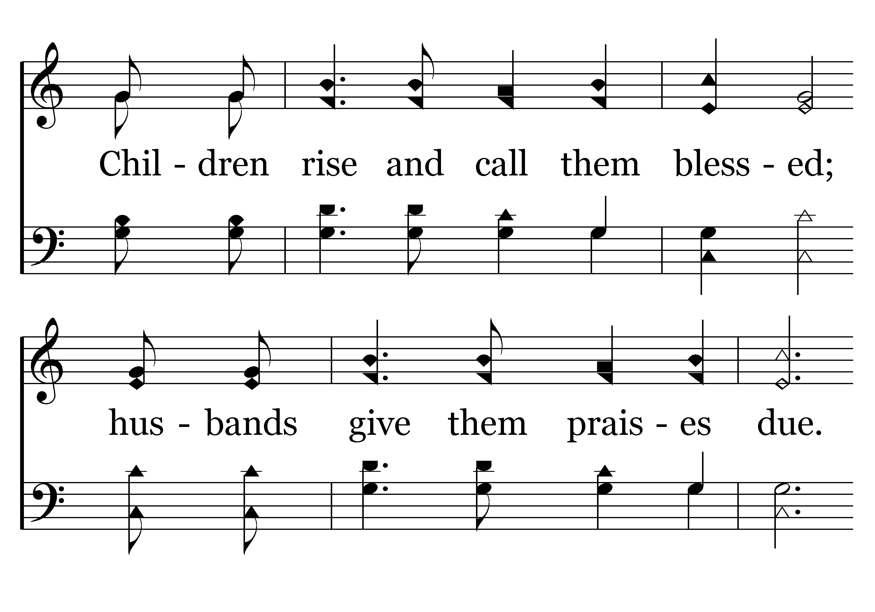
702 - THANK YOU LORD – 3.3

Slide 77
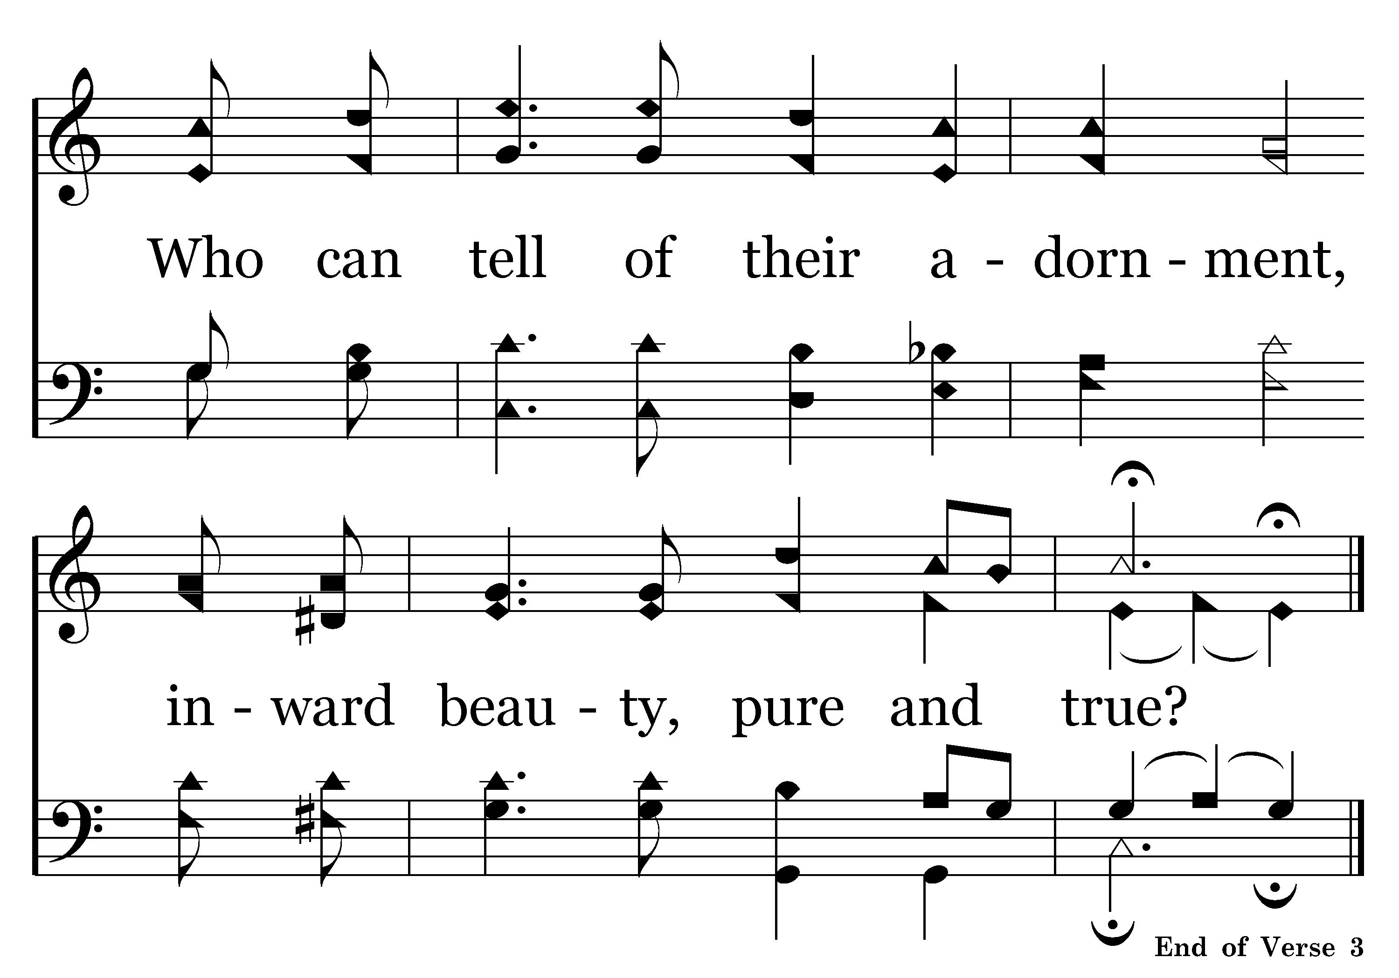
702 - THANK YOU LORD – 3.4

Slide 78
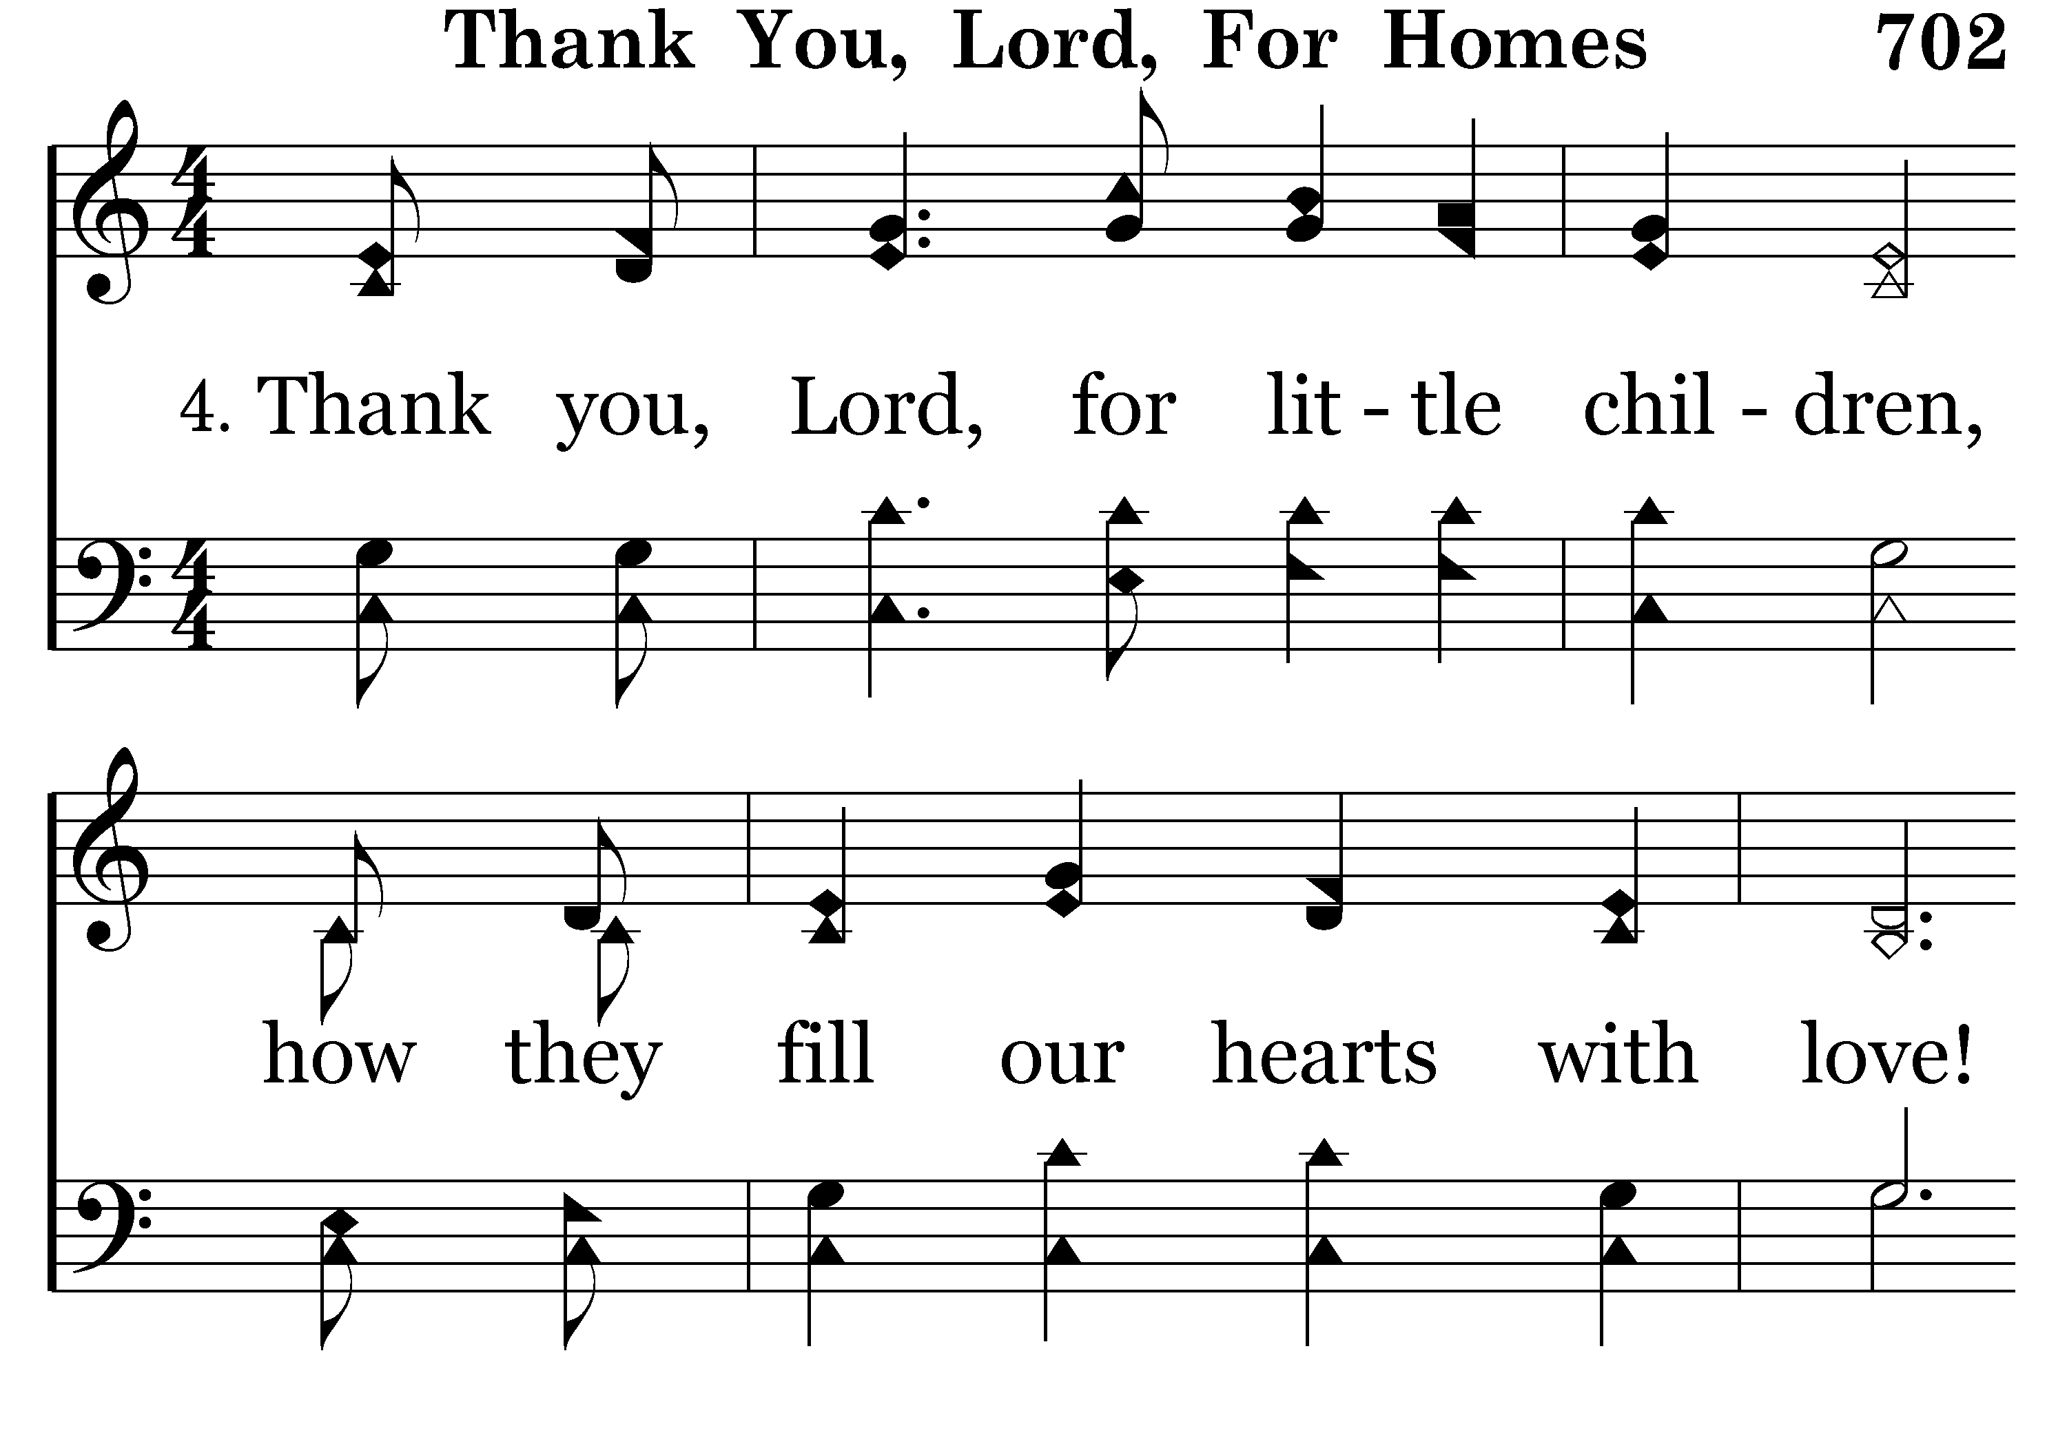
702 - THANK YOU LORD – 4.1

Slide 79

702 - THANK YOU LORD – 4.2

Slide 80

702 - THANK YOU LORD – 4.3

Slide 81

702 - THANK YOU LORD – 4.4

Slide 83
Children are Led to Know Christ.
Ephesians 6:1,4 – “Children, obey your parents in the Lord, for this is right.”
Proverbs 22:6 – “Train up a child . . .”
Proverbs 23:13 – “Do not withhold correction from a child. . .”
Proverbs 13:24 – “He who spares his rod hates his son, but he who loves him disciplines him promptly.”

Slide 85

700 - TRAIN YOUR CHILDREN - TITLE

Slide 86

700 - TRAIN YOUR CHILDREN – 1.1

Slide 87

700 - TRAIN YOUR CHILDREN – 1.2

Slide 88

700 - TRAIN YOUR CHILDREN – 1.3-C1

Slide 89

700 - TRAIN YOUR CHILDREN – 1.4-C2

Slide 90

700 - TRAIN YOUR CHILDREN – 2.1

Slide 91

700 - TRAIN YOUR CHILDREN – 2.2

Slide 92

700 - TRAIN YOUR CHILDREN – 2.3-C1

Slide 93

700 - TRAIN YOUR CHILDREN – 2.4-C2
End of Song

Slide 94

700 - TRAIN YOUR CHILDREN – 3.1

Slide 95

700 - TRAIN YOUR CHILDREN – 3.2

Slide 96

700 - TRAIN YOUR CHILDREN – 3.3-C1

Slide 97

700 - TRAIN YOUR CHILDREN – 3.4-C2

Slide 99
“God Give Us Christian Homes”
Where the Bible is Loved & Taught.
Where the Father is True & Strong.
Where the Mother is the Homemaker.
Where the Children are Led to Know Christ.
Next slide: Invitation Song

