Slide 2
I John 2:15-17
15 Do not love the world or the things in the world. If anyone loves the world, the love of the Father is not in him.
16 For all that is in the world-- the lust of the flesh, the lust of the eyes, and the pride of life-- is not of the Father but is of the world.
17 And the world is passing away, and the lust of it; but he who does the will of God abides forever.

Slide 3
I John 2:15-17
15 Do not love the world or the things in the world. If anyone loves the world, the love of the Father is not in him.
16 For all that is in the world-- the lust of the flesh, the lust of the eyes, and the pride of life -- is not of the Father but is of the world.
17 And the world is passing away, and the lust of it; but he who does the will of God abides forever.

Slide 4
James 4:4
4 Do you not know that friendship with the world is enmity with God? Whoever therefore wants to be a friend of the world makes himself an enemy of God.

Slide 5
Matthew 6:24
24 "No one can serve two masters; for either he will hate the one and love the other, or else he will be loyal to the one and despise the other. You cannot serve God and mammon.

Slide 7
I John 5:17
17 All unrighteousness (wrong-doing) is sin , . .
I John 3:4
4 Whoever commits sin also commits lawlessness, and sin is lawlessness.

Slide 9
Proverbs 6:16-19
16 These six things the LORD hates, Yes, seven are an abomination to Him:
17 A proud look, A lying tongue, Hands that shed innocent blood,
18 A heart that devises wicked plans, Feet that are swift in running to evil,
19 A false witness who speaks lies, And one who sows discord among brethren.

Slide 10
Ephesians 5:11
11 And have no fellowship with the unfruitful works of darkness, but rather expose them.

Slide 12
WHAT DOES GOD WANT FROM ME
. . . IN REGARD TO SIN?
PERFECTION.

Slide 13
I John 2:1
1 My little children, these things I write to you, so that you may not sin. . .

Slide 15
Psalm 139:23-24
23 Search me, O God, and know my heart; try me, and know my anxieties;
24 And see if there is any wicked way in me, and lead me in the way everlasting.

Slide 16
1 Peter 2:21
21 For to this you were called, because Christ also suffered for us, leaving us an example, that you should follow His steps:

Slide 17
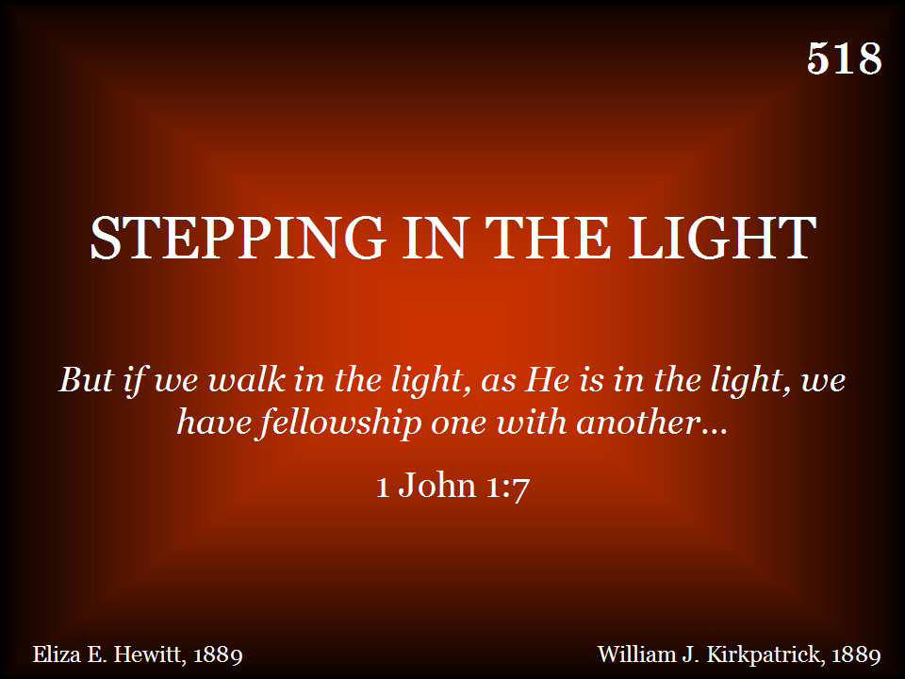

Slide 18
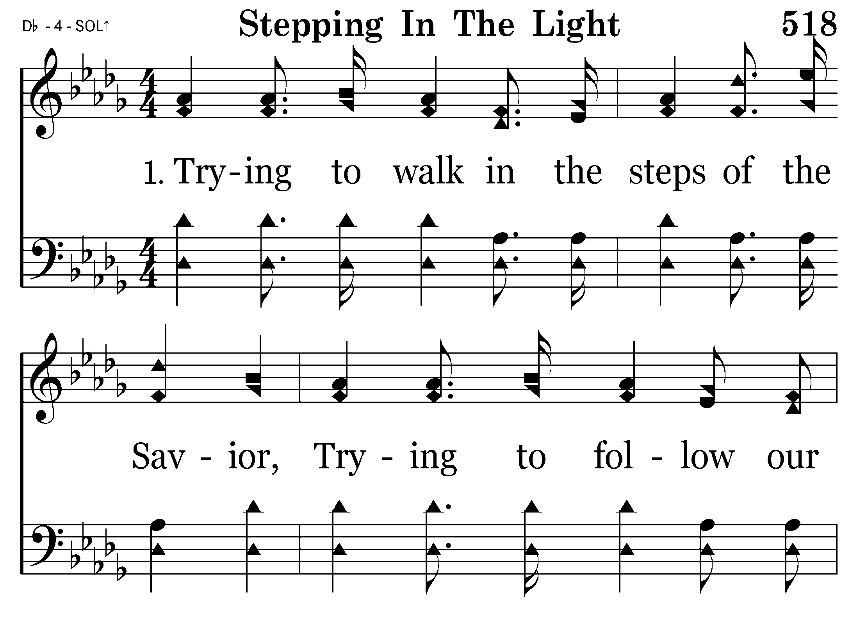

Slide 19
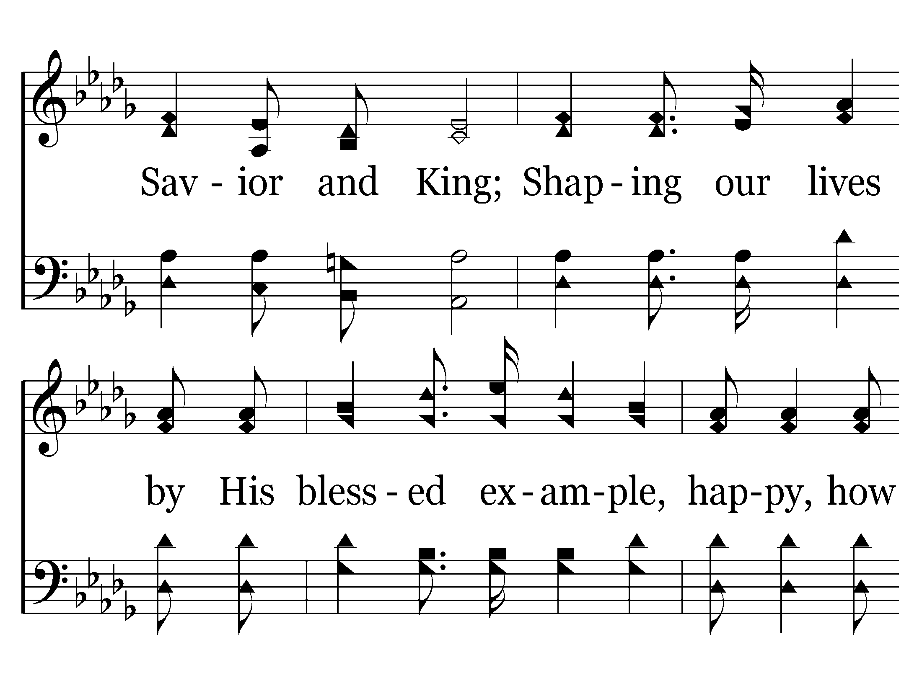

Slide 20
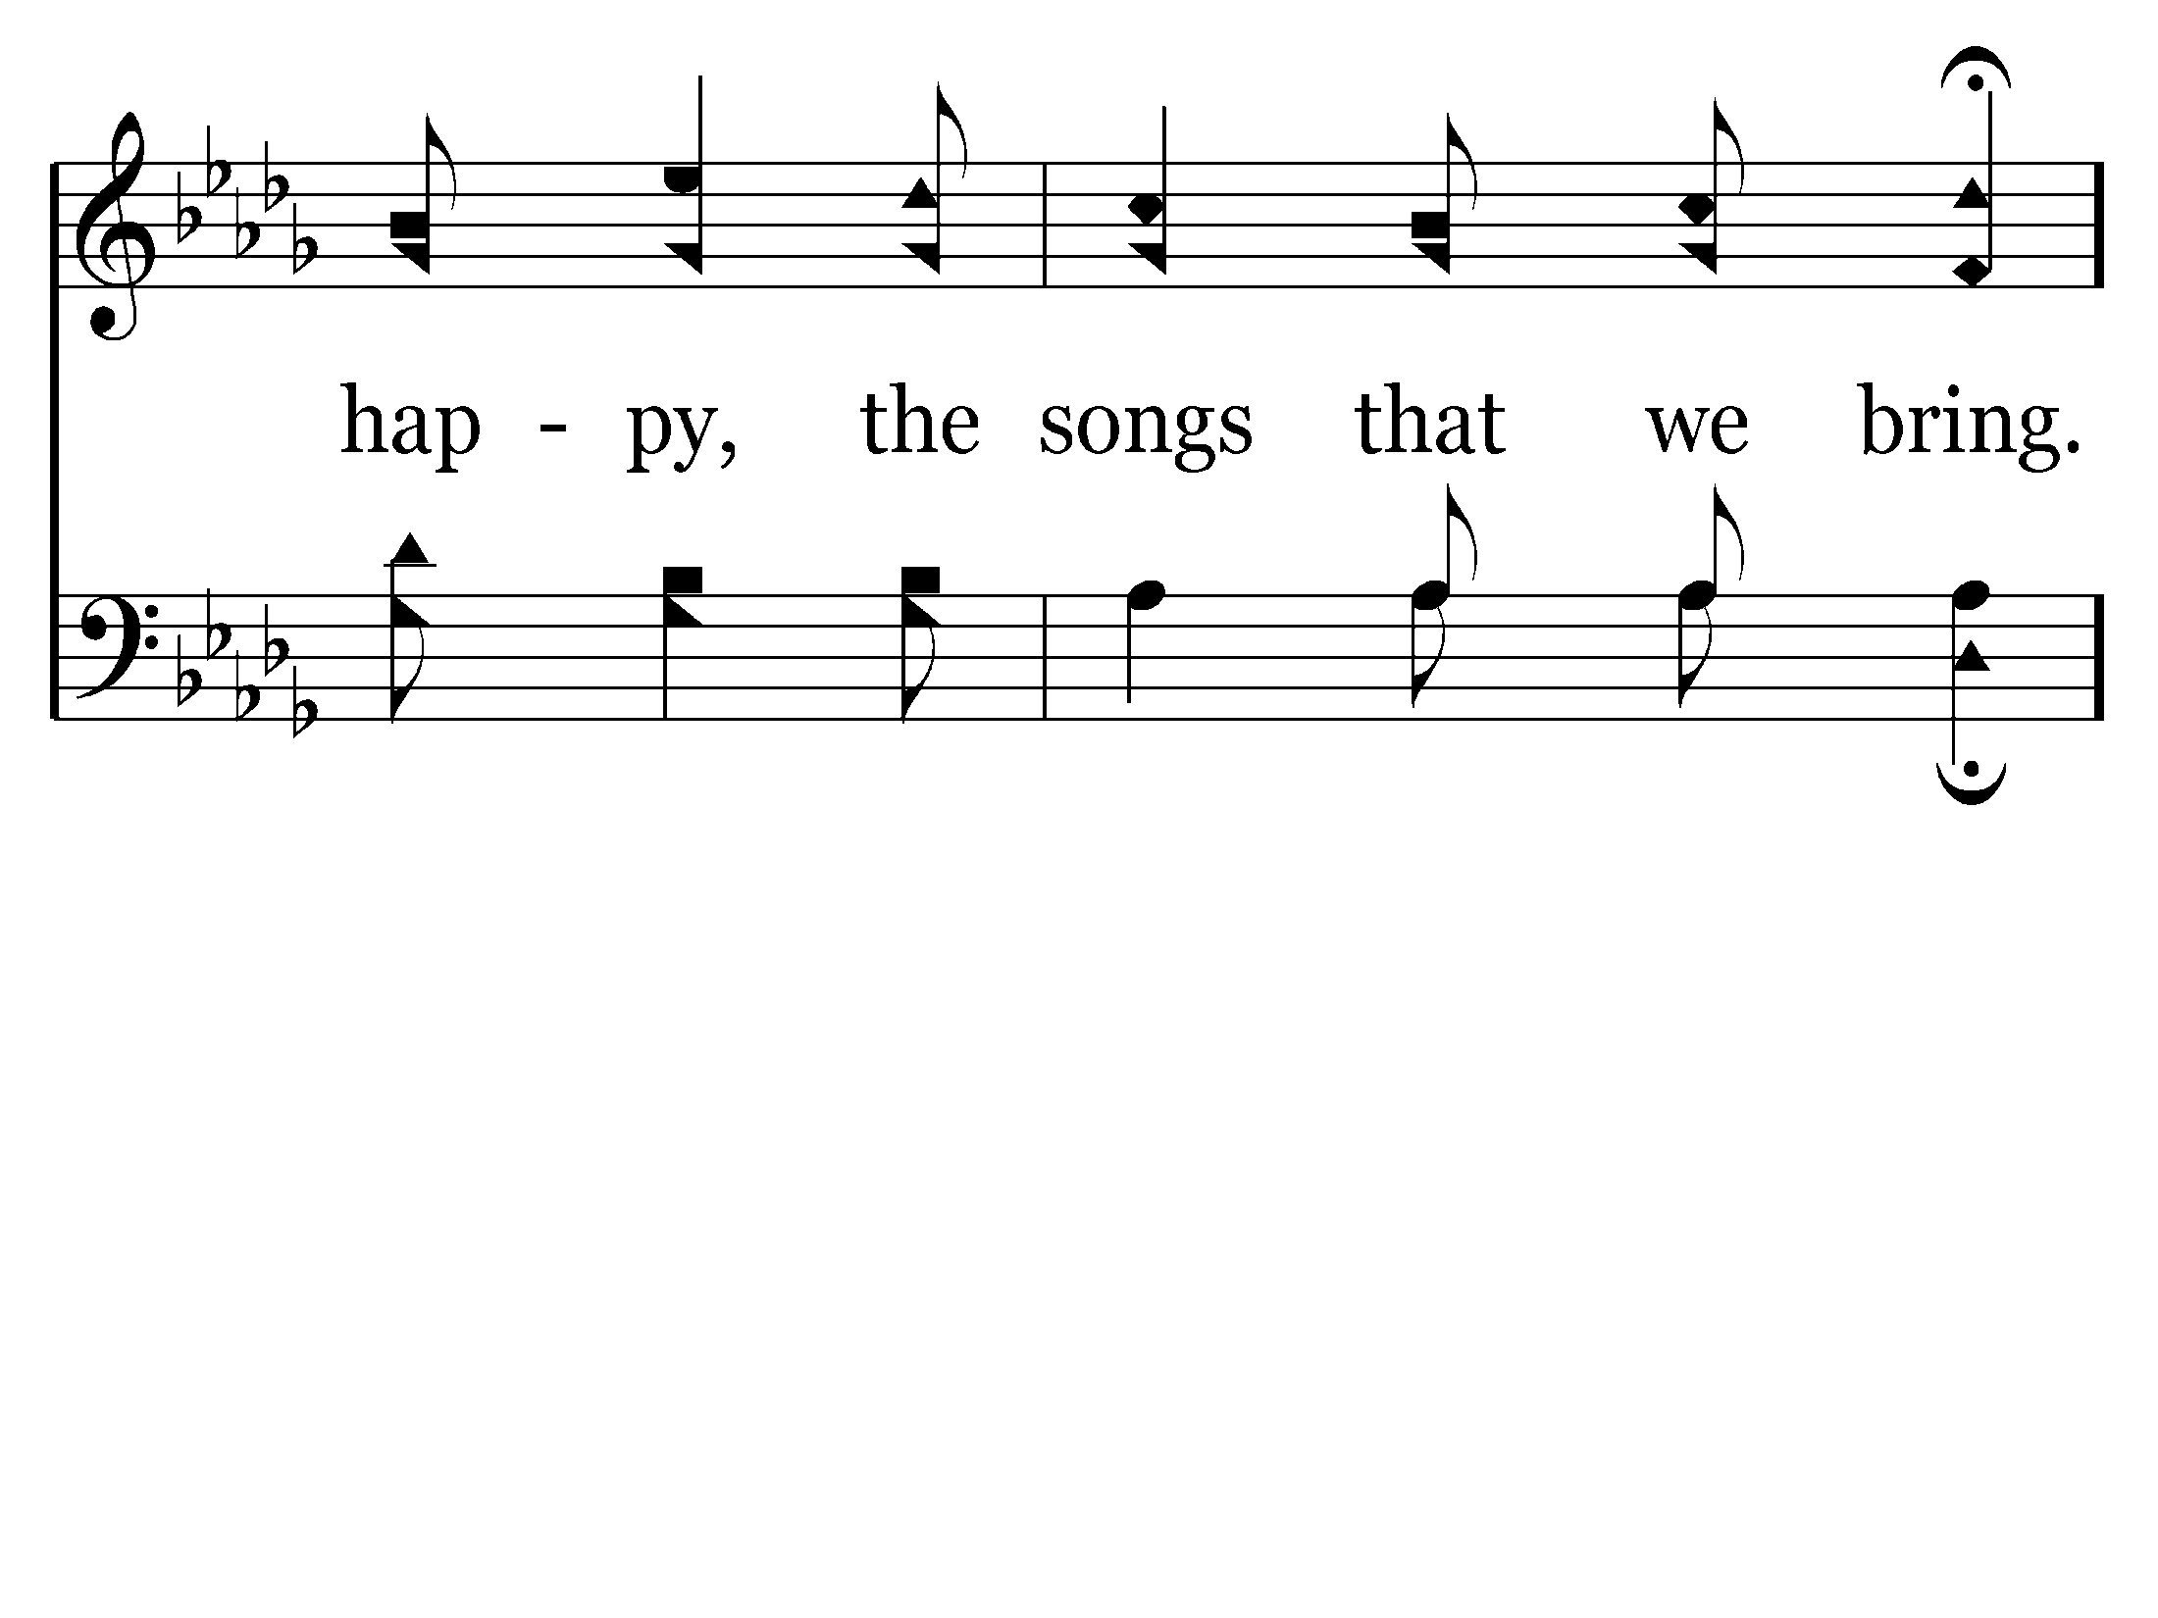
End of Song

Slide 21
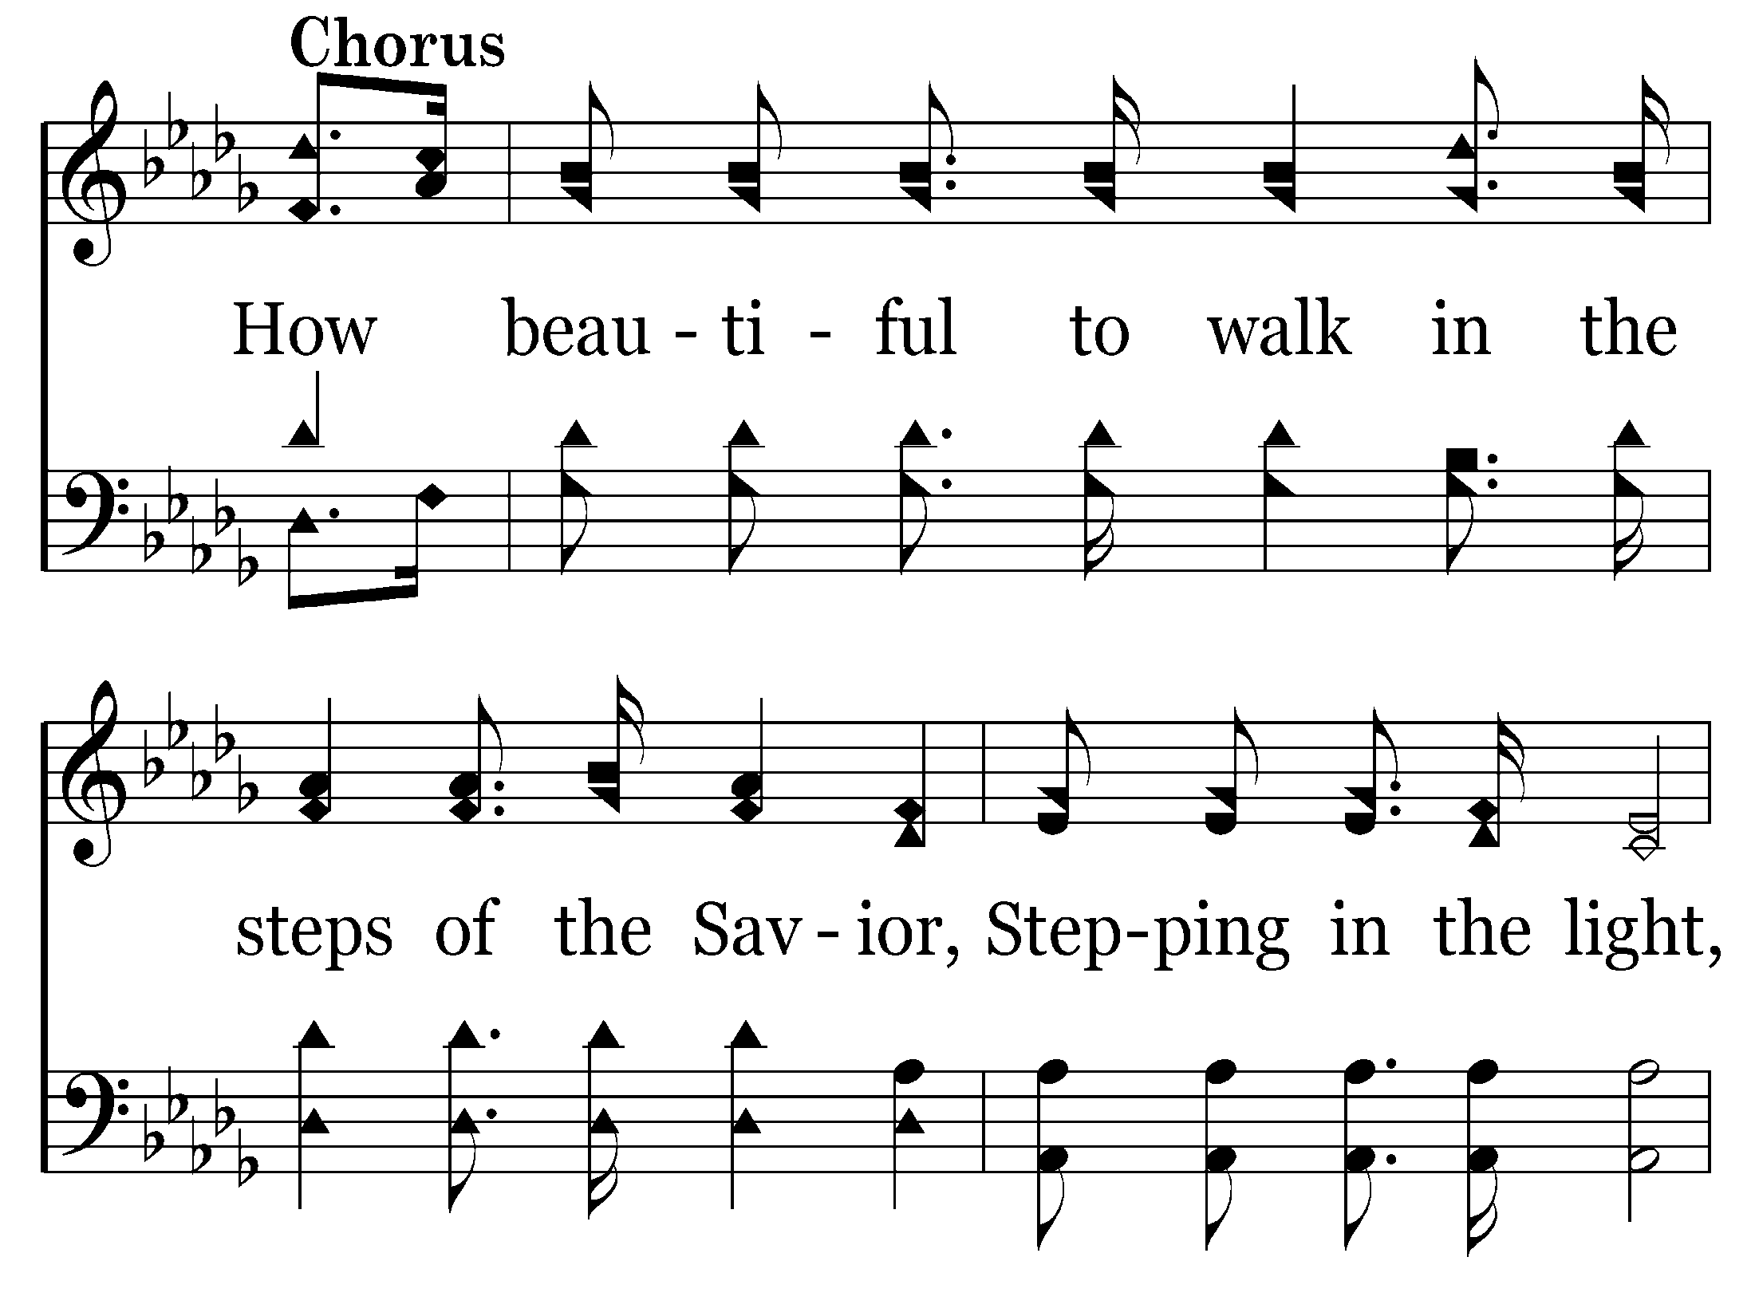

Slide 22
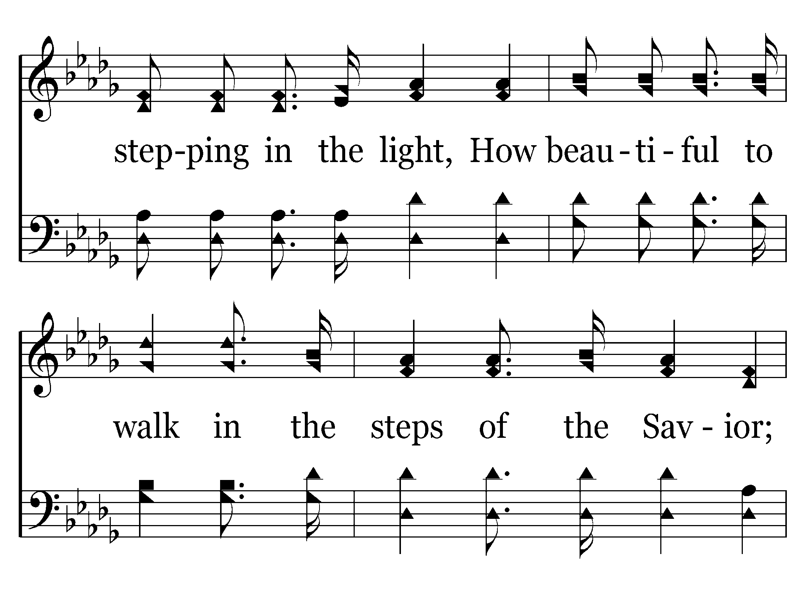

Slide 23
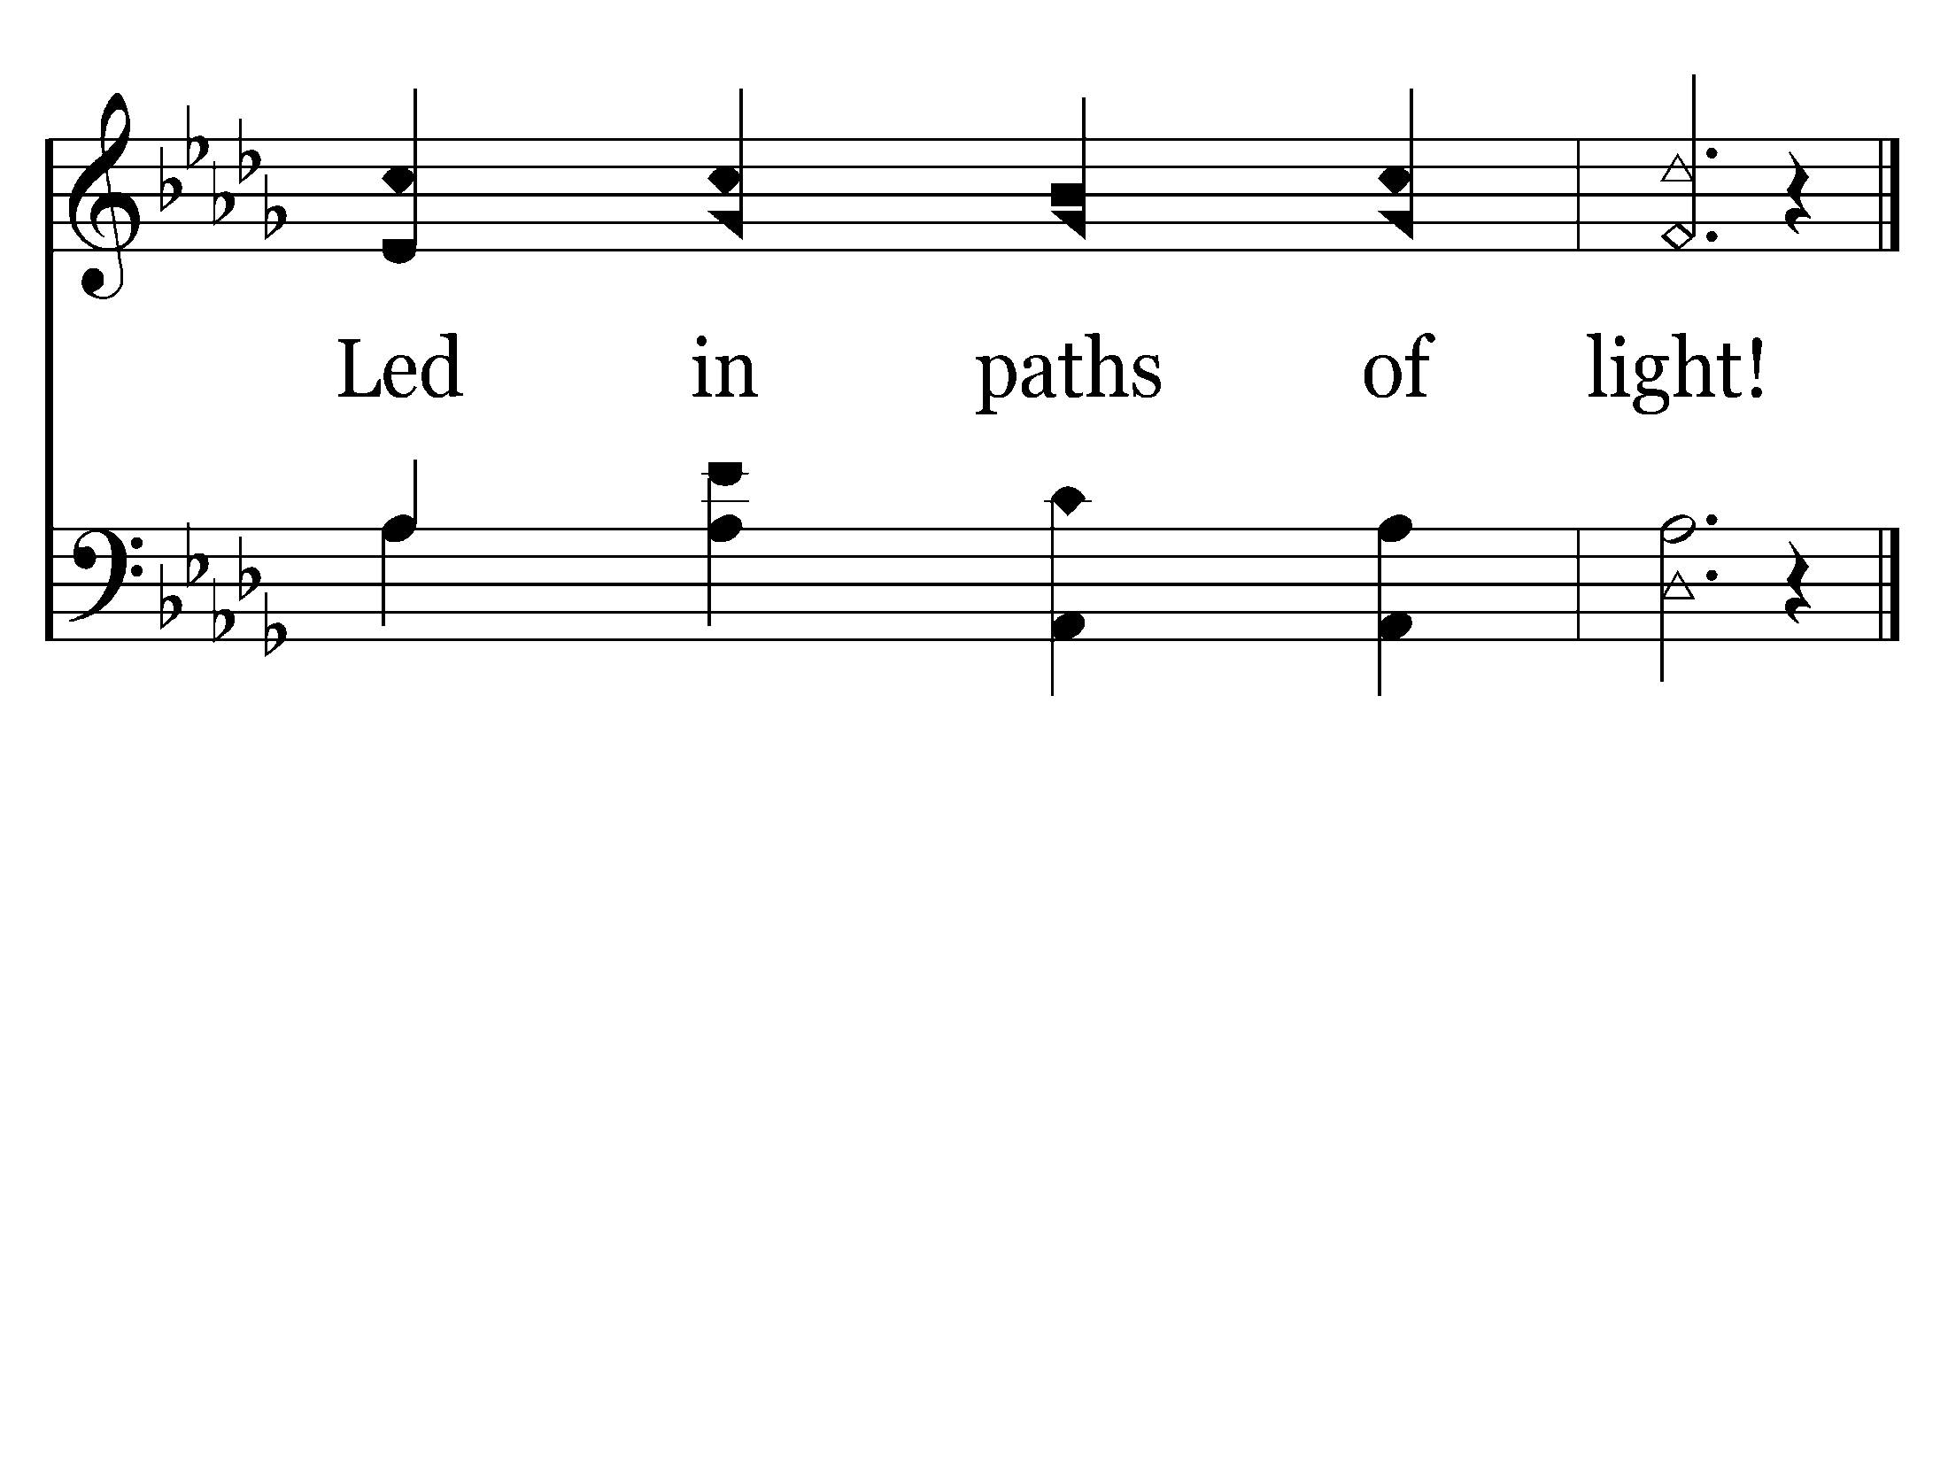
End of Song

Slide 24
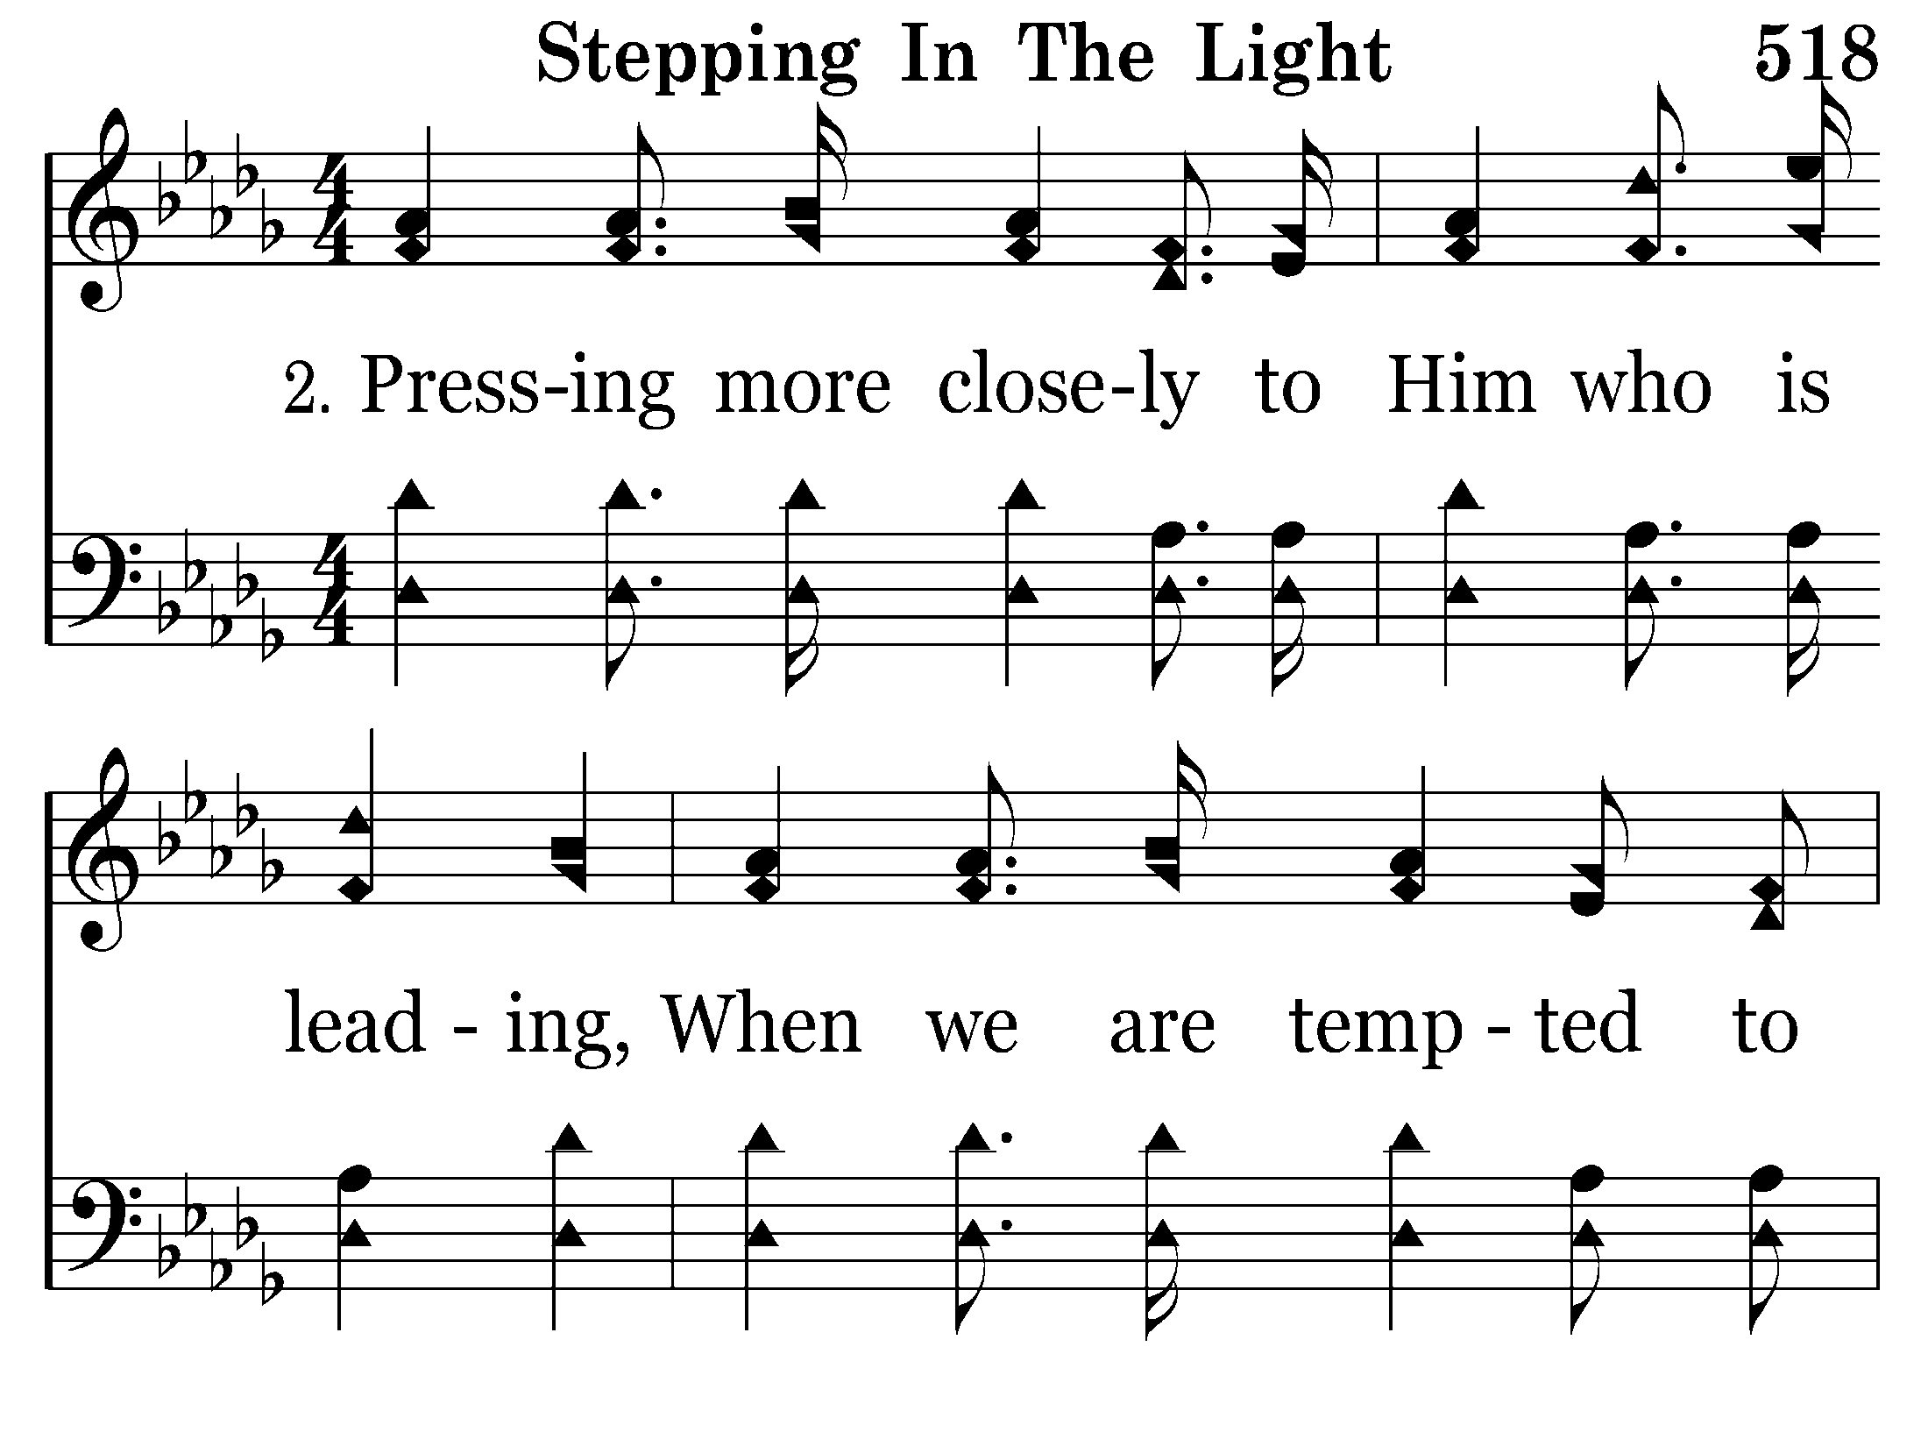

Slide 25
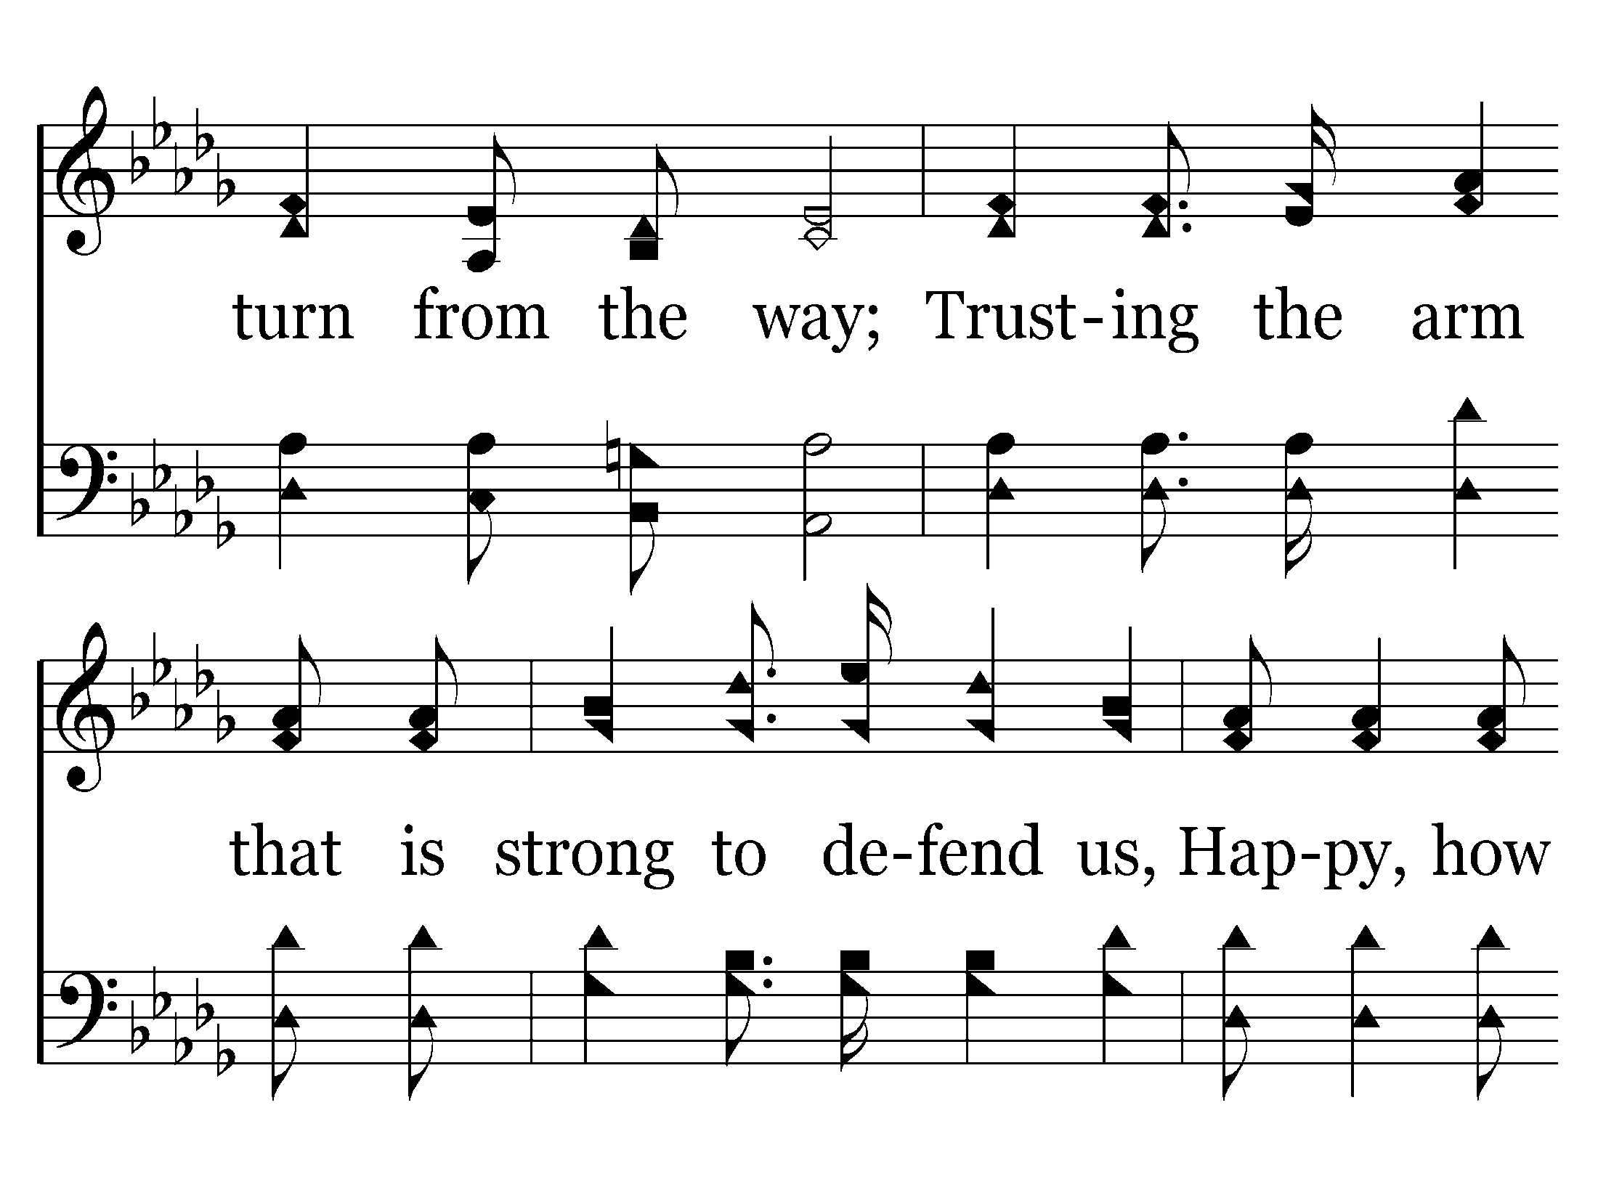

Slide 26
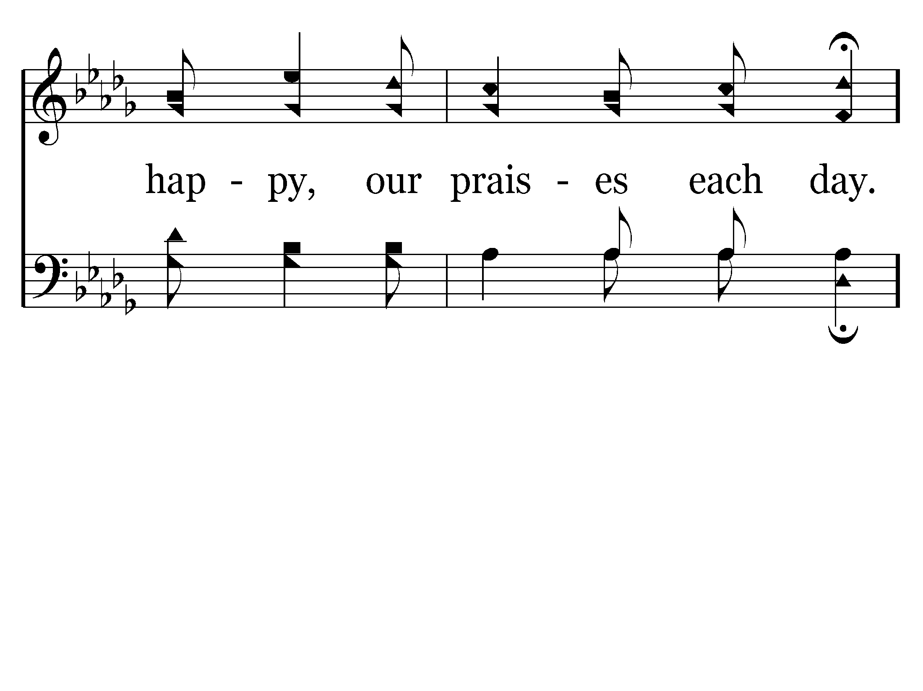
End of Song

Slide 29
End of Song

Slide 31
Romans 3:23
23 for all have sinned and fall short of the glory of God,

Slide 32
Isaiah 59:2
2 But your iniquities (“SINS”) have separated you from your God; and your sins have hidden His face from you, so that He will not hear.

Slide 34
Ephesians 1:3-4
3 Blessed be the God and Father of our Lord Jesus Christ, who has blessed us with every spiritual blessing in the heavenly places in Christ,
4 just as He chose us in Him before the foundation of the world, that we should be holy and without blame before Him in love,

Slide 35
Ephesians 1:7
7 In Him we have redemption through His blood, the forgiveness of sins, according to the riches of His grace

Slide 37
I John 2:1-2
1 My little children, these things I write to you, so that you may not sin. And if anyone sins, we have an Advocate with the Father, Jesus Christ the righteous.
2 And He Himself is the propitiation for our sins, and not for ours only but also for the whole world.

Slide 39
I John 1:7-10
7 But if we walk in the light as He is in the light, we have fellowship with one another, and the blood of Jesus Christ His Son cleanses us from all sin.
8 If we say that we have no sin, we deceive ourselves, and the truth is not in us.

Slide 40
9 If we confess our sins, He is faithful and just to forgive us our sins and to cleanse us from all unrighteousness.
10 If we say that we have not sinned, we make Him a liar, and His word is not in us.

Slide 41
WHAT DOES GOD WANT FROM ME
. . . IN REGARD TO SIN?
GOD CALLS ME TO PERFECTION.
HIS GRACE & FORGIVENESS KEEPS ME PERFECT.

Slide 42
Proverbs 14:9
9 Fools mock at sin, but among the upright there is favor.

Slide 43
Romans 6:23
23 For the wages of sin is death, but the gift of God is eternal life in Christ Jesus our Lord.

Slide 44
Titus 2:11-14
11 For the grace of God that brings salvation has appeared to all men,
12 teaching us that, denying ungodliness and worldly lusts, we should live soberly, righteously, and godly in the present age,

Slide 45
Romans 6:1-2
1 What shall we say then? Shall we continue in sin that grace may abound?
2 Certainly not! How shall we who died to sin live any longer in it?

Slide 46
Titus 2:11-14
11 For the grace of God that brings salvation has appeared to all men,
12 teaching us that, denying ungodliness and worldly lusts, we should live soberly, righteously, and godly in the present age,

Slide 47
13 looking for the blessed hope and glorious appearing of our great God and Savior Jesus Christ,
14 who gave Himself for us, that He might redeem us from every lawless deed and purify for Himself His own special people, zealous for good works.

Slide 49
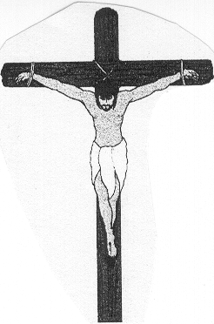
Relationship Between BAPTISM & the BLOOD of Christ
REMISSION OF SINS
Jesus’ BLOOD shed for … Mt. 26:28
BAPTIZED in the name of Jesus for…Acts 2:38
BLOOD shed in His Death (Jn. 19:34)
BAPTIZED into His Death (Rom. 6:3)
DEATH
RES.
BURIAL

Slide 50
Relationship Between BAPTISM & the BLOOD of Christ
REMISSION OF SINS
Jesus’ BLOOD shed for … Mt. 26:28
BAPTIZED in the name of Jesus for…Acts 2:38
BLOOD shed in His Death (Jn. 19:34)
BAPTIZED into His Death (Rom. 6:3)
CLEANSES
BLOOD of Jesus cleanses us from sin. 1 Jn. 1:7
BAPTIZED & wash away your sins. Acts 22:16
DEATH
RES.
BURIAL

Slide 51
Relationship Between BAPTISM & the BLOOD of Christ
REMISSION OF SINS
Jesus’ BLOOD shed for … Mt. 26:28
BAPTIZED in the name of Jesus for…Acts 2:38
BLOOD shed in His Death (Jn. 19:34)
BAPTIZED into His Death (Rom. 6:3)
CLEANSES
BLOOD of Jesus cleanses us from sin. 1 Jn. 1:7
BAPTIZED & wash away your sins. Acts 22:16
DEATH
RES.
BURIAL
SALVATION
We have REDEMPTION thru His BLOOD, the forgiveness of sins. Col.1:14
BAPTISM now saves us. 1 Peter 3:21

Slide 52
Titus 2:11-14
11 For the grace of God that brings salvation has appeared to all men,
12 teaching us that, denying ungodliness and worldly lusts, we should live soberly, righteously, and godly in the present age,

Slide 53
Ephesians 1:7
7 In Him we have redemption through His blood, the forgiveness of sins, according to the riches of His grace

Slide 54


Slide 55
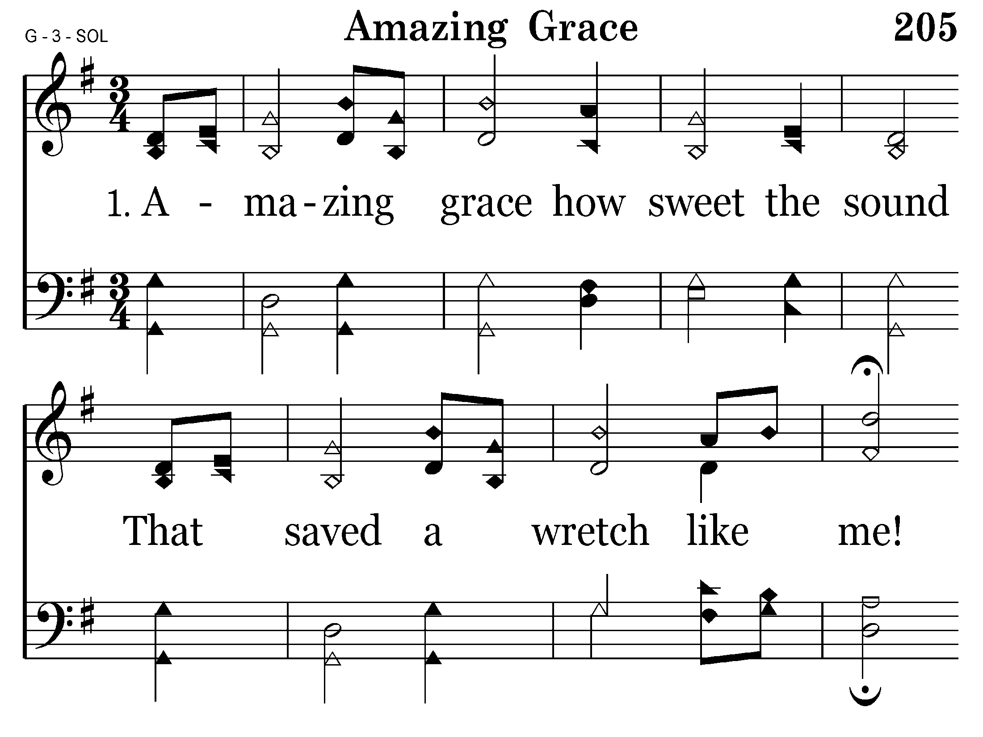

Slide 56
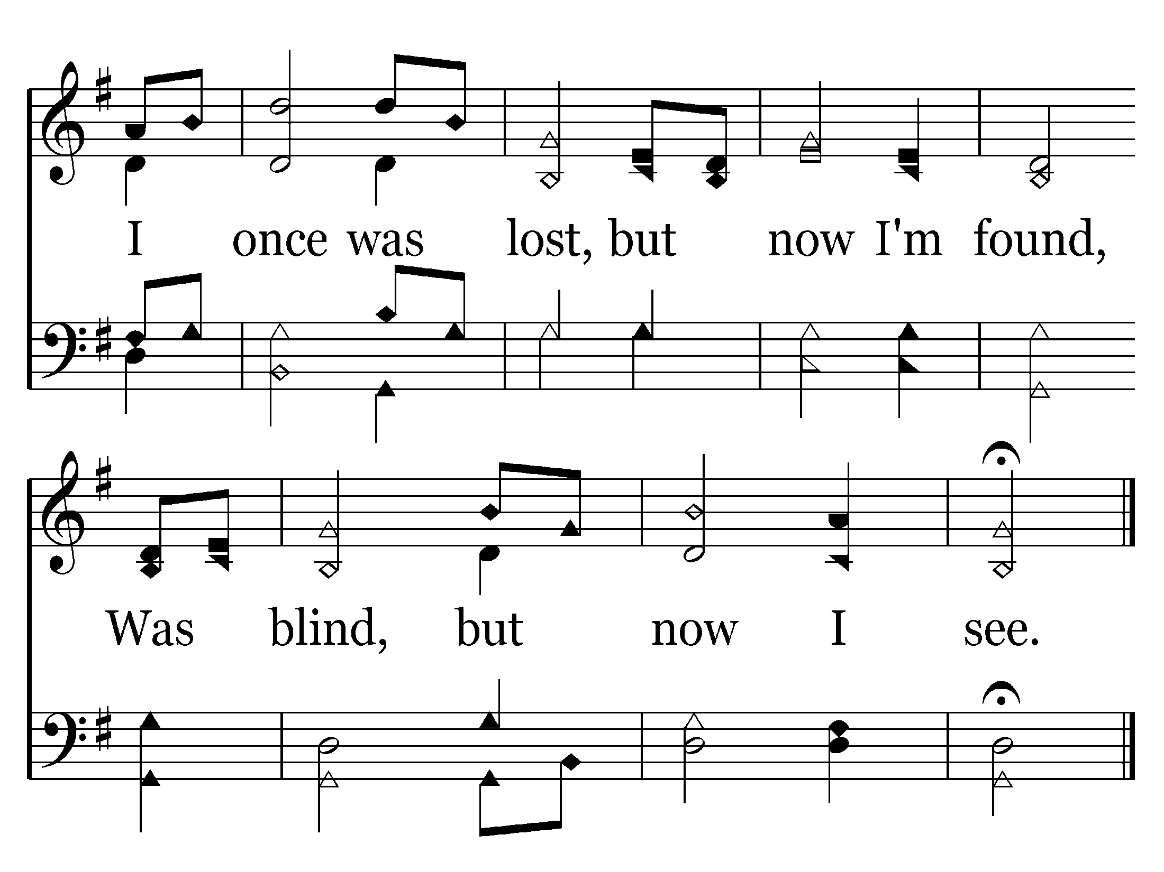
End of Verse 1

Slide 57
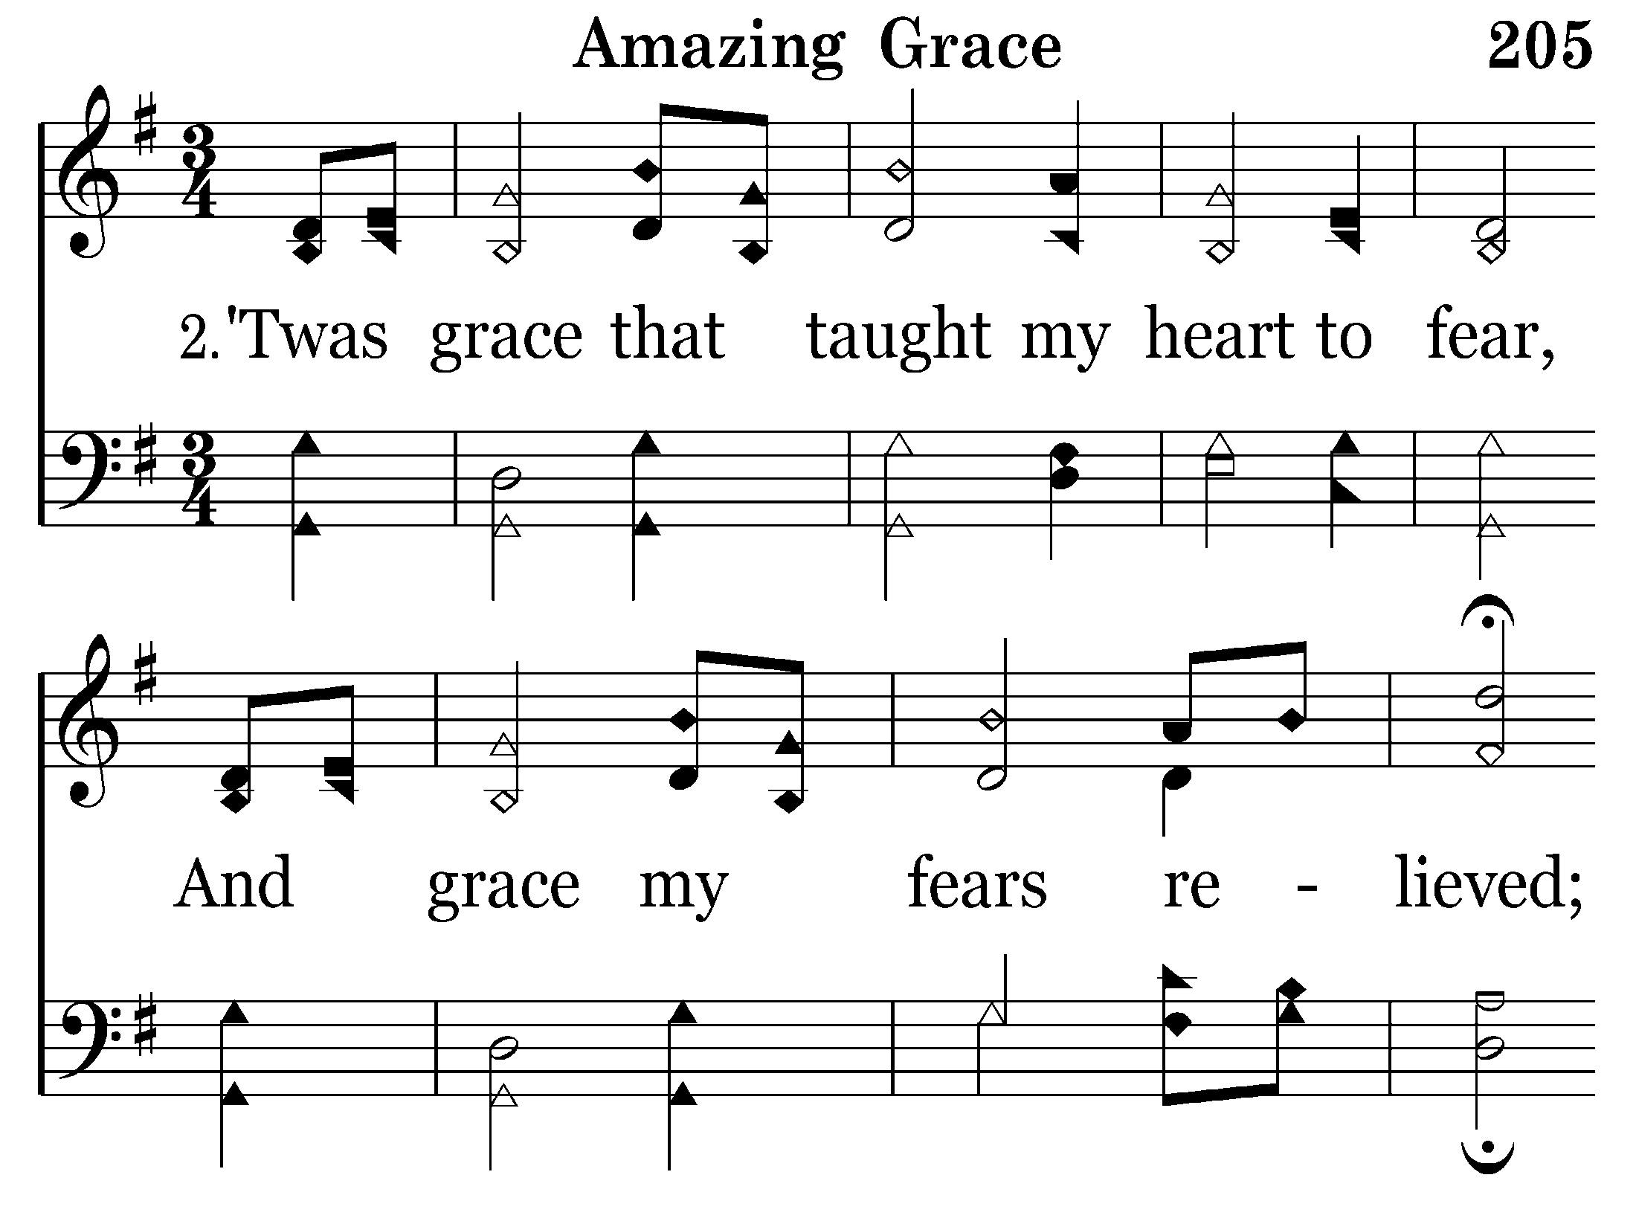

Slide 58
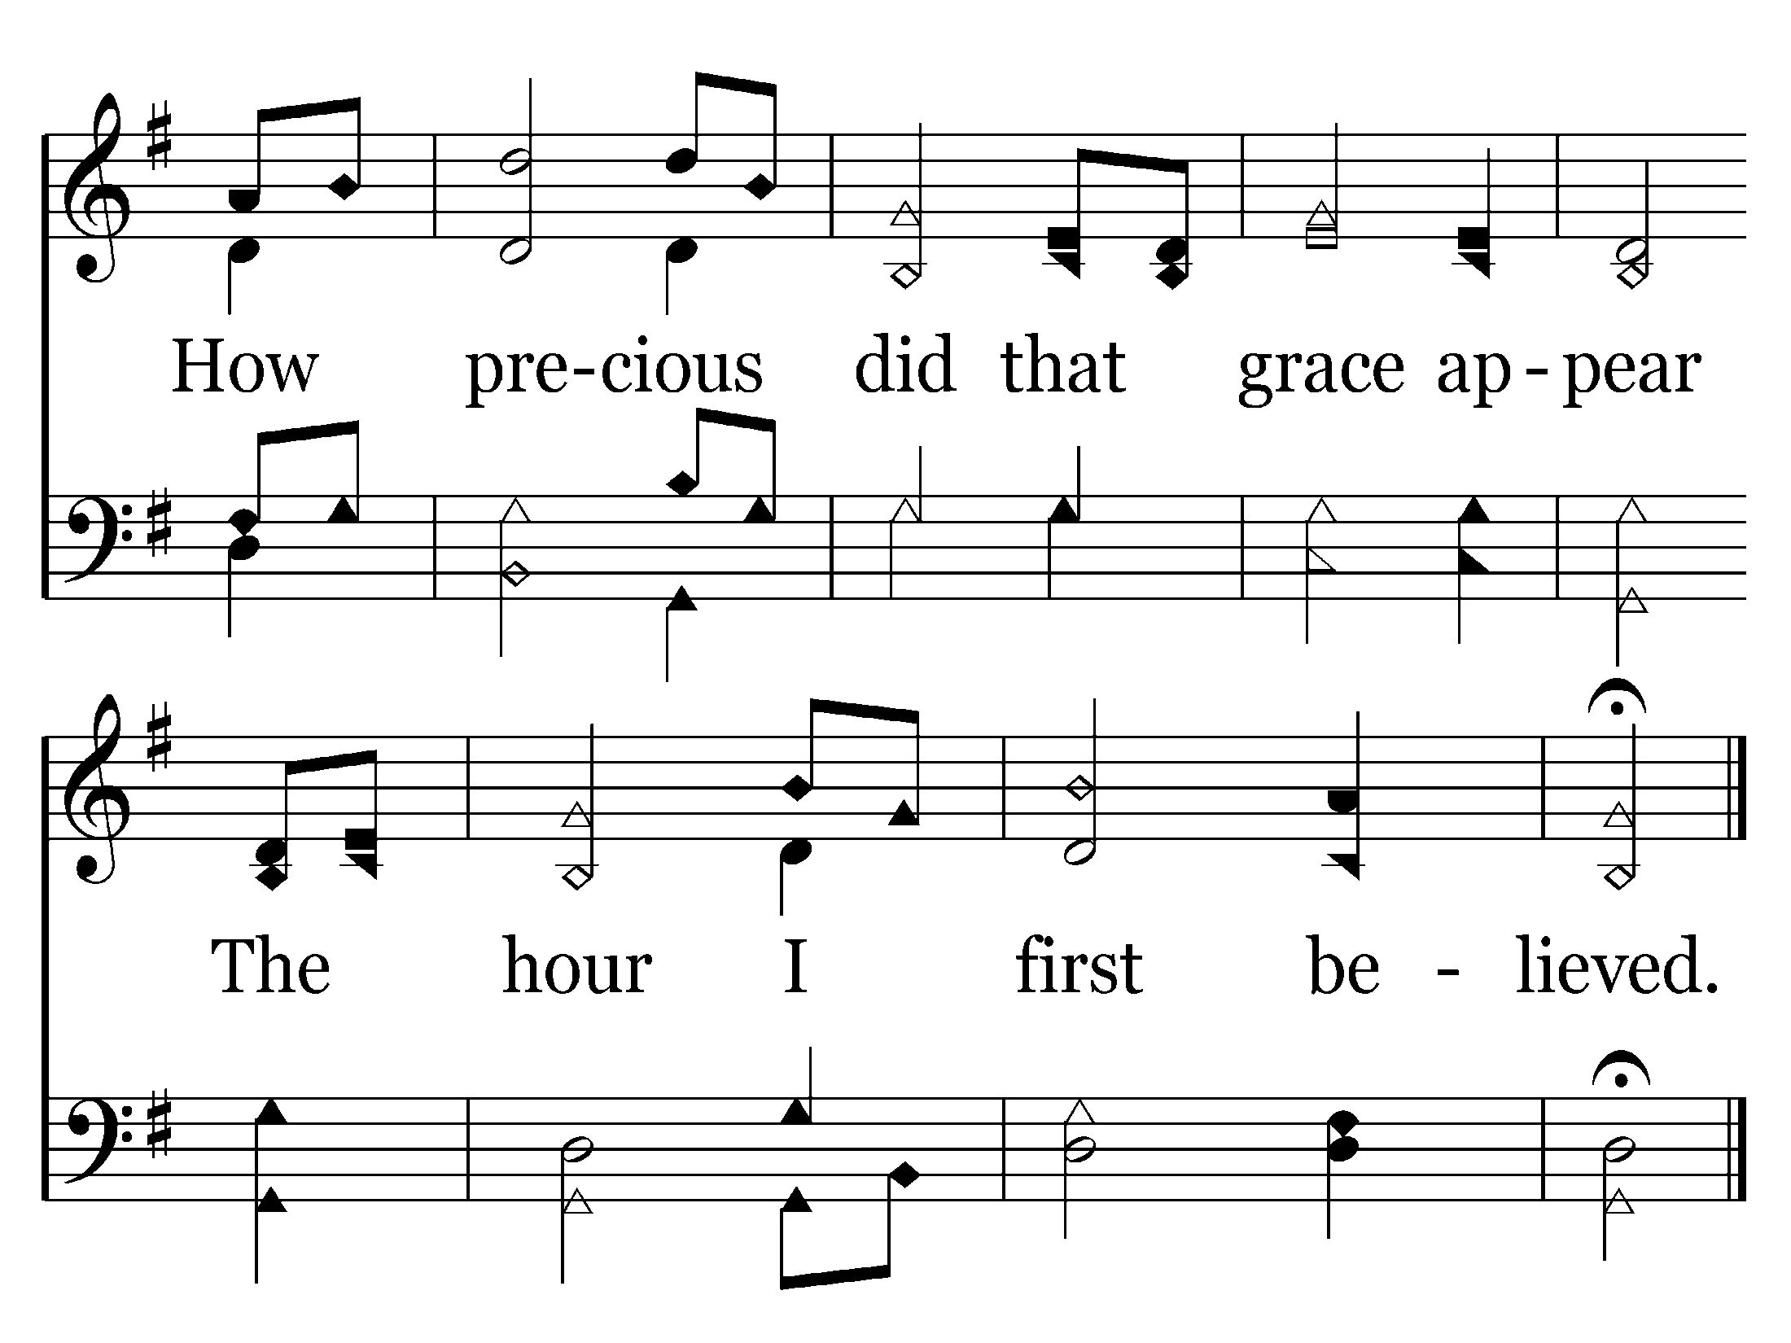
End of Verse 2

Slide 59
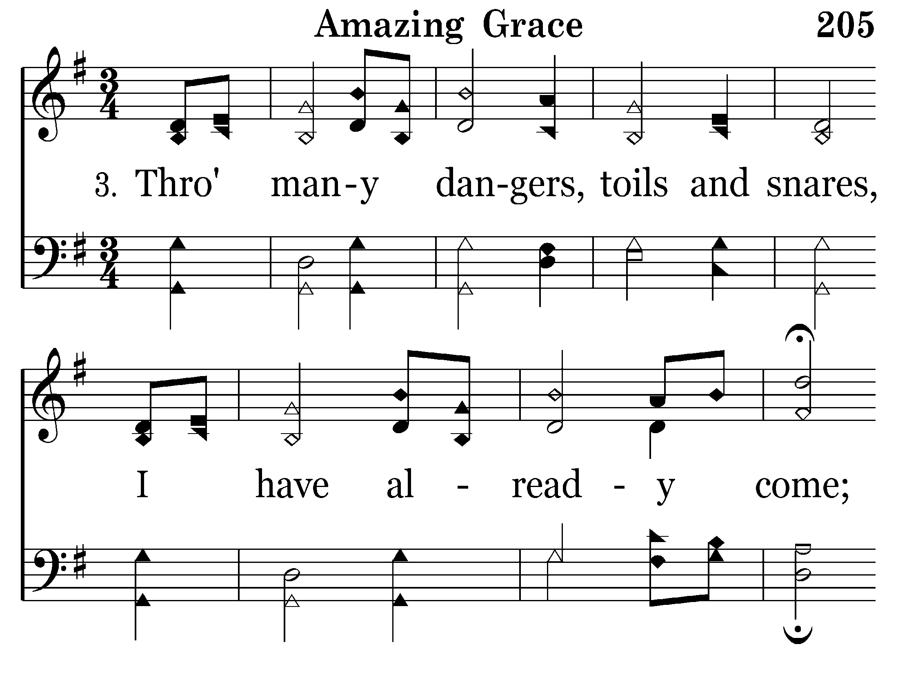

Slide 60
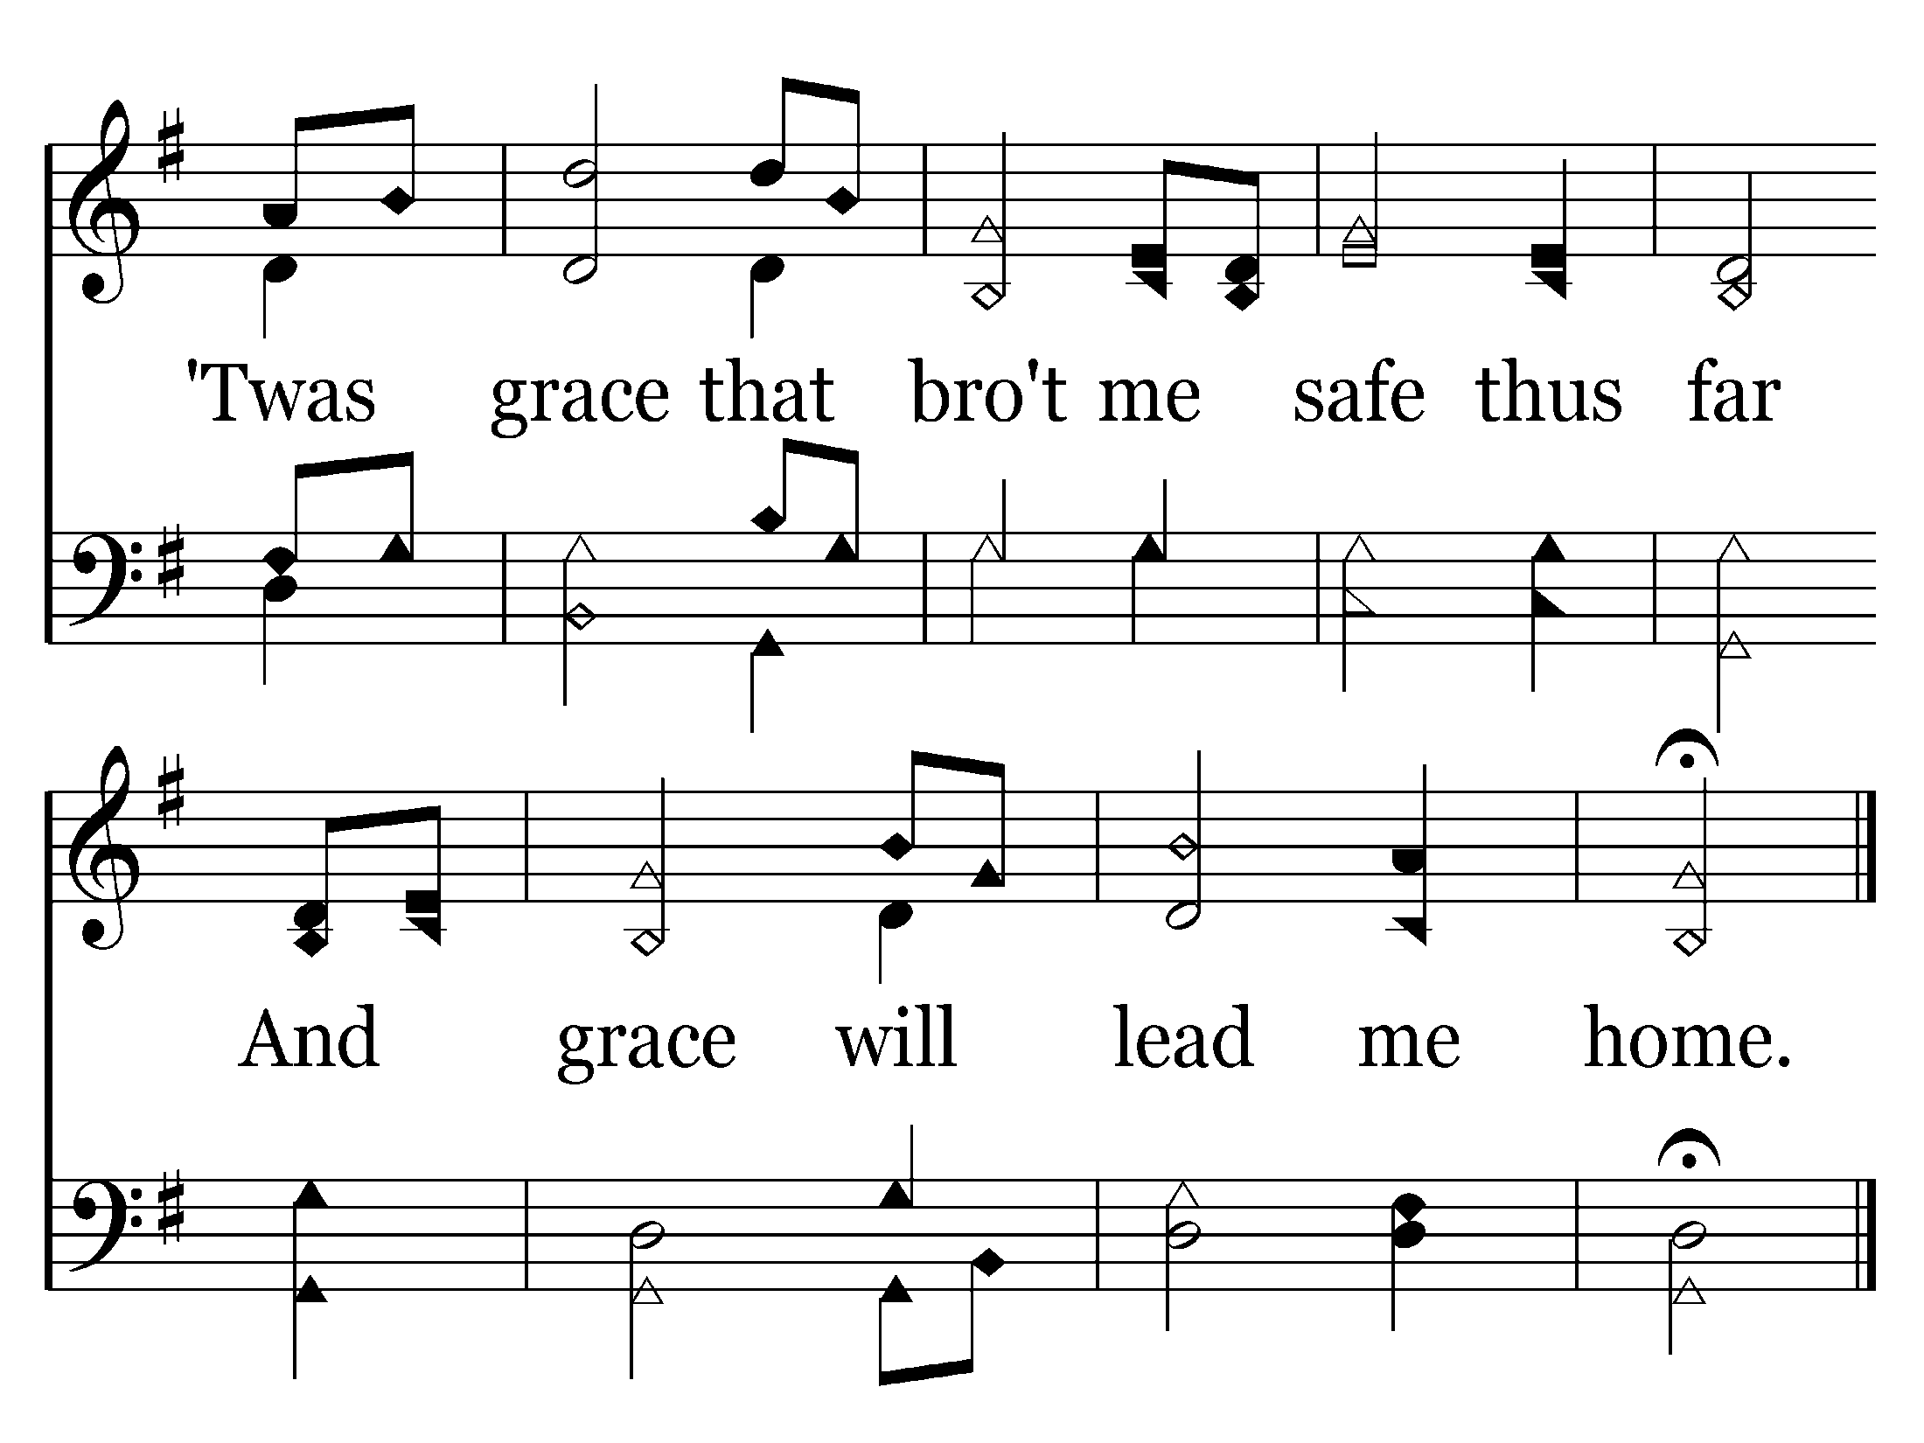
End of Song

Slide 61
Titus 2:11-14
11 For the grace of God that brings salvation has appeared to all men,
12 teaching us that, denying ungodliness and worldly lusts, we should live soberly, righteously, and godly in the present age,

Slide 62
WHAT DOES GOD WANT FROM ME
. . . IN REGARD TO SIN?
GOD CALLS ME TO PERFECTION.
GOD’S GRACE & FORGIVENESS KEEPS ME PERFECT.
GOD SEEKS MY PROGRESS.

Slide 63
Romans 6:12, 14
Therefore do not let sin reign in your mortal body, that you should obey it in its lusts.
14 For sin shall not have dominion over you, . . .

Slide 65
2 Peter 1:5-12
5 But also for this very reason, giving all diligence, add to your faith virtue, to virtue knowledge,
6 to knowledge self-control, to self- control perseverance, to persever- ance godliness,
7 to godliness brotherly kindness, and to brotherly kindness love.

Slide 66
8 For if these things are yours and abound, you will be neither barren nor unfruitful in the knowledge of our Lord Jesus Christ.
9 For he who lacks these things is shortsighted, even to blindness, and has forgotten that he was cleansed from his old sins.

Slide 67
10 Therefore, brethren, be even more diligent to make your call and election sure, for if you do these things you will never stumble;
11 for so an entrance will be supplied to you abundantly into the everlasting kingdom of our Lord and Savior Jesus Christ.

Slide 69

322 - Bring Christ Your Broken Life - Title

Slide 70
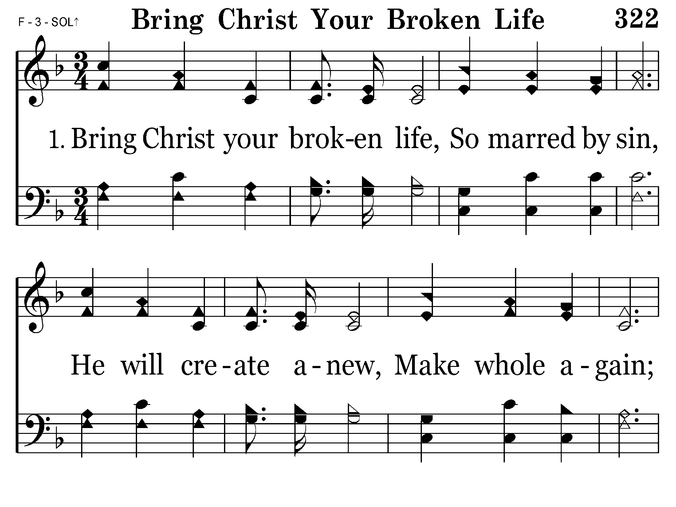
322 - Bring Christ Your Broken Life - 1.1

Slide 71
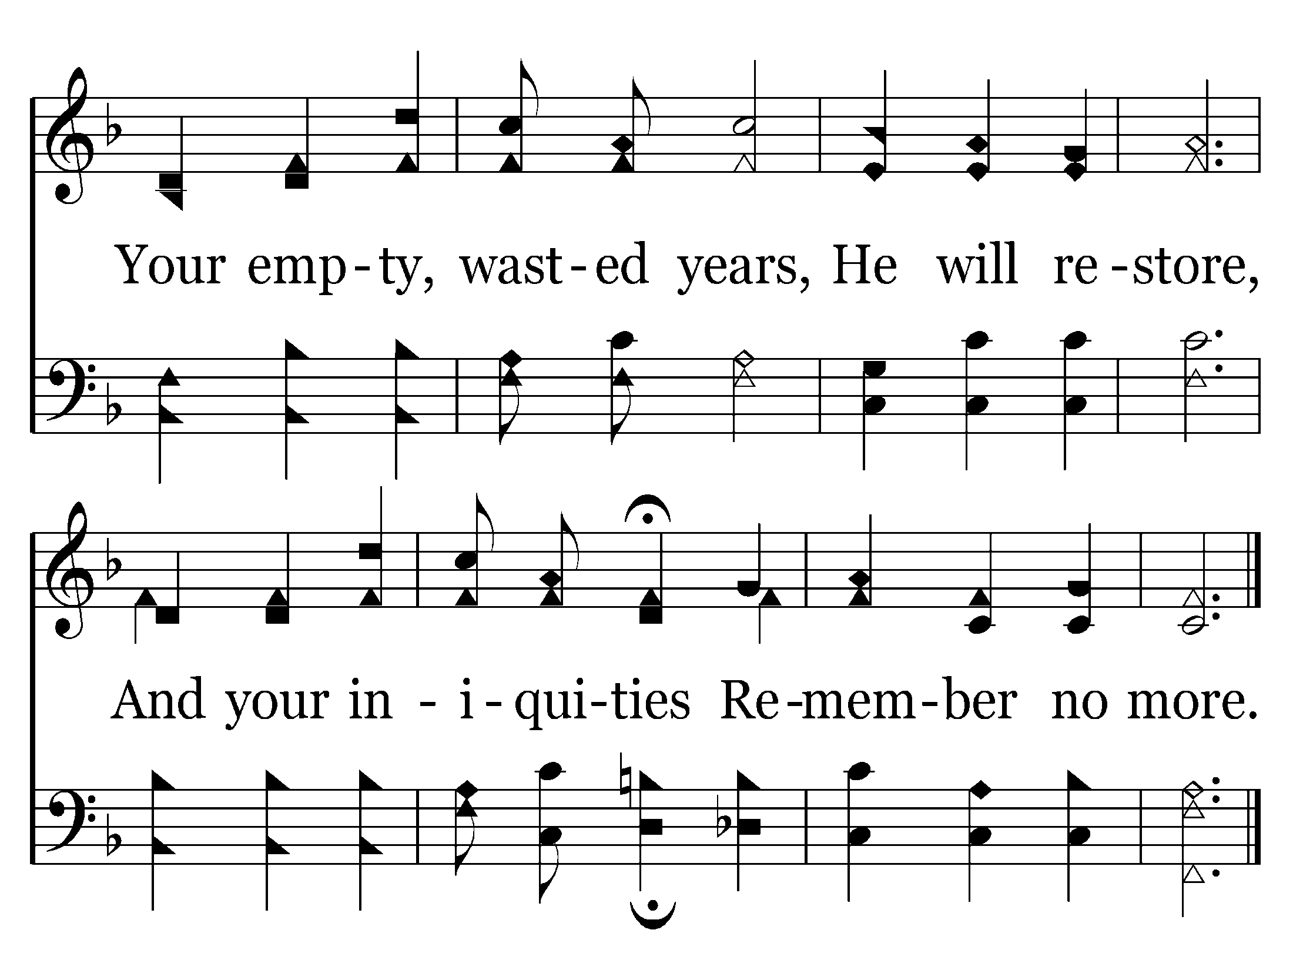
322 - Bring Christ Your Broken Life - 1.2
End of Verse 1

Slide 72
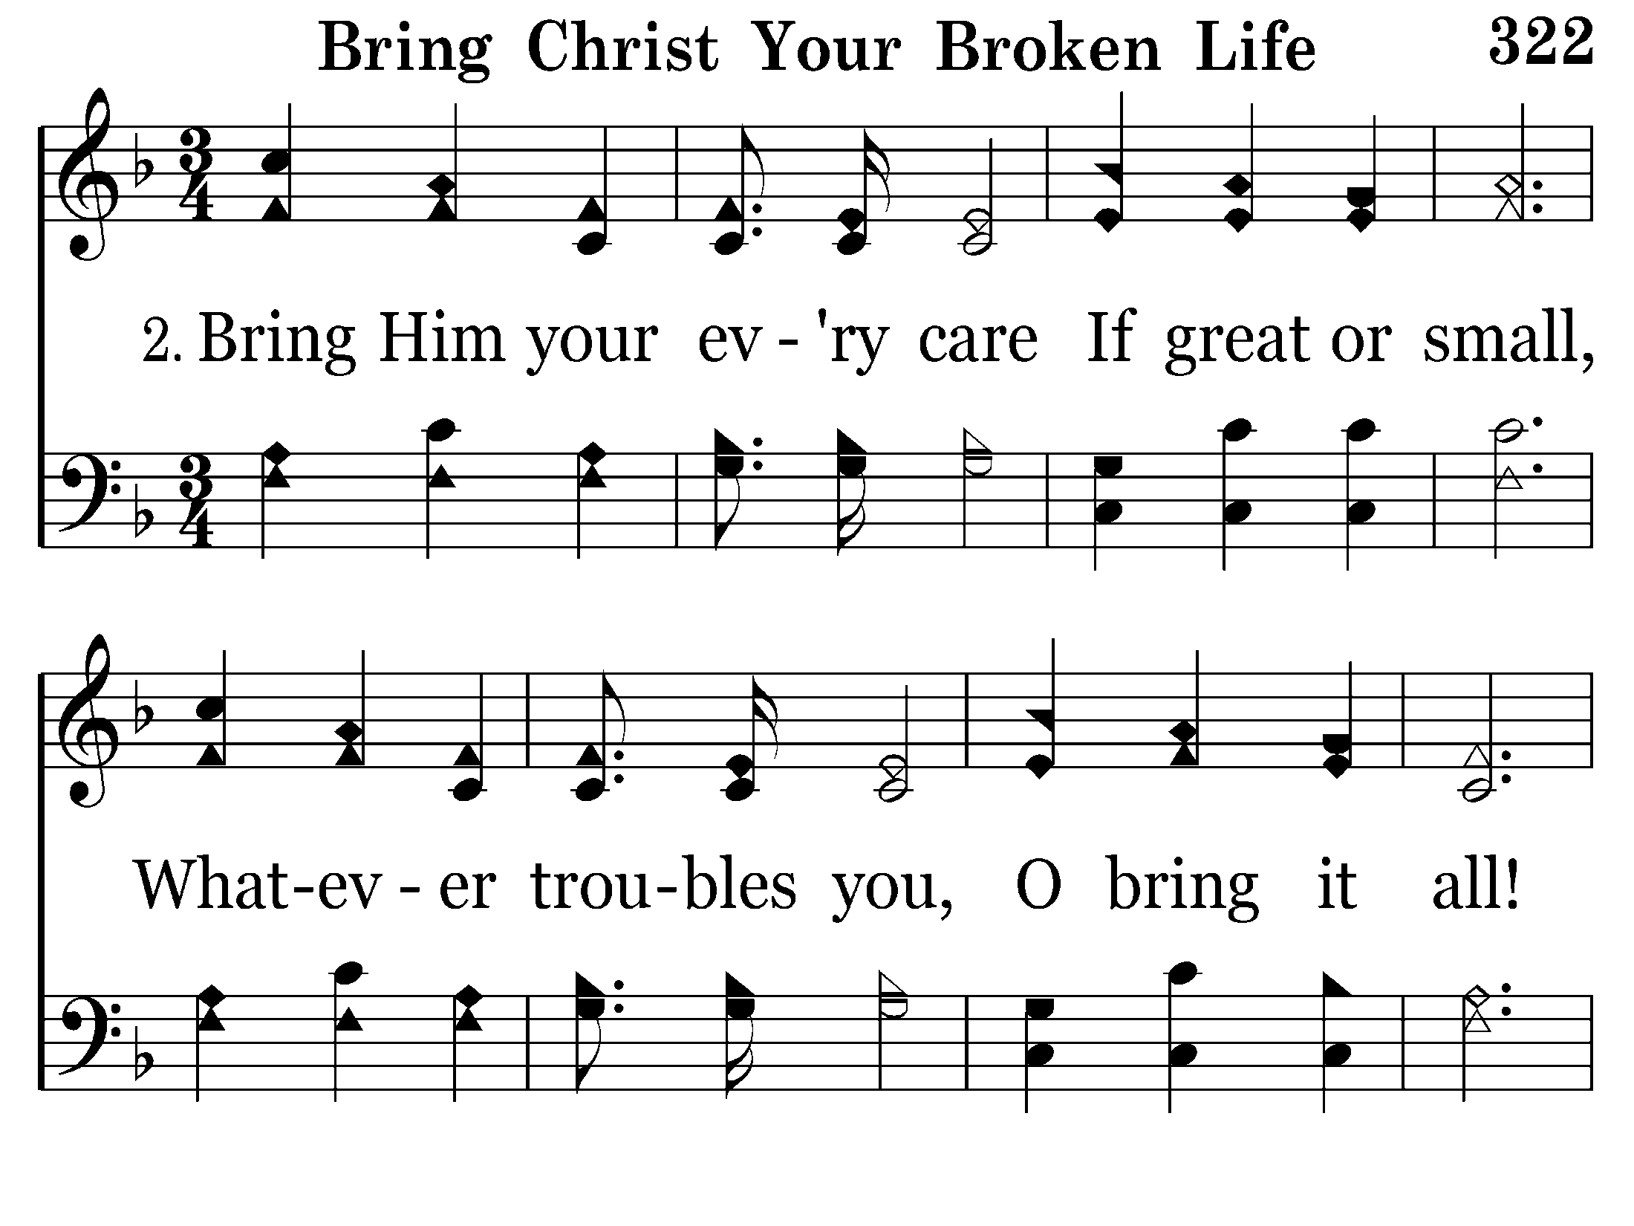
322 - Bring Christ Your Broken Life - 2.1

Slide 73
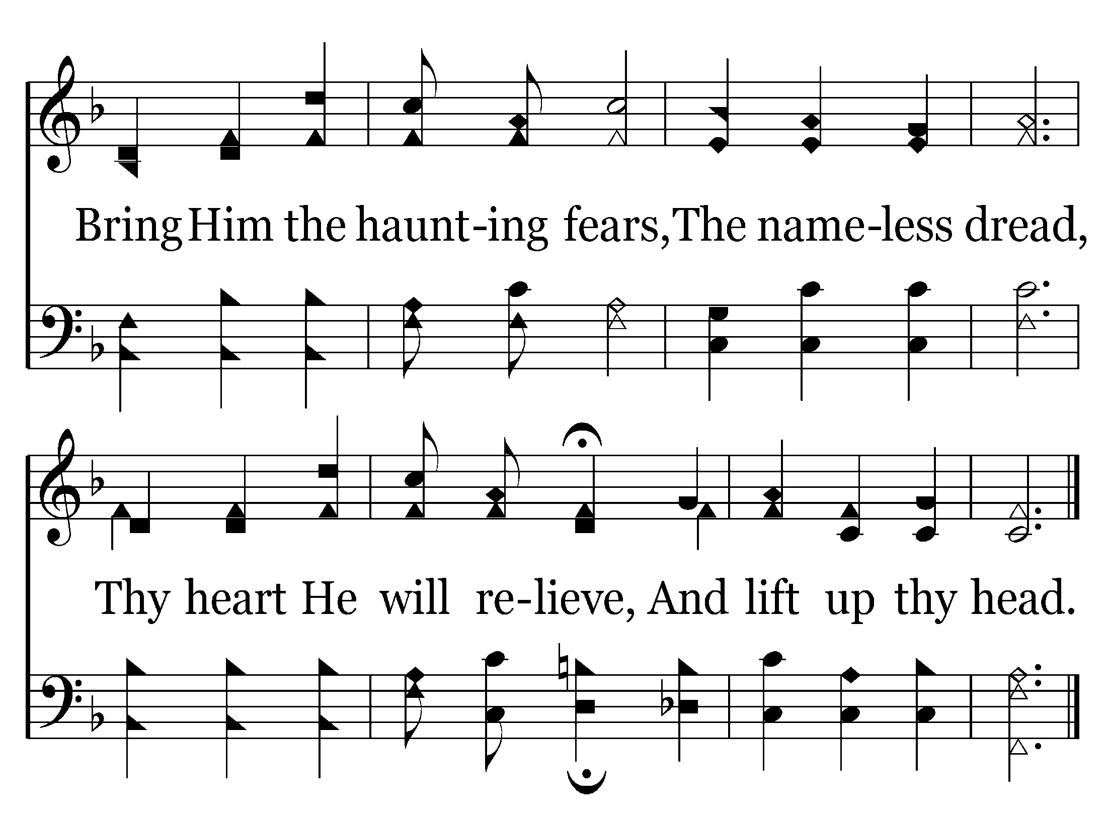
322 - Bring Christ Your Broken Life - 2.2
End of Verse 2

Slide 74
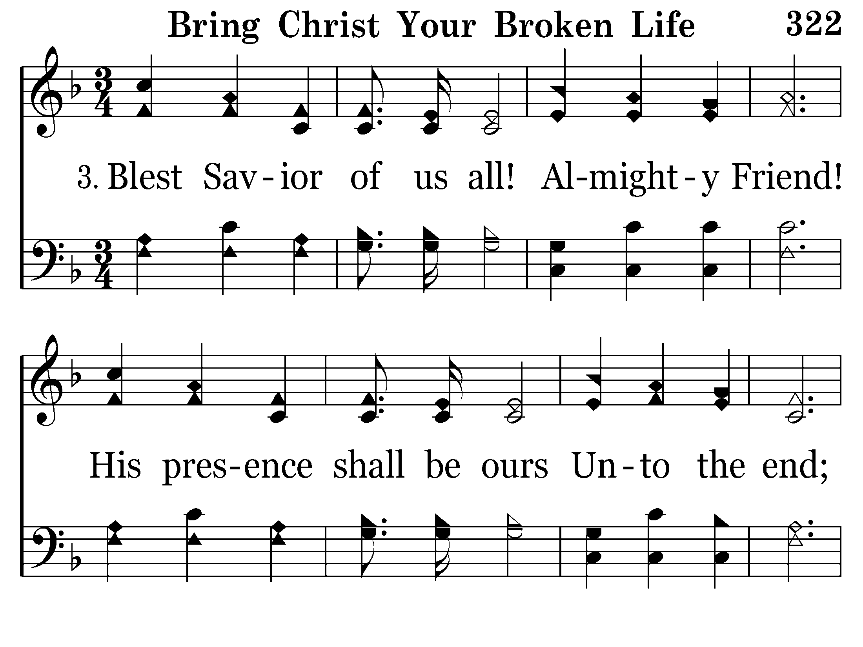
322 - Bring Christ Your Broken Life - 3.1

Slide 75
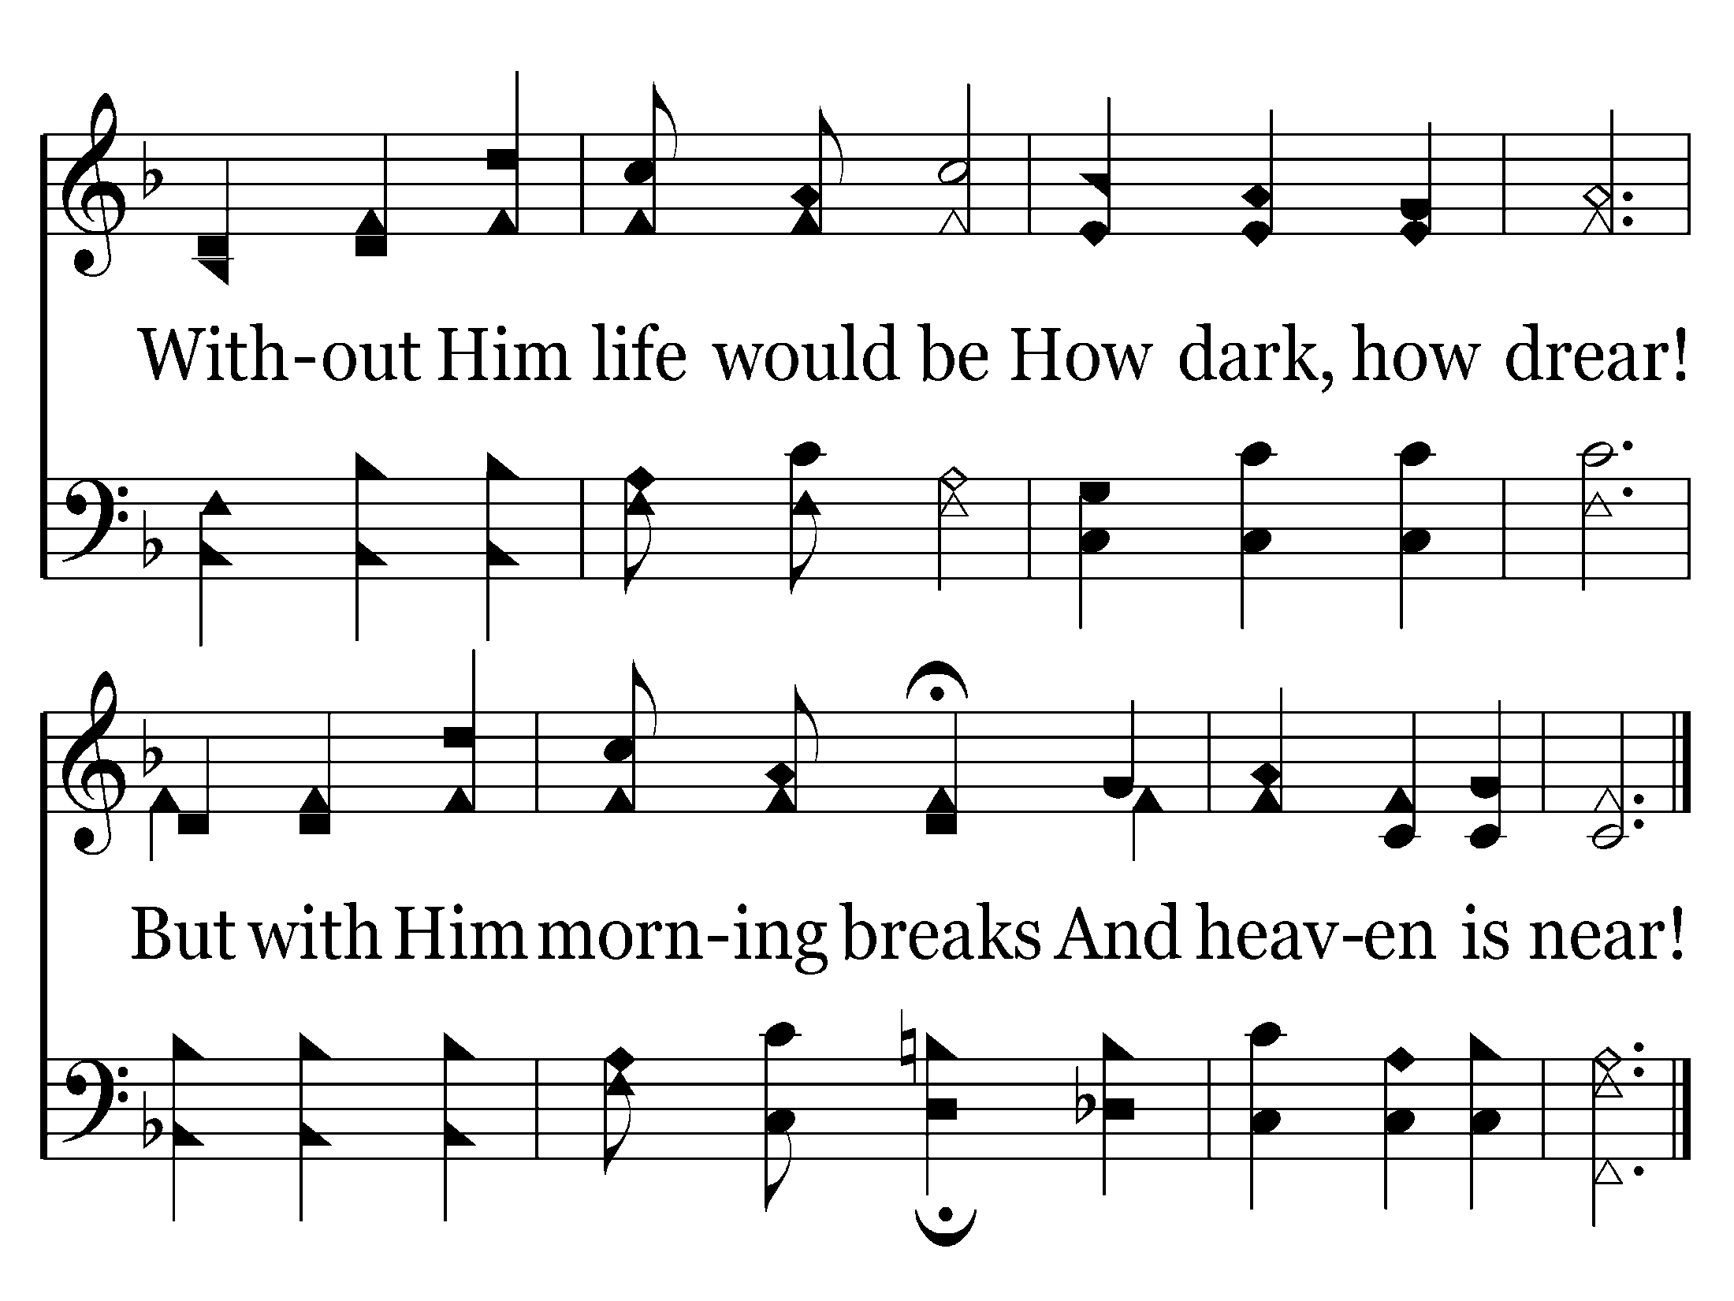
322 - Bring Christ Your Broken Life - 3.2
End of Song

Slide 79
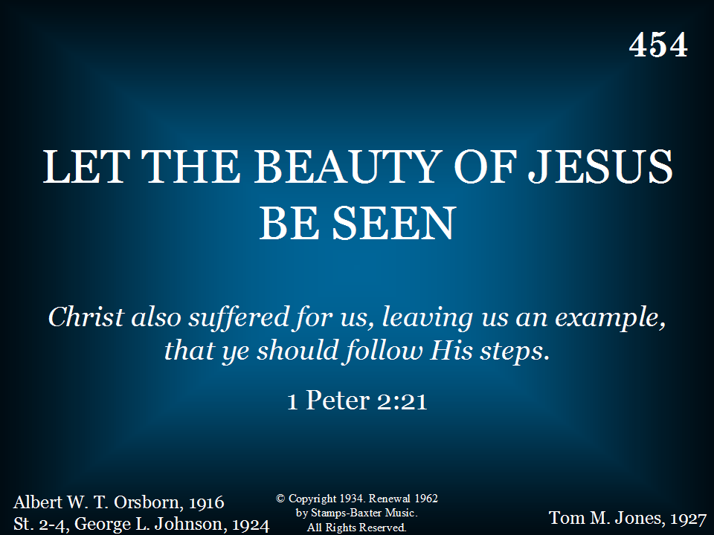
454 - Let The Beauty Of Jesus Be Seen - Title

Slide 80
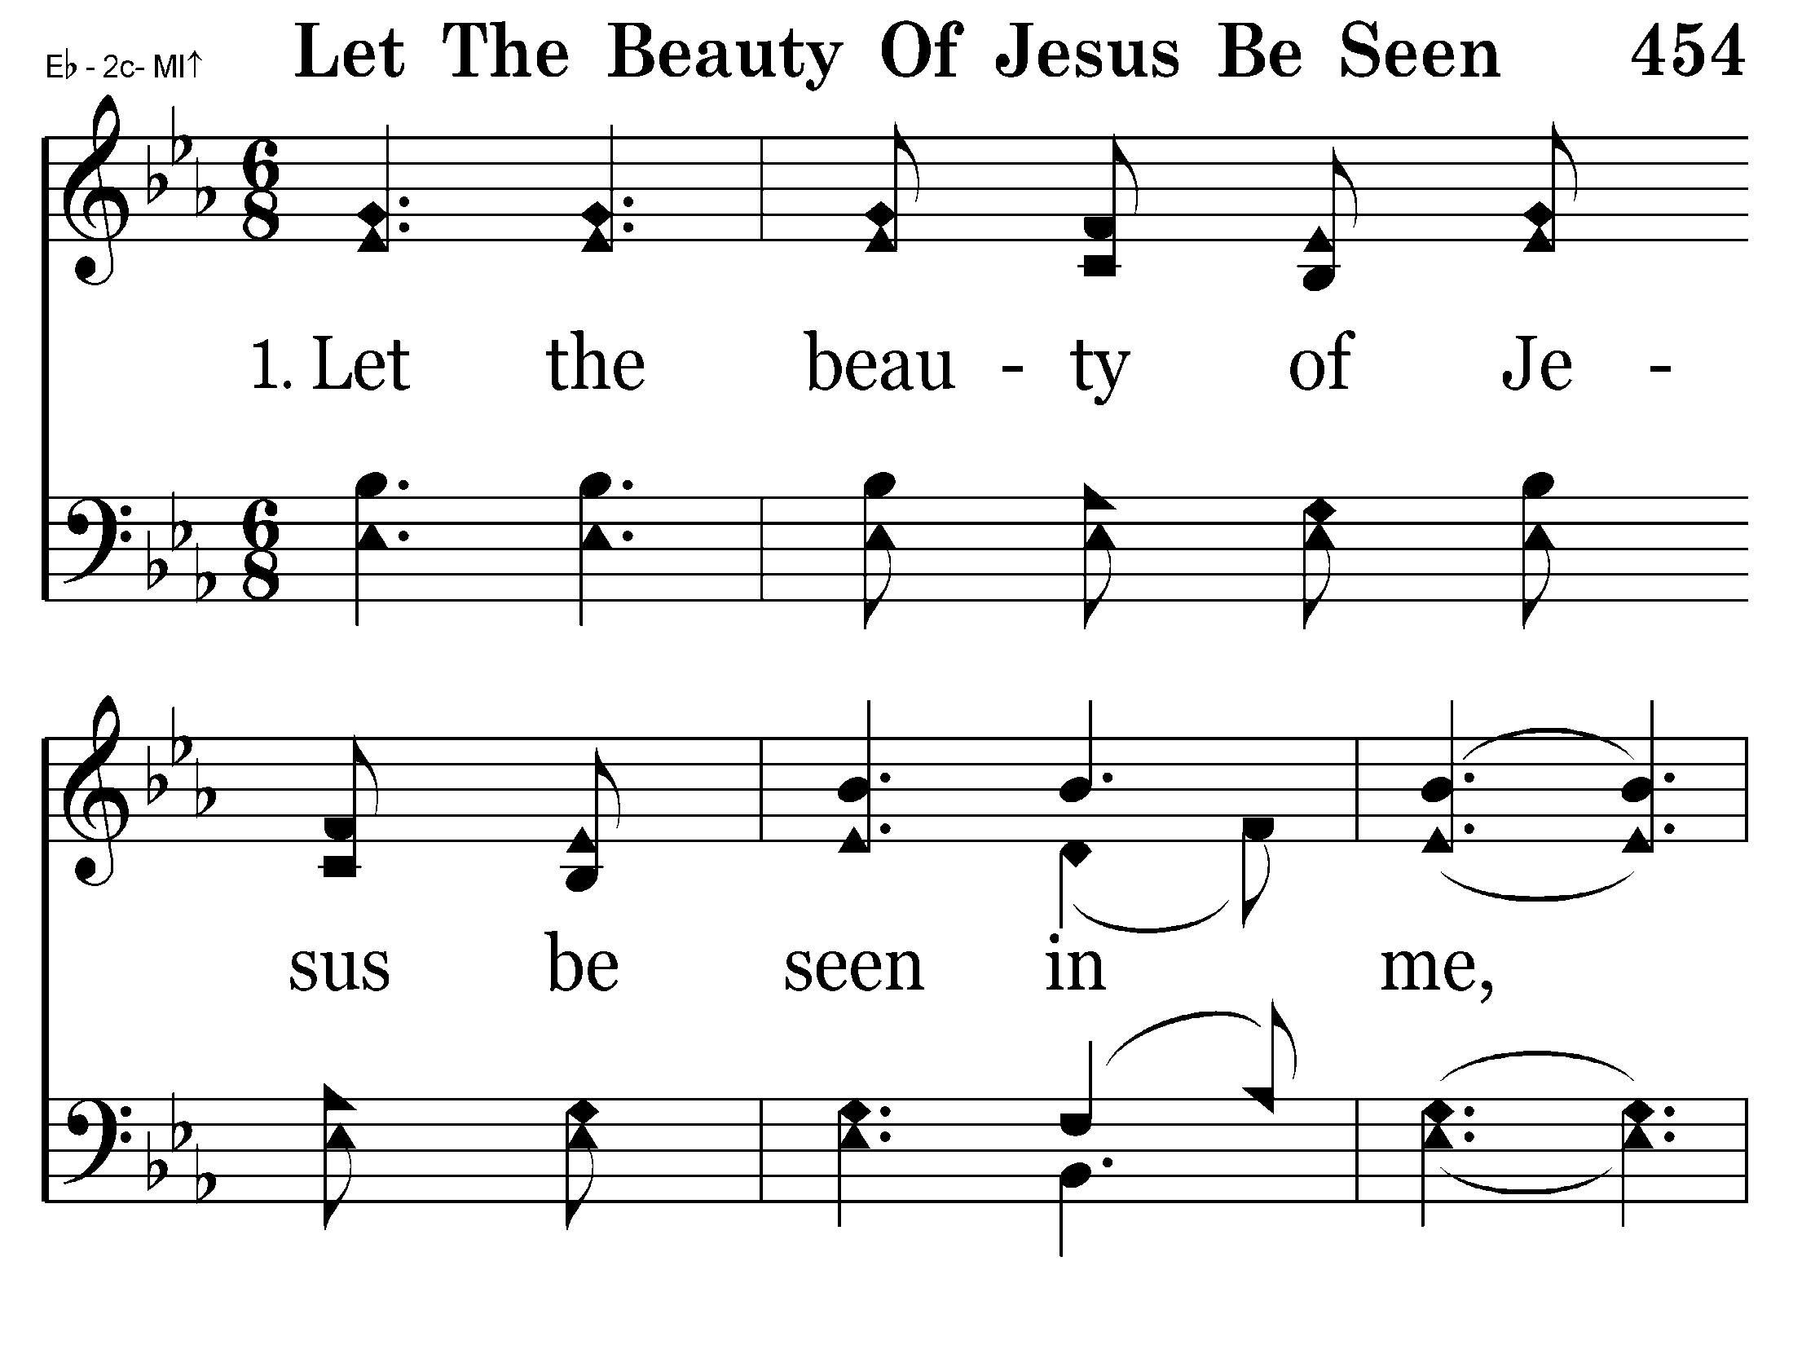
454 - Let The Beauty Of Jesus Be Seen - 1.1

Slide 81
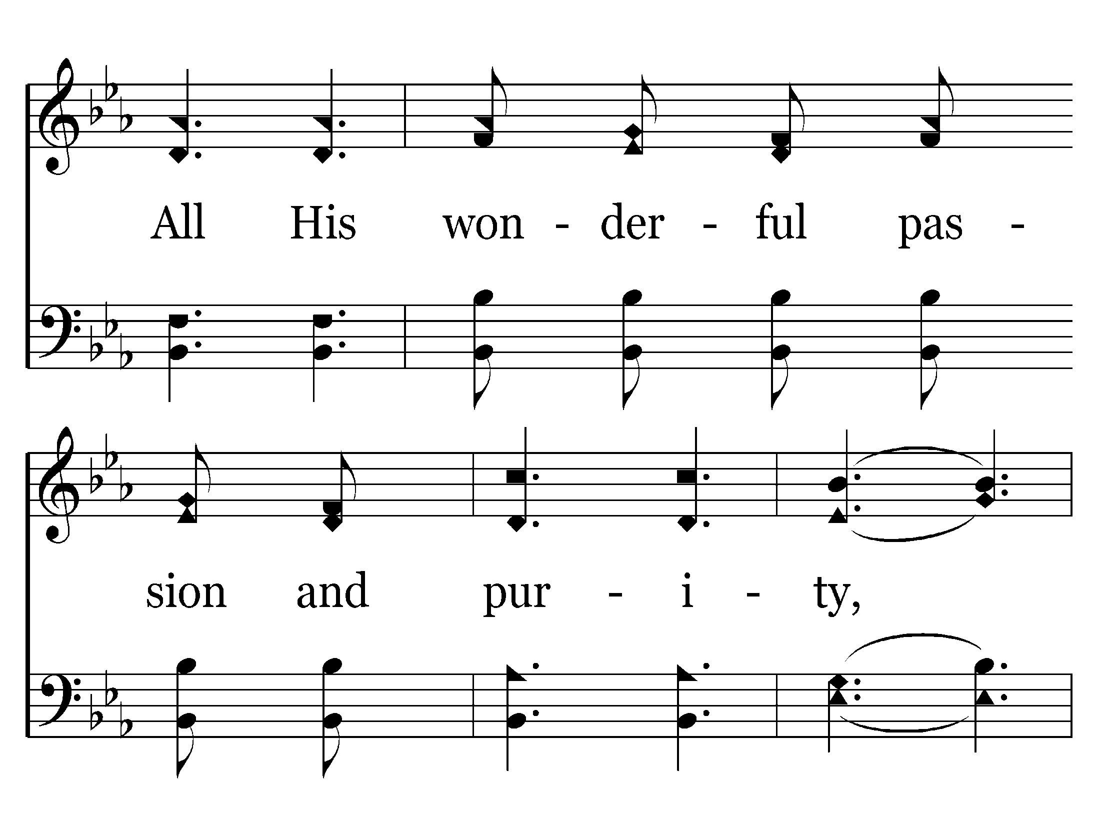
454 - Let The Beauty Of Jesus Be Seen - 1.2

Slide 82
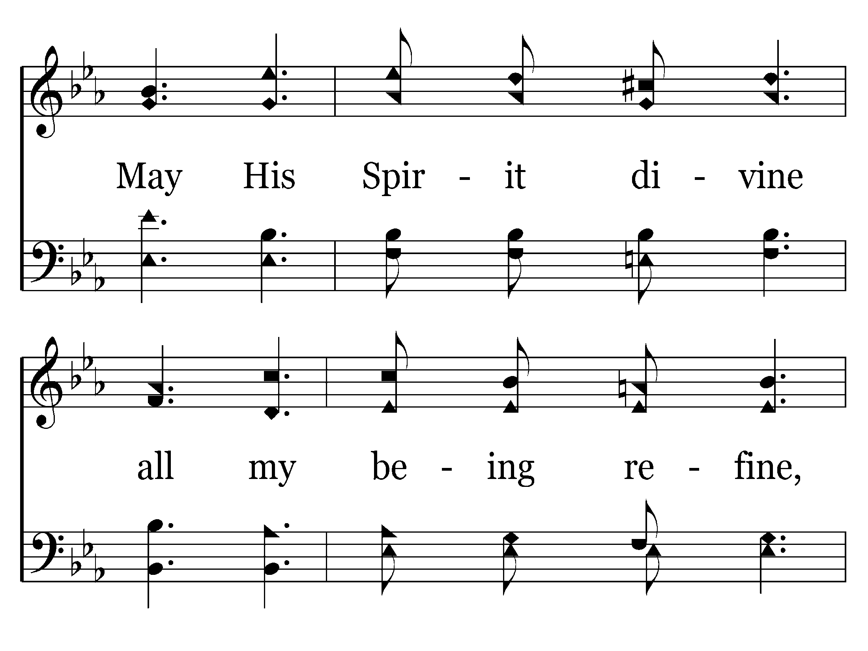
454 - Let The Beauty Of Jesus Be Seen - 1.3

Slide 83
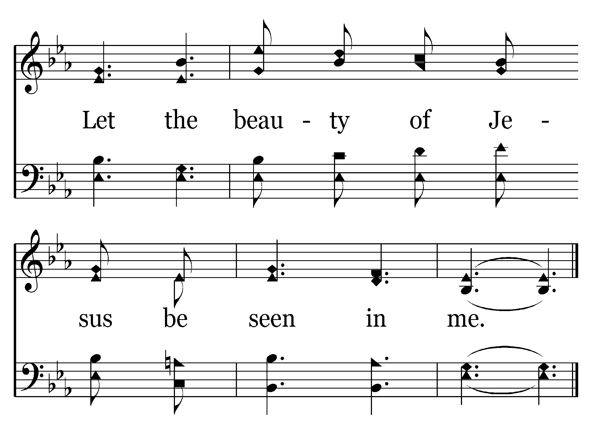
454 - Let The Beauty Of Jesus Be Seen - 1.4
End of Verse 1

Slide 84
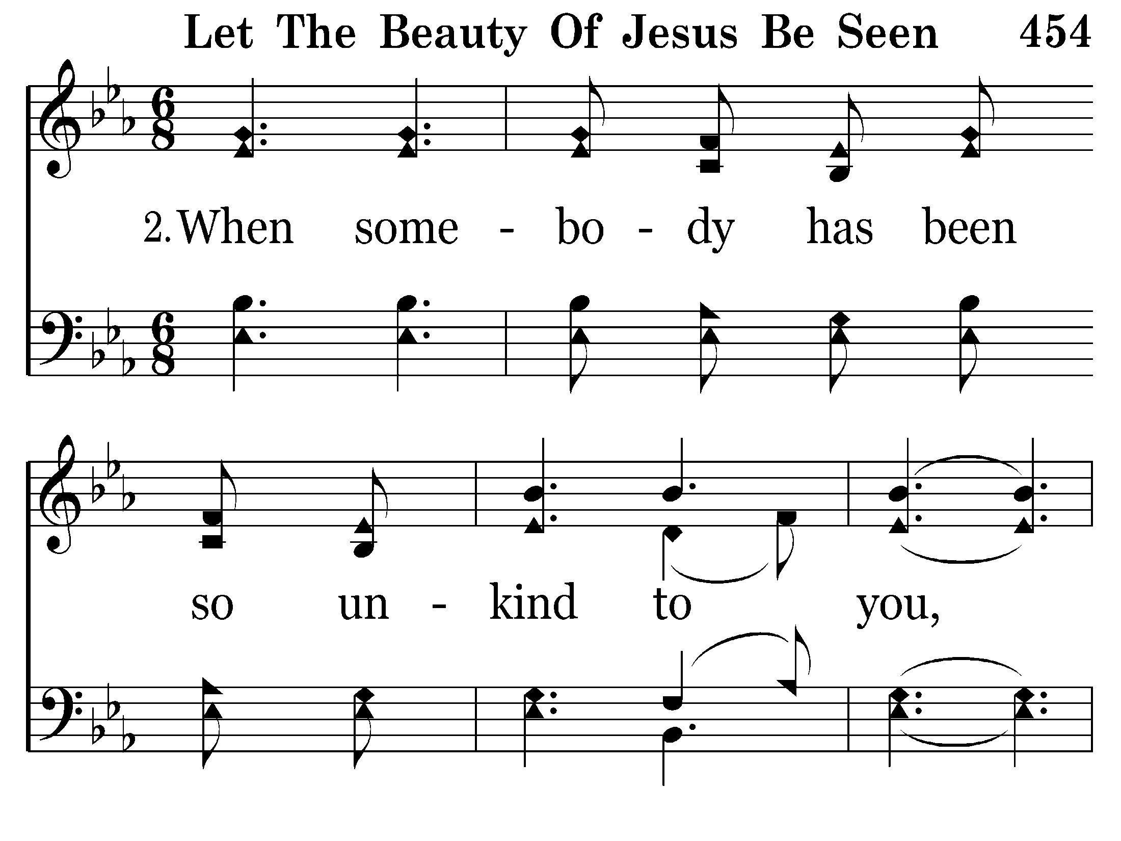
454 - Let The Beauty Of Jesus Be Seen - 2.1

Slide 85
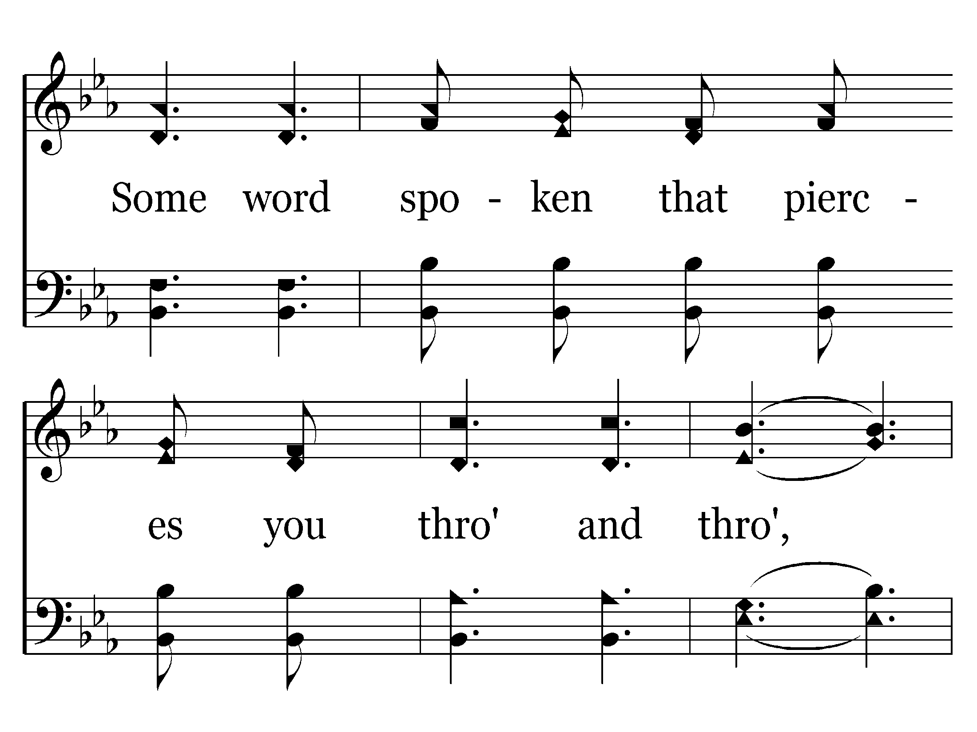
454 - Let The Beauty Of Jesus Be Seen - 2.2

Slide 86
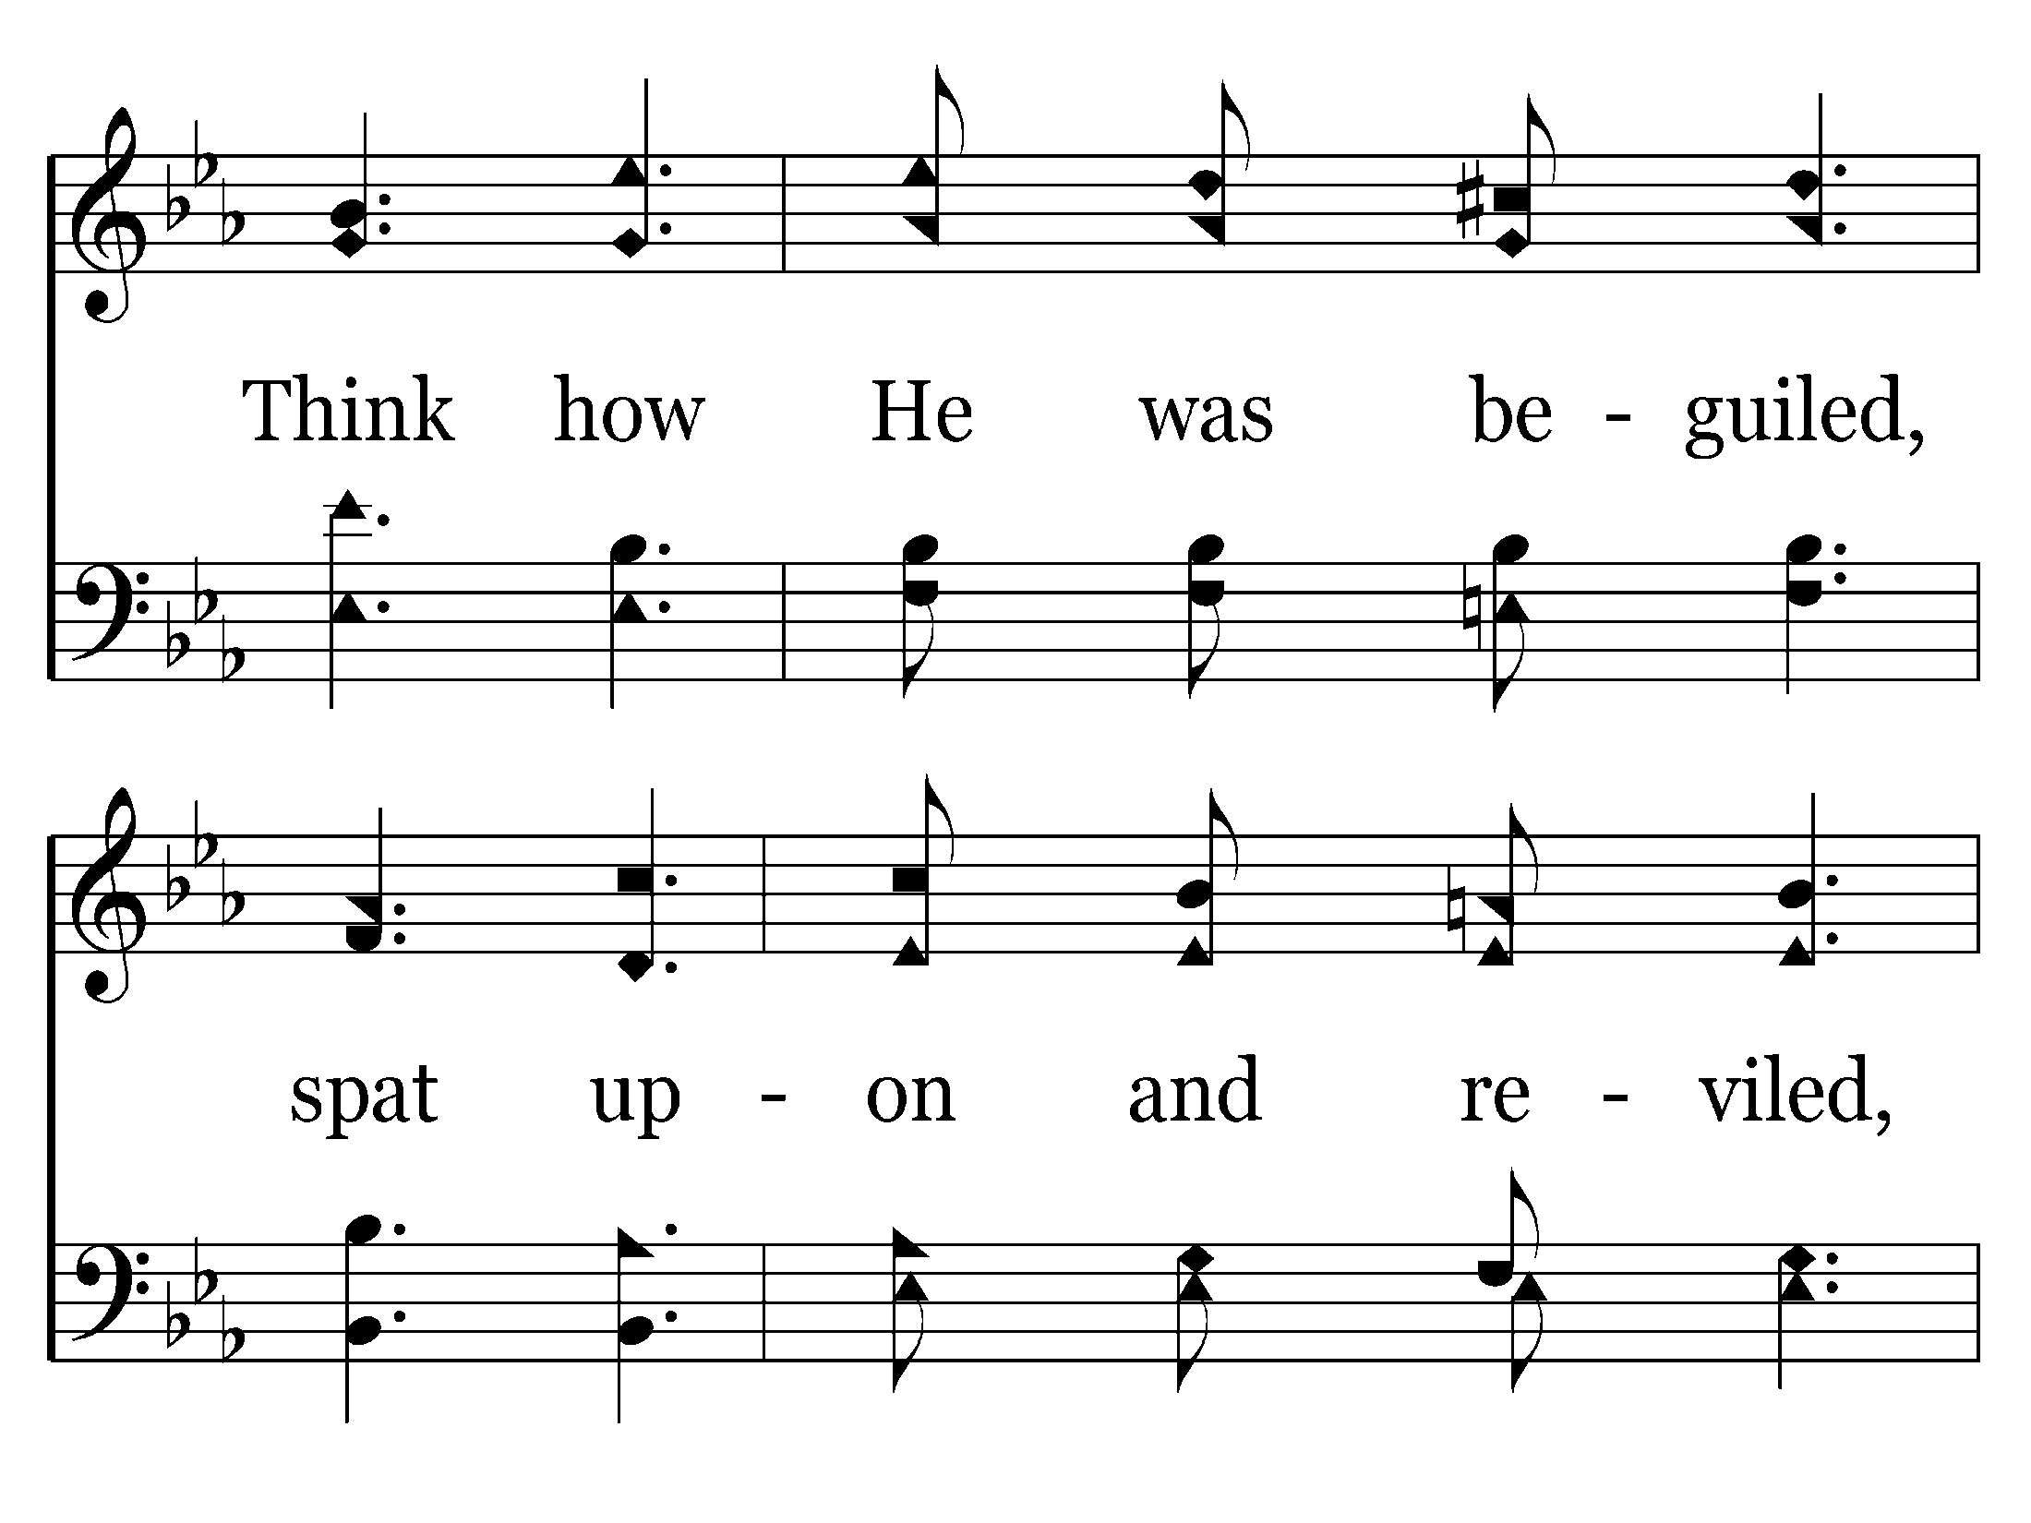
454 - Let The Beauty Of Jesus Be Seen - 2.3

Slide 87

454 - Let The Beauty Of Jesus Be Seen - 2.4
End of Verse 2

Slide 88
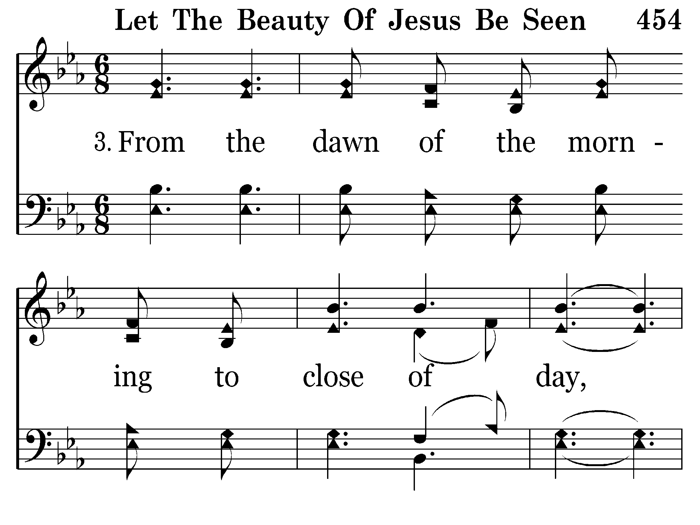
454 - Let The Beauty Of Jesus Be Seen - 3.1

Slide 89
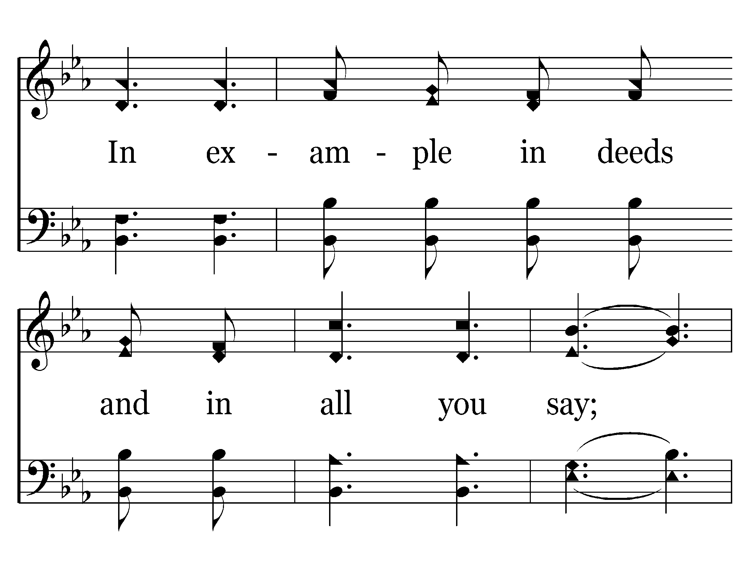
454 - Let The Beauty Of Jesus Be Seen - 3.2

Slide 90
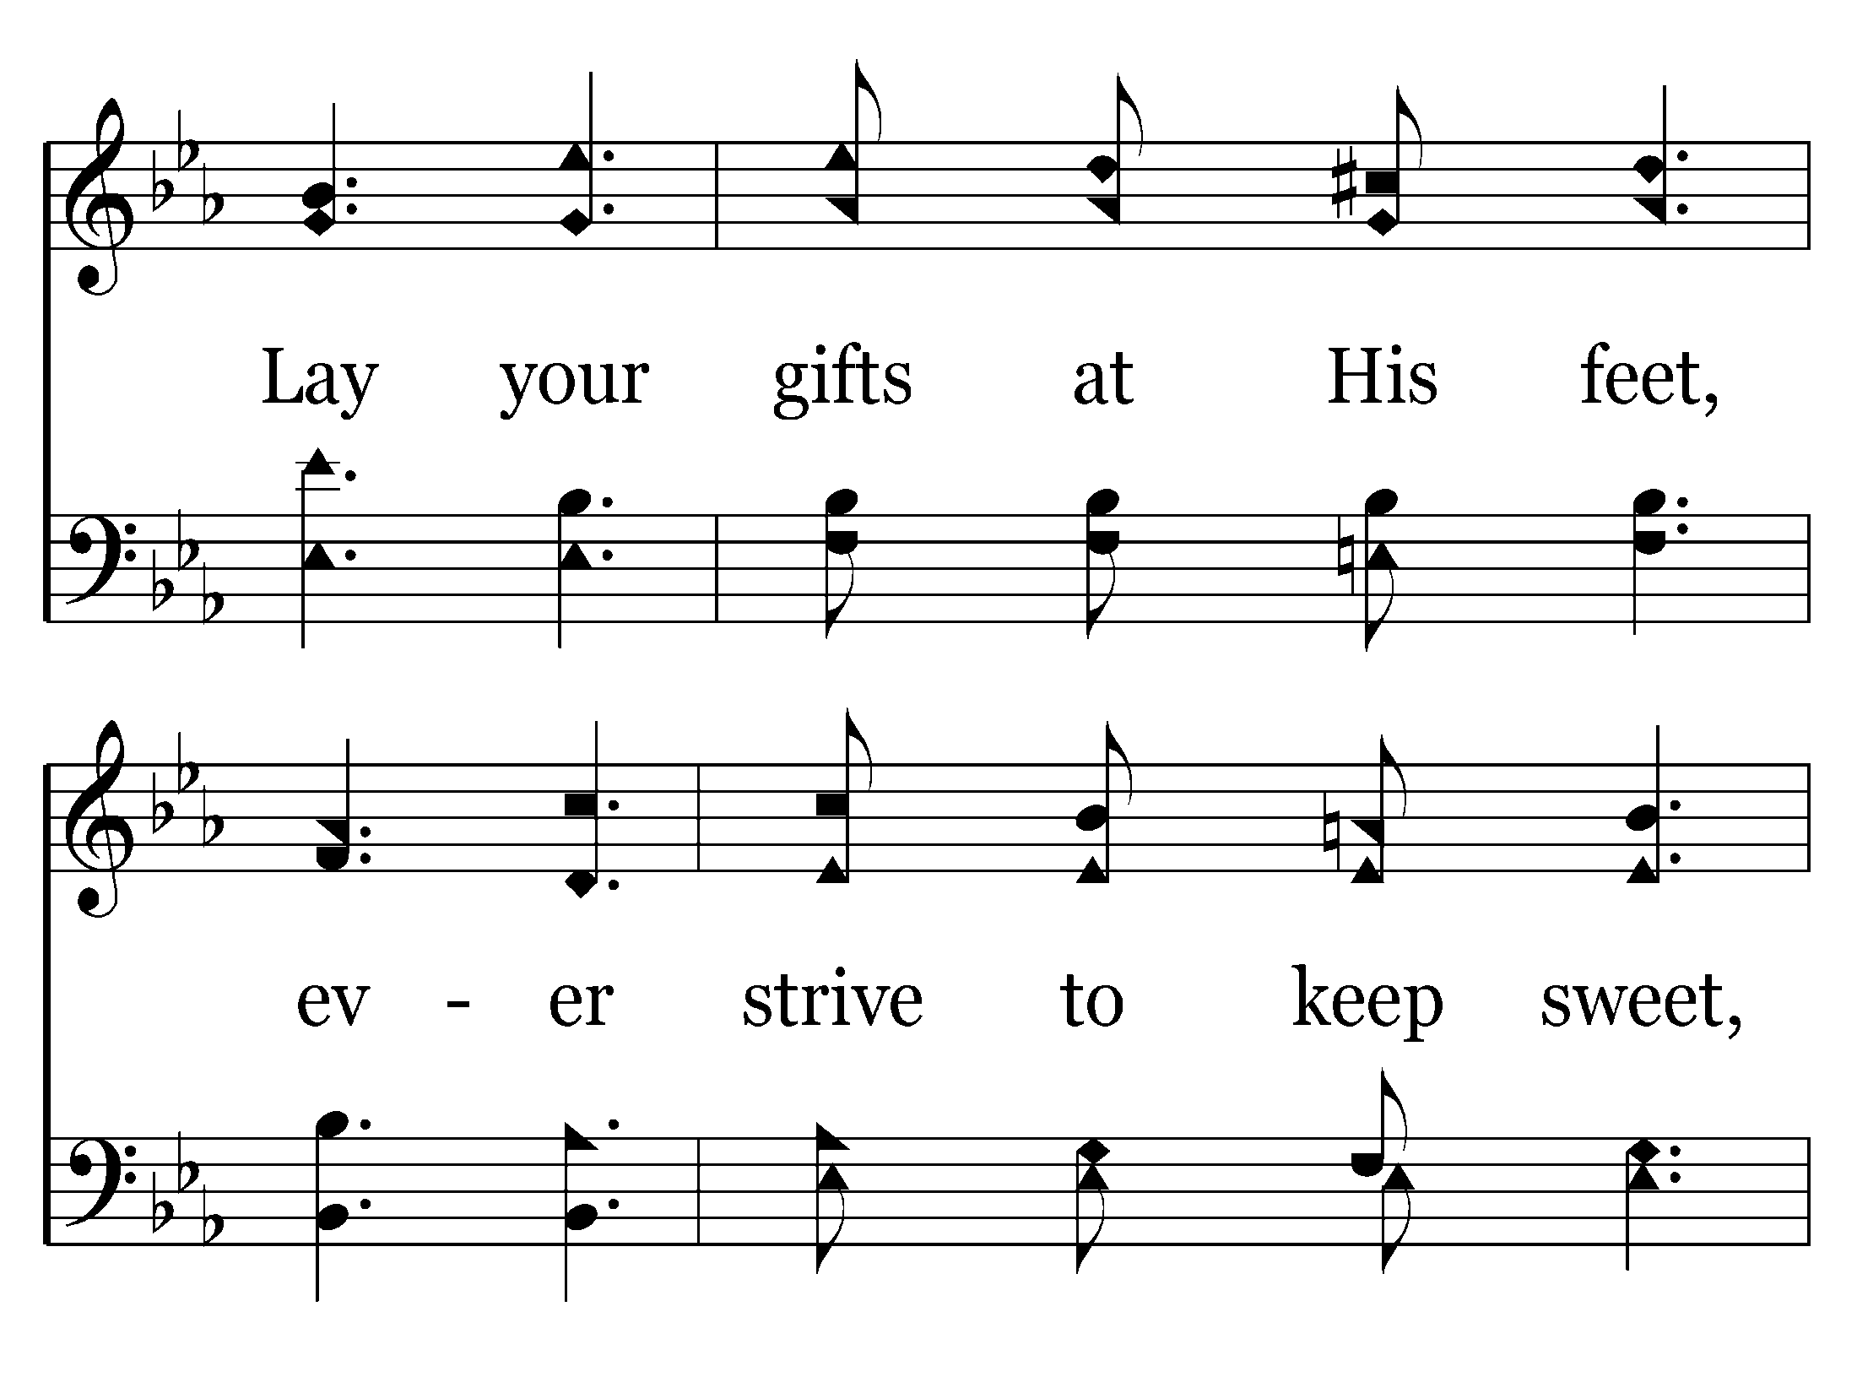
454 - Let The Beauty Of Jesus Be Seen - 3.3

Slide 91
454 - Let The Beauty Of Jesus Be Seen - 3.4
End of Song

