Slide 2
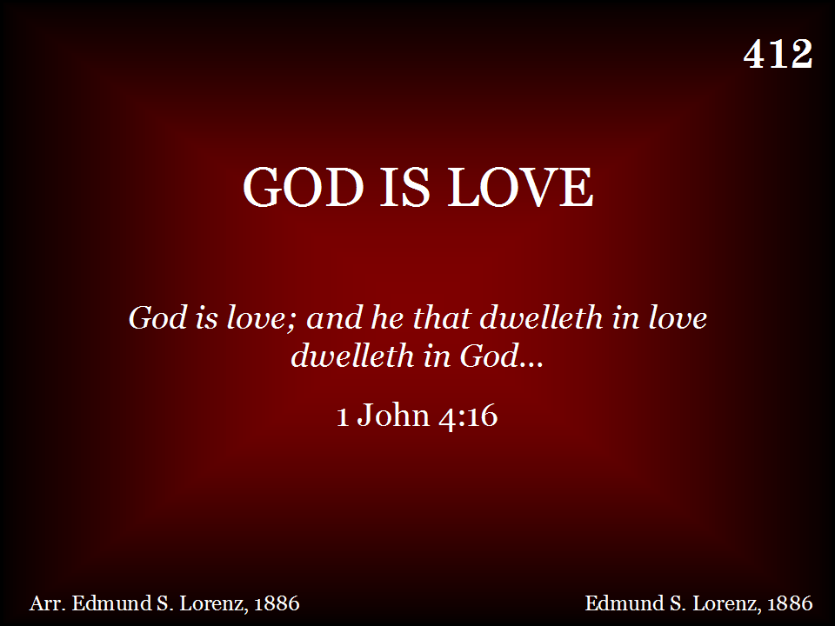
412 - GOD IS LOVE – TITLE

Slide 3
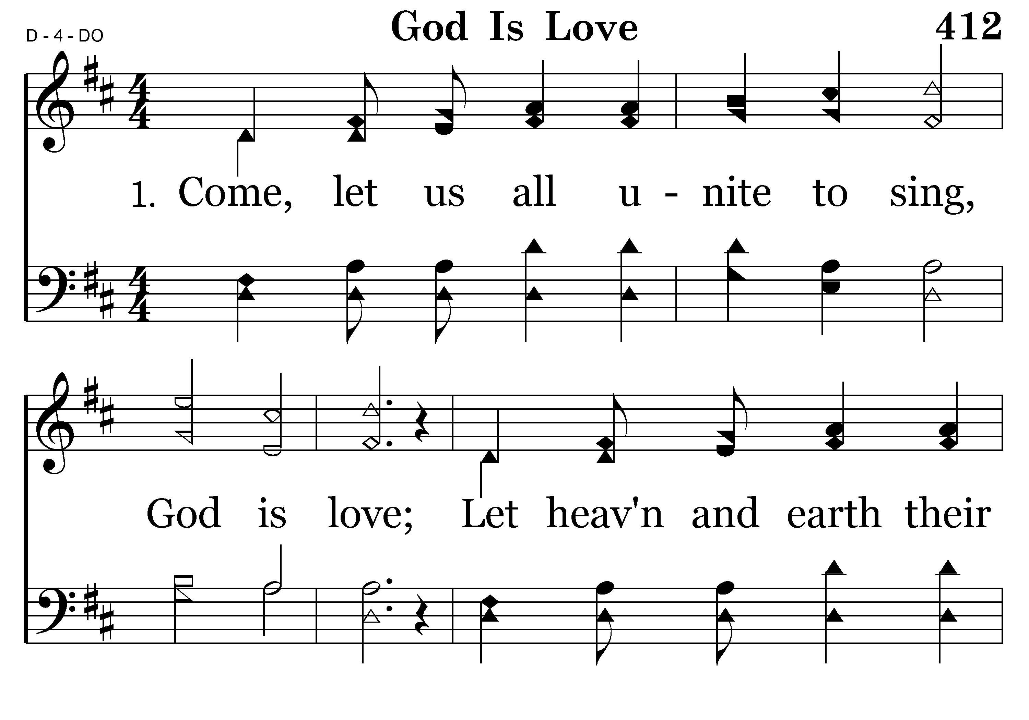
412 - GOD IS LOVE – 1.1

Slide 4
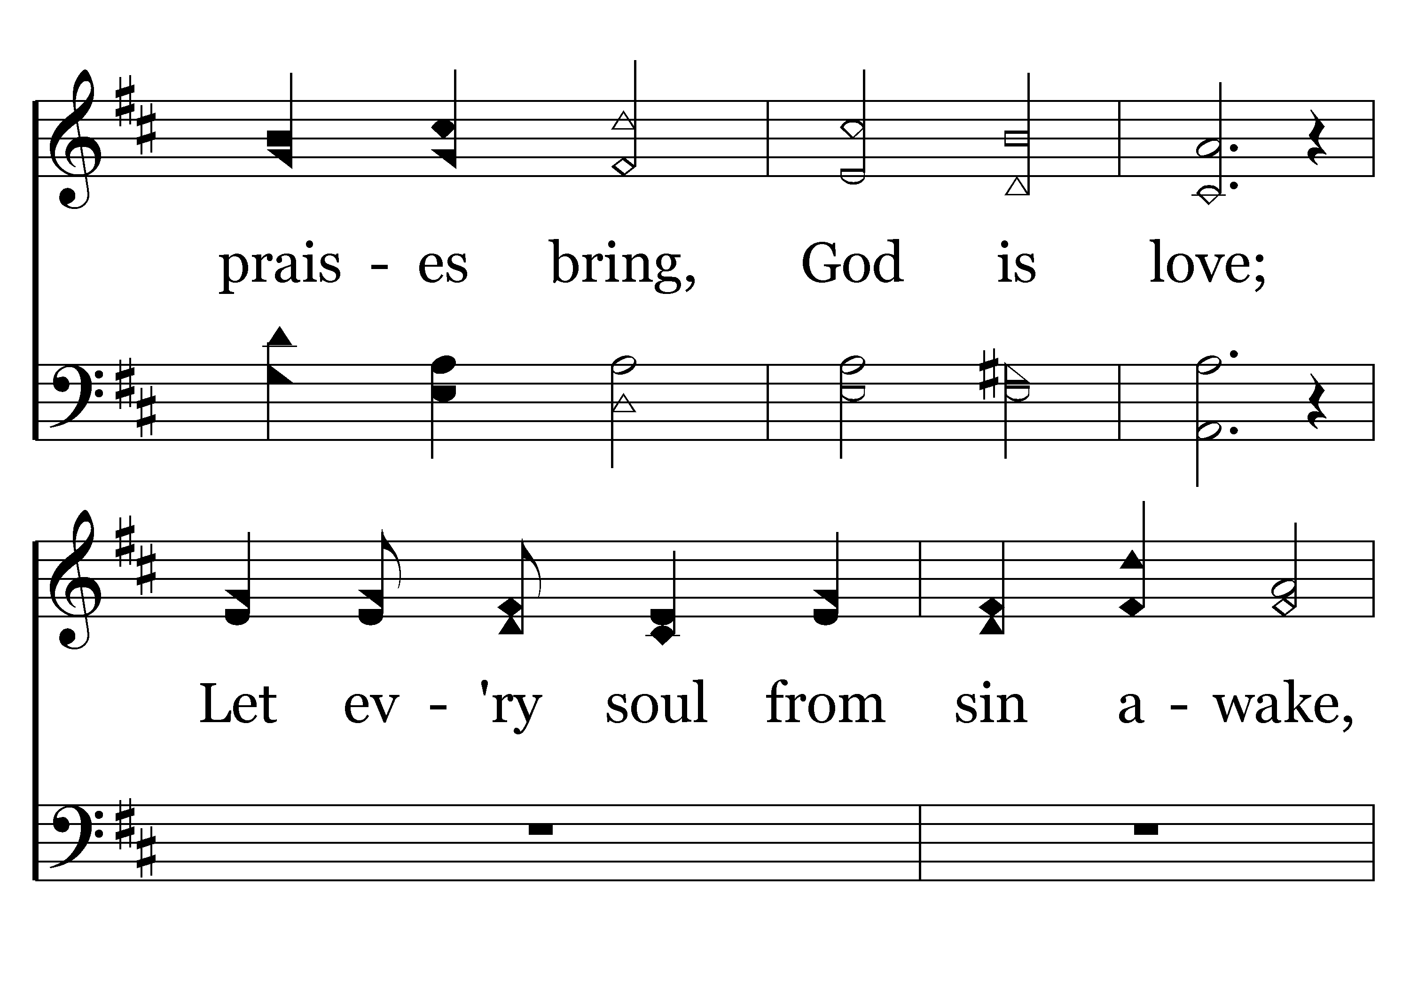
412 - GOD IS LOVE – 1.2

Slide 5
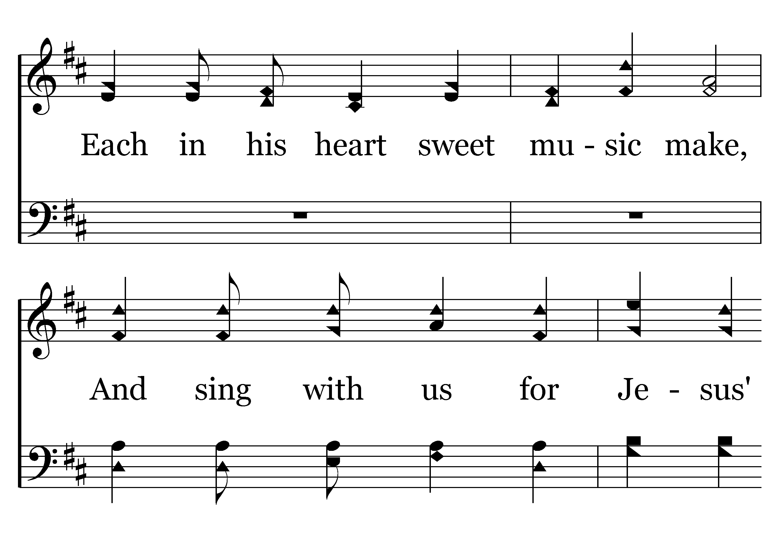
412 - GOD IS LOVE – 1.3

Slide 6
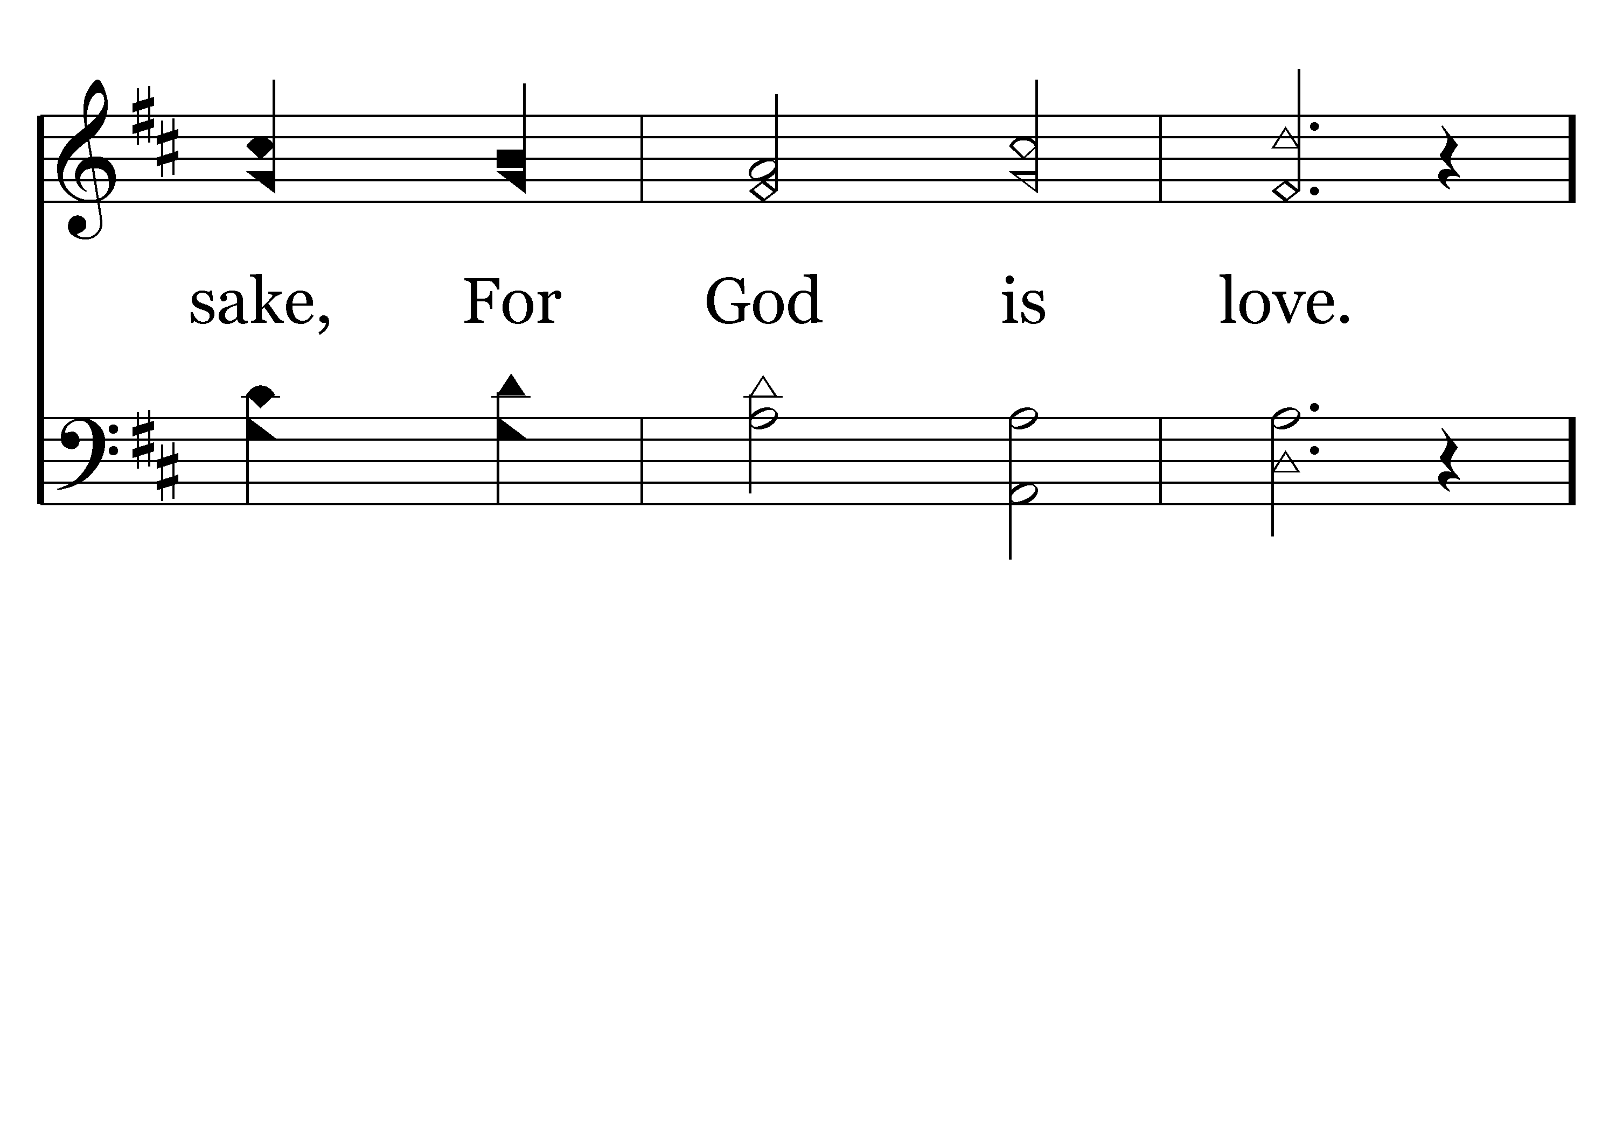
412 - GOD IS LOVE – 1.4

Slide 7
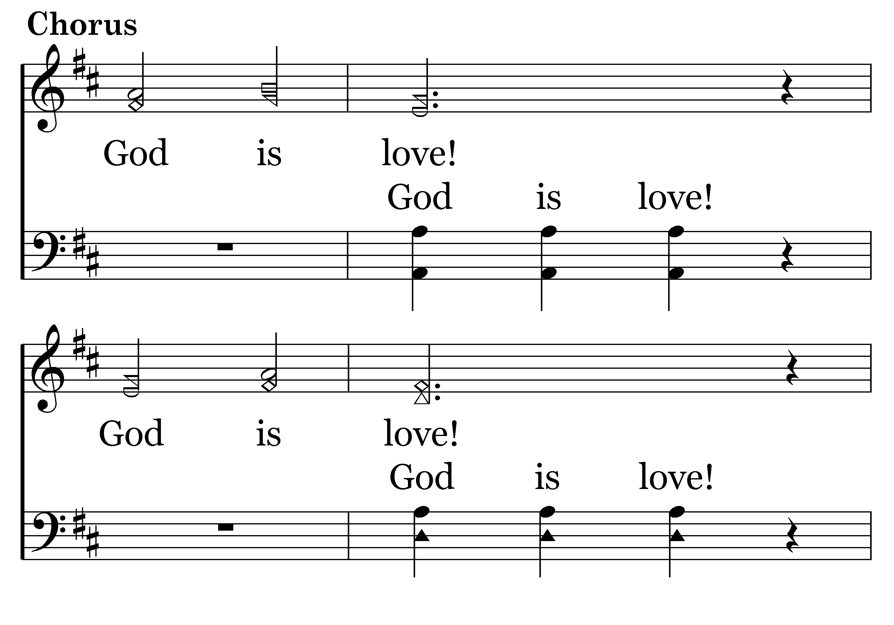
412 - GOD IS LOVE – 1.5-C1

Slide 8
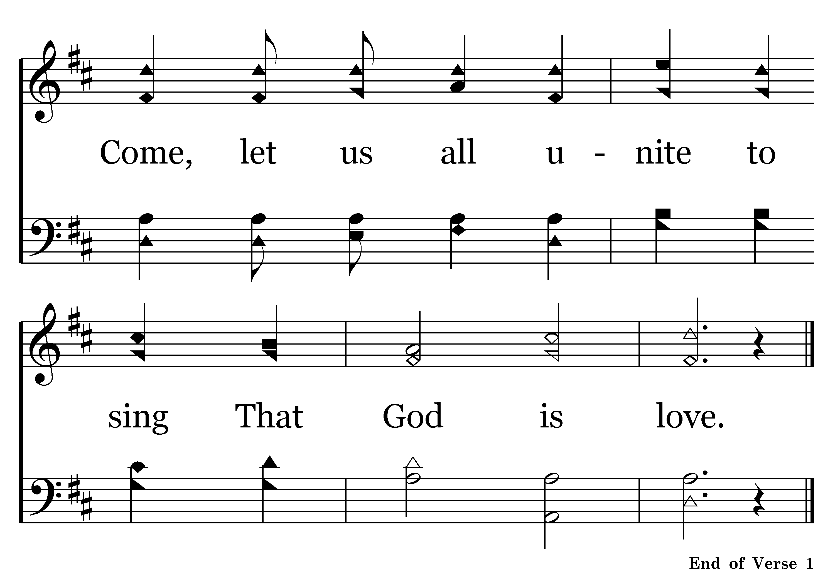
412 - GOD IS LOVE – 1.6-C2

Slide 9
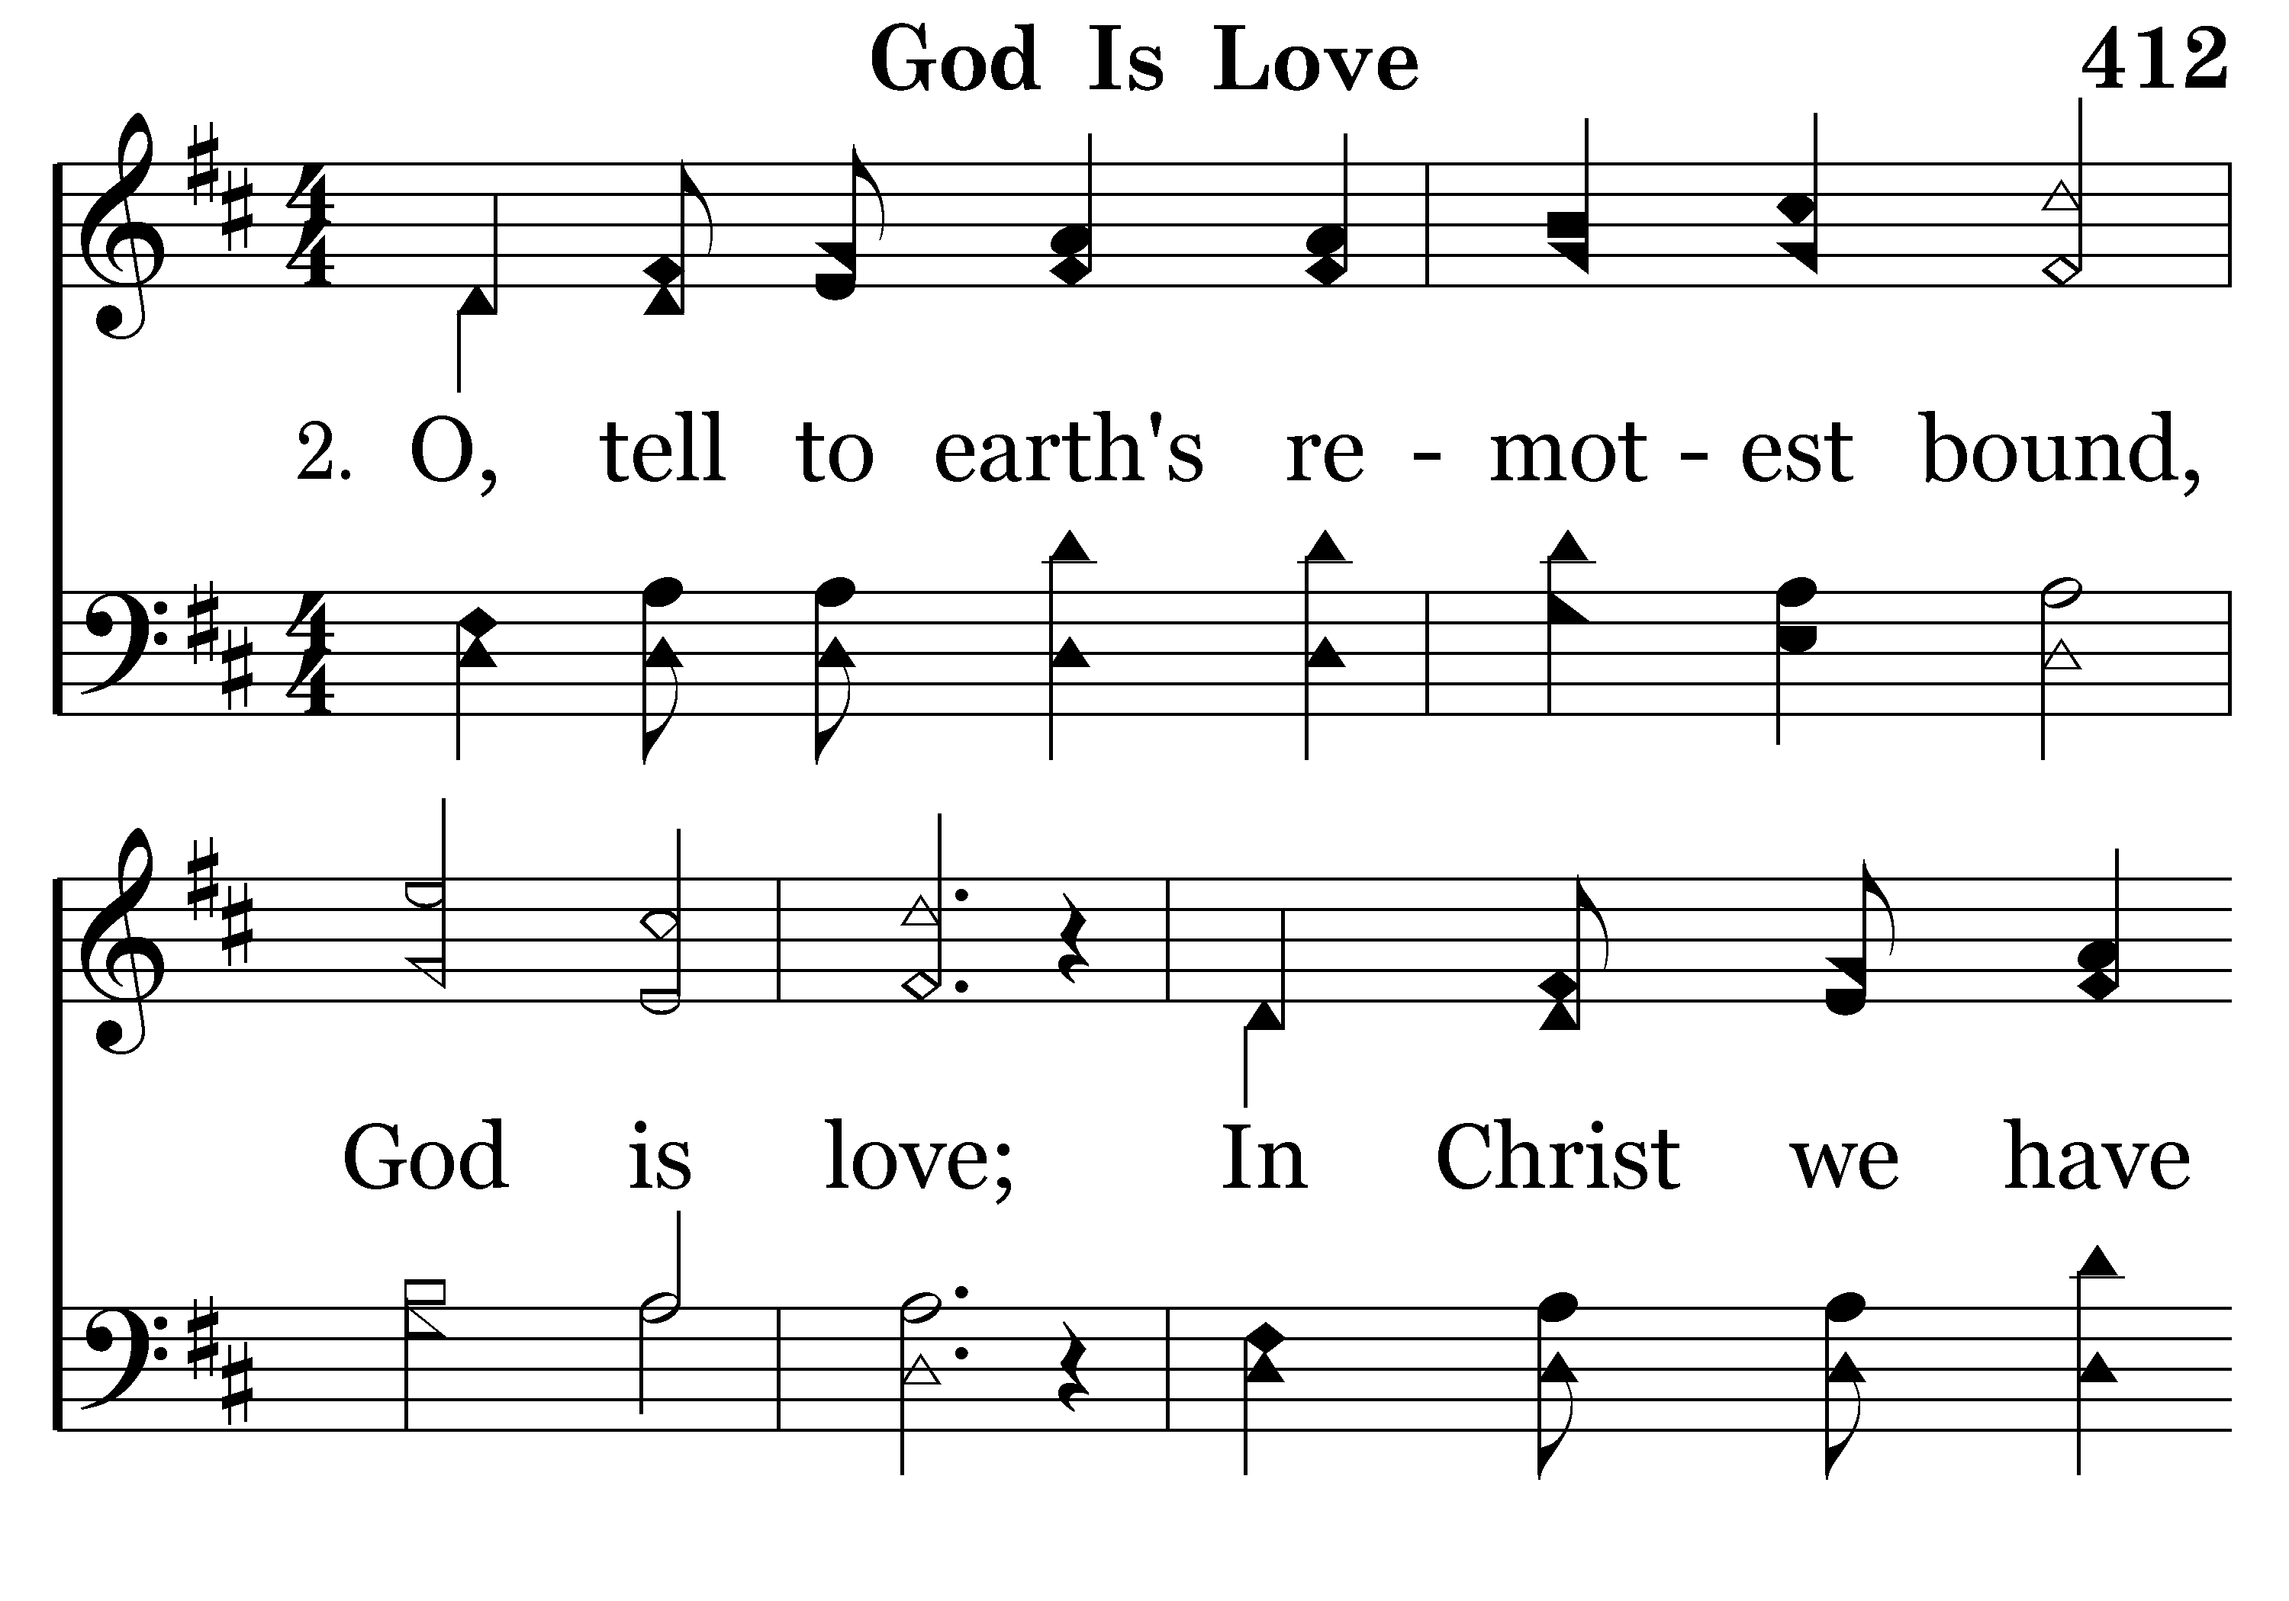
412 - GOD IS LOVE – 2.1

Slide 10
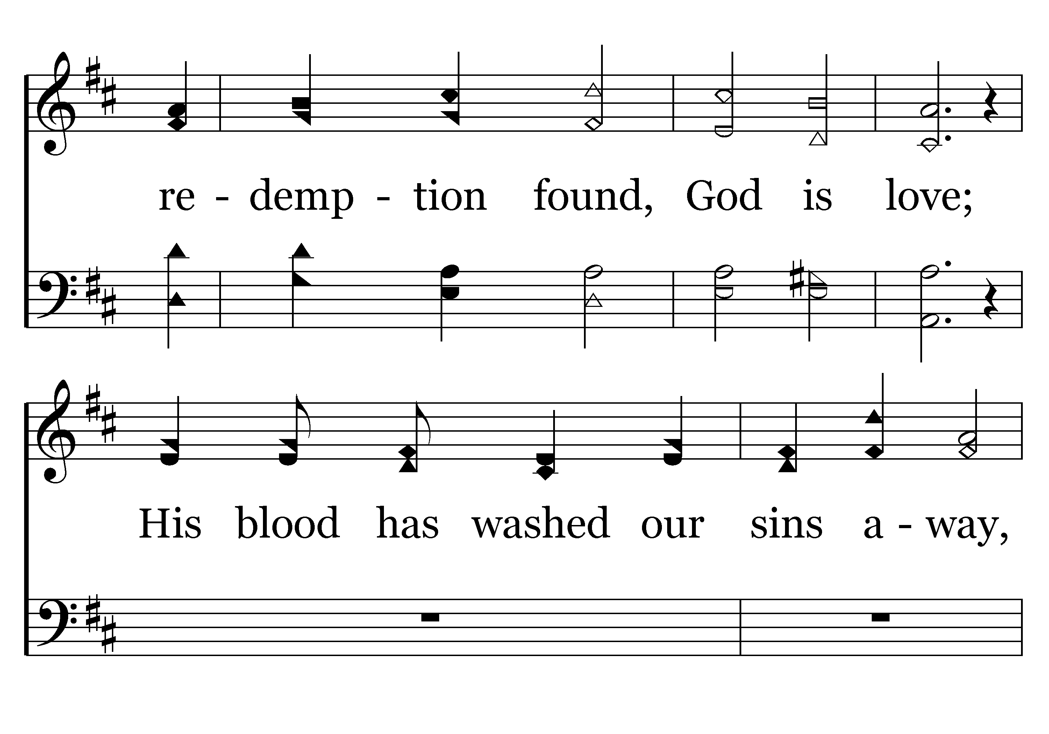
412 - GOD IS LOVE – 2.2

Slide 11
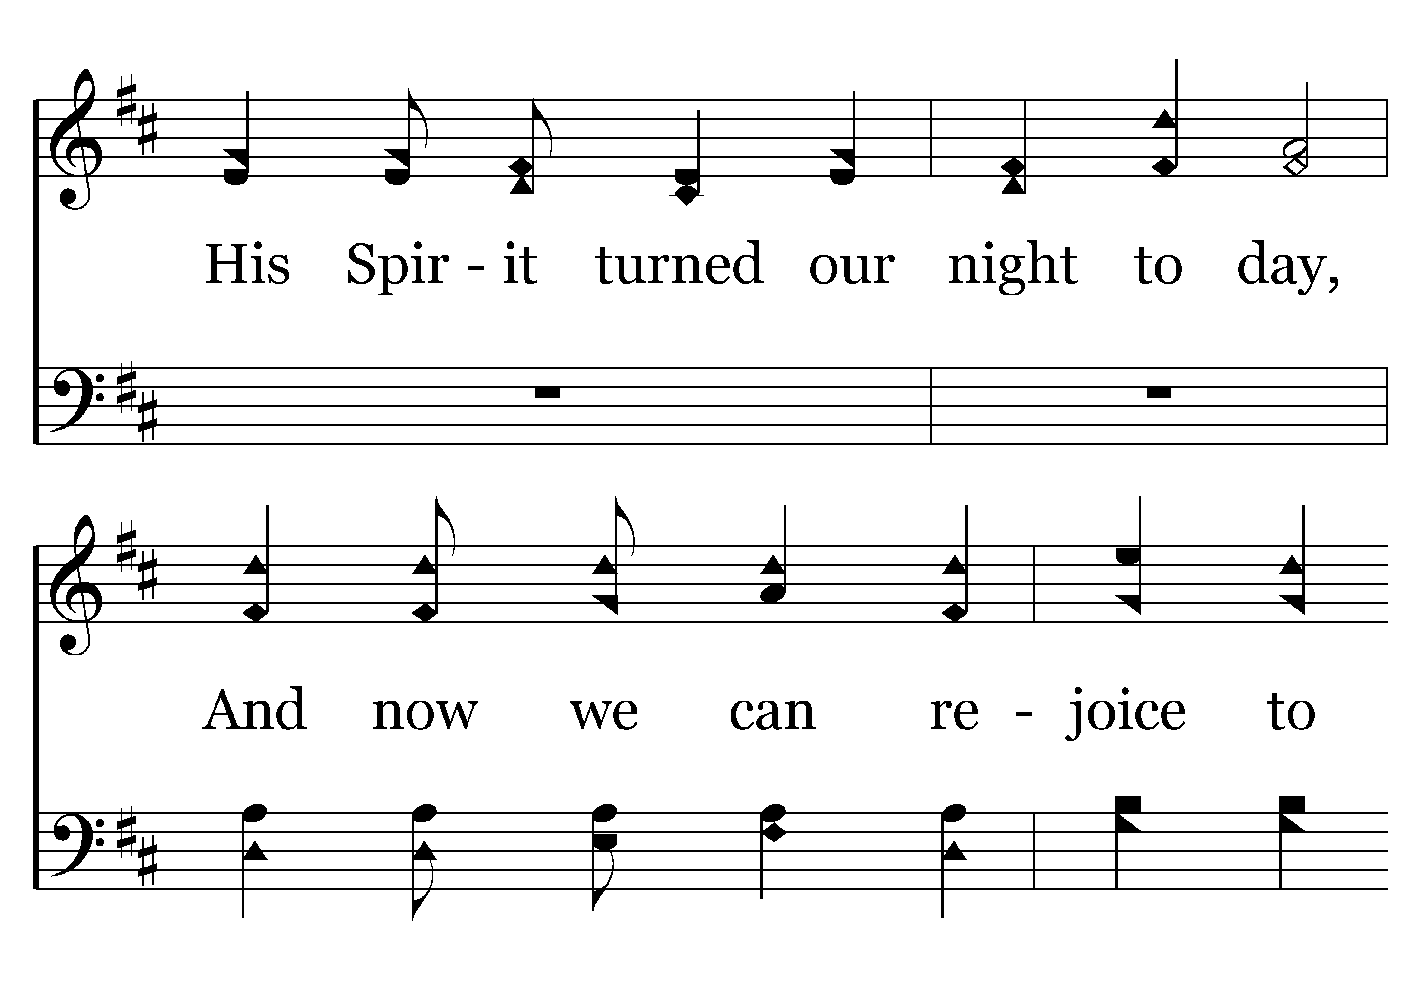
412 - GOD IS LOVE – 2.3

Slide 12
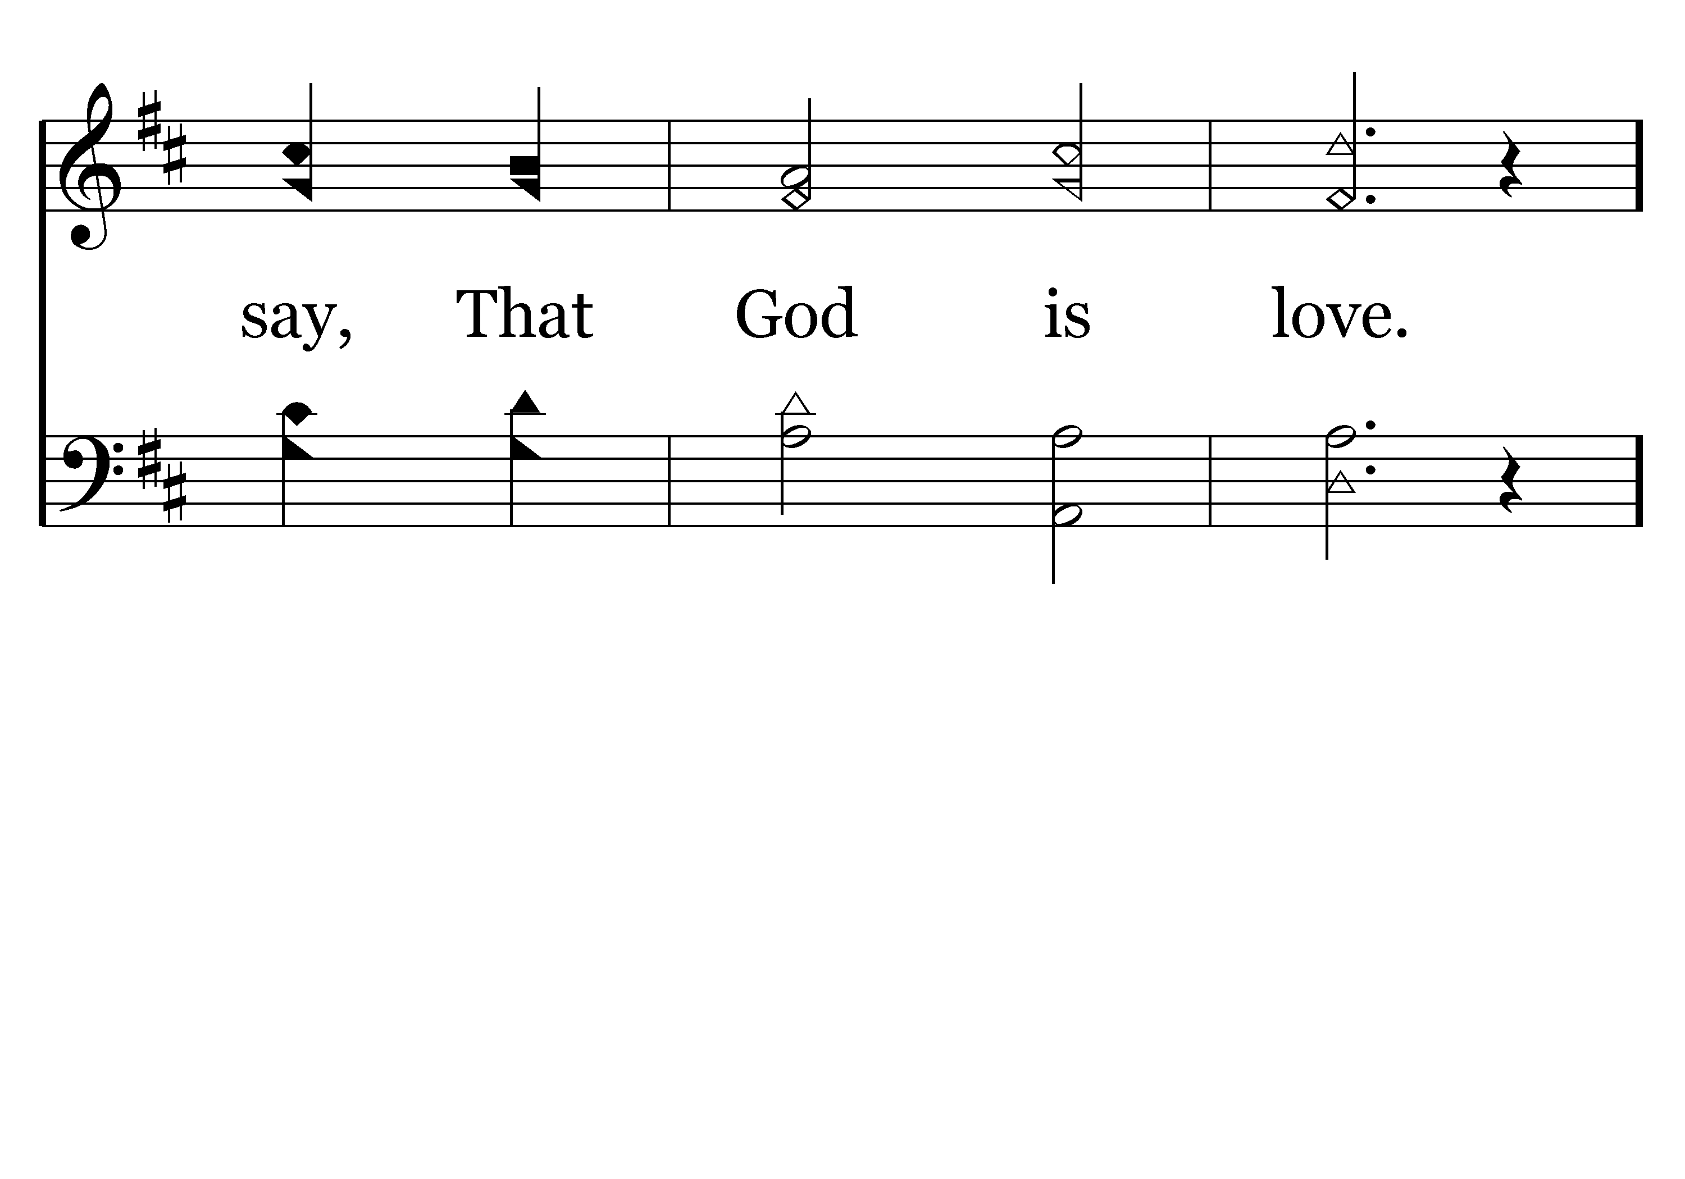
412 - GOD IS LOVE – 2.4

Slide 13
412 - GOD IS LOVE – 2.5-C1

Slide 14
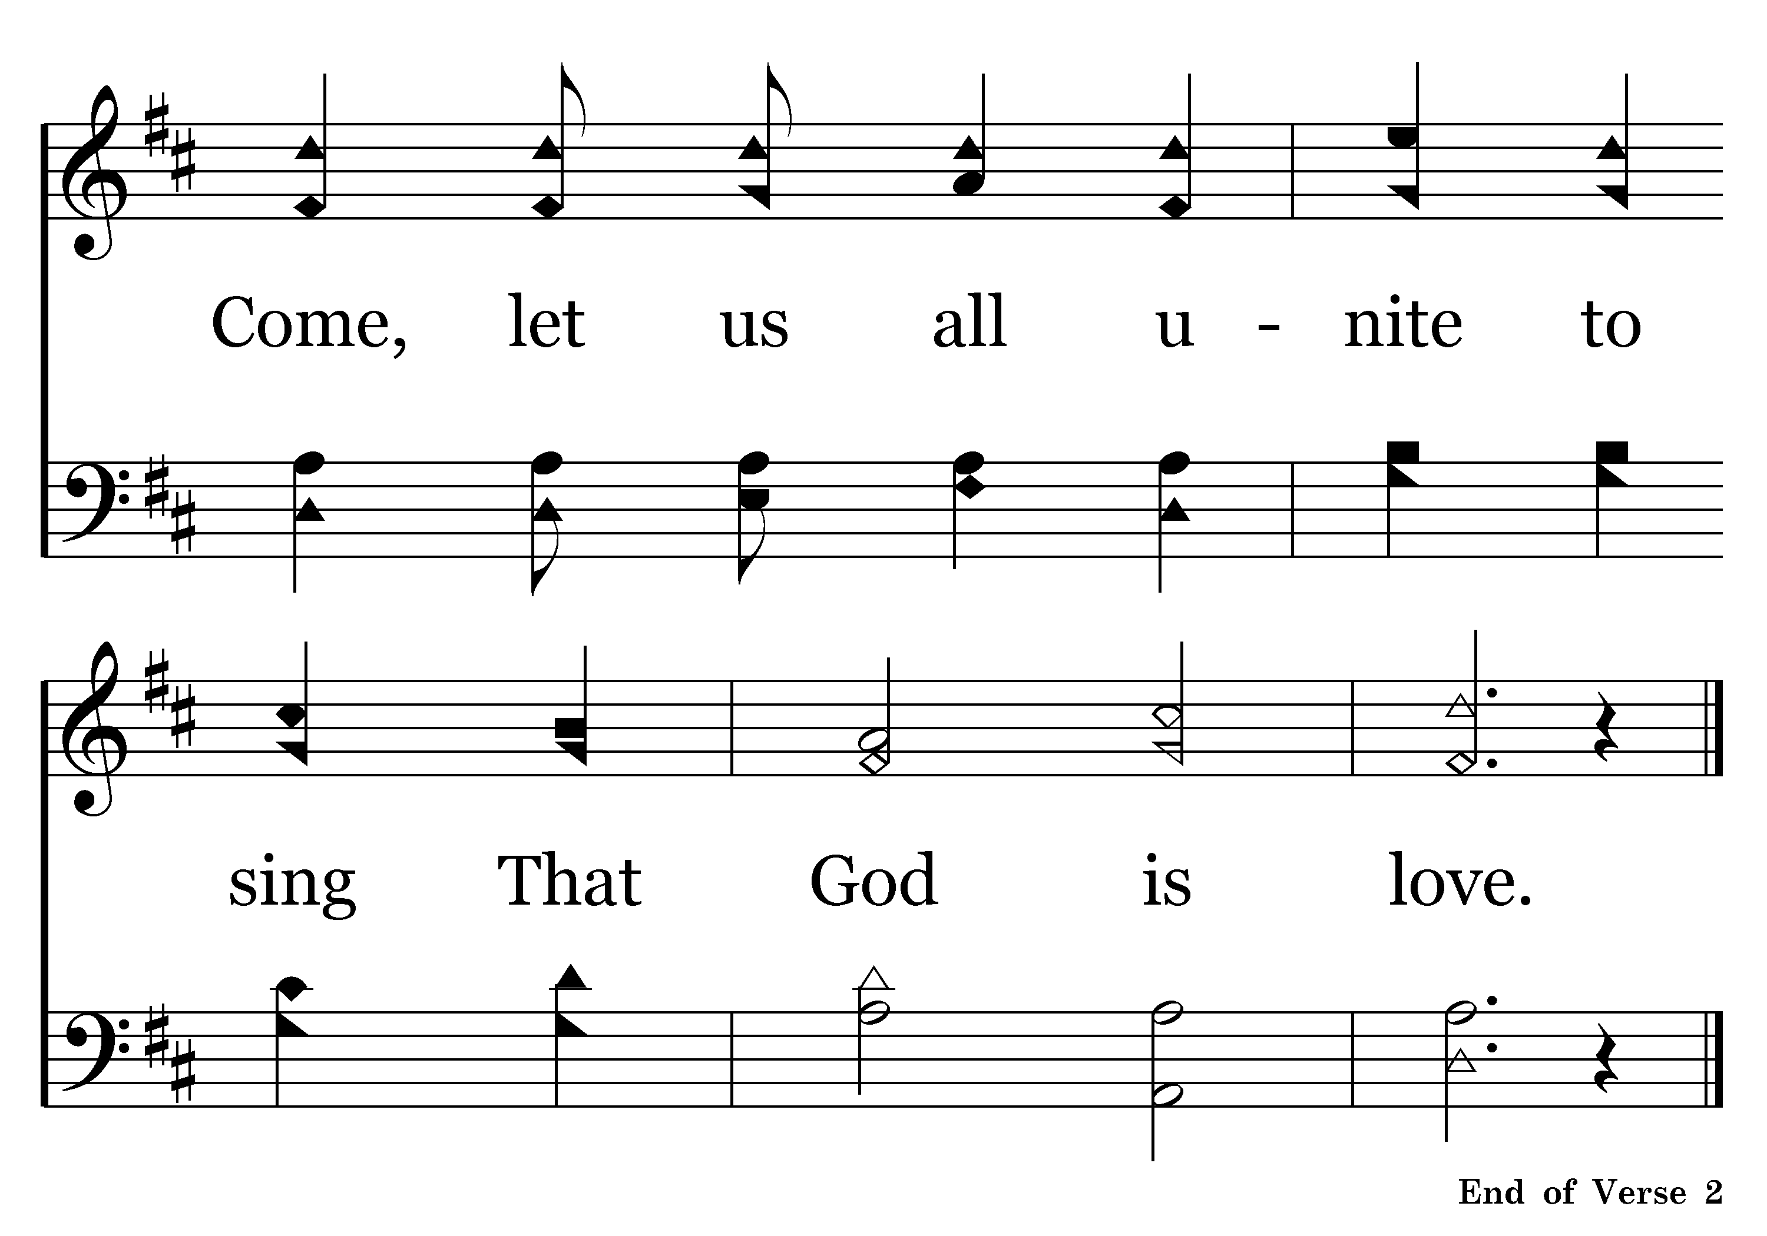
412 - GOD IS LOVE – 2.6-C2

Slide 15
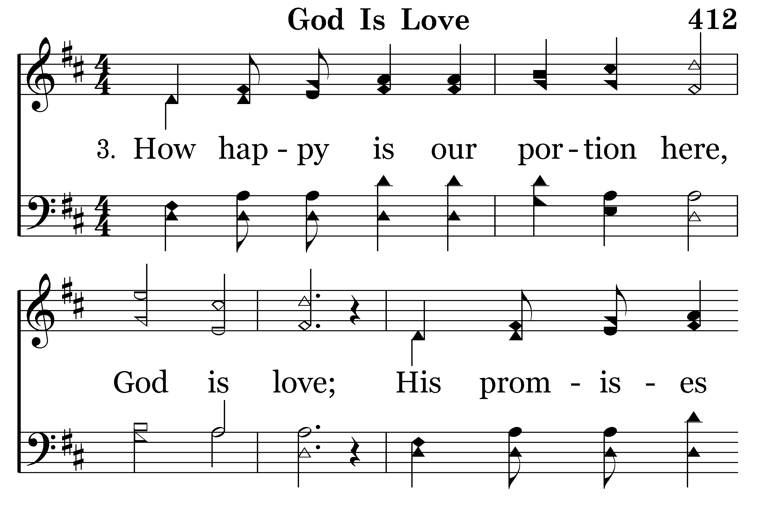
412 - GOD IS LOVE – 3.1

Slide 16
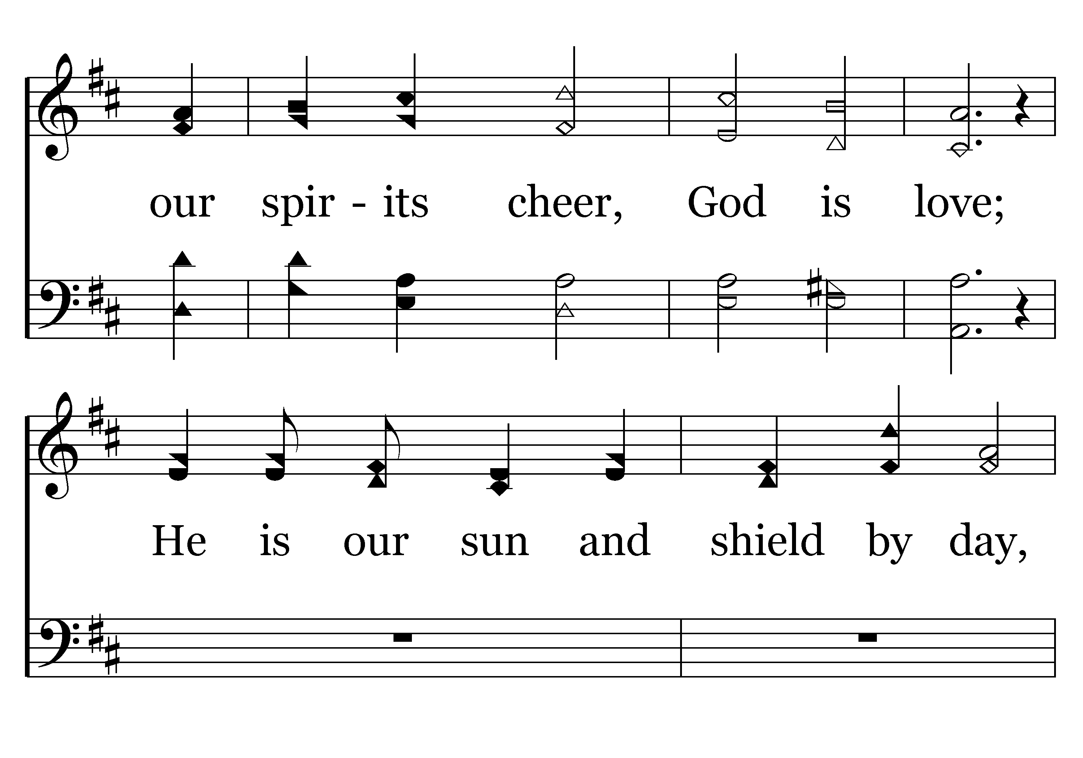
412 - GOD IS LOVE – 3.2

Slide 17
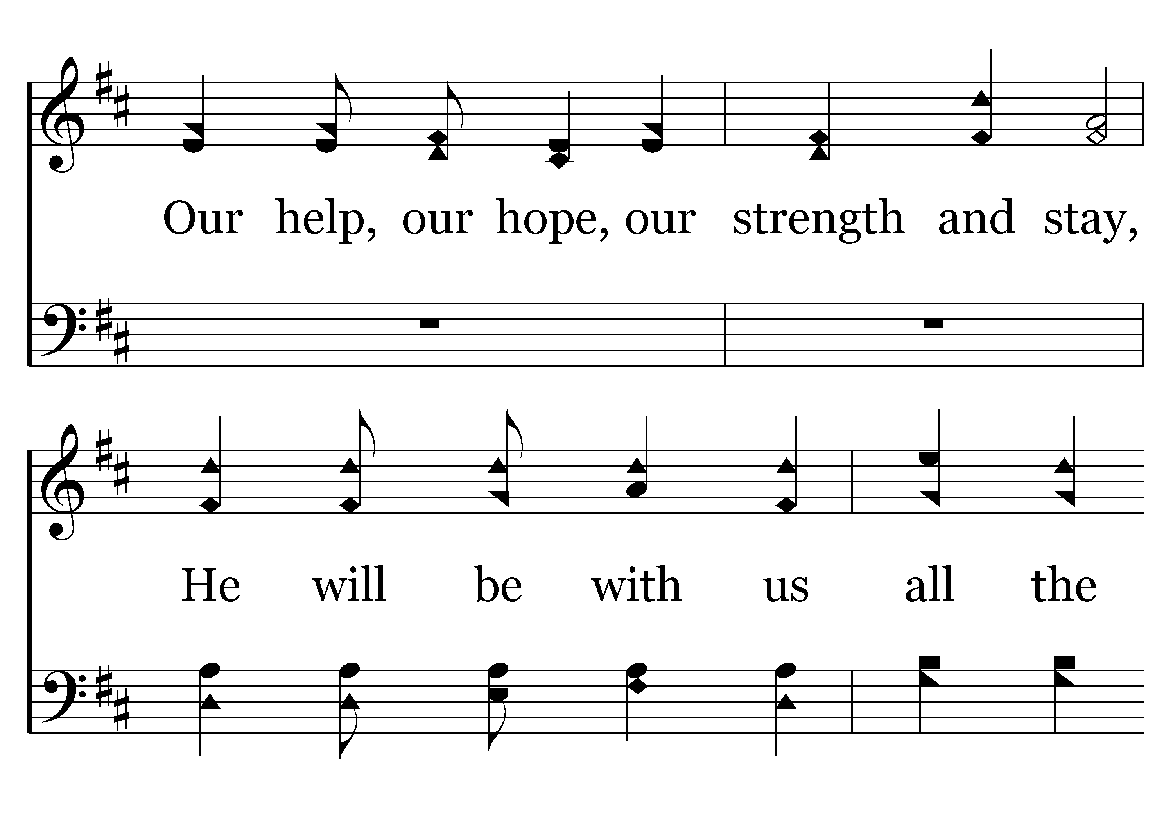
412 - GOD IS LOVE – 3.3

Slide 18
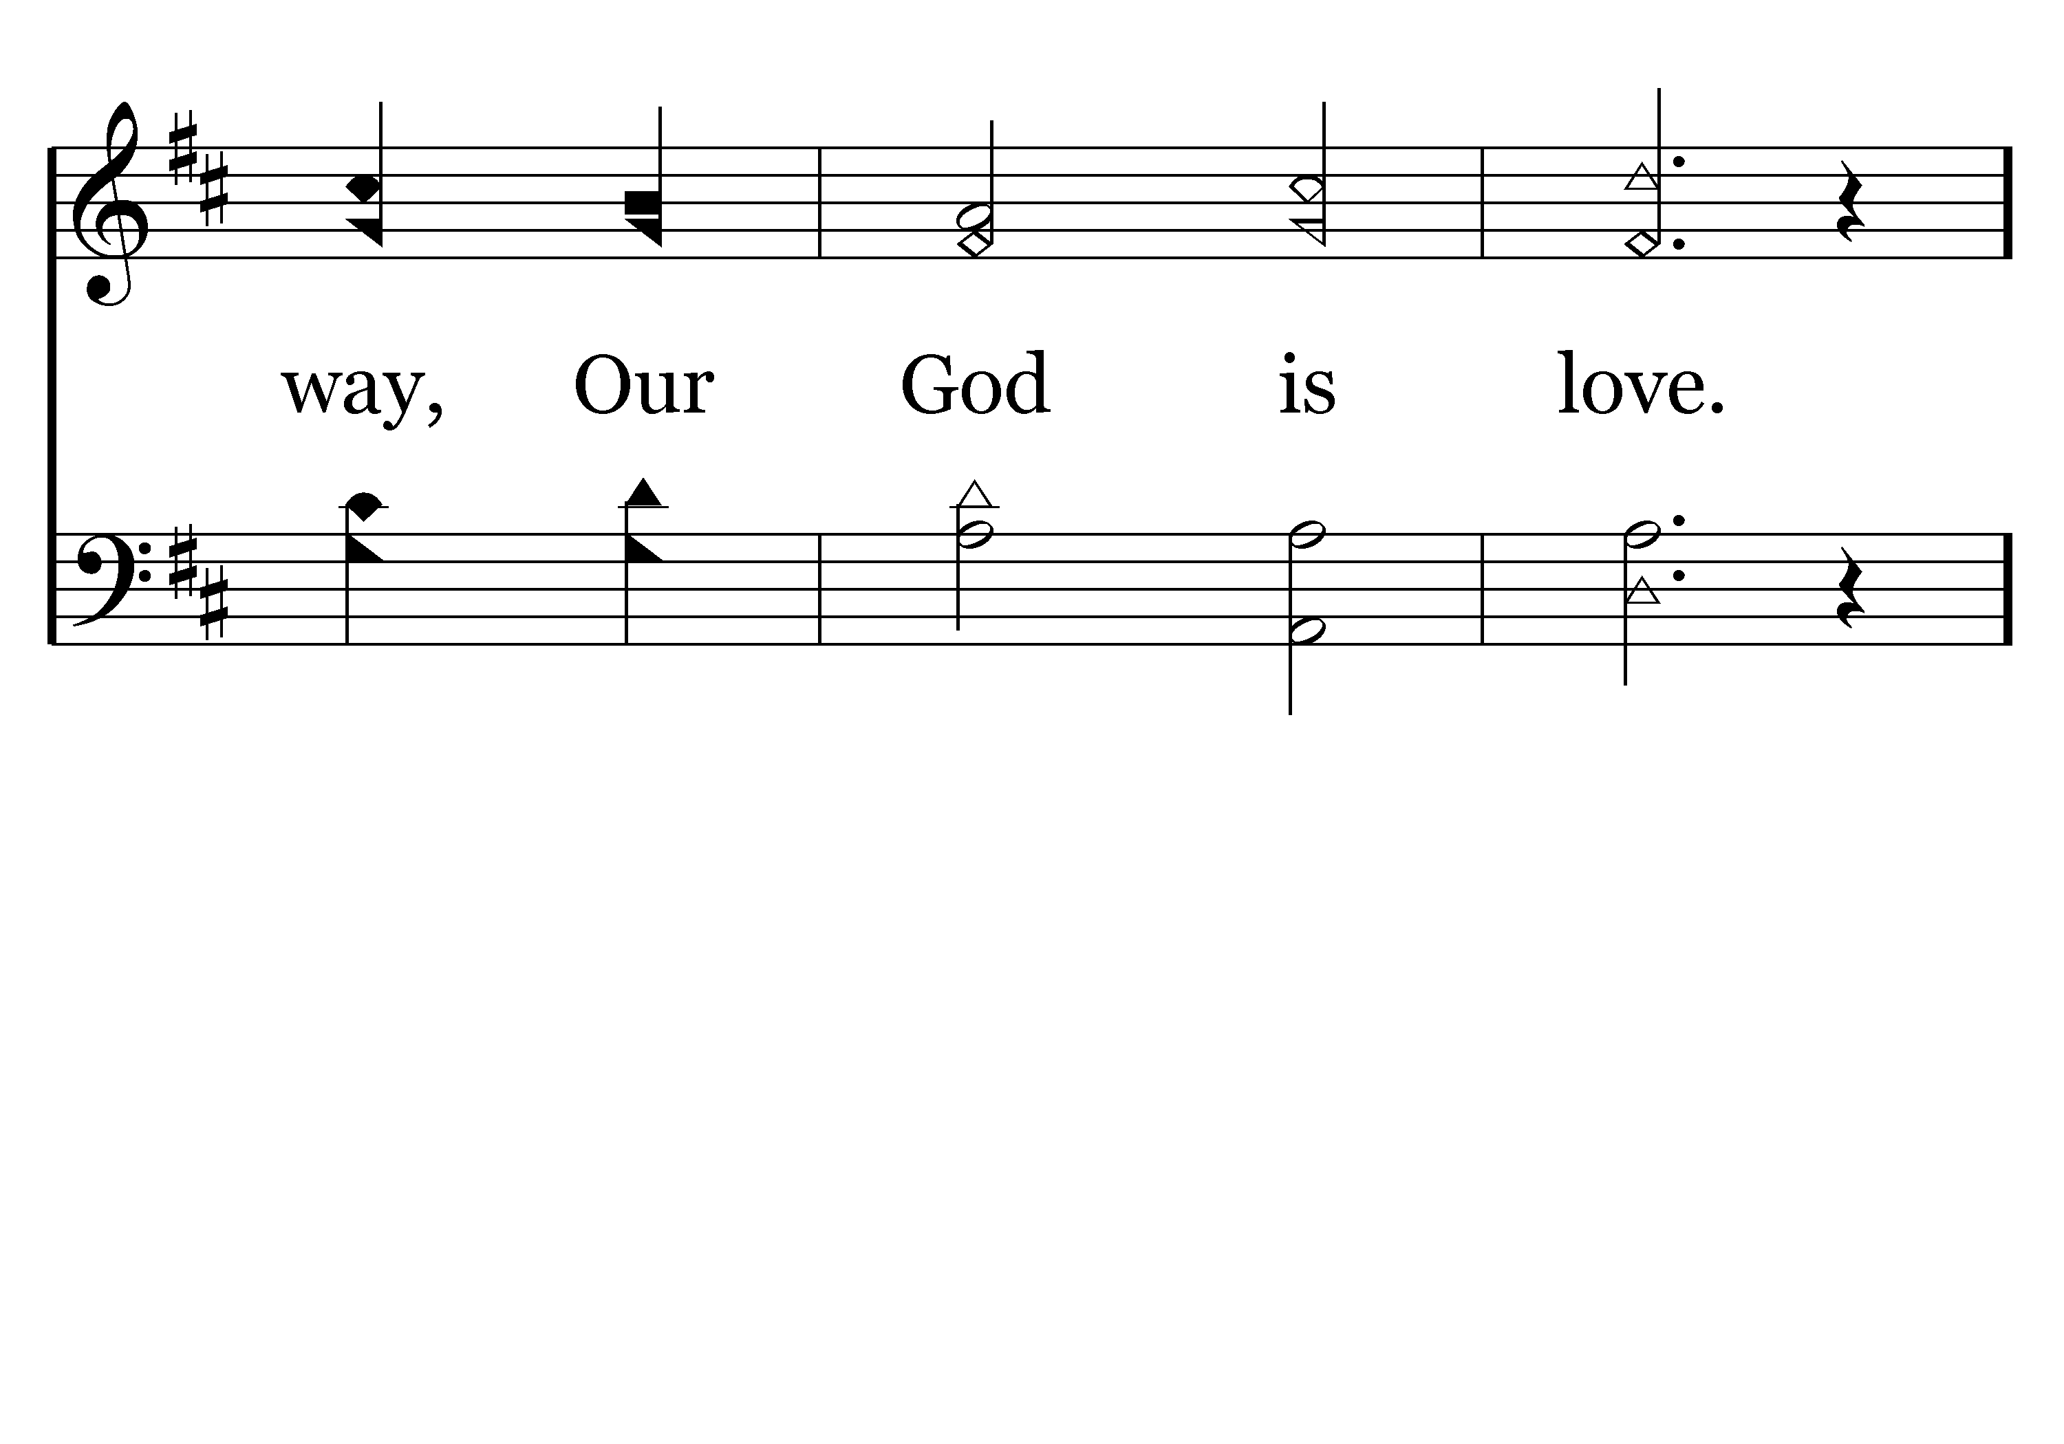
412 - GOD IS LOVE – 3.4

Slide 19
412 - GOD IS LOVE – 3.5-C1

Slide 20
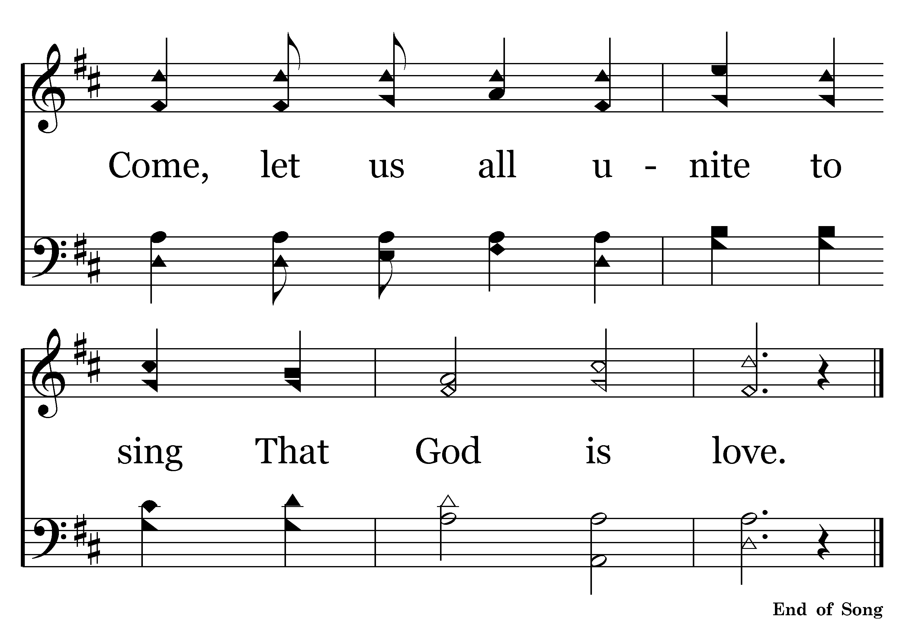
412 - GOD IS LOVE – 3.6-C2

Slide 22
“Next to the Word of God, the noble art of music is the greatest treasure in the world. Music controls our thoughts, minds, hearts and spirits. The precious gift of music has been given to man alone that he might . . . remind himself that God has created man for the purpose of praising God. A person who does not regard music as a marvelous creation of God must be a clodhopper indeed and does not deserve to be called a human being.” Martin Luther - 1538

Slide 24
Sing praise to the LORD, You saints of His, and give thanks at the remembrance of His holy name.
Psalm 30:4
The “heart of man” involves his ability: to think, reason, understand, believe
Also: to trust, hope, love & rejoice!!
O. T. TIMES (Law of Moses)
“the assembly worshipped, the singers sang & the trumpeters sounded”
(2 Chron. 29:25-28)
N. T. TIMES (Law of Christ)
“singing and making melody in your heart to the Lord”
(Eph. 5:19)

Slide 26
Colossians 3:12-16
Ephesians 5:1-19
12 Therefore, as the elect of God,
15 let the peace of God rule in your hearts, to which also you were called in one body; and be thankful.
16 Let the word of Christ dwell in you richly in all wisdom, teaching and admonishing one another in psalms and hymns and spiritual songs, singing with grace in your hearts to the Lord.
1 Therefore be imitators of God as dear children.
17 Therefore do not be unwise, but understand what the will of the Lord is.
18 And do not be drunk with wine, in which is dissipation; but be filled with the Spirit,
19 speaking to one another in psalms and hymns and spiritual songs, singing and making melody in your heart to the Lord,

Slide 27
Colossians 3:12-16
Ephesians 5:1-19
12 Therefore, as the elect of God,
15 let the peace of God rule in your hearts, to which also you were called in one body; and be thankful.
16 Let the word of Christ dwell in you richly in all wisdom, teaching and admonishing one another in psalms and hymns and spiritual songs, singing with grace in your hearts to the Lord.
1 Therefore be imitators of God as dear children.
17 Therefore do not be unwise, but understand what the will of the Lord is.
18 And do not be drunk with wine, in which is dissipation; but be filled with the Spirit,
19 speaking to one another in psalms and hymns and spiritual songs, singing and making melody in your heart to the Lord,

Slide 28
Colossians 3:12-16
Ephesians 5:1-19
12 Therefore, as the elect of God,
15 let the peace of God rule in your hearts, to which also you were called in one body; and be thankful.
16 Let the word of Christ dwell in you richly in all wisdom, teaching and admonishing one another in psalms and hymns and spiritual songs, singing with grace in your hearts to the Lord.
1 Therefore be imitators of God as dear children.
17 Therefore do not be unwise, but understand what the will of the Lord is.
18 And do not be drunk with wine, in which is dissipation; but be filled with the Spirit,
19 speaking to one another in psalms and hymns and spiritual songs, singing and making melody in your heart to the Lord,

Slide 29
Colossians 3:12-16
Ephesians 5:1-19
12 Therefore, as the elect of God,
15 let the peace of God rule in your hearts, to which also you were called in one body; and be thankful.
16 Let the word of Christ dwell in you richly in all wisdom, teaching and admonishing one another in psalms and hymns and spiritual songs, singing with grace in your hearts to the Lord.
1 Therefore be imitators of God as dear children.
17 Therefore do not be unwise, but understand what the will of the Lord is.
18 And do not be drunk with wine, in which is dissipation; but be filled with the Spirit,
19 speaking to one another in psalms and hymns and spiritual songs, singing and making melody in your heart to the Lord,
WHO SINGS?
TO WHOM?
WHEN?
WHY?
WHAT?
HOW?

Slide 30
Colossians 3:12-16
Ephesians 5:1-19
12 Therefore, as the elect of God,
15 let the peace of God rule in your hearts, to which also you were called in one body; and be thankful.
16 Let the word of Christ dwell in you richly in all wisdom, teaching and admonishing one another in psalms and hymns and spiritual songs, singing with grace in your hearts to the Lord.
1 Therefore be imitators of God as dear children.
17 Therefore do not be unwise, but understand what the will of the Lord is.
18 And do not be drunk with wine, in which is dissipation; but be filled with the Spirit,
19 speaking to one another in psalms and hymns and spiritual songs, singing and making melody in your heart to the Lord,
WHO SINGS?
THE RIGHTEOUS !
“the righteous sings and rejoices” (Prov. 29:6)
Moses – Ex. 15
Jesus & Apostles – Mt. 26:30
David – Psa. 108
Paul & Silas – Acts 16:25

Slide 31
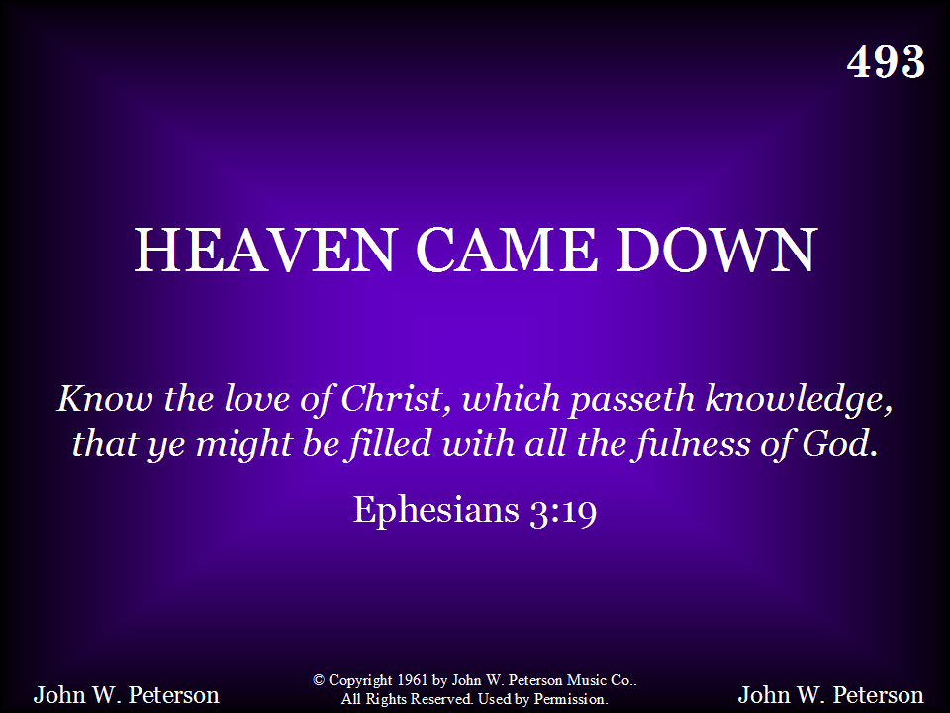
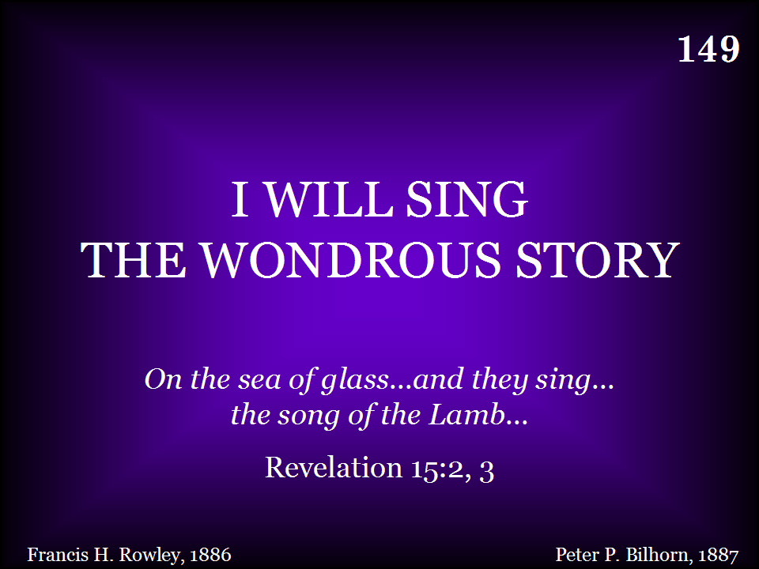
149 - I WILL SING - TITLE

Slide 32
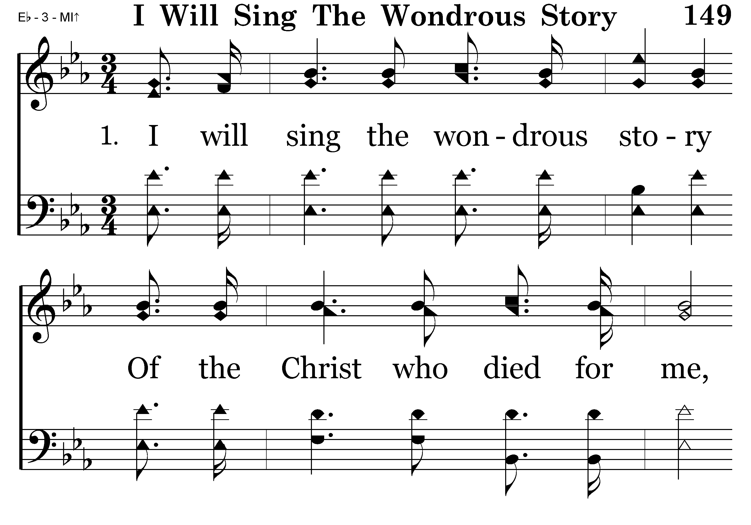
149 - I WILL SING – 1.1

Slide 33
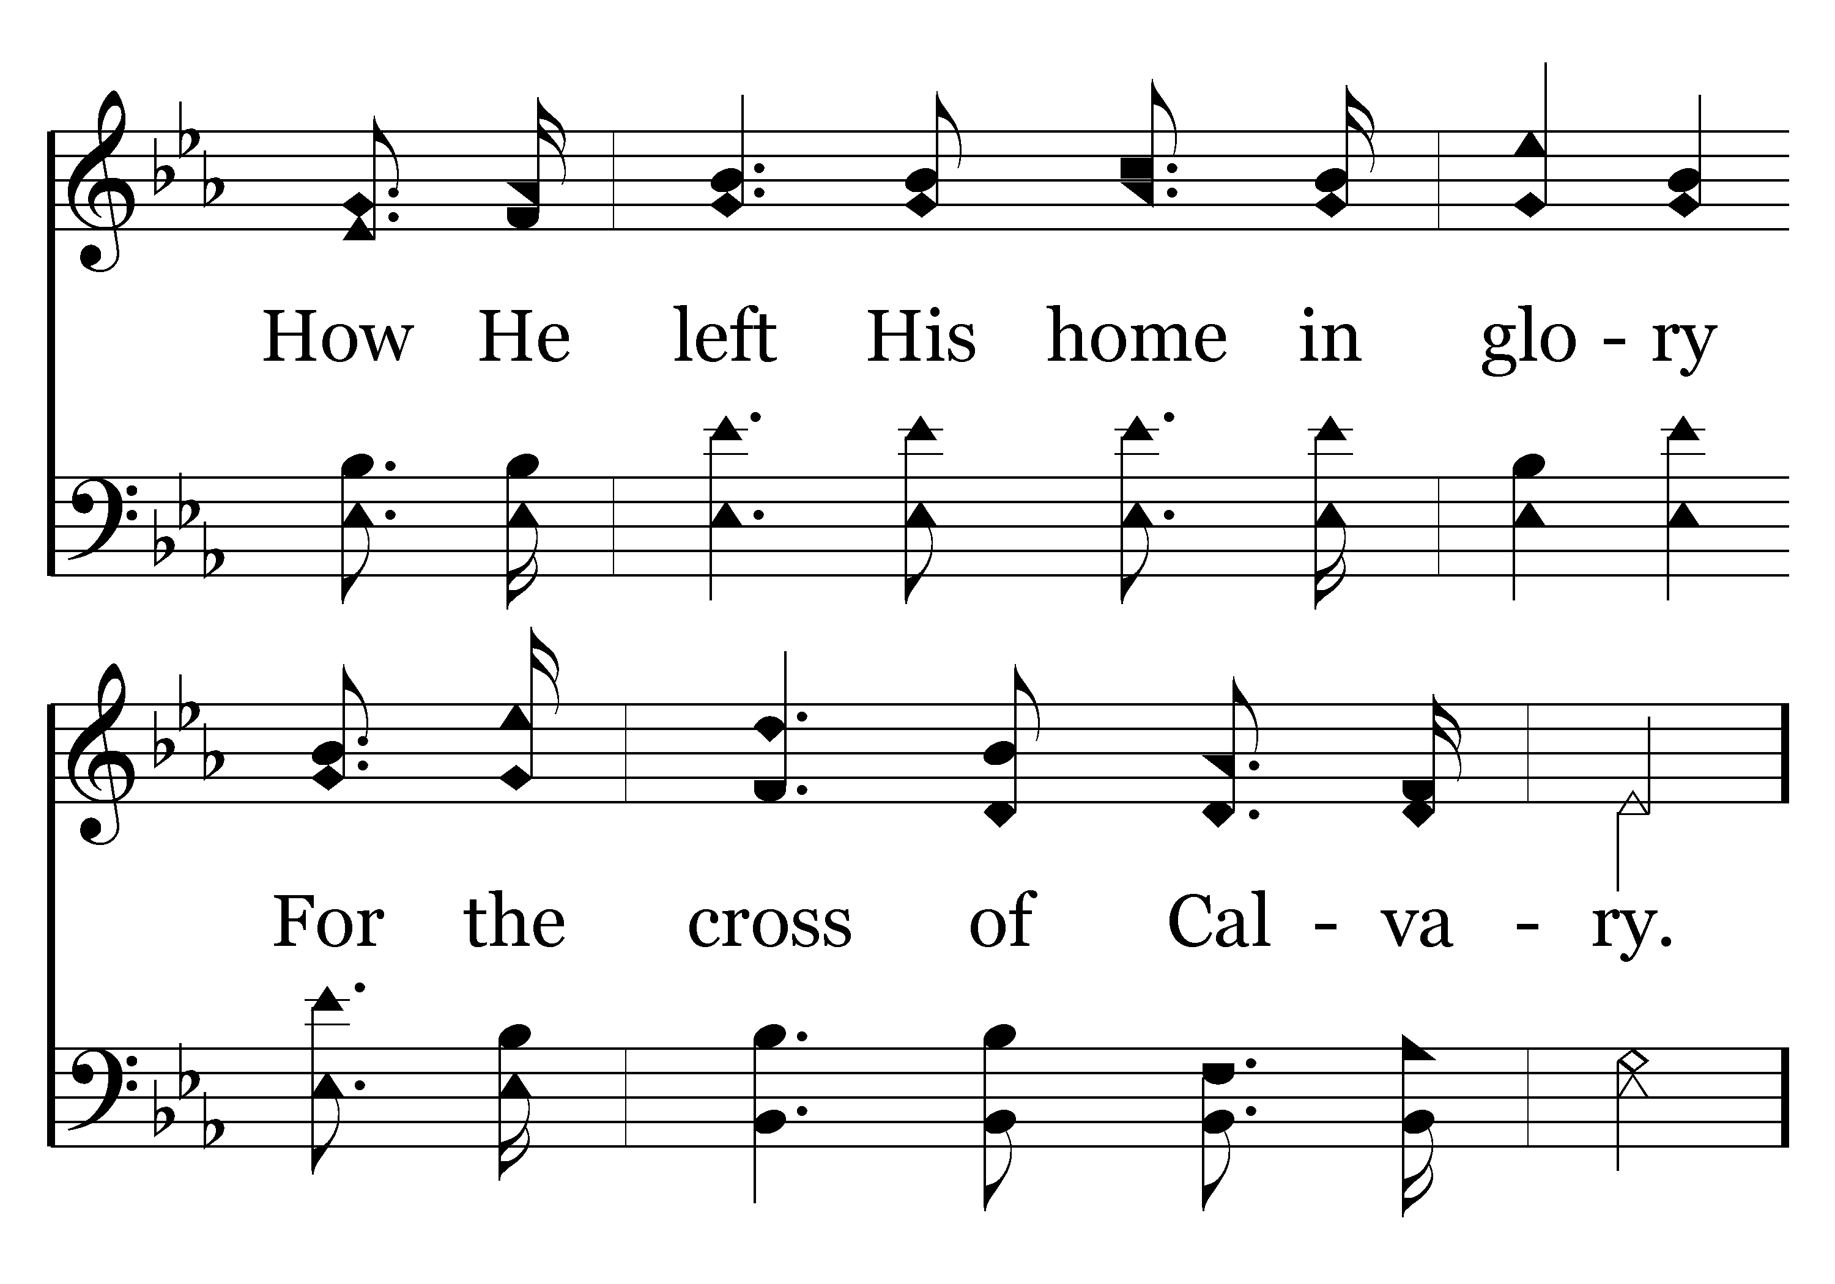
149 - I WILL SING – 1.2

Slide 34
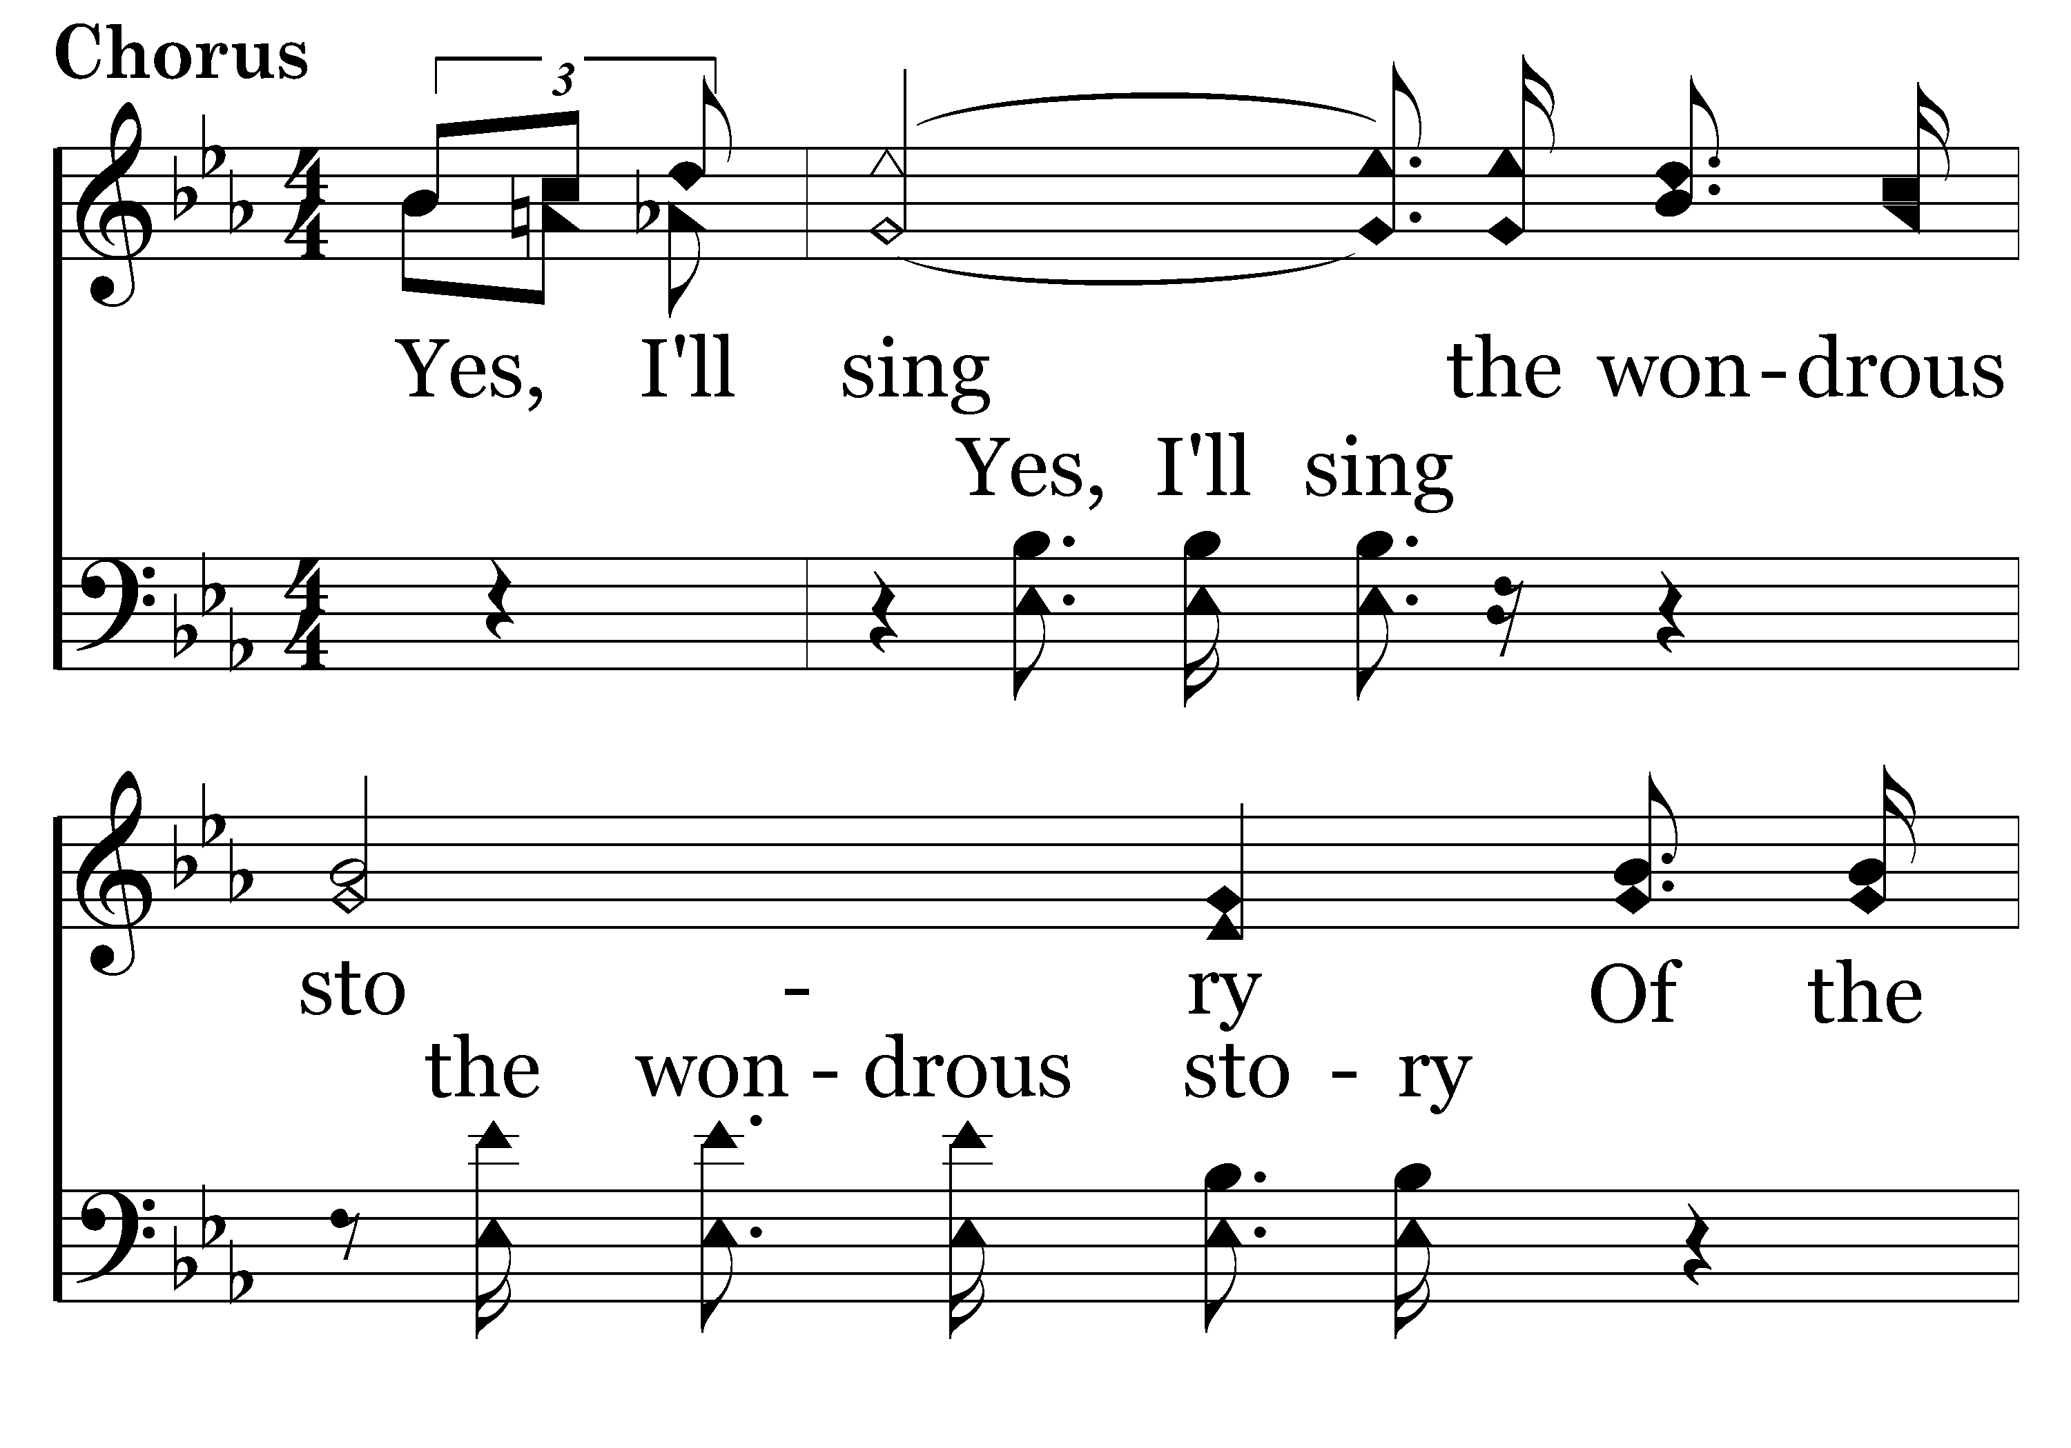
149 - I WILL SING – 1.3-C1

Slide 35
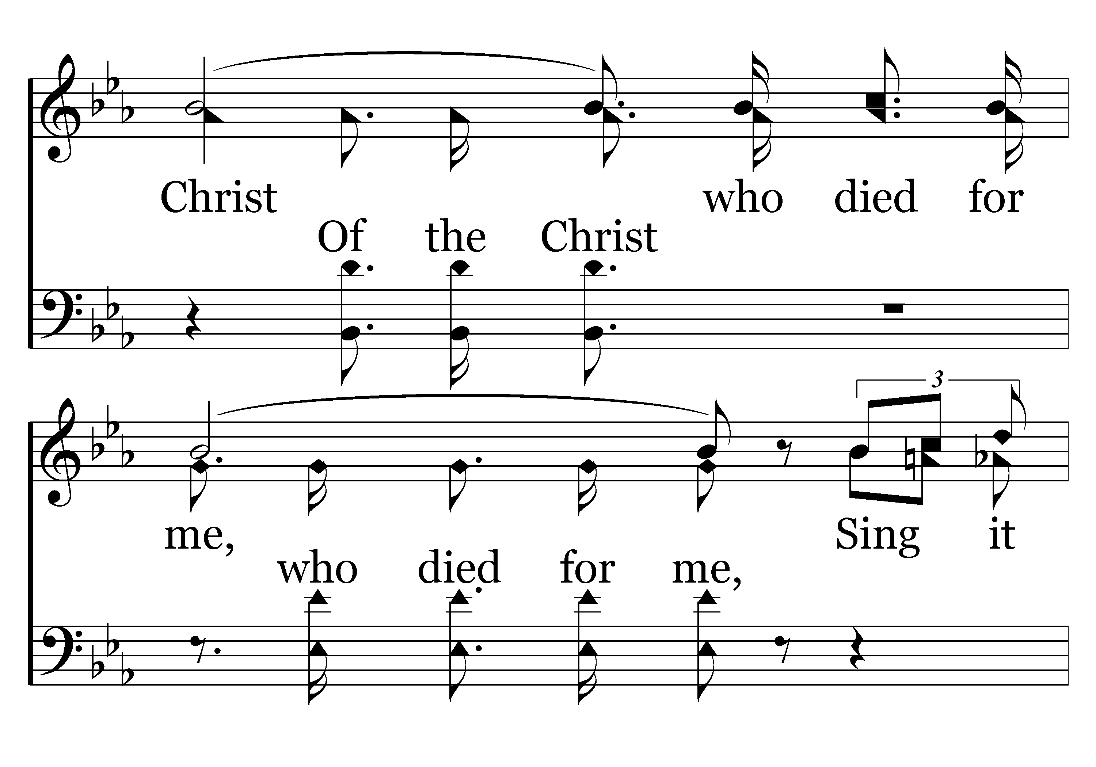
149 - I WILL SING – 1.4-C2

Slide 36
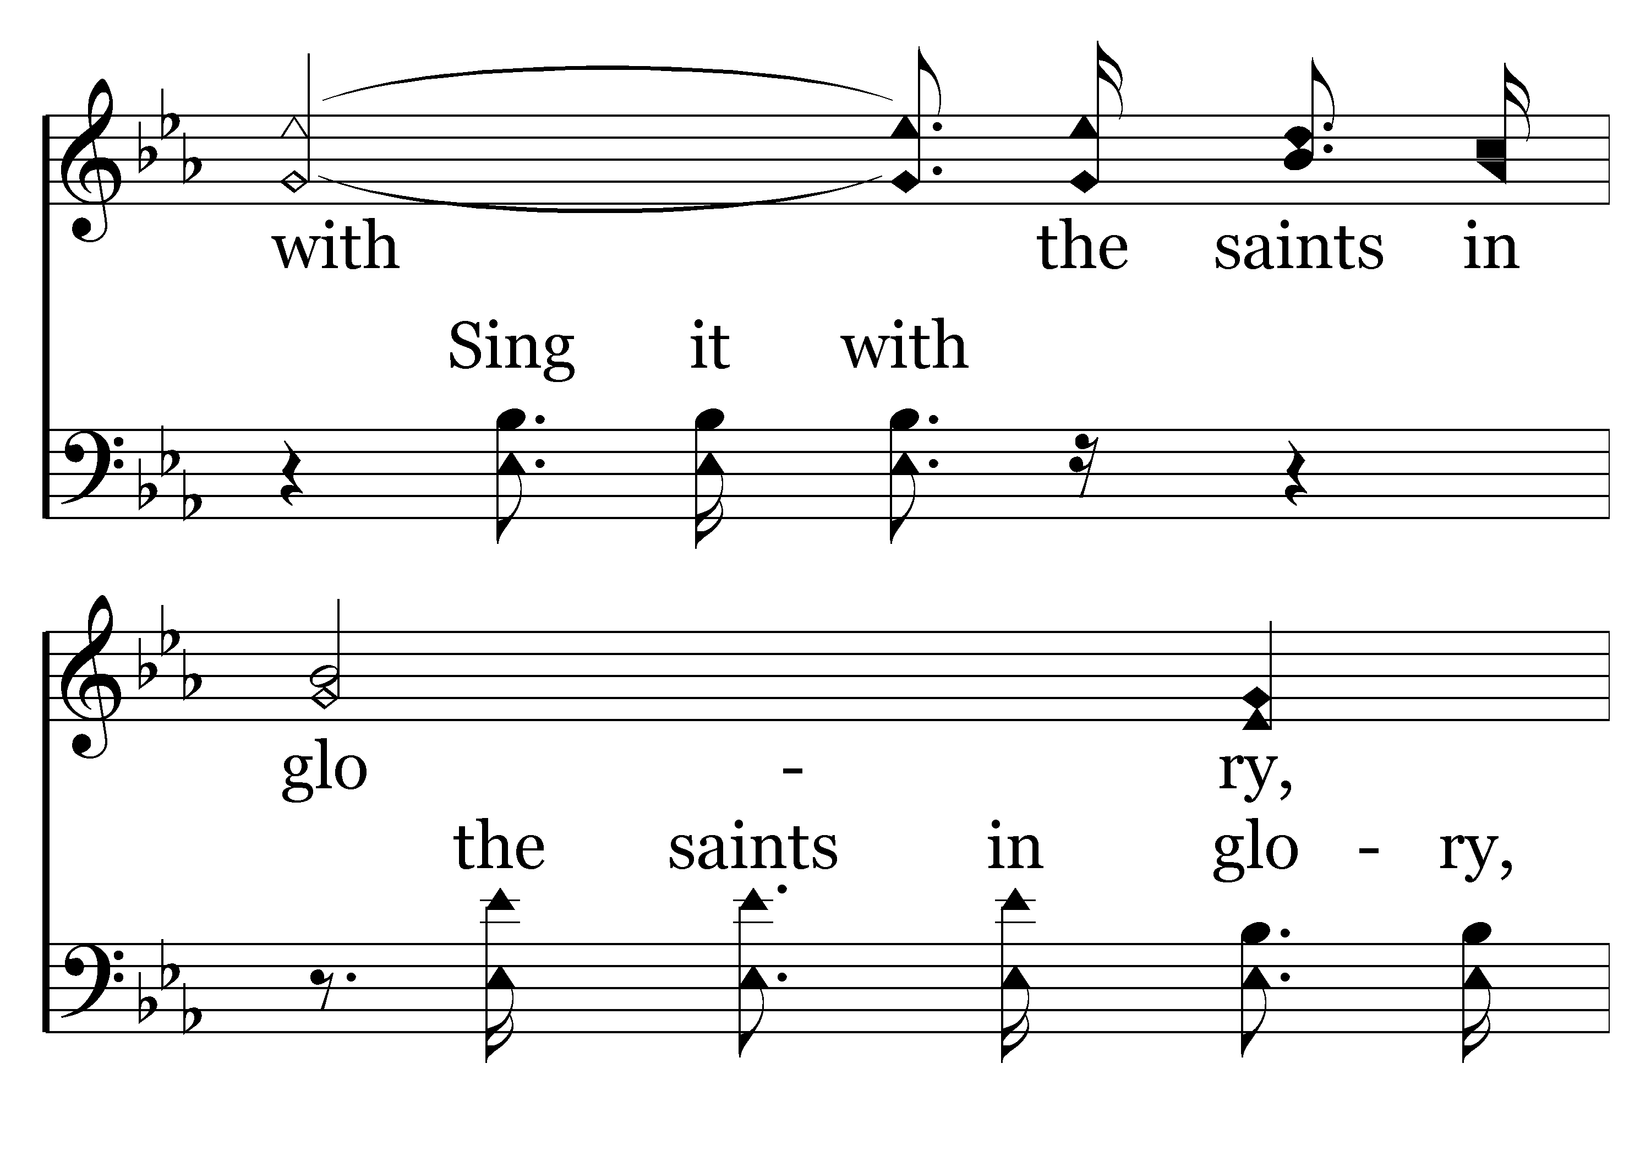
149 - I WILL SING – 1.5-C3

Slide 37
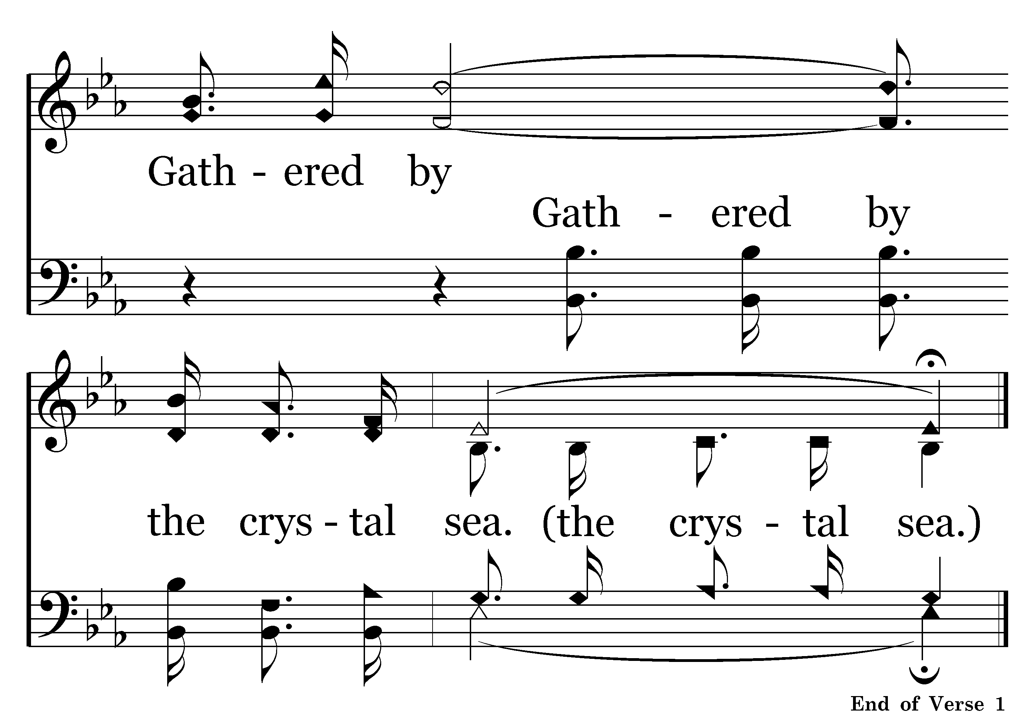
149 - I WILL SING – 1.6-C4

Slide 38
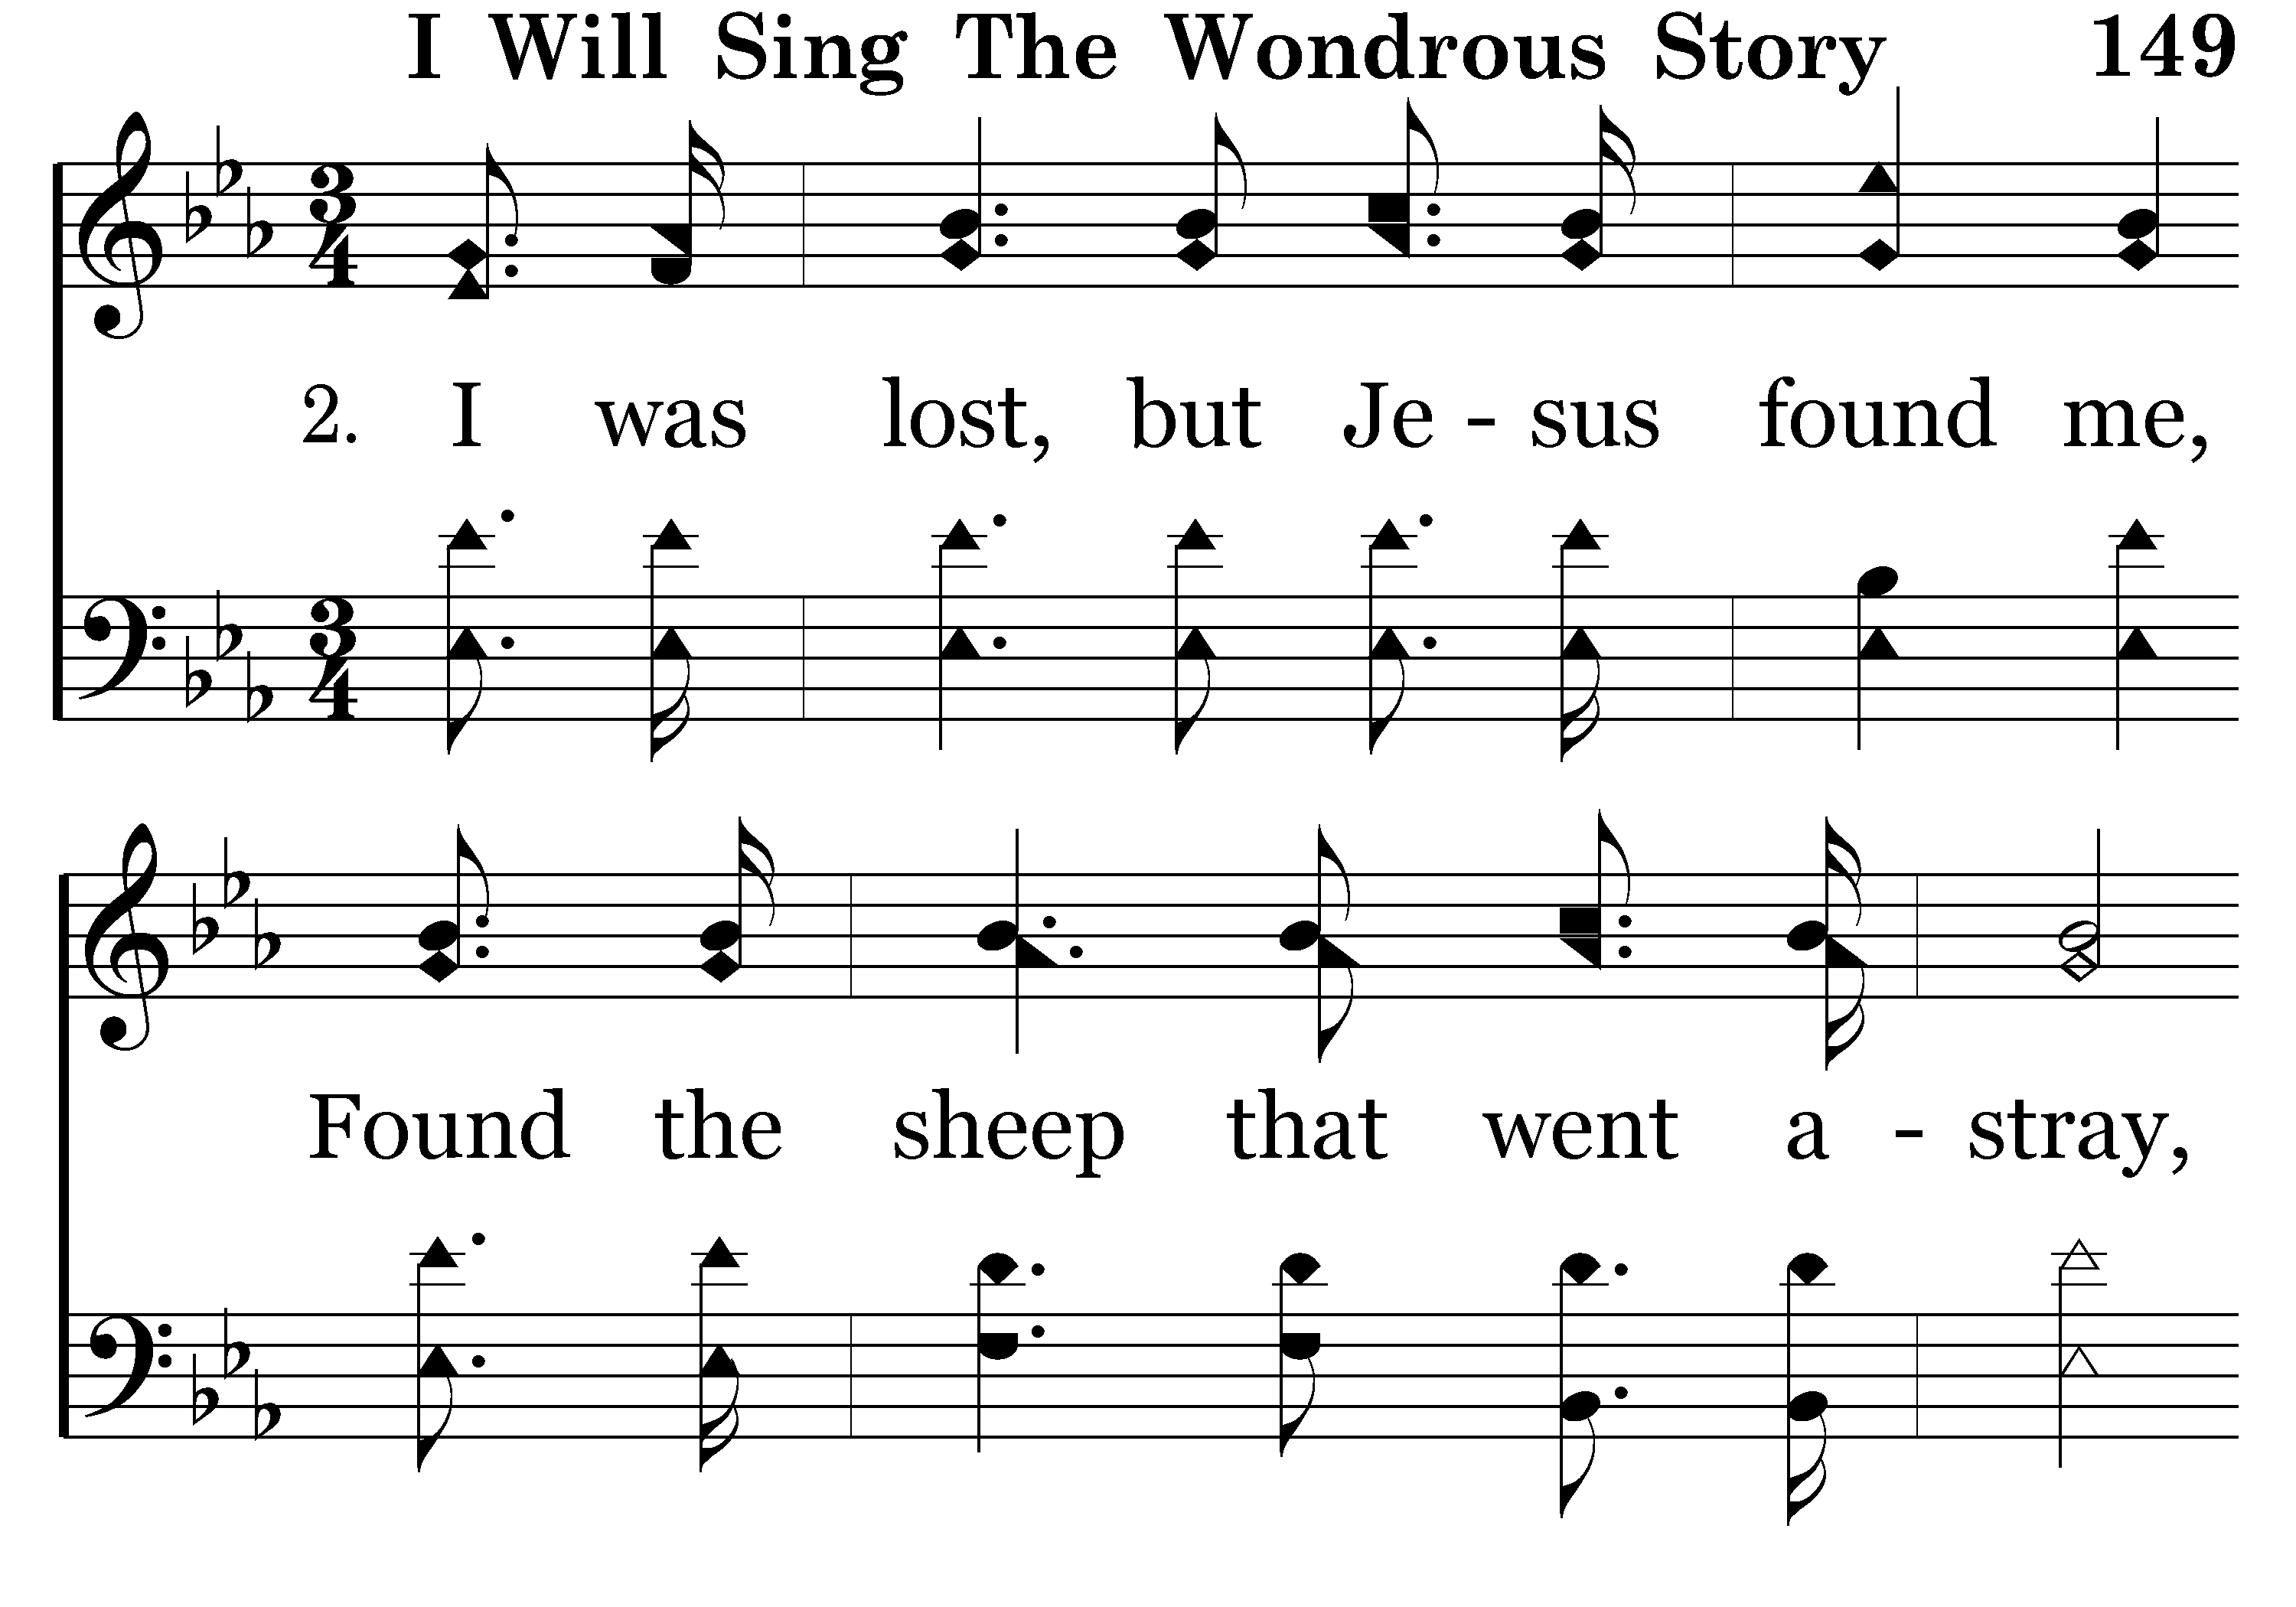
149 - I WILL SING – 2.1

Slide 39
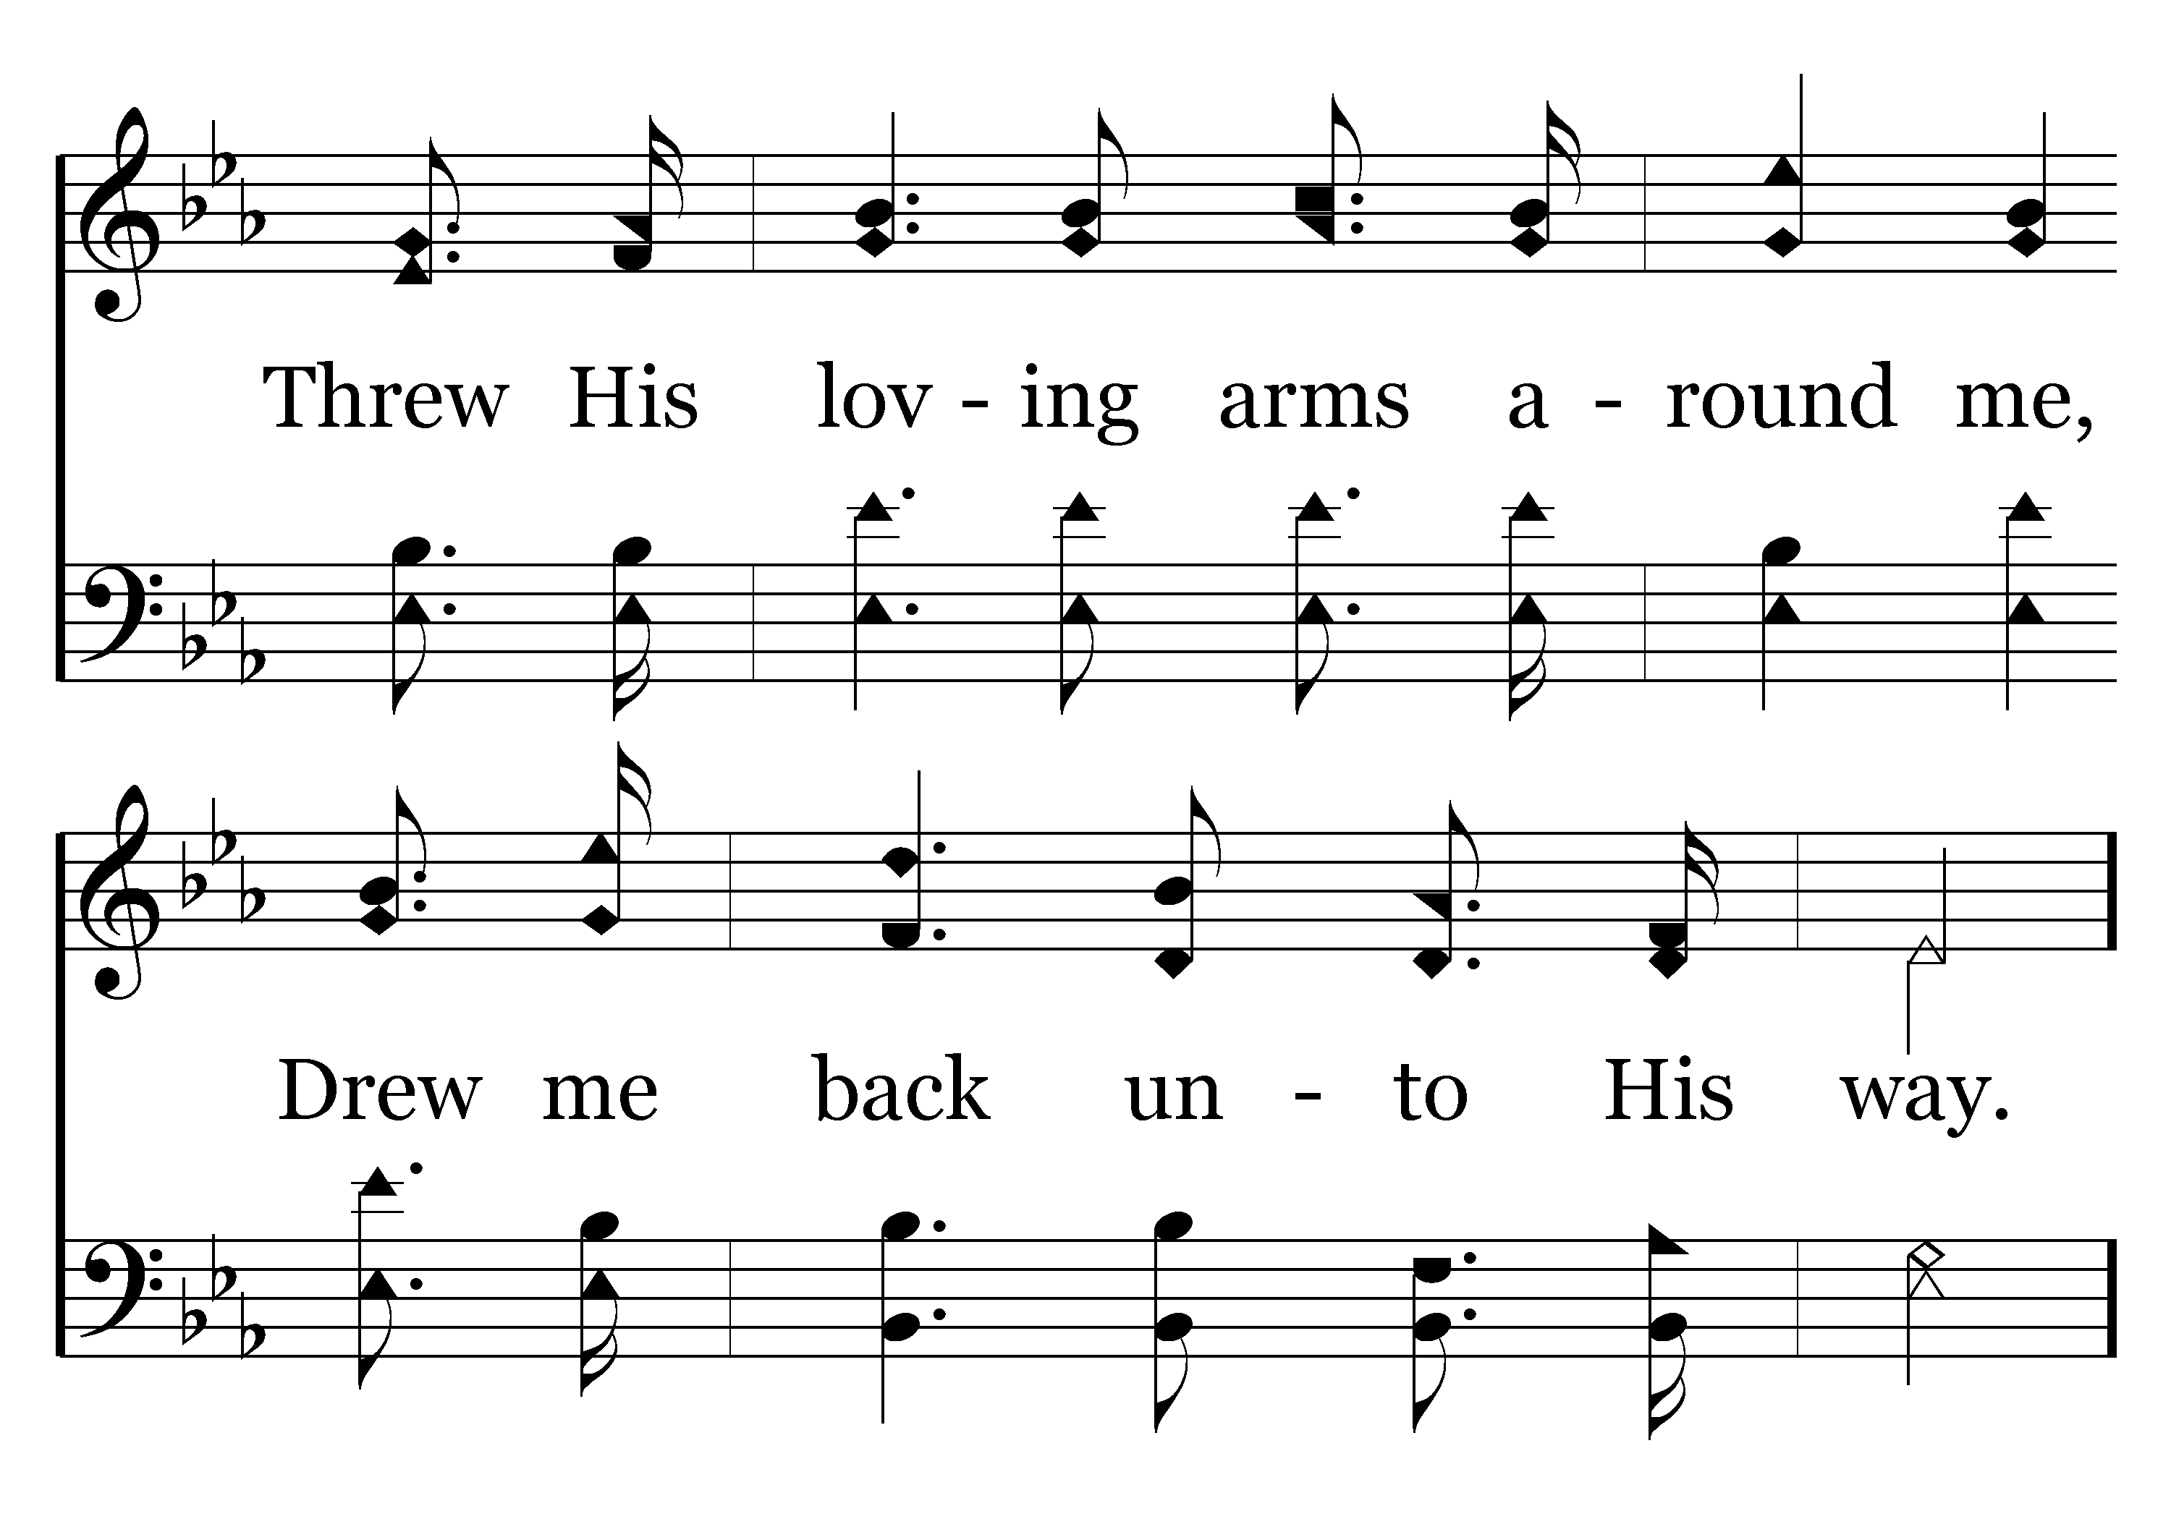
149 - I WILL SING – 2.2

Slide 40
149 - I WILL SING – 2.3-C1

Slide 41
149 - I WILL SING – 2.4-C2

Slide 42
149 - I WILL SING – 2.5-C3

Slide 43

149 - I WILL SING – 2.6-C4
End of Song

Slide 45
Colossians 3:12-16
Ephesians 5:1-19
12 Therefore, as the elect of God,
15 let the peace of God rule in your hearts, to which also you were called in one body; and be thankful.
16 Let the word of Christ dwell in you richly in all wisdom, teaching and admonishing one another in psalms and hymns and spiritual songs, singing with grace in your hearts to the Lord.
1 Therefore be imitators of God as dear children.
17 Therefore do not be unwise, but understand what the will of the Lord is.
18 And do not be drunk with wine, in which is dissipation; but be filled with the Spirit,
19 speaking to one another in psalms and hymns and spiritual songs, singing and making melody in your heart to the Lord,
TO WHOM?

Slide 47
Psalm 95:1-3
1 Oh come, let us sing to the LORD! Let us shout joyfully to the Rock of our salvation.
2 Let us come before His presence with thanksgiving; let us shout joyfully to Him with psalms.
3 For the LORD is the great God, and the great King above all gods.

Slide 48
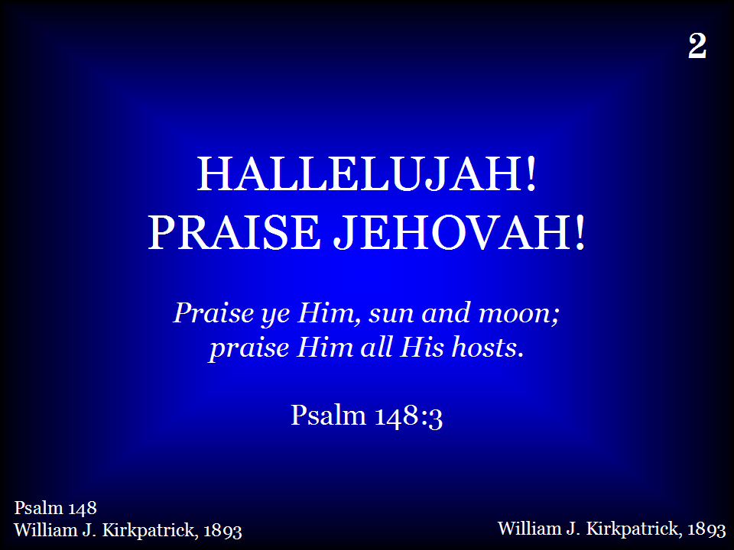
002 – HALLELUJAH PRAISE JEHOVAH – TITLE

Slide 49
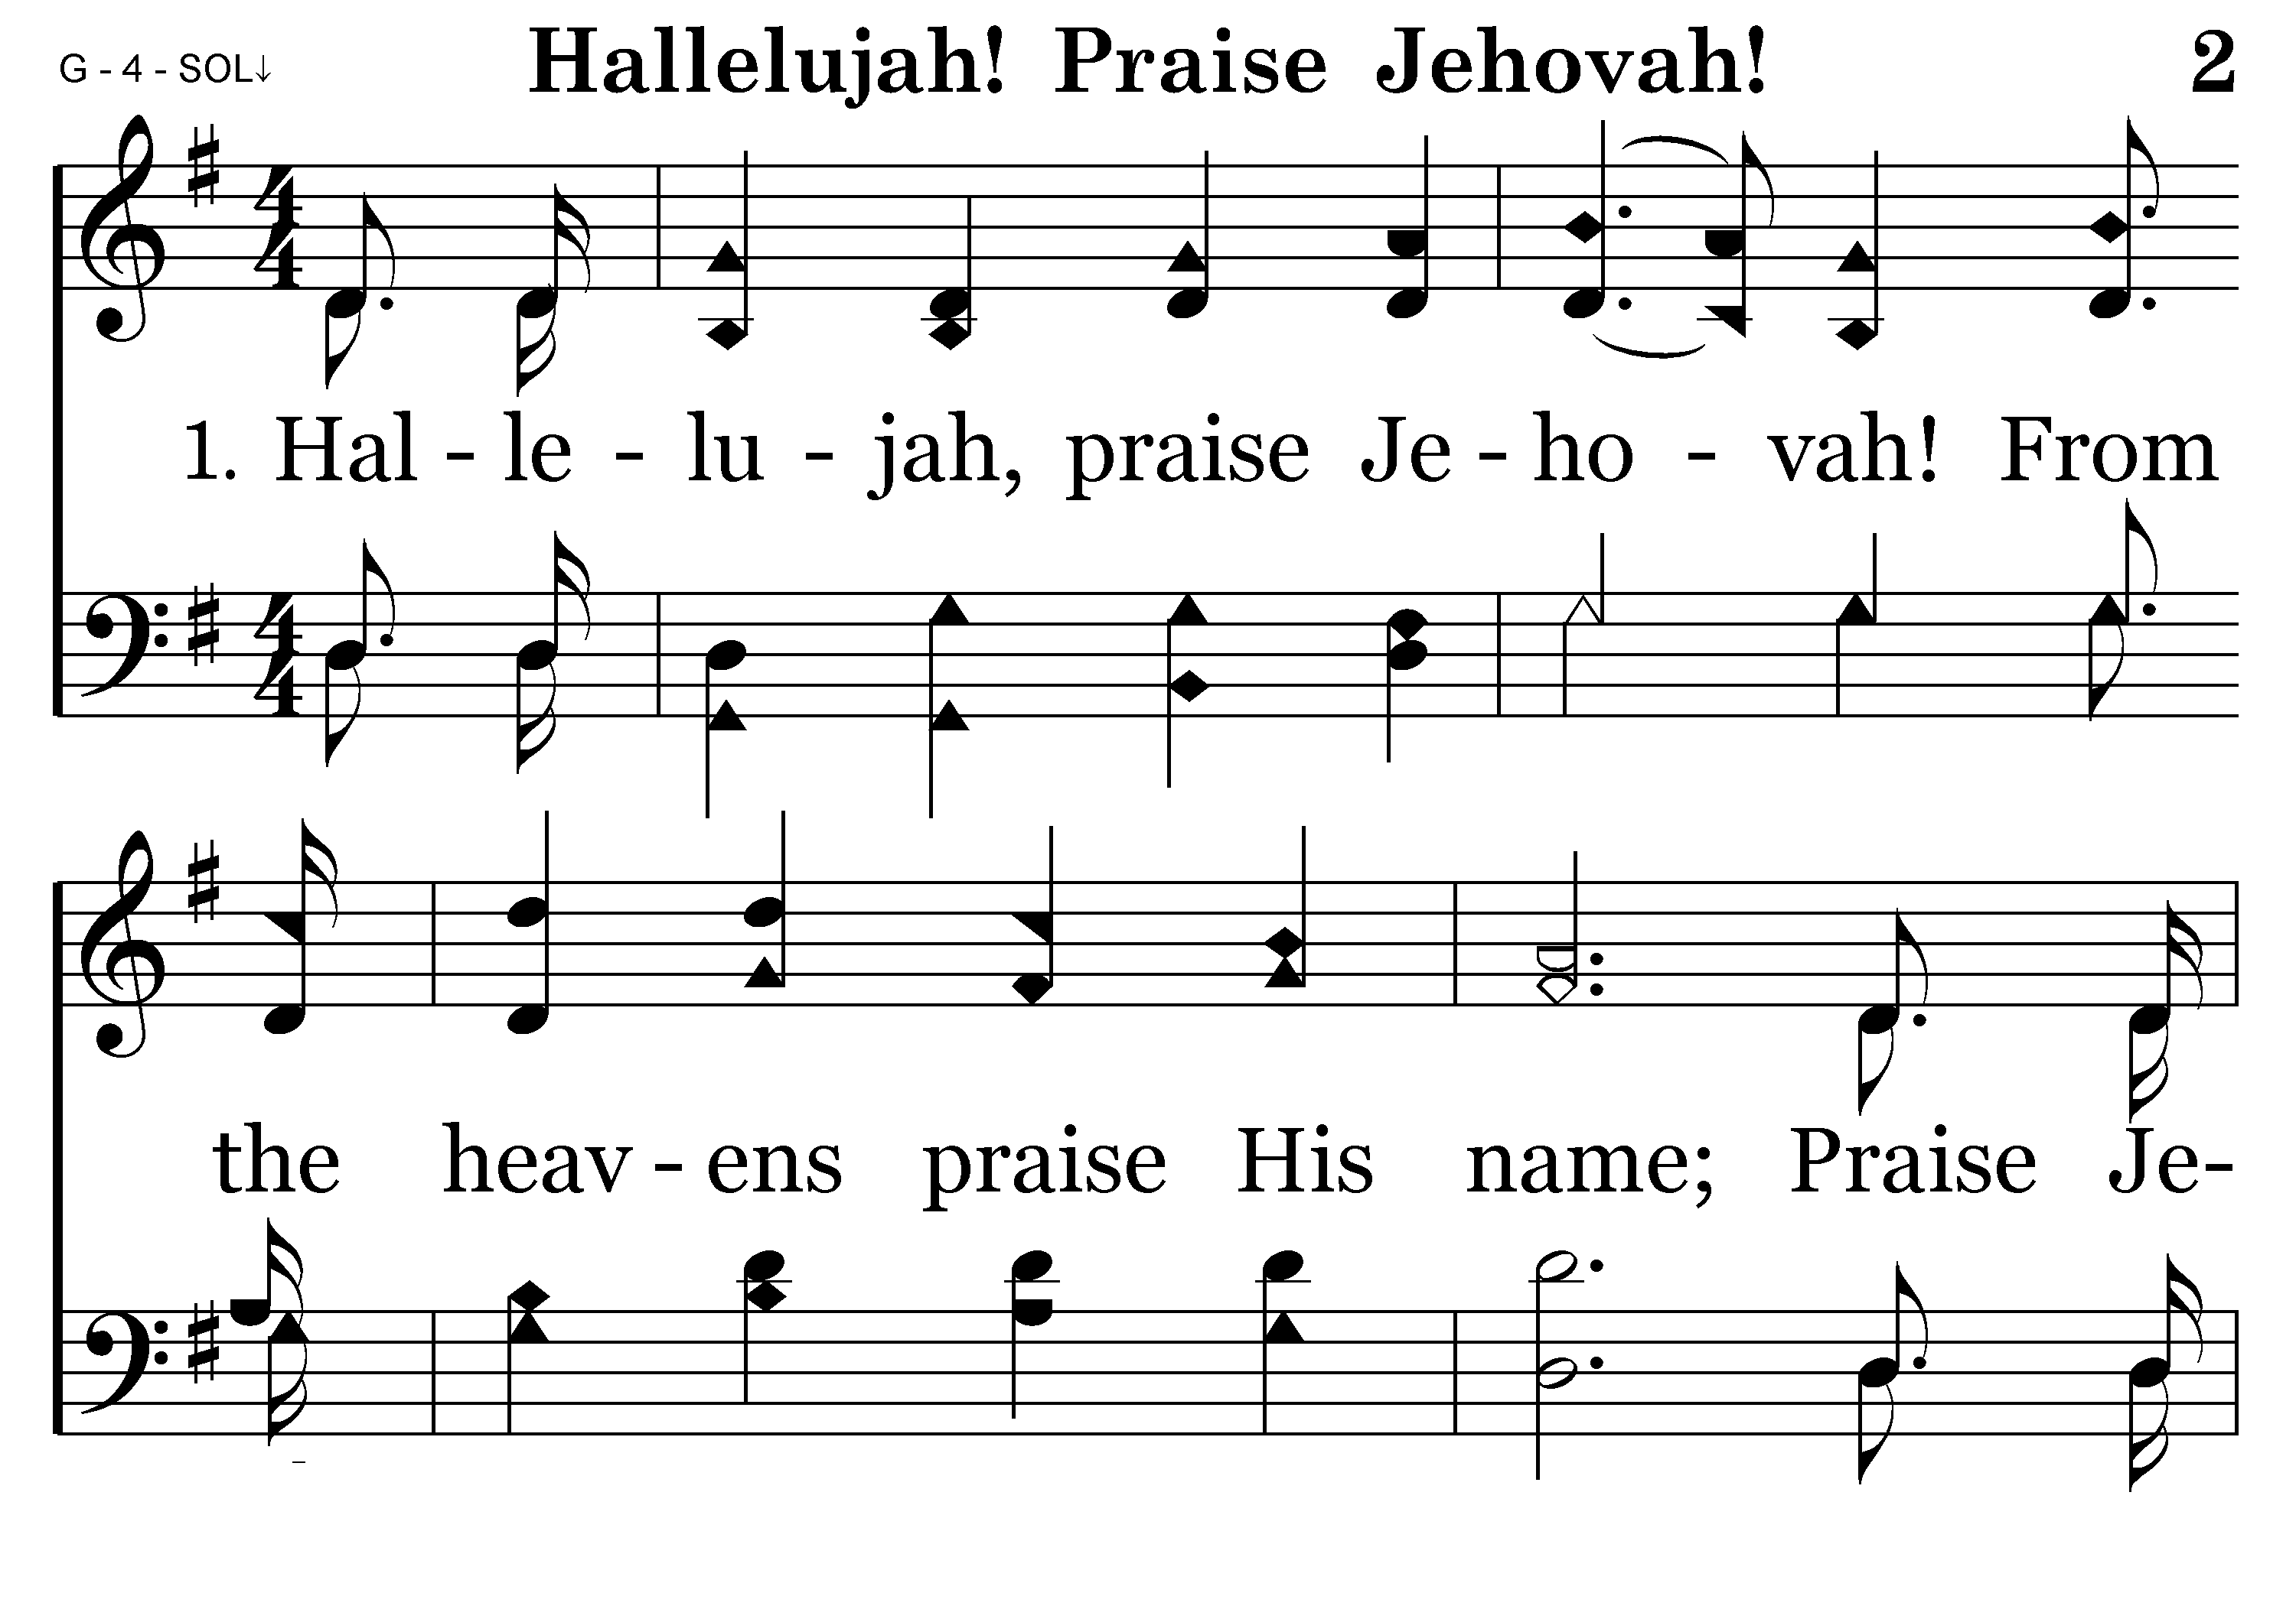
002 – HALLELUJAH PRAISE JEHOVAH – 1.1

Slide 50
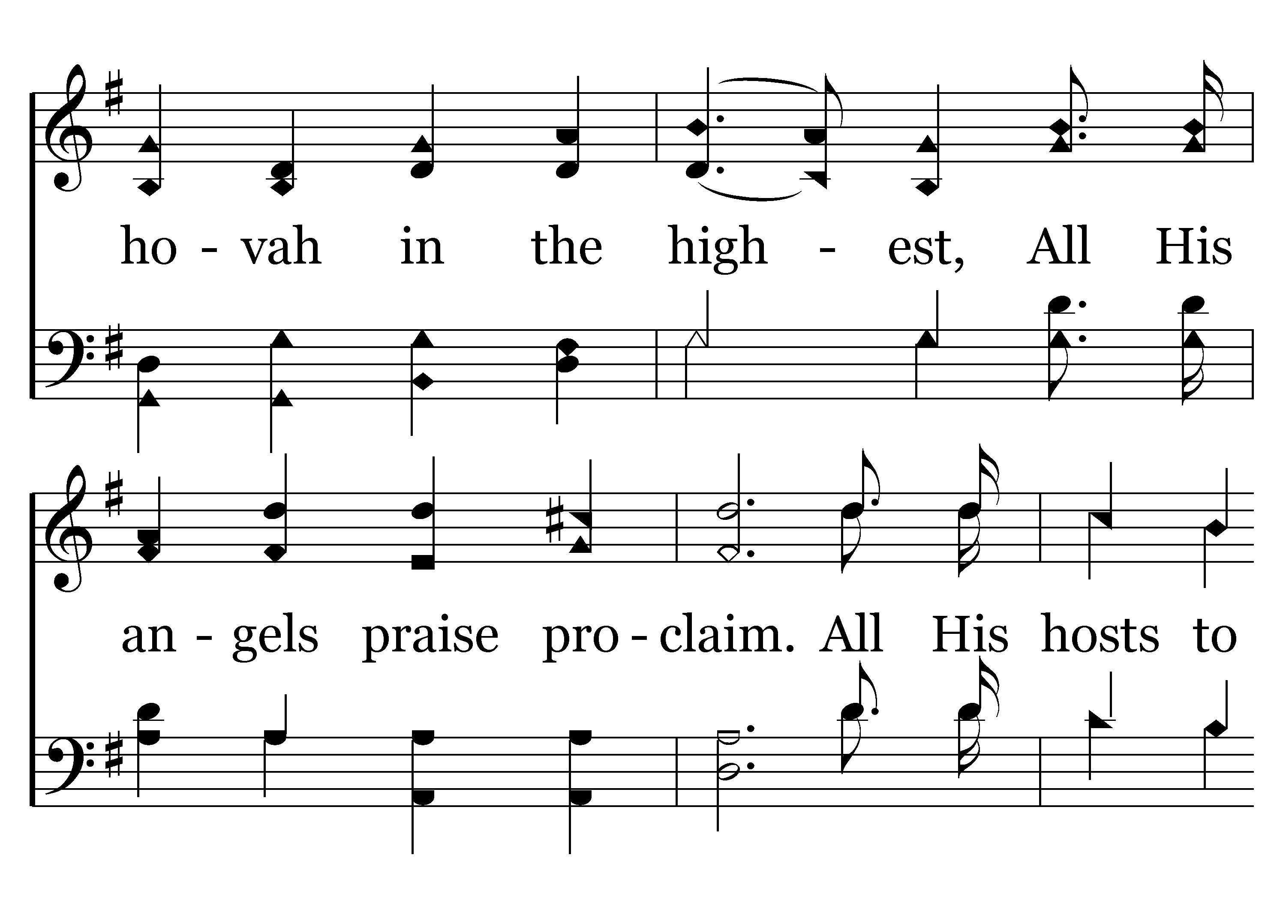
002 – HALLELUJAH PRAISE JEHOVAH – 1.2

Slide 51
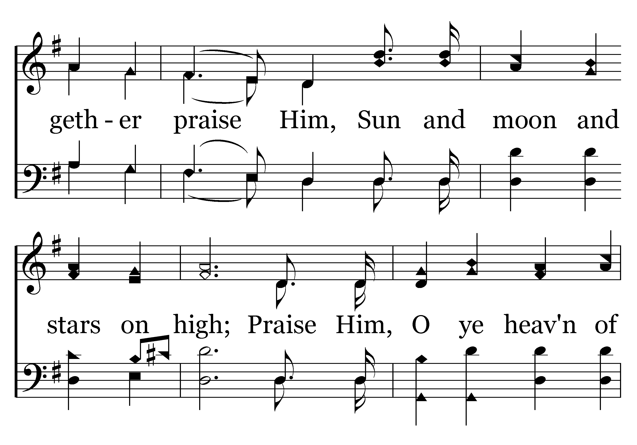
002 – HALLELUJAH PRAISE JEHOVAH – 1.3

Slide 52
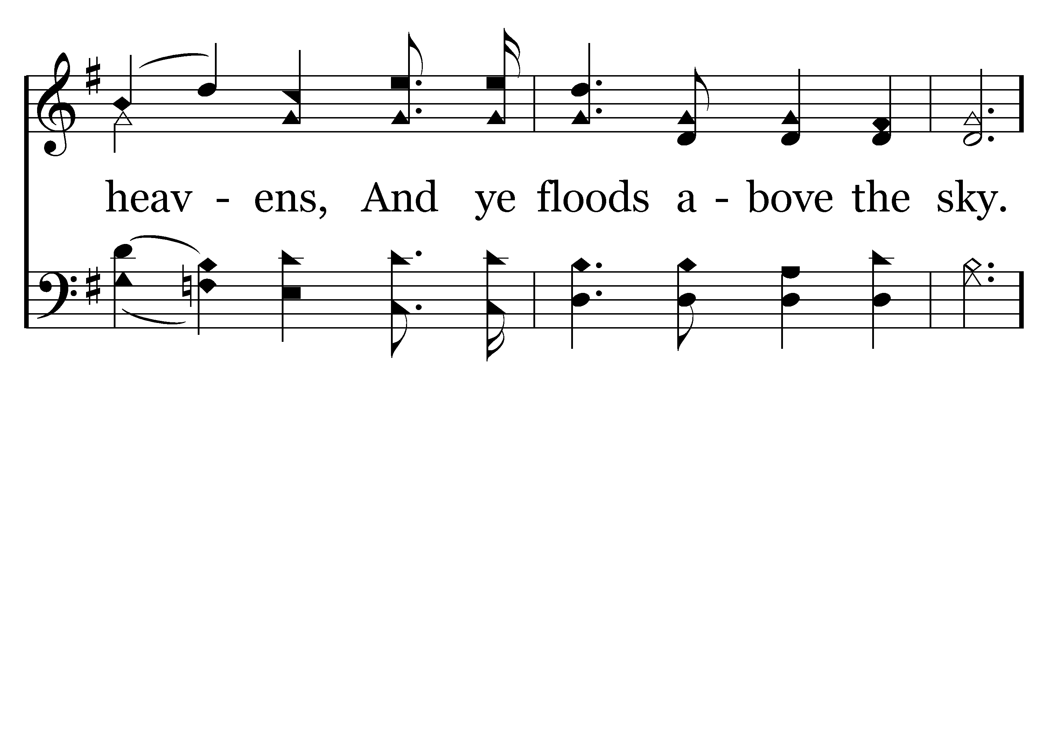
002 – HALLELUJAH PRAISE JEHOVAH – 1.4

Slide 53
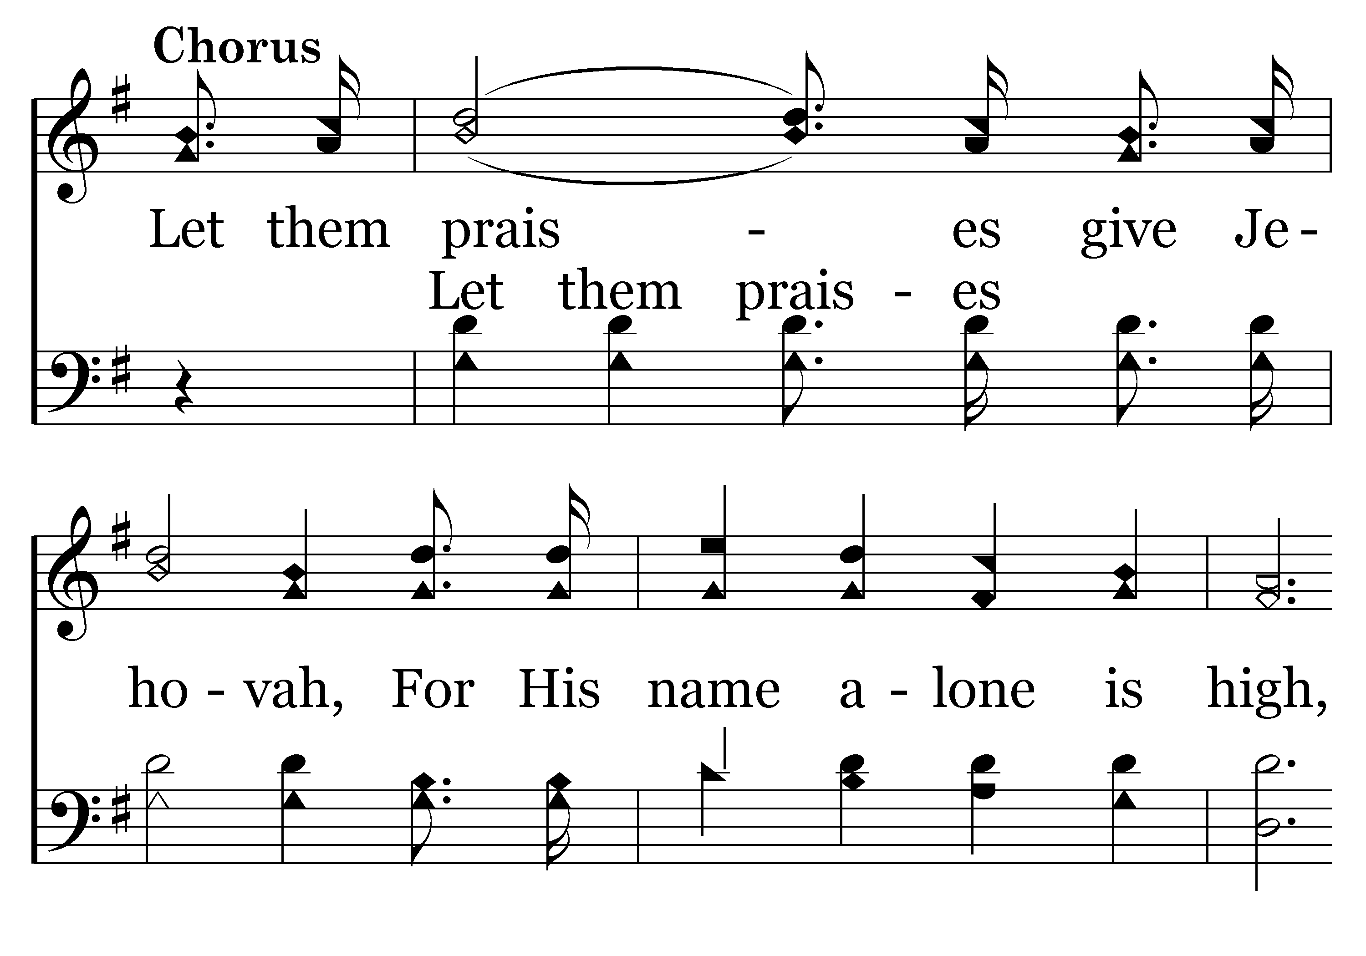
002 – HALLELUJAH PRAISE JEHOVAH – 1.5-C1

Slide 54
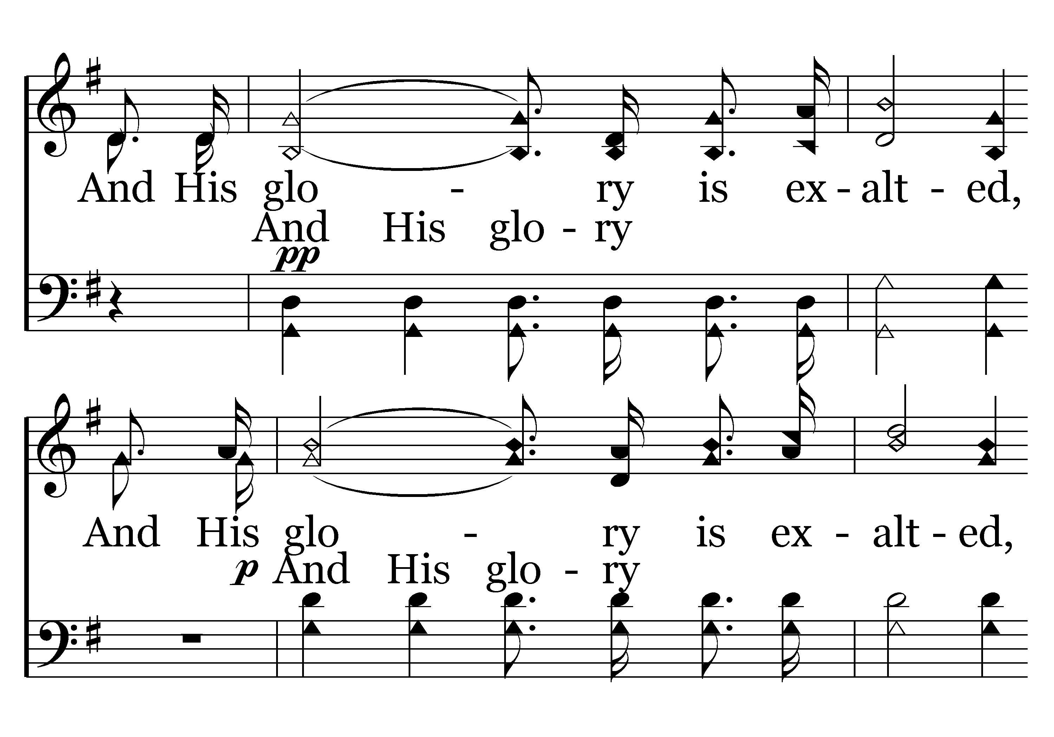
002 – HALLELUJAH PRAISE JEHOVAH – 1.6-C2

Slide 55
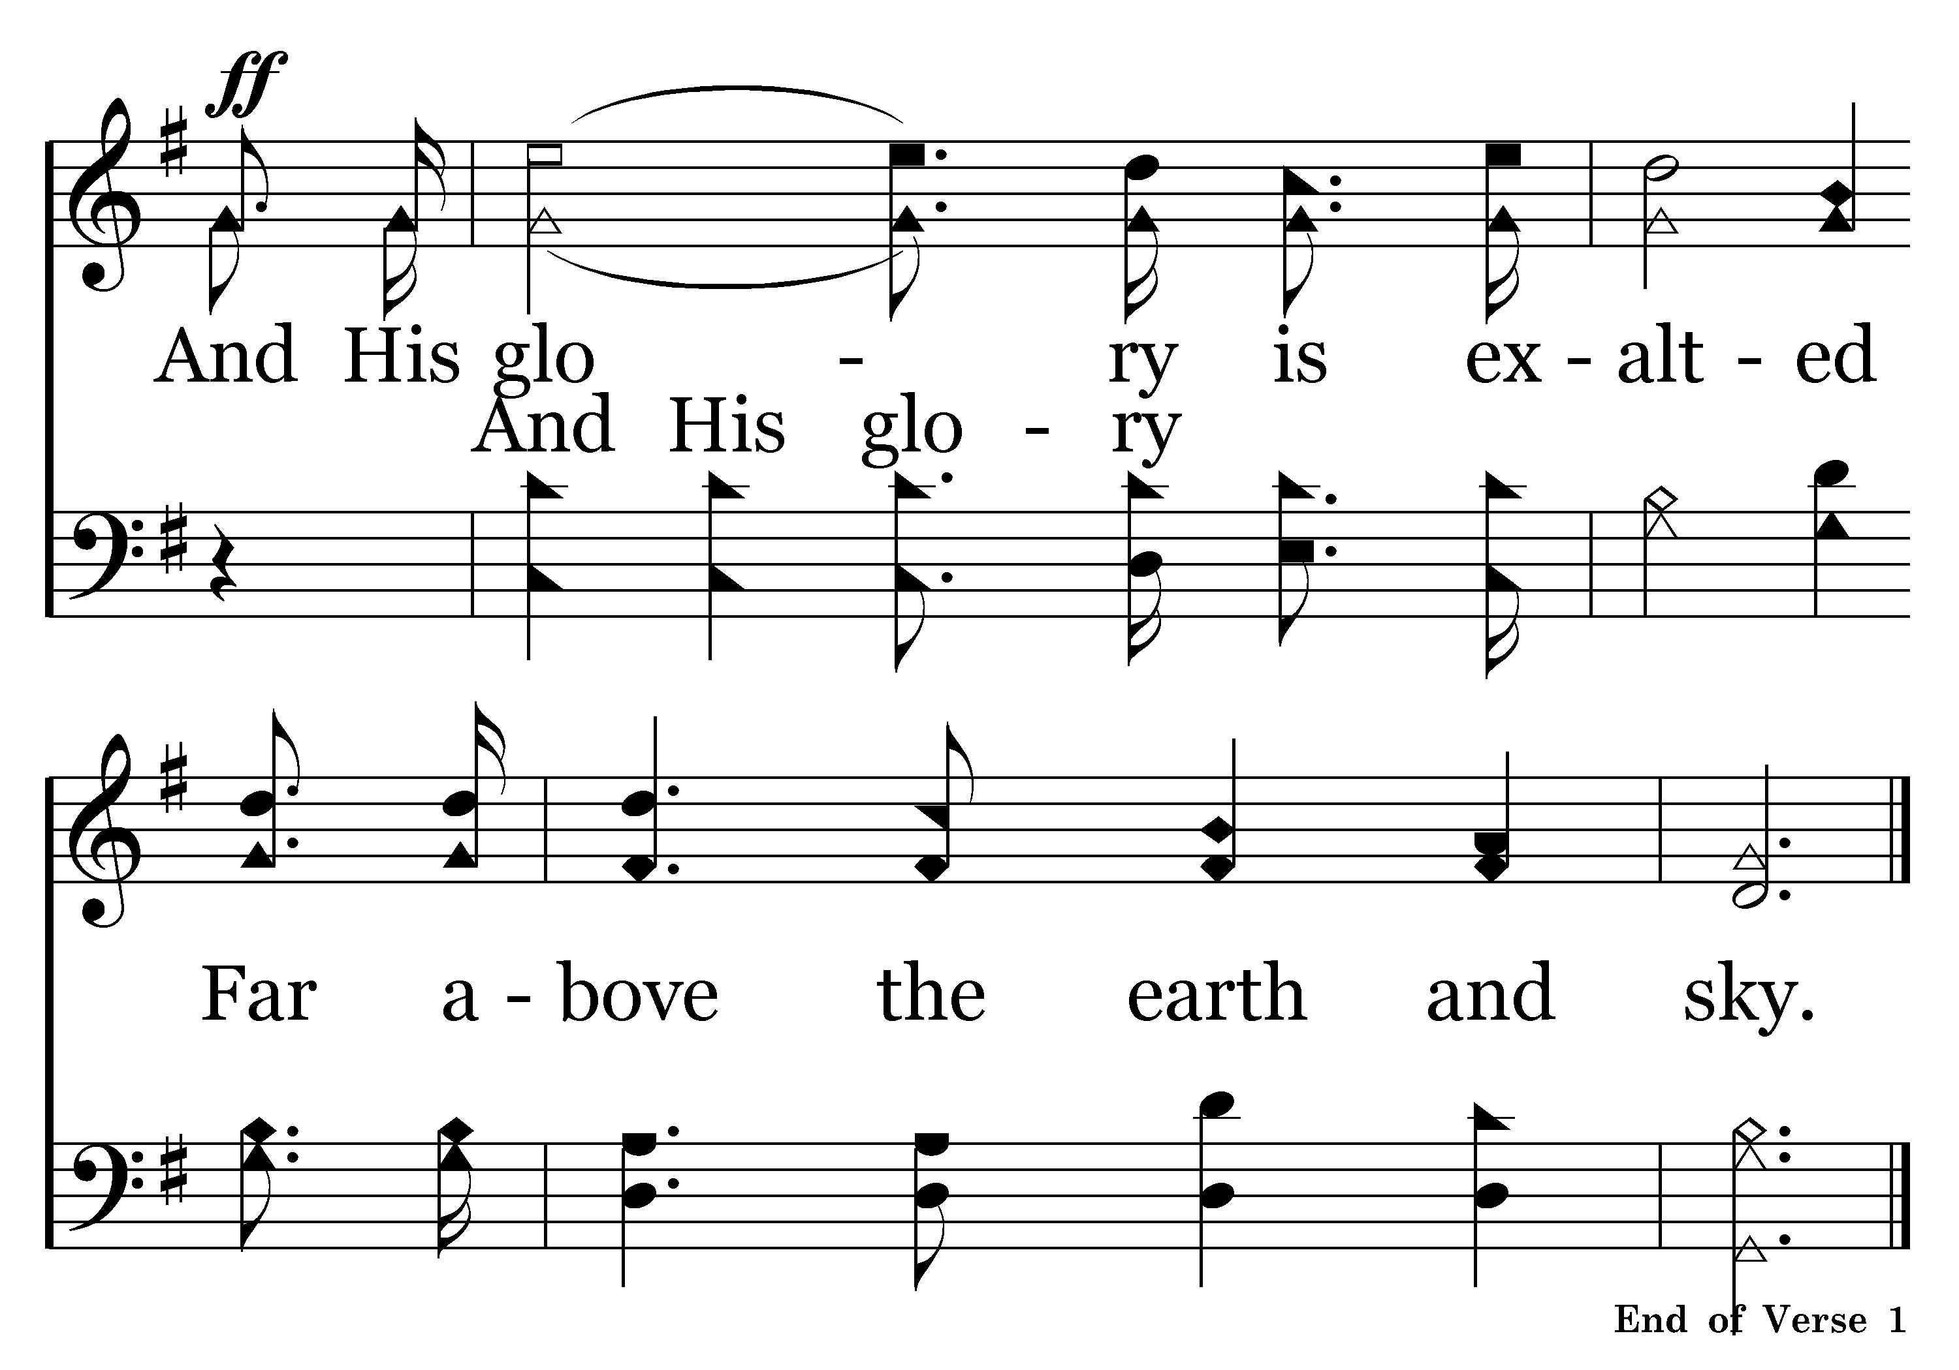
002 – HALLELUJAH PRAISE JEHOVAH – 1.7-C3
End of Song

Slide 57
Colossians 3:12-16
Ephesians 5:1-19
Psalm 34:3
Oh, magnify the LORD with me, and let us exalt His name together.
12 Therefore, as the elect of God,
15 let the peace of God rule in your hearts, to which also you were called in one body; and be thankful.
16 Let the word of Christ dwell in you richly in all wisdom, teaching and admonishing one another in psalms and hymns and spiritual songs, singing with grace in your hearts to the Lord.
1 Therefore be imitators of God as dear children.
17 Therefore do not be unwise, but understand what the will of the Lord is.
18 And do not be drunk with wine, in which is dissipation; but be filled with the Spirit,
19 speaking to one another in psalms and hymns and spiritual songs, singing and making melody in your heart to the Lord,
WHEN?

Slide 59
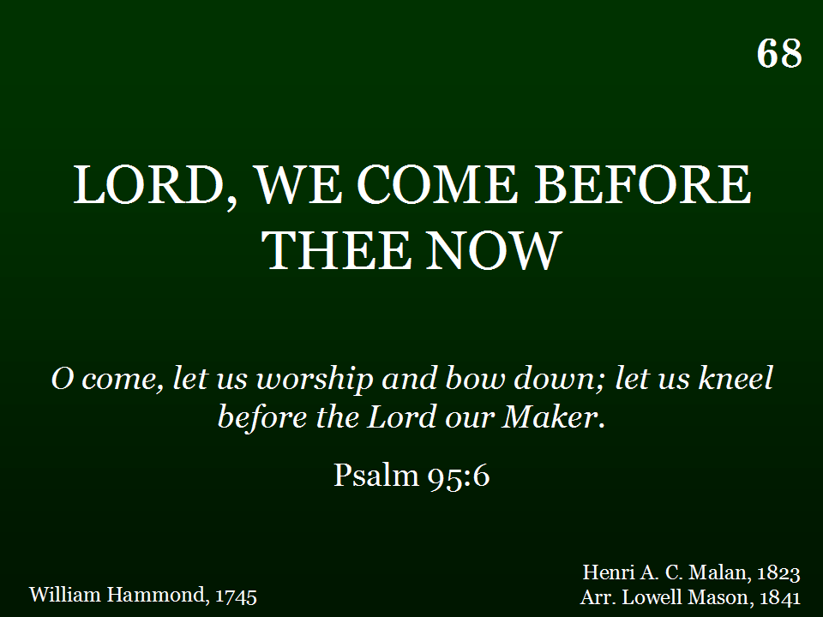
068 - LORD WE COME BEFORE THEE - TITLE

Slide 60
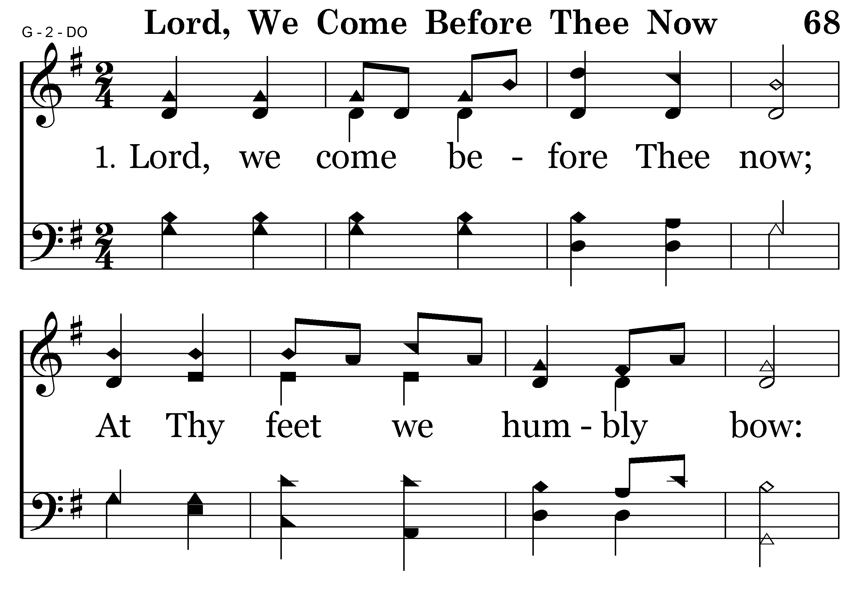
068 - LORD WE COME BEFORE THEE – 1.1

Slide 61
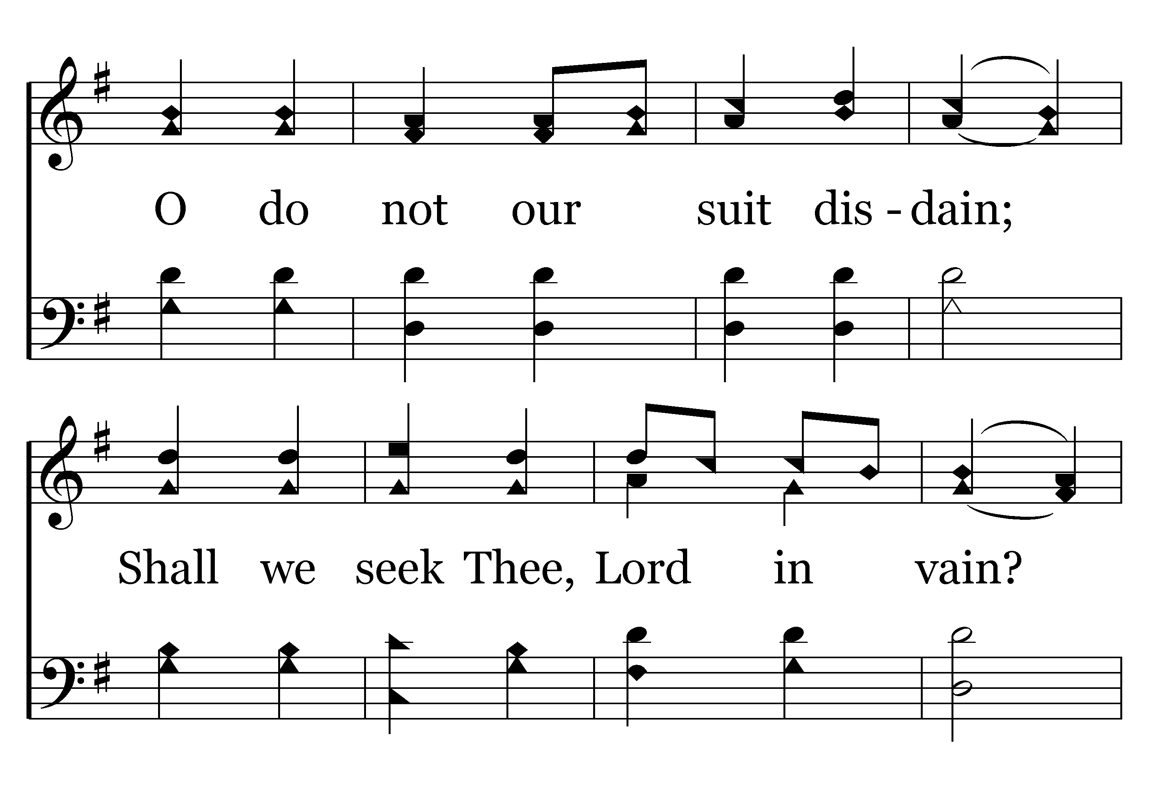
068 - LORD WE COME BEFORE THEE – 1.2

Slide 62
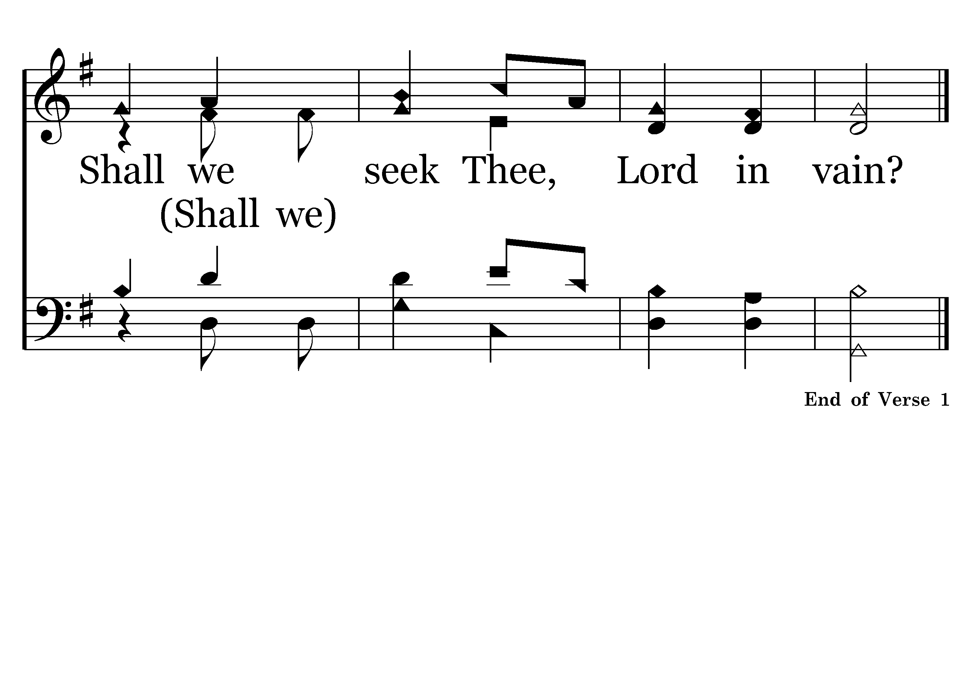
068 - LORD WE COME BEFORE THEE – 1.3

Slide 63
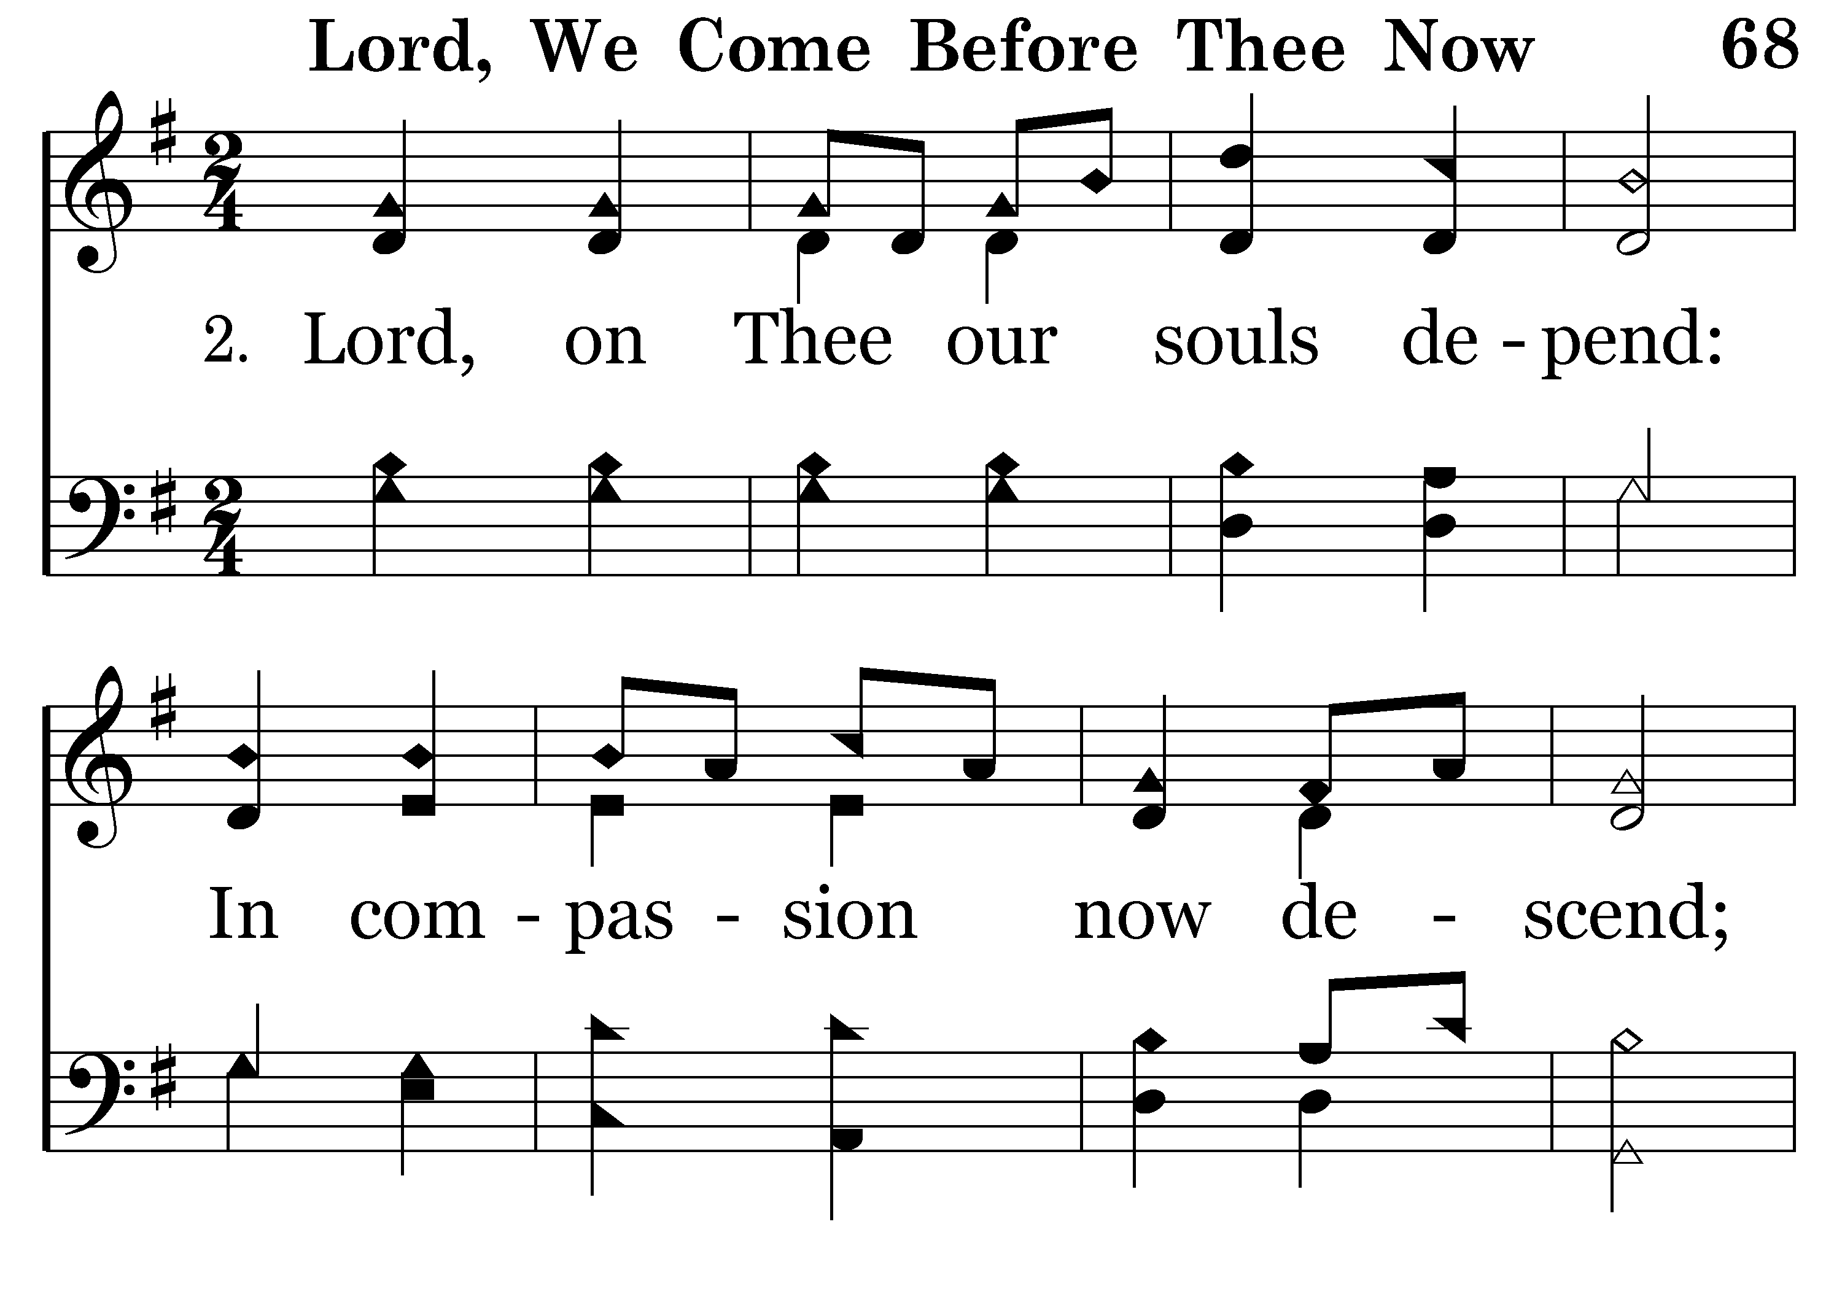
068 - LORD WE COME BEFORE THEE – 2.1

Slide 64
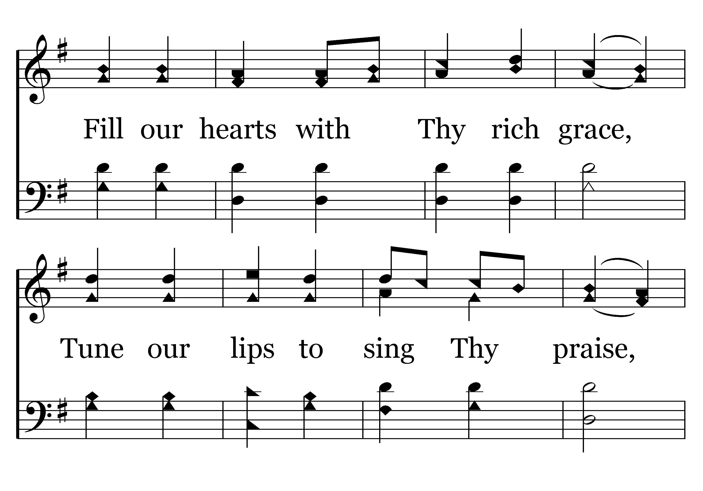
068 - LORD WE COME BEFORE THEE – 2.2

Slide 65
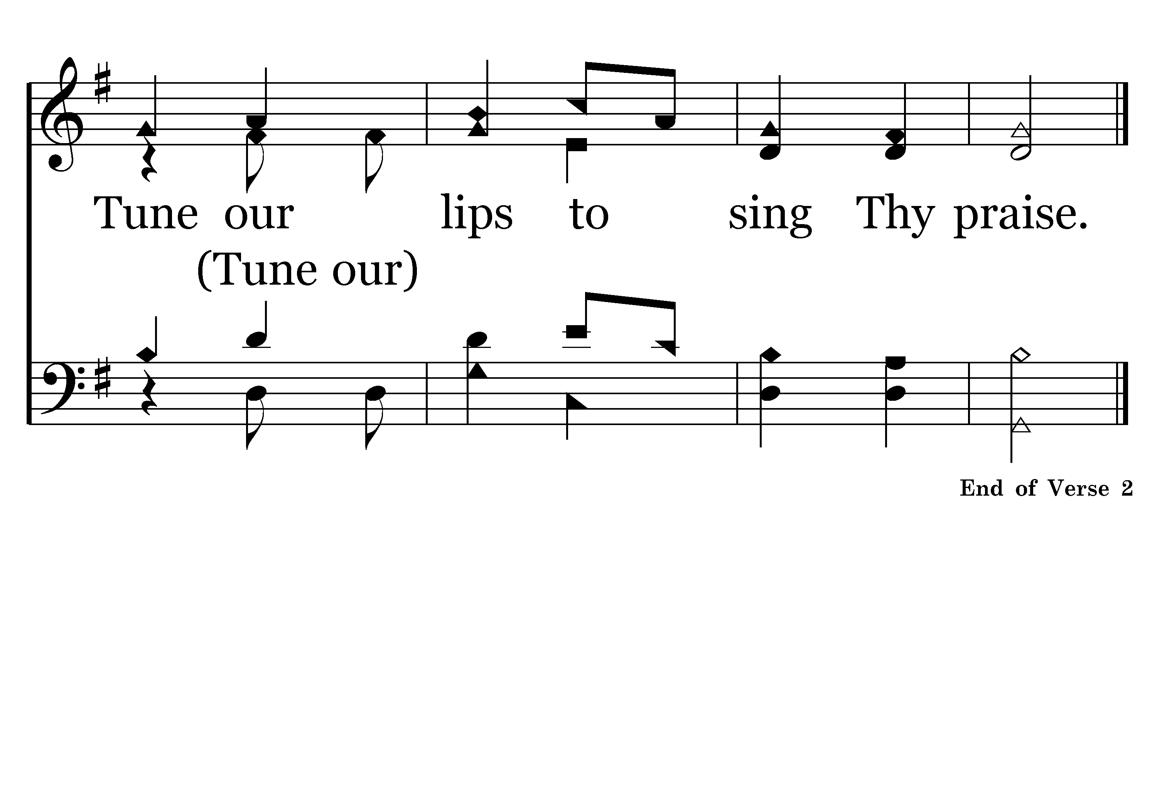
068 - LORD WE COME BEFORE THEE – 2.3

Slide 66
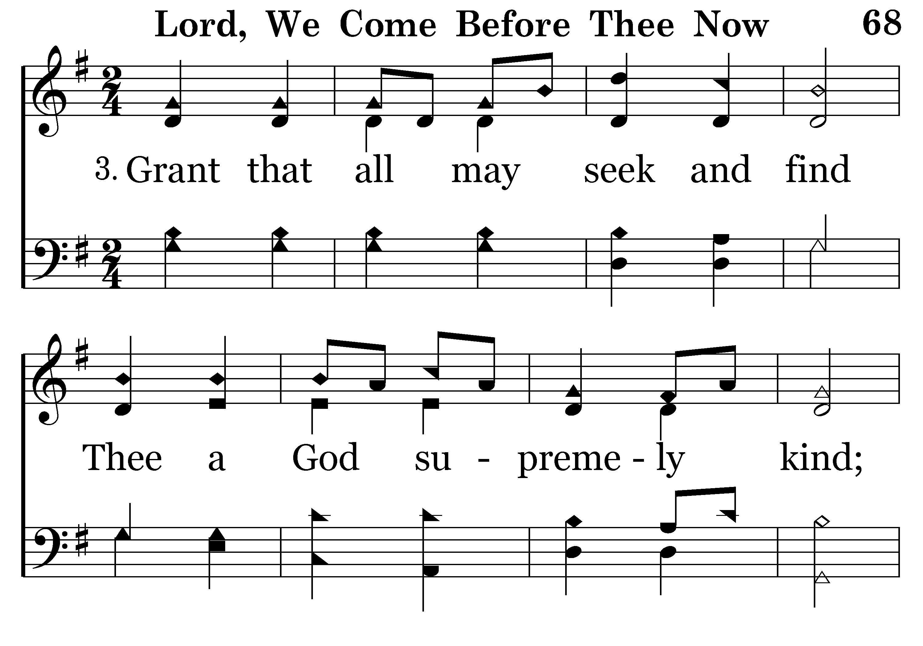
068 - LORD WE COME BEFORE THEE – 3.1

Slide 67
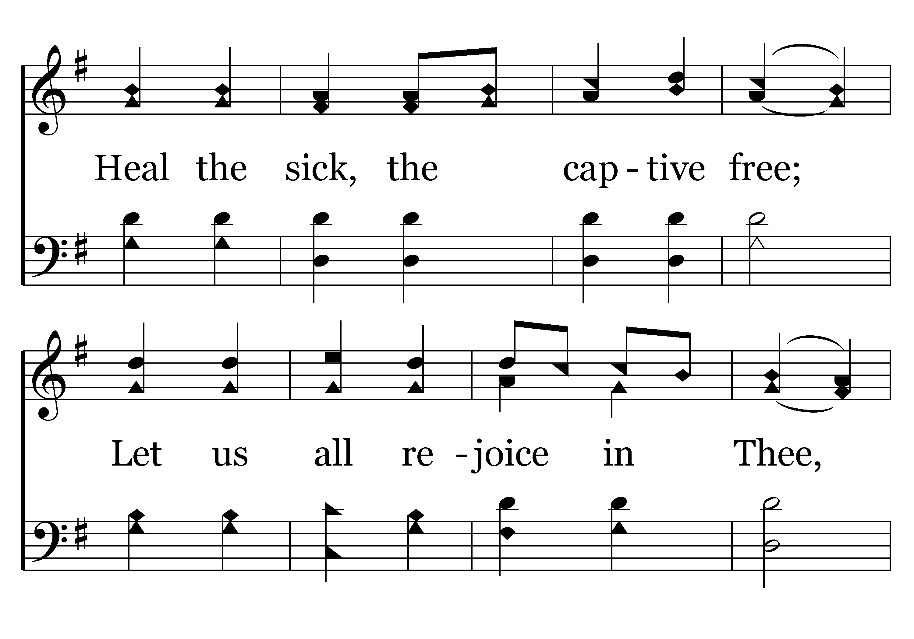
068 - LORD WE COME BEFORE THEE – 3.2

Slide 68
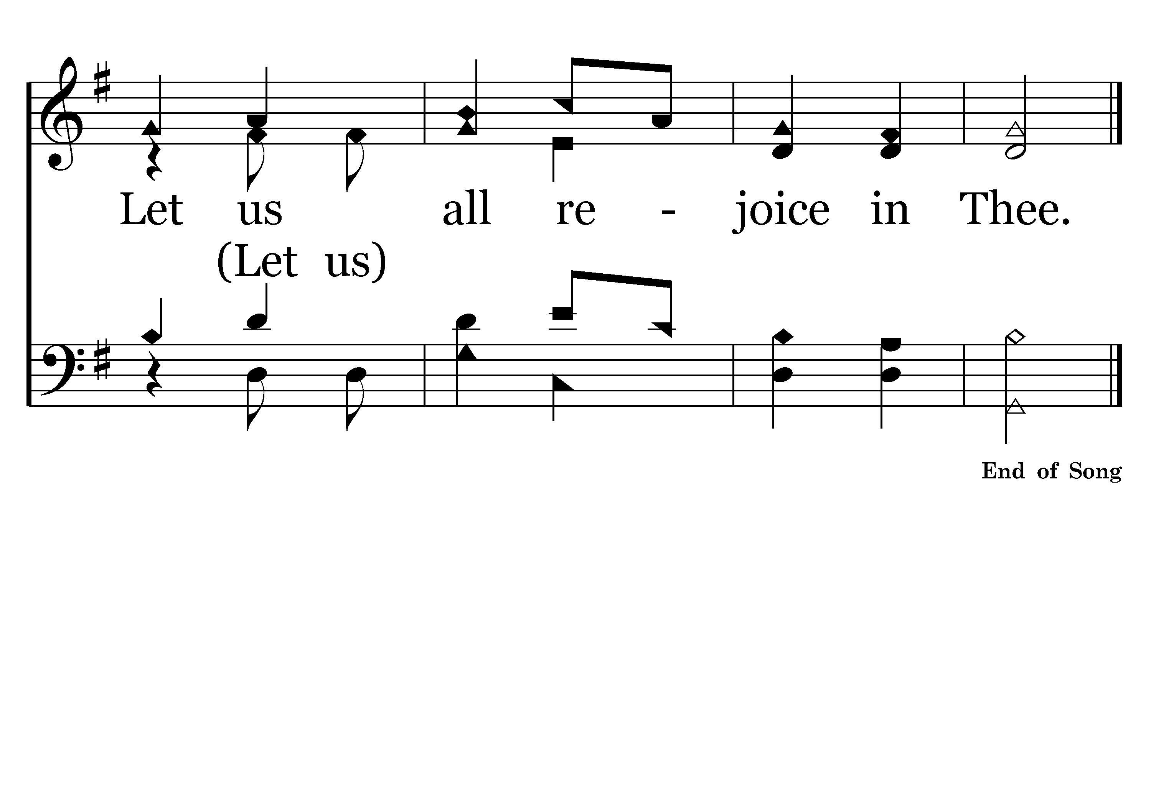
068 - LORD WE COME BEFORE THEE – 3.3

Slide 70
Hebrews 13:15
Therefore by Him let us continually offer the sacrifice of praise to God, that is, the fruit of our lips, giving thanks to His name.
Colossians 3:12-16
Ephesians 5:1-19
12 Therefore, as the elect of God,
15 let the peace of God rule in your hearts, to which also you were called in one body; and be thankful.
16 Let the word of Christ dwell in you richly in all wisdom, teaching and admonishing one another in psalms and hymns and spiritual songs, singing with grace in your hearts to the Lord.
1 Therefore be imitators of God as dear children.
17 Therefore do not be unwise, but understand what the will of the Lord is.
18 And do not be drunk with wine, in which is dissipation; but be filled with the Spirit,
19 speaking to one another in psalms and hymns and spiritual songs, singing and making melody in your heart to the Lord,
WHY?

Slide 72
1 Cor. 14:15
I will pray with the spirit, and I will also pray with the understanding. I will sing with the spirit, and I will also sing with the understanding.
Acts 16:25
But at midnight Paul and Silas were praying and singing hymns to God, and the prisoners were listening to them.

Slide 74
Colossians 3:12-16
Ephesians 5:1-19
PSALMS – songs of praise
Hymns
Spiritual Songs
12 Therefore, as the elect of God,
15 let the peace of God rule in your hearts, to which also you were called in one body; and be thankful.
16 Let the word of Christ dwell in you richly in all wisdom, teaching and admonishing one another in psalms and hymns and spiritual songs, singing with grace in your hearts to the Lord.
1 Therefore be imitators of God as dear children.
17 Therefore do not be unwise, but understand what the will of the Lord is.
18 And do not be drunk with wine, in which is dissipation; but be filled with the Spirit,
19 speaking to one another in psalms and hymns and spiritual songs, singing and making melody in your heart to the Lord,
WHAT?

Slide 75
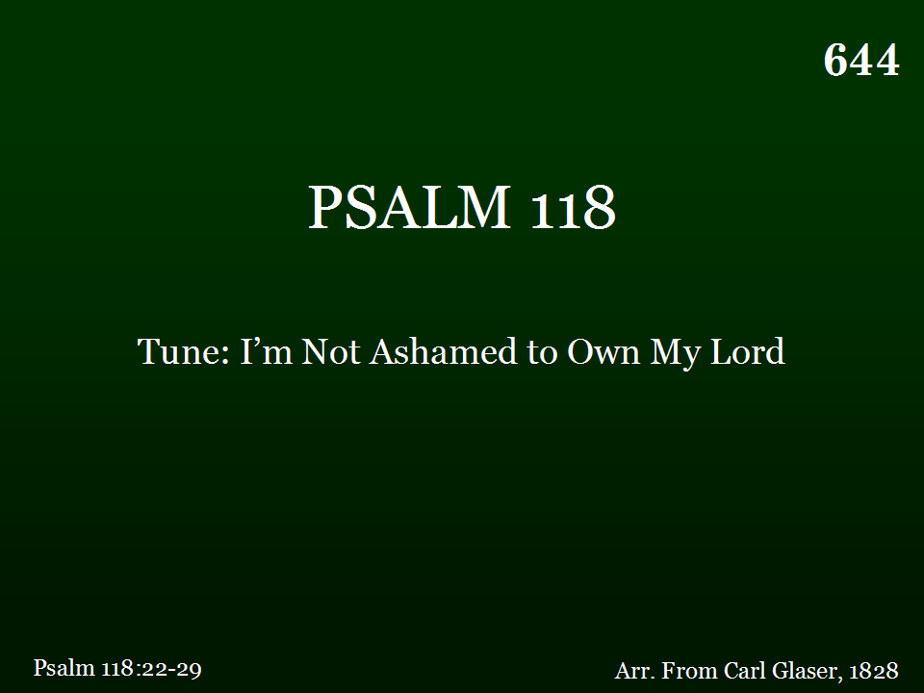
644 - PSALM 118 - TITLE

Slide 76
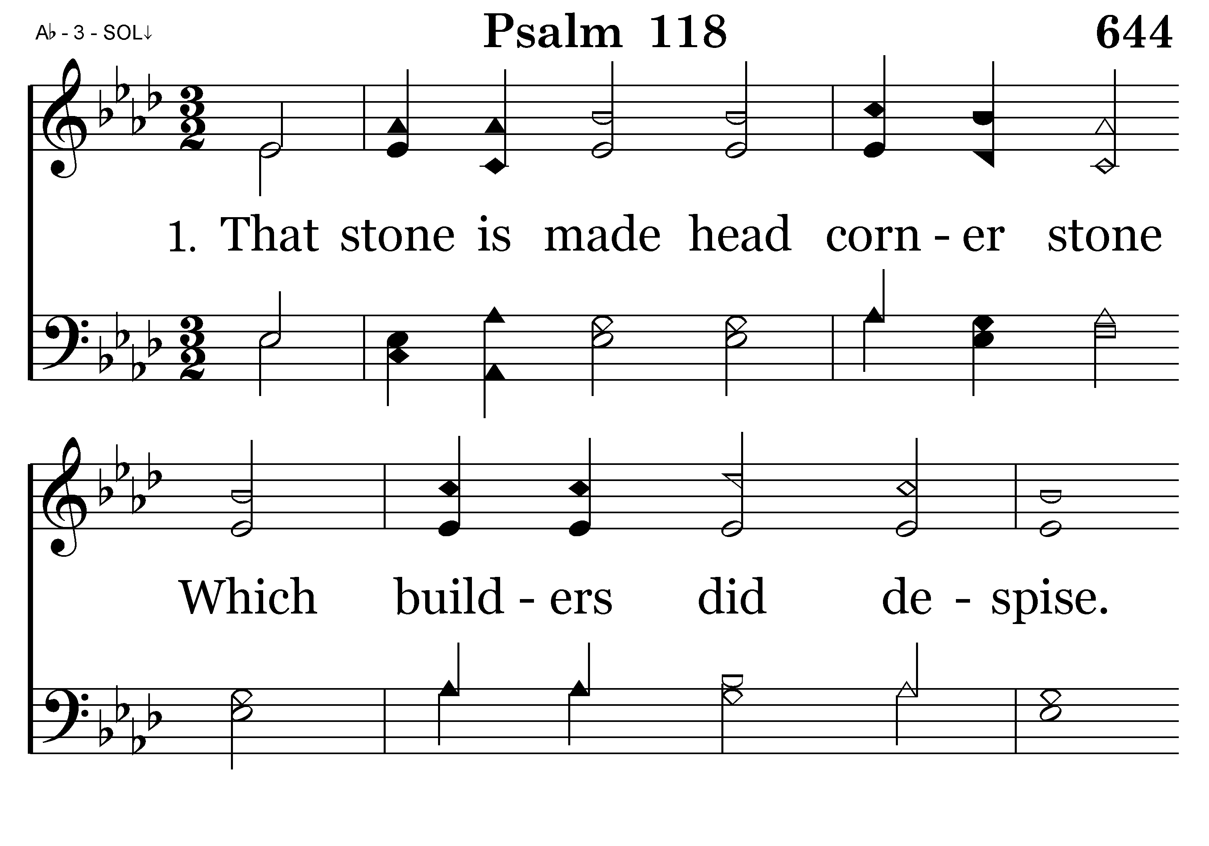
644 - PSALM 118 – 1.1

Slide 77
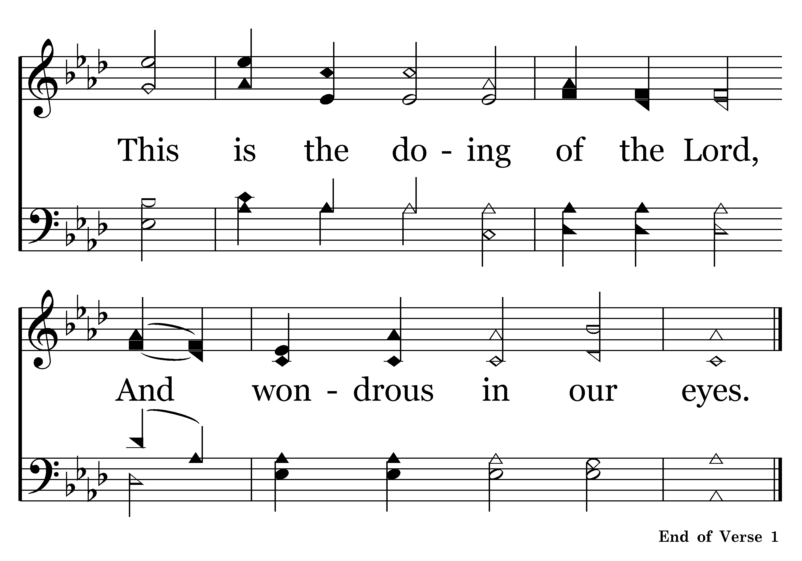
644 - PSALM 118 – 1.2

Slide 78
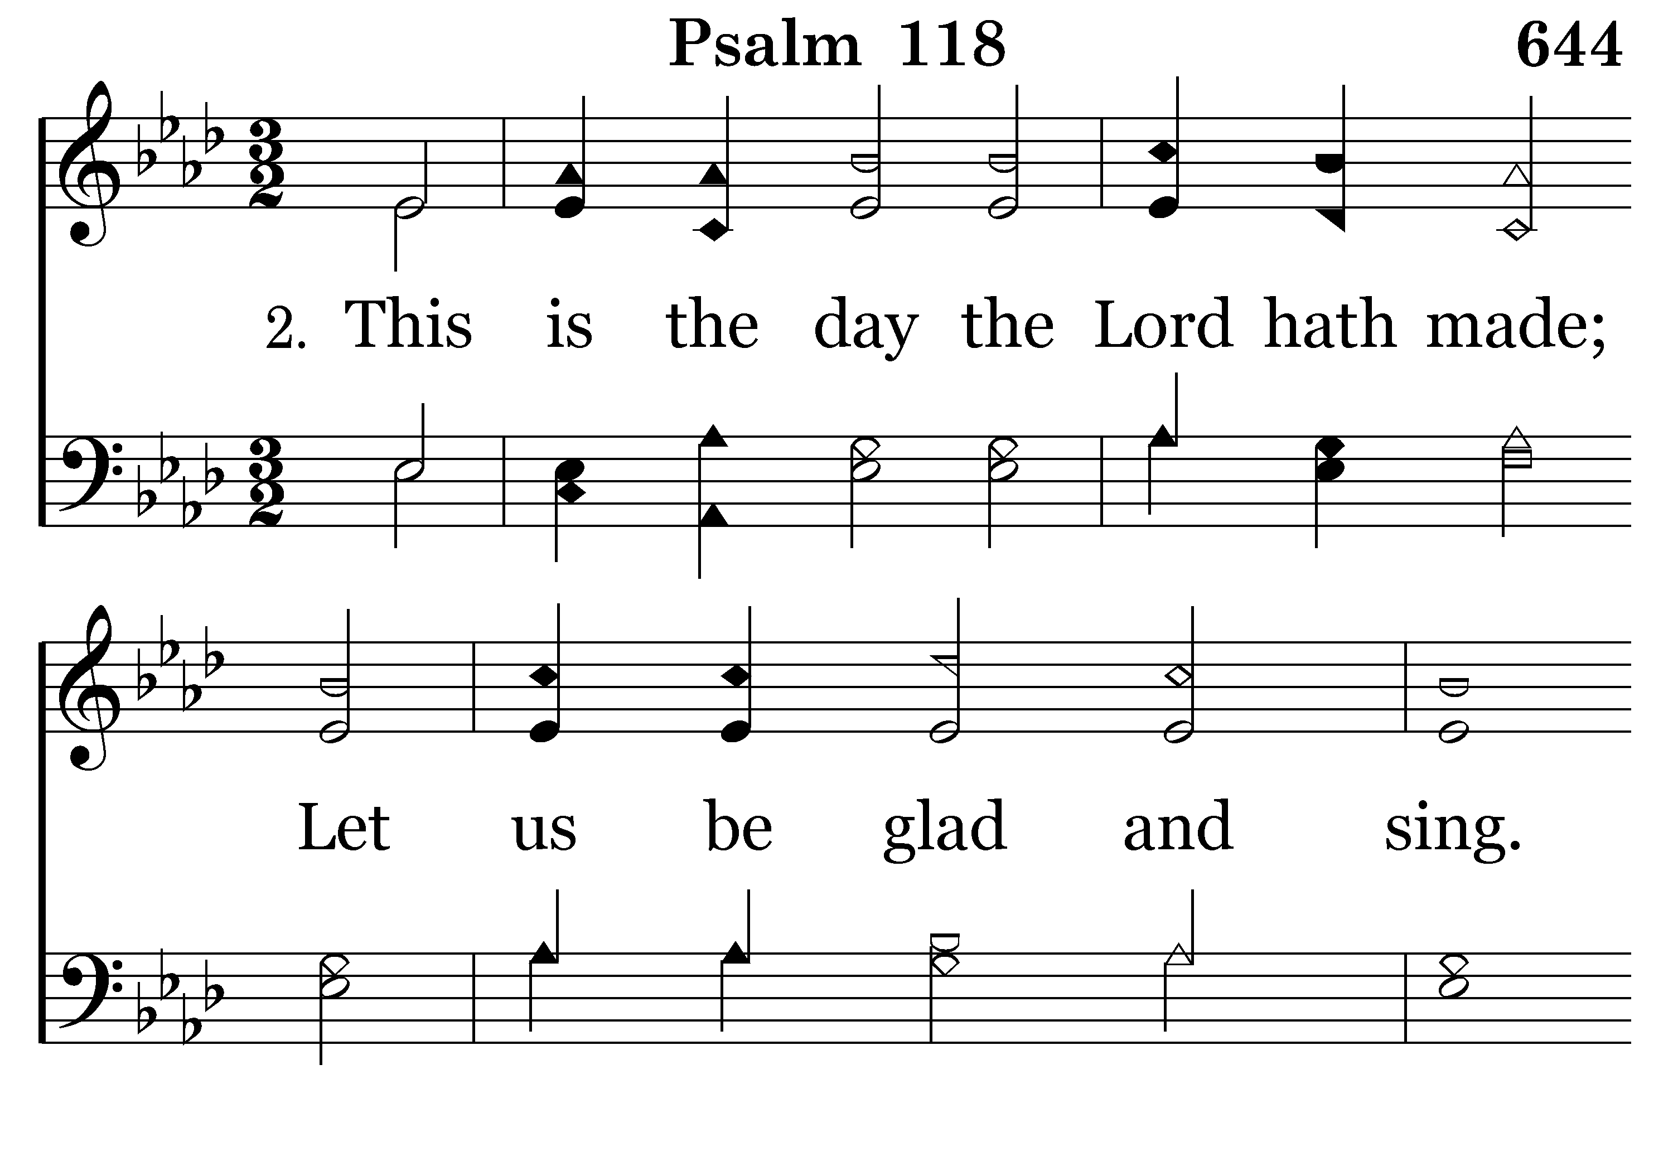
644 - PSALM 118 – 2.1

Slide 79
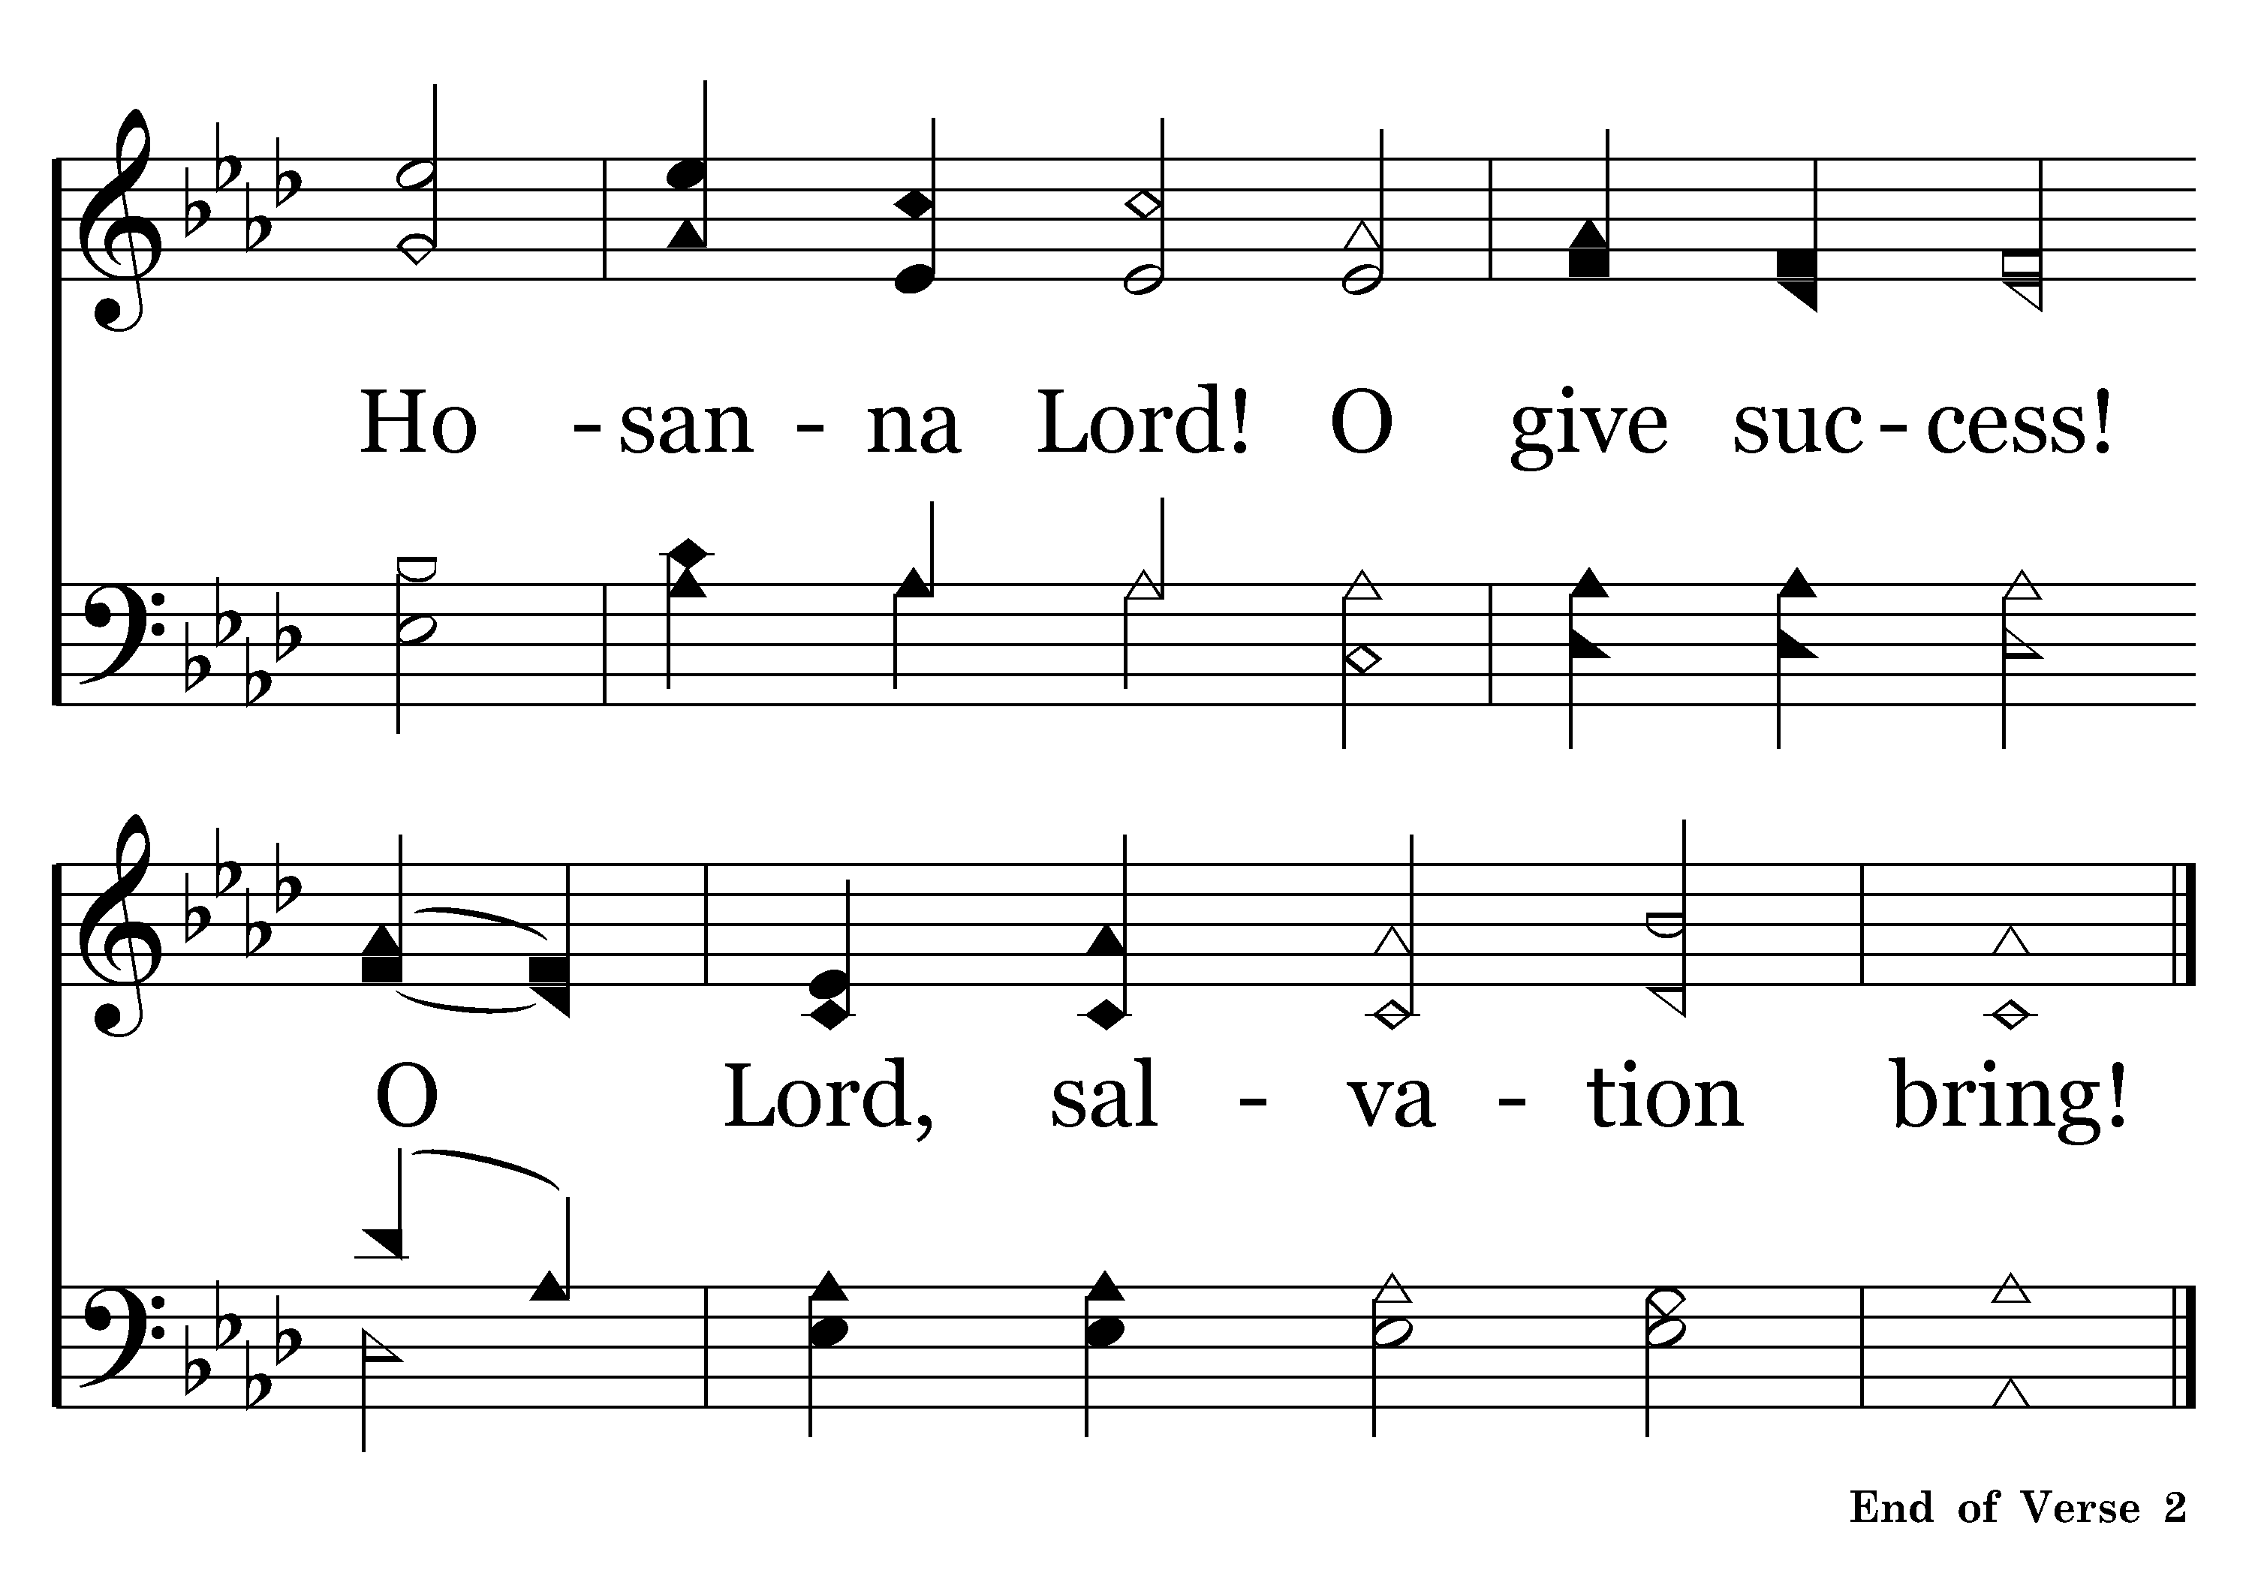
644 - PSALM 118 – 2.2

Slide 80

644 - PSALM 118 – 3.1

Slide 81

644 - PSALM 118 – 3.2

Slide 82
Colossians 3:12-16
Ephesians 5:1-19
Psalms – songs of praise
HYMNS – songs of praise & thanksgiving
Spiritual Songs
12 Therefore, as the elect of God,
15 let the peace of God rule in your hearts, to which also you were called in one body; and be thankful.
16 Let the word of Christ dwell in you richly in all wisdom, teaching and admonishing one another in psalms and hymns and spiritual songs, singing with grace in your hearts to the Lord.
1 Therefore be imitators of God as dear children.
17 Therefore do not be unwise, but understand what the will of the Lord is.
18 And do not be drunk with wine, in which is dissipation; but be filled with the Spirit,
19 speaking to one another in psalms and hymns and spiritual songs, singing and making melody in your heart to the Lord,

Slide 83

034 - WORTHY ART THOU – TITLE

Slide 84

034 - WORTHY ART THOU – 1.1

Slide 85

034 - WORTHY ART THOU – 1.2

Slide 86

034 - WORTHY ART THOU – 1.3-C1

Slide 87

034 - WORTHY ART THOU – 1.4-C2
End of Song

Slide 88
Colossians 3:12-16
Ephesians 5:1-19
Psalms – songs of praise
Hymns – songs of praise & thanksgiving
SPIRITUAL SONGS – includes psalms & hymns, but the expression emphasizes the importance of heart motivation.
12 Therefore, as the elect of God,
15 let the peace of God rule in your hearts, to which also you were called in one body; and be thankful.
16 Let the word of Christ dwell in you richly in all wisdom, teaching and admonishing one another in psalms and hymns and spiritual songs, singing with grace in your hearts to the Lord.
1 Therefore be imitators of God as dear children.
17 Therefore do not be unwise, but understand what the will of the Lord is.
18 And do not be drunk with wine, in which is dissipation; but be filled with the Spirit,
19 speaking to one another in psalms and hymns and spiritual songs, singing and making melody in your heart to the Lord,

Slide 90
Colossians 3:12-16
Ephesians 5:1-19
12 Therefore, as the elect of God,
15 let the peace of God rule in your hearts, to which also you were called in one body; and be thankful.
16 Let the word of Christ dwell in you richly in all wisdom, teaching and admonishing one another in psalms and hymns and spiritual songs, singing with grace in your hearts to the Lord.
1 Therefore be imitators of God as dear children.
17 Therefore do not be unwise, but understand what the will of the Lord is.
18 And do not be drunk with wine, in which is dissipation; but be filled with the Spirit,
19 speaking to one another in psalms and hymns and spiritual songs, singing and making melody in your heart to the Lord,
HOW?

Slide 92
“The very best way now to rejuvenate dead churches would be to SING them into life.”

Slide 94

190 - WE'RE MARCHING TO ZION - TITLE

Slide 95

190 - WE'RE MARCHING TO ZION – 1.1

Slide 96


190 - WE'RE MARCHING TO ZION – 1.2

Slide 97

190 - WE'RE MARCHING TO ZION – 1.3

Slide 98

190 - WE'RE MARCHING TO ZION – 1.4-C1

Slide 99

190 - WE'RE MARCHING TO ZION – 1.5-C2
End of Song

Slide 101

263 - IS THY HEART RIGHT - TITLE

Slide 102

263 - IS THY HEART RIGHT – 1.1

Slide 103

263 - IS THY HEART RIGHT – 1.2

Slide 104

263 - IS THY HEART RIGHT – 1.3-C1

Slide 105

263 - IS THY HEART RIGHT – 1.4-C2

Slide 106

263 - IS THY HEART RIGHT – 2.1

Slide 107

263 - IS THY HEART RIGHT – 2.2

Slide 108

263 - IS THY HEART RIGHT – 2.3-C1

Slide 109

263 - IS THY HEART RIGHT – 2.4-C2

Slide 110

263 - IS THY HEART RIGHT – 3.1

Slide 111

263 - IS THY HEART RIGHT – 3.2

Slide 112

263 - IS THY HEART RIGHT – 3.3-C1

Slide 113

263 - IS THY HEART RIGHT – 3.4-C2

Slide 115
Commitment to Worshipping God in Song :
Tucson, AZ (Country Club Road) – Oct. 22, 2006 (Sun. PM)
Concord, NC – March 4, 2007 (Sun. A.M. Class) REVISED FOR “SONGS OF FAITH & PRAISE” HYMNAL
Searcy, AR – March 2008 (Sunday P.M.) REVISED FOR “PRAISE FOR THE LORD” HYMNAL
Folsom, CA – April 13, 2008 (Sunday A.M.) REVISED FOR “HYMNS FOR WORSHIP” HYMNAL
Pampa, TX – May 4, 2008 (Sunday P.M.) REVISED FOR “HYMNS FOR WORSHIP” HYMNAL

