Slide 2
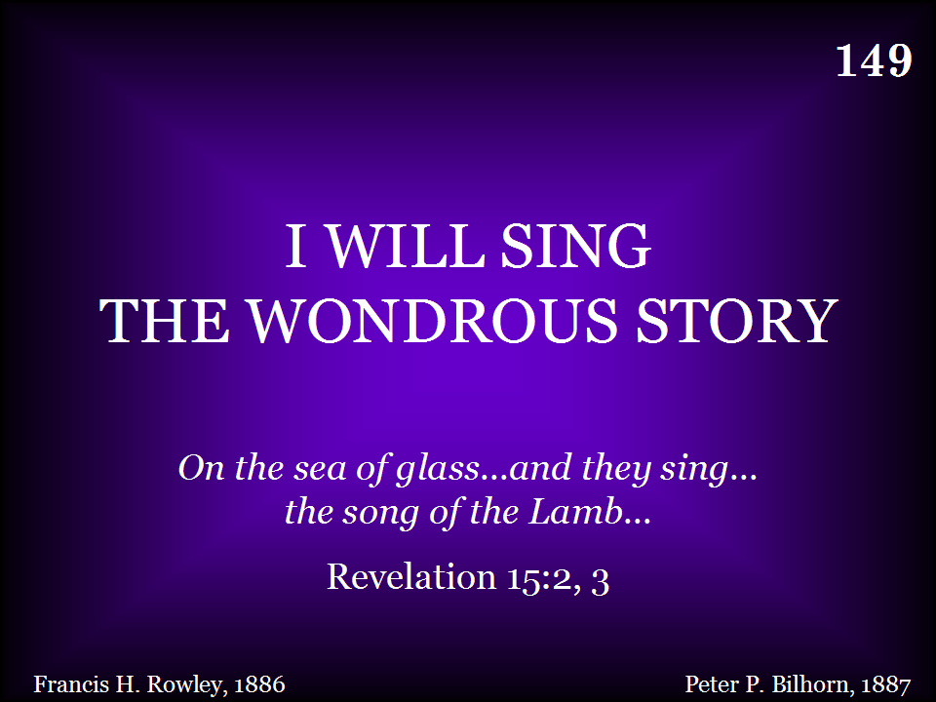

Slide 3
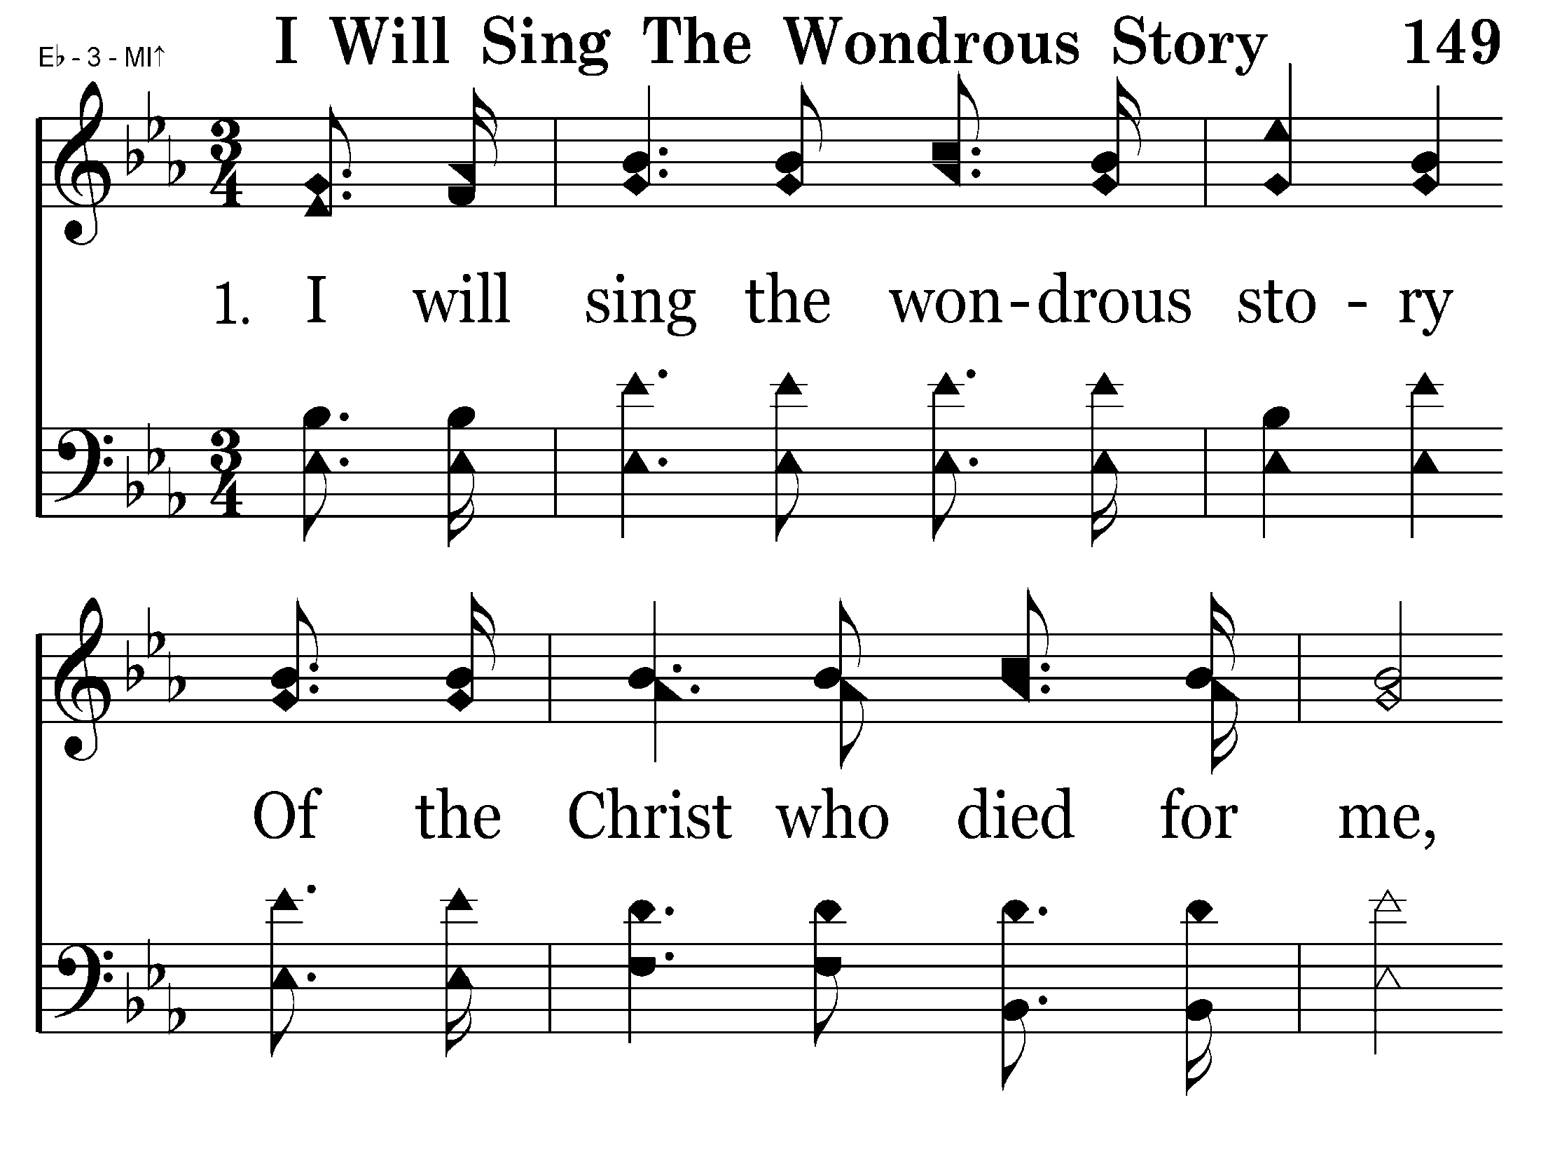

Slide 4
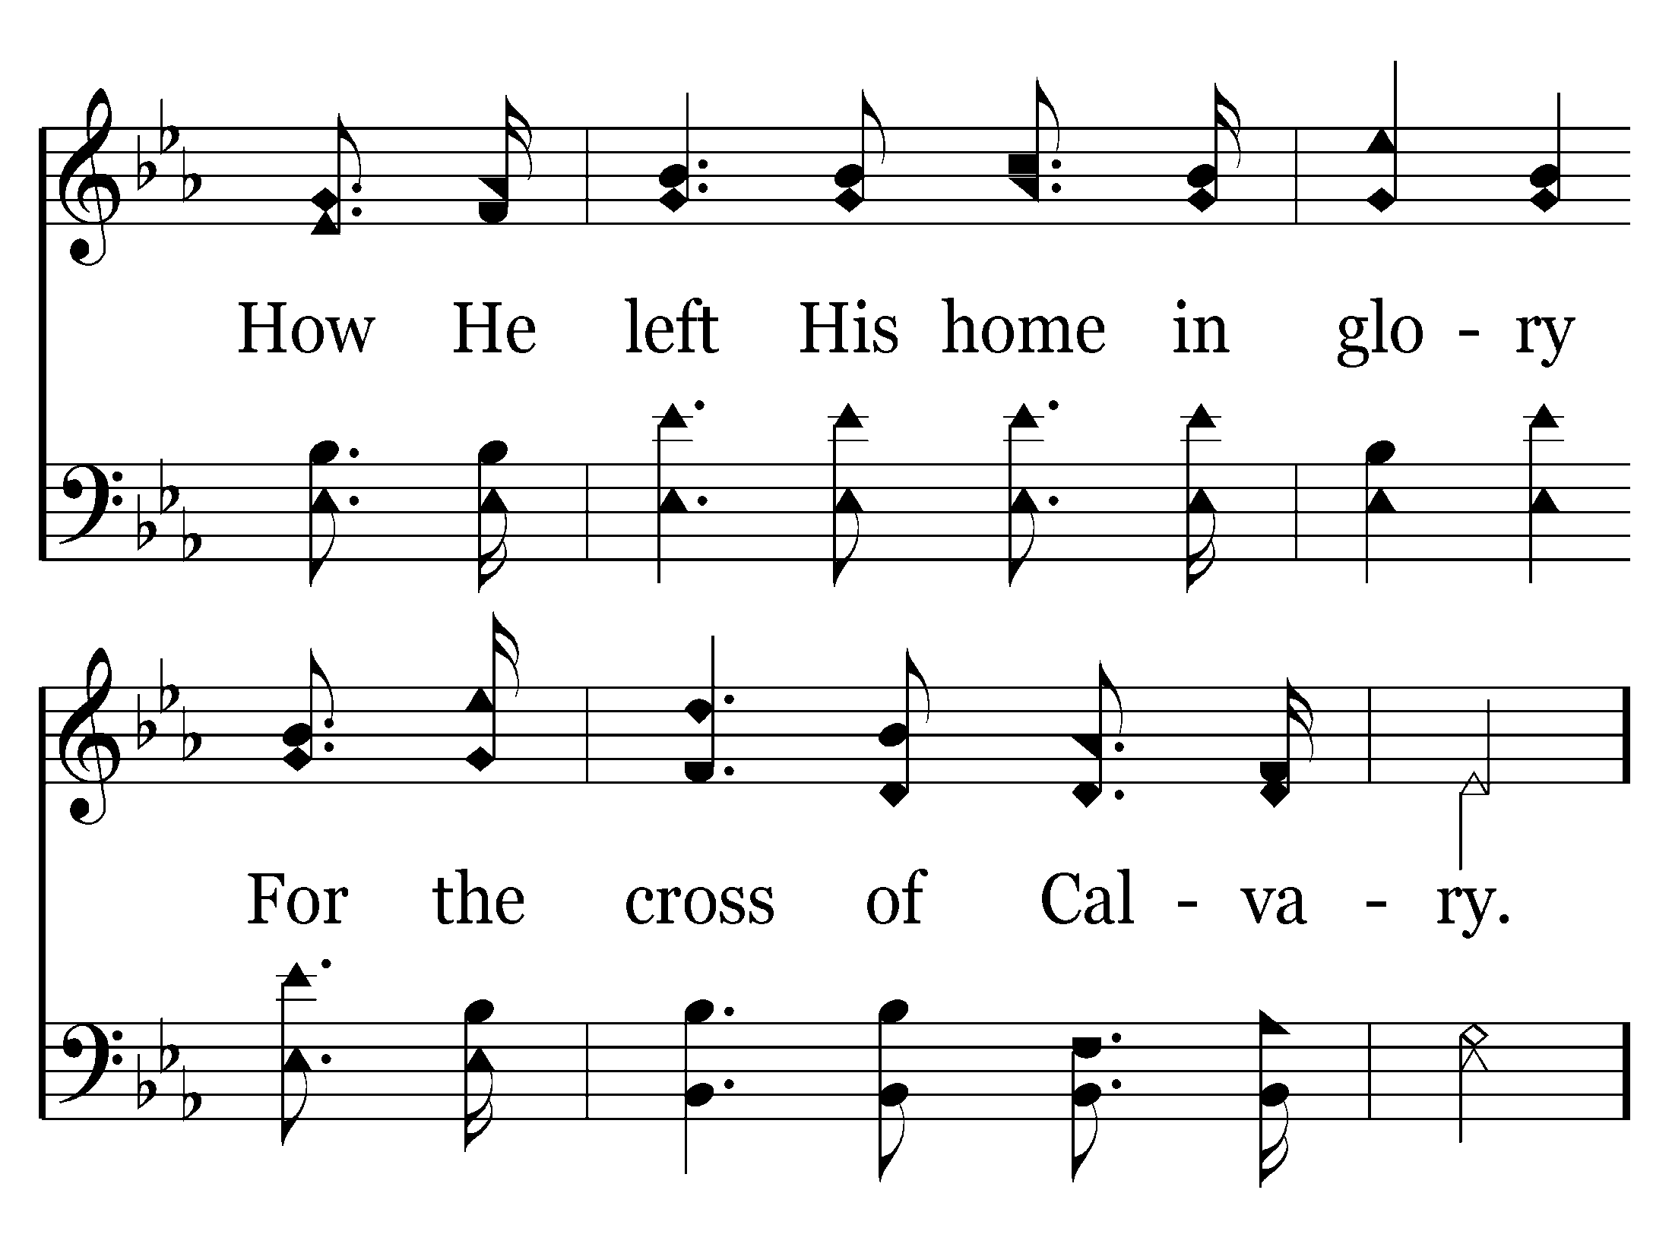

Slide 5
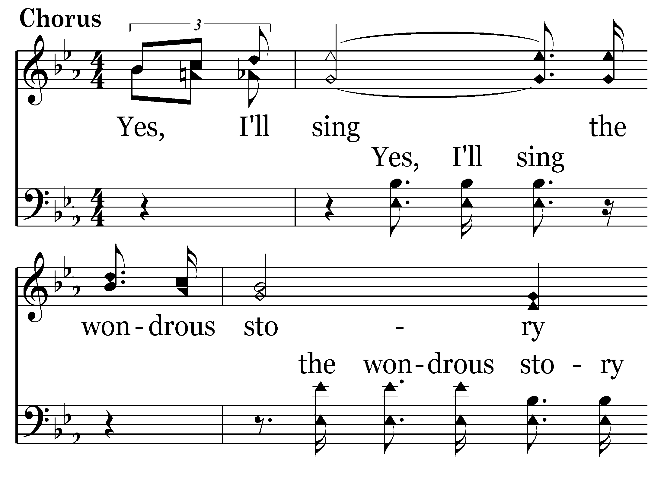

Slide 6
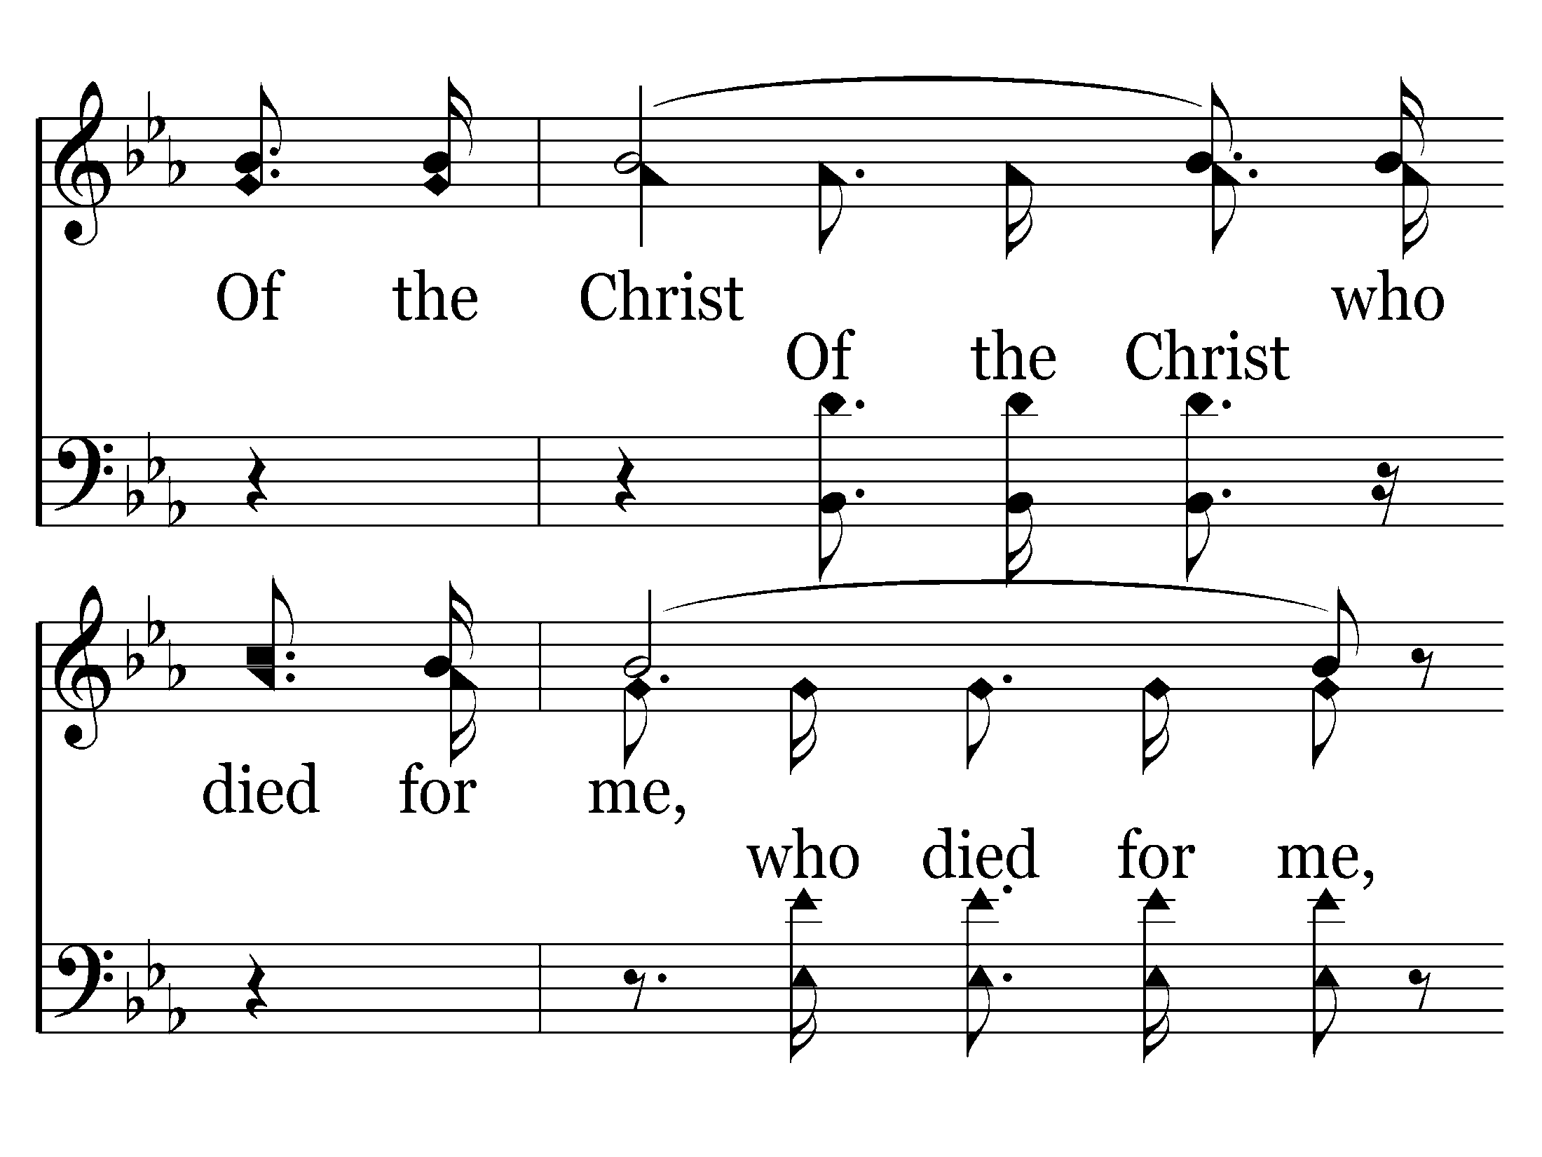

Slide 7
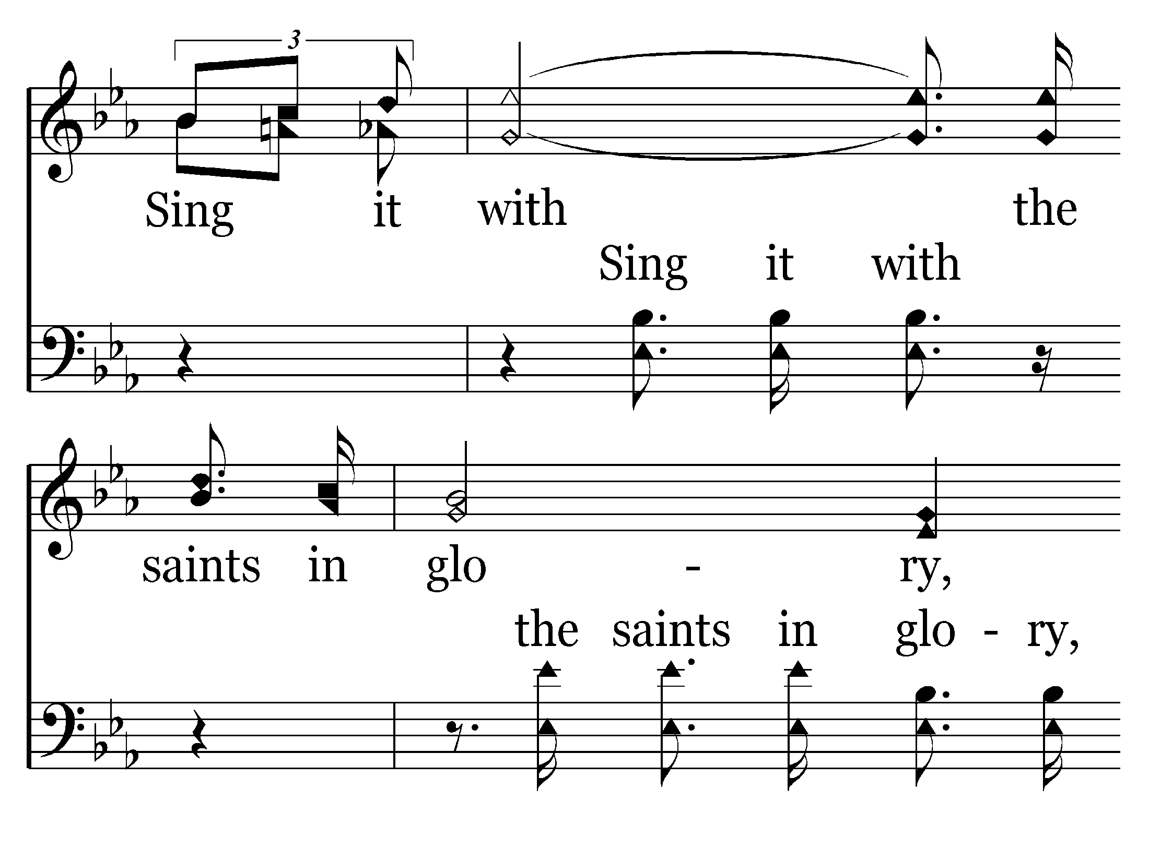

Slide 8
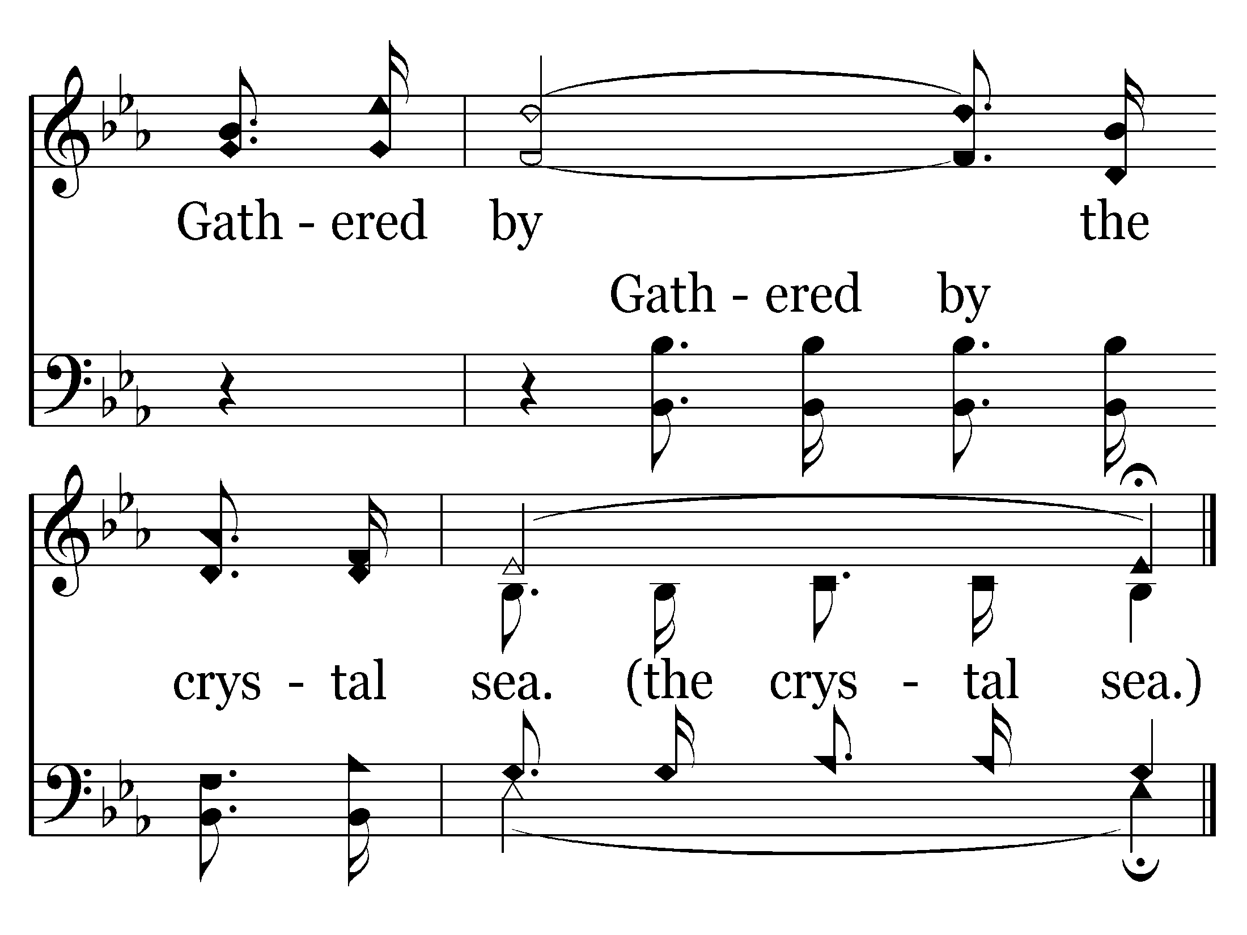
End of Verse 1

Slide 9
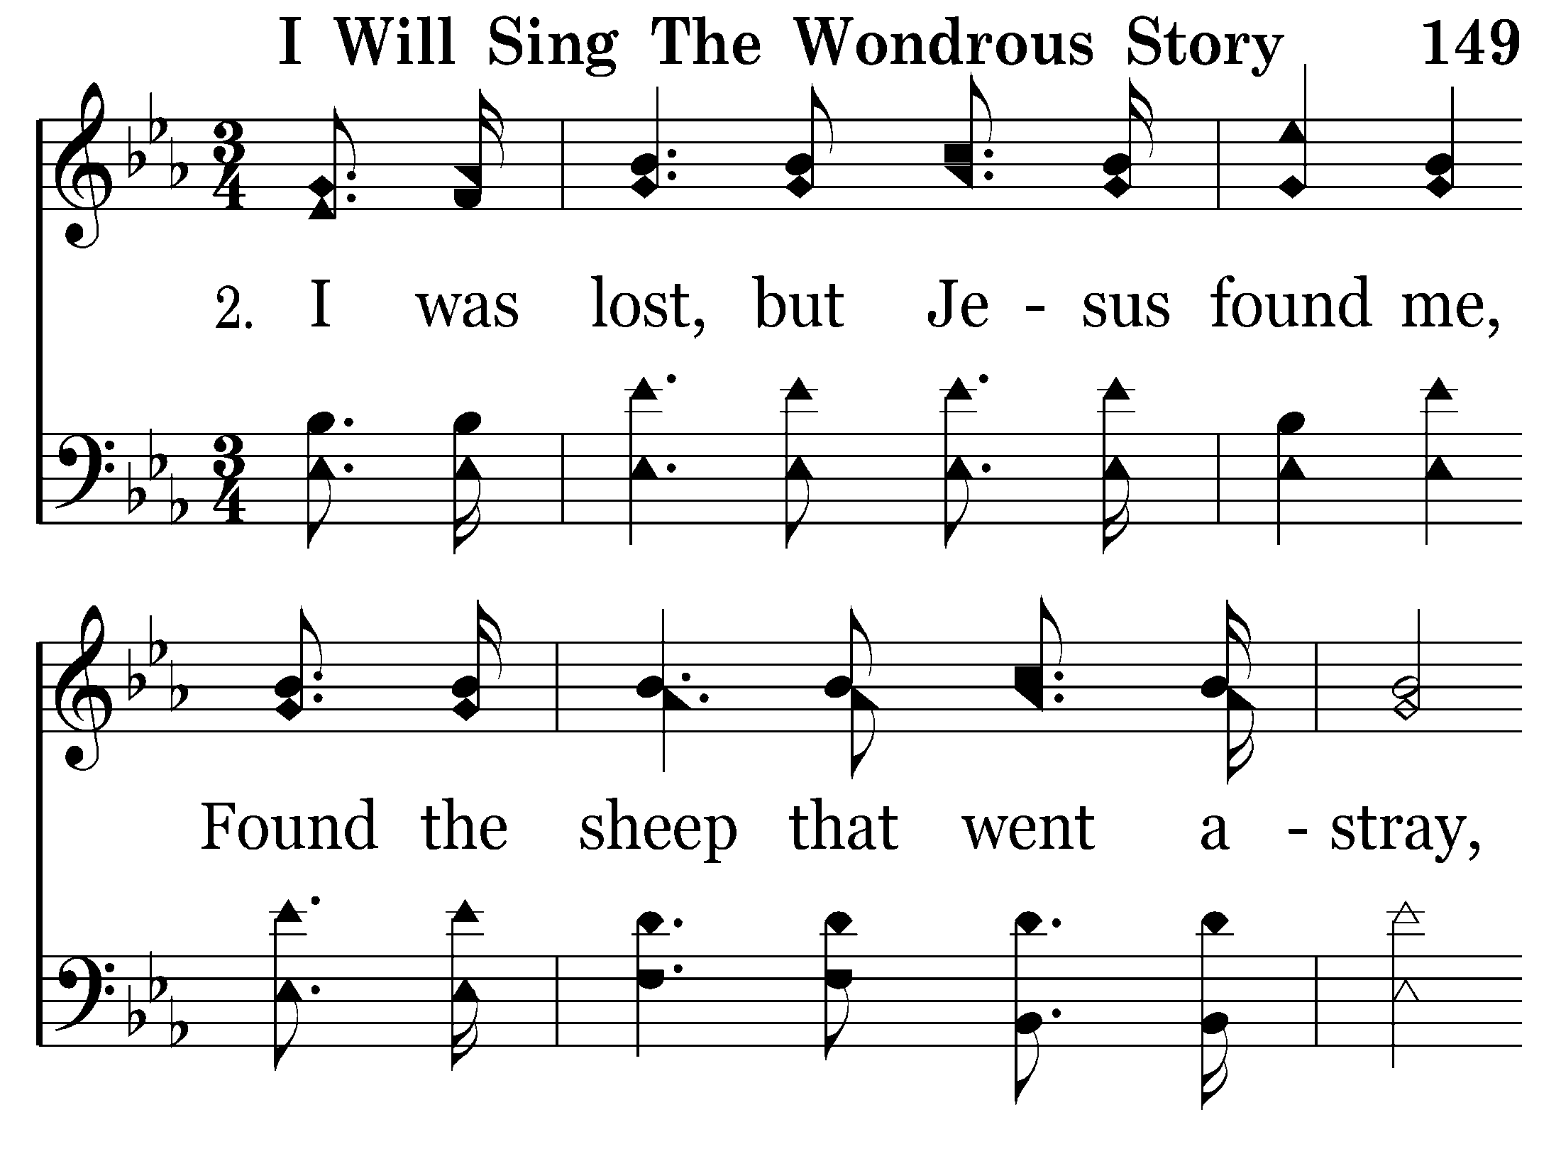

Slide 10
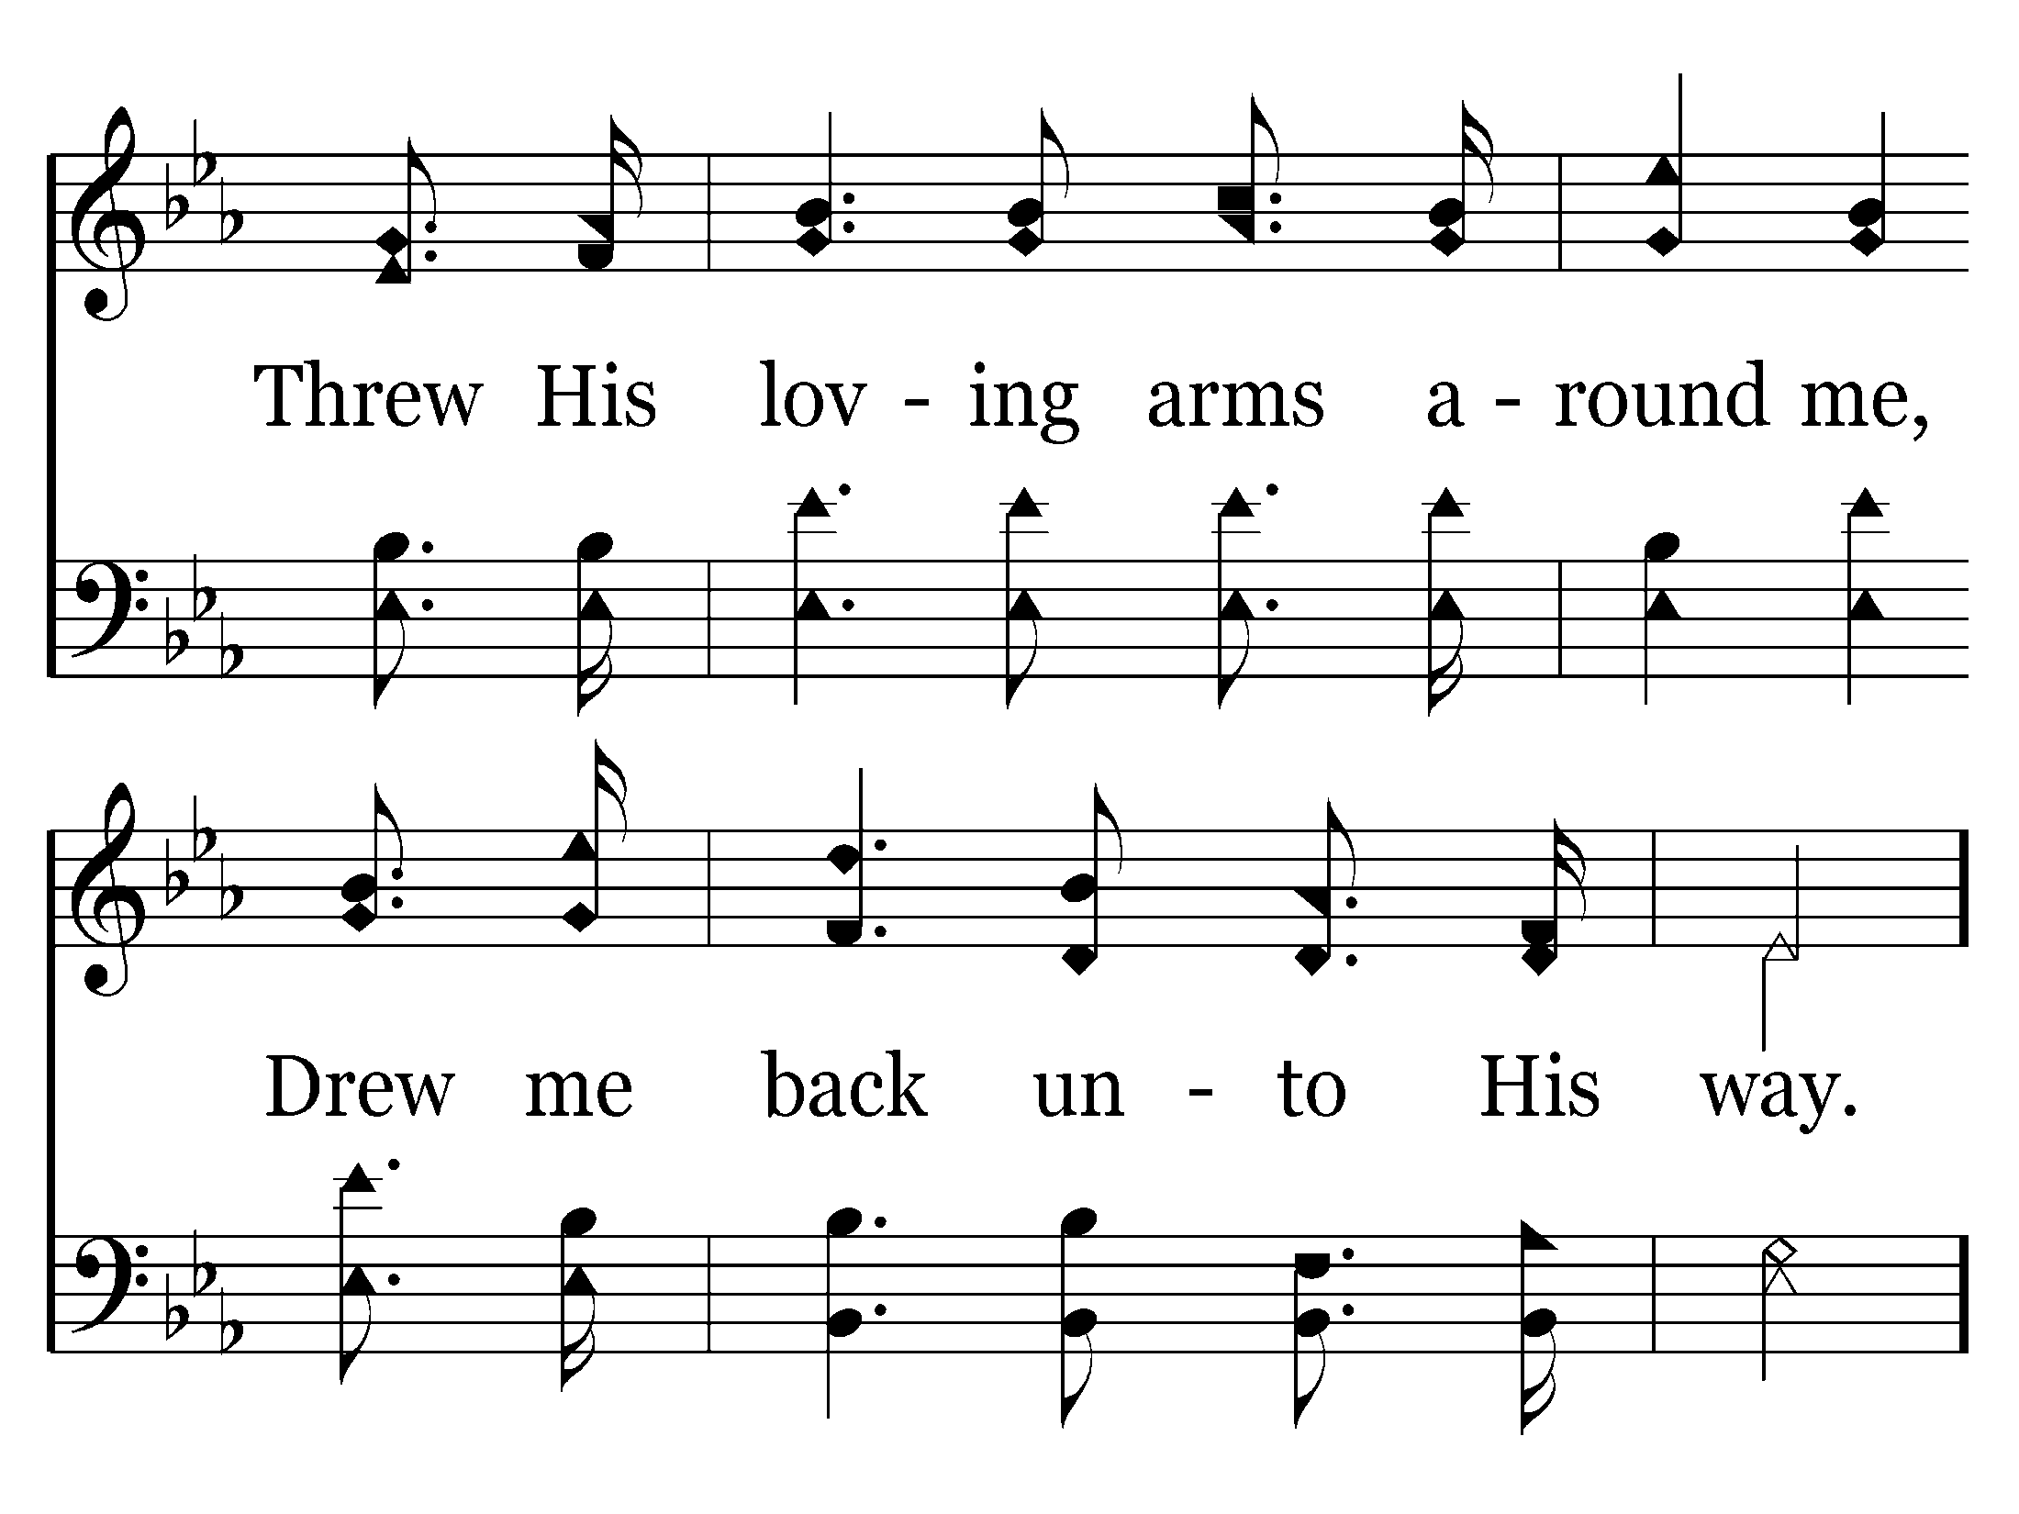

Slide 14
End of Verse 2

Slide 15
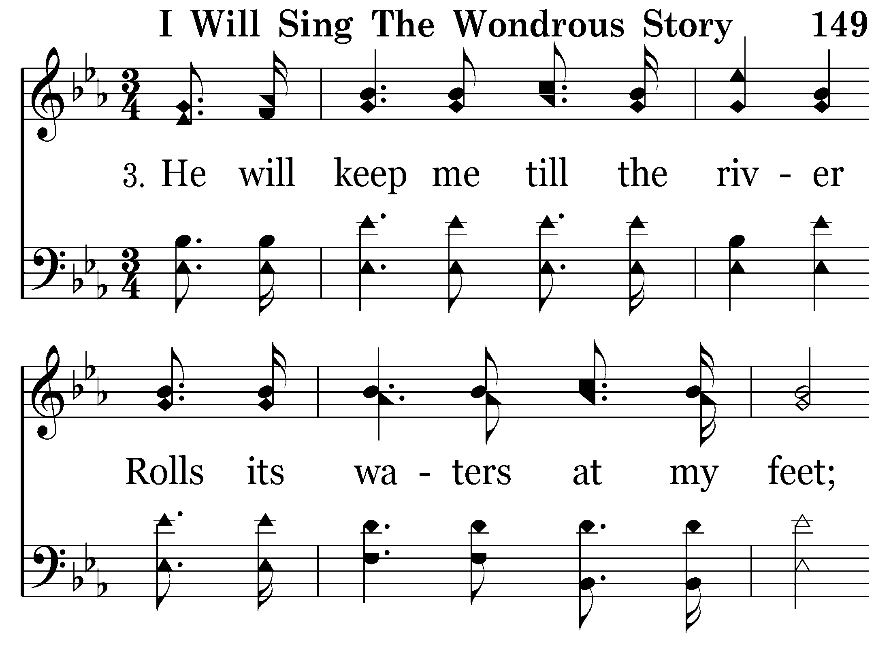

Slide 16
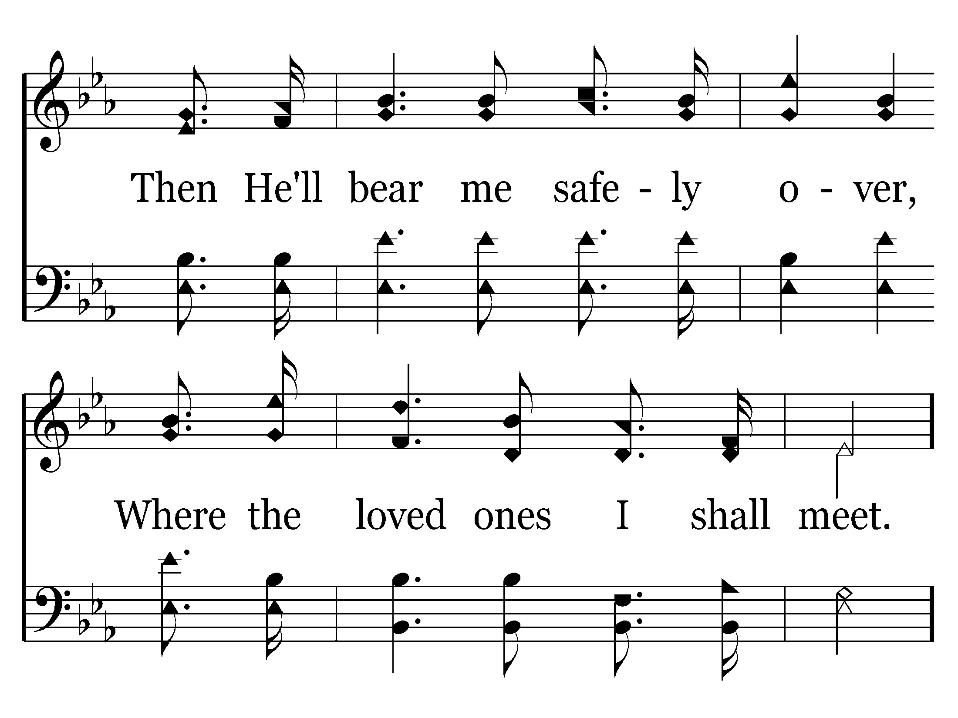

Slide 20
End of Song

Slide 22
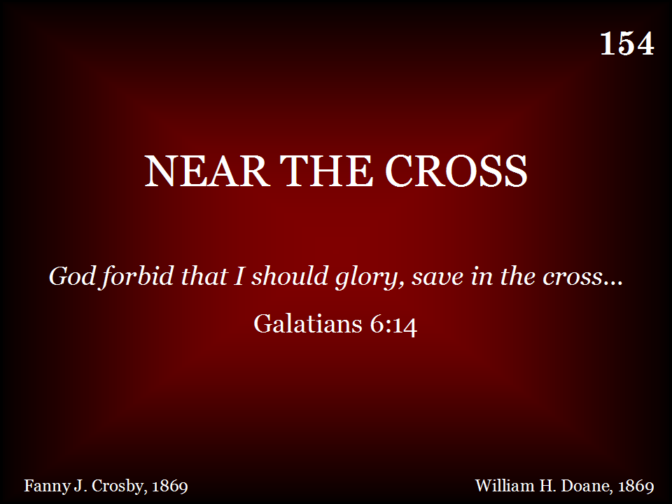

Slide 23
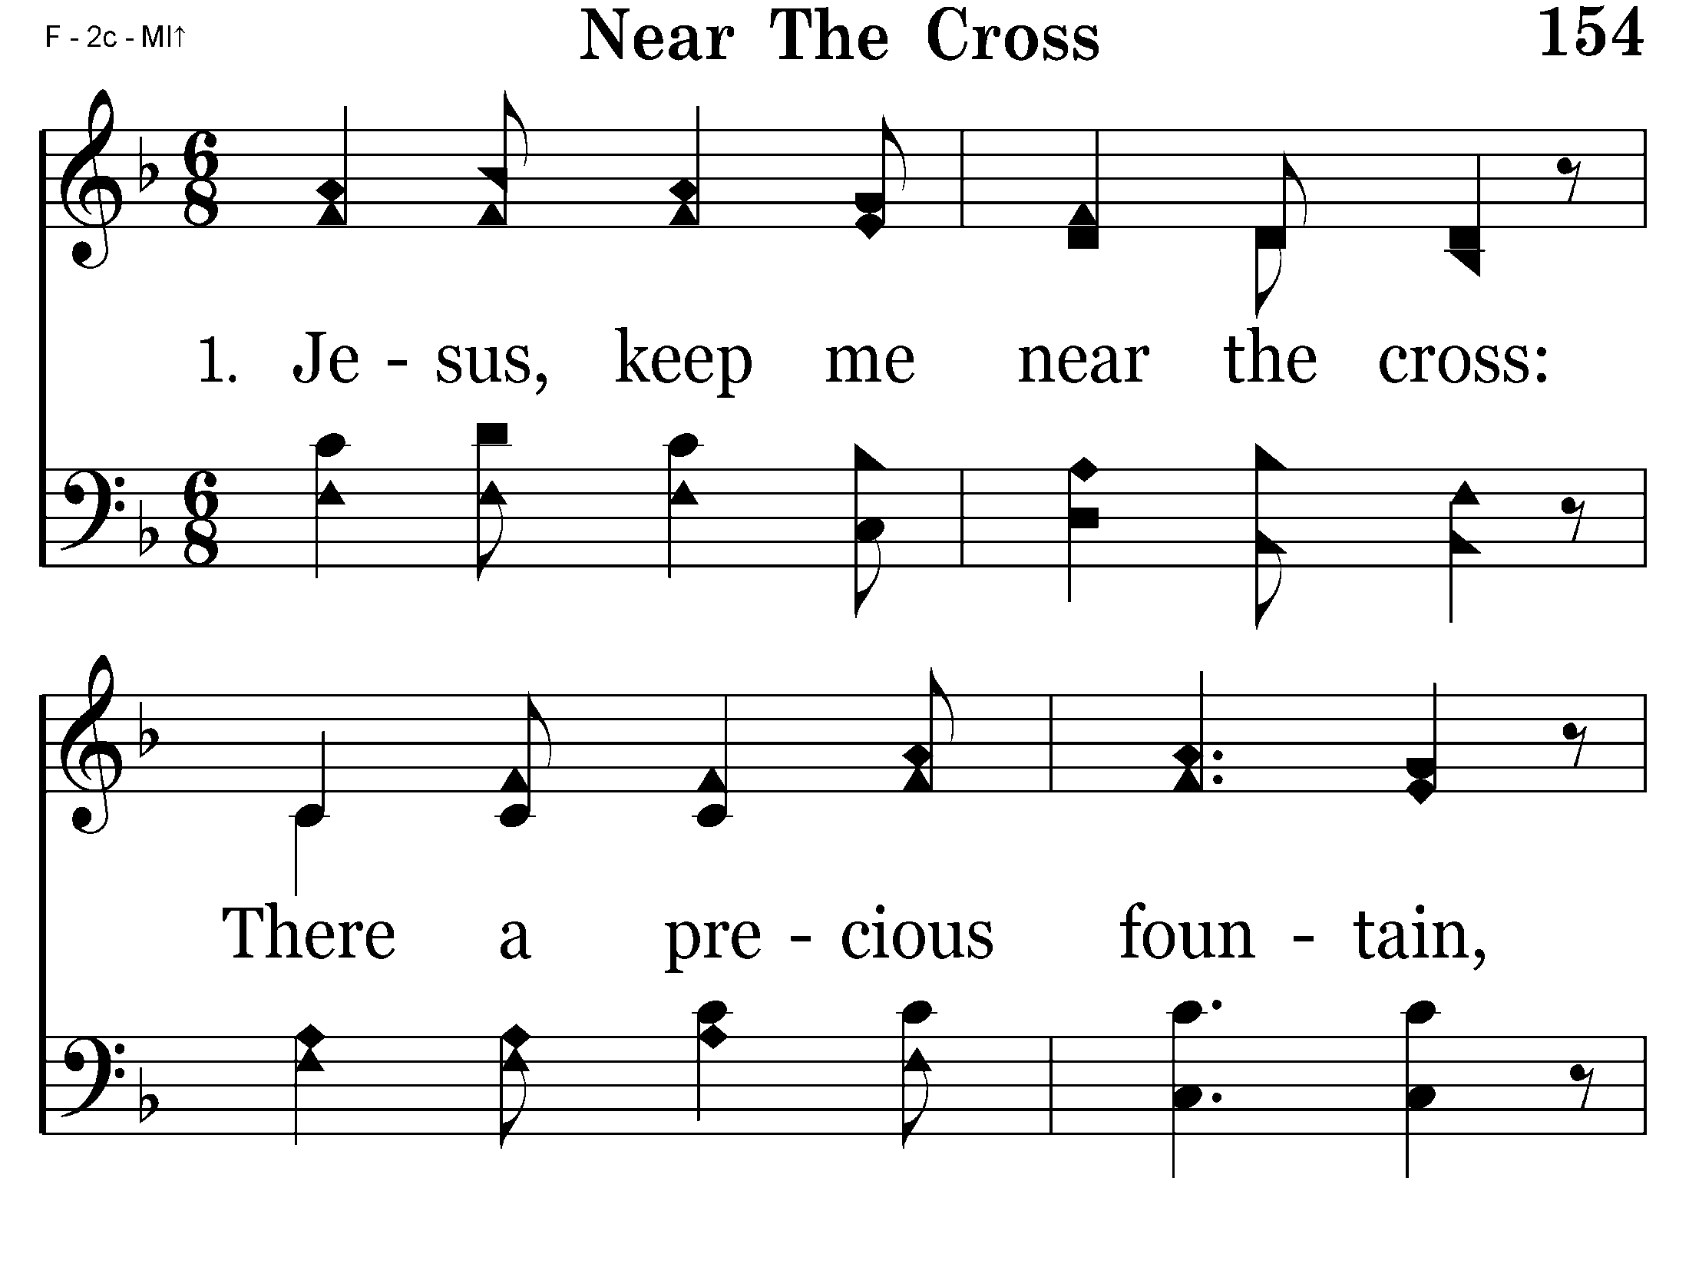

Slide 24
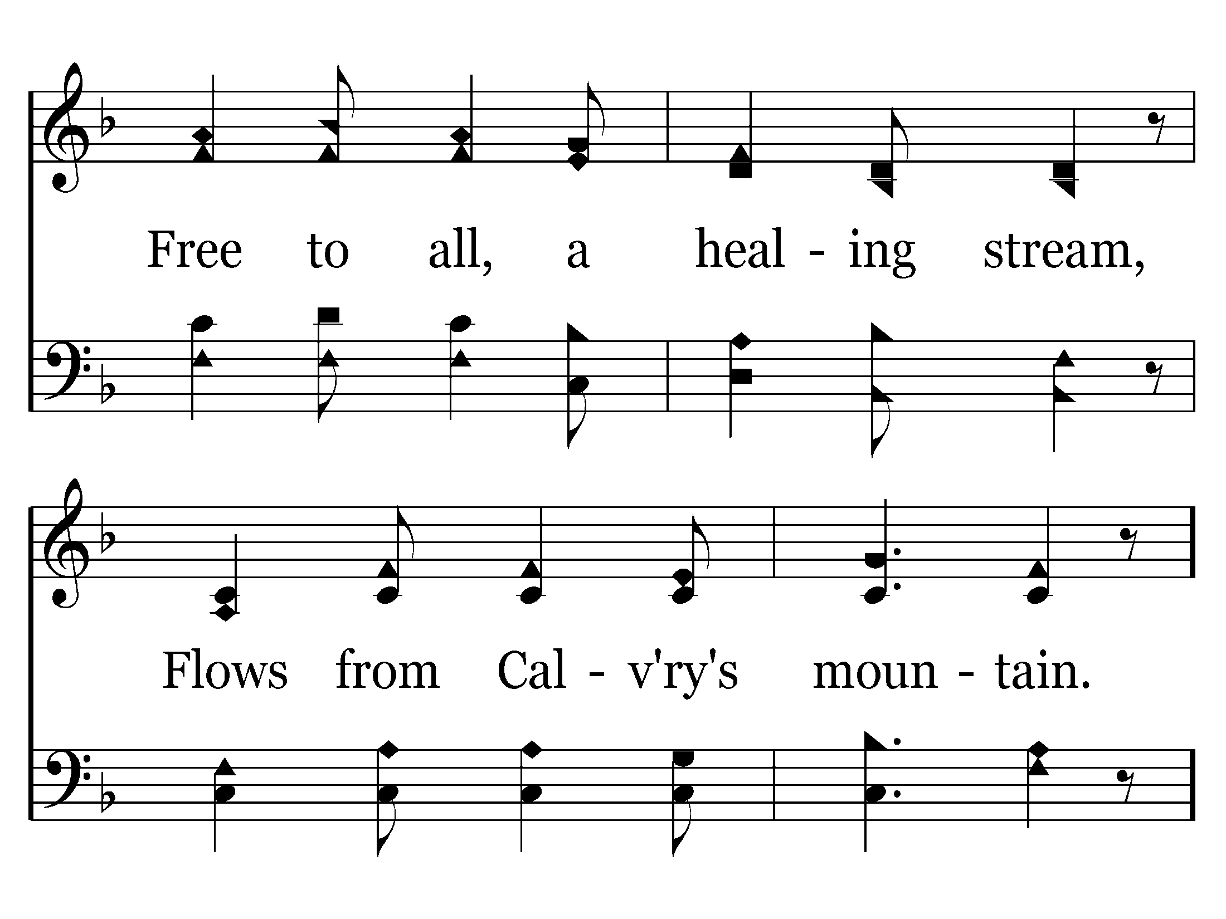

Slide 25
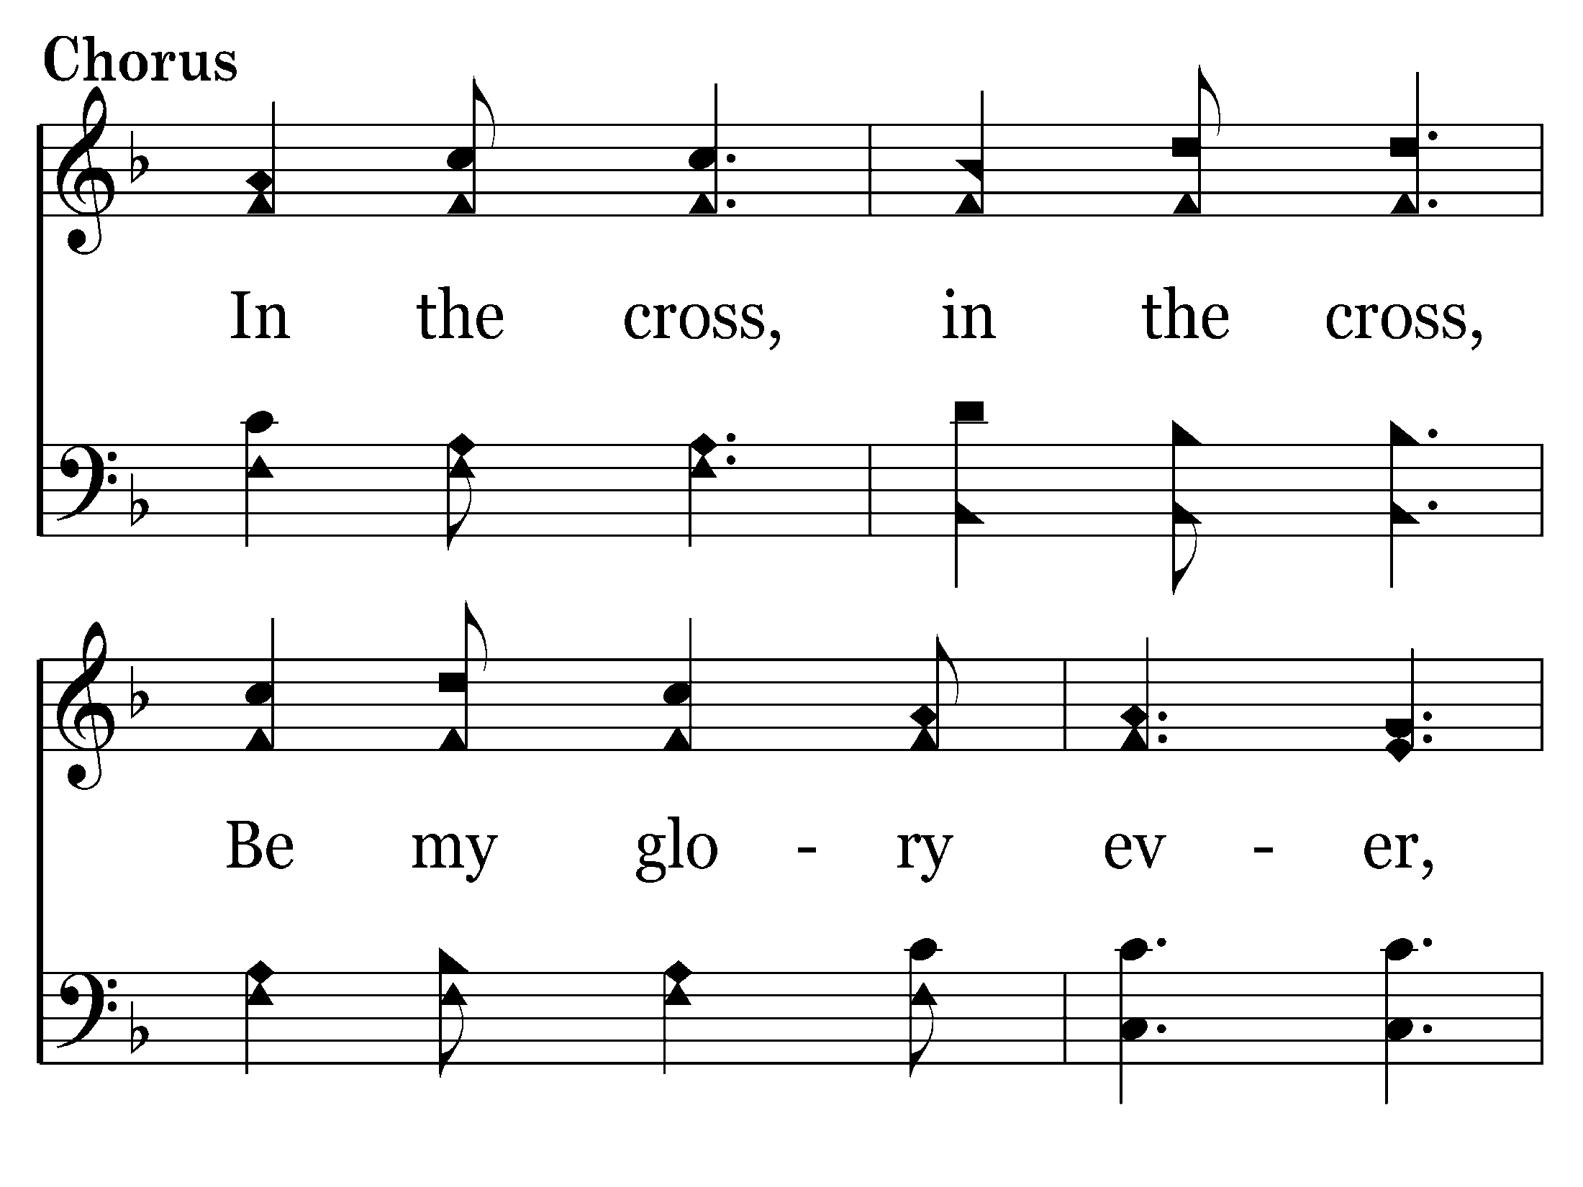

Slide 26
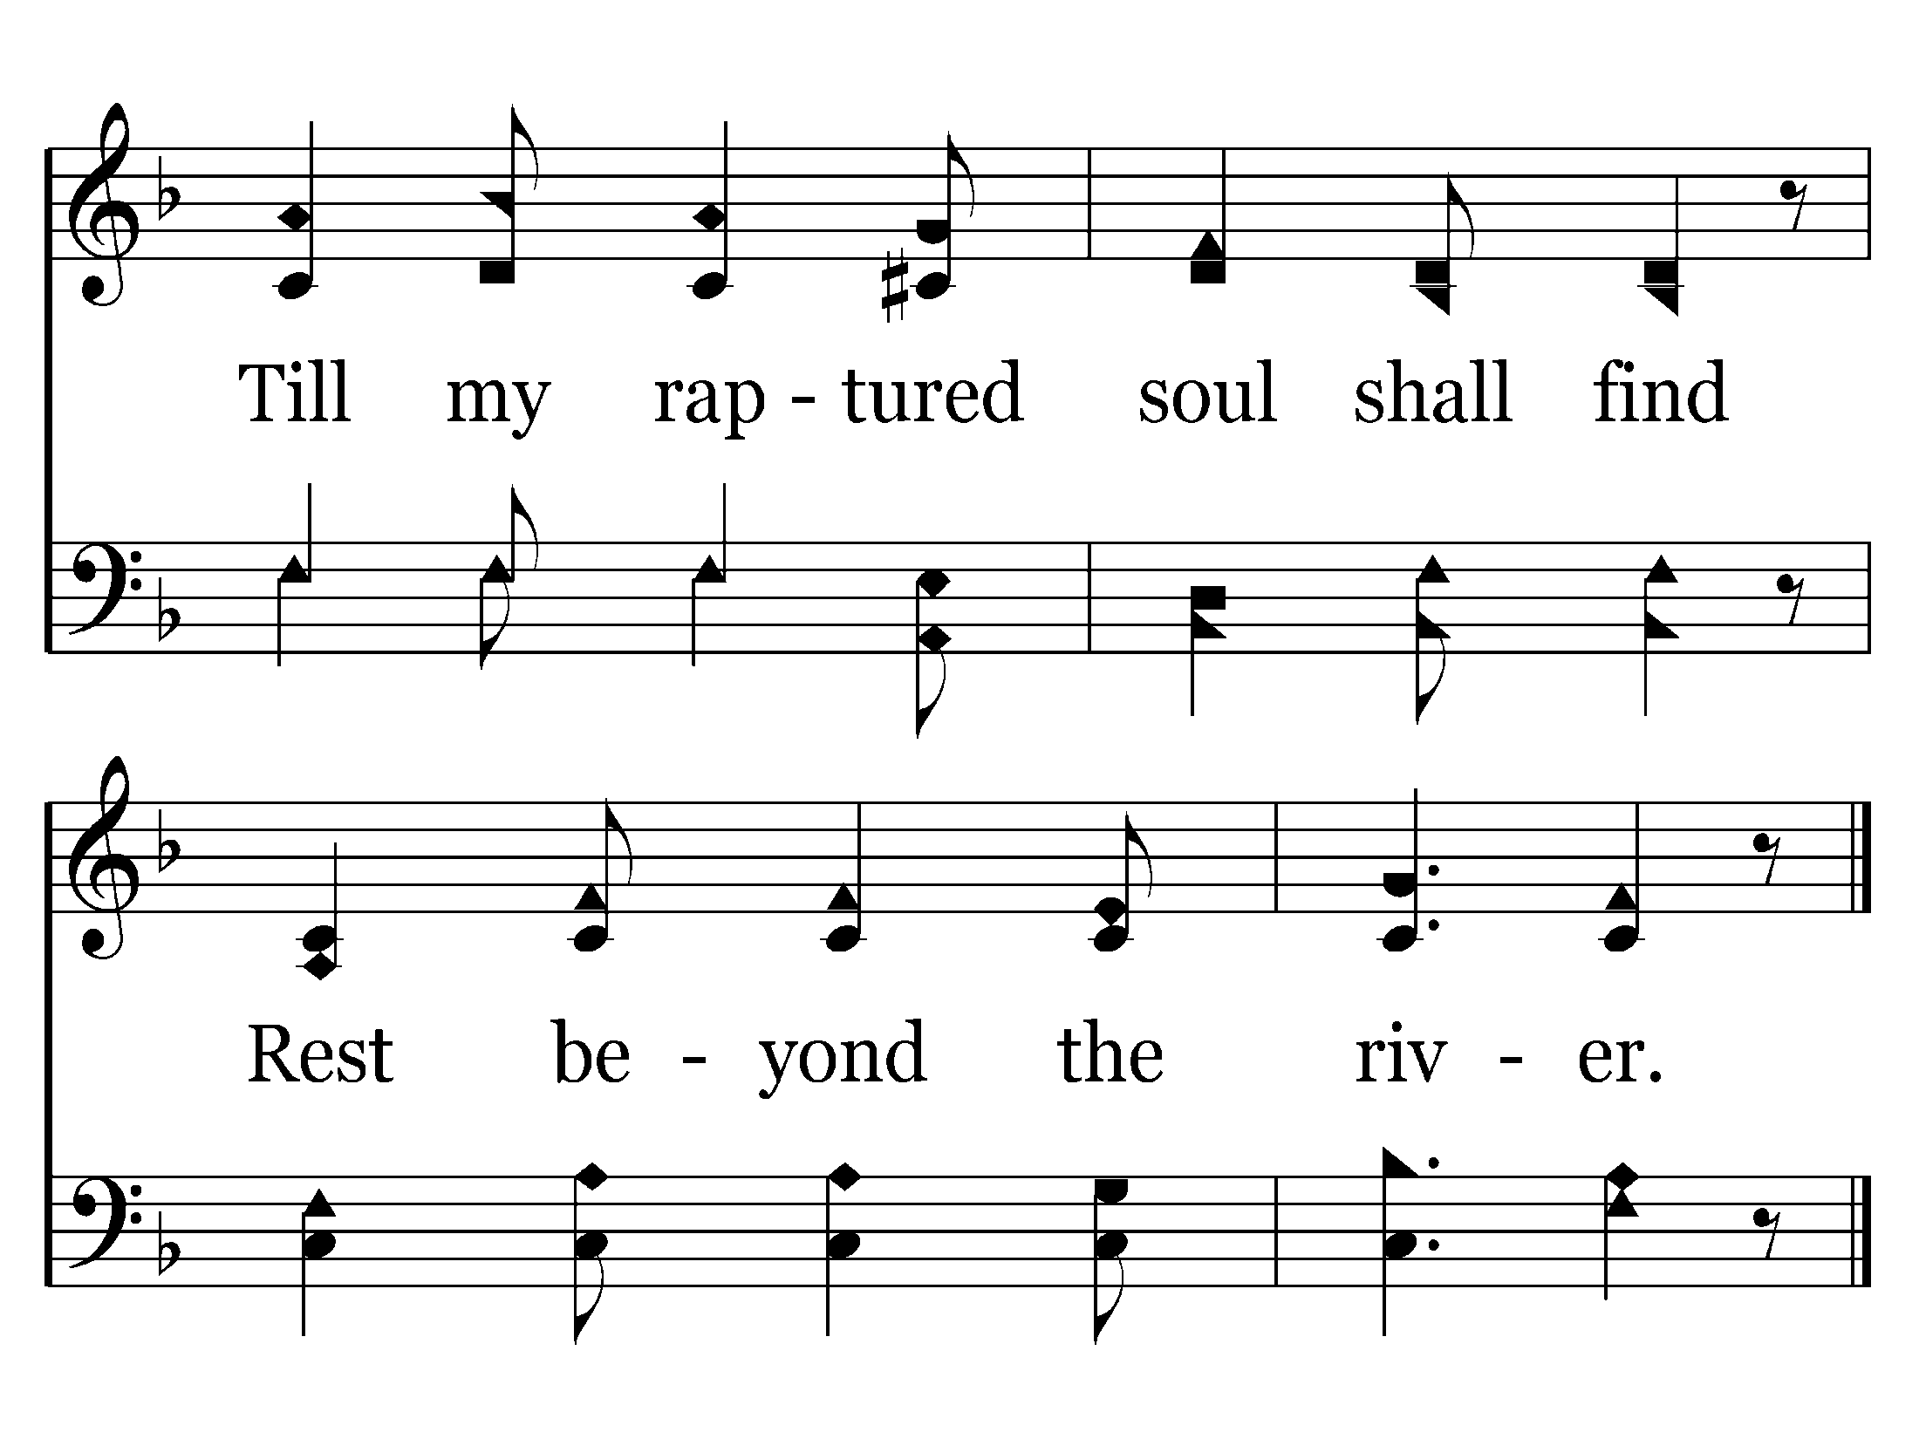
End of Verse 1

Slide 27
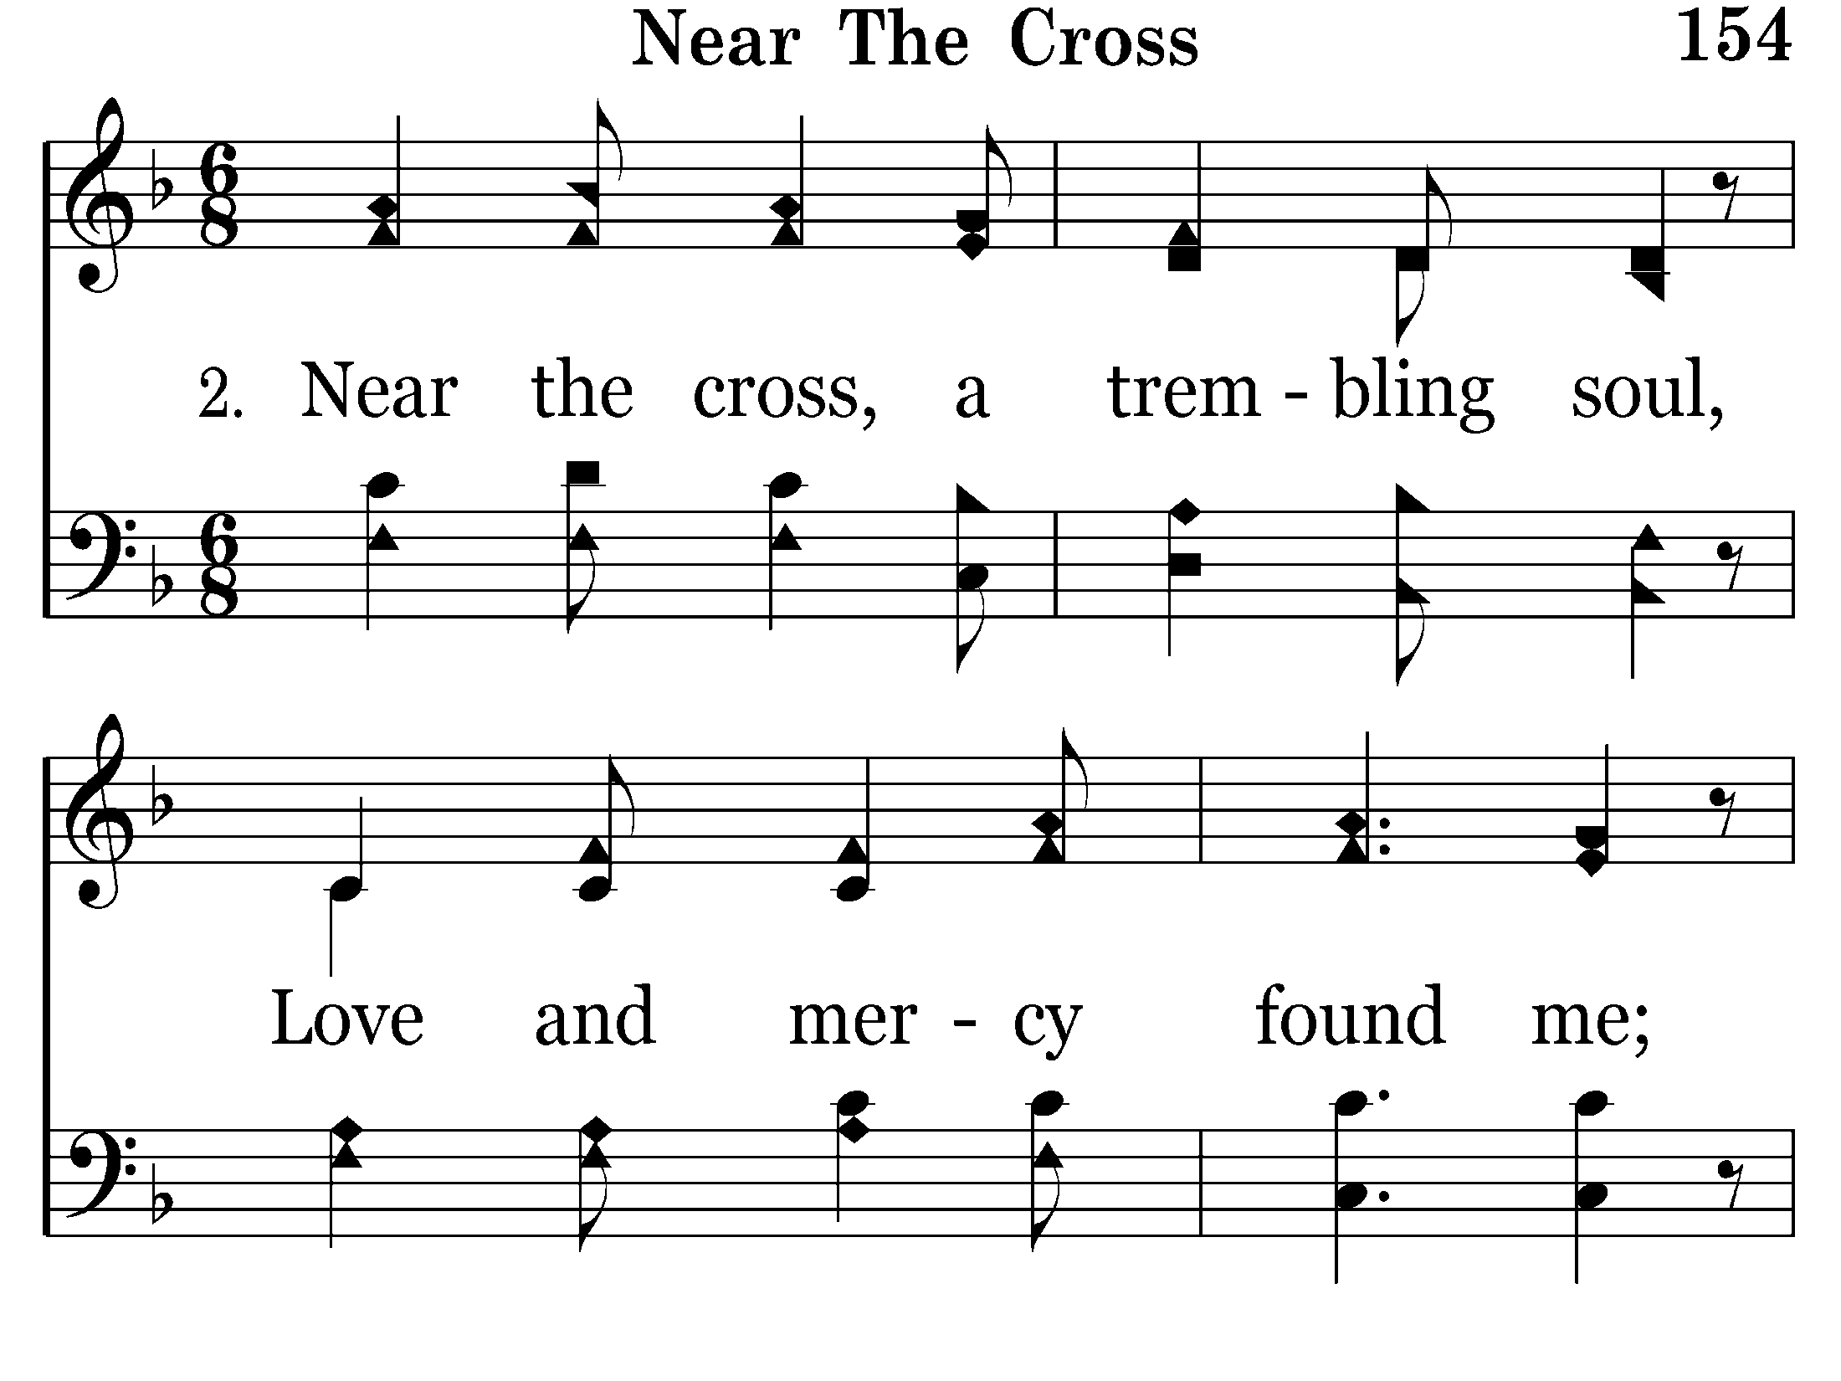

Slide 28
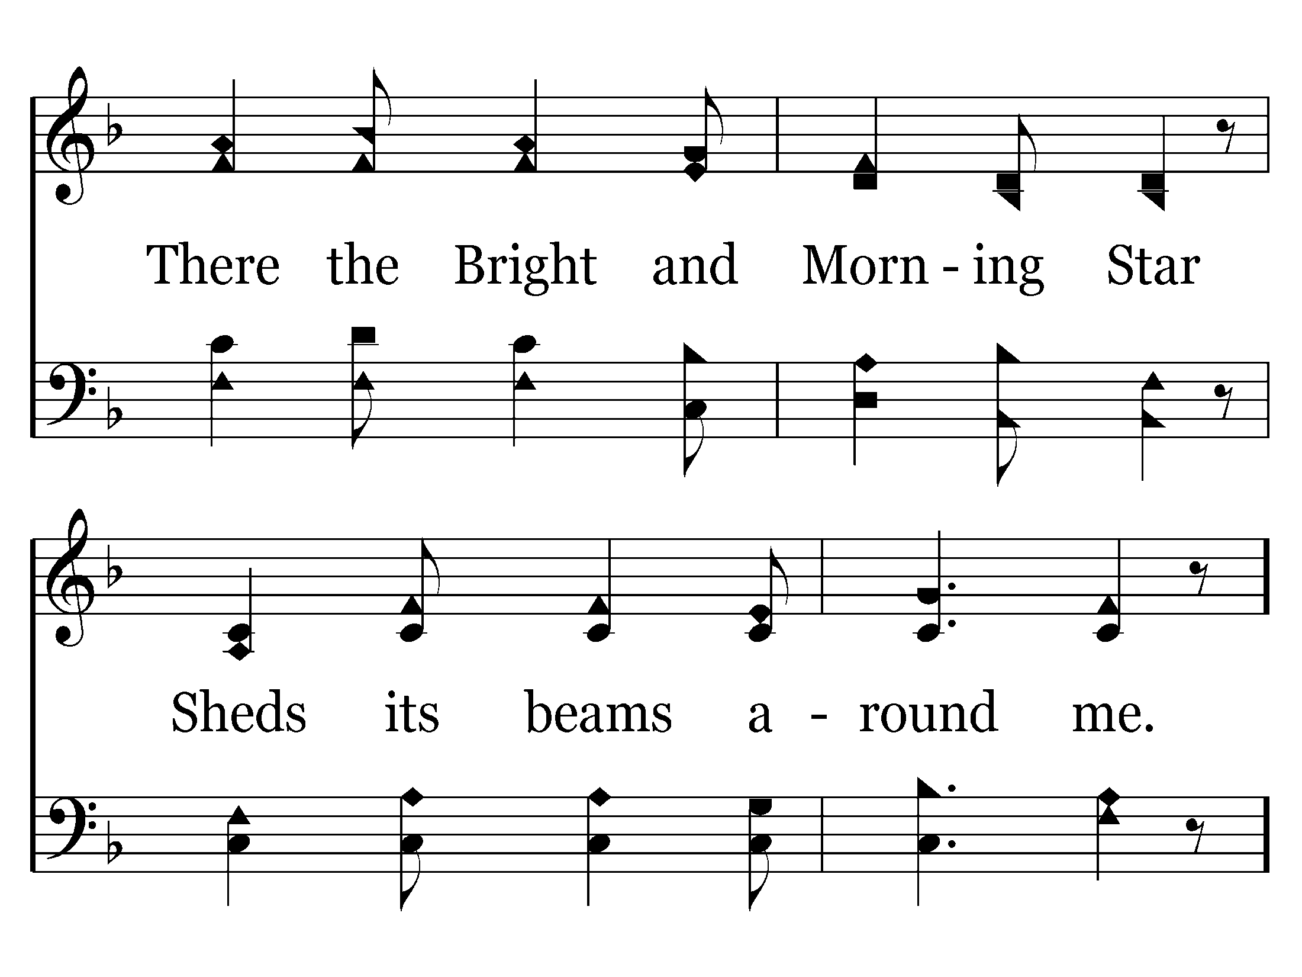

Slide 30
End of Verse 2

Slide 31
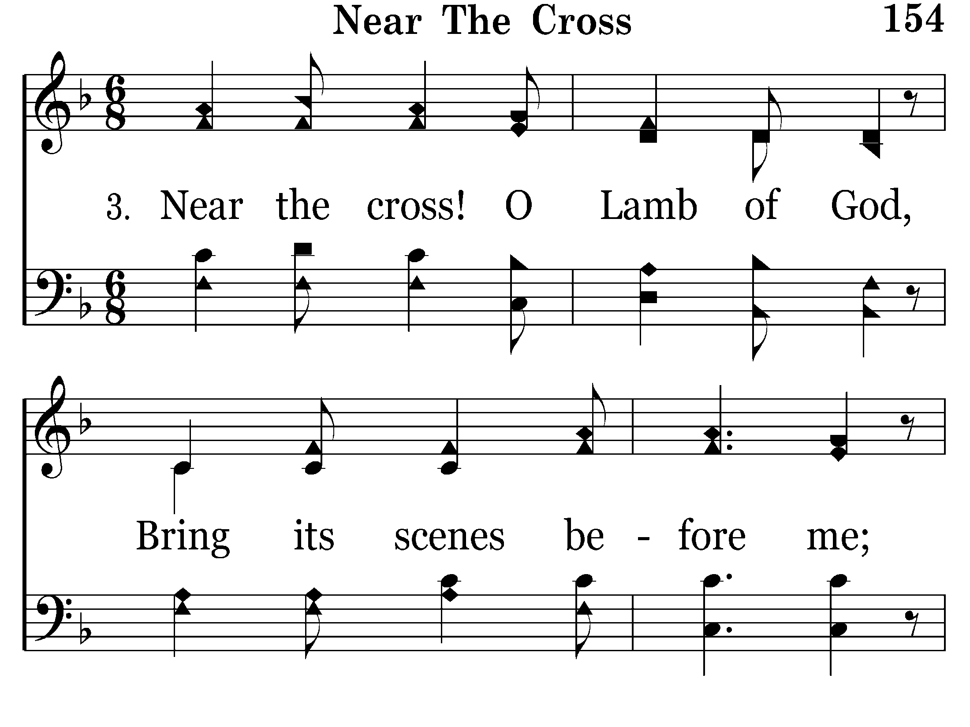

Slide 32
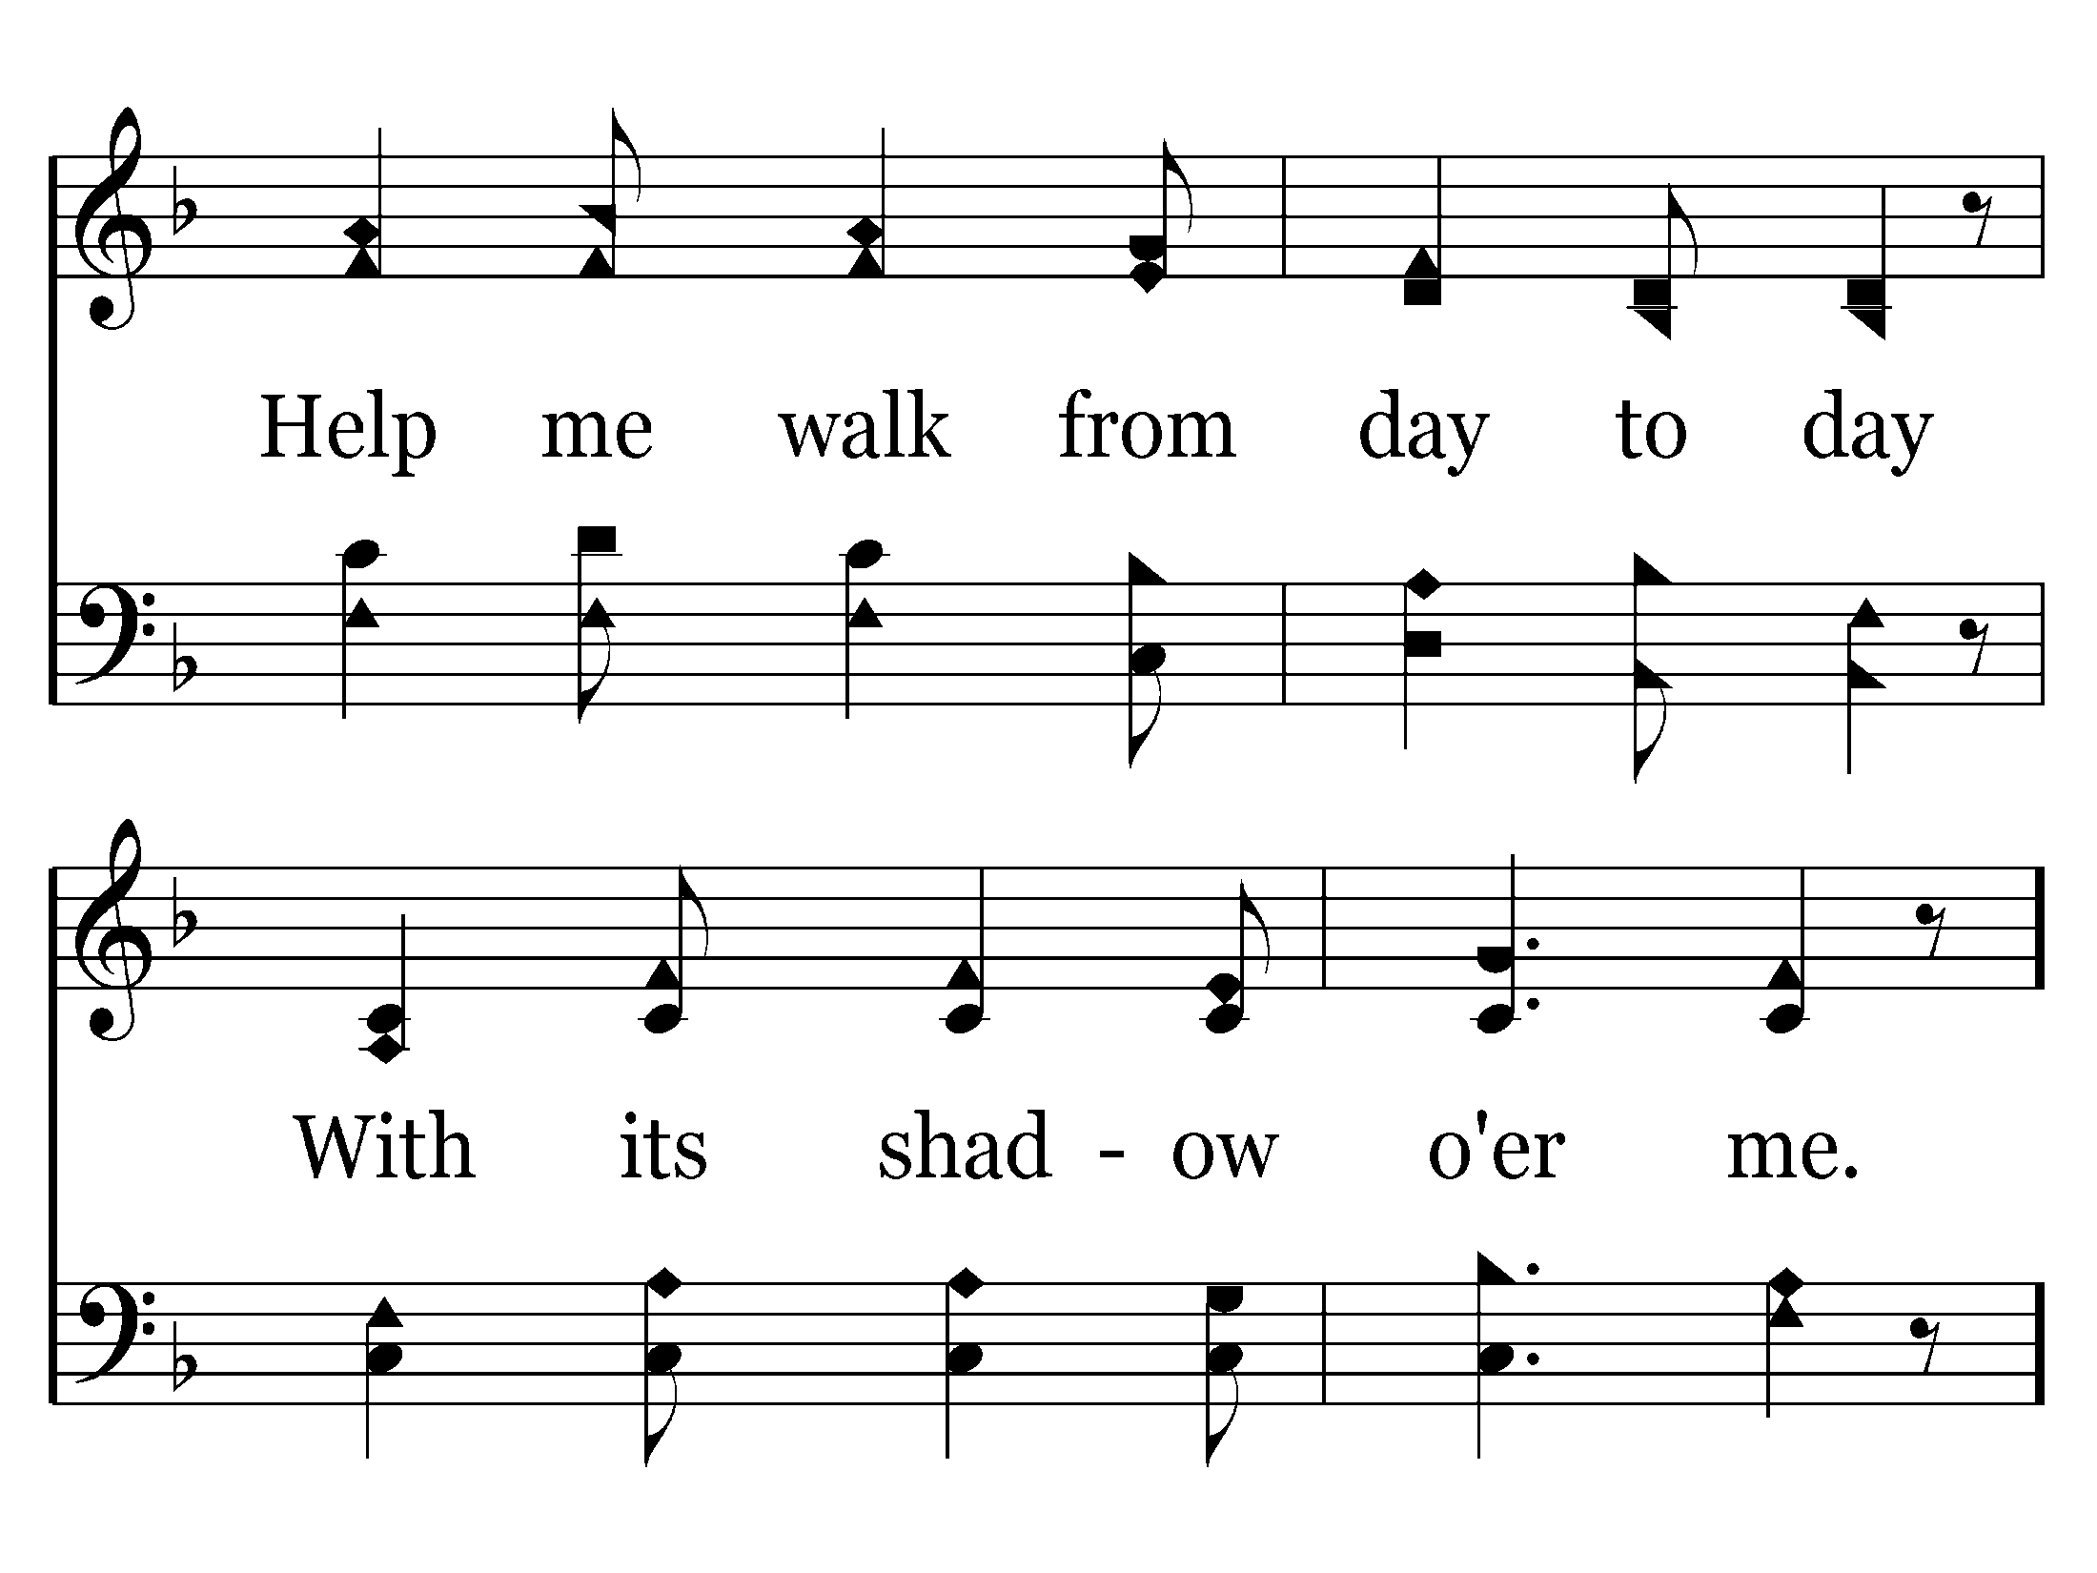

Slide 34
End of Song

Slide 36
Luke 23:44-46
44 Now it was about the sixth hour, and there was darkness over all the earth until the ninth hour.
45 Then the sun was darkened, and the veil of the temple was torn in two.
46 And when Jesus had cried out with a loud voice, He said, "Father, 'into Your hands I commit My spirit.'" Having said this, He breathed His last.

Slide 37
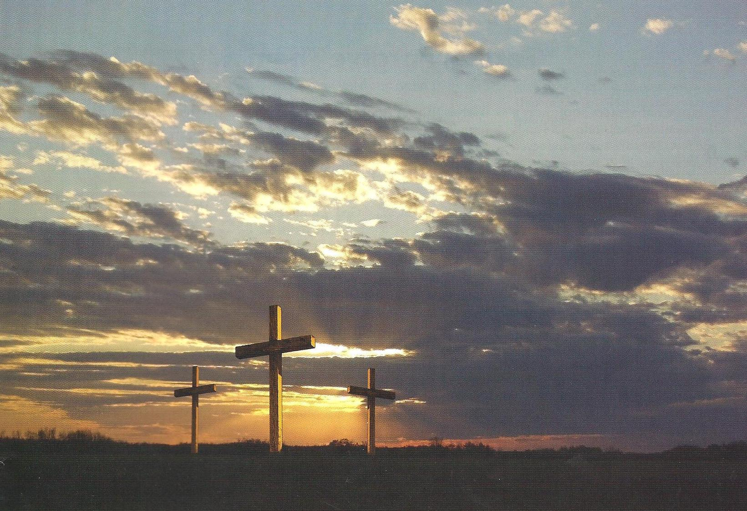
AGONY
“. . . it was about the sixth hour, and there was darkness over all the earth until the ninth hour. Then the sun was darkened” LK 23:44-45
CRUCIFIXION
THE DARKEST
OF
DAYS!
DREAD
HUMILIATION
INFAMY

Slide 38
DAY OF AGONY
Mark 14:
46 Then they laid their hands on Him and took Him.
65 Then some began to spit on Him, and to blindfold Him, and to beat Him, and to say to Him, "Prophesy!" And the officers struck Him with the palms of their hands.
Luke 22:
63 Now the men who held Jesus mocked Him and beat Him.
64 And having blindfolded Him, they struck Him on the face and asked Him, saying, "Prophesy! Who is the one who struck You?”

Slide 39
Luke 23:11
11 Then Herod, with his men of war, treated Him with contempt and mocked Him, arrayed Him in a gorgeous robe, and sent Him back to Pilate.

Slide 40
scourge

Slide 41
Matthew 27:27-31
27 Then the soldiers of the governor took Jesus into the Praetorium and gathered the whole garrison around Him.
28 And they stripped Him and put a scarlet robe on Him.
29 When they had twisted a crown of thorns, they put it on His head, and a reed in His right hand. And they bowed the knee before Him and mocked Him, saying, "Hail, King of the Jews!"
30 Then they spat on Him, and took the reed and struck Him on the head.
31 And when they had mocked Him, they took the robe off Him, put His own clothes on Him, and led Him away to be crucified.

Slide 42
The Flogging
Roman floggings were known to be horribly brutal. They usually consisted of 39 lashes but were a lot more than that usually. The amount of lashings was determined by the mood of the Roman soldier applying the punishment. You must take into account that Roman executioners intentionally brutalized people condemned to the cross to extract maximum suffering. This was the tradition of Rome to keep its subjects in line. Roman Law did not afford mercy or compassion when dealing with criminals or rebels to the throne.
A study on Nero Caesar's persecution of first century Christians will make abundantly clear how the Roman Government felt about any perceived threat to Rome.

Slide 43
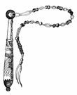
The soldier would use a whip of braided leather thongs with metal balls woven into them. When the whip would hit the flesh, these balls whip around the torso or limb, picking up speed as the thong became shortened and striking the flesh in excess of 90 miles per hour, causing deep bruises or contusions. The whip also had pieces of sharp bone that would cut the flesh severely. The second and seceding lashes would cause the sharp bone to cut into the bruise causing it to bleed and ribbon. After the third lash, the victim would be reduced to mangled, shredded flesh. The back was so shredded that quite often the spine would be exposed due to the deep cuts. The whippings would have gone from the shoulders all the way down the back, the buttocks, and the back of the legs. Also, before the flogging commenced, the victim would be stripped naked; an embarrassment of immense proportions in those times.

Slide 44
John 19:
2 And the soldiers twisted a crown of thorns and put it on His head, and they put on Him a purple robe.
3 Then they said, "Hail, King of the Jews!" And they struck Him with their hands.
17 And He, bearing His cross, went out to a place called the Place of a Skull, which is called in Hebrew, Golgotha,
John 10:17-18
17 "Therefore My Father loves Me, because I lay down My life that I may take it again.
18 "No one takes it from Me, but I lay it down of Myself. I have power to lay it down, and I have power to take it again. This command I have received from My Father.”

Slide 45
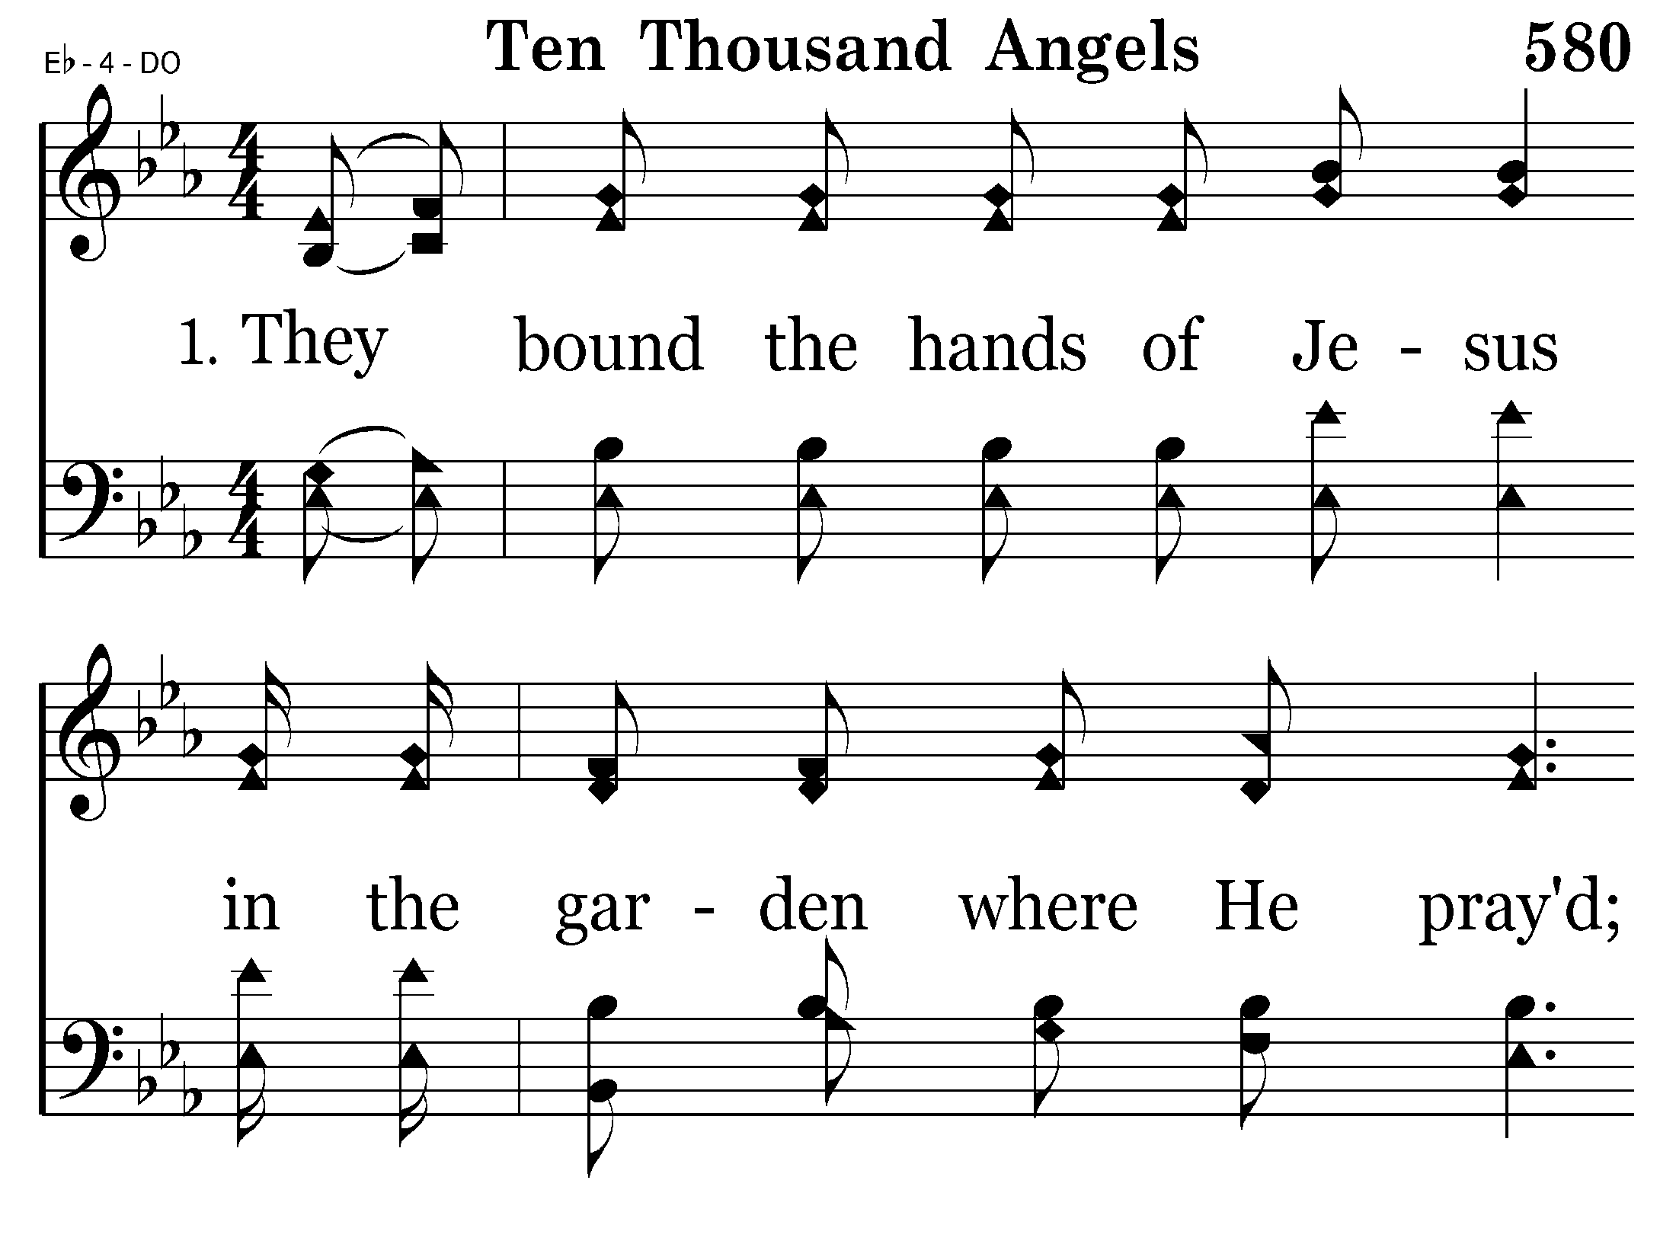
580 - Ten Thousand Angels - 1.1

Slide 46
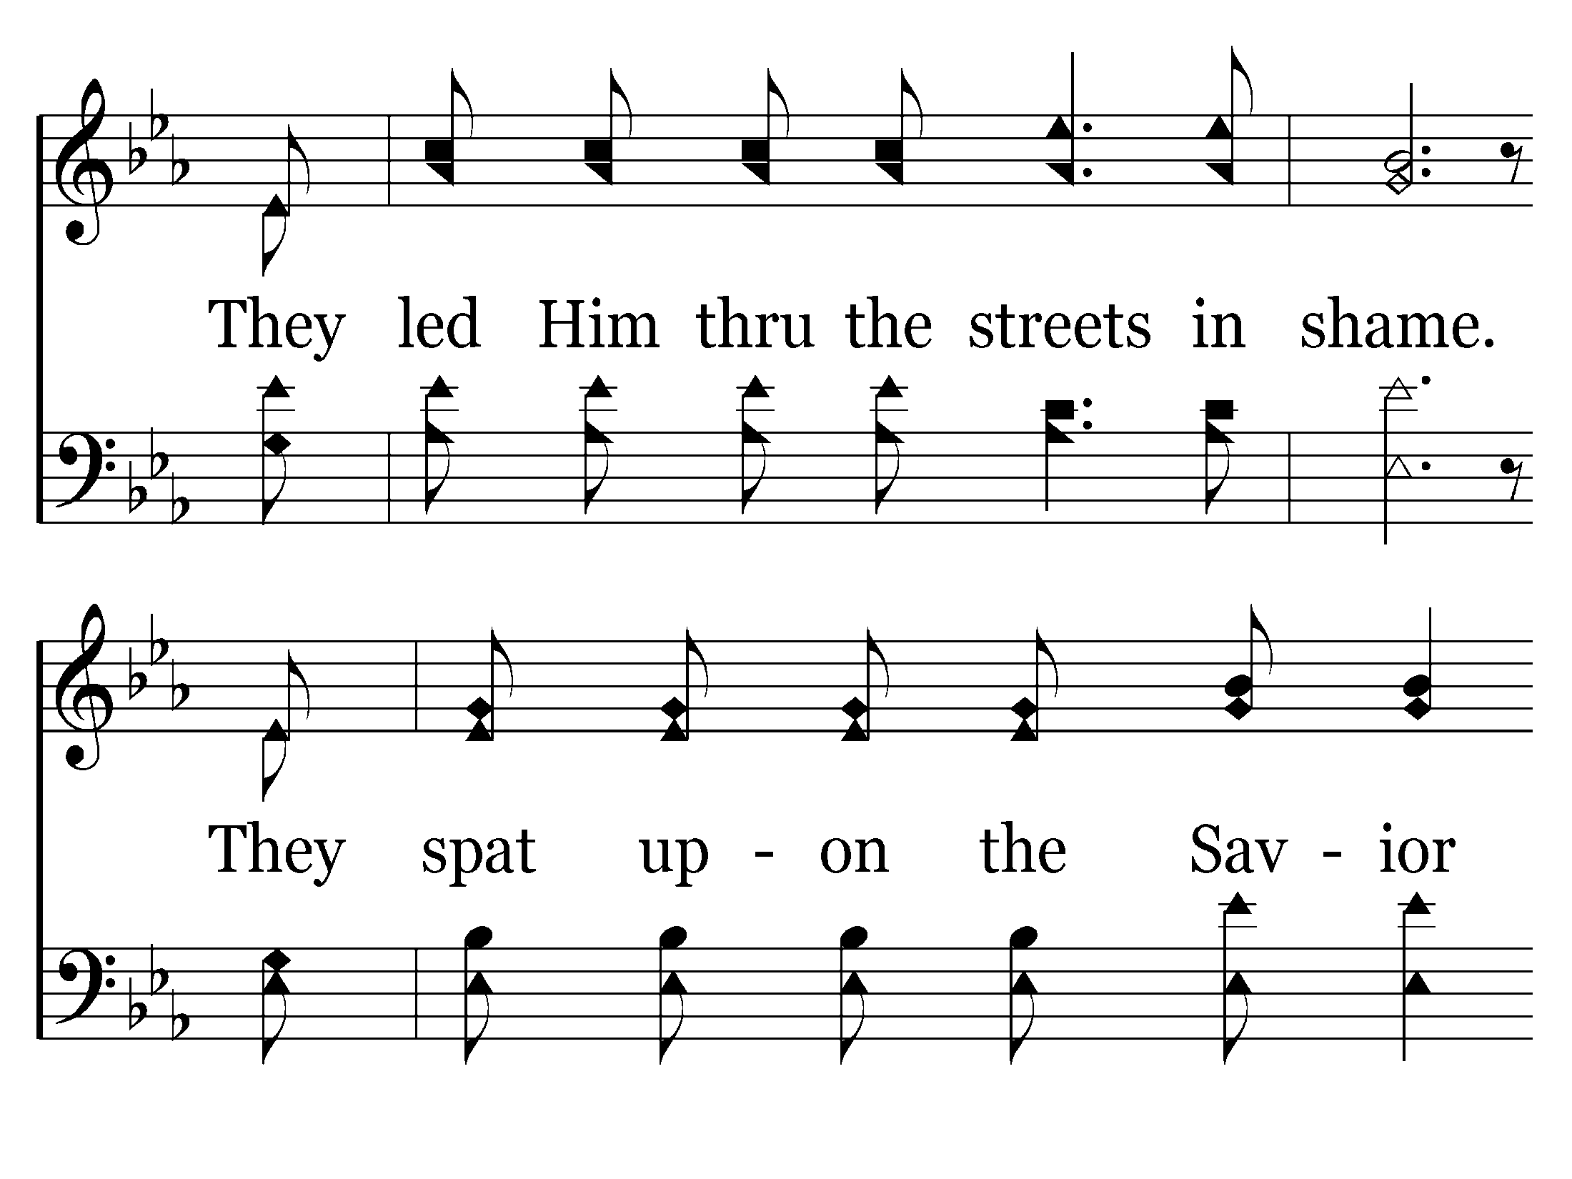
580 - Ten Thousand Angels - 1.2

Slide 47
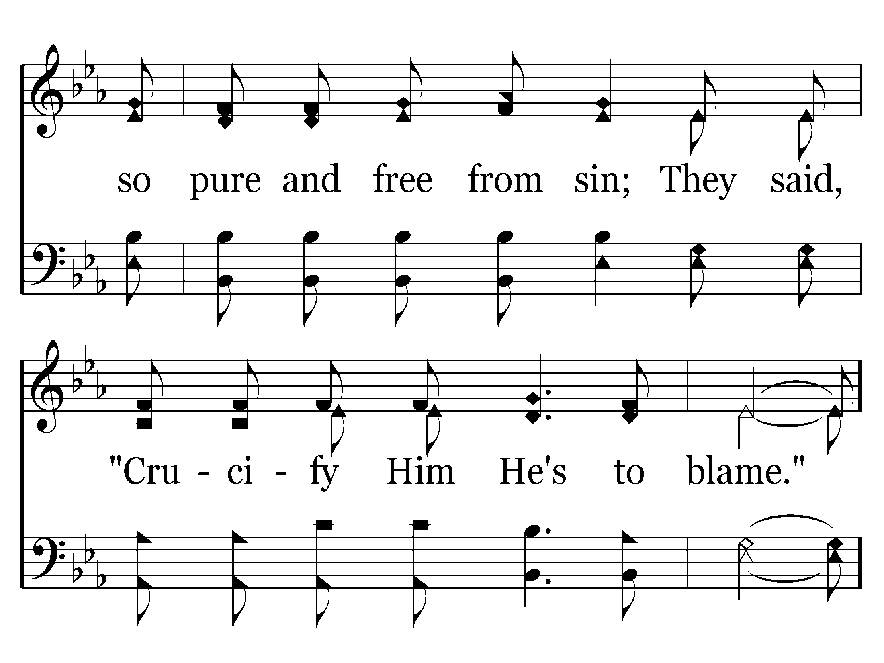
580 - Ten Thousand Angels - 1.3
End of Verse 1 – Go to Verse 2

Slide 48
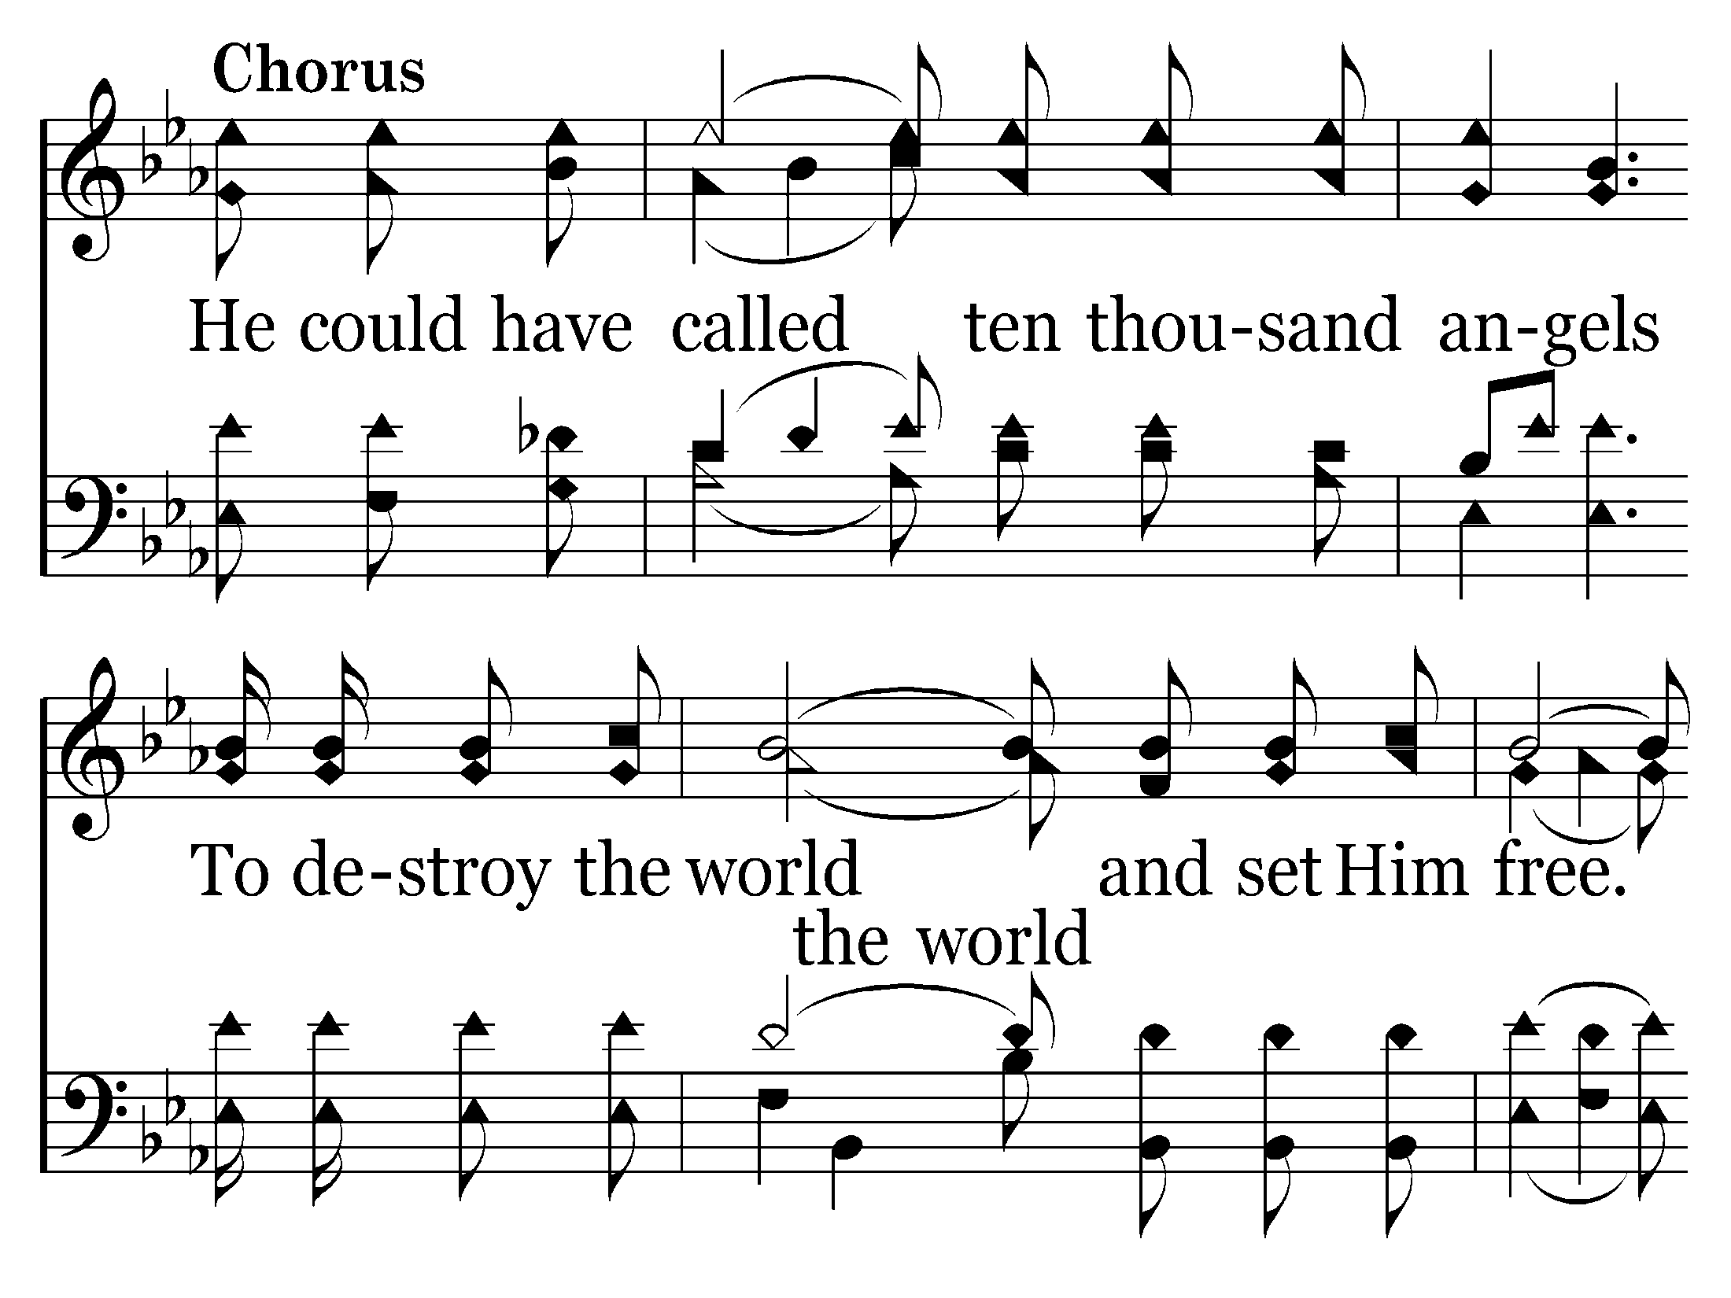
580 - Ten Thousand Angels - C.1

Slide 49
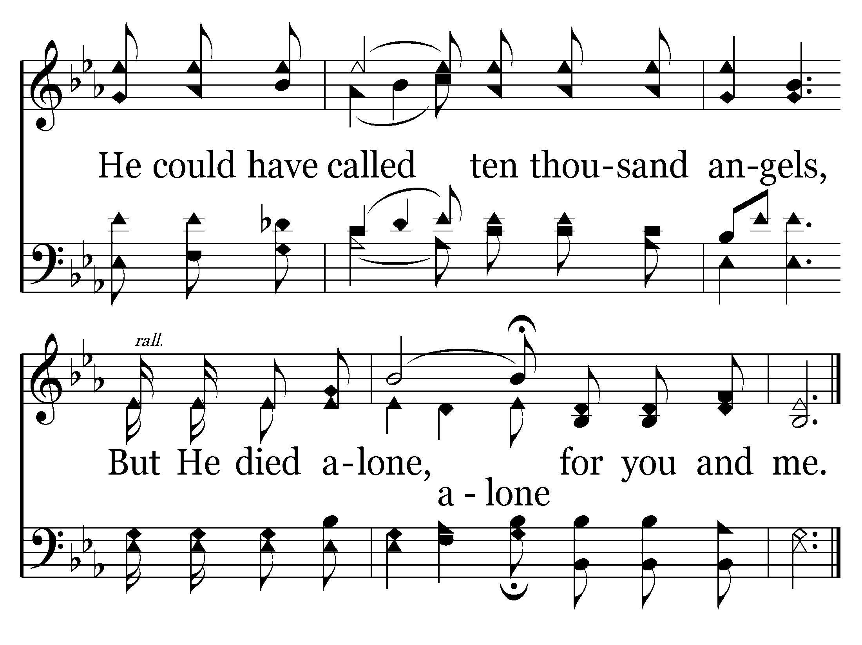
580 - Ten Thousand Angels - C.2
End of Verse 1

Slide 50
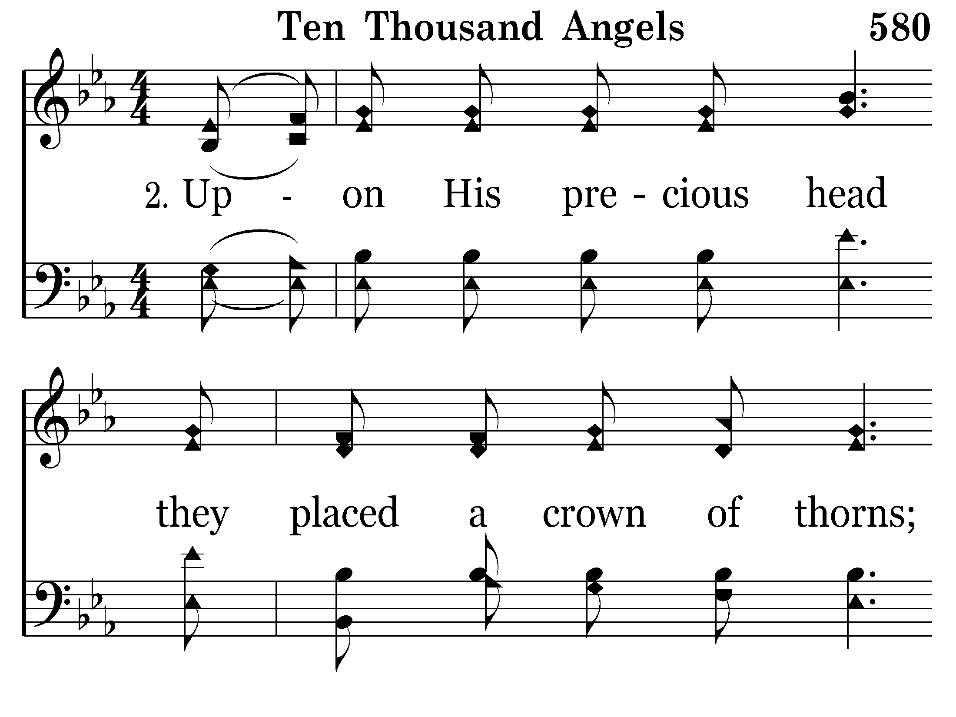
580 - Ten Thousand Angels - 2.1

Slide 51
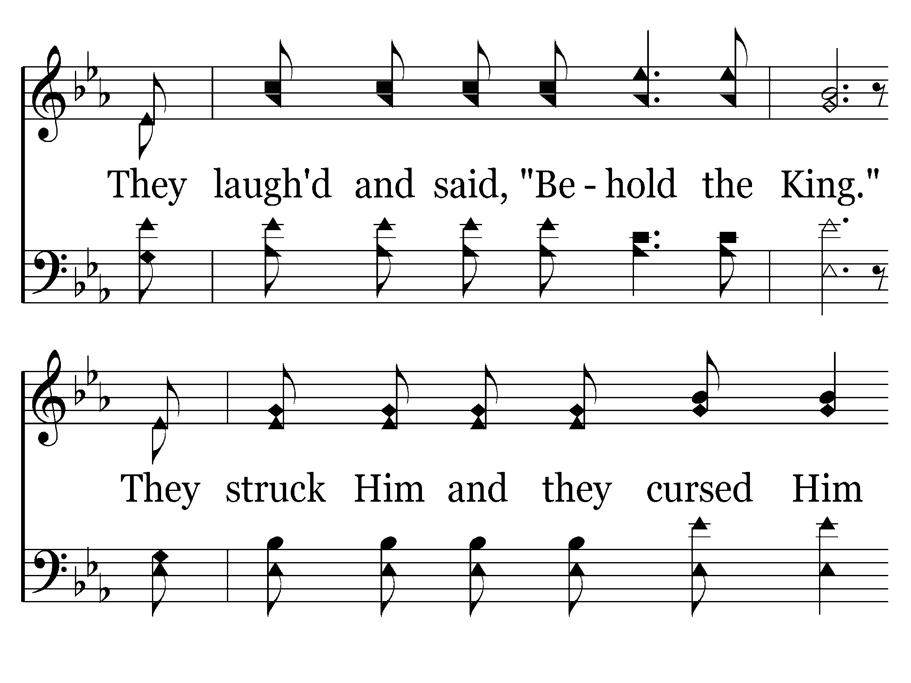
580 - Ten Thousand Angels - 2.2

Slide 52
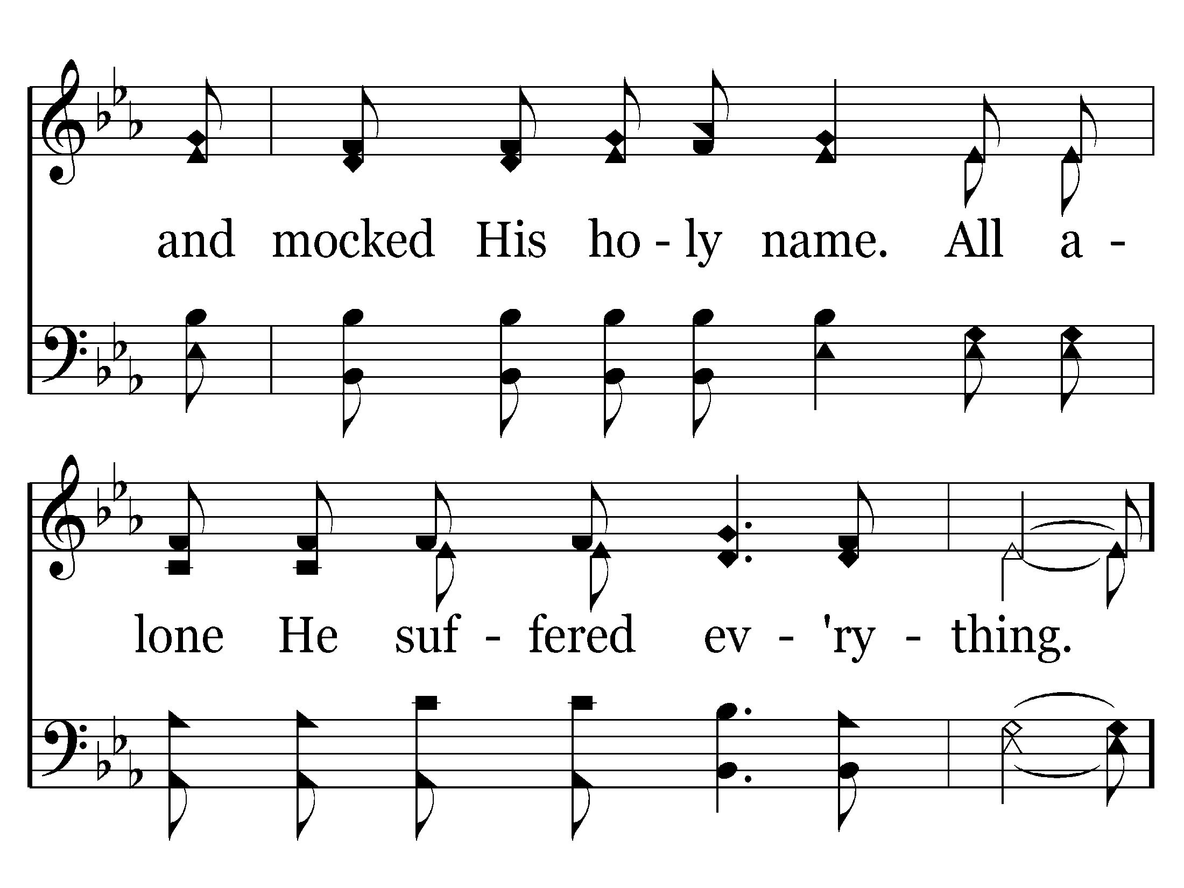
580 - Ten Thousand Angels - 2.3

Slide 53
580 - Ten Thousand Angels - C.1

Slide 54
580 - Ten Thousand Angels - C.2
End of Song

Slide 55
scourge

Slide 56
DAY OF DREAD
John 2:19
19 Jesus answered and said to them, "Destroy this temple, and in three days I will raise it up.”
John 3:14
14 "And as Moses lifted up the serpent in the wilderness, even so must the Son of Man be lifted up,
Matthew 16:21
21 From that time Jesus began to show to His disciples that He must go to Jerusalem, and suffer many things from the elders and chief priests and scribes, and be killed, and be raised the third day.

Slide 57
Matthew 20:19
19 "and deliver Him to the Gentiles to mock and to scourge and to crucify. And the third day He will rise again.”
John 12:27
27 "Now My soul is troubled, and what shall I say? 'Father, save Me from this hour'? But for this purpose I came to this hour.
Matthew 26:38
38 Then He said to them, "My soul is exceedingly sorrowful, even to death. Stay here and watch with Me.”

Slide 58
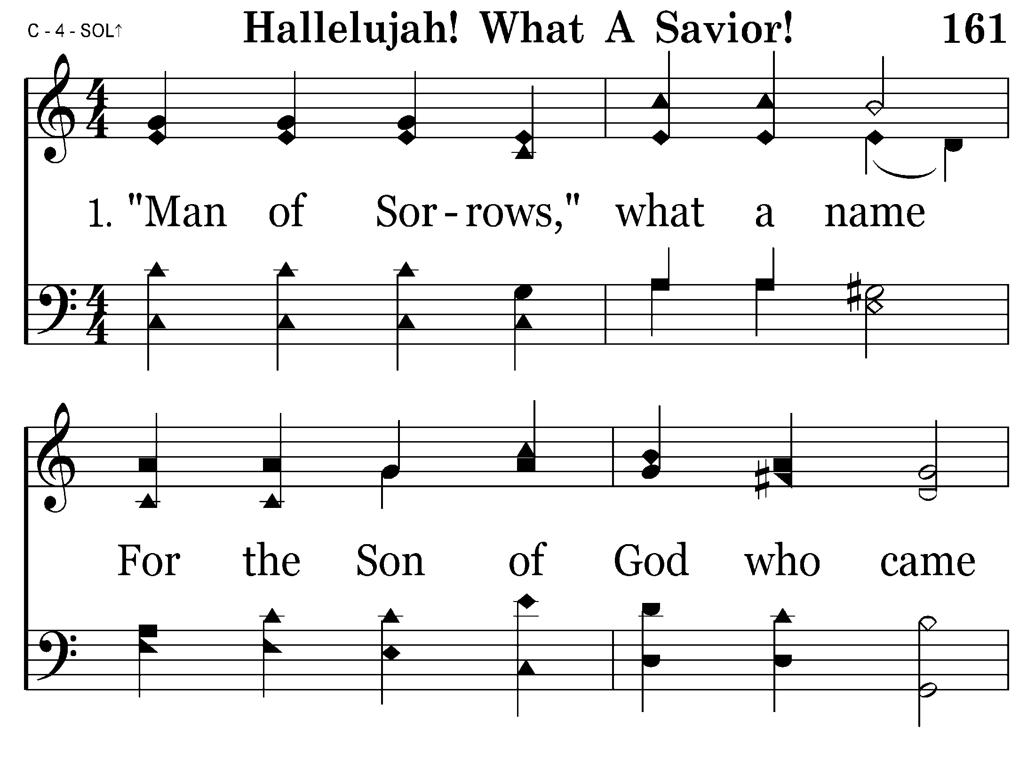
161 - Hallelujah! What A Savior! - 1.1

Slide 59
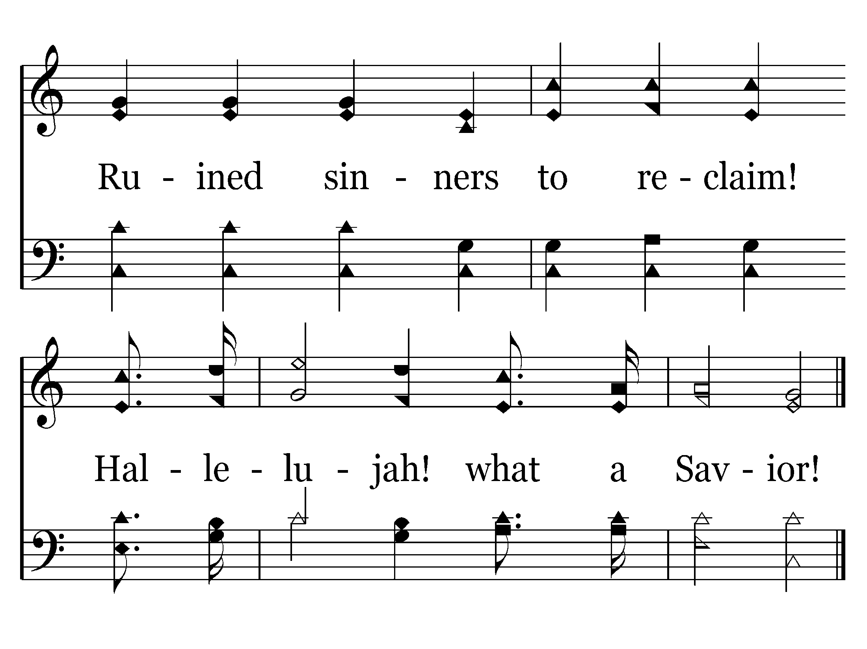
161 - Hallelujah! What A Savior! - 1.2
End of Verse 1

Slide 60
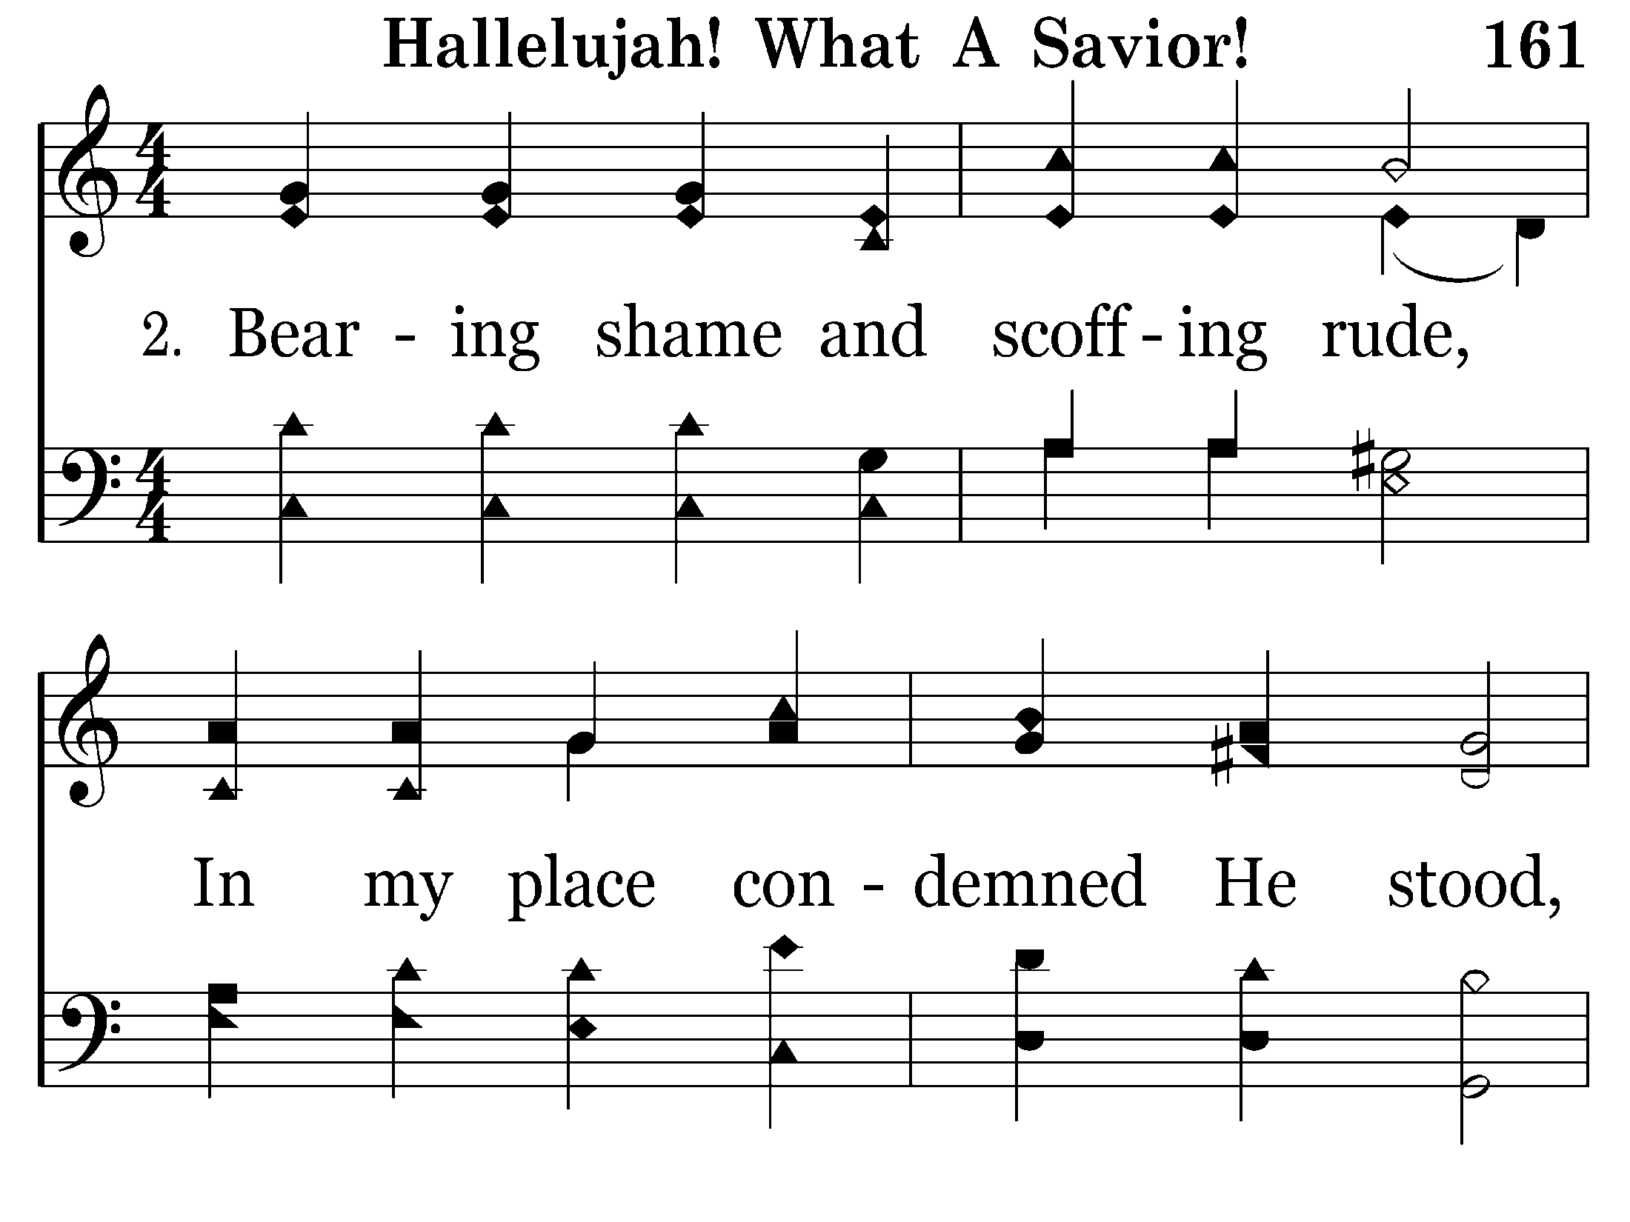
161 - Hallelujah! What A Savior! - 2.1

Slide 61
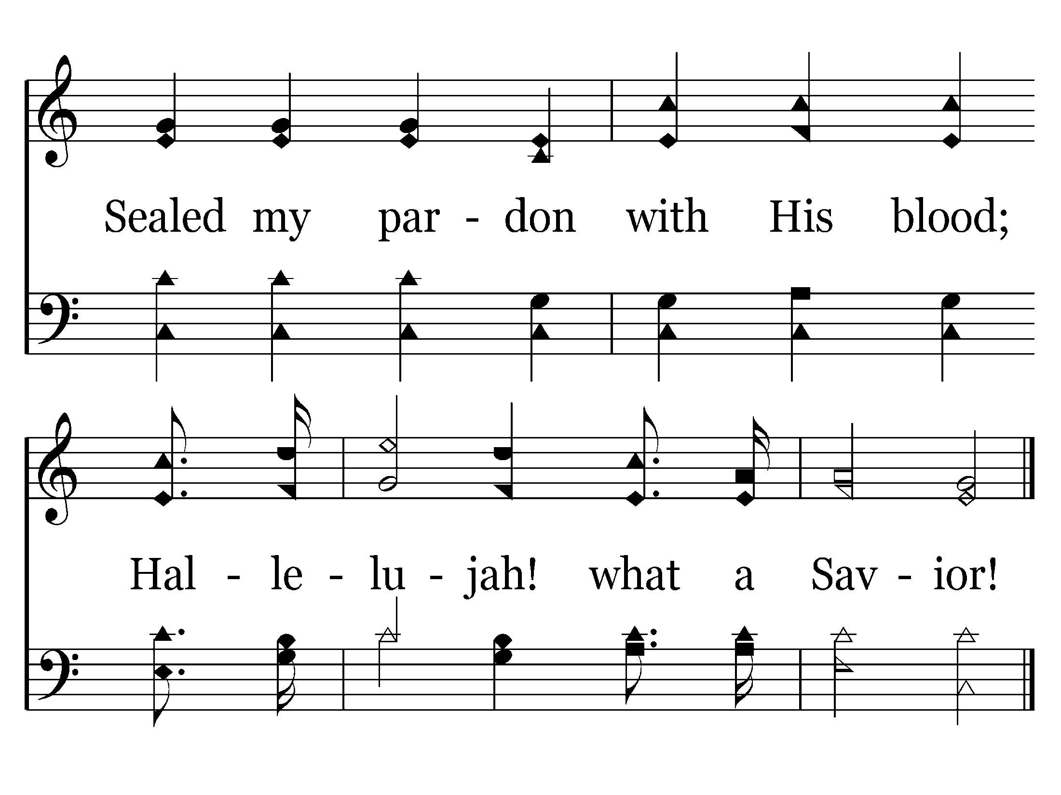
161 - Hallelujah! What A Savior! - 2.2
End of Verse 2 – Go to Verse 4

Slide 62
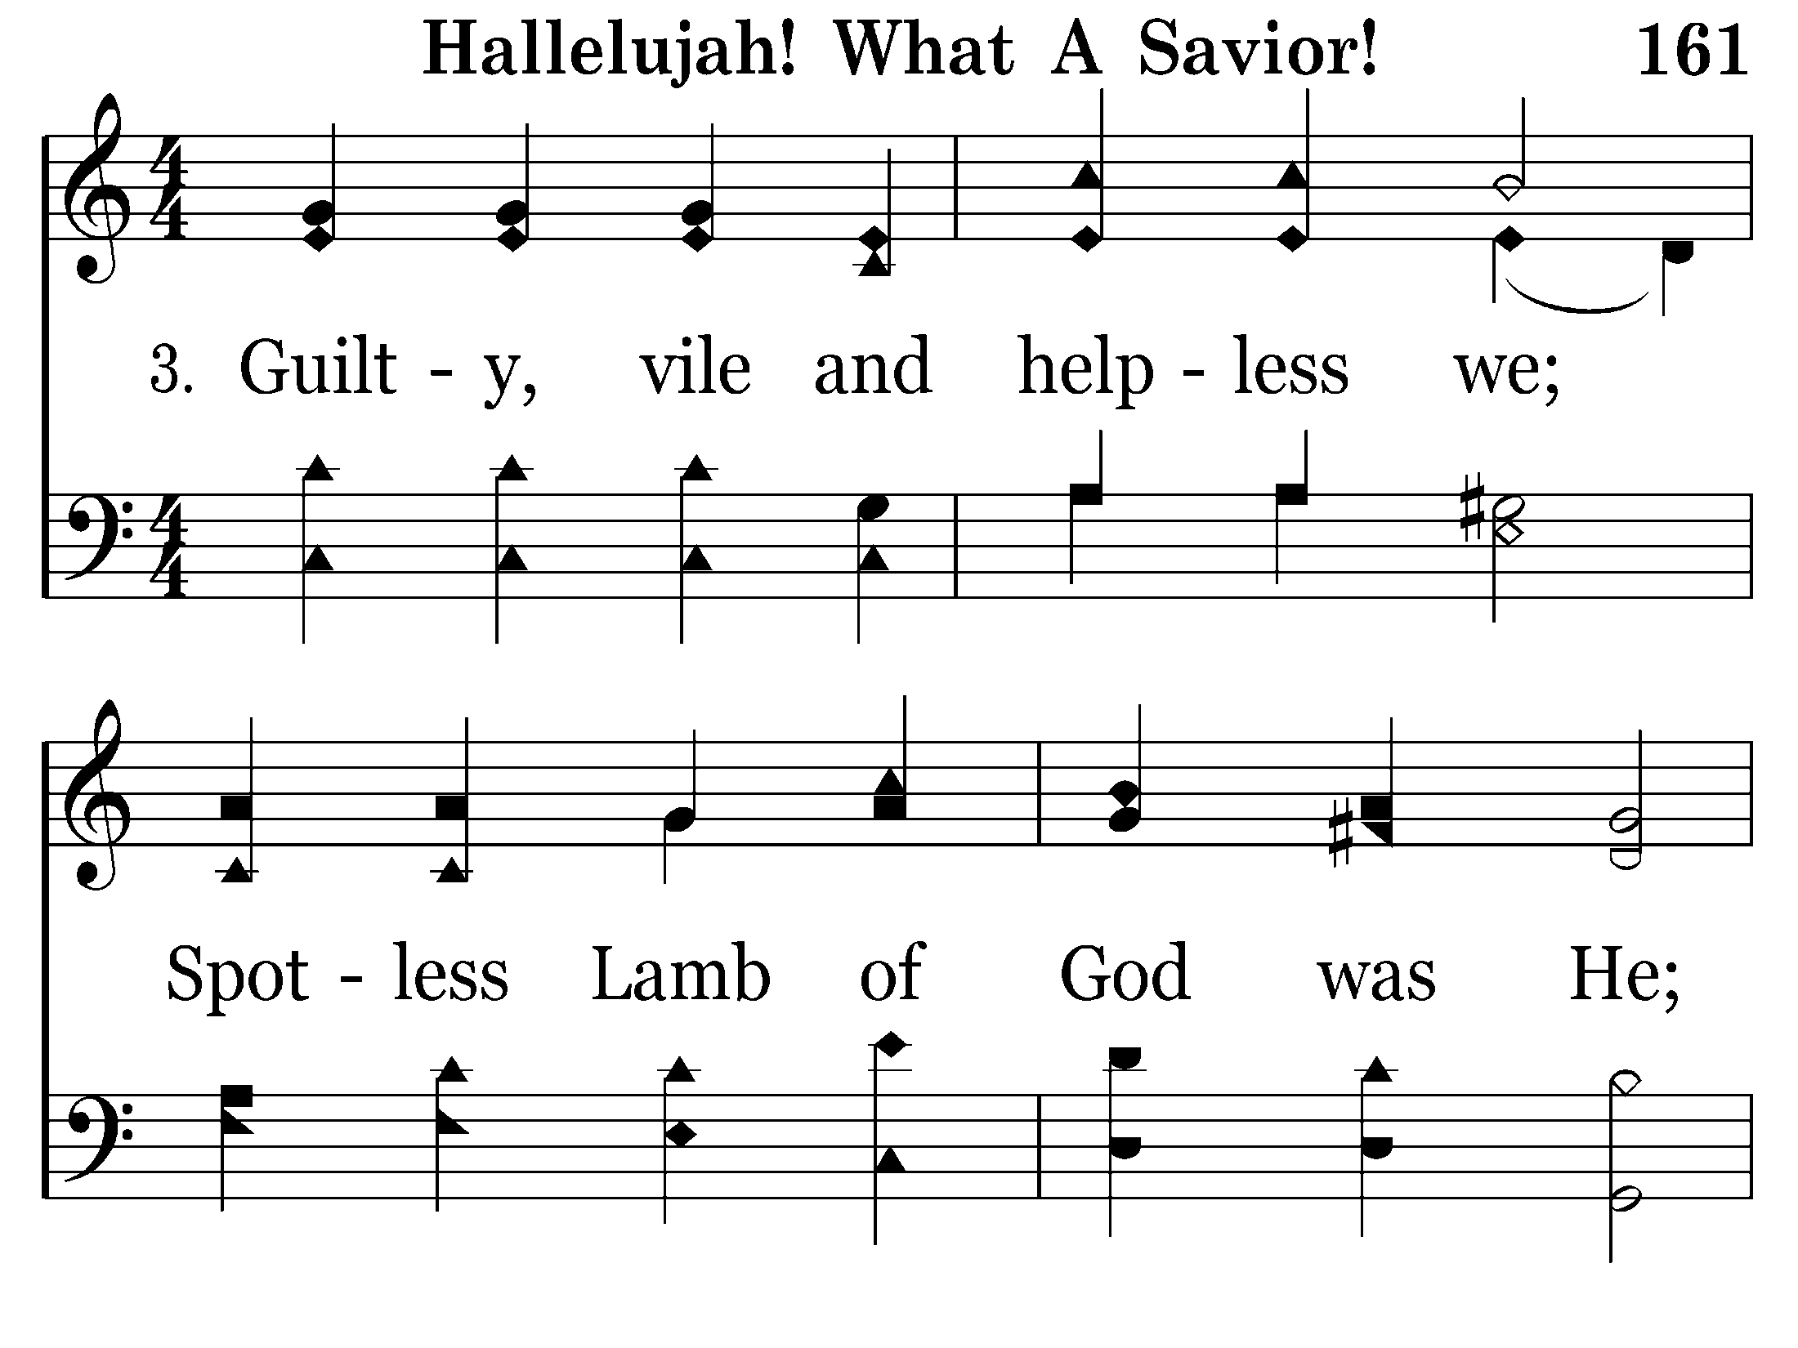
161 - Hallelujah! What A Savior! - 3.1

Slide 63
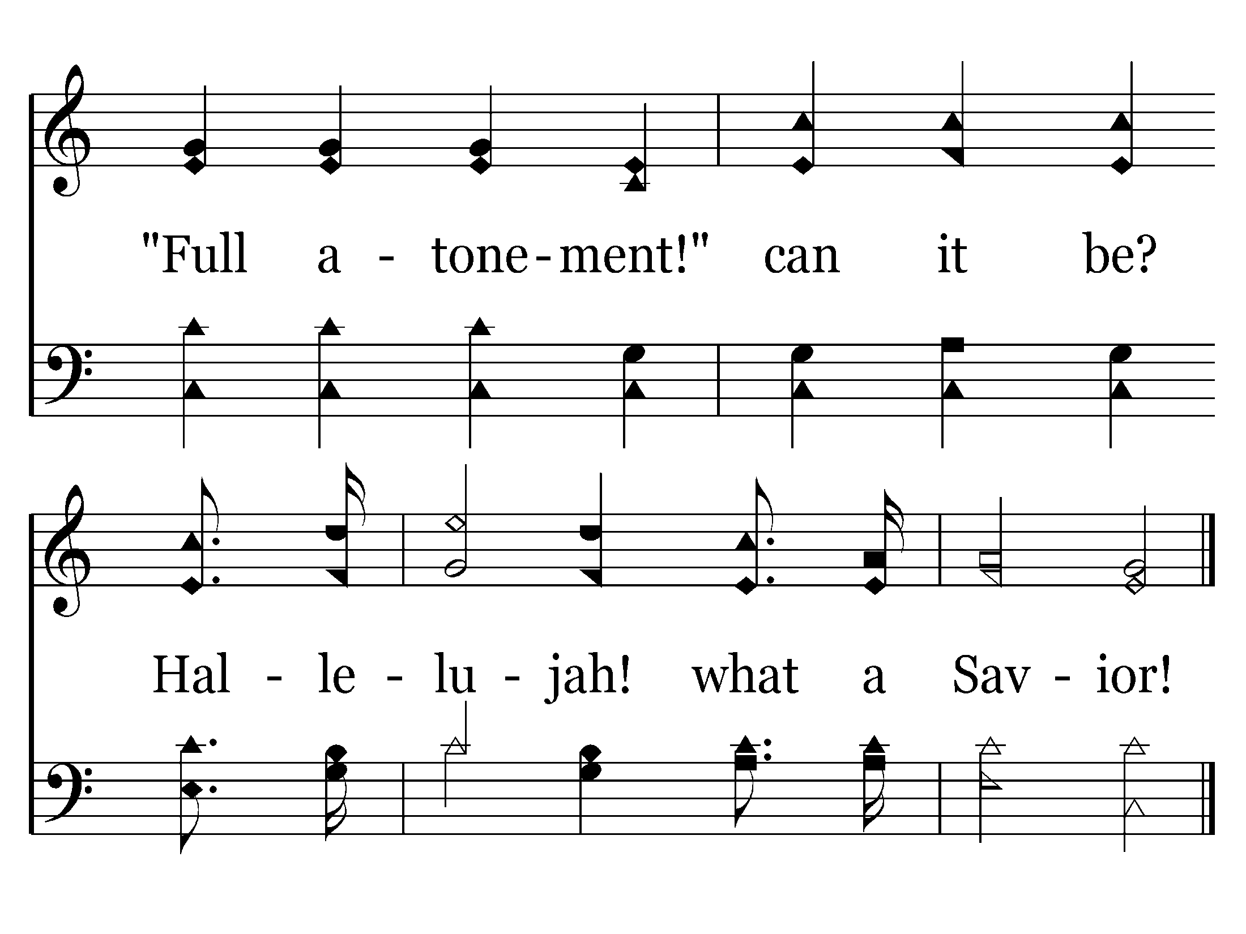
161 - Hallelujah! What A Savior! - 3.2
End of Verse 3

Slide 64
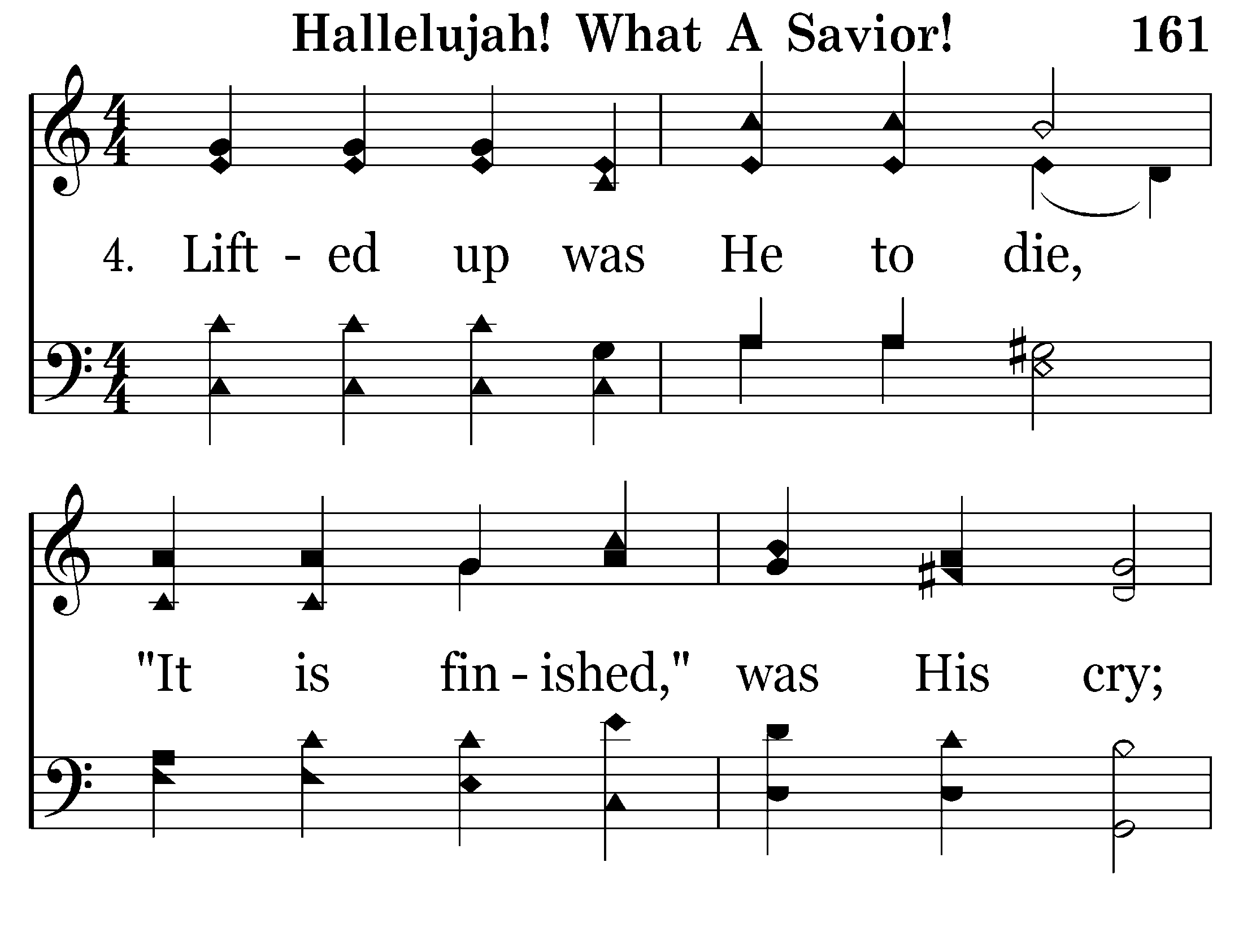
161 - Hallelujah! What A Savior! - 4.1

Slide 65
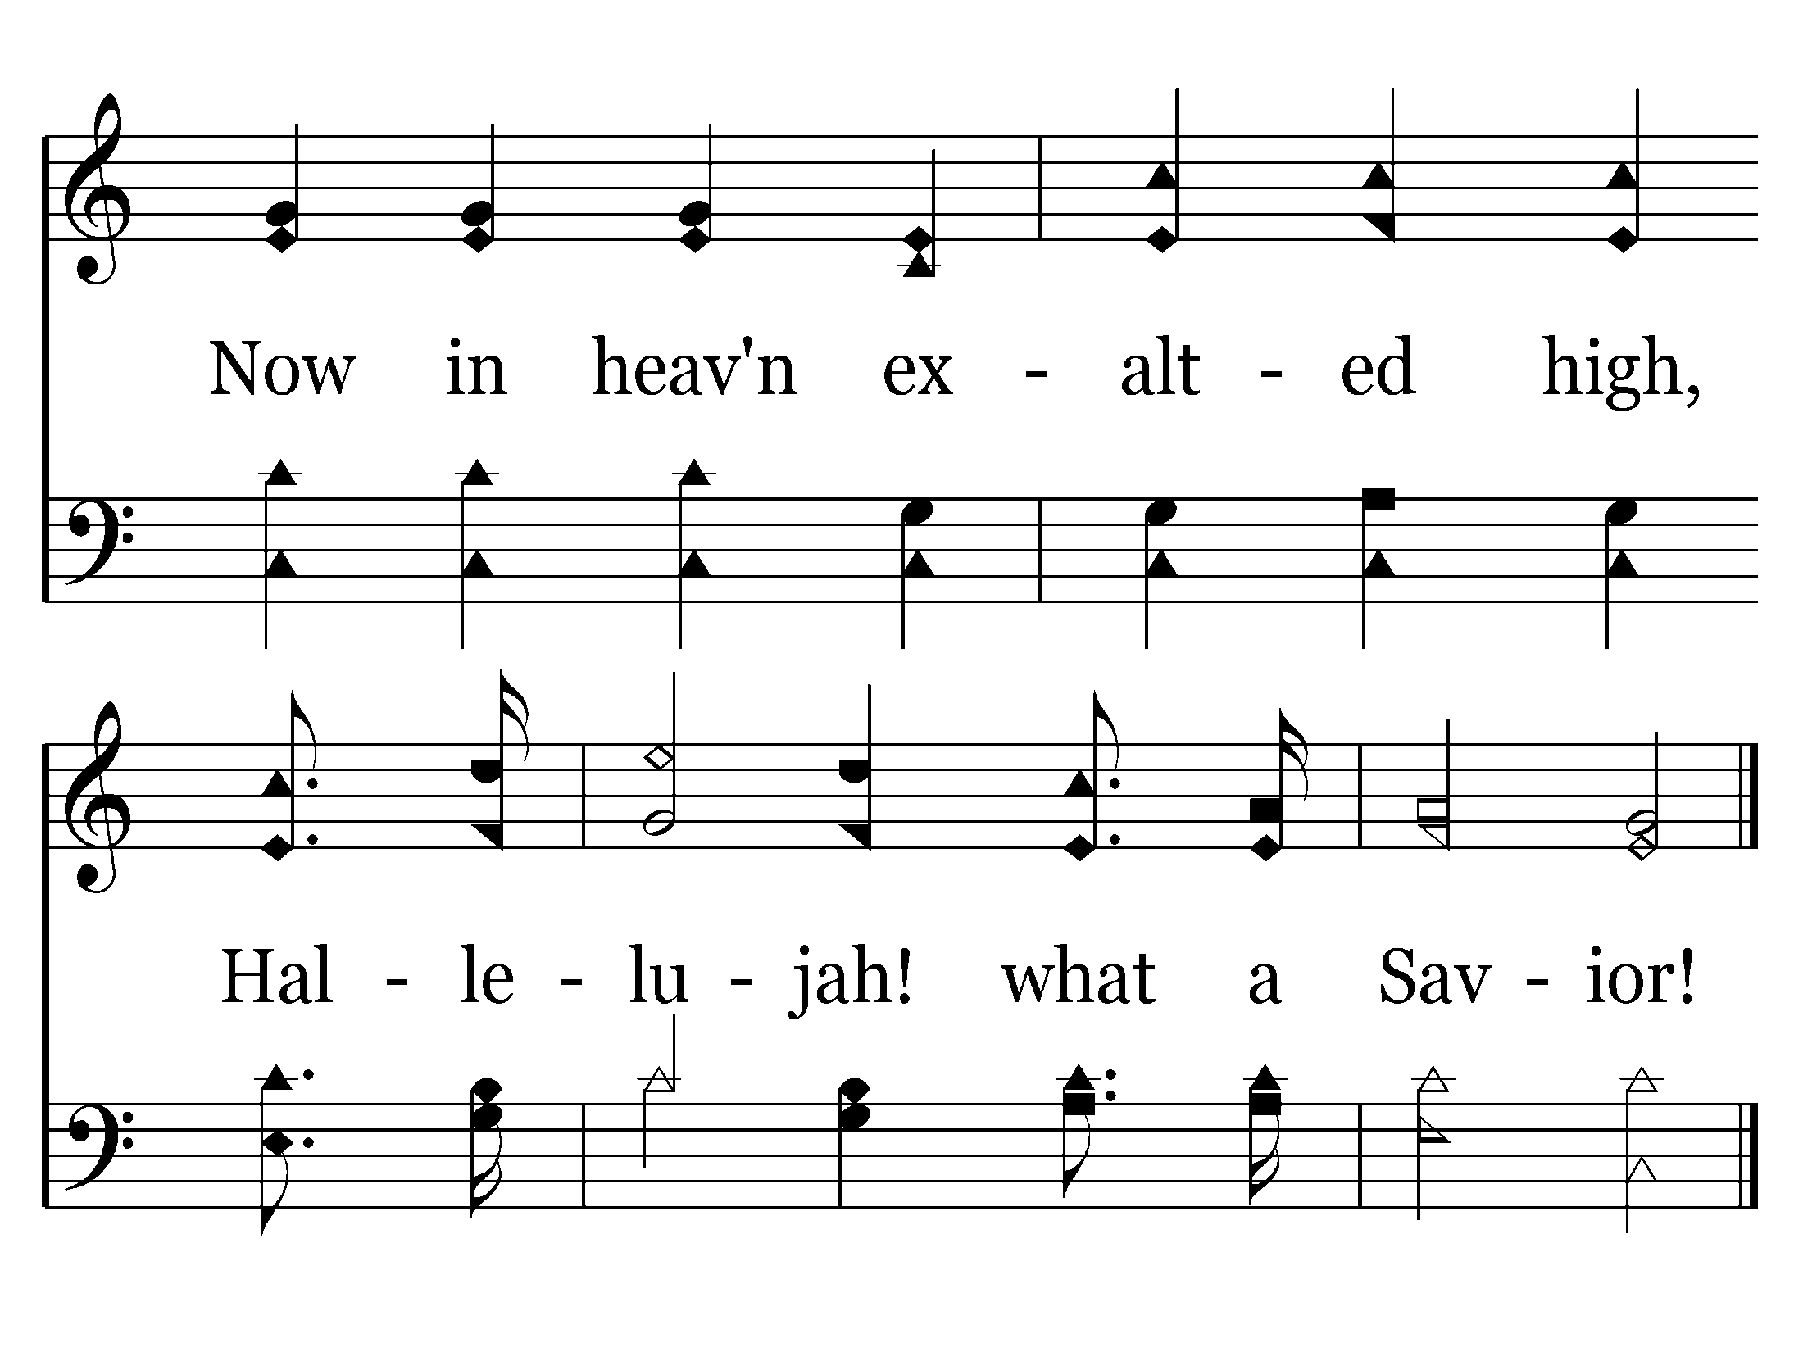
161 - Hallelujah! What A Savior! - 4.2
End of Song

Slide 66
scourge

Slide 67
DAY OF HUMILIATION
Deuteronomy 21:22-23
22 "If a man has committed a sin deserving of death, and he is put to death, and you hang him on a tree,
23 "his body shall not remain overnight on the tree, but you shall surely bury him that day, so that you do not defile the land which the LORD your God is giving you as an inheritance; for he who is hanged is accursed of God.
Galatians 3:13
13 Christ has redeemed us from the curse of the law, having become a curse for us (for it is written, "Cursed is everyone who hangs on a tree"),

Slide 68
Hebrews 12:3
3 For consider Him who endured such hostility from sinners against Himself, lest you become weary and discouraged in your souls.

Slide 69
Philippians 2:5-8
5 Let this mind be in you which was also in Christ Jesus,
6 who, being in the form of God, did not consider it robbery to be equal with God,
7 but made Himself of no reputation, taking the form of a bondservant, and coming in the likeness of men.
8 And being found in appearance as a man, He humbled Himself and became obedient to the point of death, even the death of the cross.

Slide 70
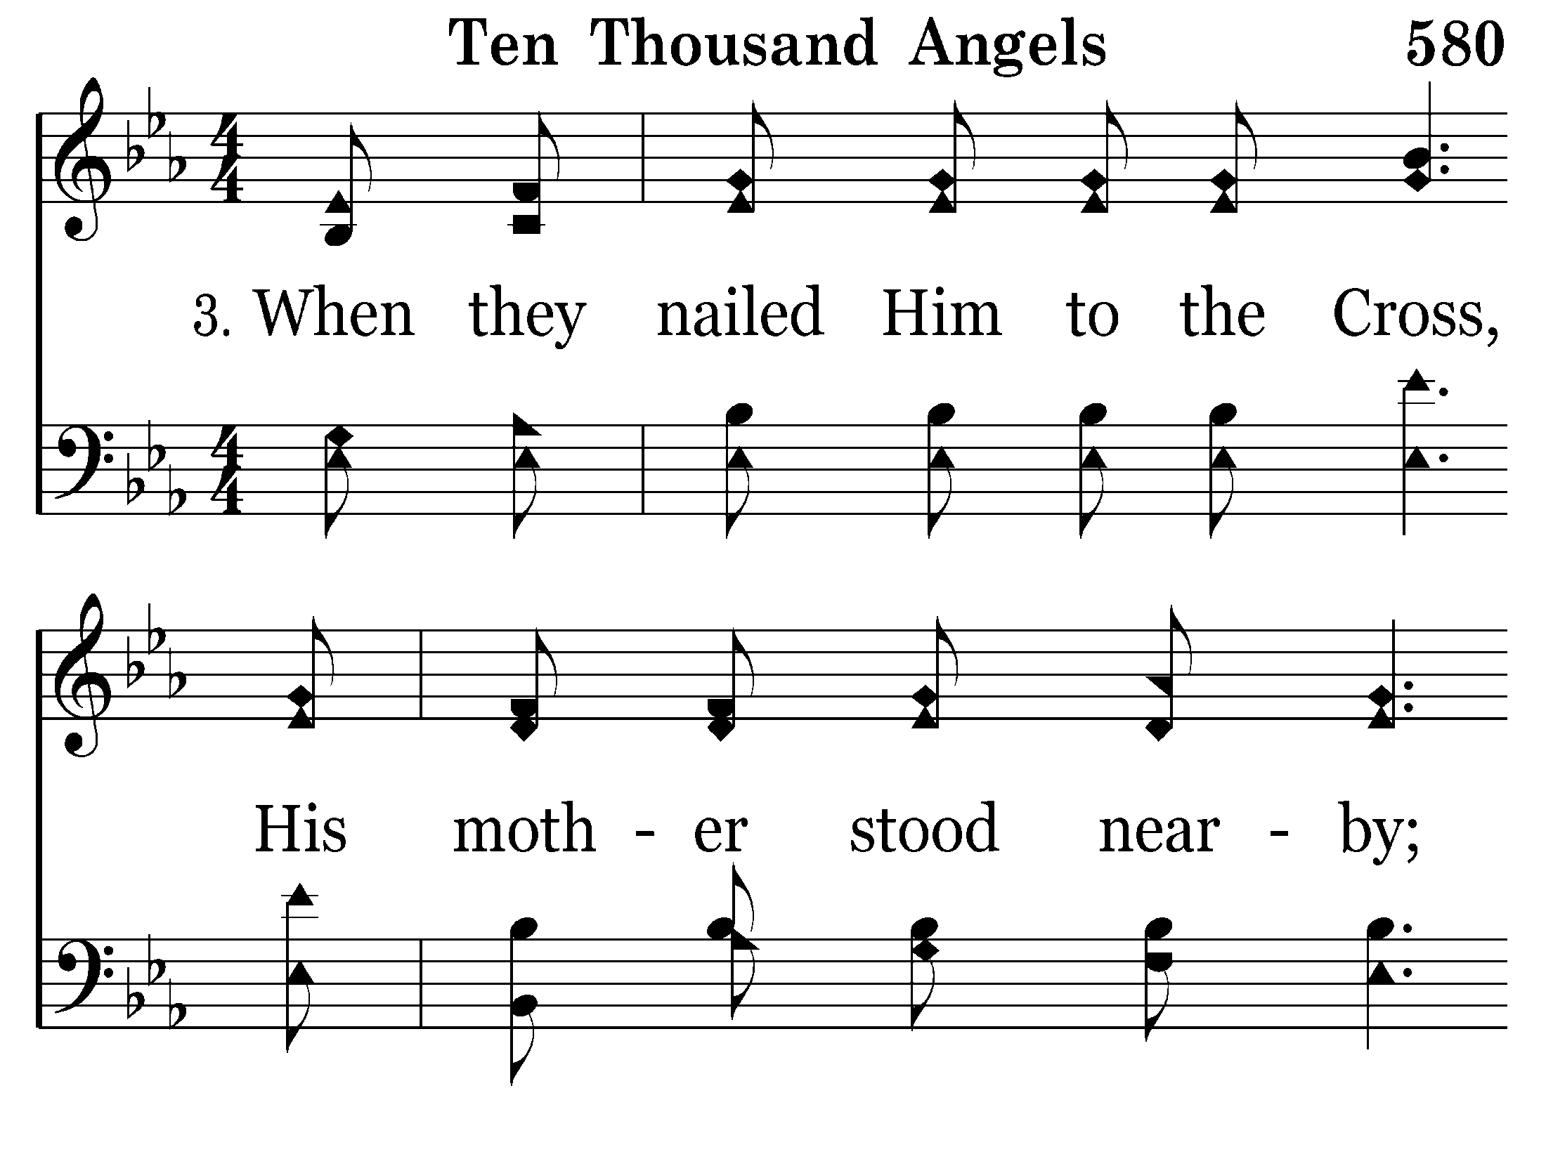
580 - Ten Thousand Angels - 3.1

Slide 71
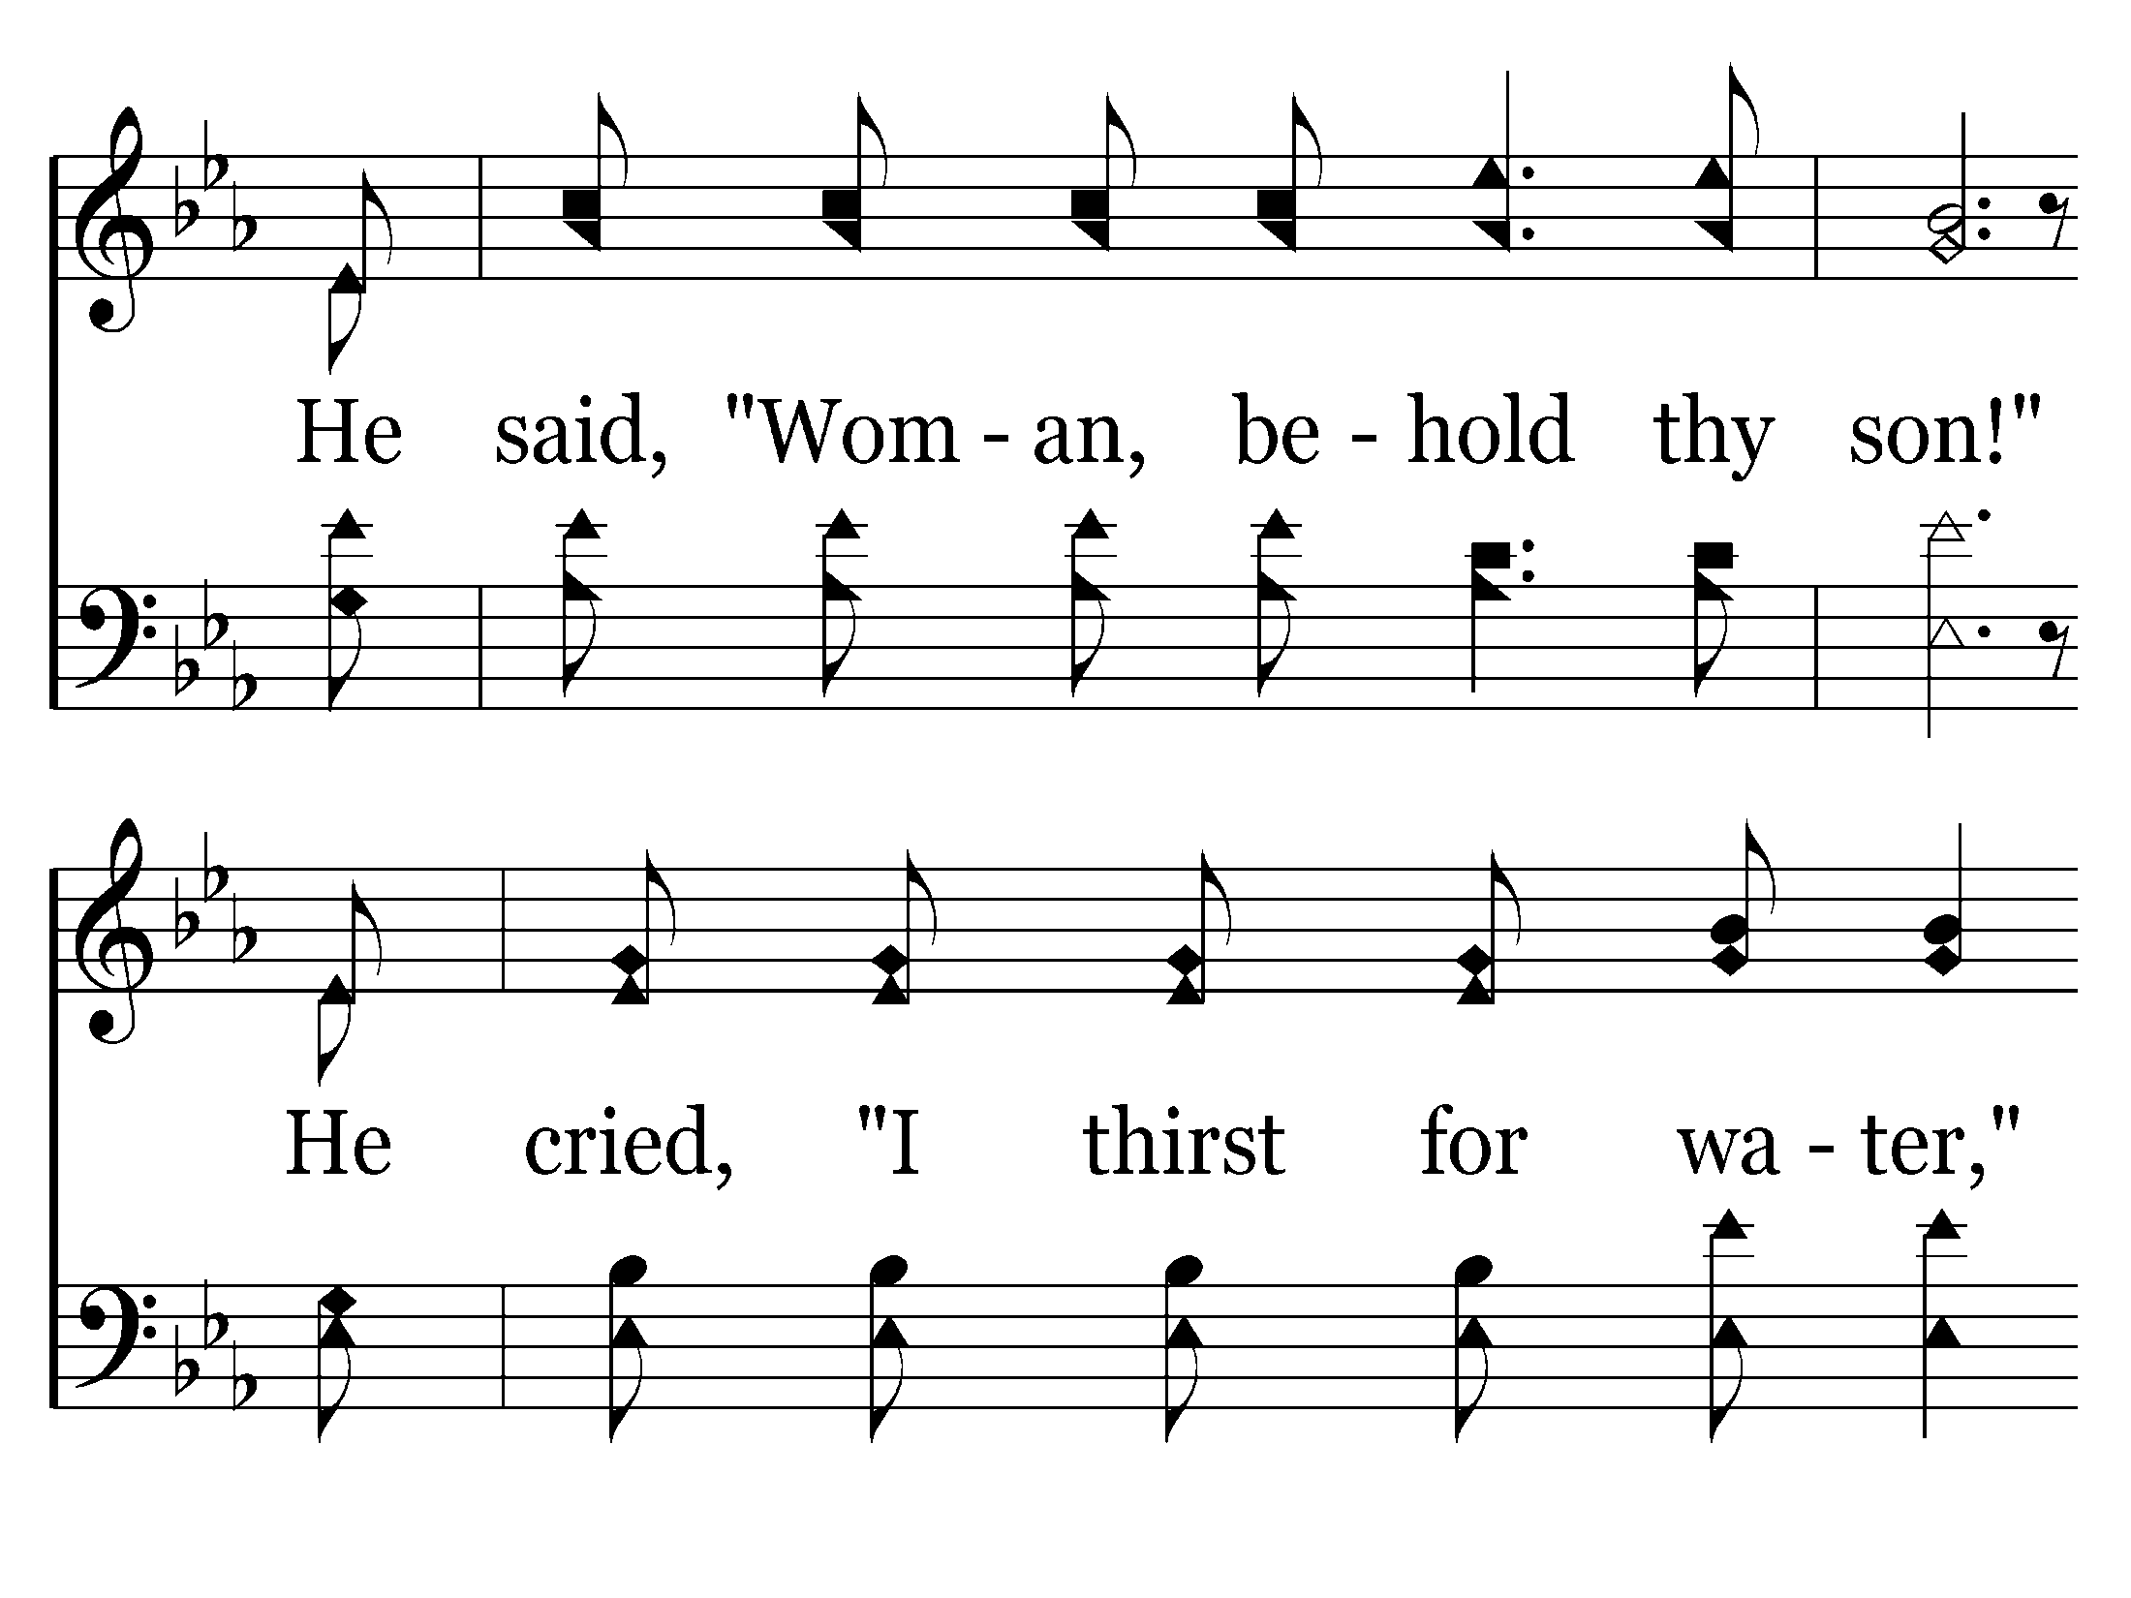
580 - Ten Thousand Angels - 3.2

Slide 72
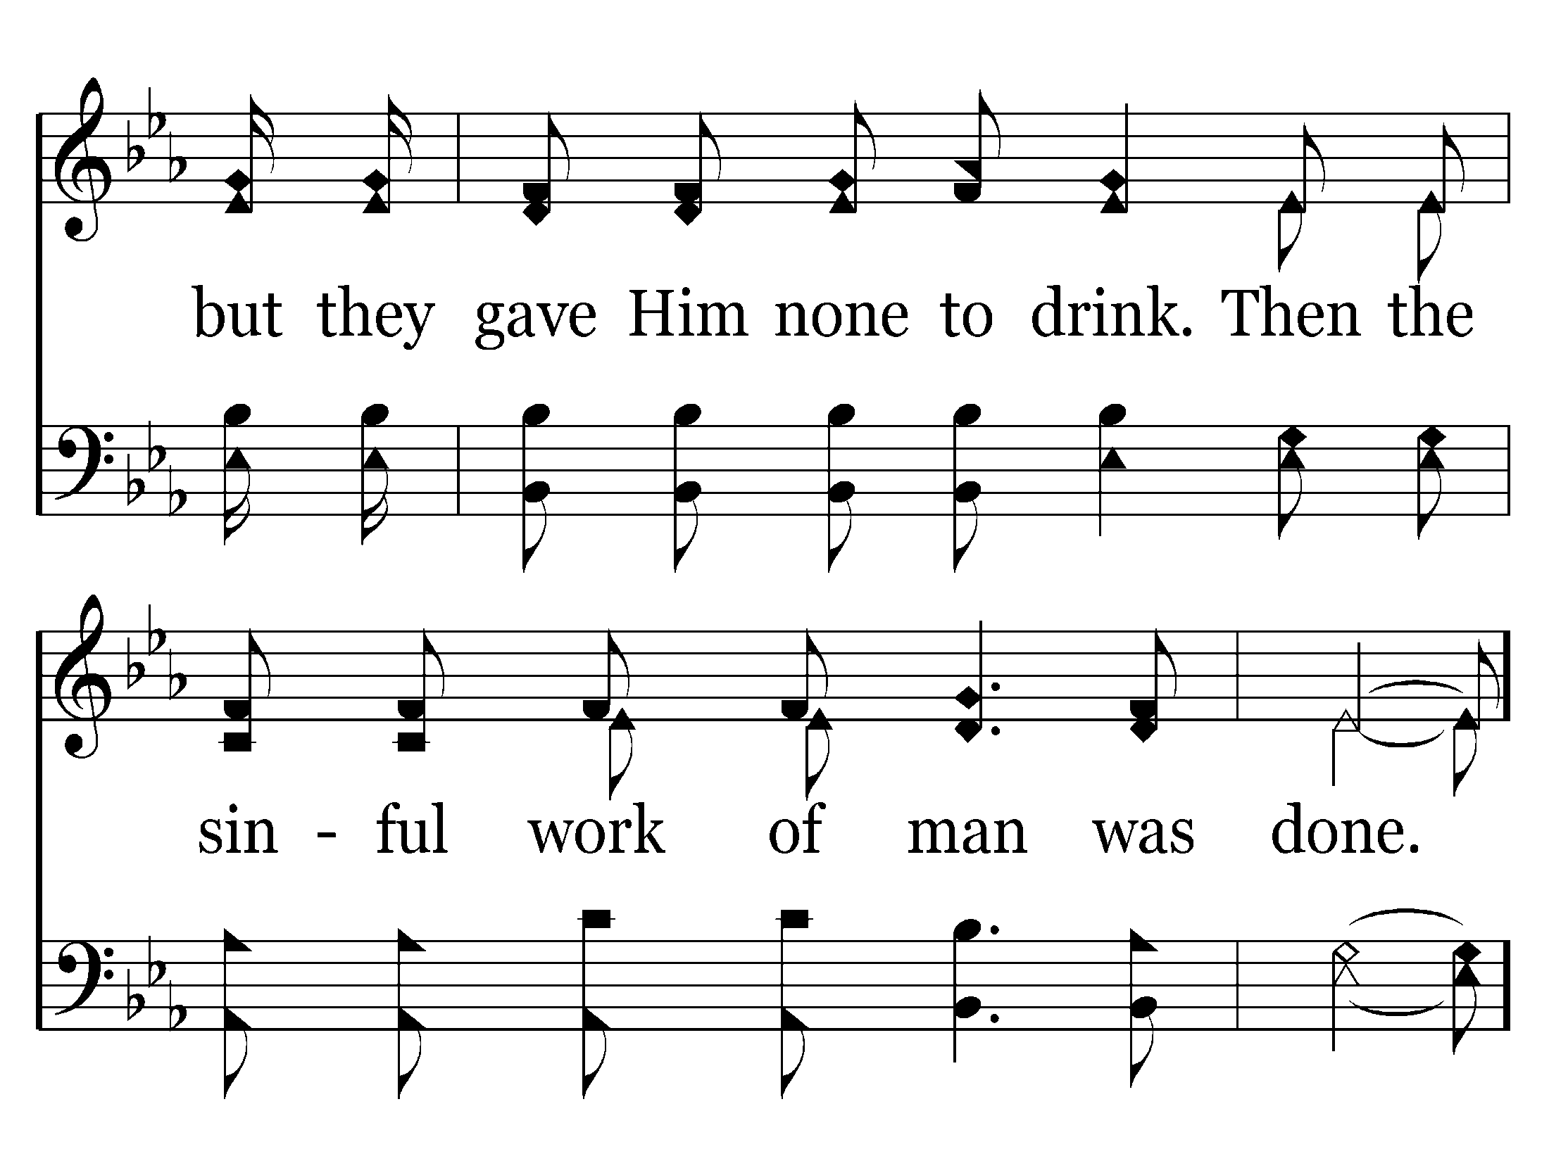
580 - Ten Thousand Angels - 3.3
End of Verse 3 – Go to Verse 4

Slide 73
580 - Ten Thousand Angels - C.1

Slide 74
580 - Ten Thousand Angels - C.2
End of Verse 3

Slide 75
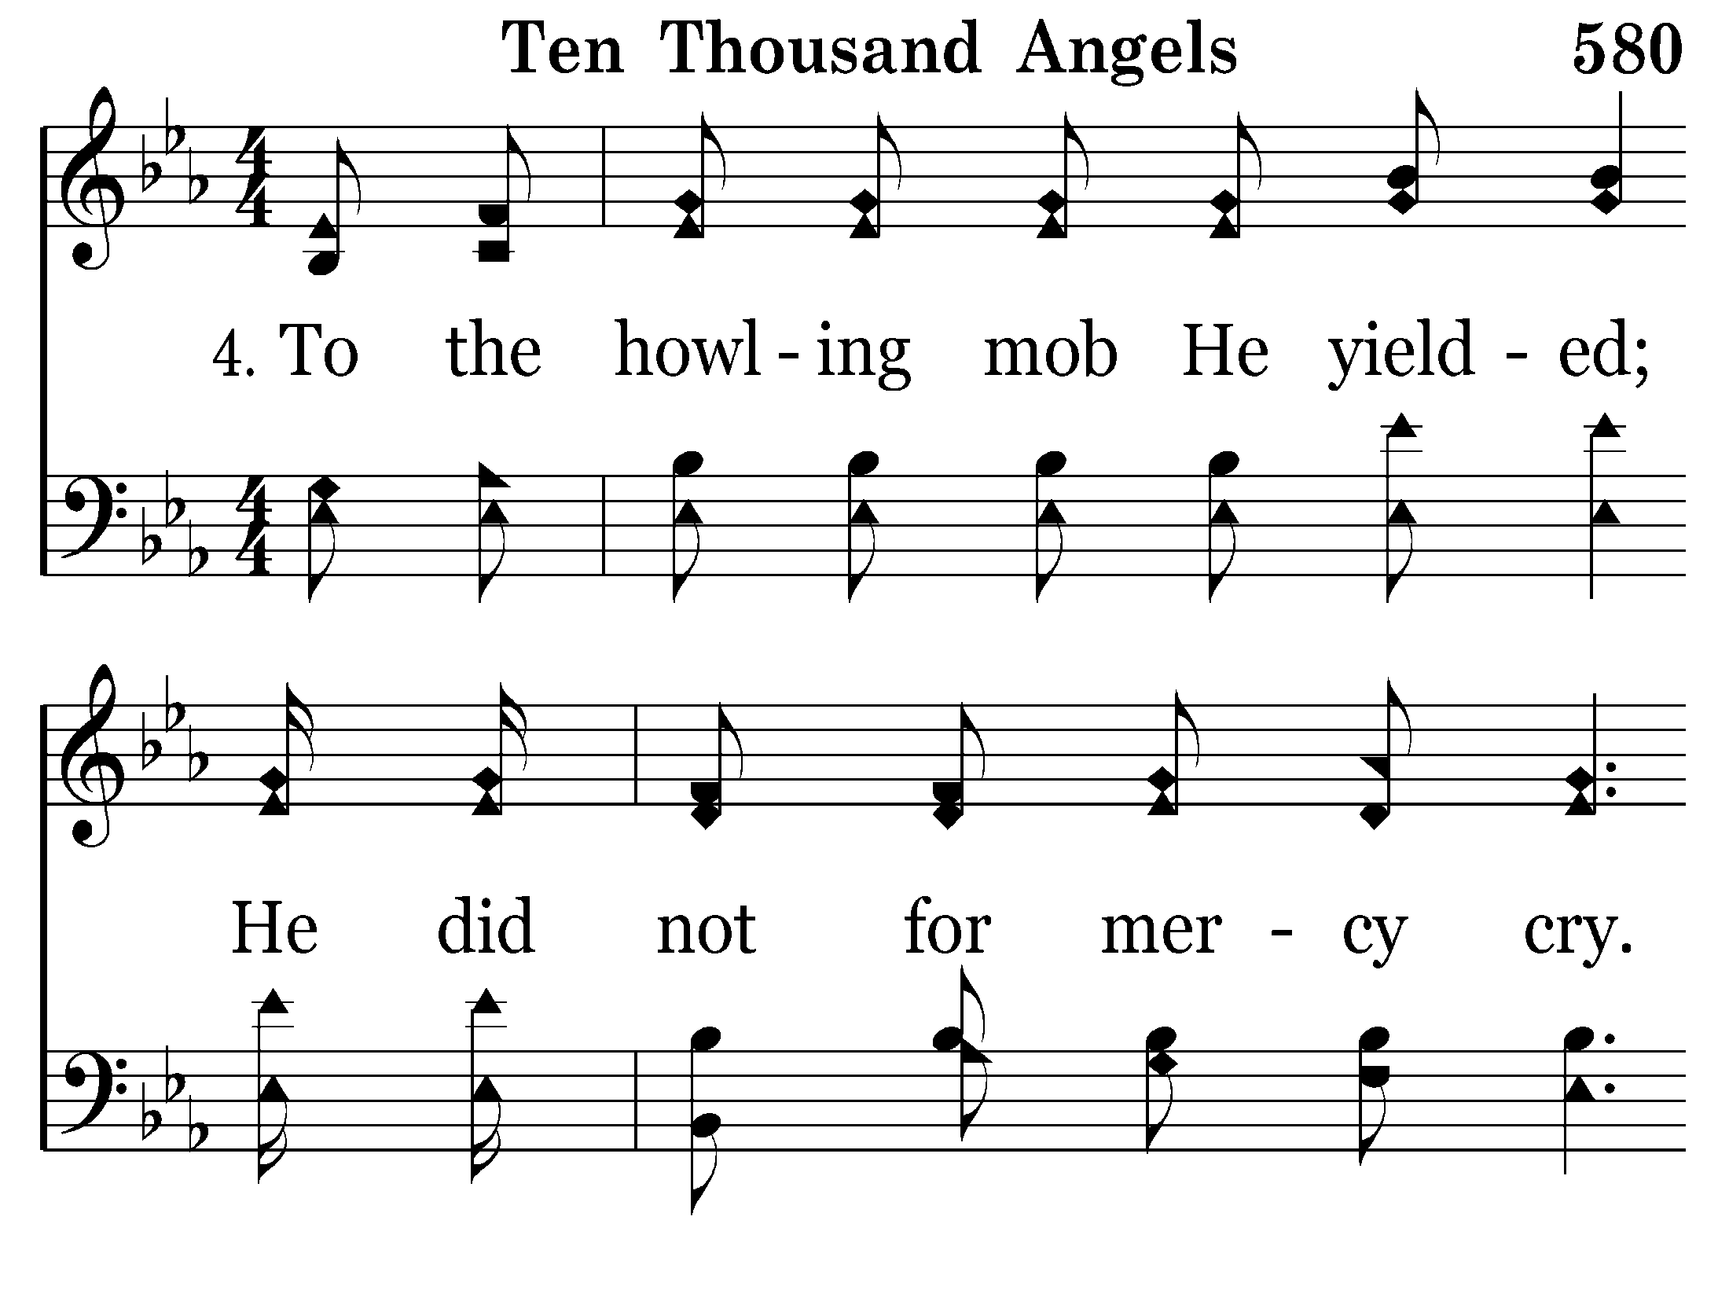
580 - Ten Thousand Angels - 4.1

Slide 76
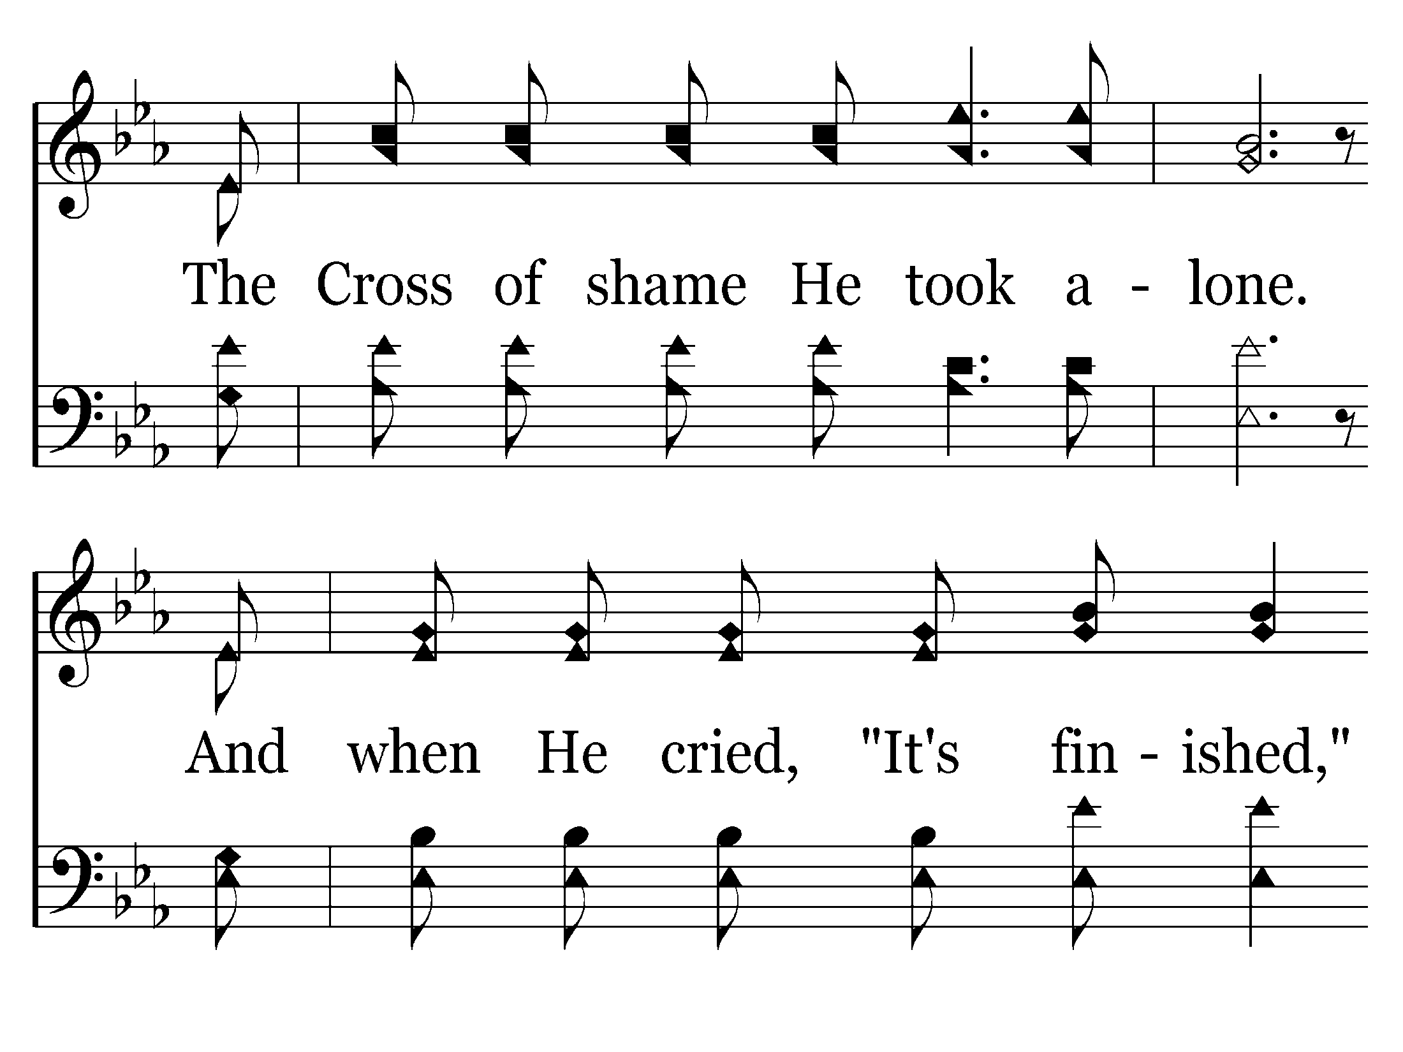
580 - Ten Thousand Angels - 4.2

Slide 77
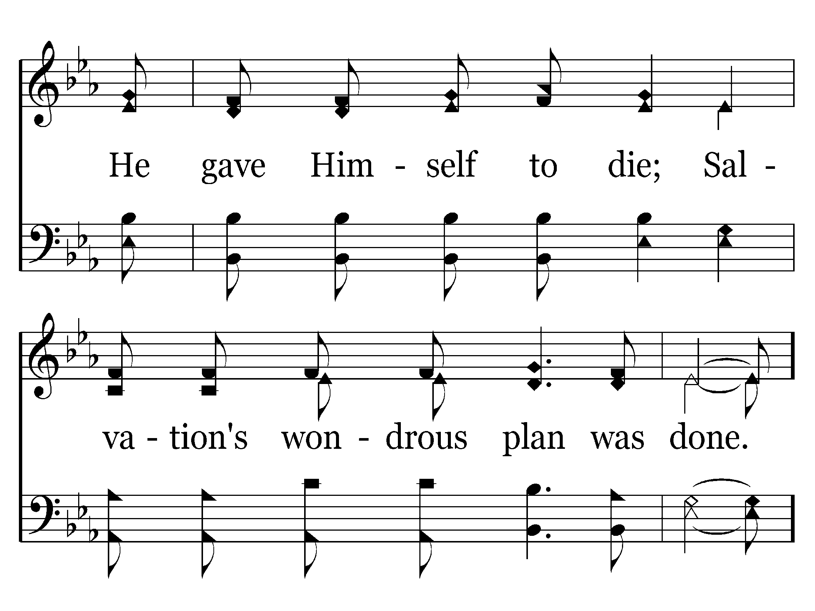
580 - Ten Thousand Angels - 4.3

Slide 78
580 - Ten Thousand Angels - C.1

Slide 79
580 - Ten Thousand Angels - C.2
End of Song

Slide 80
scourge

Slide 81
DAY OF INFAMY

Slide 82
Yesterday, Dec. 7, 1941 - a date which will live in infamy - the United States of America was suddenly and deliberately attacked by naval and air forces of the Empire of Japan.
Yesterday, Dec. 7, 1941 - a date which will live in infamy - the United States of America was suddenly and deliberately attacked by naval and air forces of the Empire of Japan.
Yesterday, Dec. 7, 1941 - a date which will live in infamy - the United States of America was suddenly and deliberately attacked by naval and air forces of the Empire of Japan.
- Franklin D. Roosevelt

Slide 83
DAY OF INFAMY
John 19:14
14 Now it was the Preparation Day of the Passover, and about the sixth hour. And he said to the Jews, "Behold your King!”
Luke 23:27
27 And a great multitude of the people followed Him, and women who also mourned and lamented Him.

Slide 84
Matthew 27:41-43
41 Likewise the chief priests also, mocking with the scribes and elders, said,
42 "He saved others; Himself He cannot save. If He is the King of Israel, let Him now come down from the cross, and we will believe Him.
43 "He trusted in God; let Him deliver Him now if He will have Him; for He said, 'I am the Son of God.‘”
44 Even the robbers who were crucified with Him reviled Him with the same thing.

Slide 85
CRUCIFIXION
THE DARKEST
OF
DAYS!
AGONY
DREAD
HUMILIATION
INFAMY

Slide 86
Hebrews 12:2
2 looking unto Jesus, the author and finisher of our faith, who for the joy that was set before Him endured the cross, despising the shame, and has sat down at the right hand of the throne of God.

Slide 87
Romans 8:32
32 He who did not spare His own Son, but delivered Him up for us all, how shall He not with Him also freely give us all things?

Slide 88
Ephesians 1:19-21
and what is the exceeding greatness of His power toward us who believe, according to the working of His mighty power
which He worked in Christ when He raised Him from the dead and seated Him at His right hand in the heavenly places,
21 far above all principality and power and might and dominion, and every name that is named, not only in this age but also in that which is to come.

Slide 89
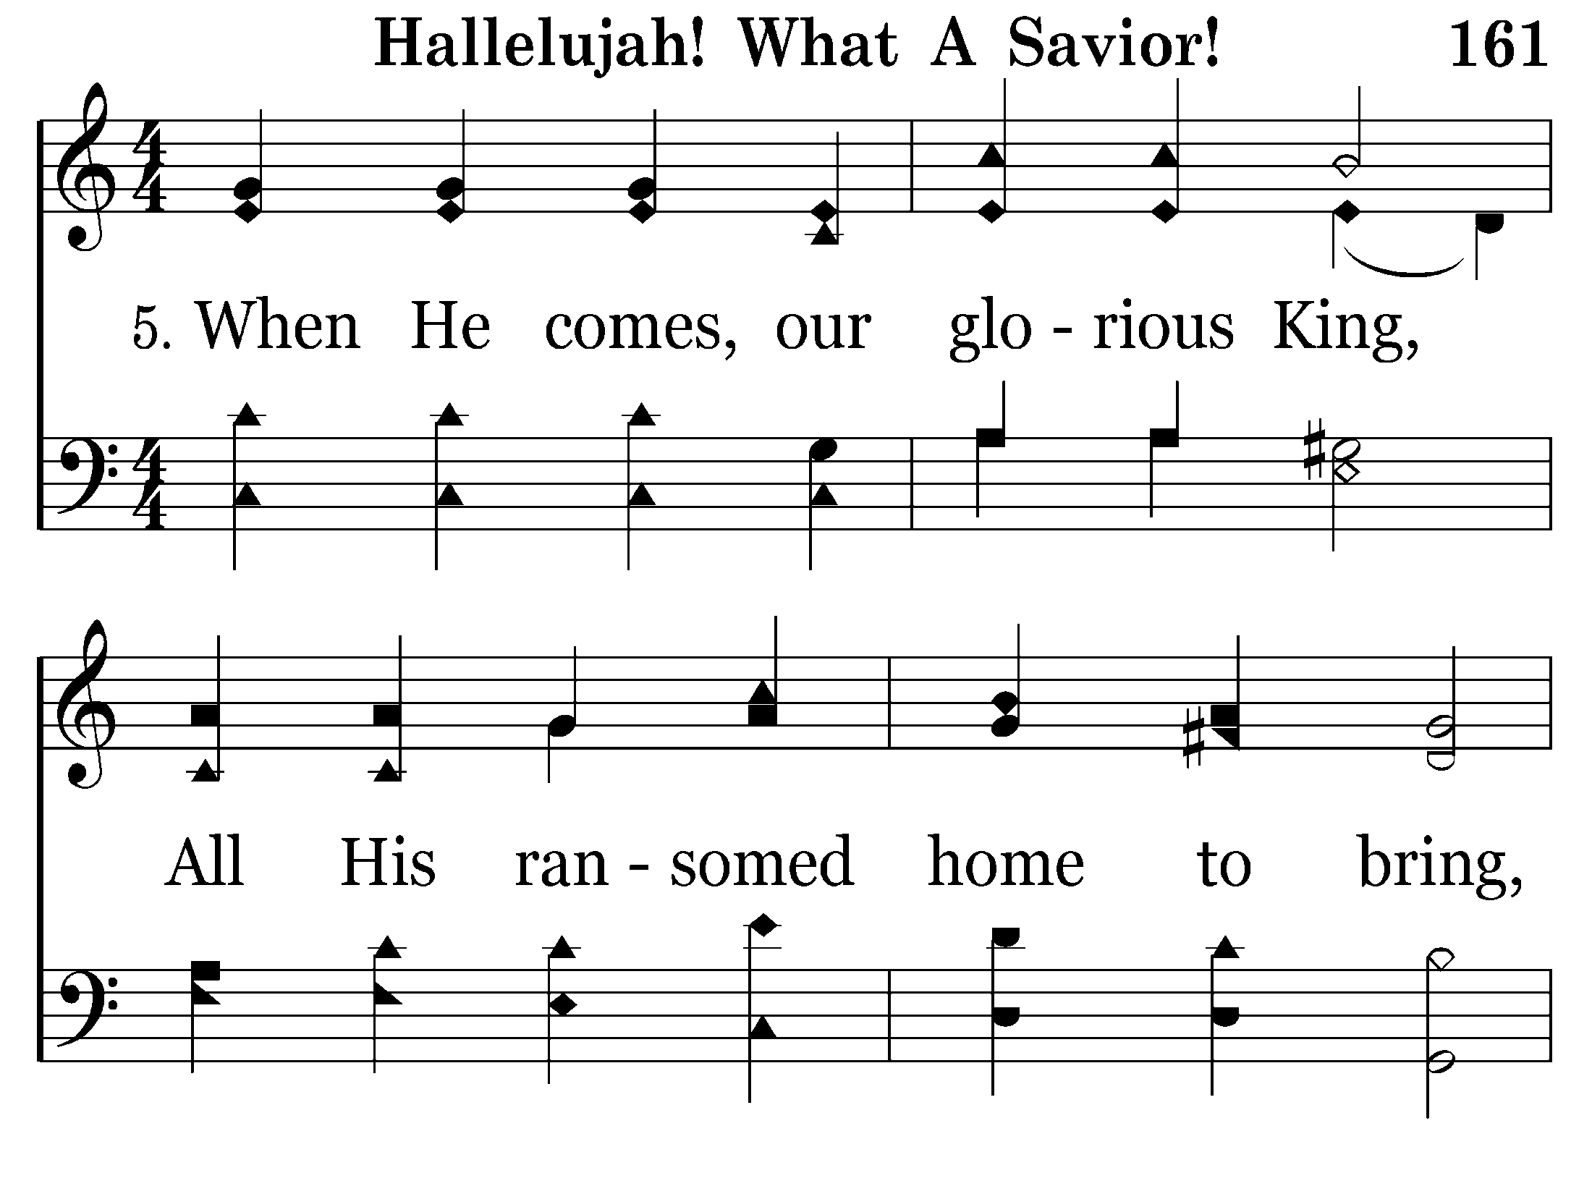
161 - Hallelujah! What A Savior! - 5.1

Slide 90
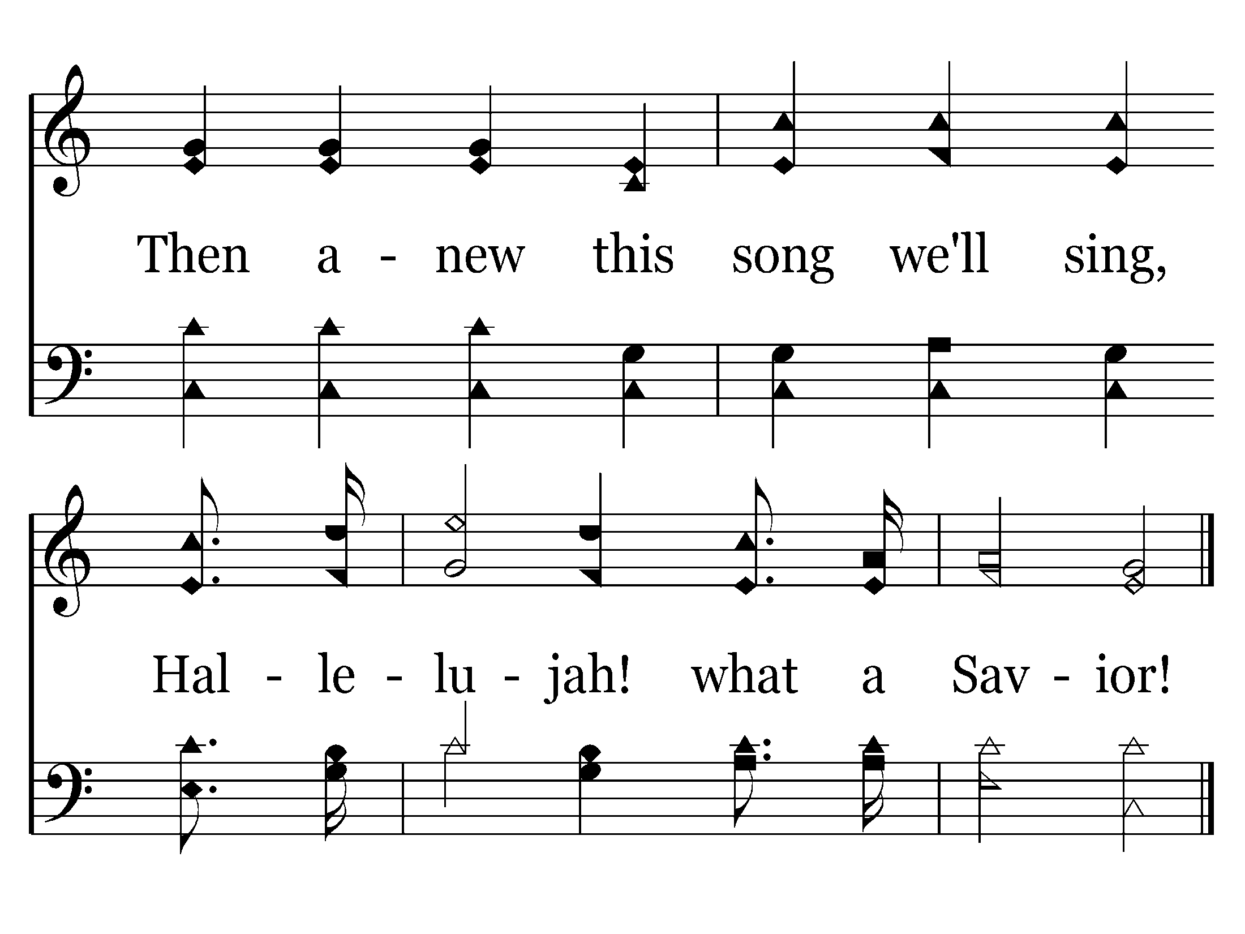
161 - Hallelujah! What A Savior! - 5.2
End of Song

Slide 92
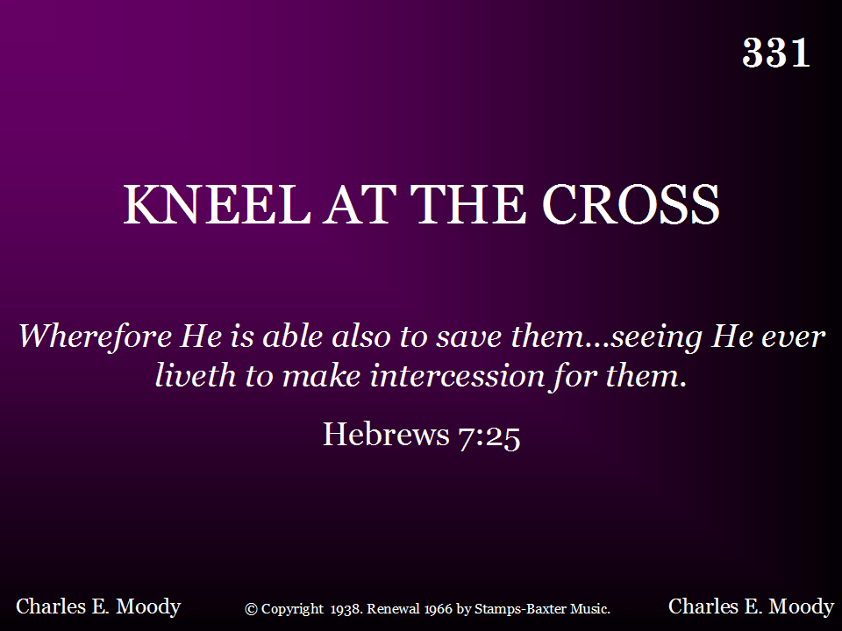
331 - Kneel At The Cross - Title

Slide 93
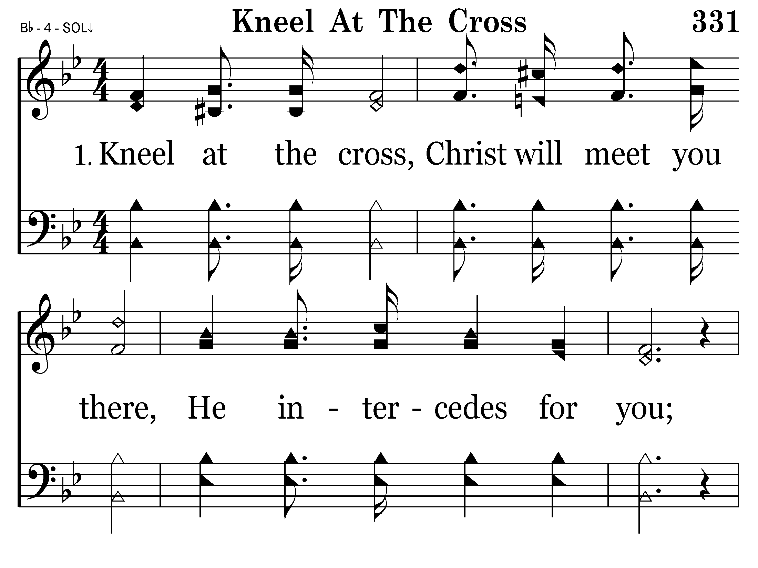
331 - Kneel At The Cross - 1.1

Slide 94
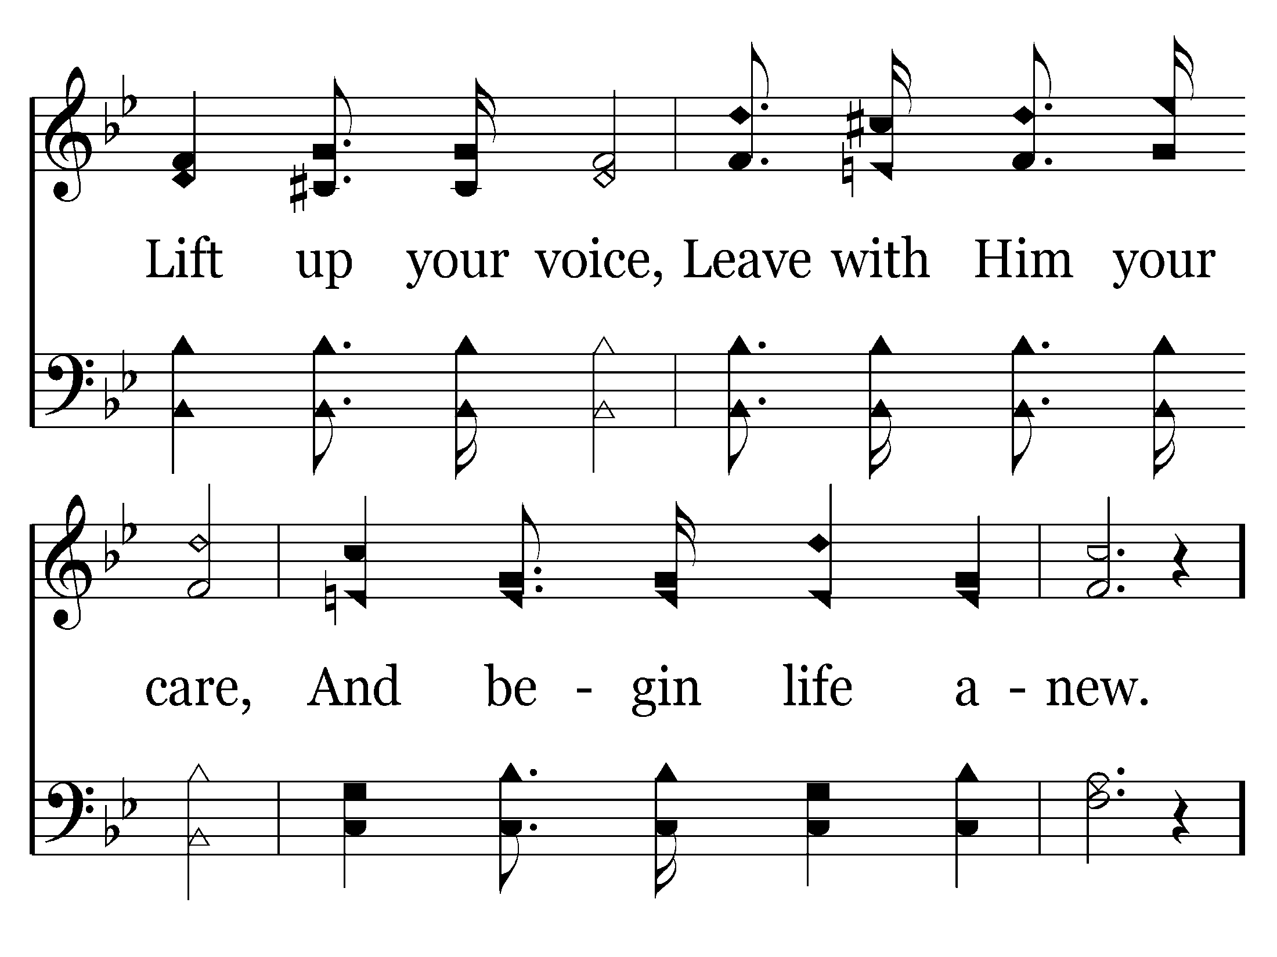
331 - Kneel At The Cross - 1.2

Slide 95
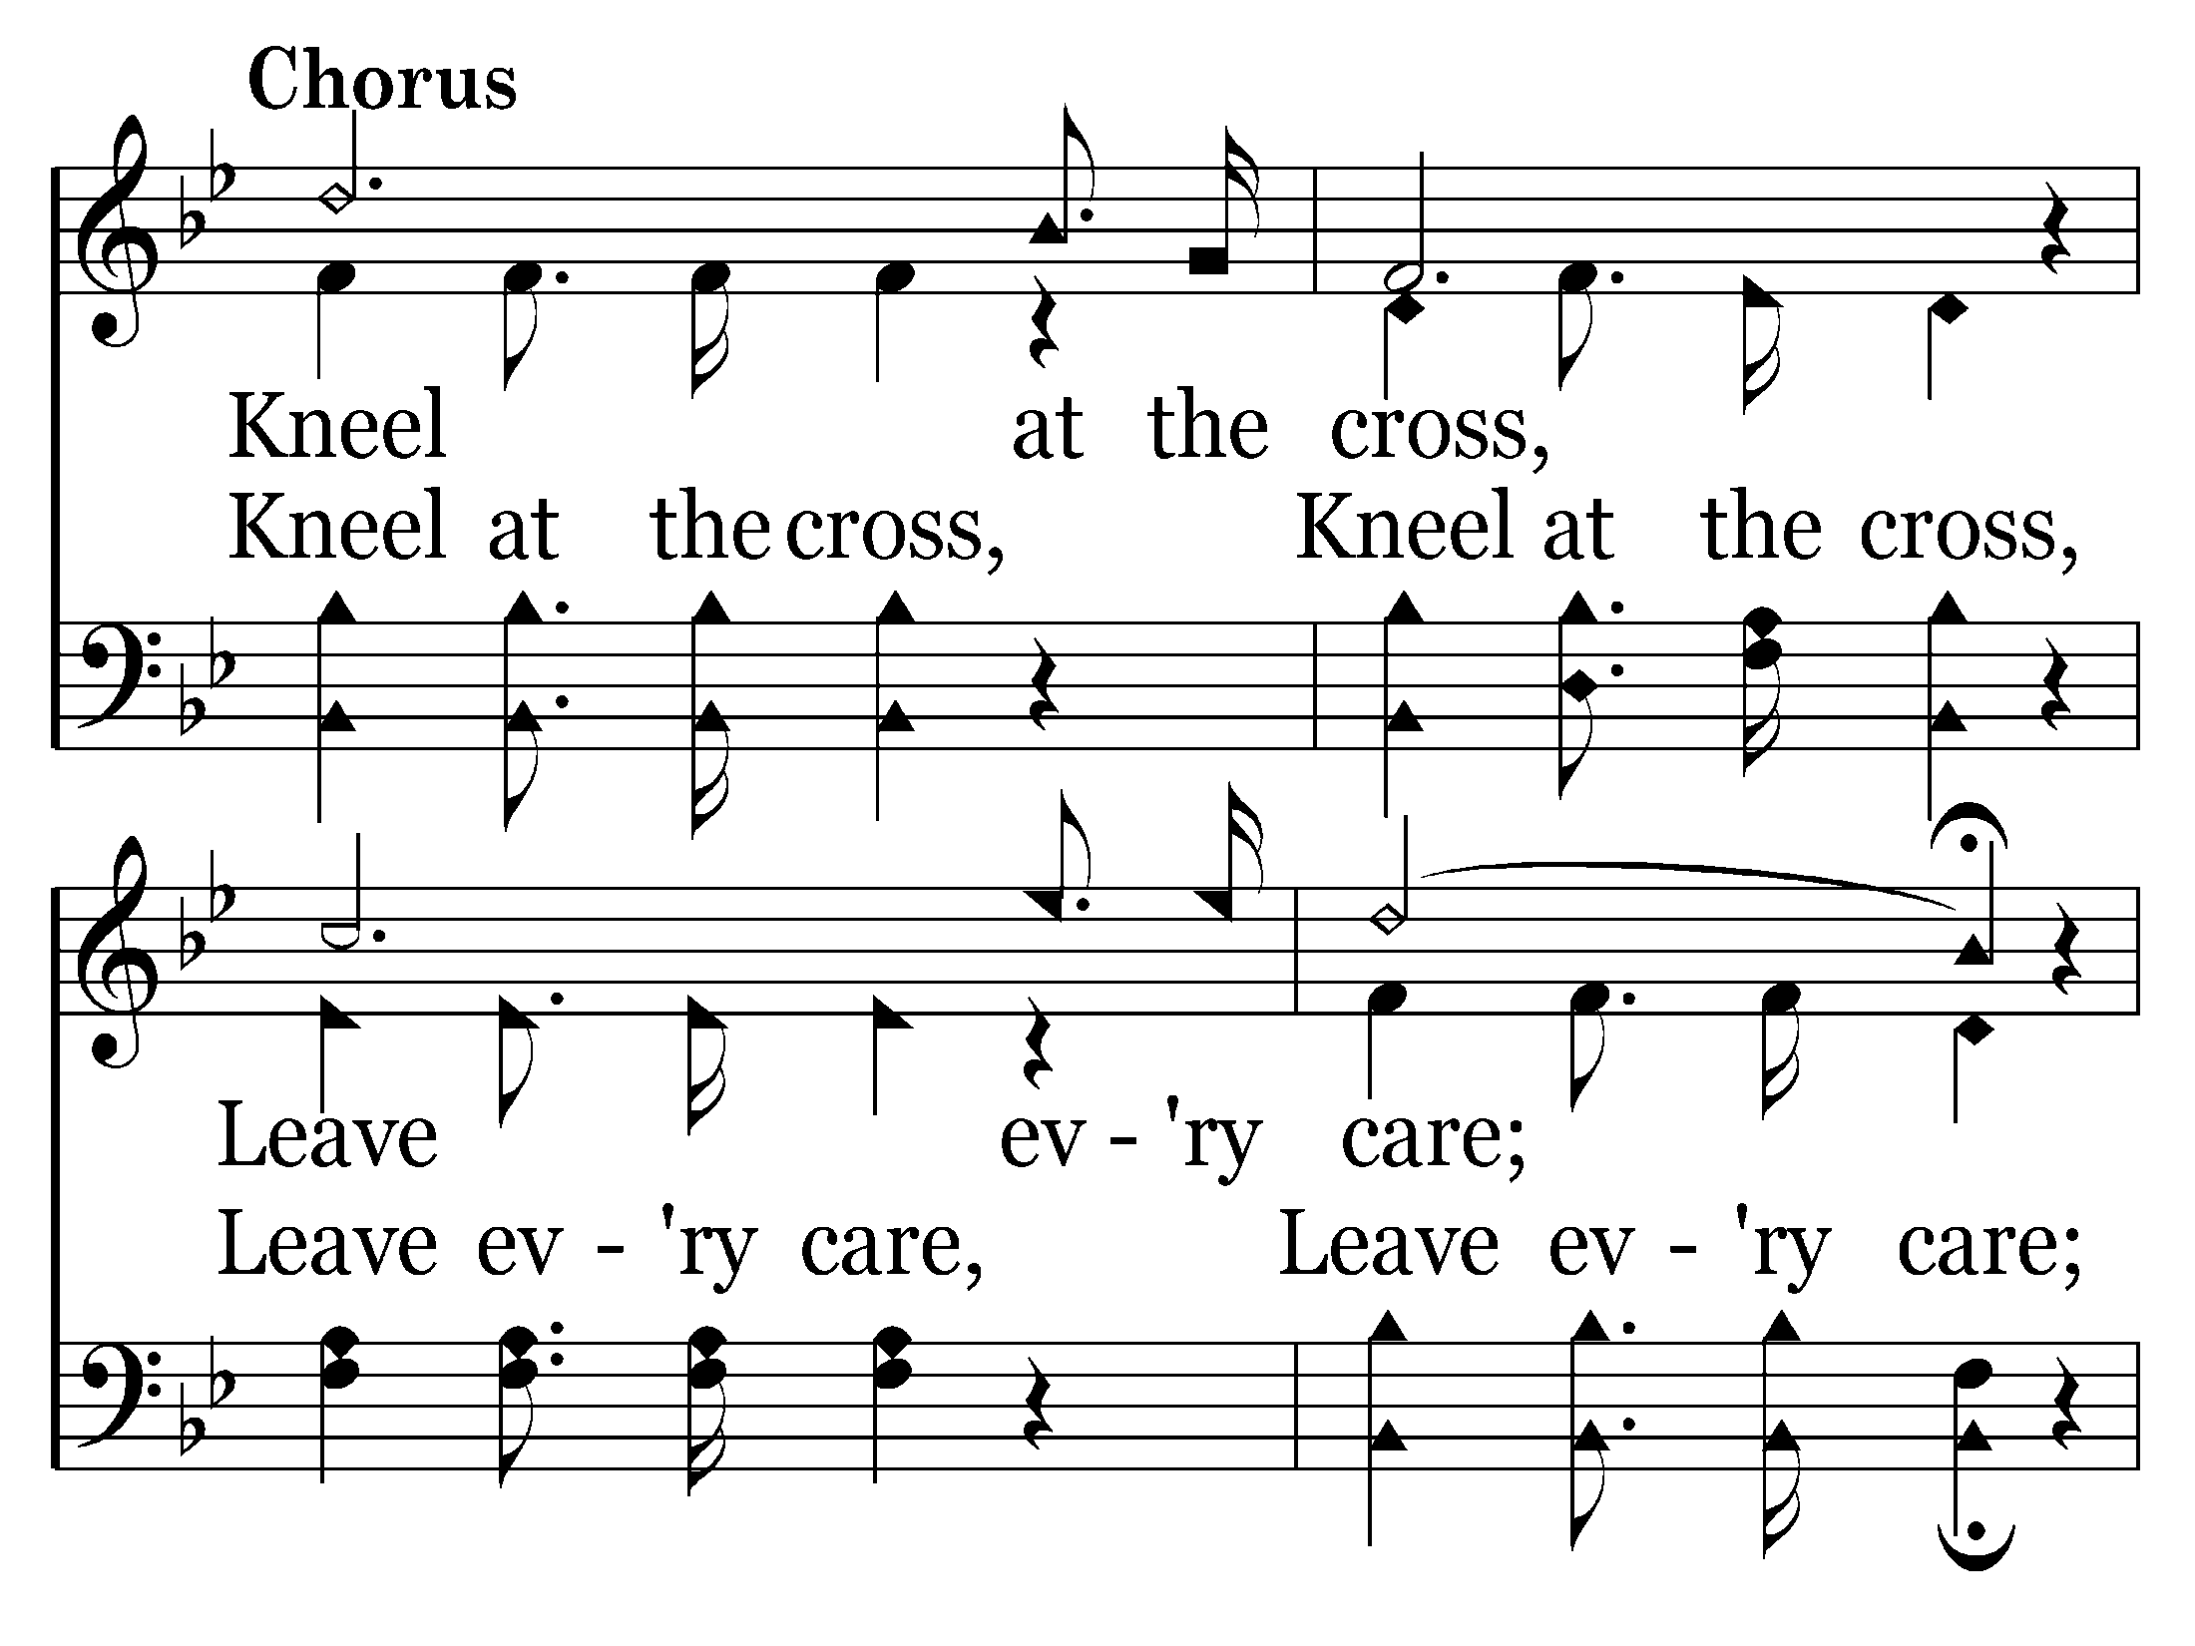
331 - Kneel At The Cross - C.1

Slide 96

331 - Kneel At The Cross - C.2
End of Verse 1

Slide 97

331 - Kneel At The Cross - 2.1

Slide 98

331 - Kneel At The Cross - 2.2

Slide 99
331 - Kneel At The Cross - C.1

Slide 100
331 - Kneel At The Cross - C.2
End of Verse 2

Slide 101

331 - Kneel At The Cross - 3.1

Slide 102

331 - Kneel At The Cross - 3.2

Slide 103
331 - Kneel At The Cross - C.1

Slide 104
331 - Kneel At The Cross - C.2
End of Song

Slide 107


Slide 108

End of Song
Back to vs. 2

Slide 109


Slide 110

End of Song

Slide 111


Slide 112

Back to vs. 3

Slide 113


Slide 114

End of Song
Back to vs. 4

Slide 115


Slide 116

End of Song

Slide 118
End of Song

