Slide 2
Sermon on the Mount
Matthew 5-7
1 And seeing the multitudes, He (Jesus) went up on a mountain, and when He was seated His disciples came to Him.
2 Then He opened His mouth and taught them, . . .

Slide 3
Sermon on Mars Hill
Acts 17:22-34
Then Paul stood in the midst of the Areopagus and said, "Men of Athens, I perceive that in all things you are very religious;

Slide 4
23 "for as I was passing through and considering the objects of your worship, I even found an altar with this inscription: TO THE UNKNOWN GOD. Therefore, the One whom you worship without knowing, Him I proclaim to you:

Slide 5
Romans 1:16-17
16 For I (Paul) am not ashamed of the gospel of Christ, for it is the power of God to salvation for everyone who believes, for the Jew first and also for the Greek.
17 For in it (the gospel) the righteousness of God is revealed from faith to faith; as it is written, "The just shall live by faith."

Slide 6
The GOSPEL
- the Good News (message)
- of the kingdom of God and of salvation thru Christ
- to be received by faith
- on the basis of His death, burial, resurrection & ascension.

Slide 7
“Gospel” Sermon on Pentecost
Acts 2:14-39
14 But Peter, standing up with the eleven, raised his voice and said to them, "Men of Judea and all who dwell in Jerusalem, let this be known to you, and heed my words . . .

Slide 8
Gospel Sermon on Pentecost:
Scriptures Discussed & Explained.
Christ Presented as Man’s Only Hope.
Disturbed the Audience.
Caused People to Think & Ask Questions.
Answers Given as How to be Saved!
Produced Conviction – Leading a Person into the Lord’s Church.
Next Blank

Slide 9
1. DISCUSS & EXPLAIN SCRIPTURES
PETER
Acts 2
Quoted O.T. Prophets
(Joel, David)
STEPHEN
Acts 7
Referred to O.T. History
(Abraham; Patriarchs in Egypt; Israel Delivered out of Egypt)
PHILIP
Acts 8
Read from O.T. Prophet
(Isaiah)
vs. 16, 25, 34-35
vs. 28-35
read next slide

Slide 10
Acts 8:28-35
“ . . . And sitting in his chariot, he was reading Isaiah the prophet.
Then the Spirit said to Philip, "Go near and overtake this chariot.“
So Philip ran to him, and heard him reading the prophet Isaiah, and said, "Do you understand what you are reading?“

Slide 11
31 And he said, "How can I, unless someone guides me?" And he asked Philip to come up and sit with him.
32 The place in the Scripture which he read was this: "He was led as a sheep to the slaughter; and as a lamb before its shearer is silent, so He opened not His mouth.

Slide 12
33 In His humiliation His justice was taken away, and who will declare His generation? For His life is taken from the earth.“
34 So the eunuch answered Philip and said, "I ask you, of whom does the prophet say this, of himself or of some other man?"
35 Then Philip opened his mouth, and beginning at this Scripture, preached Jesus to him.

Slide 13
2. CHRIST AS MAN’S ONLY HOPE
PETER
Acts 2
Preached Jesus & Salvation on Pentecost.
4 Therefore those who were scattered went everywhere preaching the word.
5 Then Philip went down to the city of Samaria and preached Christ to them.
PHILIP
Acts 8
Preached Christ to Samaritans & Ethiopian.
PAUL
Acts 16
“Spoke the word of the Lord” to Philippian Jailer (vs. 32). (2 Cor. 4:5 - next)
vs. 22-24; 31-33; 36
vs. 4-5

Slide 14
2 Corinthians 4:5
5 For we do not preach ourselves, but Christ Jesus the Lord, and ourselves your bondservants for Jesus' sake.”
1 Cor. 2:2

Slide 15
1 Corinthians 2:2
2 “For I determined not to know anything among you except Jesus Christ and Him crucified.” (1 Cor. 3:6)
1 Cor. 3:6 – “I planted, Apollos watered, but God gave the increase.”
(1 Pet. 1:3,4)

Slide 16
1 Peter 1:3-4
3 Blessed be the God and Father of our Lord Jesus Christ, who according to His abundant mercy has begotten us again to a living hope through the resurrection of Jesus Christ from the dead,
4 to an inheritance incorruptible and undefiled and that does not fade away, reserved in heaven for you,
Next Blank

Slide 17

378 - The Solid Rock - Title

Slide 18
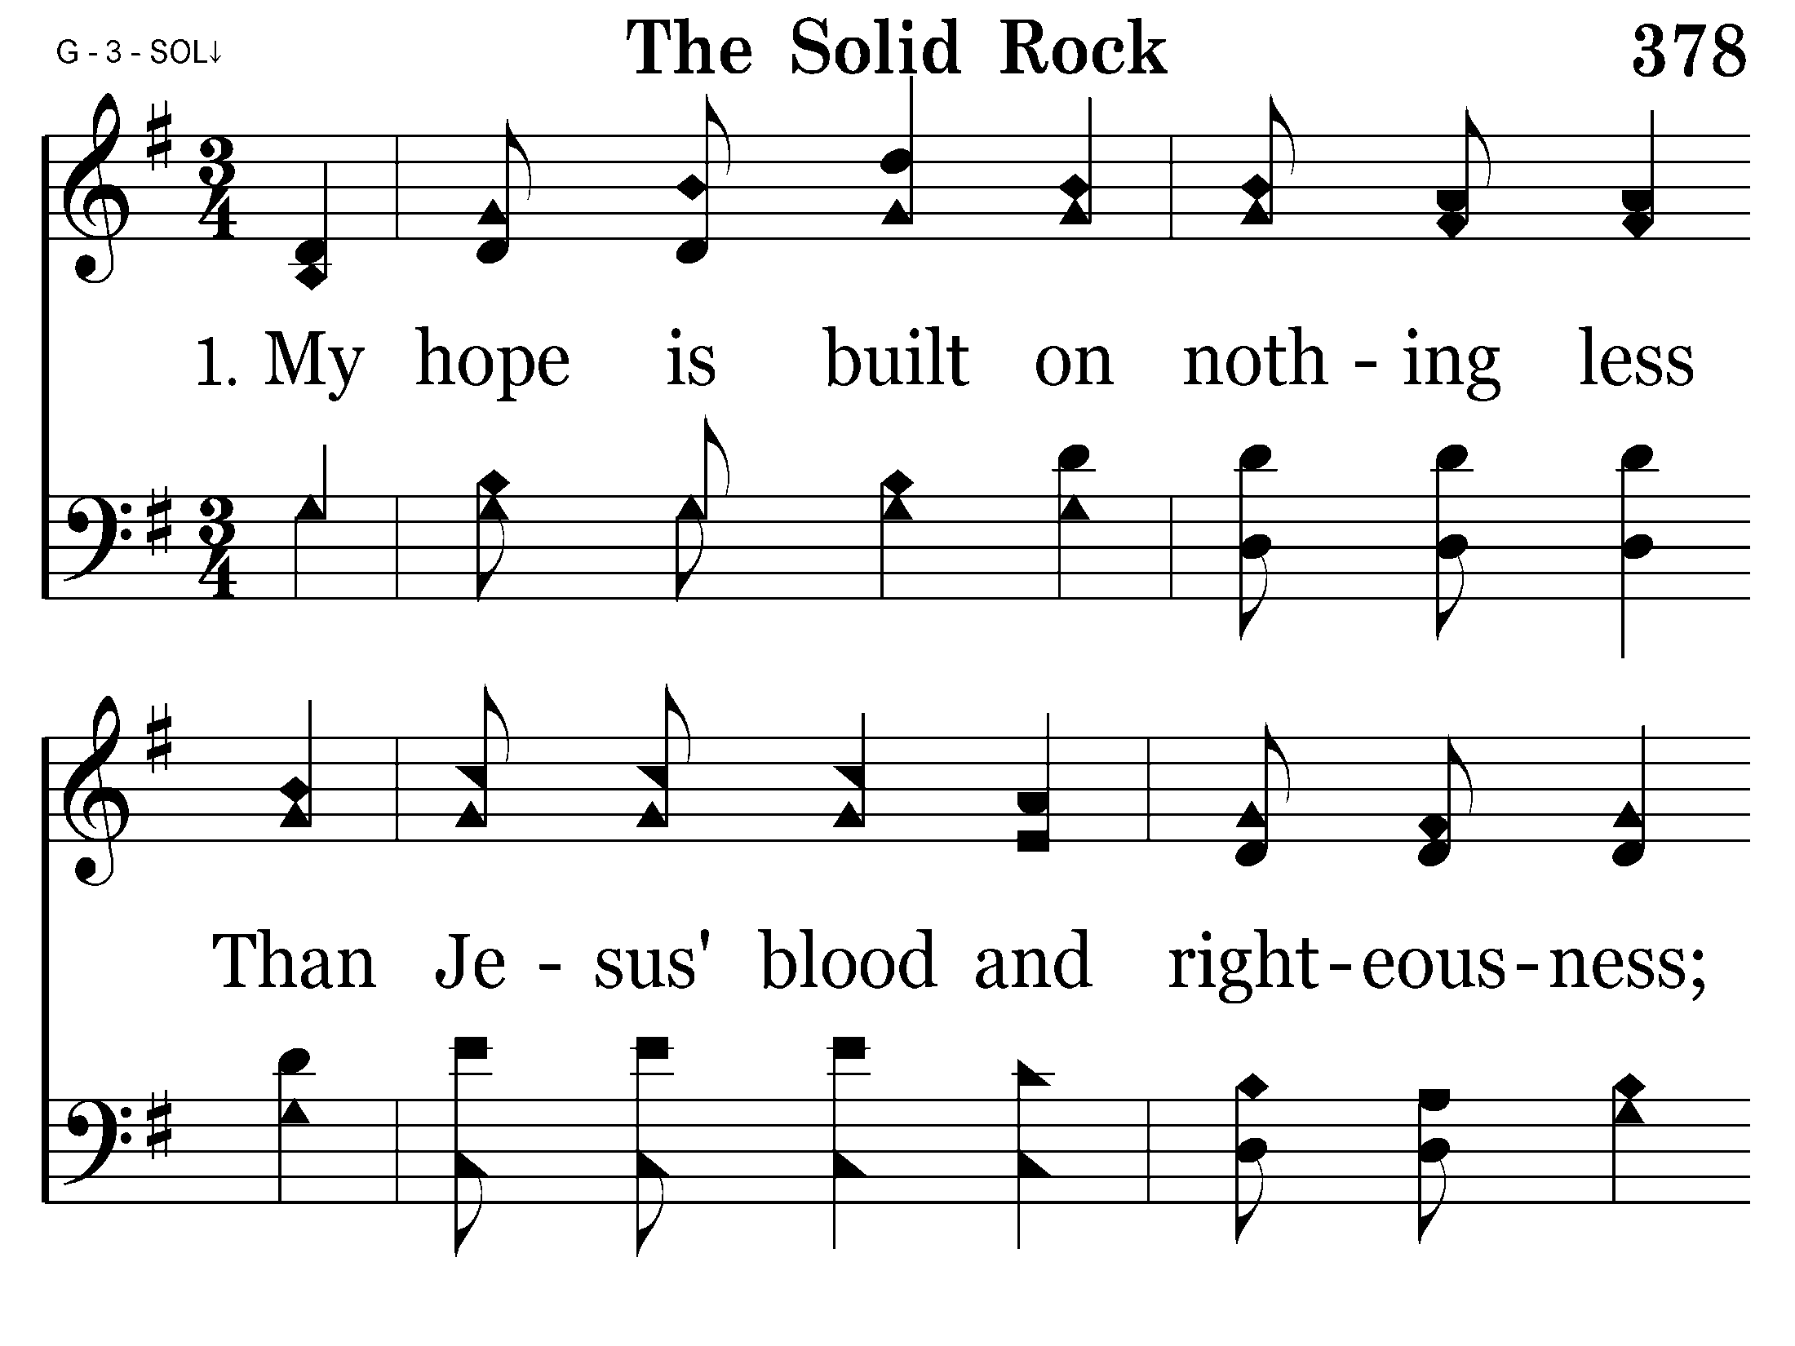
378 - The Solid Rock - 1.1

Slide 19
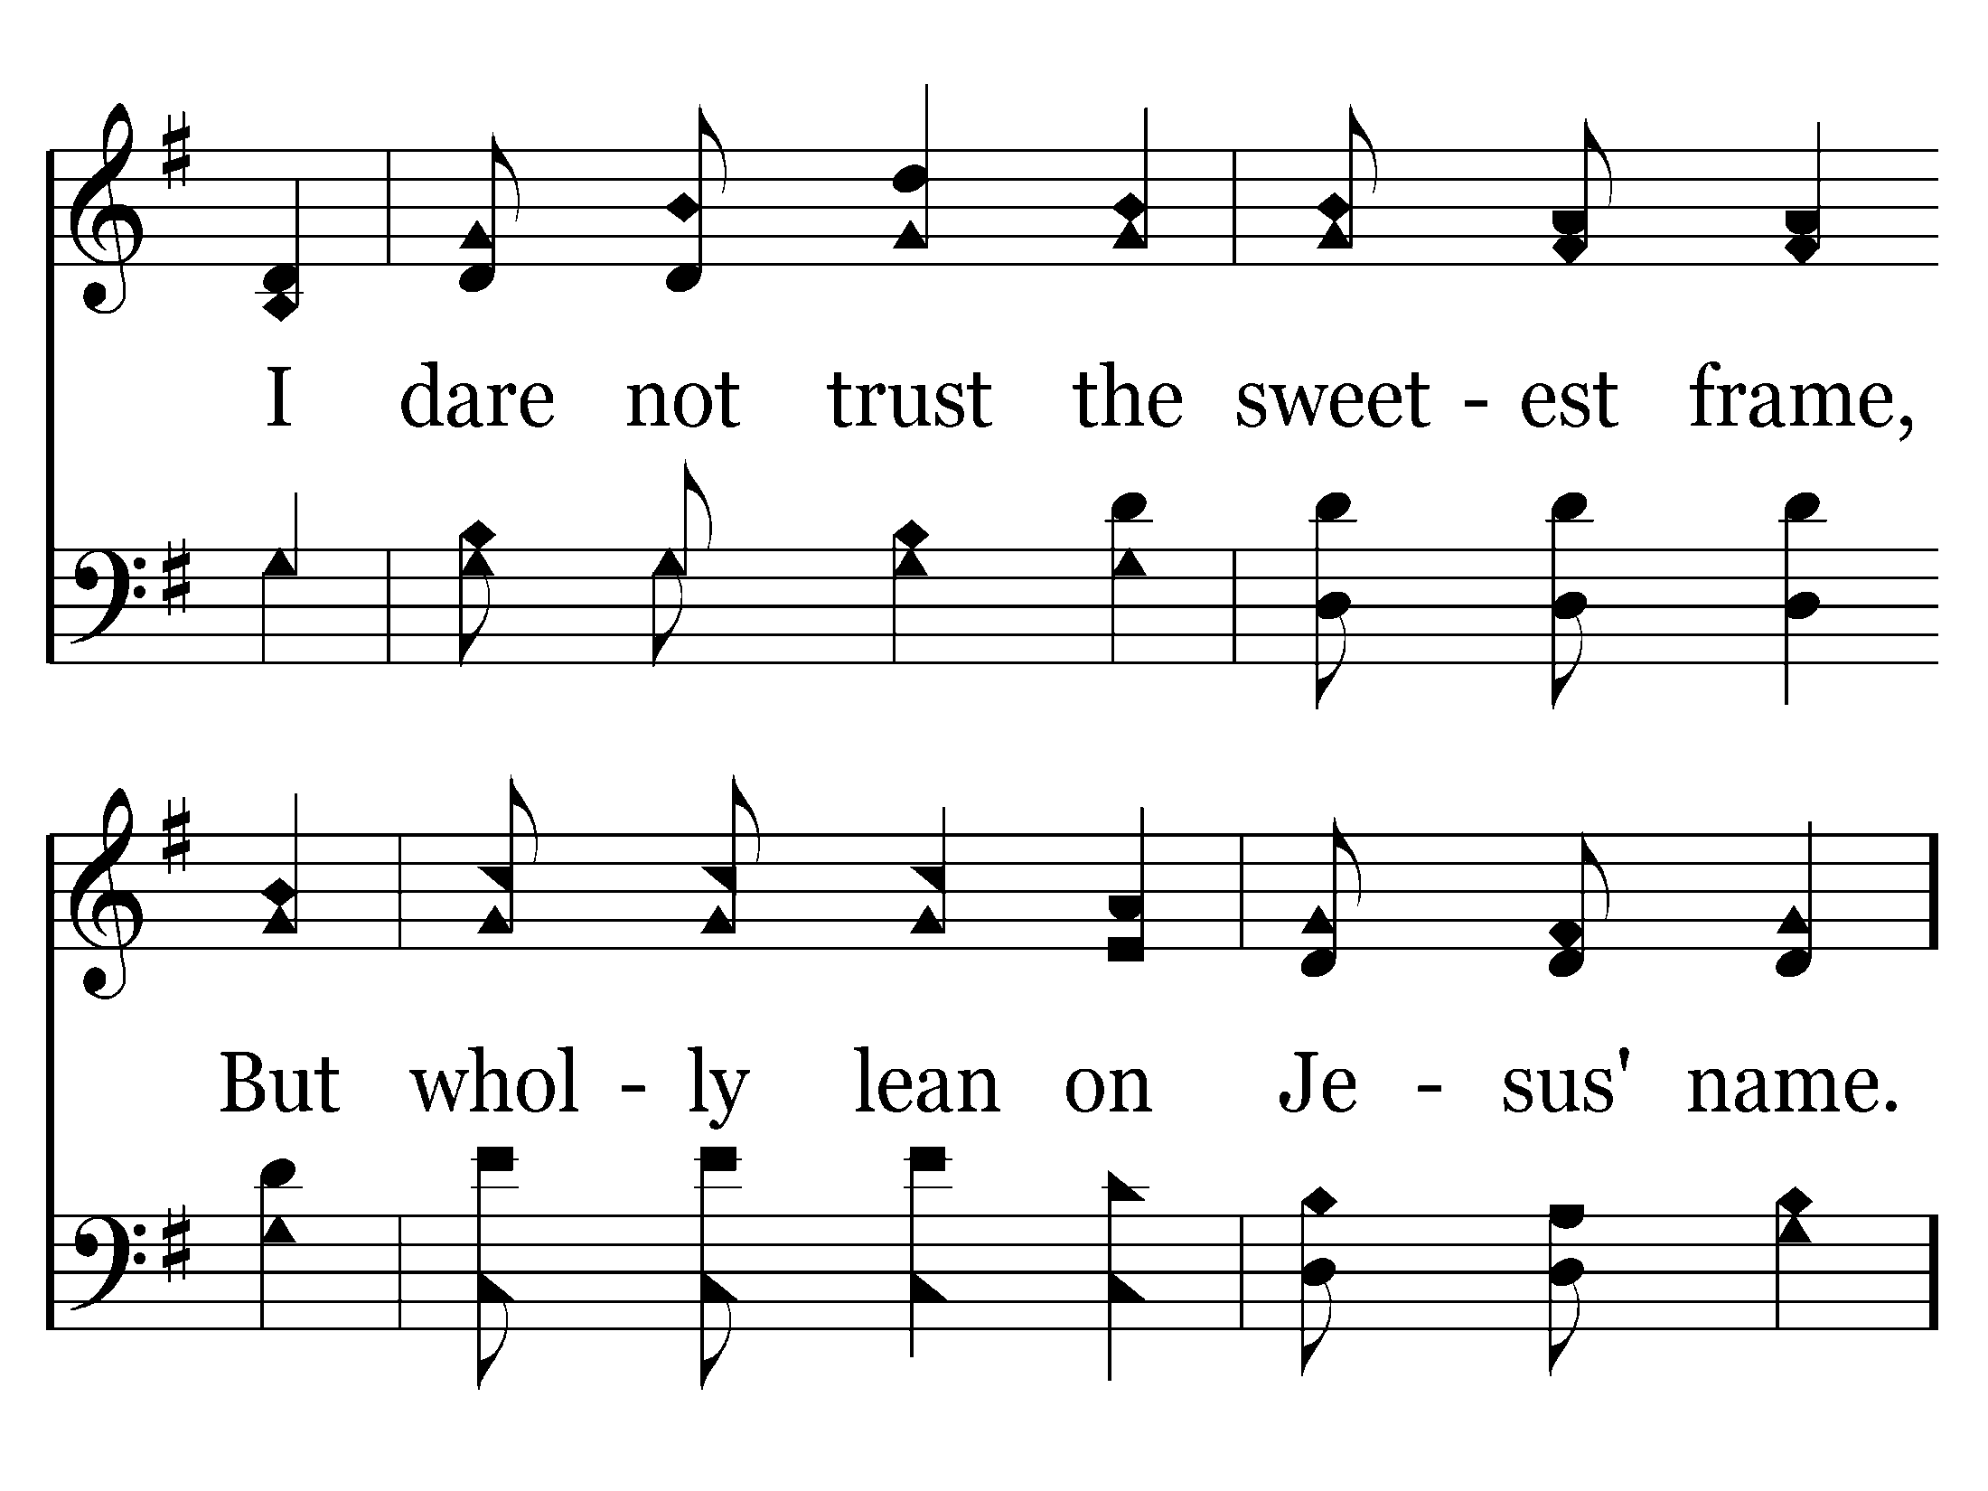
378 - The Solid Rock - 1.2
End of Verse 1 – Go to Verse 2

Slide 20
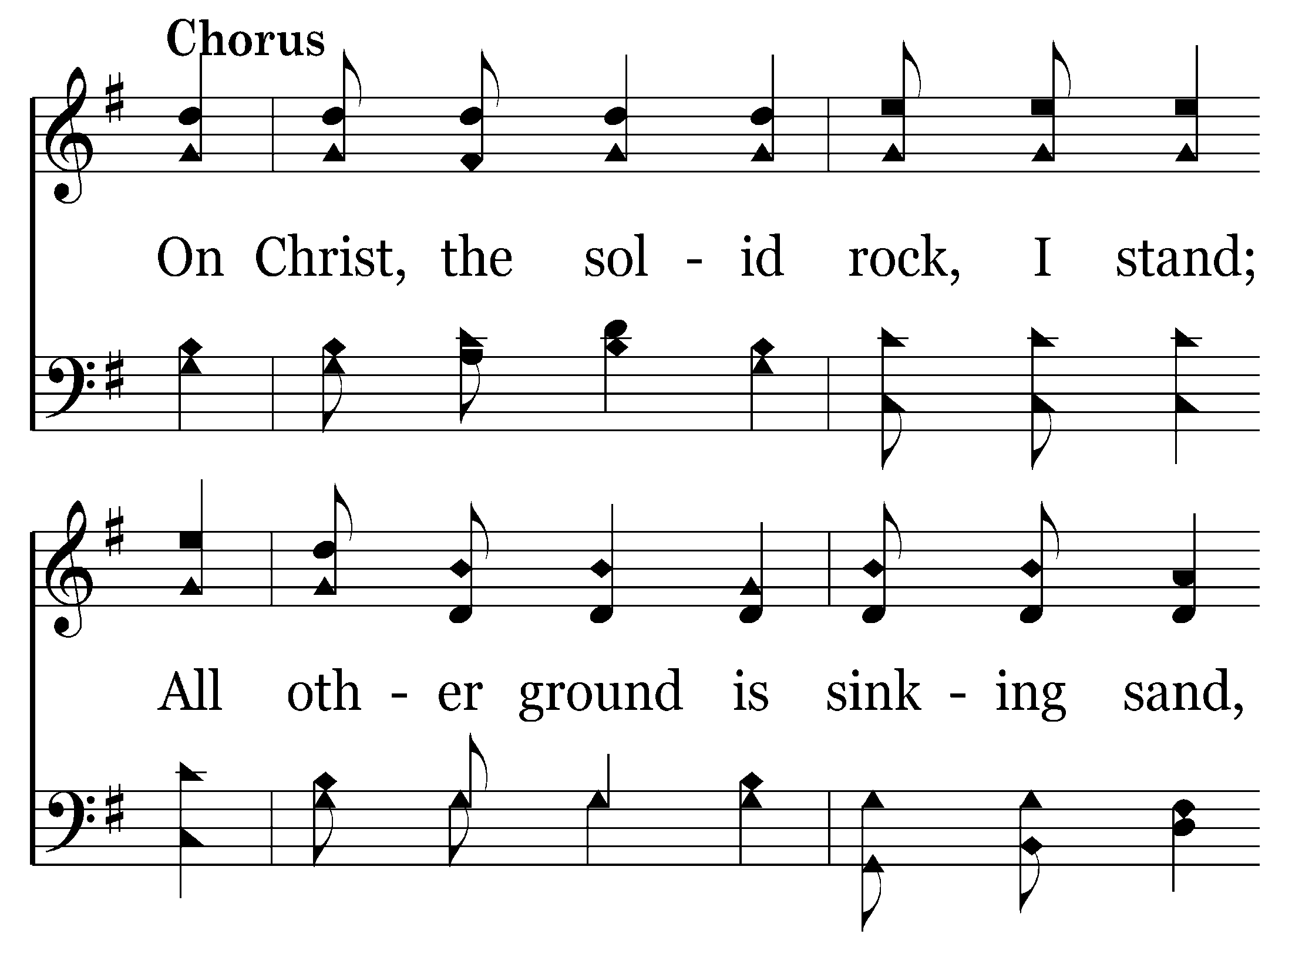
378 - The Solid Rock - C.1

Slide 21
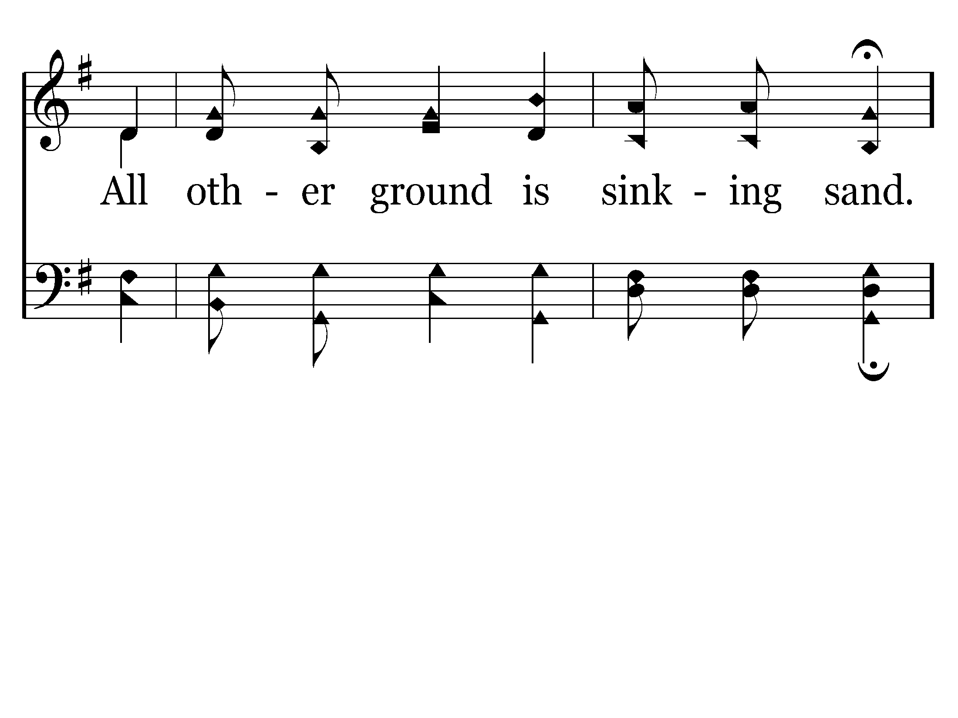
378 - The Solid Rock - C.2
End of Verse 1

Slide 22
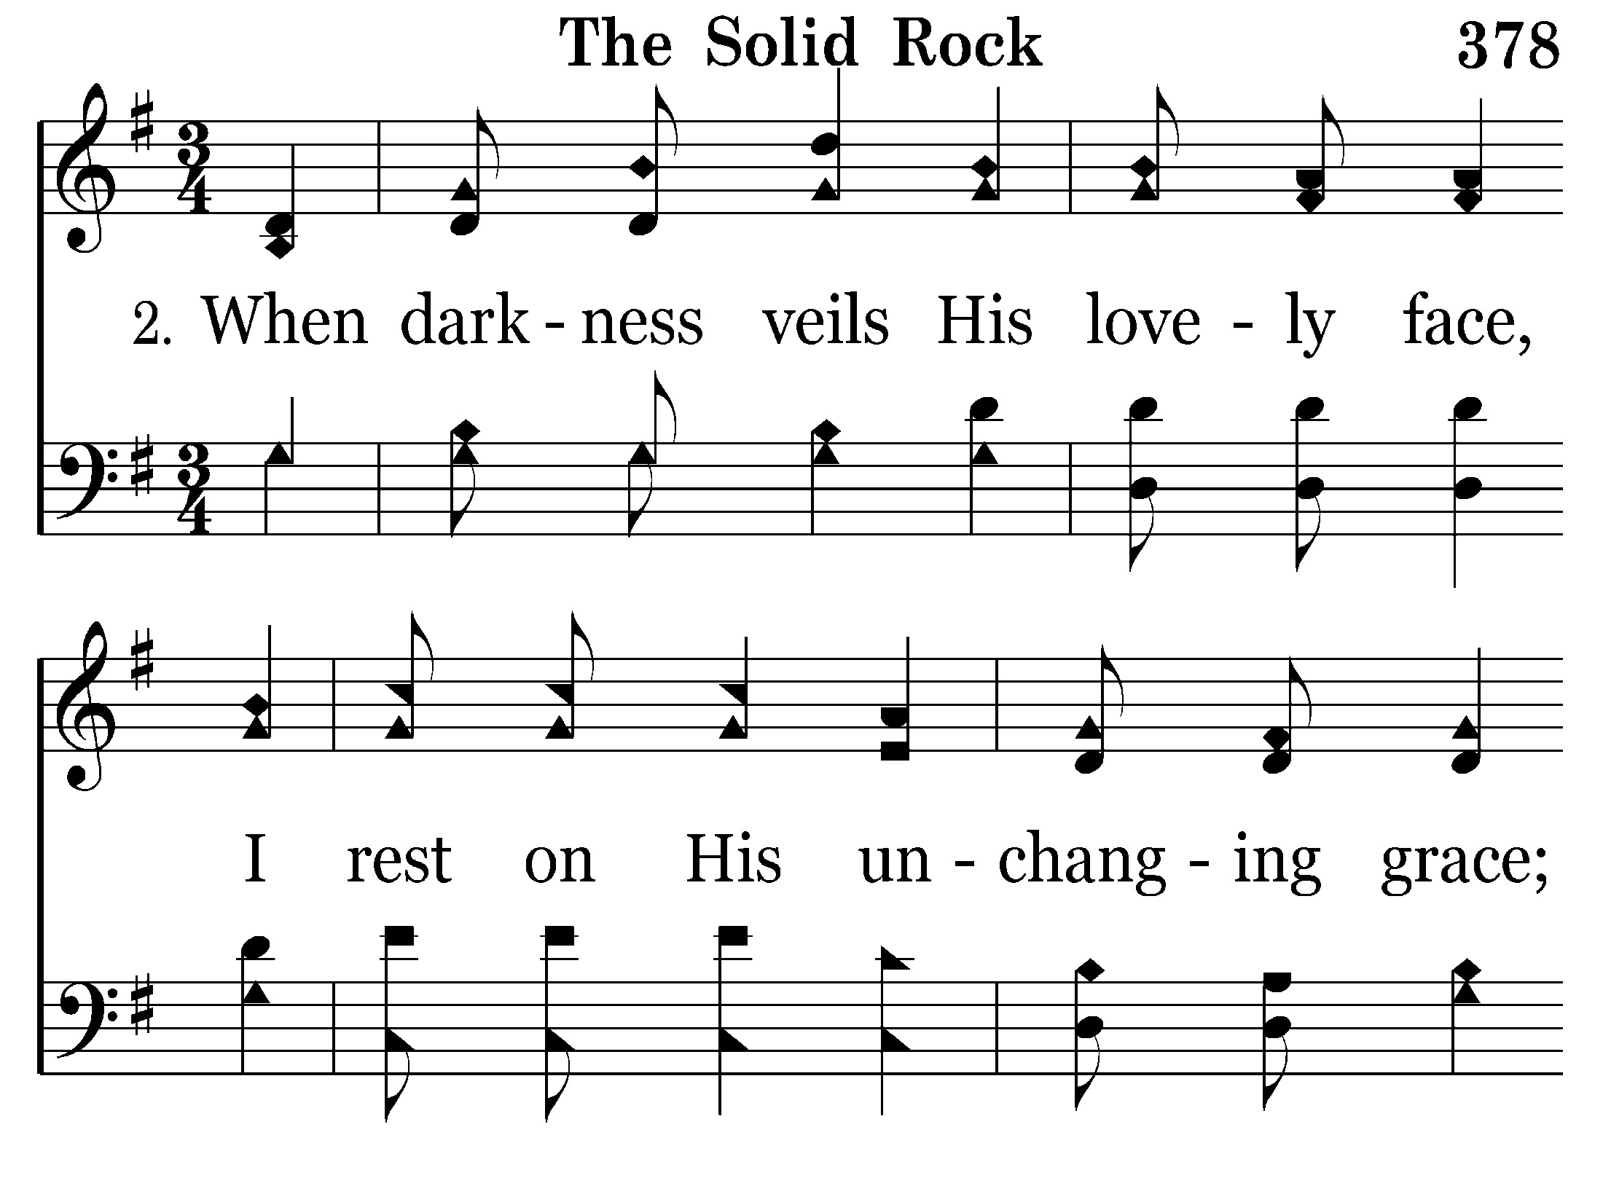
378 - The Solid Rock - 2.1

Slide 23
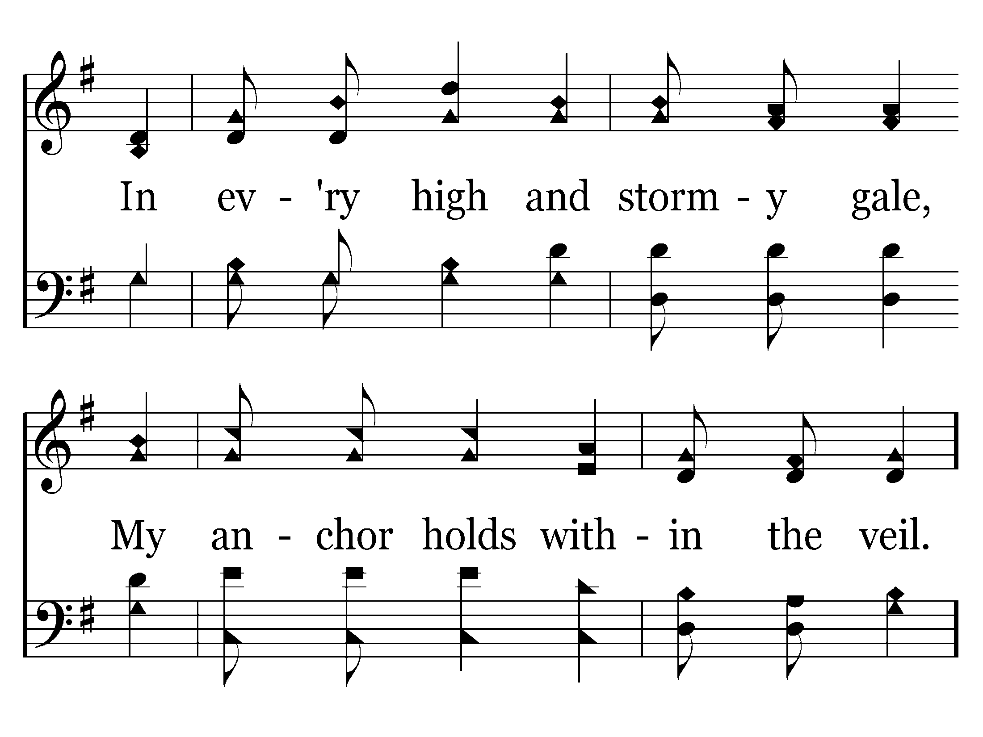
378 - The Solid Rock - 2.2

Slide 24
378 - The Solid Rock - C.1

Slide 25
378 - The Solid Rock - C.2
End of Verse 2

Slide 26
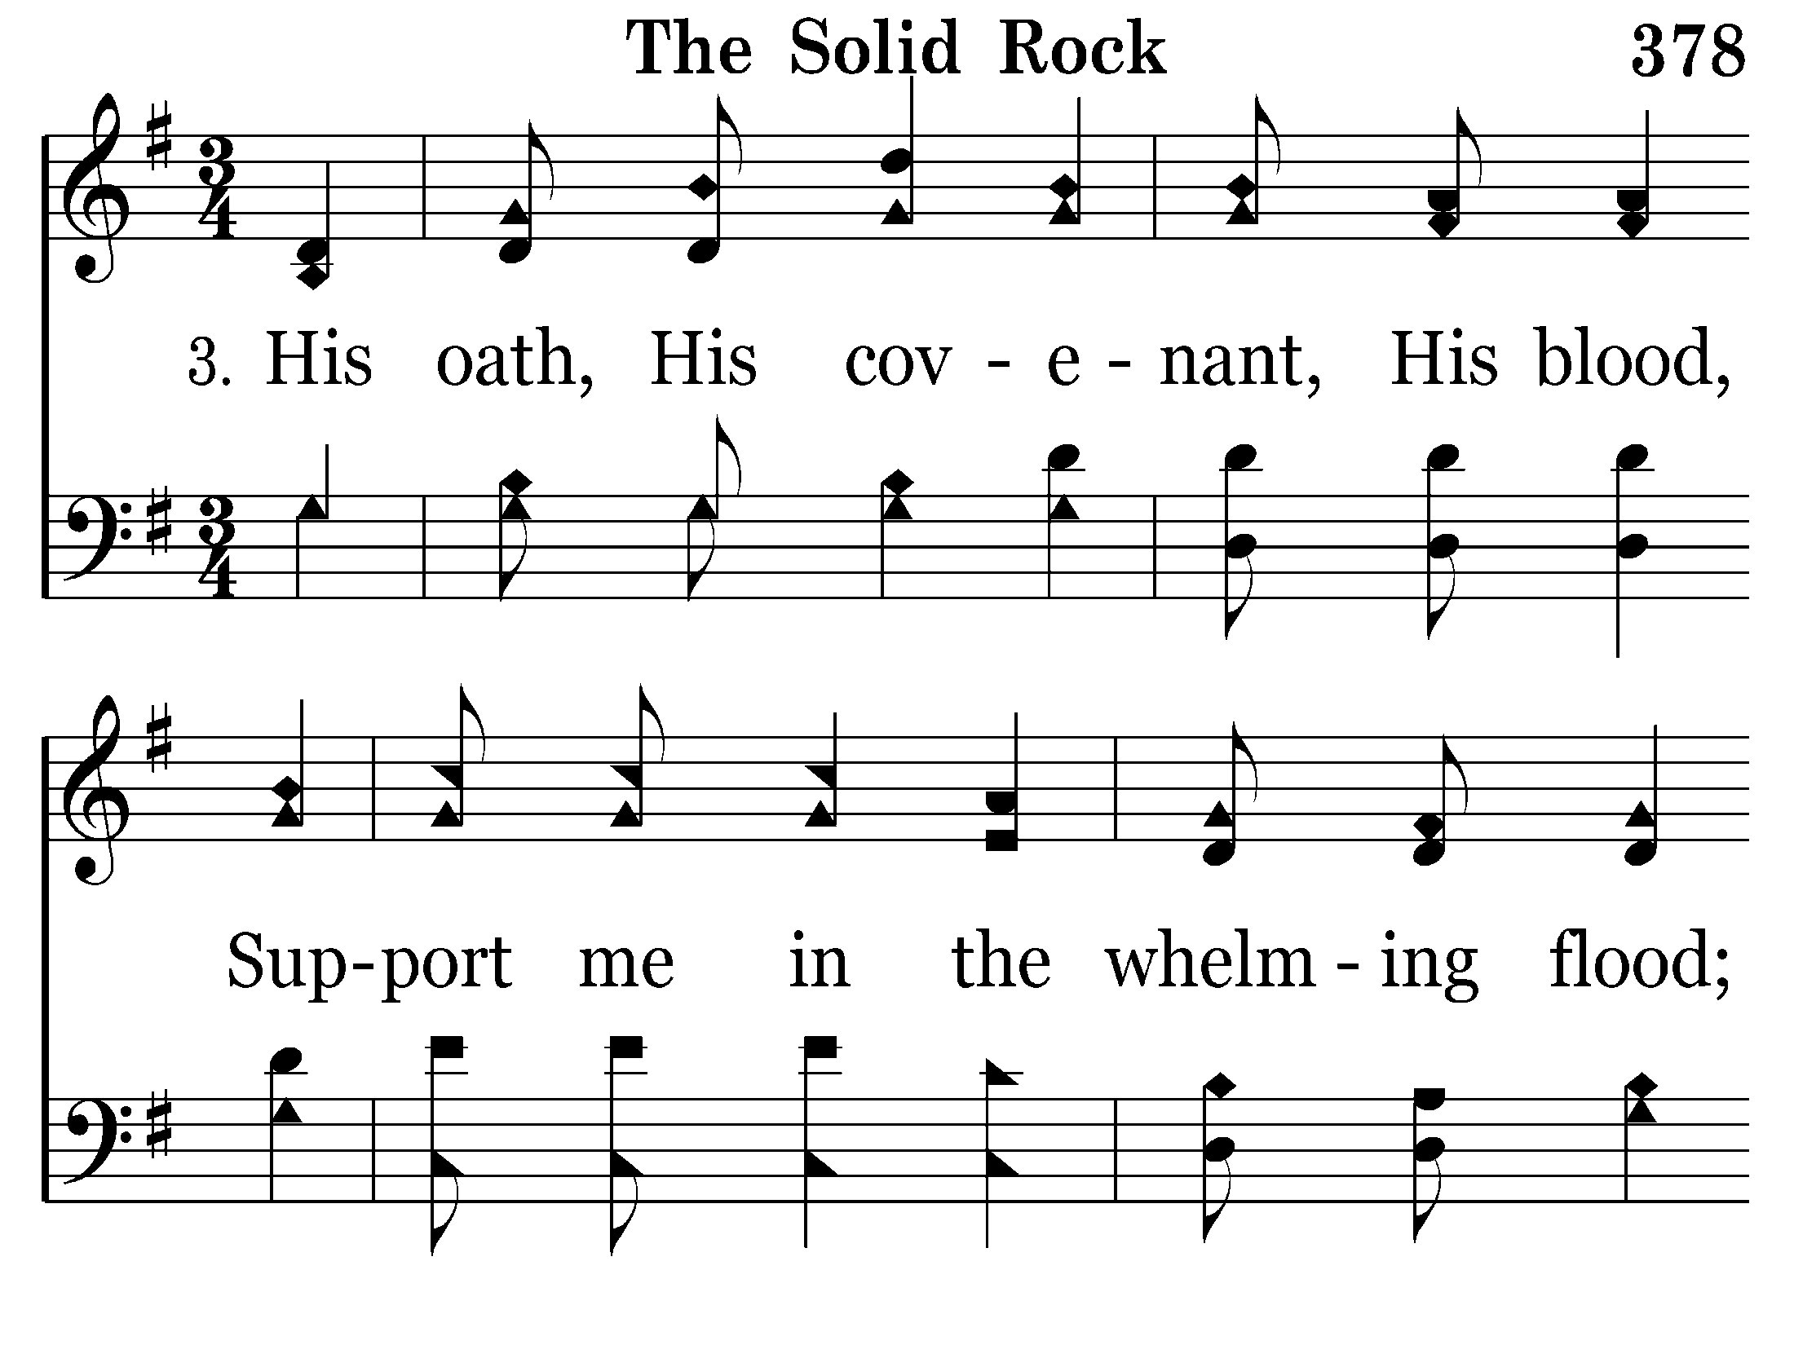
378 - The Solid Rock - 3.1

Slide 27
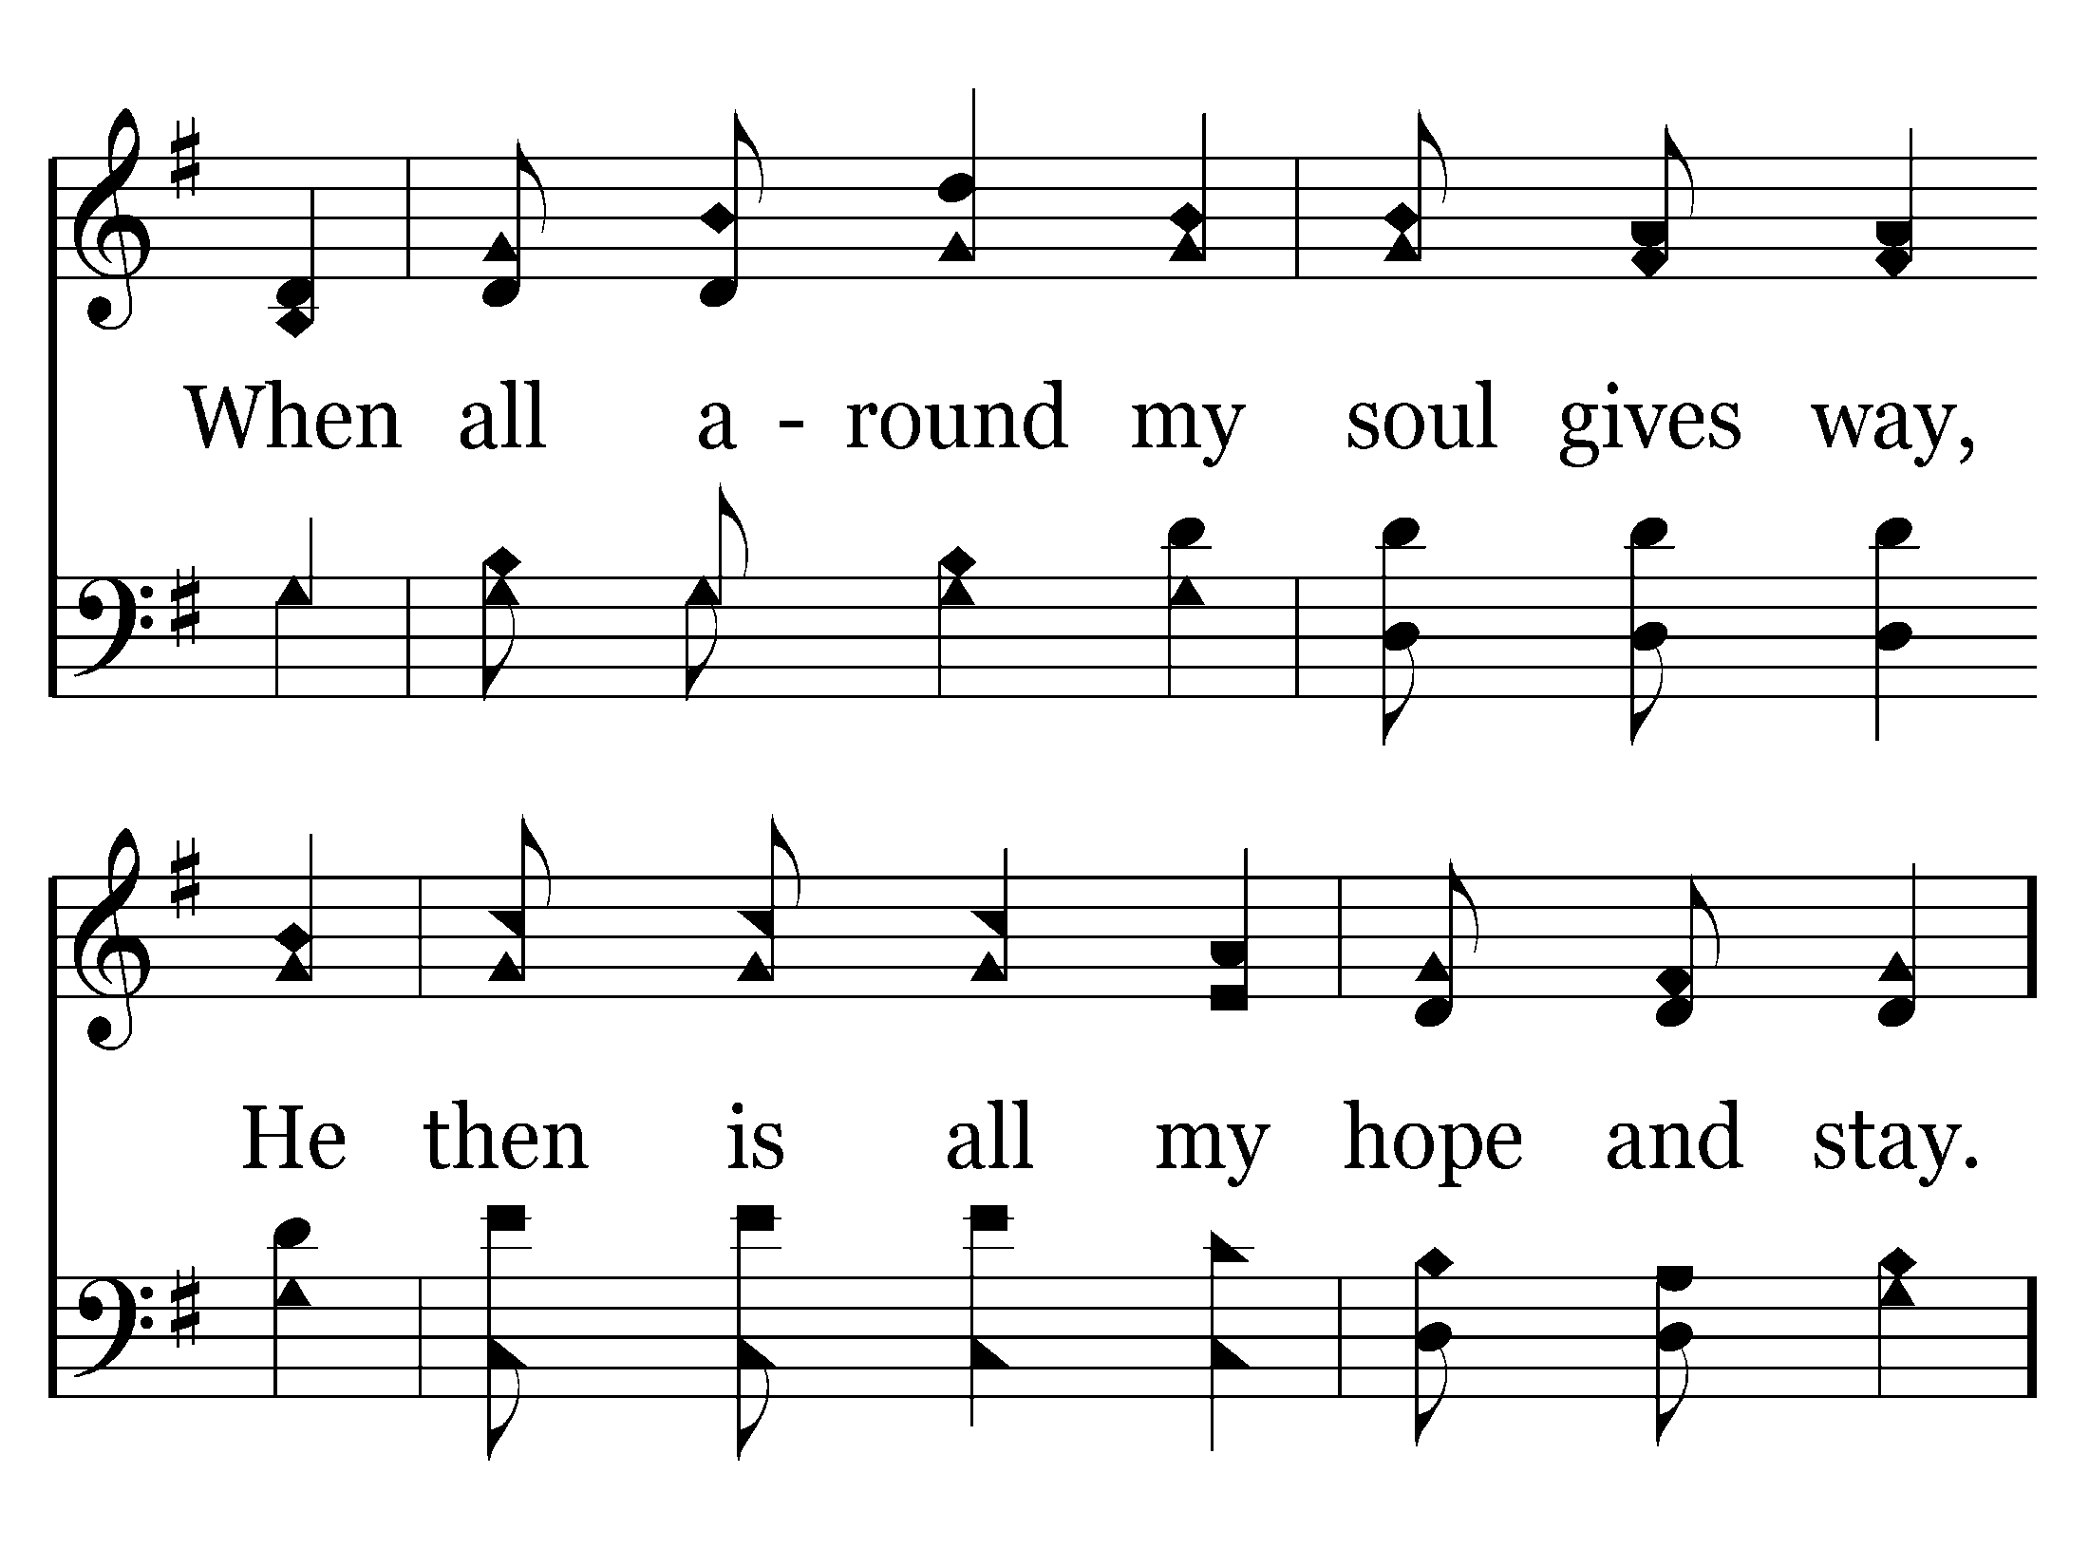
378 - The Solid Rock - 3.2
End of Verse 3 – Go to Verse 4

Slide 28
378 - The Solid Rock - C.1

Slide 29
378 - The Solid Rock - C.2
End of Verse 3

Slide 30
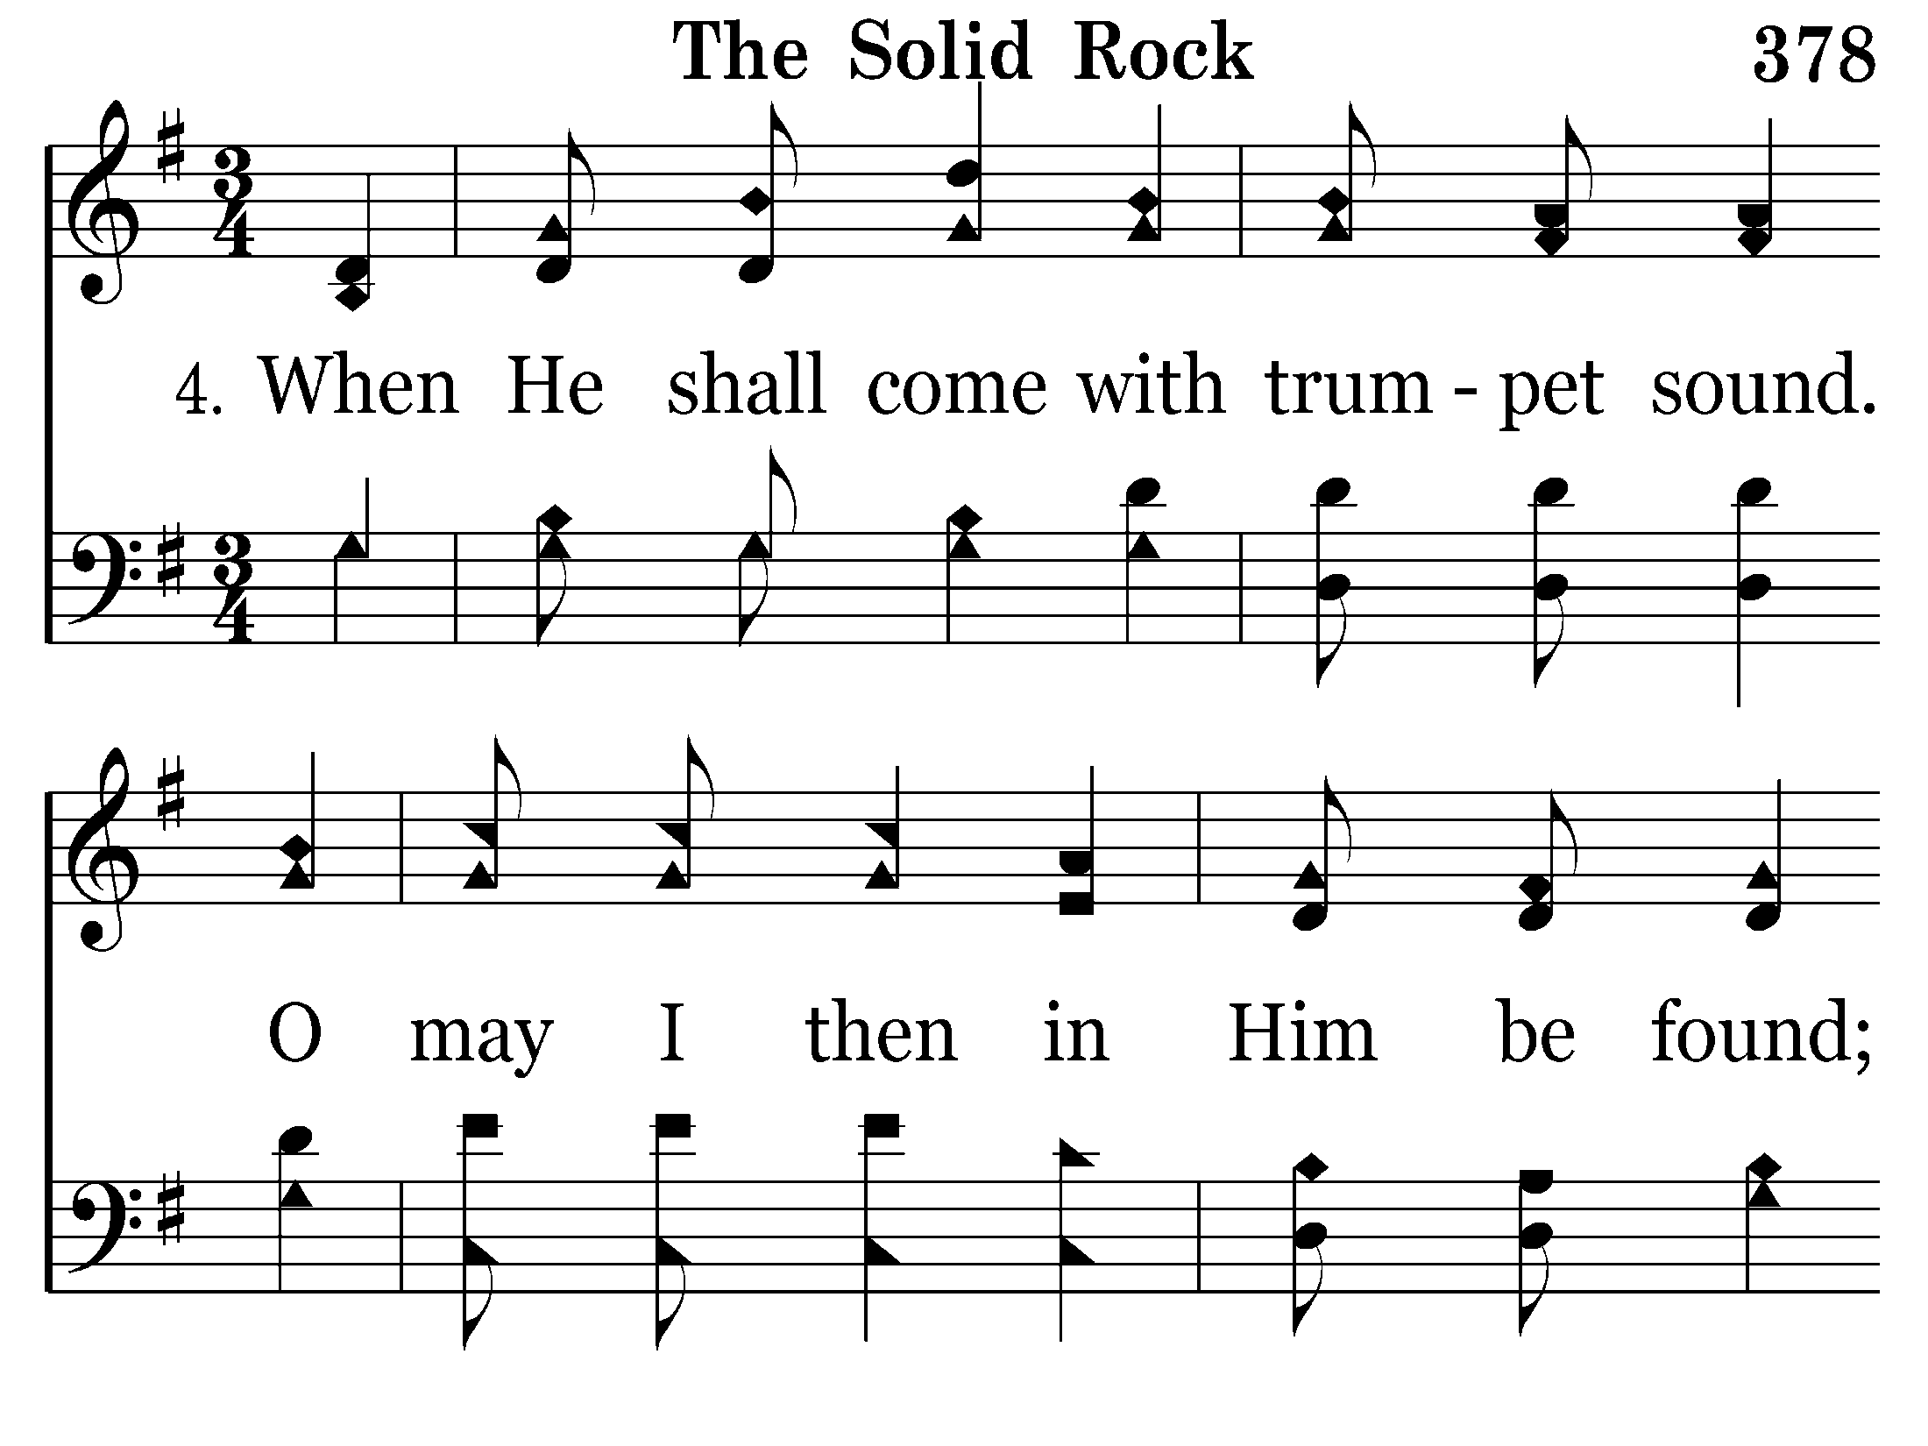
378 - The Solid Rock - 4.1

Slide 31
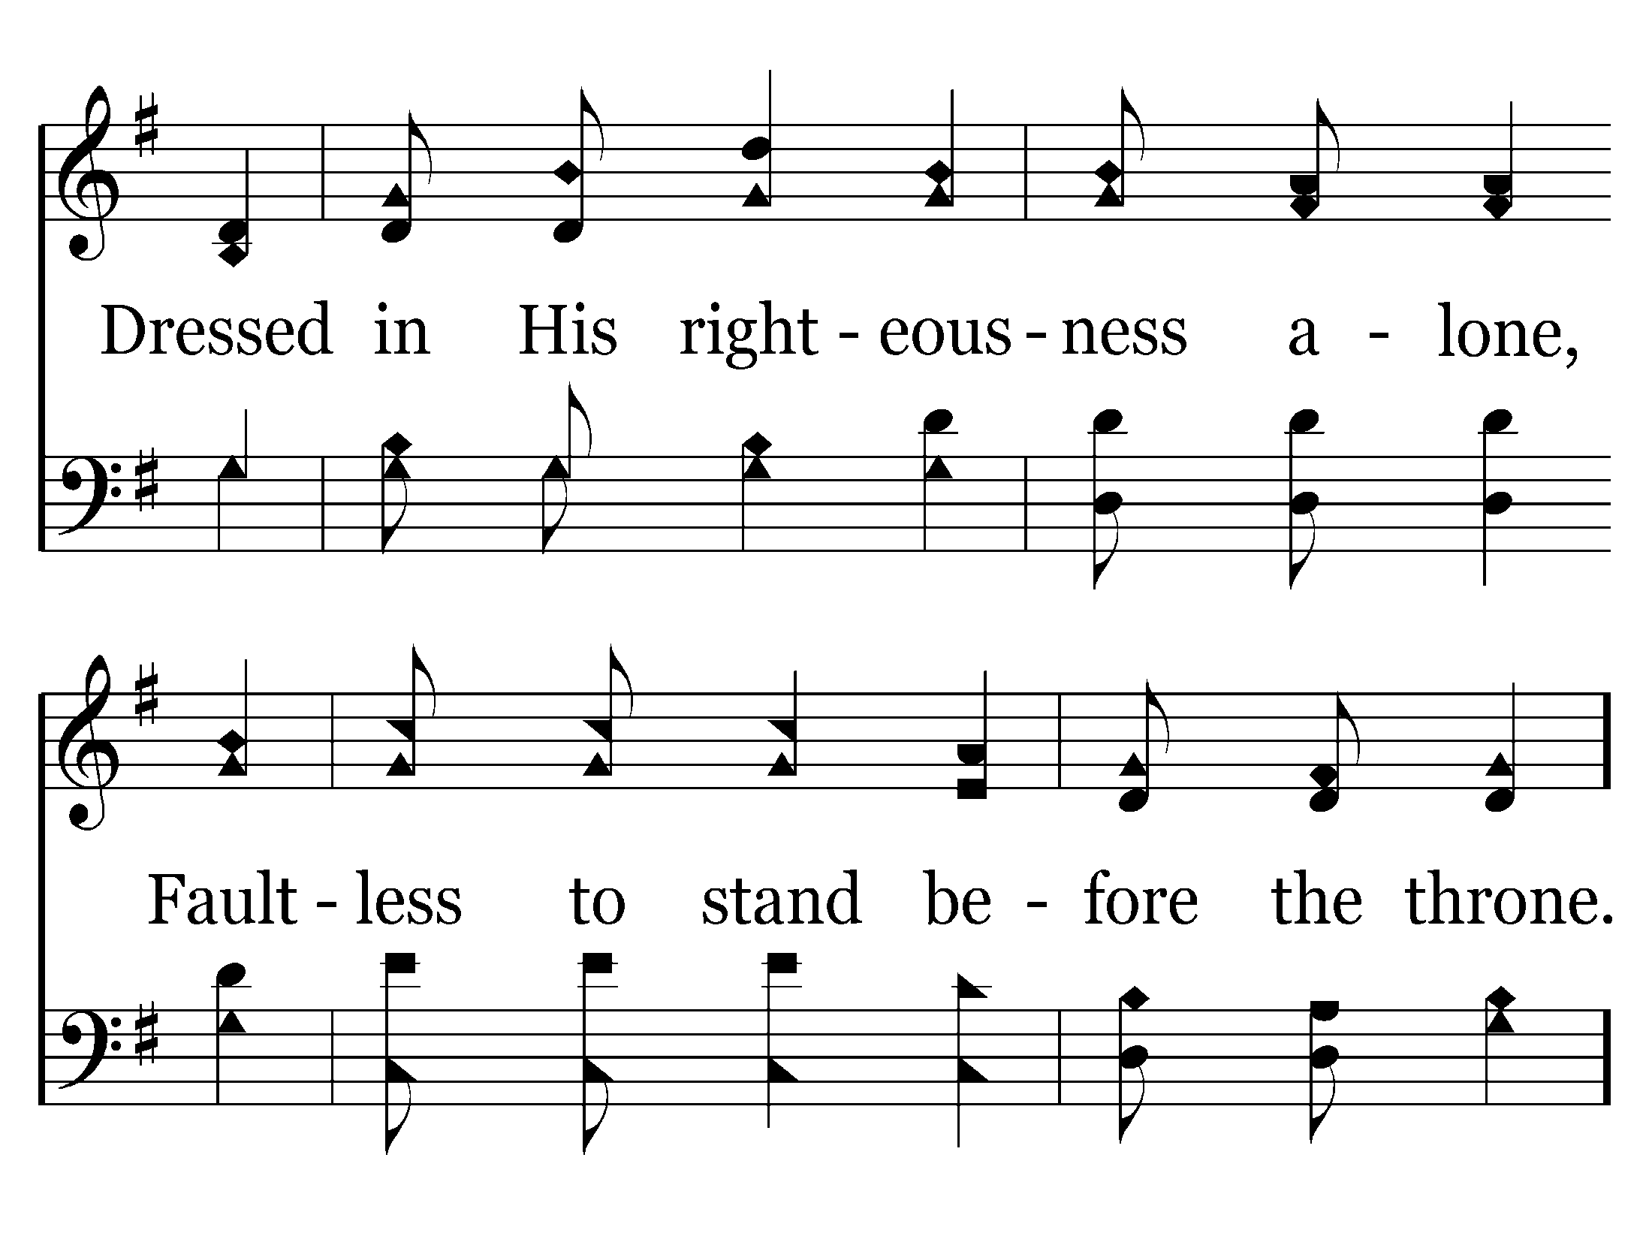
378 - The Solid Rock - 4.2

Slide 32
378 - The Solid Rock - L.1

Slide 33
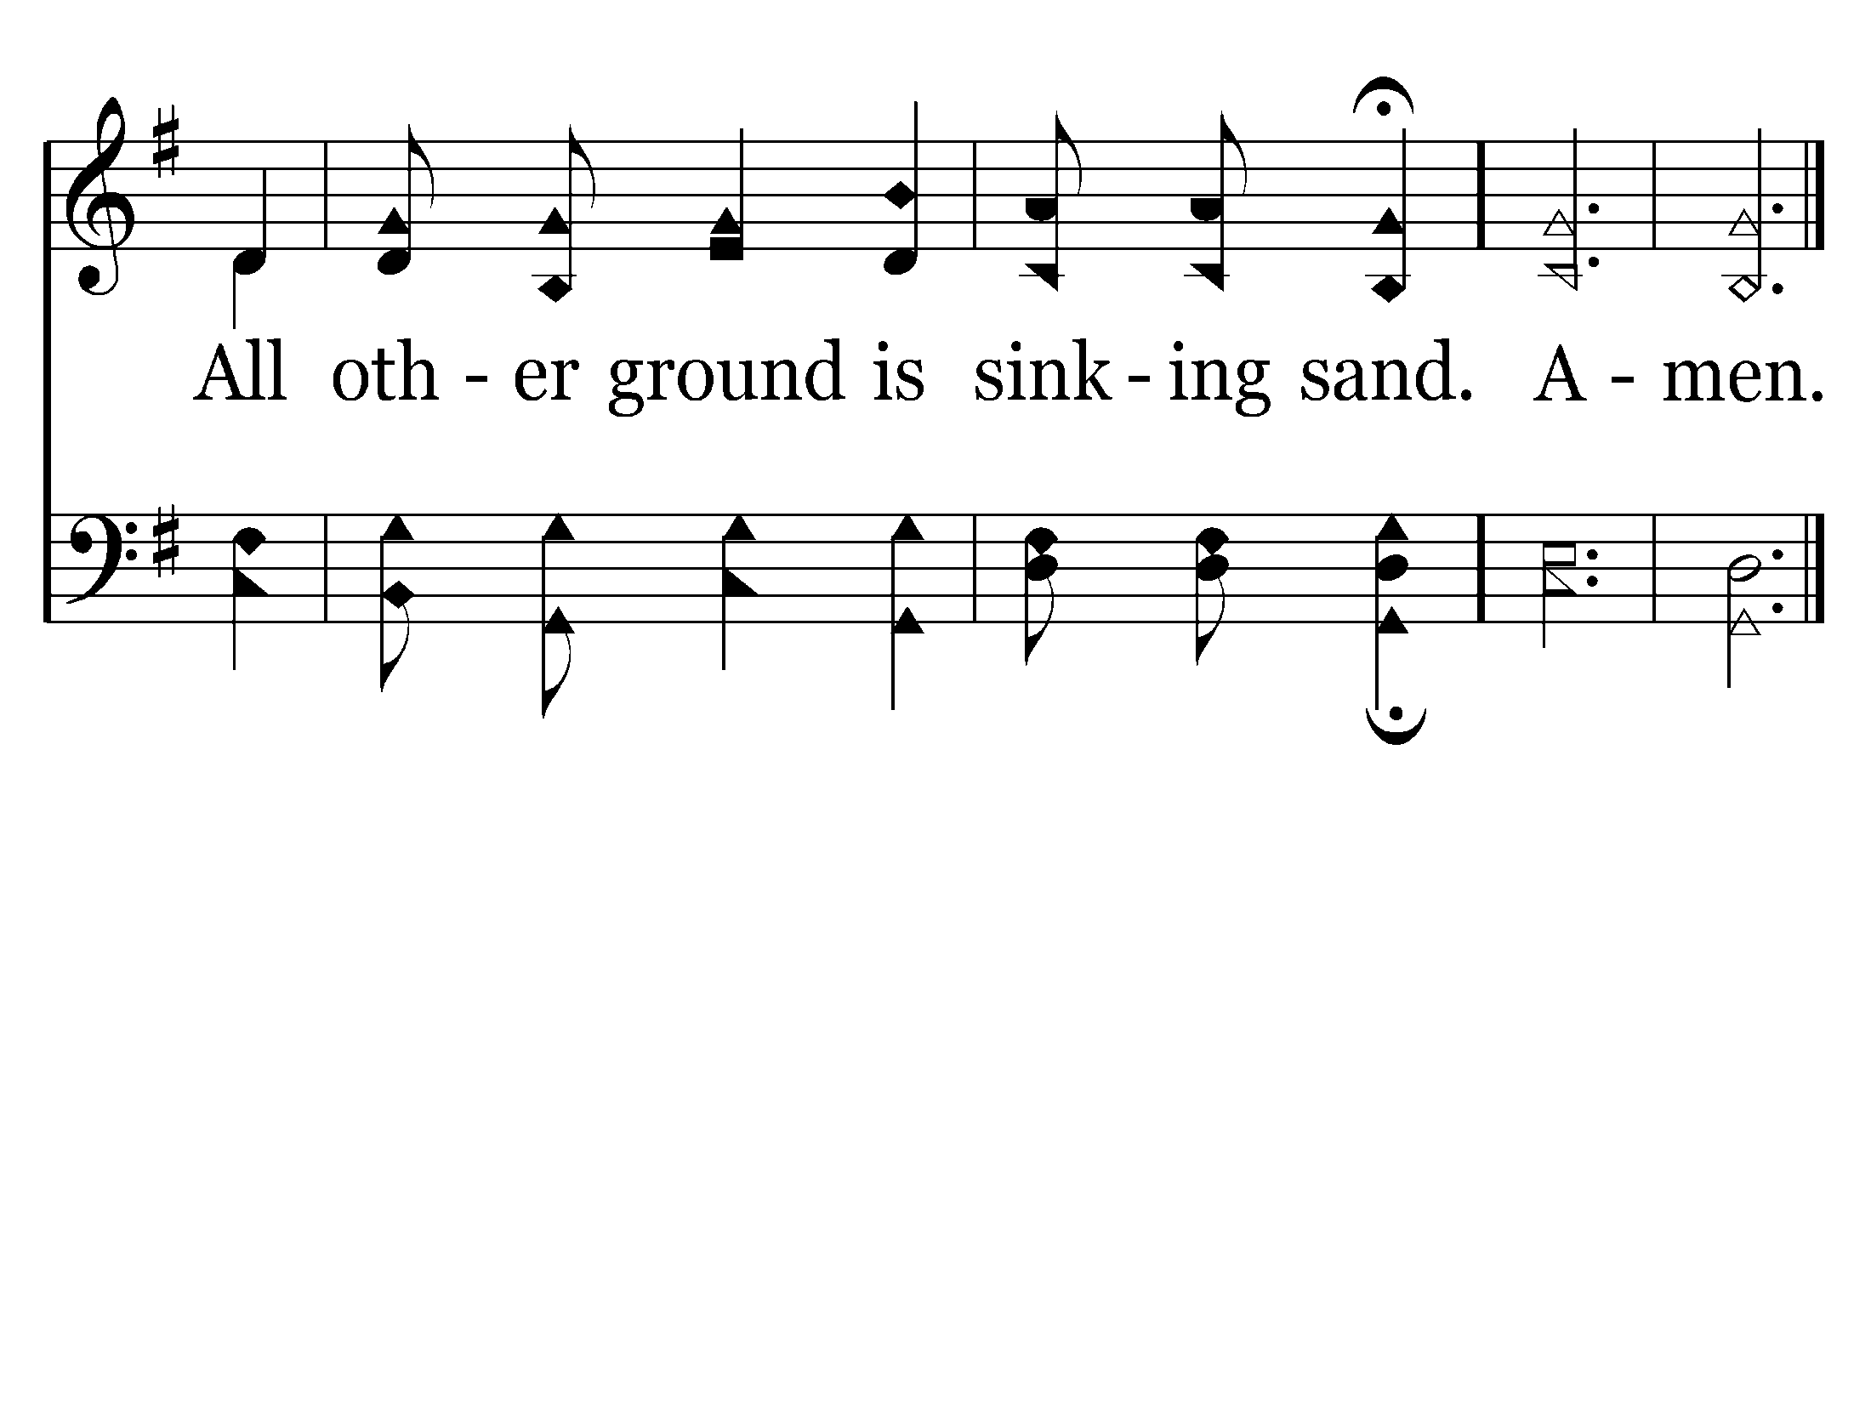
378 - The Solid Rock - L.2
End of Song

Slide 34

612 - Love Lifted Me - Title

Slide 35
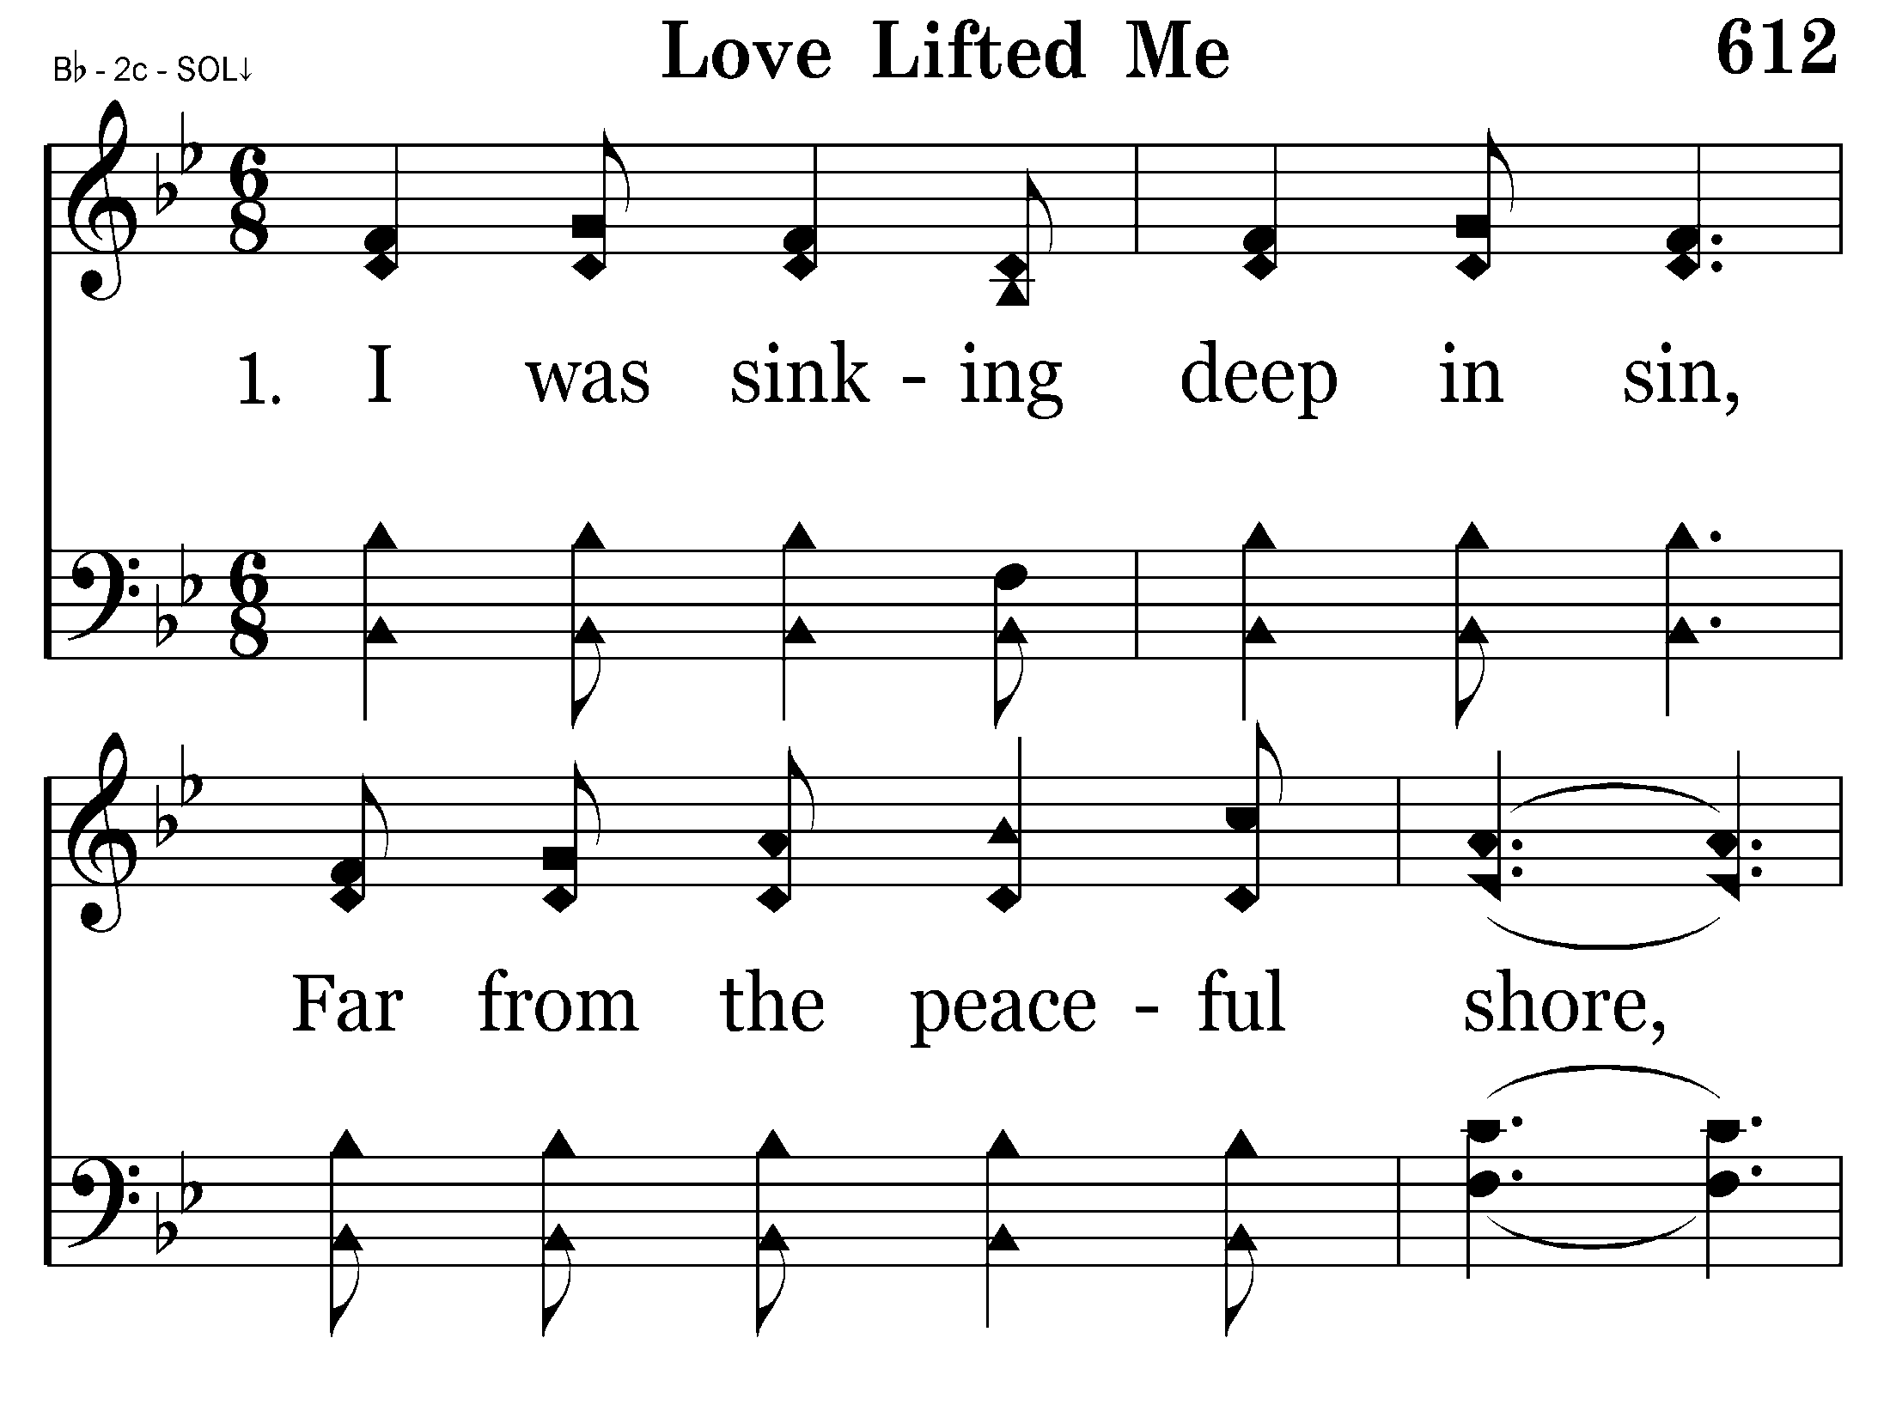
612 - Love Lifted Me - 1.1

Slide 36
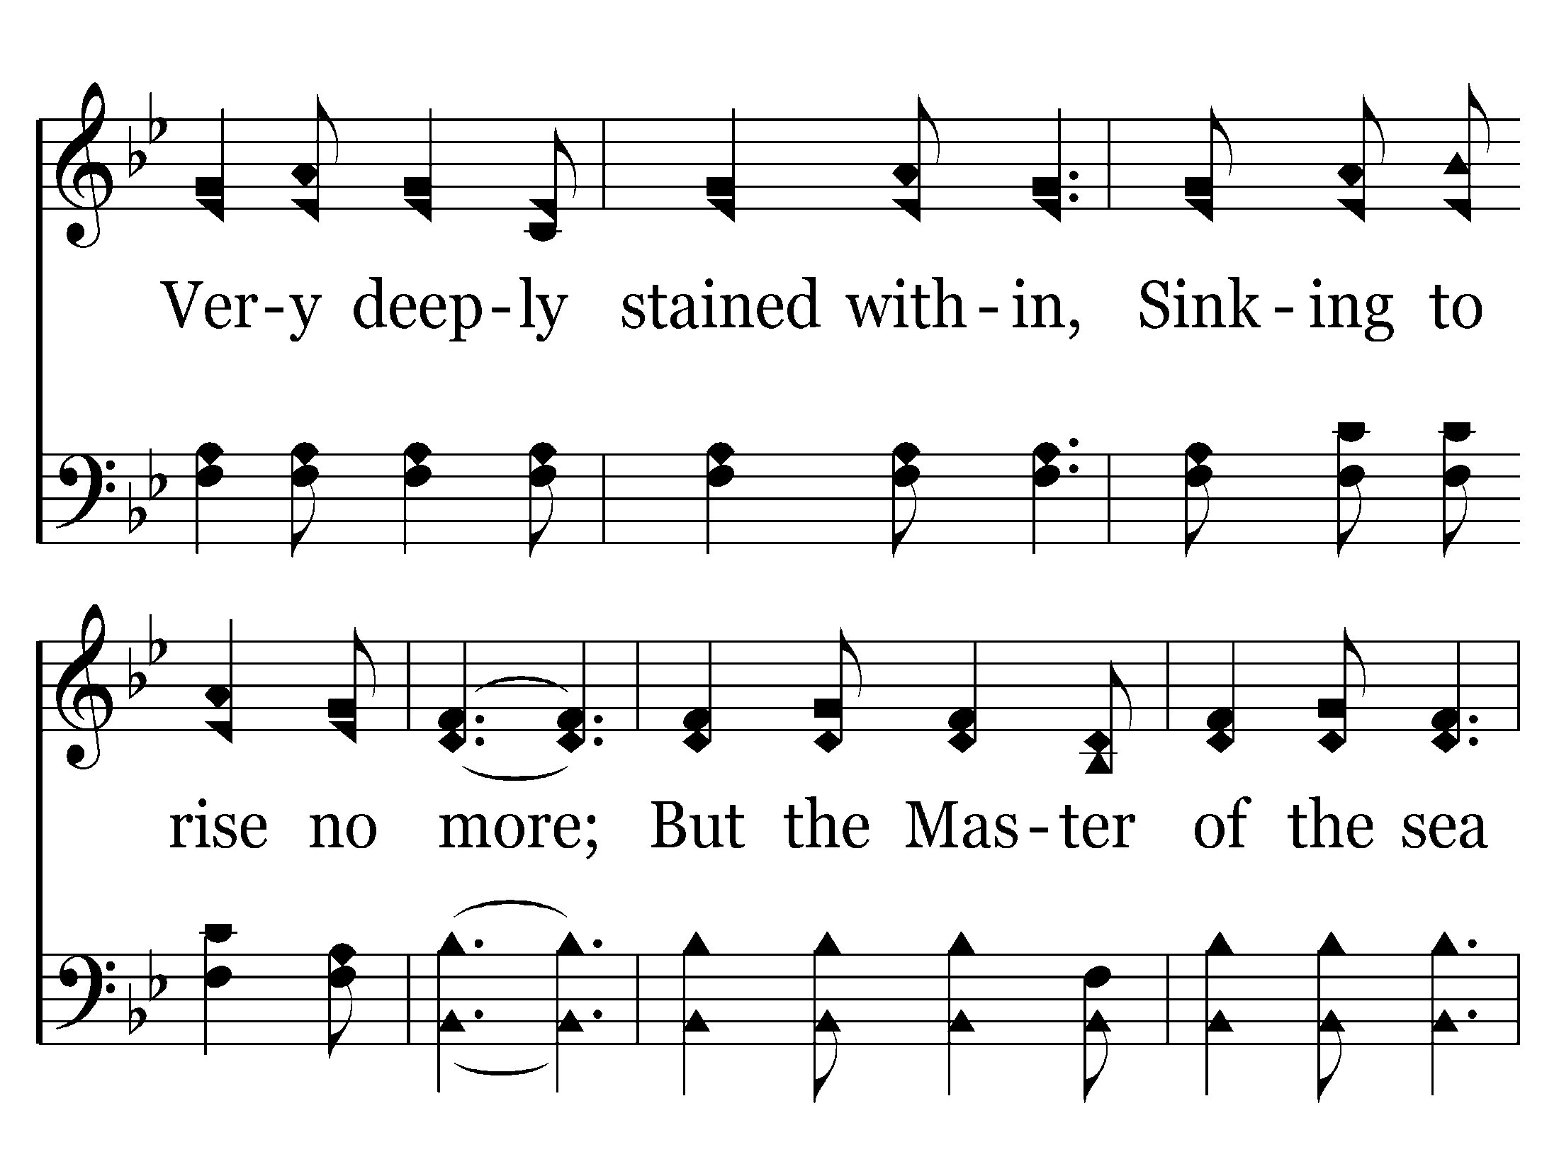
612 - Love Lifted Me - 1.2

Slide 37
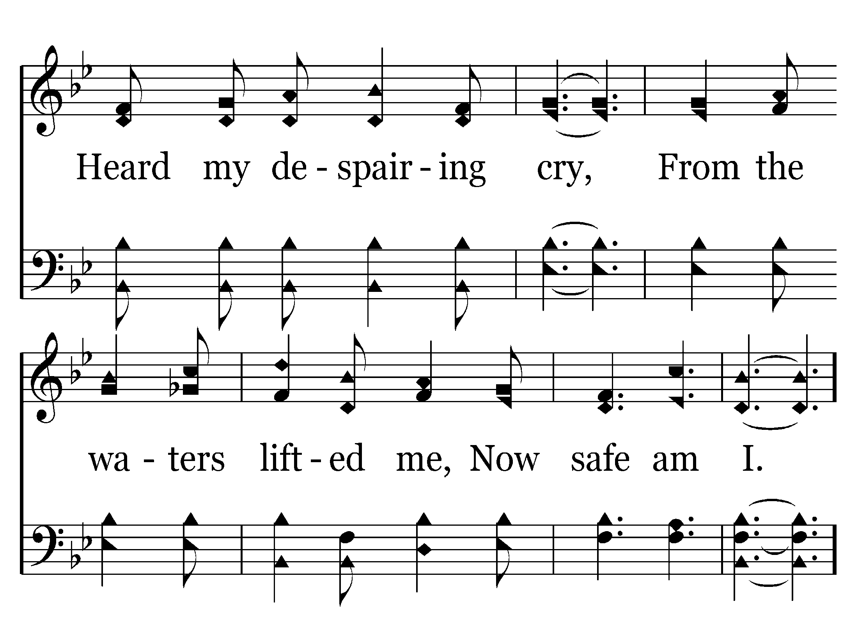
612 - Love Lifted Me - 1.3

Slide 38
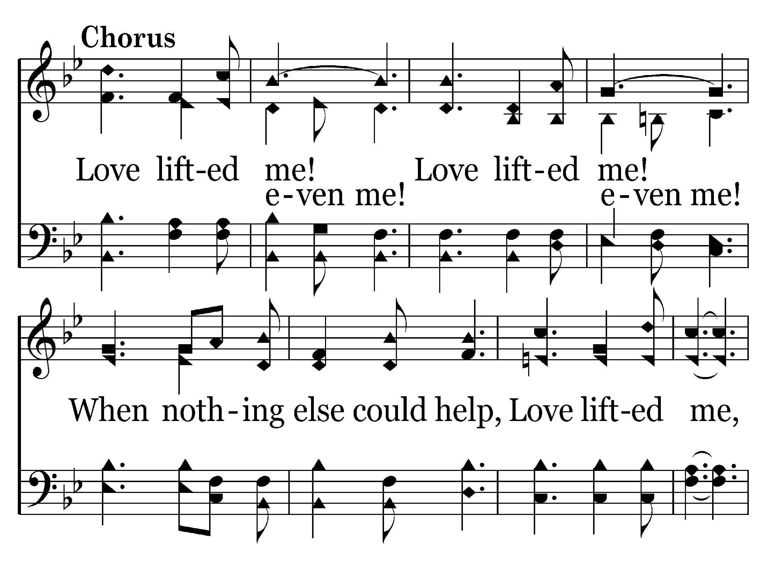
612 - Love Lifted Me - C.1

Slide 39
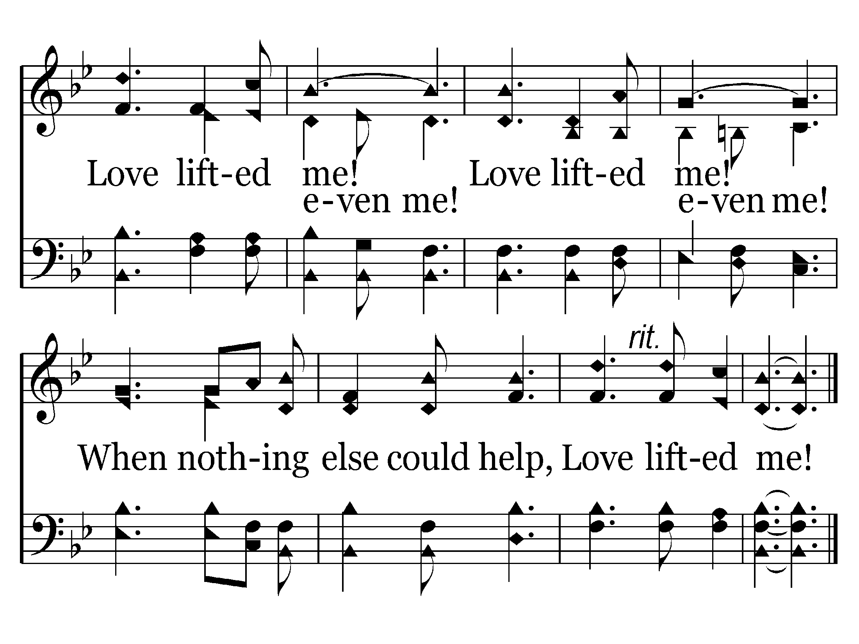
612 - Love Lifted Me - C.2
End of Verse 1

Slide 40
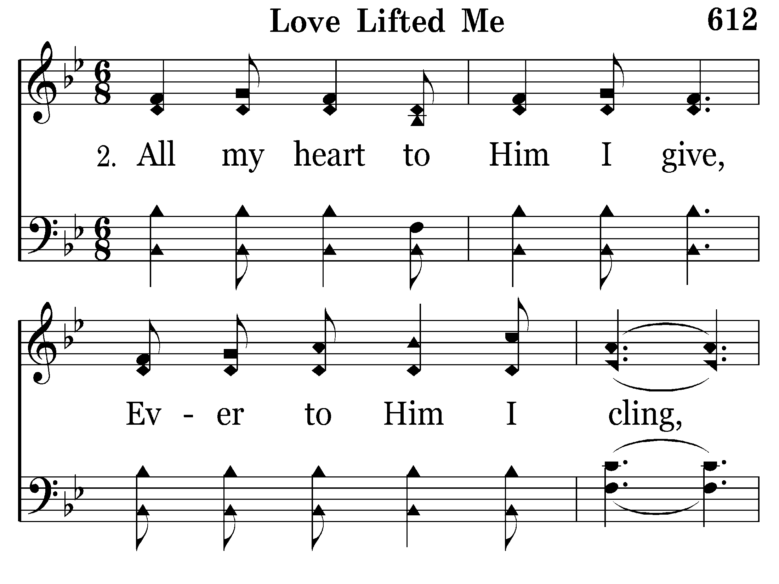
612 - Love Lifted Me - 2.1

Slide 41
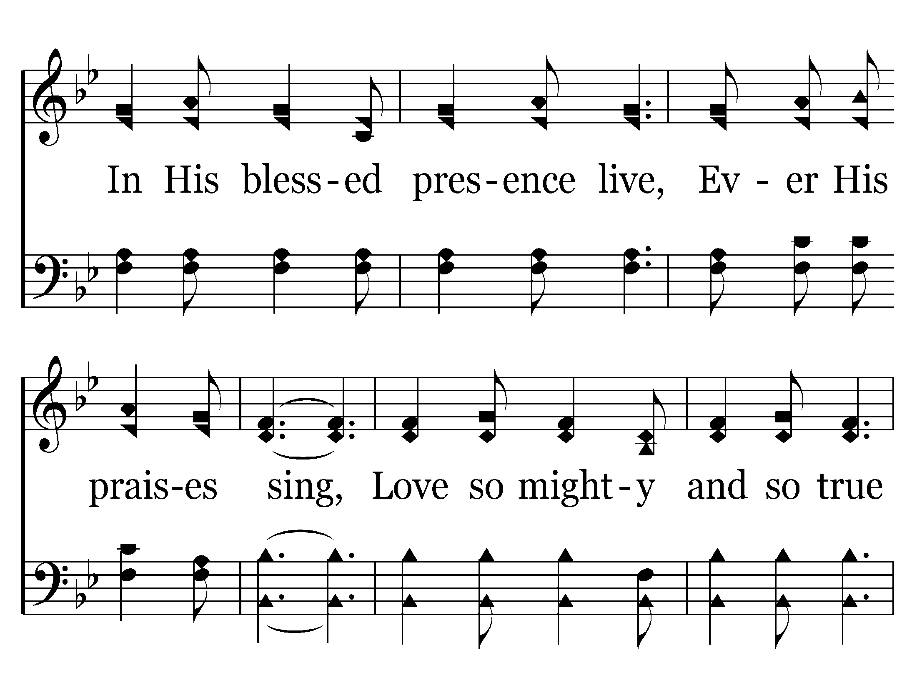
612 - Love Lifted Me - 2.2

Slide 42
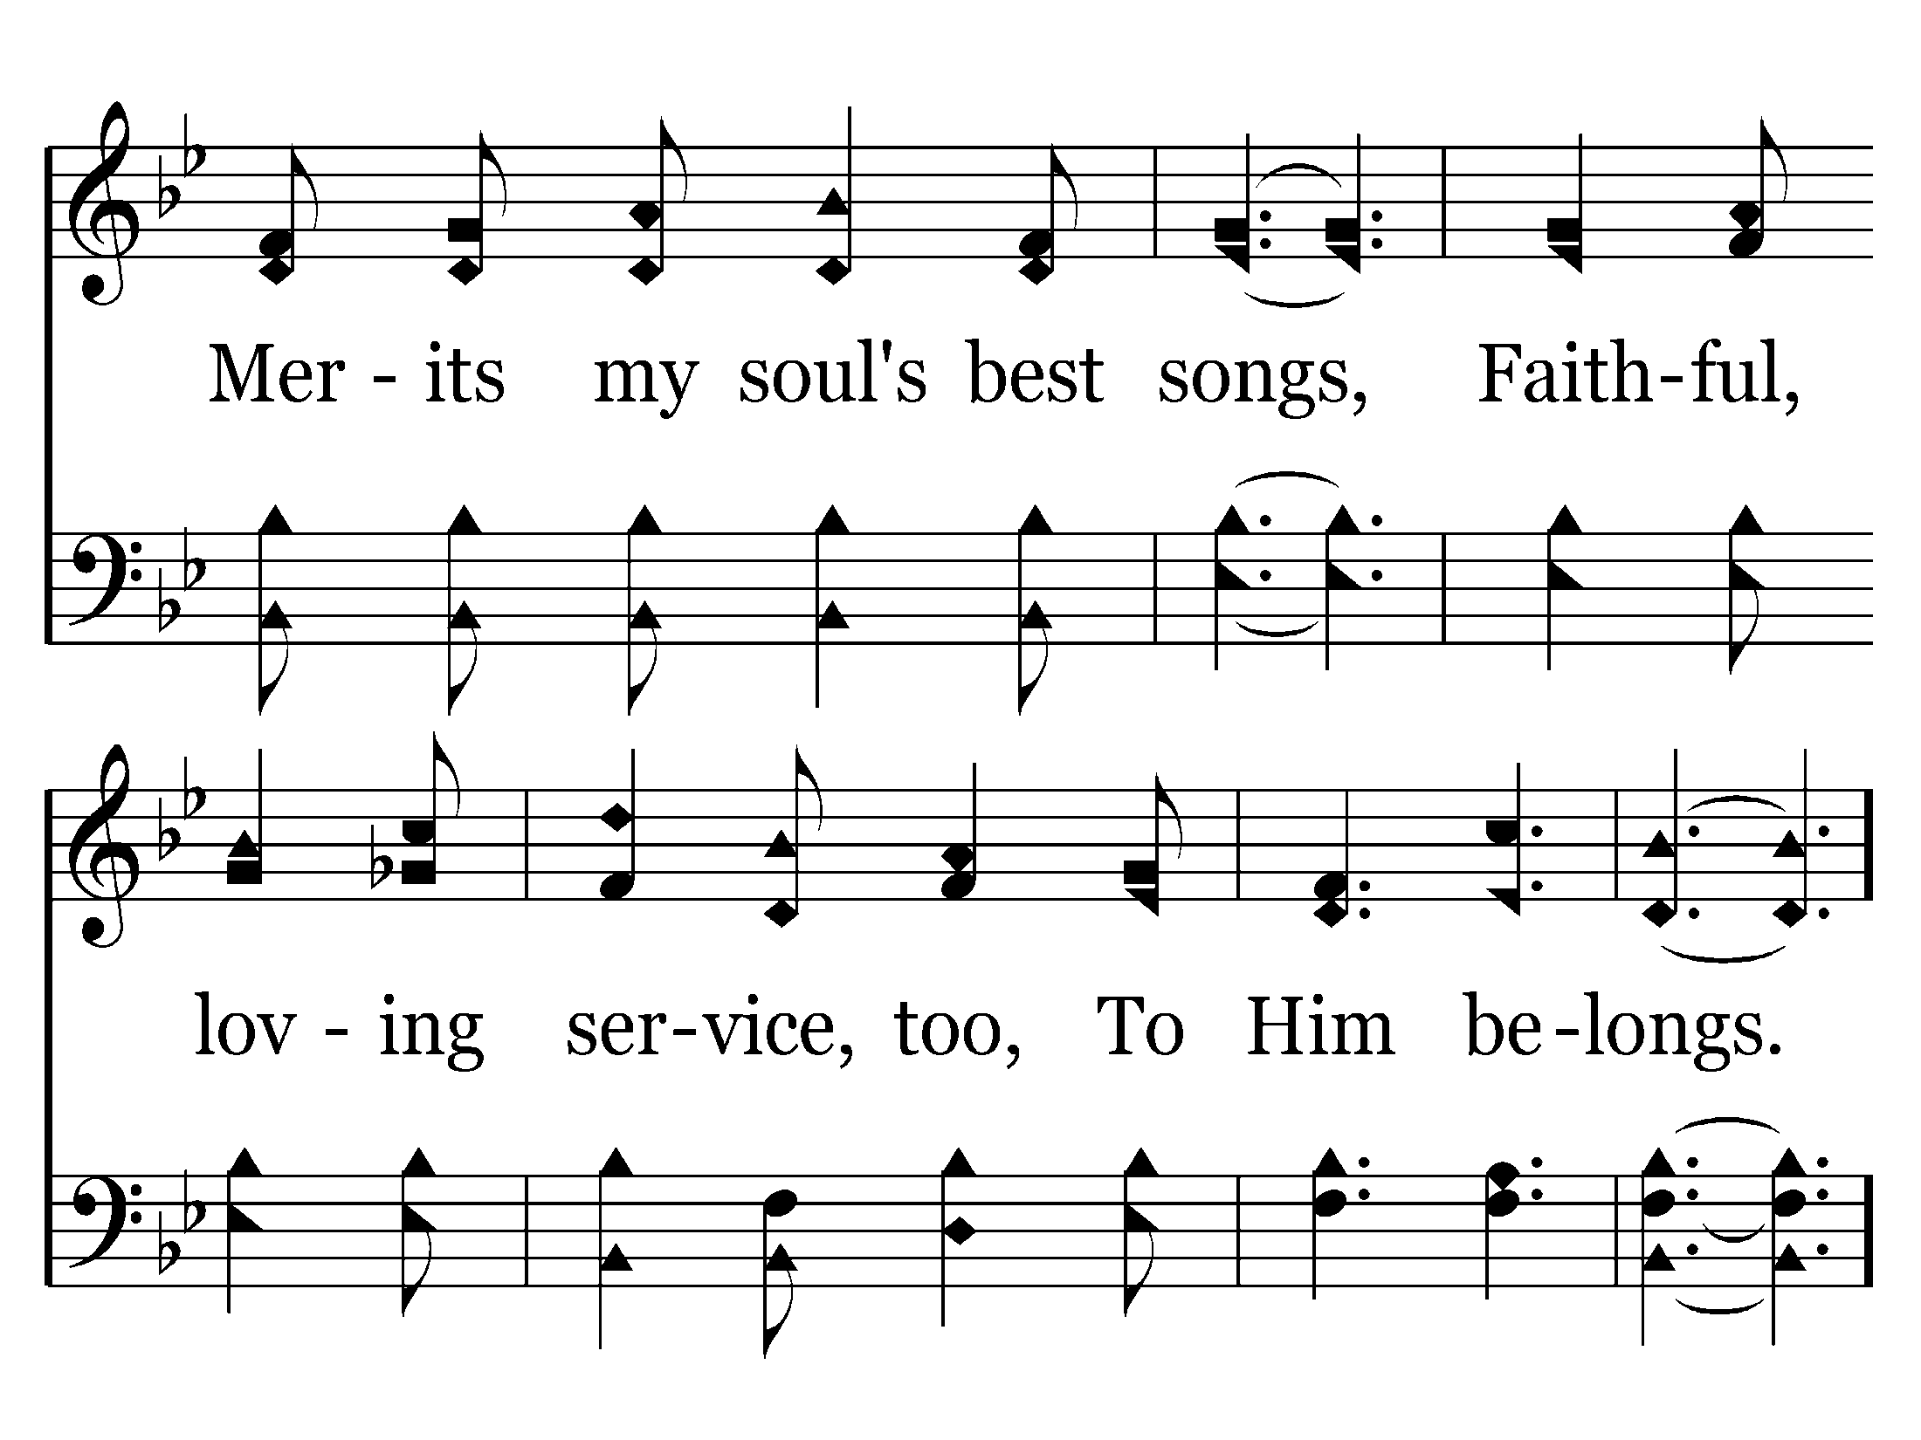
612 - Love Lifted Me - 2.3

Slide 43
612 - Love Lifted Me - C.1

Slide 44
612 - Love Lifted Me - C.2
End of Verse 2

Slide 45
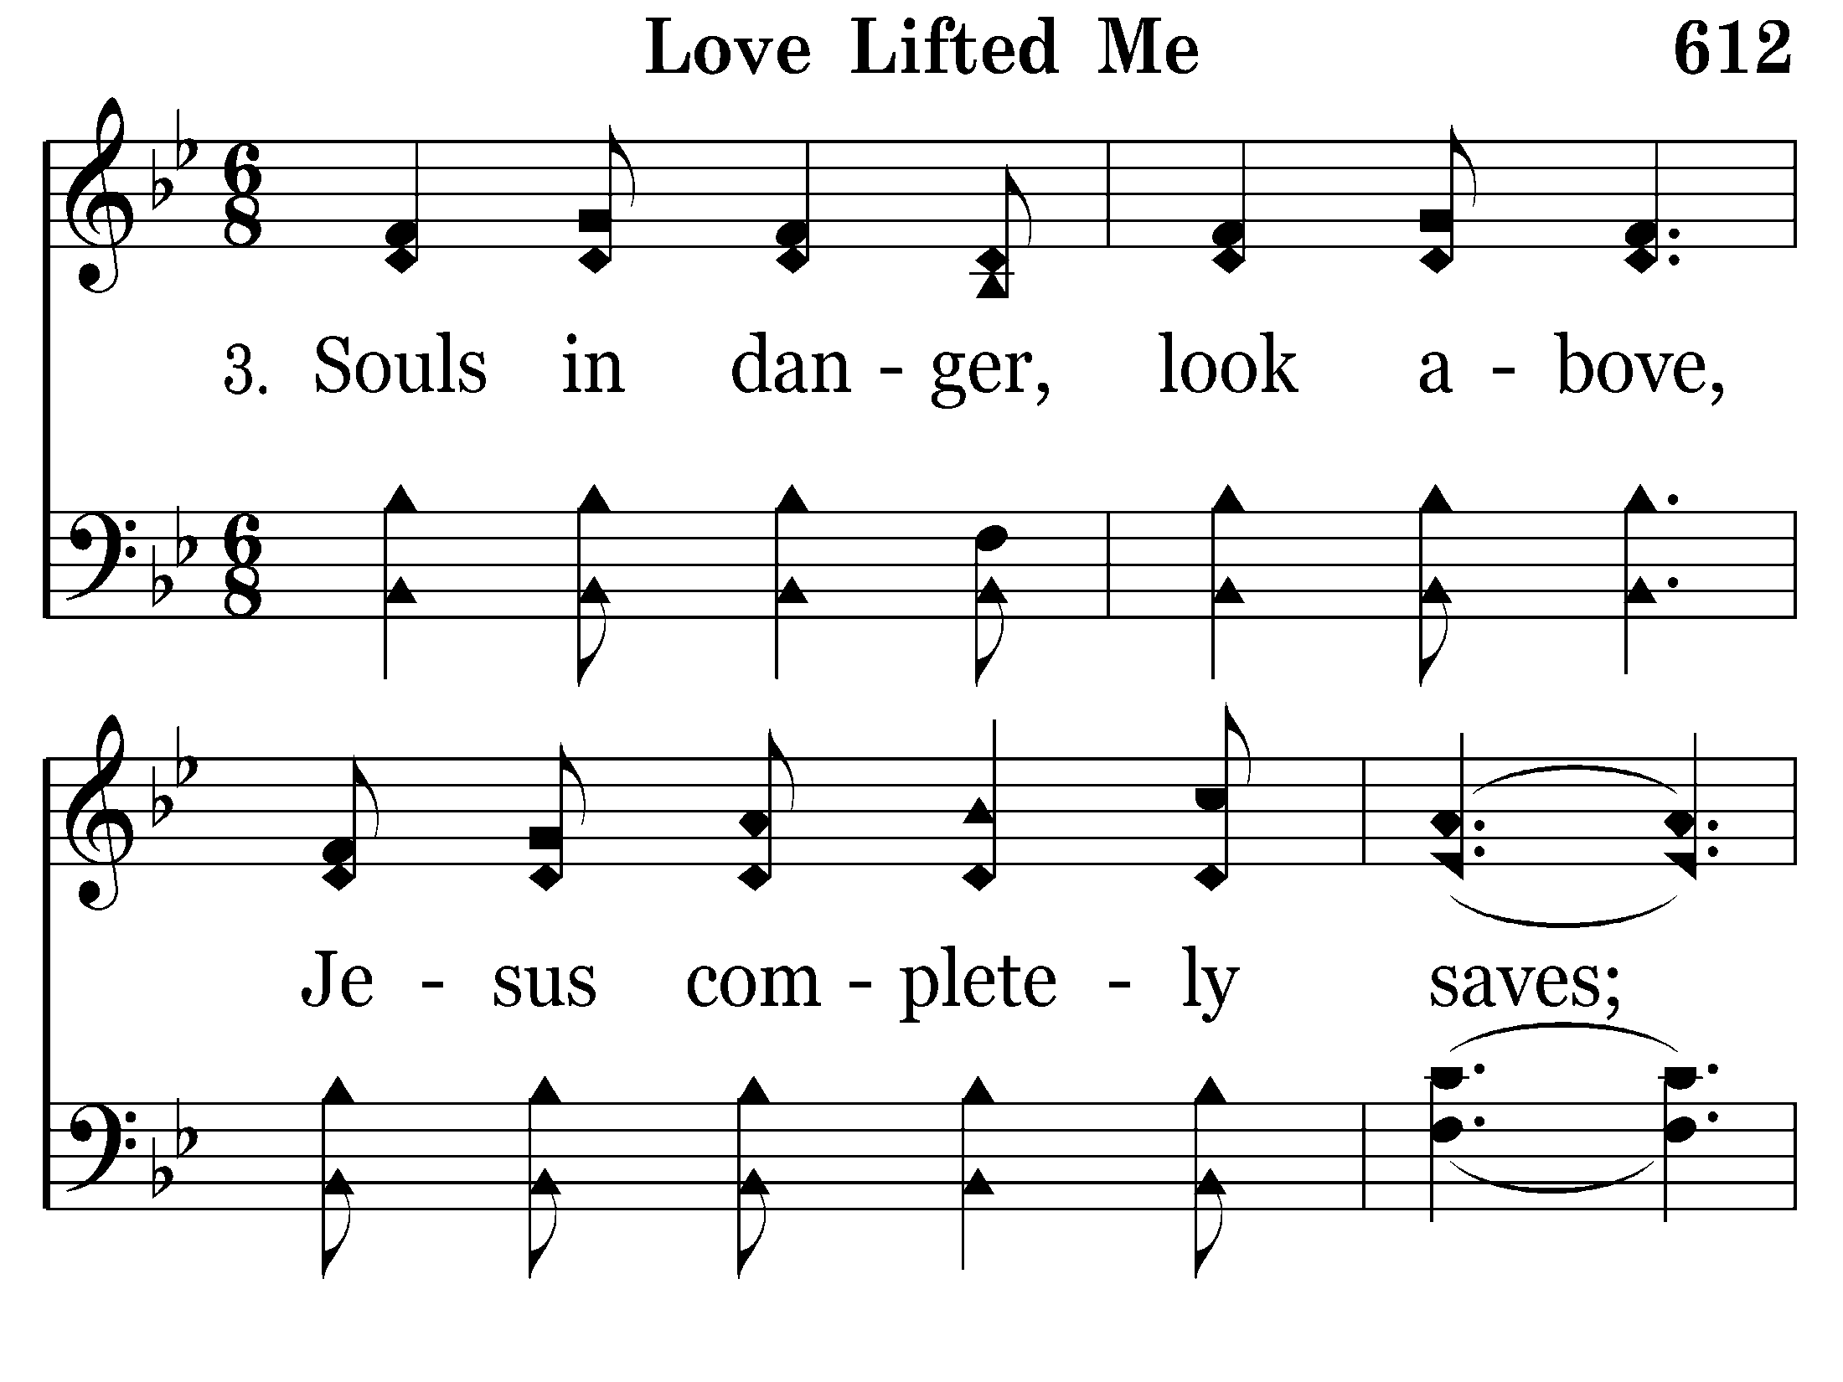
612 - Love Lifted Me - 3.1

Slide 46
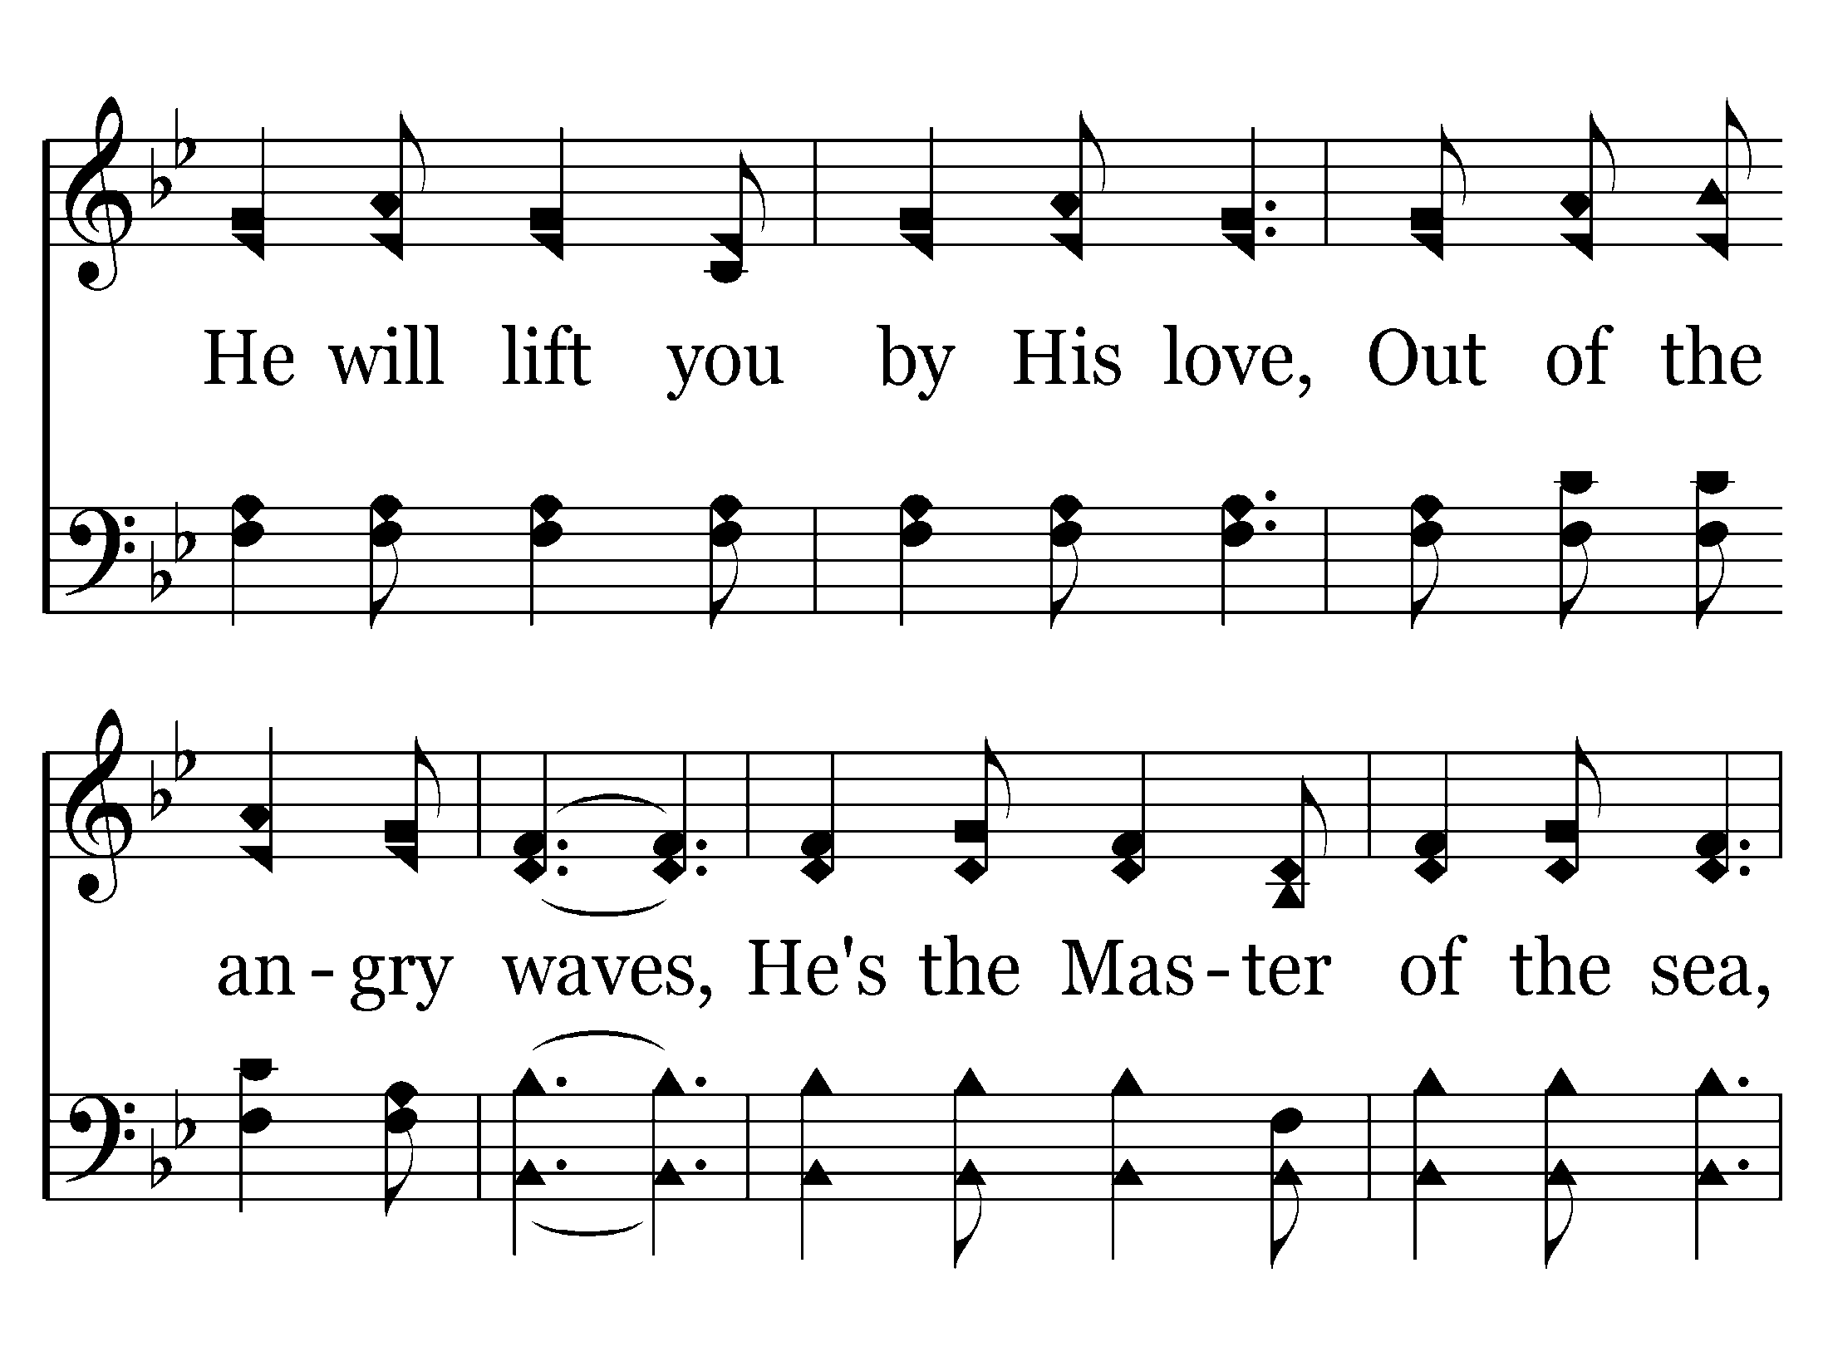
612 - Love Lifted Me - 3.2

Slide 47
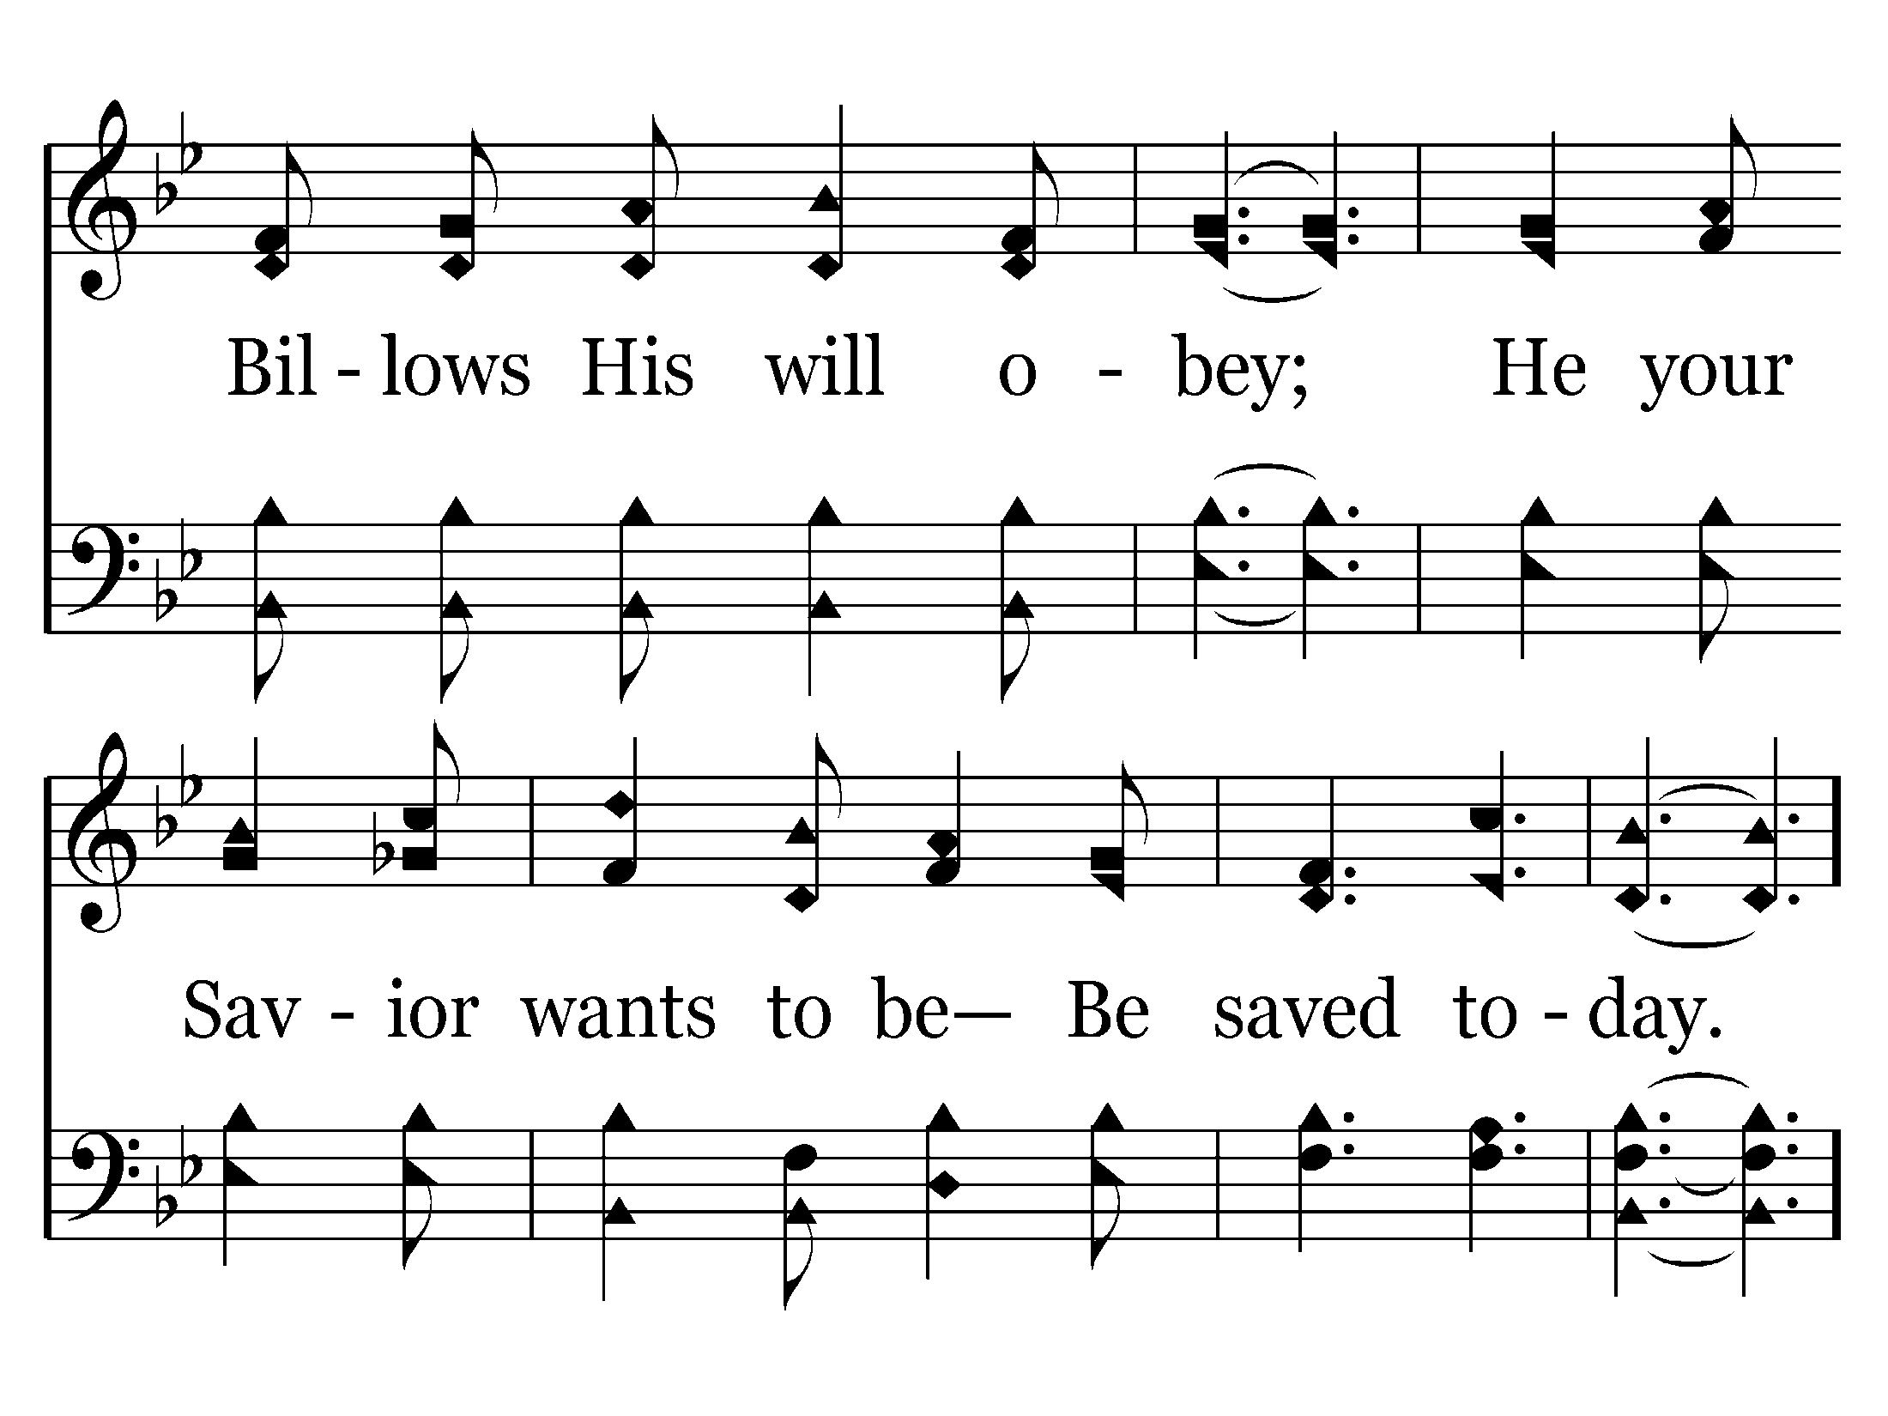
612 - Love Lifted Me - 3.3

Slide 48
612 - Love Lifted Me - C.1

Slide 49
612 - Love Lifted Me - C.2
End of Song

Slide 51
Acts 2:36-37
36 "Therefore let all the house of Israel know assuredly that God has made this Jesus, whom you crucified, both Lord and Christ."
37 Now when they heard this, they were cut to the heart, . . .”

Slide 52
3. DISTURBED THE AUDIENCE
PETER
Acts 2
Jews “cut to the heart” on Pentecost.
STEPHEN
Acts 7
Stoned to death!
PAUL
Acts 17
Some in Athens “mocked” – some “believed” !
“You stiff-necked & uncircumcised in heart & ears! You always resist the Holy Spirit; as your fathers did, so do you” (vs. 51)
vs. 37
Jesus - Mt. 21:45

Slide 53
Isaiah 30:9-10
9 That this is a rebellious people, Lying children, Children who will not hear the law of the LORD;
10 Who say to the seers, "Do not see," And to the prophets, "Do not prophesy to us right things; Speak to us smooth things, prophesy deceits.

Slide 54
Acts 20:27 –
"For I (Paul) have not shunned to declare to you the whole counsel of God.

Slide 55
2 Timothy 4:2
2 Preach the word! Be ready in season and out of season. Convince, rebuke, exhort, with all longsuffering and teaching.

Slide 56
Acts 4:29, 31
29 "Now, Lord, look on their threats, and grant to Your servants that with all boldness they may speak Your word,
31 And when they had prayed, . . they spoke the word of God with boldness.

Slide 58
4. CAUSED ONE TO ASK QUESTIONS!
PETER
Acts 2
Jews on Pentecost - “Men & brethren, what shall we do?”
PHILIP
Acts 8
Ethiopian – “What hinders me from being baptized?” (vs. 36)
PAUL
Acts 16
Philippian Jailer – “Sirs, what must I do to be saved?” (vs. 30)
(vs. 37)
Next Blank

Slide 59
5. TOLD “HOW” TO BE SAVED
PETER
Acts 2
Jews on Pentecost were told - “Repent & be baptized”
PHILIP
Acts 8
Samaritans & Ethiopian believed & baptized.
(vs. 38)
(vs. 12, 37-39)

Slide 60
Acts 8:12 (Conversion of Samaritans)
12 But when they believed Philip as he preached the things concerning the kingdom of God and the name of Jesus Christ, both men and women were baptized.

Slide 61
Acts 8:36-39 (Conversion of Ethiopian Eunuch)
36 “. . . And the eunuch said, "See, here is water. What hinders me from being baptized?"
37 Then Philip said, "If you believe with all your heart, you may." And he answered and said, "I believe that Jesus Christ is the Son of God."
38 So he commanded the chariot to stand still. And both Philip and the eunuch went down into the water, and he baptized him.
39 Now when they came up out of the water, the Spirit of the Lord caught Philip away, so that the eunuch saw him no more; and he went on his way rejoicing.

Slide 62
5. TOLD “HOW” TO BE SAVED
30 "Sirs, what must I do to be saved?"
31 So they said, "Believe on the Lord Jesus Christ, and you will be saved, you and your household."
32 Then they spoke the word of the Lord to him and to all who were in his house.
33 And he took them the same hour of the night and washed their stripes. And immediately he and all his family were baptized.
PETER
Acts 2
Jews on Pentecost were told - “Repent & be baptized”
PHILIP
Acts 8
Samaritans & Ethiopian believed & baptized.
PAUL
Acts 16
Philippian Jailer believed & baptized.
vs. 12, 37-39
(vs. 30-33)
vs. 38
Next Salvation Chart

Slide 63
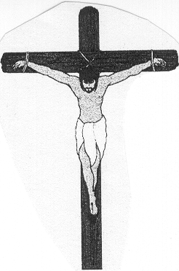
THE PLAN OF SALVATION
Man says:
Water Baptism “Outward Showing of an Inward Doing”
Rem. of Sins
Saved!
Alive!
Child!
Man’s Version
If ALL this happens before Baptism, then . . .
Repent
Admit being a sinner.
Believe
(Read Romans 6:3,4)
Pray Sinner’s Prayer
Then . . . Buried Alive
Romans 6:3-4
3 Or do you not know that as many of us as were baptized into Christ Jesus were baptized into His death?
4 Therefore we were buried with Him through baptism into death, that just as Christ was raised from the dead by the glory of the Father, even so we also should walk in newness of life.
Man Places Salvation HERE . . . before Baptism
Rem. Of Sins
Saved! Alive!
Child! In Christ!
Added to the church
Live Faithful until Death! Rev. 2:10
God’s Version
Acts 2:38, 47 Mk. 16:16 Rom. 6:3,4 Gal. 3:27
Hear
Believe
Repent
Confess
Baptized
Acts 10:33; Rom. 10:17
Acts 18:8; Jn. 8:24
Acts 2:38; Lk. 13:3
Acts 8:37 Rom. 10:10
God Places Salvation Here

Slide 64
6. PRODUCED CONVICTION! (LEADING A PERSON INTO THE LORD’S CHURCH)
PETER
Acts 2:41,47
Jews on Pentecost “added” to the church.
“Then those who gladly received his word were baptized; and that day about three thousand souls were added to them” (v. 41)
“And the Lord added to the church daily those who were being saved” (v. 47)

Slide 65
“PREACHING” - also
HELPS CHRISTIANS GROW !!
Acts 2:42 – “they continued stead- fastly in the apostles’ doctrine & fellowship”
PRODUCES UNITY !!
Acts 2:44 – “all who believed were together”

Slide 66
Sermon on Pentecost – a Model Today!
Scriptures Discussed & Explained.
Christ Presented as Man’s Only Hope.
Disturbs the Audience.
Causes People to Think & Ask Questions.
Answers Given as How to be Saved!
Produces Conviction – Leading a Person into the Lord’s Church.
Next Blank

Slide 67
Acts 22:16
16 'And now why are you waiting? Arise and be baptized, and wash away your sins, calling on the name of the Lord.’

Slide 70

Kind of Preaching God Wants:
Scriptures Discussed & Explained.
Christ Presented as Man’s Only Hope.
Disturbs the Audience.
Causes People to Think & Ask Questions.
Answers Given as How to be Saved!
Produces Conviction – Leading That Person into the Lord’s Church.

Slide 71

WHAT IF I NEGLECT BEING BAPTIZED?
Put on Christ – Gal. 3:27
IF
Wash away your sins – Acts 22:16; Mk. 16:16
when baptized
Obtain forgiveness – Acts 2:38
Are made free from sin – Rom. 6:17,18
you
Benefit by Jesus’ death – Rom. 6:3,4
Enter the Body (church) of Christ – 1 Cor. 12:13
and these scriptures say you do!!!
Next Blank
Then – what is YOUR CONDITION without Baptism?

Slide 72
Relationship Between BAPTISM & the BLOOD of Christ
REMISSION OF SINS
Jesus’ BLOOD shed for … Mt. 26:28
BAPTIZED in the name of Jesus for…Acts 2:38
BLOOD shed in His Death (Jn. 19:34)
BAPTIZED into His Death (Rom. 6:3)
DEATH
RES.
BURIAL

Slide 73
Relationship Between BAPTISM & the BLOOD of Christ
REMISSION OF SINS
Jesus’ BLOOD shed for … Mt. 26:28
BAPTIZED in the name of Jesus for…Acts 2:38
BLOOD shed in His Death (Jn. 19:34)
BAPTIZED into His Death (Rom. 6:3)
CLEANSES
BLOOD of Jesus cleanses us from sin. 1 Jn. 1:7
BAPTIZED & wash away your sins. Acts 22:16
DEATH
RES.
BURIAL

Slide 74
Relationship Between BAPTISM & the BLOOD of Christ
REMISSION OF SINS
Jesus’ BLOOD shed for … Mt. 26:28
BAPTIZED in the name of Jesus for…Acts 2:38
BLOOD shed in His Death (Jn. 19:34)
BAPTIZED into His Death (Rom. 6:3)
CLEANSES
BLOOD of Jesus cleanses us from sin. 1 Jn. 1:7
BAPTIZED & wash away your sins. Acts 22:16
DEATH
RES.
BURIAL
SALVATION
We have REDEMPTION thru His BLOOD, the forgiveness of sins. Col.1:14
BAPTISM now saves us. 1 Peter 3:21

Slide 75
WHERE CAN I FIND THE PLAN OF SALVATION?
?
O. T. ?
GOSPELS?
EPISTLES?
REVELATION
Heb. 1:1,2
Noah, Abraham, Jacob, 12 Patriarchs
Ex. 20; Deut. 5 Law of Moses
Isa. 9:6,7 Prophets spoke of Christ
Matthew Mark Luke John
Jesus’ birth – life – ministry – death – burial – resurrec- tion
Jn. 20:30
Romans, Corinthians, Galatians, Philippians, Colossians, Thes. Heb. Tim, Titus, Philemon, James, Peter, John, Jude
Written to Encourage Christians
Reveals Future & Destiny of the church.
Also, heaven is pictured

Slide 76
WHERE CAN I FIND THE PLAN OF SALVATION?
?
O. T. ?
GOSPELS?
EPISTLES?
REVELATION
Heb. 1:1,2
Noah, Abraham, Jacob, 12 Patriarchs
Ex. 20; Deut. 5 Law of Moses
Isa. 9:6,7 Prophets spoke of Christ
Matthew Mark Luke John
Jesus’ birth – life – ministry – death – burial – resurrec- tion
Jn. 20:30
Romans, Corinthians, Galatians, Philippians, Colossians, Thes. Heb. Tim, Titus, Philemon, James, Peter, John, Jude
Written to Encourage Christians
Reveals Future & Destiny of the church.
Also, heaven is pictured

Slide 77
WHERE CAN I FIND THE PLAN OF SALVATION?
?
O. T. ?
GOSPELS?
EPISTLES?
REVELATION
Heb. 1:1,2
Noah, Abraham, Jacob, 12 Patriarchs
Ex. 20; Deut. 5 Law of Moses
Isa. 9:6,7 Prophets spoke of Christ
Matthew Mark Luke John
Jesus’ birth – life – ministry – death – burial – resurrec- tion
Jn. 20:30
Romans, Corinthians, Galatians, Philippians, Colossians, Thes. Heb. Tim, Titus, Philemon, James, Peter, John, Jude
Written to Encourage Christians
Reveals Future & Destiny of the church.
Also, heaven is pictured

Slide 78
WHERE CAN I FIND THE PLAN OF SALVATION?
?
O. T. ?
GOSPELS?
EPISTLES?
REVELATION
Heb. 1:1,2
Noah, Abraham, Jacob, 12 Patriarchs
Ex. 20; Deut. 5 Law of Moses
Isa. 9:6,7 Prophets spoke of Christ
Matthew Mark Luke John
Jesus’ birth – life – ministry – death – burial – resurrec- tion
Jn. 20:30
Romans, Corinthians, Galatians, Philippians, Colossians, Thes. Heb. Tim, Titus, Philemon, James, Peter, John, Jude
Written to Encourage Christians
Reveals Future & Destiny of the church.
Also, heaven is pictured

Slide 79
WHERE CAN I FIND THE PLAN OF SALVATION?
O. T. ?
GOSPELS?
ACTS
EPISTLES?
REVELATION?
Heb. 1:1,2
Noah, Abraham, Jacob, 12 Patriarchs
Ex. 20; Deut. 5 Law of Moses
Isa. 9:6,7 Prophets spoke of Christ
Matthew Mark Luke John
Jesus’ birth – life – ministry – death – burial – resurrec- tion
Jn. 20:30
Early church
Converts Jews Samaritans Eunuch, Saul, Cornelius, Lydia, Jailer, Corinthians, Ephesians
WHAT MUST I DO TO BE SAVED?
Romans, Corinthians, Galatians, Philippians, Colossians, Thes. Heb. Tim, Titus, Philemon, James, Peter, John, Jude
Written to Encourage Christians
Reveals Future & Destiny of the church.
Also, heaven is pictured

Slide 80
WHERE CAN I FIND THE PLAN OF SALVATION?
?
O. T. ?
GOSPELS?
ACTS ?
EPISTLES?
REVELATION
Heb. 1:1,2
Noah, Abraham, Jacob, 12 Patriarchs
Ex. 20; Deut. 5 Law of Moses
Isa. 9:6,7 Prophets spoke of Christ
Matthew Mark Luke John
Jesus’ birth – life – ministry – death – burial – resurrec- tion
Jn. 20:30
Early church
Converts Jews Samaritans Eunuch, Saul, Cornelius, Lydia, Jailer, Corinthians, Ephesians
WHAT MUST I DO TO BE SAVED?
Romans, Corinthians, Galatians, Philippians, Colossians, Thes. Heb. Tim, Titus, Philemon, James, Peter, John, Jude
Written to Encourage Christians
Reveals Future & Destiny of the church.
Also, heaven is pictured

Slide 81
3. DISTURBED THE AUDIENCE
PETER
Acts 2
Jews “cut to the heart” on Pentecost.
Acts 20:27 –
"For I (Paul) have not shunned to declare to you the whole counsel of God.
vs. 37
Jesus - Mt. 21:45
Next Blank

